Slide 1
Handwriting Recognition Machida Hiroaki

Slide 2
Contents
Summary
Demo
Structure
Flow
Q&A
(Appendix)

Slide 3

Read handwriting images and return the probabilities of what the number is.
Summary
Read 28 x 28 pixel handwriting images with 256 gray scale.
Return the probabilities of the number for each 0, 1, 2, …, 9.
Able to learn from training data.
Neural Network
[0, 0, 0, 0, 0, 0.95, 0.05, 0, 0, 0]
This is 95% 5!

Slide 4
Demo

Slide 5

Neurons have parameters, that are called weights and biases, and the network has a loss as result
Structure
10 values
784 dots
50 neurons
10 neurons
[0, 0, 0, 0, 0, 0.95, 0.05, 0, 0, 0]
This is 95% 5!
The loss is 1.504…
…
…
Softmax-with-Loss
$$x$$
[0, 0, 0, 0, 0, 1, 0, 0, 0, 0]
The answer is 5.
Affine
ReLU
Affine
$x_{1}∗{weight}_{1}+⋯+x_{784}∗{weight}_{784}+bias=y$

Slide 6
The neural network updates weights and biases so that the loss will be minimized
Flow
Start
In the beginning, fulfill weights and biases with random numbers, and calculate the loss by the loss function.
Next, calculate gradients (how much the loss will change if weight_{i} or bias_{i} is changed by 1?) and update the weights and biases by small values (let say, 0.05 * gradient).
Repeat the processes above for predetermined iterations.
1
1
Calculate loss
2
2
Update weights and biases
Repeat?
3
3
Yes
No
End

Slide 7
Q&A
How much time did it take?
A whole three to four days.
Where do you think a failure?
The accuracy would be improved if I tried different numbers of neurons.
What function would you add?
A function that try to change numbers of neurons.
What if an invalid case?
Downloading images fails if the internet is not available, and it will say “The internet is disconnected”.

Slide 8





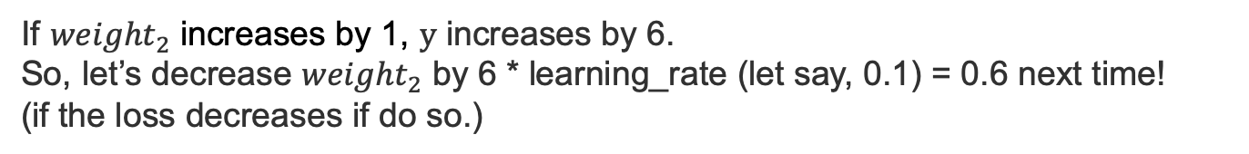








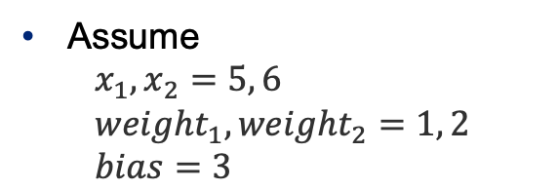
















Gradient of weight or bias to loss can be calculated from right to left
Appendix: gradient calculation(Affine layer)
$x$₁
$x_{1}∗{weight}_{1}+x_{2}∗{weight}_{2}+bias=y$
$x$₂
Assume
$$x_{1}, x_{2}=5, 6$$
$${weight}_{1}, {weight}_{2}=1, 2$$
$$bias=3$$
$$x_{1}$$
$$\vec{5}$$
$$\overset{⃖}{1∙E}$$
$×$
$$\vec{1}$$
$$\vec{5}$$
$${weight}_{1}$$
$$\overset{⃖}{5∙E}$$
$$\overset{⃖}{1∙E}$$
$$\vec{17}$$
$$\vec{20}$$
$+$
$+$
$$y$$
$$x_{2}$$
$$\vec{6}$$
$$\vec{12}$$
$$\overset{⃖}{1∙E}$$
$$\overset{⃖}{1∙E}$$
$$\overset{⃖}{2}∙E$$
$×$
$$\overset{⃖}{1∙E}$$
$$\vec{2}$$
$$\vec{3}$$
$${weight}_{2}$$
$$\overset{⃖}{6∙E}$$
$$\overset{⃖}{1∙E}$$
$$bias$$
If ${weight}_{2}$ increases by 1, $y$ increases by 6.
So, let’s decrease ${weight}_{2}$ by 6 * learning_rate (let say, 0.1) = 0.6 next time!
(if the loss decreases if do so.)

Slide 9
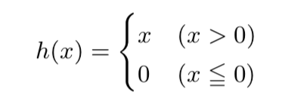
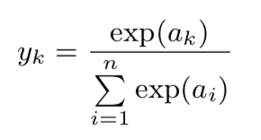
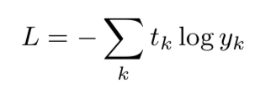
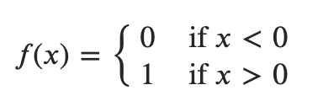

Need to calculate the gradients of the ReLU layer and Softmax-with-loss as well
Appendix: gradient calculation(ReLU, Softmax-with-loss)
ReLU
Function
Gradient
Softmax-with-loss
Function
Gradient
$f\left(x\right)=y_{k}−t_{k}$

