Slide 1

Team 1 Machida Hiroaki Ding Shenjie Deshpande Amol Sinha Shaurya Shenyuan Wu Peiyan Duan

Slide 2
Access! http://team1.work

Slide 3
Contents
http://team1.work
Overview Concept User stories Architecture
Status report Iteration 1 Iteration 2 Issues
Demo Hiroaki Peiyan Shaurya
Next plan Iteration 3
Appendix Reference

Slide 4


Users can sell & buy used textbooks
Overview - Concept
Figure
Book Exchange
Market
User stories
# | User story^{[1]}
1 | You buy textbook from the market
2 | You post textbook you want in the market and I sell it

Slide 5
You buy textbook from the market
Overview - User story #1
Figure
I sell this!
I buy that!
Book Exchange
Market
User story
# | Action
1 | I post textbook for selling.
2 | You buy textbook
3 | I ship textbook
4 | You receive textbook!
5 | You write review about me

Slide 6
You post textbook you want in the market and I sell it
Overview - User story #2
Figure
I need this!
I have that!
Book Exchange
Market
User story
# | Action
1 | You post textbook for buying.
2 | I sell textbook
3 | I ship textbook
4 | You receive textbook!

Slide 7
React + Redux for application and Firebase Realtime Database for database
REPEAT
Overview - Architecture(Application)
AWS^{[5]}
React^{[2]} + Redux^{[3]}
Node.js^{[4]}
Firebase^{[7]}
Firebase Realtime Database^{[6]}

Slide 8








MRTG for monitoring, Cypress for integration test and BERT-SQuAD for Natural Language Processing
Overview - Architecture(Infrastructure)
1. Server monitoring
^{[9]}
2. Integration test
Developers
^{[2][3]}
^{[7]}
^{[11]}
^{[10]}
BERT-SQuAD
^{[8]}
Cron
3. Natural Language Processing

Slide 9
Prototype implemented and released, and CI/CD environment is set up on iteration 1
REPEAT
Status report – Iteration 1
# | Item | Person in charge | Status
1 | Framework setup^{[12]} | Shaurya | Done
2 | DB schema design | Shaurya | Done
3 | CI/CD environment setup^{[13][14]} | Hiroaki | Done
4 | Minimum user story^{[15][16]} | Hiroaki | Done
5 | User review | Amol | Done
6 | Post for buying textbook | Shenyuan + Shaurya | Done
7 | Bar code detection | Shenjie | In progress
8 | Auto completion for search | Peiyang + Machida | Done

Slide 10
Server monitoring is set up and NLP for category detection is integrated to the project
Status report – Iteration 2
# | Item | Person in charge | Status | Reason for not completed
1 | Server Monitoring^{[9]} | Hiroaki | Done | -
3 | UI Improvement - Menu and Tx Flow | Hiroaki | In progress | Sickness Return to home country^{[17]}
4 | UI Improvement - Overall Design | Amol | In progress | Workload outside class Sickness
5 | Category Detection | Hiroaki | Done | -
6 | Category Search | Shenyuan + Peiyan | Done | -
7 | Paypal Payment^{[18]} | Shaurya | In progress | Workload outside class
8 | Barcode Reader | Shenjie | In progress | No face-to-face support^{[17]}
9 | Event Notification | Hiroaki | Done | -

Slide 11
We made resolution plans for two major issues
Status report – Issues
# | Issue | Detail | Resolution plan
1 | Corona virus pandemic | No more face-to-face^{[17]} support for implementation Implementation progress is not good | Reschedule and change the scope after iteration 2
2 | High workload outside class | Some members have high workload outside class and cannot proceed tasks | Keep it going. Cannot control situation outside of class Change task owners accordingly to avoid bottlenecks

Slide 12
Demo (Hiroaki, Shenyuan + Peiyan) Access! http://team1.work

Slide 13
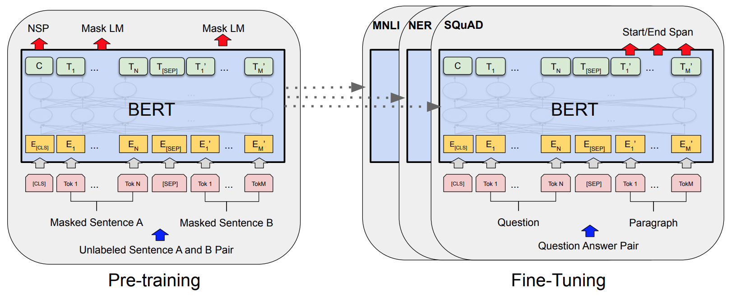
The category of book is automatically detected with BERT-SQuAD
Demo - Category Detection
Application calls API for category detection
Application
{ "document": "Introduction to Algorithms (The MIT Press) 3rd Edition, Kindle Edition","question":"Name the category." }
BERT-SQuAD^{[11]}
{"result":{"answer":"Introduction to Algorithms", "confidence":0.206455,"document":(skip),"end":2,"start":0}}
BERT-SQuAD is a Natural Language Processing(NLP) model
BERT^{[20]} is a NLP model by Google AI Language team. BERT-SQuAD is pretrained with BooksCorpus (800M words)^{[21]} and English Wikipedia (2,500M words) for 4 days with 16TPU (worth $6,000) and fine tuned with SQuAD v1.1 (100,000+ QAs on 500+ articles.)^{[22]} for 1 hour with 1TPU.

Slide 14
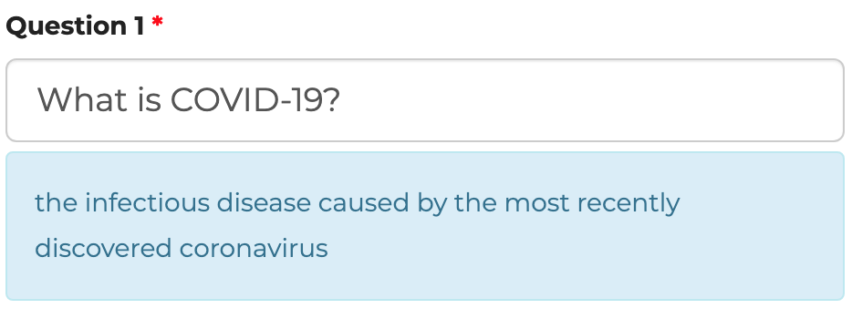
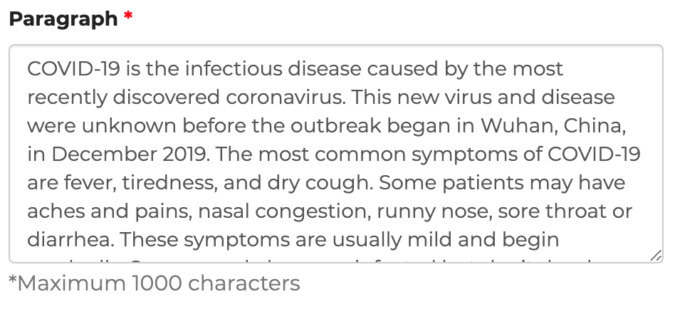
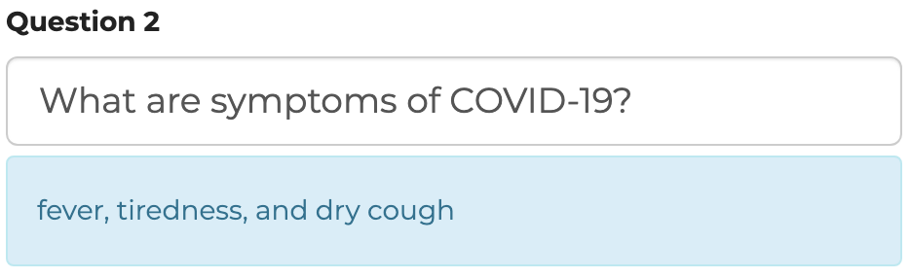
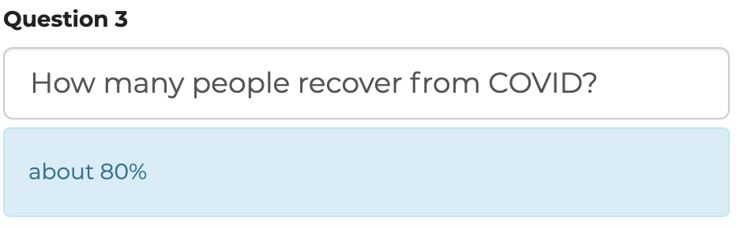
BERT-SQuAD answers question with surprising accuracy
Demo - BERT-SQuAD sample
Input paragraph
Input question & output answer
Sample from https://www.pragnakalp.com/demos/BERT-NLP-QnA-Demo/

Slide 15
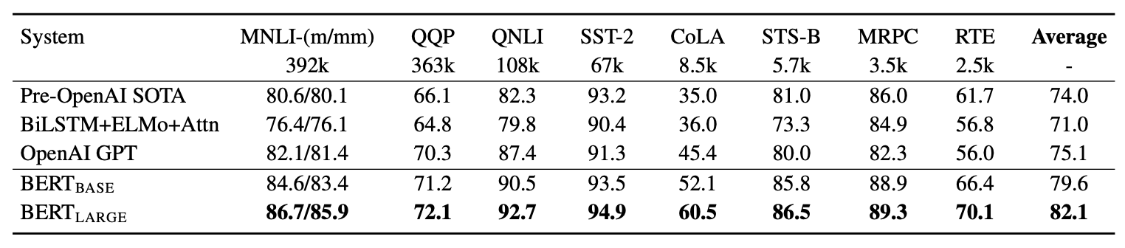
BERT has an excellent score on GLUE, a General Language Understanding Evaluation benchmark
Demo – Why BERT-SQuAD?
BERT has an excellent score on GLUE^{[23]}
*MNLI(MultiNLI Matched/Mismatched)^{[24]}/ QQP(Quora Question Pairs)^{[25]}/ QNLI(Question NLI)^{[24]}/ SST-2(The Stanford Sentiment Treebank)^{[26]}/ STS-B(Semantic Textual Similarity Benchmark)^{[27]}/ MRPC(Microsoft Research Paraphrase Corpus)^{[28]}/ RTE(Recognizing Textual Entailment)^{[29]}
BERT-SQuAD^{[11]} is easy to integrate
kamalkraj/BERT-SQuAD
[Server] python api.py
[Client] curl -X POST http://52.7.150.192:8000/predict -H 'Content-Type: application/json' -d '{ "document": ”[doc]","question":”[question]" }'

Slide 16
Reference(1/3)
Appendix
[1] Ian Sommerville, "ENGINEERING SOFTWARE PRODUCTS", p.66
[2] https://reactjs.org/
[3] https://redux.js.org/
[4] https://nodejs.org/en/
[5] https://aws.amazon.com/
[6] https://firebase.google.com/docs/database
[7] https://firebase.google.com/
[8] https://github.com/
[9] https://oss.oetiker.ch/mrtg/
[10] https://www.cypress.io/
[11] https://github.com/kamalkraj/BERT-SQuAD
[12] https://github.com/prescottprue/generator-react-firebase
[13] Ian Sommerville, p.312
[14] Ian Sommerville, p.316
[15] Ian Sommerville, p.16
[16] Ian Sommerville, p.66

Slide 17
Reference(2/3)
Appendix
[17] https://www.bu.edu/president/letter-to-the-community-on-coronavirus-followup/
[18] https://www.paypal.me/
[19] Ian Sommerville, p.273
[20] Jacob Devlin, Ming-Wei Chang, Kenton Lee, Kristina Toutanov, "BERT: Pre-training of Deep Bidirectional Transformers for Language Understanding"
[21] Yukun Zhu, Ryan Kiros, Rich Zemel, Ruslan Salakhutdinov, Raquel Urtasun, Antonio Torralba, SanjaFidler, "Aligning books and movies: Towards story-like visual explanations by watching movies and reading books"
[22] Pranav Rajpurkar, Jian Zhang, Konstantin Lopyrev, Percy Liang. "Squad: 100,000+ questions formachine comprehension of text"
[23] Alex Wang, Amanpreet Singh, Julian Michael, Felix Hill, Omer Levy, Samuel Bowman, "Glue: A multi-task benchmark and analysis platform"
[24] Adina Williams, Nikita Nangia, Samuel R Bowman, "A broad-coverage challenge corpus for sentence understanding through inference"
[25] Z. Chen, H. Zhang, X. Zhang, L. Zhao, "Quora question pairs"

Slide 18
Reference(3/3)
Appendix
[26] Richard Socher, Alex Perelygin, Jean Wu, Jason Chuang, Christopher D Manning, Andrew Ng, Christopher Potts, "Recursive deep models for semantic compositionality over a sentiment treebank"
[27] Daniel Cer, Mona Diab, Eneko Agirre, Inigo LopezGazpio, Lucia Specia, "Semeval-2017 task 1: Semantic textual similarity multilingual and crosslingual focused evaluation"
[28] William B Dolan and Chris Brockett, "Automatically constructing a corpus of sentential paraphrases"
[29] Luisa Bentivogli, Bernardo Magnini, Ido Dagan, Hoa Trang Dang, and Danilo Giampiccolo, "The fifth PASCAL recognizing textual entailment challenge"

Slide 19
Further user experience improvement is coming on iteration 3
Status report – Iteration 3
# | Item | Person in charge
1 | Remaining of iteration 2 | All
2 | Integration Test^{[19]} | All
3 | Return Book | Hiroaki + Shaurya
4 | Auto Complete Book Cover | Shenyuan + Shenjie
5 | Recommendations Engine | Amol + Peiyan

