Slide 1

Team 1 Machida Hiroaki Ding Shenjie Deshpande Amol Sinha Shaurya Shenyuan Wu Peiyan Duan

Slide 2
Access! http://team1.work

Slide 3
Contents
http://team1.work
Overview Concept Architecture Architecture selection
Status report Iteration 1 Iteration 2 Issues
Demo Hiroaki Peiyan Shenjie Amol Shenyuan

Slide 4


Users can buy & sell used textbooks
Overview - Concept
Figure
Book
Exchange
Basic user story
# | Action
1 | I post textbook for selling.
2 | You buy textbook
3 | I ship textbook
4 | You receive textbook!

Slide 5
React + Redux for application and Firebase Realtime Database for database
Overview - Architecture
AWS
React + Redux
Node.js
Firebase
Firebase Realtime Database

Slide 6
Node.js(React + Redux) + Firebase got chosen by voting because no backend is needed
Overview - Architecture selection
# | Option | Advantages | Disadvantages | # of votes obtained
1 | Node.js(React + Redux) + Firebase | No backend needed | Less people experienced No SQL
2 | Java(Spring) + MySQL | More people experience on Java | Learning Spring takes a time
3 | Ruby on Rails + MySQL | Easy scaffold | Less people experienced

Slide 7
Minimum user story is implemented on iteration 1
Status report – Iteration 1
# | Item | Person in charge | Status
1 | Framework setup | Shaurya | Done
2 | DB schema design | Shaurya | Done
3 | Continuous integration setup | Hiroaki | Done
4 | Minimum user story | Hiroaki | Done
5 | User review | Amol | Done
6 | Post for buying textbook | Shenyuan + Shaurya | Done
7 | Bar code detection | Shenjie | In progress
8 | Auto completion for search | Peiyang + Machida | Done

Slide 8
Better user experience is coming on iteration 2
Status report – Iteration 2
# | Item | Person in charge
1 | Whole user interface improvement | Shaurya + Amol + Hiroaki
2 | Advanced search | Shenyuan + Peiyan
3 | Paypal payment | Shenjie
4 | Event notification | Hiroaki

Slide 9
We made resolution plans for two major issues
Status report – Issues
# | Issue | Detail | Resolution plan
1 | Technical difficulty | Implementation is progressing not well React + Redux + Firebase requires skills more than thought | More frequent face-to-face meetings
2 | Not balanced workload | Workload is not balanced very well Some people have high workload outside of class | Keep it going. Cannot control situation outside of class Change task owners accordingly to avoid bottlenecks

Slide 10
Demo (Hiroaki, Amol, Shenyuan, Peiyan) Access! http://team1.work

Slide 11


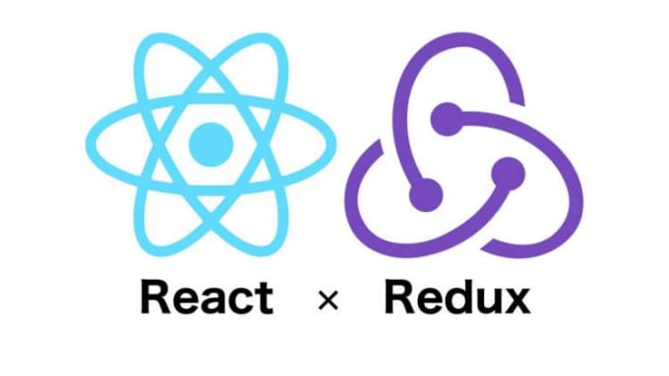



Developers get test result from Cypress
Demo - Contiguous development
4. Get test result
Developers
1.Commit
3. Execute
2. Pull
Cron

