Slide 1
Boston Crime Incident Reports Chuanxin Zeng Machida Hiroaki

Slide 2
Contents
Purpose
Dataset
Preprocessing
Analysis
Conclusion

Slide 3
Analyze crime incident reports to know where is the safer place to live in Boston
Purpose
Get an idea on where is the safer place to live in Boston
Practice the techniques of data science

Slide 4
The crime incident reports contains the offense descriptions, districts, dates, and locations
Dataset
Title: Crime incident reports by Boston Police Department
Period: August 2015 - November 2020
# of records: 527,770
Source: https://data.boston.gov/dataset/crime-incident-reports-august-2015-to-date-source-new-system
Attributes:
# | Attribute | Example
1 | INCIDENT_NUMBER | TESTTEST2
2 | OFFENSE_CODE | 423
3 | OFFENSE_CODE_GROUP | None
4 | OFFENSE_DESCRIPTION | ASSAULT - AGGRAVATED
5 | DISTRICT | External
6 | REPORTING_AREA | .
7 | SHOOTING | 0
8 | OCCURRED_ON_DATE | 2019/10/16 0:00
9 | YEAR | 2019
10 | MONTH | 10
11 | DAY_OF_WEEK | Wednesday
12 | HOUR | 0
13 | UCR_PART | None
14 | STREET | RIVERVIEW DR
15 | Lat | None
16 | Long | None
17 | Location | (0.00000000, 0.00000000)

Slide 5
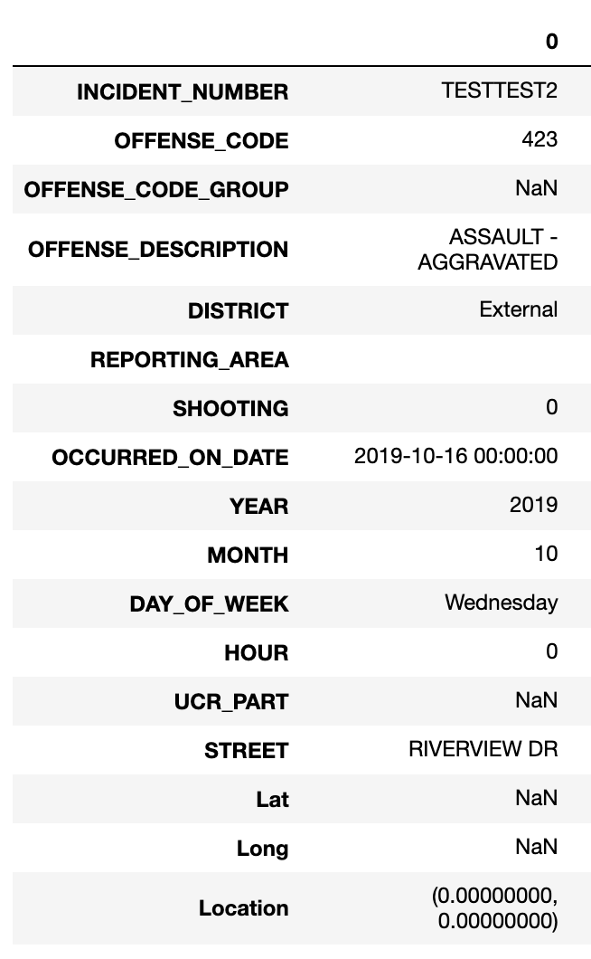
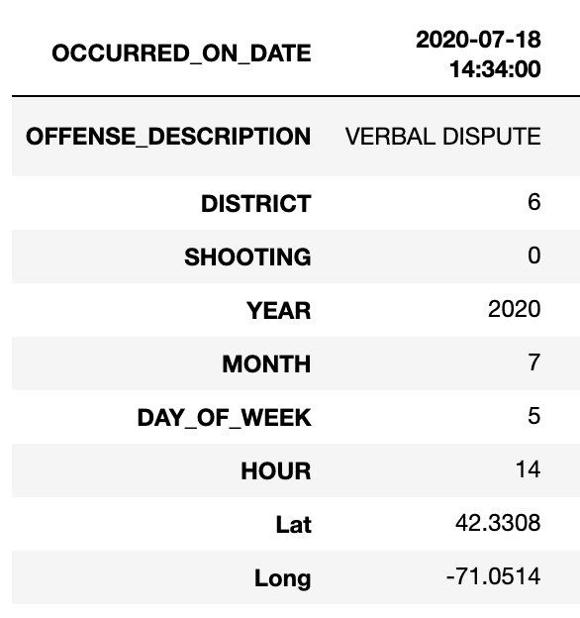
Removed fields not used, encoded categorical fields to numerical, and added the distance field
Preprocessing
Original
Preprocessed

Slide 6
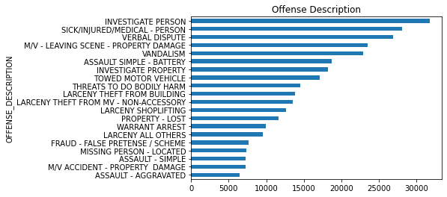
The offense description has a long tail distribution considering there are 279 unique values
Q1. Attributes - 1. Offense Description
Unique values: 279
Top 20:

Slide 7
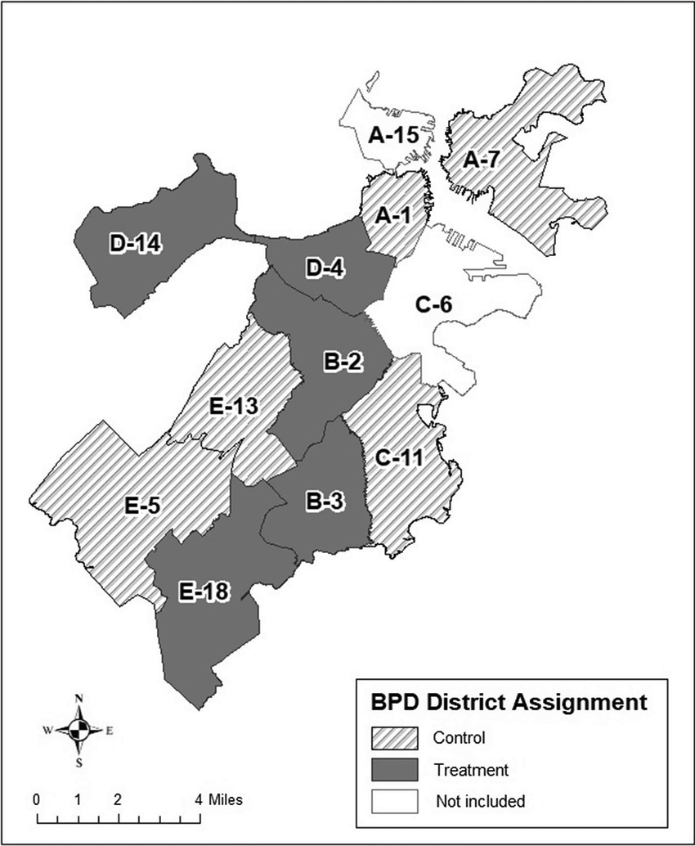
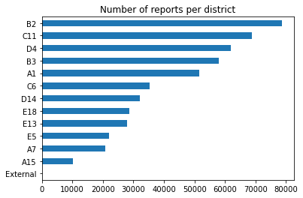
B2 (Roxbury) has 8 times more incidents reported than A15 (Charlestown)
Q1. Attributes - District
Number of crimes:
District map:
BU

Slide 8
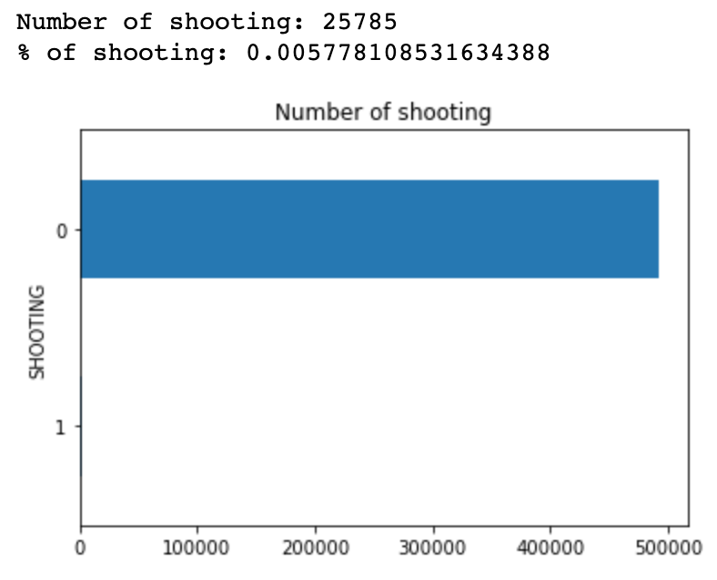
0.5% of reports involves shooting
Q1. Attributes - Shoot

Slide 9
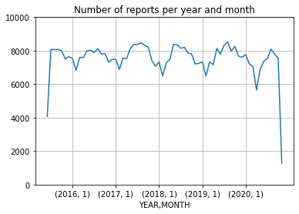
The number of crimes increases in summer
Q1. Attributes - Year and month

Slide 10
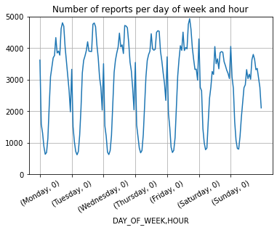
The number of crimes increases in daytime
Q1. Attributes - Day of week and hour

Slide 11
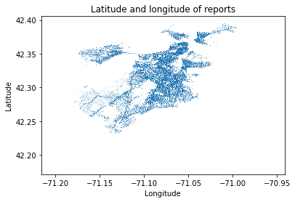
The numbers of crimes are higher in the east part
Q1. Attributes - Latitude and longitude

Slide 12
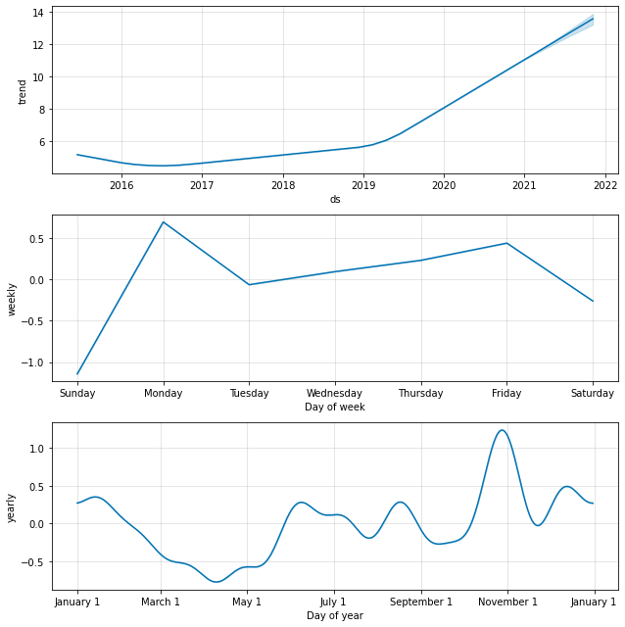
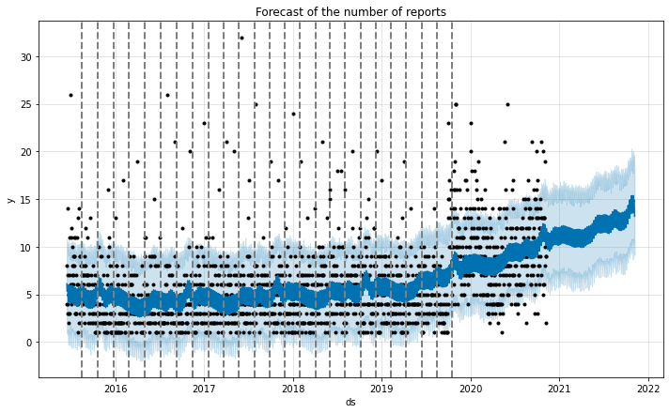
Prophet predicts the number of crime reports will increase in the future
Q2. Time Series Analysis
Components

Slide 13
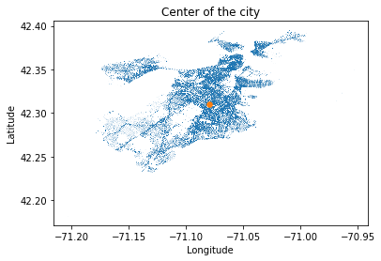
Calculated the distances to the center of Boston from the locations where incidents reported
Q3. Linear and Logistic Regression Analysis
Near Red Line
Four Corners/Geneva

Slide 14
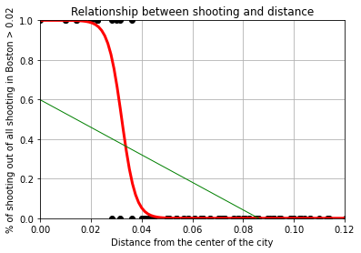
Both Linear and Logistic suggests shooting rate decreases as getting further from the center of city
Q3. Linear and Logistic Regression Analysis
* Distances are aggregated by the second decimal point

Slide 15
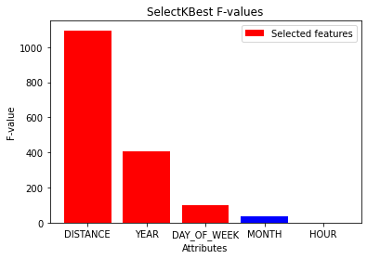
The most important attributes are the distance, year, and day of week to predict the shooting rate
Q4. Feature Selection - SelectKBest

Slide 16
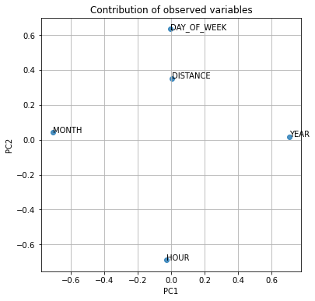
The year is the most important for the PC1, and the hour for the PC2
Q4. Feature Selection - Principal Component Analysis
Contribution:
Principal axes in feature space, representing the directions of maximum variance in the data

Slide 17
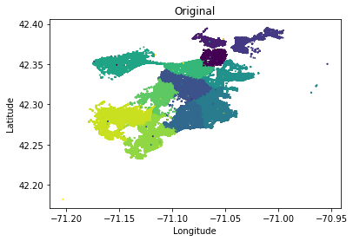
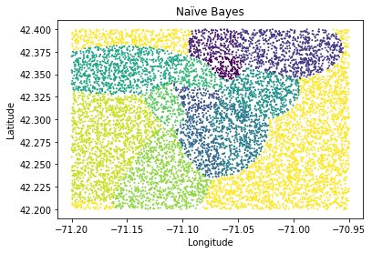
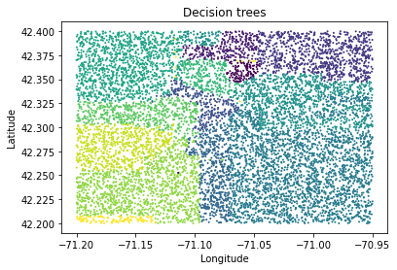
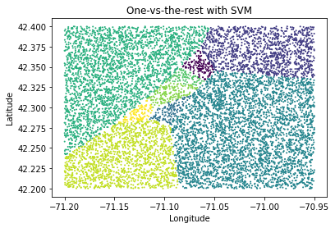
Naïve Bayes represents the original map best, followed by Decision Trees and SVM
Q5. Classification Analysis (Supervised)

Slide 18
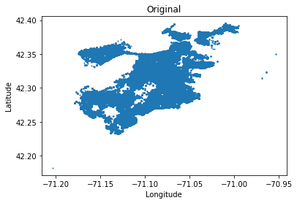
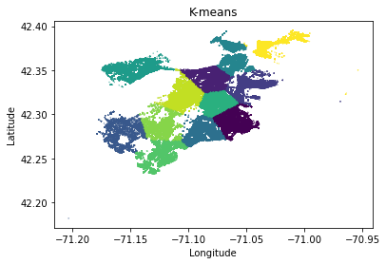
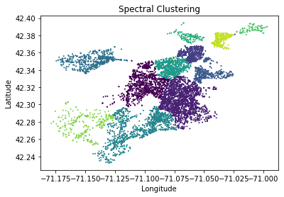
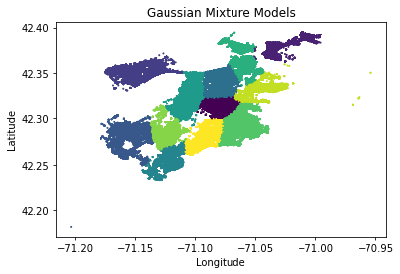
K-means divides the area the most evenly, followed by GMM, and Spectral Clustering
Q6. Clustering Techniques (Unsupervised)

Slide 19
We got the idea on where to live and learned the data science techniques
Conclusion
Get an idea on where is the safer place to live in Boston
=> The further from the center of the city, the safer.
Practice the techniques of data science
=> We learned Time Series Analysis, Regression Analysis, Feature Selection, Classification Analysis, and Clustering Techniques.
See the Jupyter notebook for more detailed interpretations

