Slide 1
Movie Recommender Systems
Building & comparing a recommender prototype — Individual Project
Recommender Systems — Prof. Marc Torrens, Esade
Hiroaki Nakano
June 2026
Live demo: https://movie-recommender-systems-bgvfxcjsf7myfvfxjyircb.streamlit.app

Slide 2
Project Goal & Approach
One prototype, built up method by method on a single dataset.
Movie track — MovieLens Latest Small (100k ratings, 610 users, 9.7k movies).
Implement and compare seven recommenders on identical data & splits.
Non-personalized baselines, content-based, item-item & user-user CF, matrix factorization.
Think beyond accuracy.
Also measure coverage, novelty, diversity and popularity bias — accuracy alone is misleading.
Ship a usable prototype.
Interactive Streamlit app: explore a user, compare algorithms, read 'why' explanations.

Slide 3
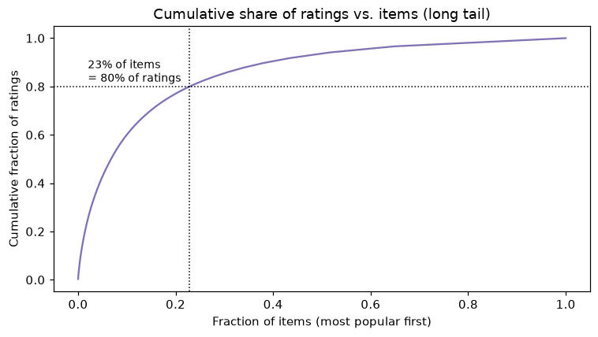
Dataset & EDA
MovieLens Latest Small (GroupLens)
610 users · 9,724 rated movies · 100,836 ratings
Ratings 0.5–5.0, mean 3.5, mode 4.0 (positivity bias)
Matrix is 98.3% sparse
Normal — even dense — by recommender standards
Sparsity is asymmetric
Users are thick: median 70 ratings each (min 20)
Items are thin: median 3 ratings; heavy long tail
~20% of movies hold 80% of all ratings
Long tail: a small head of movies dominates ratings.

Slide 4
Design Challenge: Sparsity
Each method handles the thin item axis differently:
Matrix factorization — learns dense latent vectors from observed ratings; built for sparsity.
Content-based — uses item metadata, not co-ratings; works even for long-tail items.
Neighbourhood CF — needs safeguards, or tail items produce noisy similarities:
min_support: drop items rated by < 5 users from the neighbourhood model.
shrinkage: sim_adj = n_ij / (n_ij + λ) · sim — distrust similarities from few co-ratings.
adjusted cosine: mean-center each user's ratings before similarity.
Lesson: standard methods DO work at 98% sparsity — the trick is matching method to the data's weak axis.

Slide 5
Methods Implemented
Family | Method | Idea in one line
Non-personalized | Most Popular | Rank by number of ratings
Non-personalized | Highest Average | Top mean rating, min 20 ratings
Non-personalized | Random | Lower-bound / coverage reference
Content-based | TF-IDF genres | Cosine of user profile vs item genre vectors
Collaborative | Item-Item CF | Adjusted cosine + shrinkage, k-NN over items
Collaborative | User-User CF | Same, over the (denser) user axis
Latent factor | Matrix Factorization | Biased SGD: mu + b_u + b_i + p_u·q_i
MF is written from scratch in NumPy (scikit-surprise does not build on Python 3.14) — fully transparent.

Slide 6
Evaluation Protocol
Split: per-user stratified 80/20 — every user keeps train history and held-out test items.
Relevance: a test item counts as relevant if the user rated it ≥ 4.0 (positivity-aware).
Top-N ranking metrics (K=10):
Precision@K, Recall@K, NDCG@K, MRR@K, Hit-Rate@K.
Beyond-accuracy metrics:
Catalog coverage, novelty (mean −log₂ P(item)), intra-list diversity (1 − cosine over genres).
Rating-prediction metrics (models with predict_score): RMSE, MAE.
Averaged over the 599 users that have at least one relevant test item.

Slide 7
Method Comparison — Results (K=10)
Method | NDCG | P@10 | Recall | HitRate | Coverage | Novelty | Diversity
User-User CF | 0.219 | 0.163 | 0.145 | 0.648 | 0.031 | 2.19 | 0.75
Item-Item CF | 0.211 | 0.155 | 0.126 | 0.644 | 0.086 | 2.80 | 0.72
Most Popular | 0.161 | 0.122 | 0.104 | 0.574 | 0.006 | 1.66 | 0.76
Matrix Factorization | 0.072 | 0.056 | 0.041 | 0.356 | 0.049 | 3.41 | 0.78
Highest Average | 0.062 | 0.046 | 0.034 | 0.301 | 0.004 | 3.39 | 0.66
Content-Based | 0.008 | 0.007 | 0.005 | 0.063 | 0.341 | 7.28 | 0.085
Random | 0.001 | 0.001 | 0.001 | 0.013 | 0.489 | 7.57 | 0.80
Neighbourhood CF wins ranking; user-user edges item-item because the user axis is denser.
Most-popular is a strong accuracy baseline but touches only 0.6% of the catalog — pure popularity bias.

Slide 8
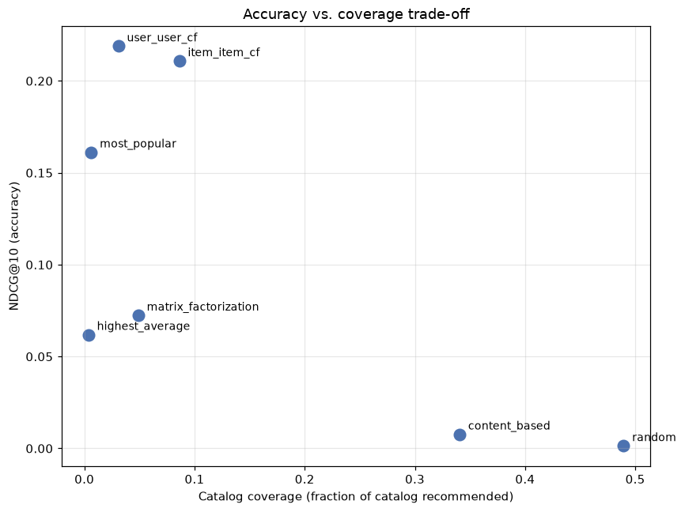
Accuracy is Not Enough
The accuracy–coverage frontier
Most accurate methods recommend from a tiny slice of the catalog.
High-coverage methods (content, random) are inaccurate.
No single winner
A product must choose a point on this frontier.
Discovery-focused service → accept lower accuracy for coverage/novelty.
'Safe' service → popularity / CF.

Slide 9
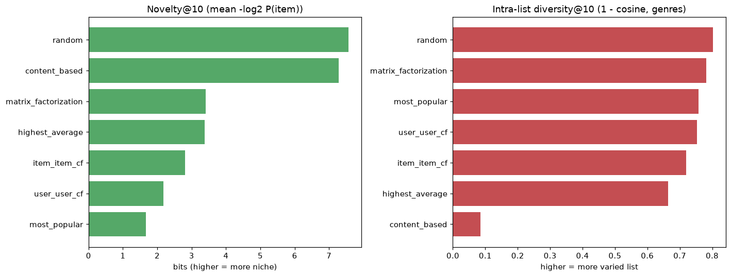
Beyond Accuracy: Novelty & Diversity
Novelty: −log₂ P(item)
Popular = low novelty; niche = high.
Diversity: spread of a single list
Content-based is highly novel but has very LOW diversity — it locks onto one genre cluster.
These trade-offs are invisible to accuracy metrics.

Slide 10
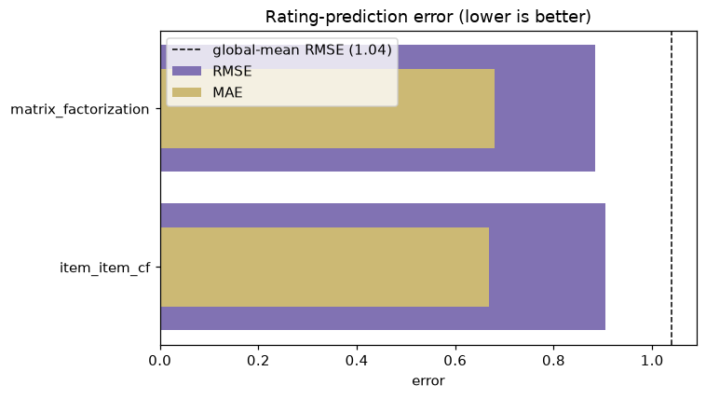
Matrix Factorization: Right Tool, Wrong Metric
MF looks weak on top-N (NDCG 0.072)…
…but it is the BEST rating predictor:
RMSE 0.885 vs item-item 0.905; ~15% better than the global-mean baseline (1.04).
Why the gap?
MF minimizes squared error, not ranking. Good RMSE ≠ good top-10.
Fix for production: ranking objective (BPR / implicit-feedback / logistic MF).
'MF doesn't work' is wrong — it optimizes a different objective.

Slide 11
Ablation — TF-IDF vs. Raw Genre Vectors
Does weighting genres by rarity (TF-IDF) beat treating every genre equally (raw 0/1)?
Content-based variant | NDCG | P@10 | Recall | HitRate | Coverage | Novelty | Diversity
TF-IDF genres | 0.0076 | 0.0068 | 0.0047 | 0.063 | 0.341 | 7.28 | 0.085
Raw genre vectors | 0.0056 | 0.0058 | 0.0035 | 0.053 | 0.352 | 7.29 | 0.075
TF-IDF wins 5 of 7 metrics — all four accuracy metrics plus diversity.
NDCG +36% relative (0.0056 → 0.0076): IDF up-weights distinctive genres (Film-Noir, Western), building more discriminative profiles.
Raw genre vectors only edge ahead on coverage and novelty.
Treating every genre equally spreads picks slightly wider across the catalog.
The effect is small by construction:
~20 genre tokens and term-frequency ≡ 1, so only the IDF term is active — richer text (tags, synopsis) would help more.

Slide 12
Recommendation Examples (User 599)
Same user, top-5 from each method — the personalities are clearly different:
Method | Top recommendations
Most Popular | Matrix · Star Wars IV · Schindler's List · Empire Strikes Back
Item-Item CF | Eternal Sunshine · Matrix · Kill Bill 2 · Star Wars IV
User-User CF | Star Wars IV · Matrix · Empire Strikes Back · LotR Fellowship
Content-Based | Home for the Holidays · Mr. Holland's Opus · Tape · Focus
Matrix Fact. | Lawrence of Arabia · Donnie Darko · Kill Bill 2 · Some Like It Hot
CF leans to well-loved classics; content-based surfaces niche same-genre titles; MF mixes acclaimed films.

Slide 13
Technical Challenges
Ranking vs. rating in CF
Normalizing scores by Σ|sim| let single-neighbour tail items flood top-N (P@10 collapsed to ~0.006).
Fix: rank by the raw weighted sum; keep normalization only for rating prediction. P@10 → 0.155.
Tuning MF for top-N
More regularization helped RMSE but hurt ranking; settled on 50 factors, 30 epochs, λ=0.01.
Library availability
scikit-surprise won't build on Python 3.14 → implemented biased SGD MF in pure NumPy.
Engineering
Kept matrices sparse; pre-trained & pickled models so the Streamlit app loads instantly; UTF-8 console fix.

Slide 14
The Prototype (Streamlit)
Explore tab
Pick a user → see their taste profile (top genres, favourite films).
Compare any subset of algorithms side by side for that user.
Every recommendation carries a 'why': matching genres, a similar film you liked, predicted rating, or popularity.
Evaluation tab
The full metrics table and comparison figures, in-app.
Engineering
Models pre-trained via build_artifacts.py and cached → instant, responsive UX.
Live app: https://movie-recommender-systems-bgvfxcjsf7myfvfxjyircb.streamlit.app
Run locally: python build_artifacts.py → streamlit run app.py

Slide 15
Final Remarks & Future Work
What the comparison taught us
Neighbourhood CF gives the best top-N here; popularity is a deceptively strong, low-coverage baseline.
Accuracy and beyond-accuracy goals genuinely conflict — the right model depends on the product.
Matrix factorization wins rating prediction; ranking needs a ranking objective.
Future work
Hybrid CF + content to cover the cold/long-tail items CF cannot score.
Implicit/ranking-loss MF (BPR, ALS) to make latent factors competitive on top-N.
Temporal split, cross-validation, and explicit cold-start analysis.
Thank you.

