Slide 1
2022/10/5
Hiroo

Slide 2
Idea of the experiment
Across Trials
slow change
Single Trial: fast change, how arousal affect optimal space
Simon’s work
smoothed RT and Neural Engagement is monotonical change as a function of rewards
⇩
Separate slow change and fast change caused by arousal
My work?
We can see the change before/after interruption
High level ideas
Q. How arousal affect to the optimal zone (reward axis, target plane axis)
Target plane will be tighter after interruption
(Q. Neural Engagement axis is consistent across interruptions?)

Slide 3
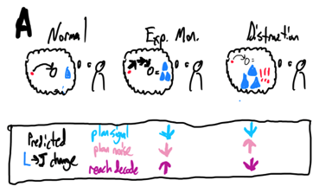
Analysis steps
Behavior difference before/after interruption
Hypothesis1: Success rate decreased
Hypothesis2: RT increased
Biosignal change
Check: Is pupil size/heart rate abruptly changed after interruption?
Neural population change
Hypothesis: Distraction
Analaysis
Compare TPPC1,2/RePC1,2 before/after
Whole/TP - signal/noise variability
Concern
shortage of trial after interruption

