Slide 1
20220929
Hiroo Miyata

Slide 2
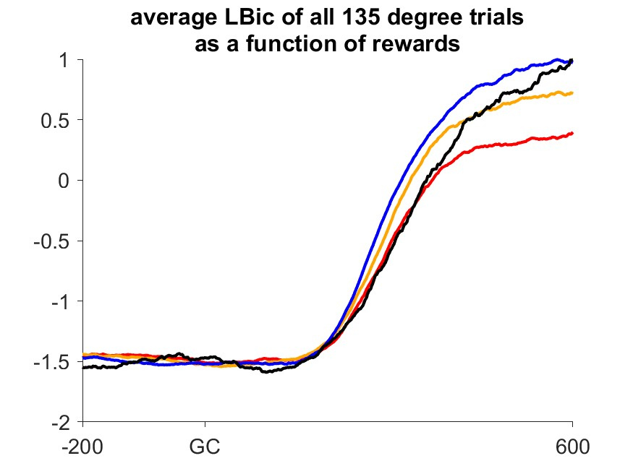
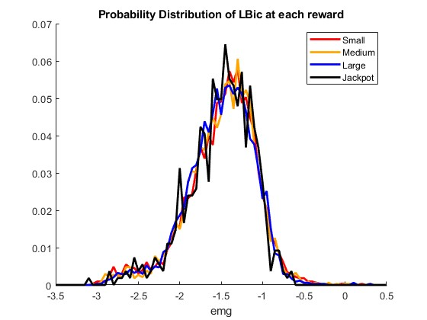
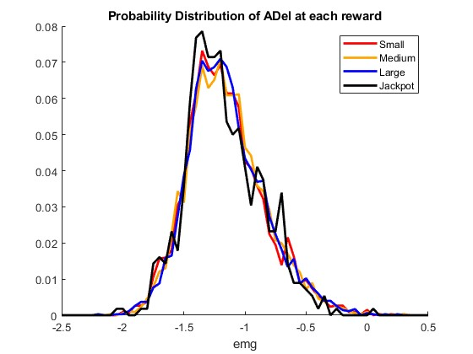
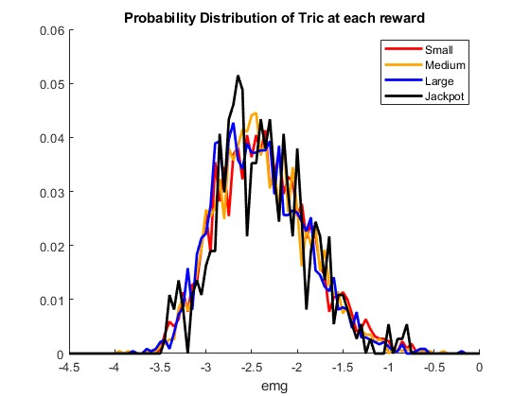
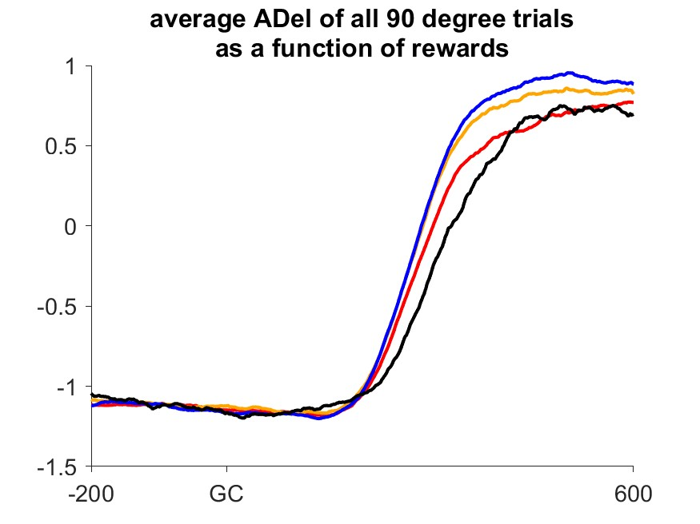
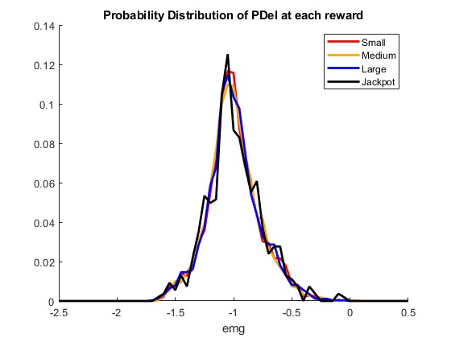
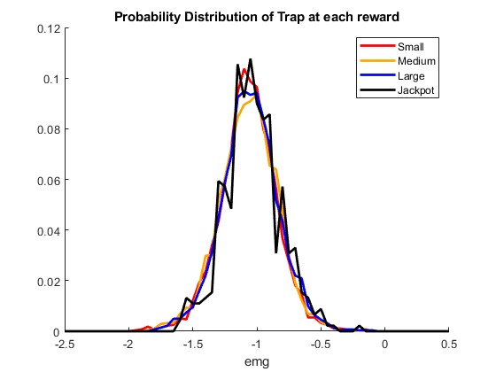
Co-contraction stuff-1

Slide 3
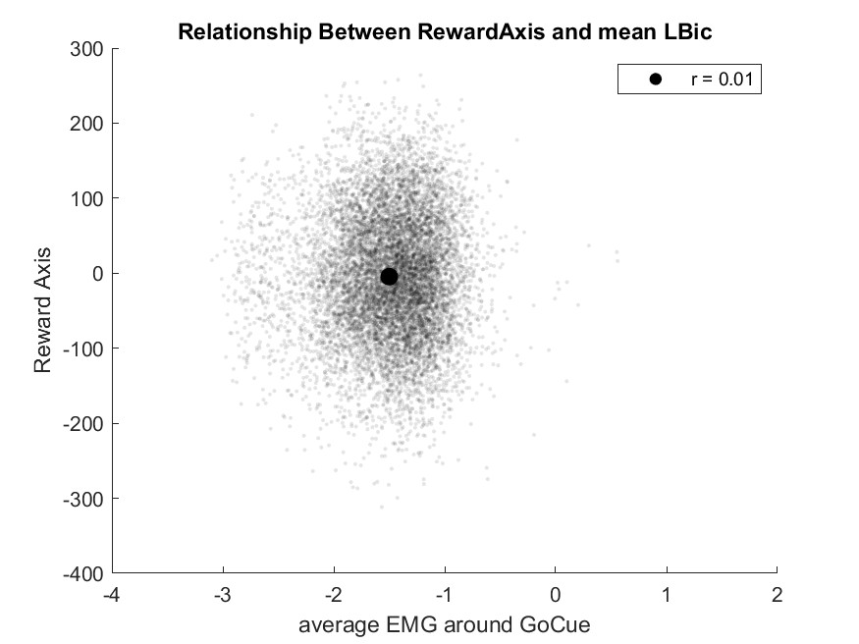
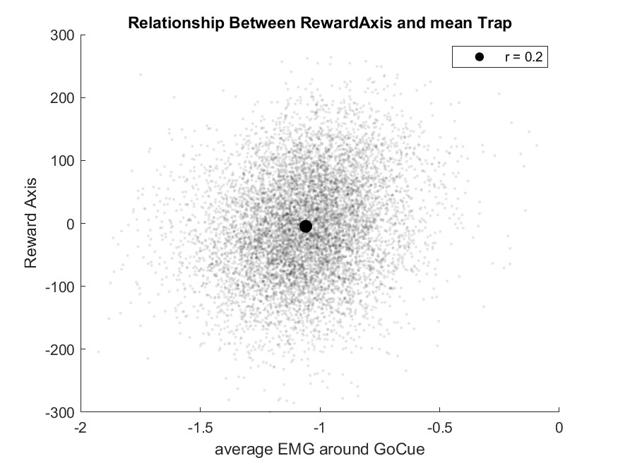
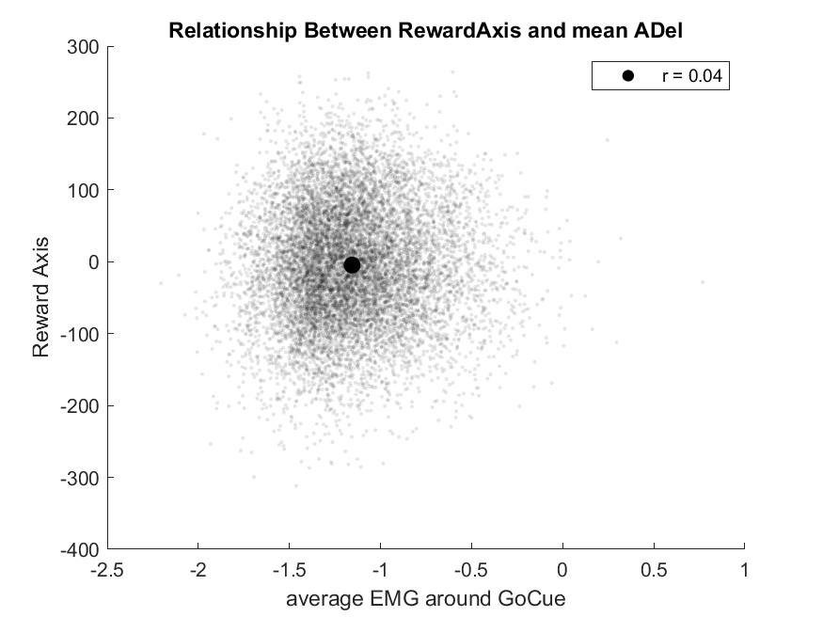
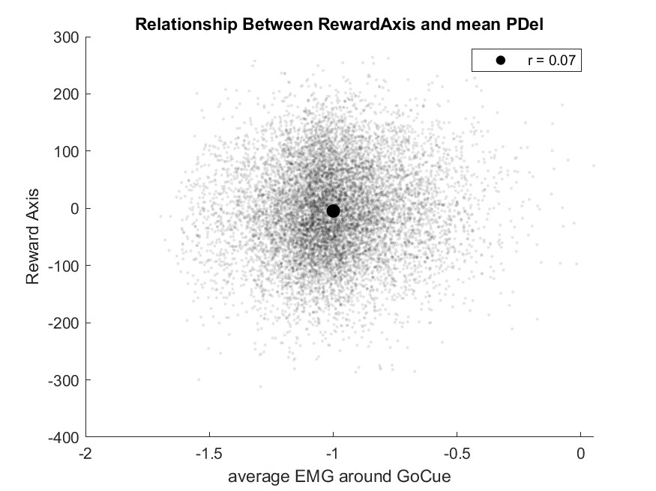
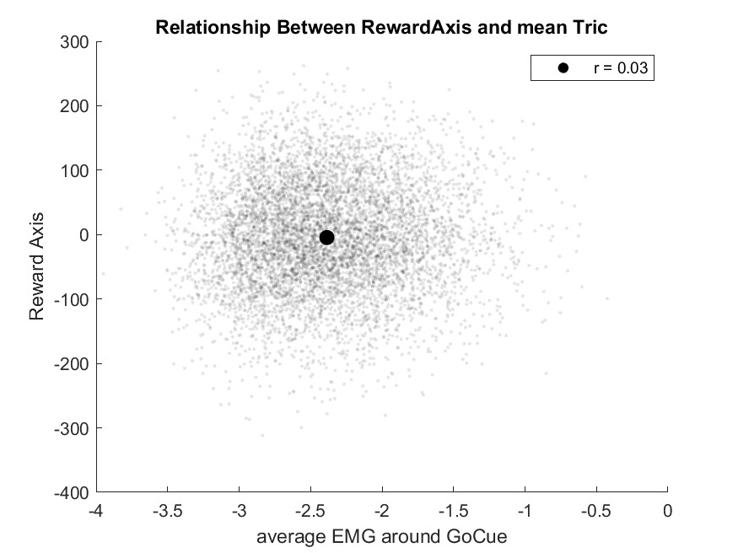
Co-contraction stuff-2

Slide 4
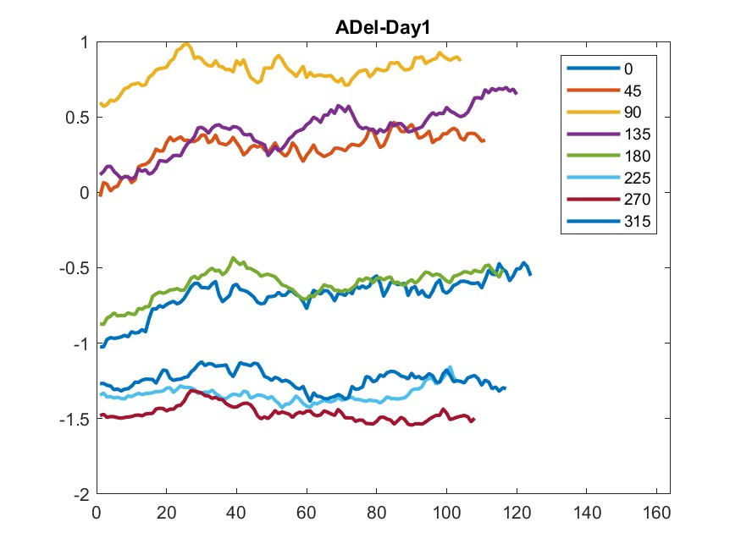
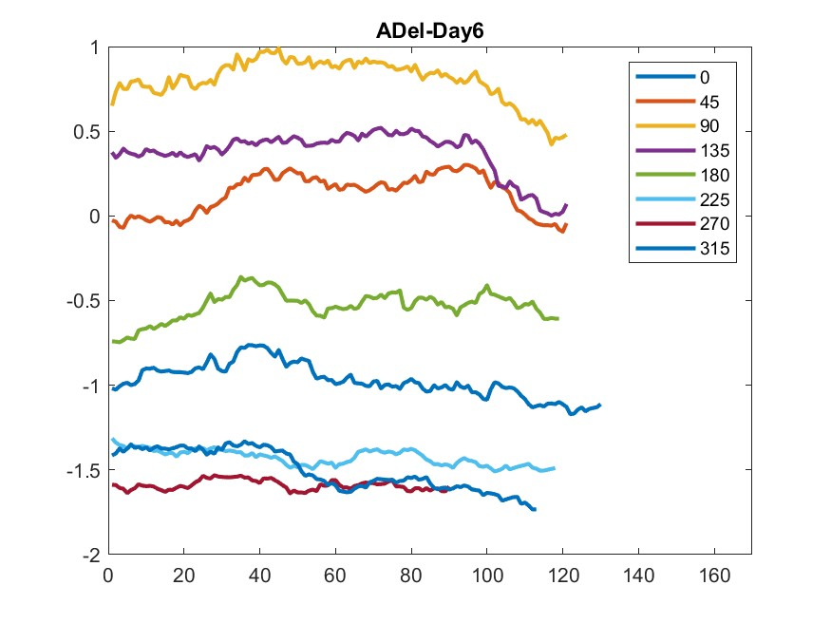
Fatigue change #ADel best and worst day
Mean EMG (PeakVelocity±100ms) and smoothed by boxcar of 20 trials

Slide 5
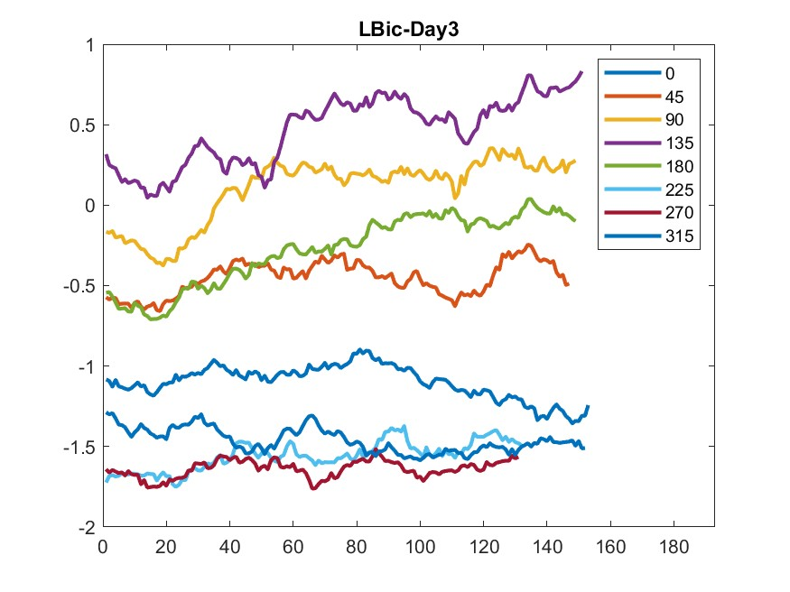
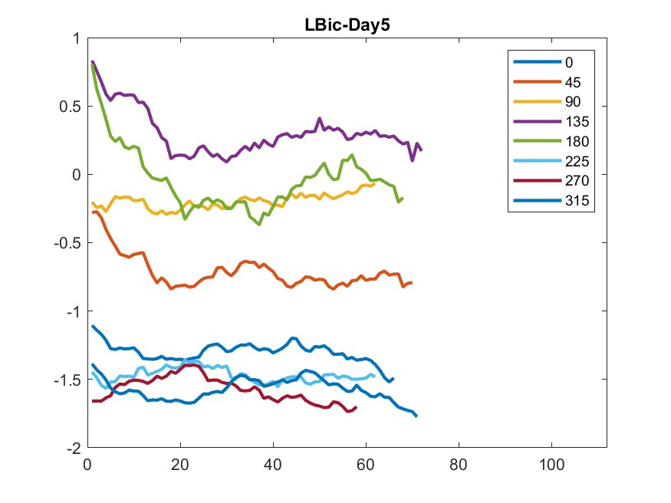
Fatigue change #LBic best and worst day
Mean EMG (PeakVelocity±100ms) and smoothed by boxcar of 20 trials

Slide 6
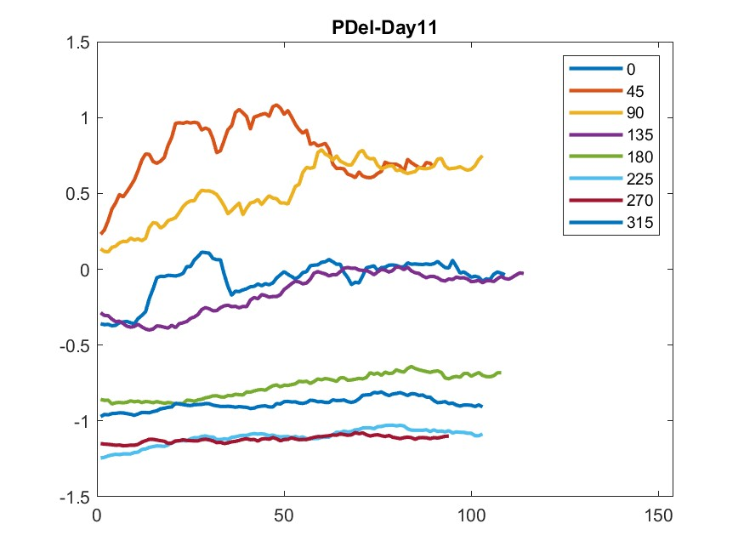
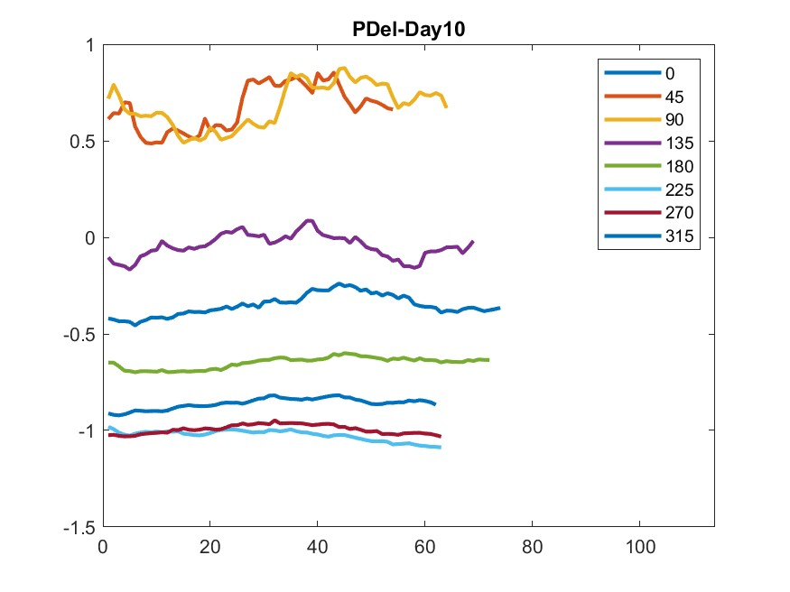
Fatigue change #PDel best and worst day
Mean EMG (PeakVelocity±100ms) and smoothed by boxcar of 20 trials

Slide 7
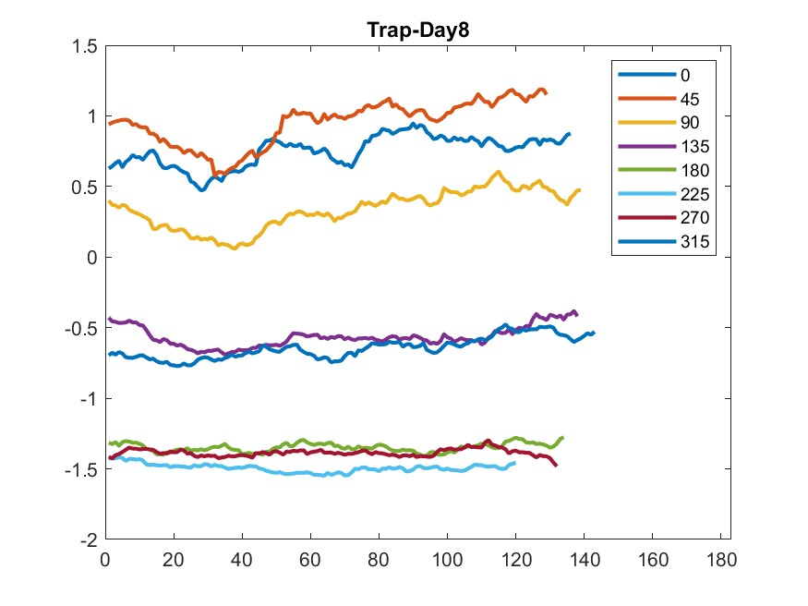
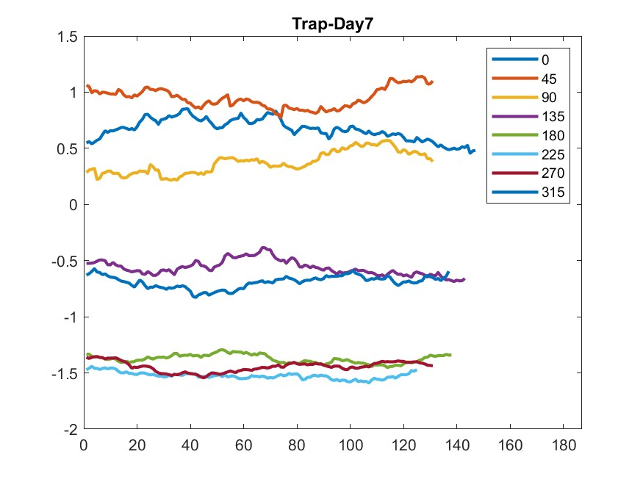
Fatigue change #Trap best and worst day
Mean EMG (PeakVelocity±100ms) and smoothed by boxcar of 20 trials

Slide 8
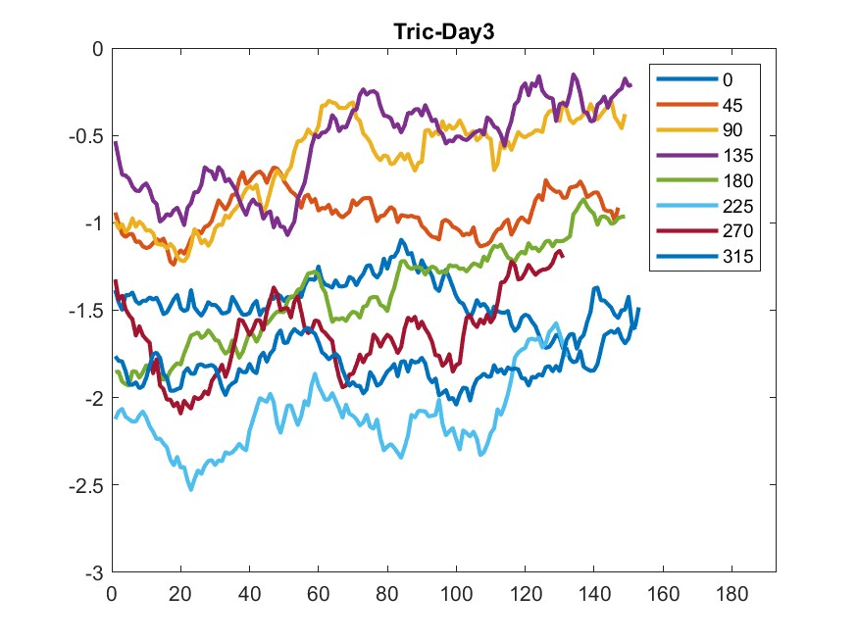
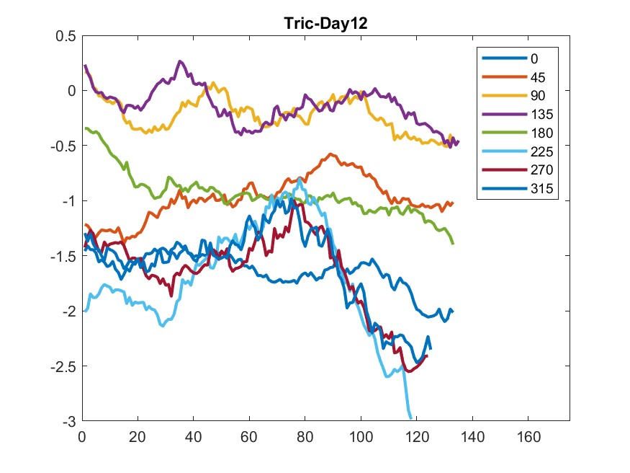
Fatigue change #Tric best and worst day
Mean EMG (PeakVelocity±100ms) and smoothed by boxcar of 20 trials

Slide 9
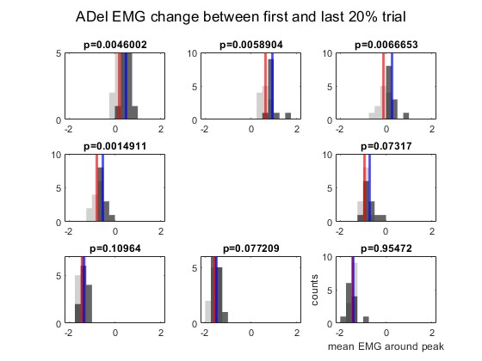


Fatigue change #ADel change across days
Gray is average of first 20% trial and Black is that of last 20%
$$\overline{first}$$
$$\overline{last}$$

Slide 10
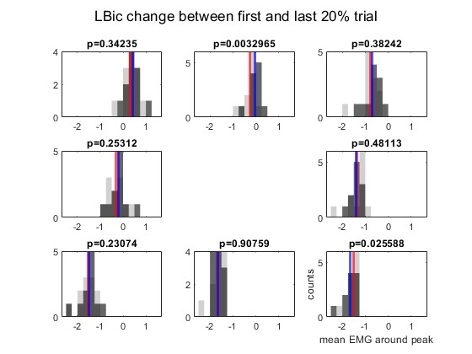
Fatigue change #LBic change across days
Gray is average of first 20% trial and Black is that of last 20%
$$\overline{first}$$
$$\overline{last}$$

Slide 11
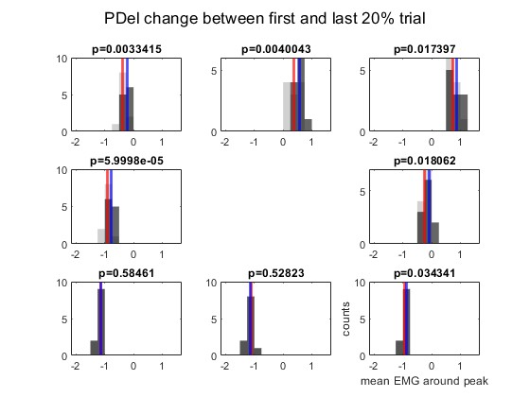
Fatigue change #PDel change across days
Gray is average of first 20% trial and Black is that of last 20%
$$\overline{first}$$
$$\overline{last}$$

Slide 12
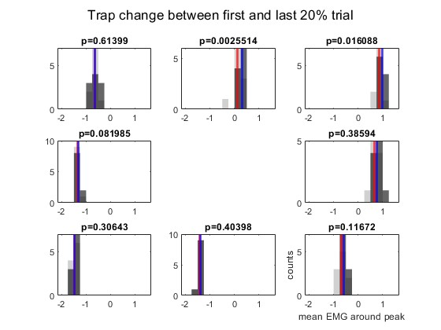
Fatigue change #Trap change across days
Gray is average of first 20% trial and Black is that of last 20%
$$\overline{first}$$
$$\overline{last}$$

Slide 13
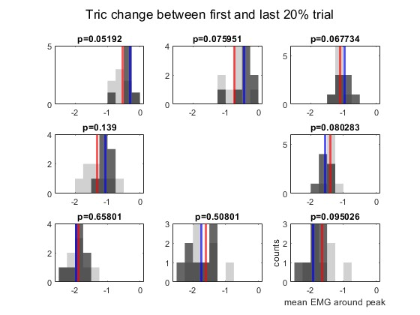
Fatigue change #Tric change across days
Gray is average of first 20% trial and Black is that of last 20%
$$\overline{first}$$
$$\overline{last}$$

