Slide 1
2022/09/16
Hiroo Miyata

Slide 2
Table of Content
New figures to prove no co-contraction in delay period
EMG changes across session

Slide 3
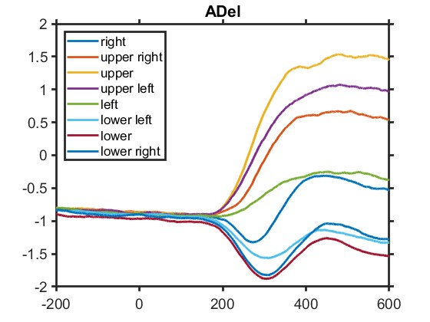
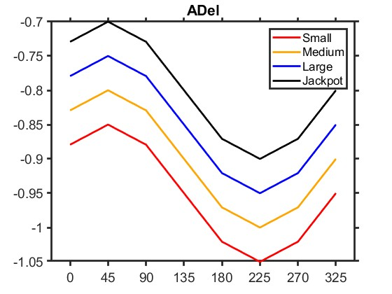
Hypothesis
EMG at holding time changes monotonically as a function of reward
Result of EMG around Go Cue among directions
Hypothesis
EMG
Analysis bin
Time
Directions

Slide 4
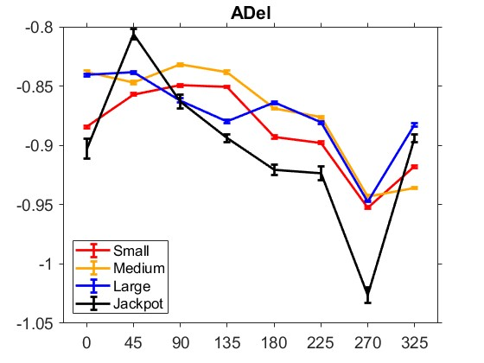
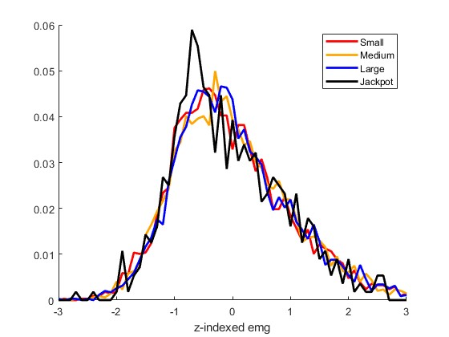
Result
There is no relationship between EMG and rewards
ADel at holding time as a function of reward
Probability distribution of ADel at each reward
EMGs are
z-indexed
in each direction
・・・
Directions
z-indexed emg

Slide 5
Table of Content
New figures to prove no co-contraction in delay period
EMG changes across session

Slide 6
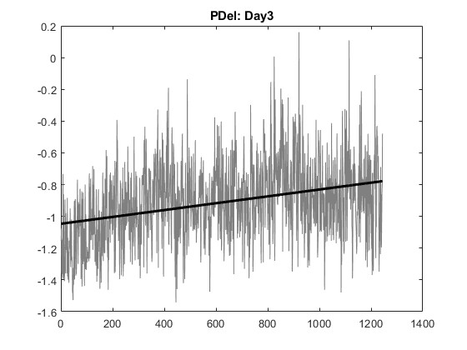
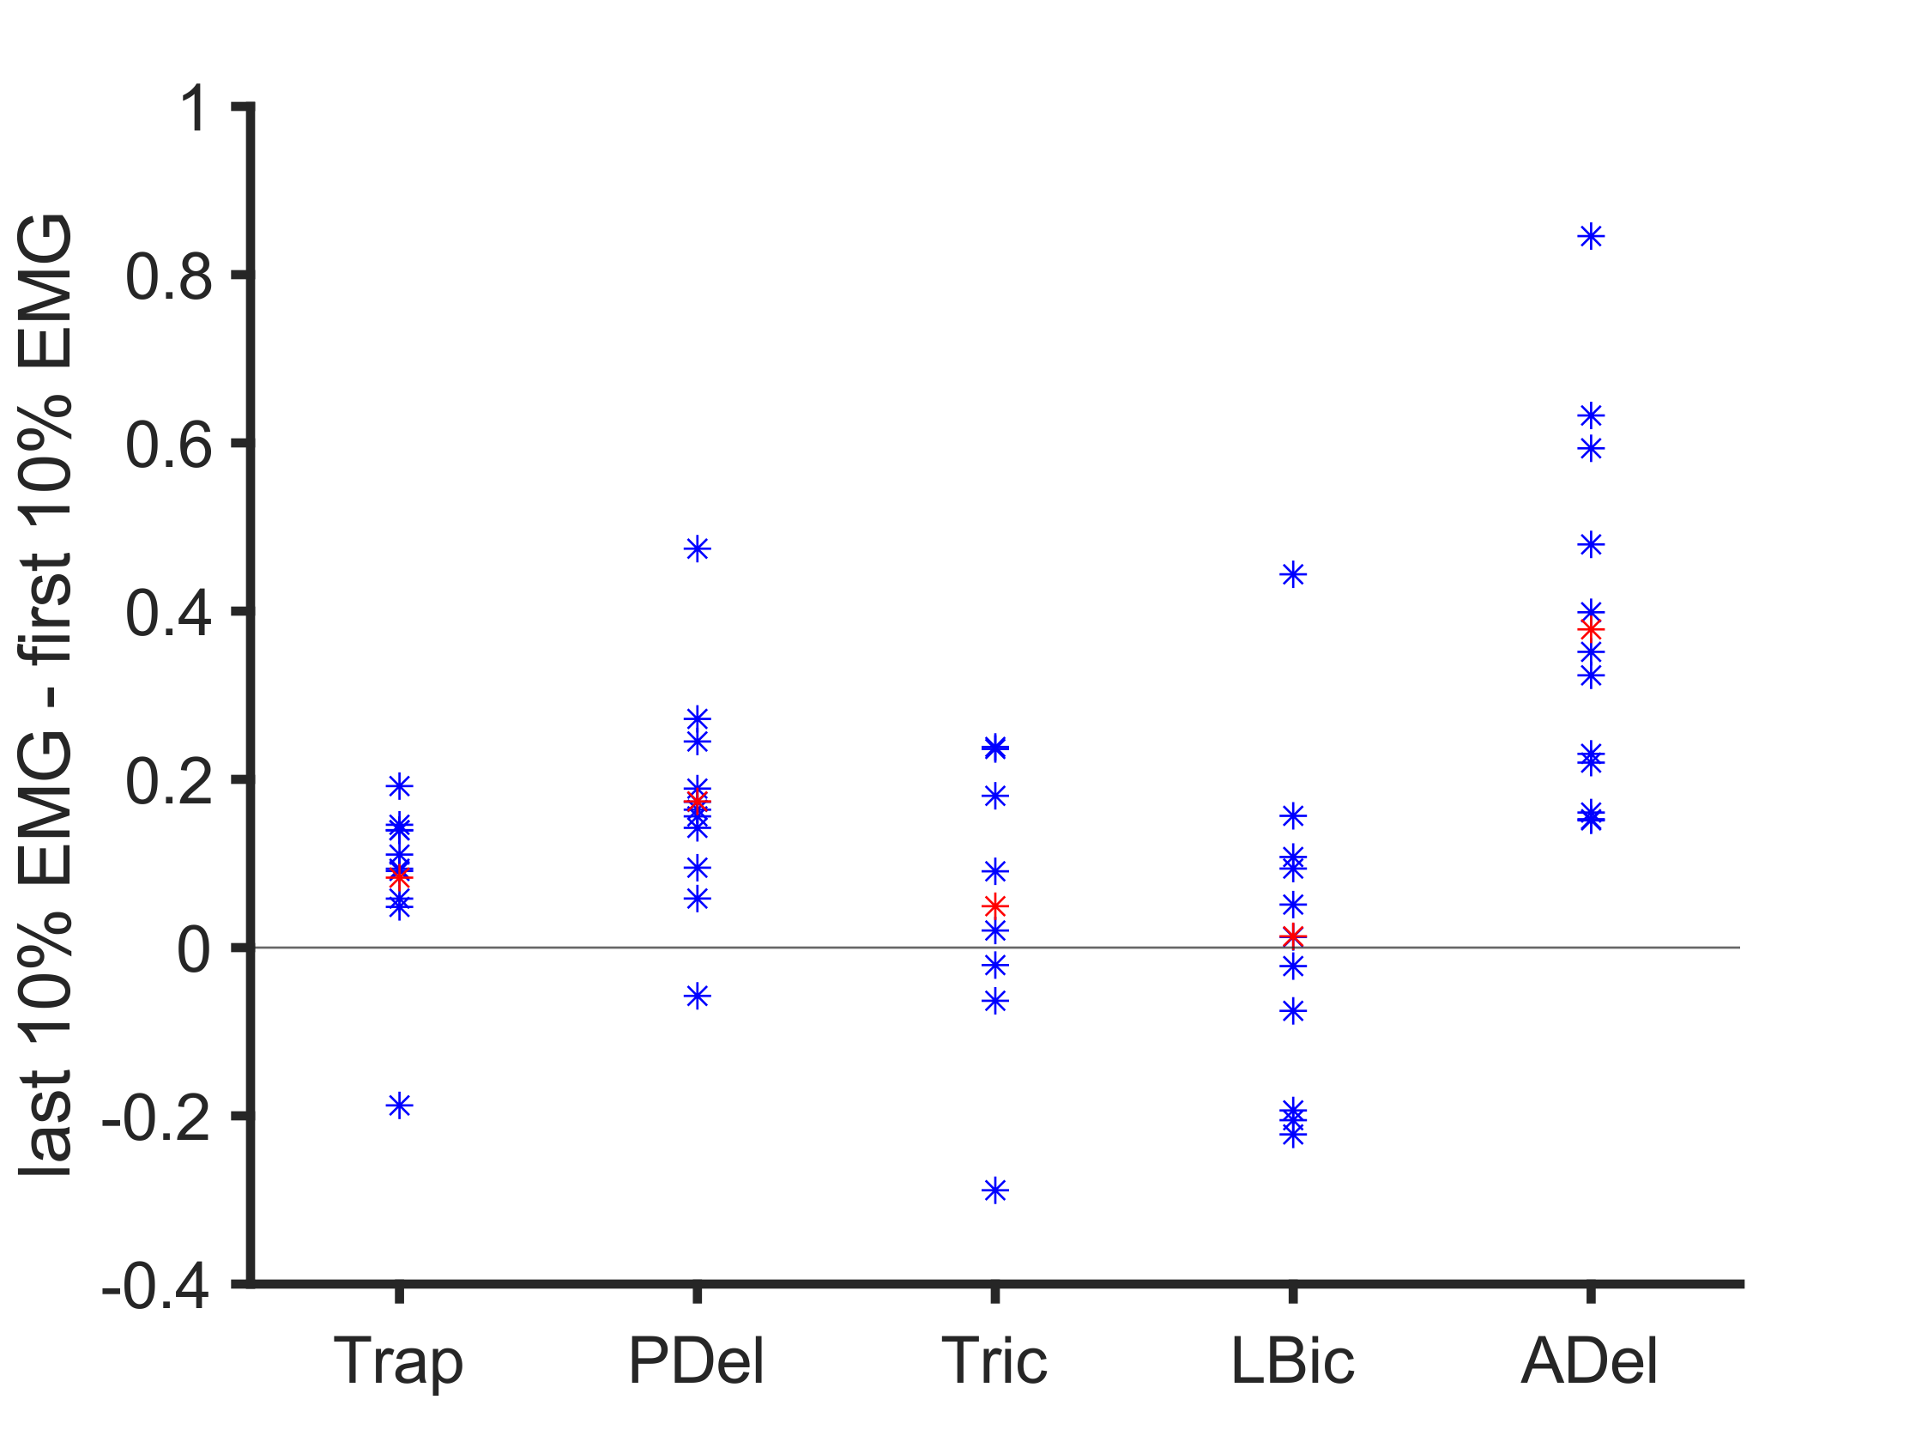
Result: EMG gradually change across session
The fact that only shoulder muscles increased
makes the fatigue-hypothesis stronger
p<0.0001
p<0.05
p<0.001

Slide 7
ToDo
Correlation coefficient of Reward axis and EMG at holding time
Integrating neural data and muscle data
Relationship between EMG and Neural Activity
Output-potent space
How fatigue is represented in neural activity

