Slide 1
Progress Report
Hiroo Miyata
2022/08/12

Slide 2
Table of Contents
(Repeat) Preprocessing of EMG signals
Visualization of EMG signals around Go Cue
Future Direction

Slide 3
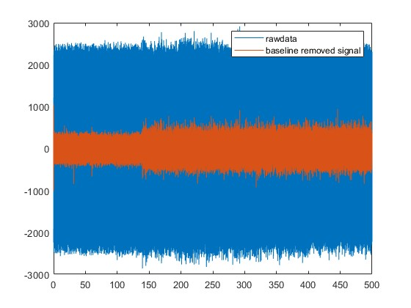
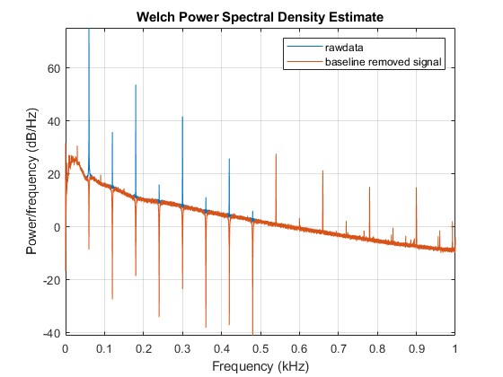
Remove baseline noise by Notch filter
(Butterworth, second order, cutoff frequency= $60n±1$Hz (n=1,…,8))
Raw Signal
Voltage(a.u)
Time (second)
Removing baseline noise make signal more clear
PSD spectrum shows only baseline noise is removed

Slide 4
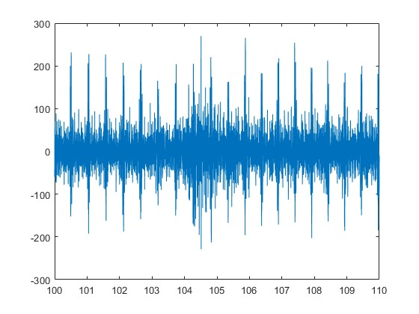
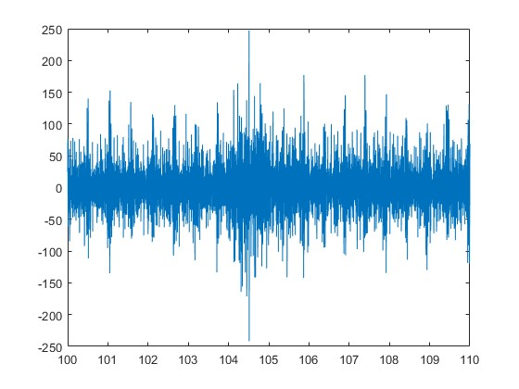
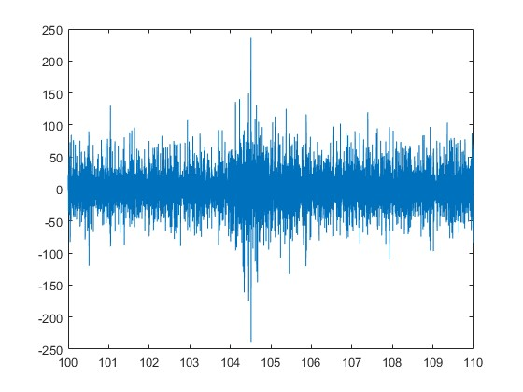
ECG signal wasn’t removed by bandpass filter
EMG signal at rest(100~110s) at different cutoff-frequency bandpass filter
Cut-off frequency as proposed is around 30 Hz (Surface Electromyography Signal Processing and Application: A Review 2009)
10 Hz
30 Hz
50 Hz
40 Hz
50 Hz

Slide 5
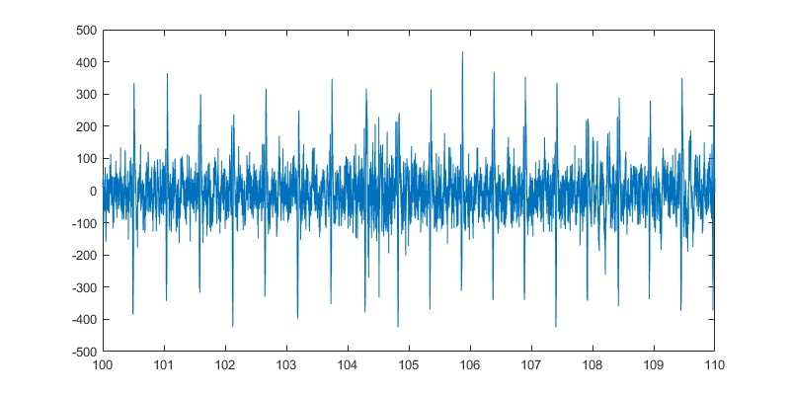
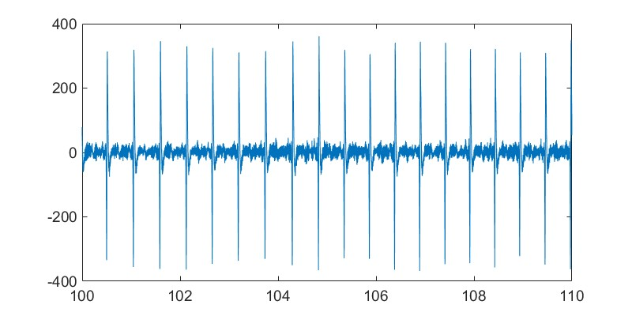
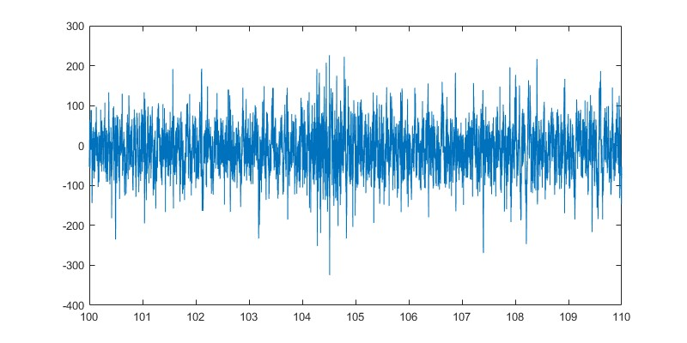
Remove ECG by adaptive filter
Before
Adaptive filter using least square fit
(A.L. Hof, Journal of Electromyography and Kinesiology, 2009)
emg(t)
new emg(t)
Detected
ecg’(t)
H(t)
ecg(t)
After
H(t)の求め方の説明
Least square fitの説明

Slide 6
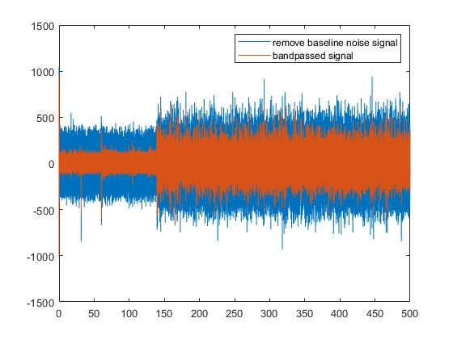
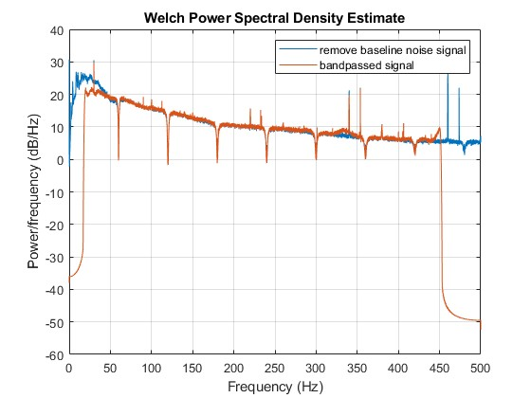
Remove unrelated signal by bandpass filter
(Butterworth, second order, cutoff frequency= ~20 Hz and 450 Hz ~
Motion artifact is 0 ~ 20 Hz (Anghoon, Biomedical Signal Processing, 2019)
Raw Signal
Voltage(a.u)
Time (second)
PSD spectrum proves it correctly removes signals
In irrelevant frequency bands

Slide 7
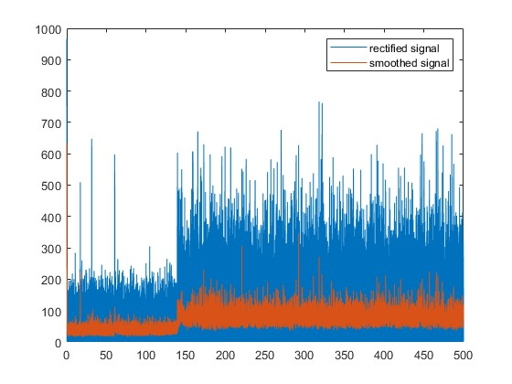
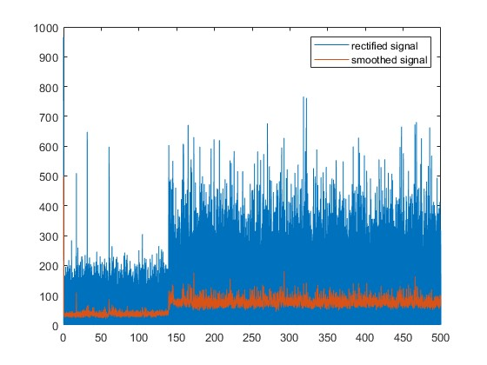
Rectify and smooth signal
Rectification: negative value to positive
Smoothing: Moving Average or Root Mean Square
Smoothed by 50ms time window
Smoothed by 200ms time window
Voltage(a.u)
Voltage(a.u)
Time (second)
Time (second)
The EMG signal is smoothed

Slide 8
Table of Contents
(Repeat) Preprocessing of EMG signals
Visualization of EMG signals around Go Cue
Future Direction

Slide 9
Visualization of EMG around Go Cue
Hypothesis
EMG signal and reach direction have a relationship during motion
EMG and reward have a relationship at delay period

Slide 10
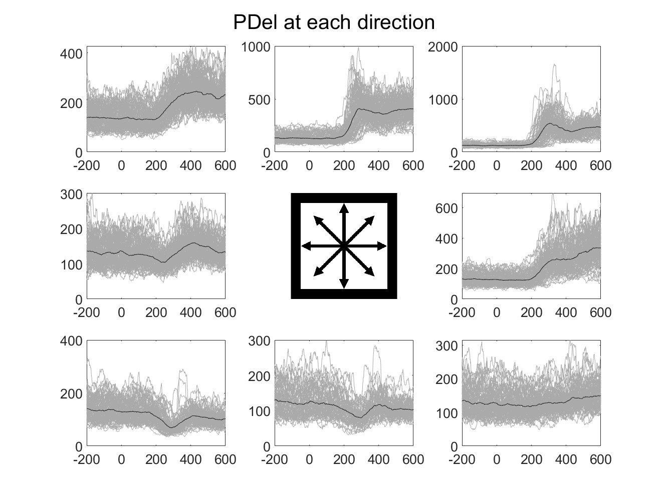
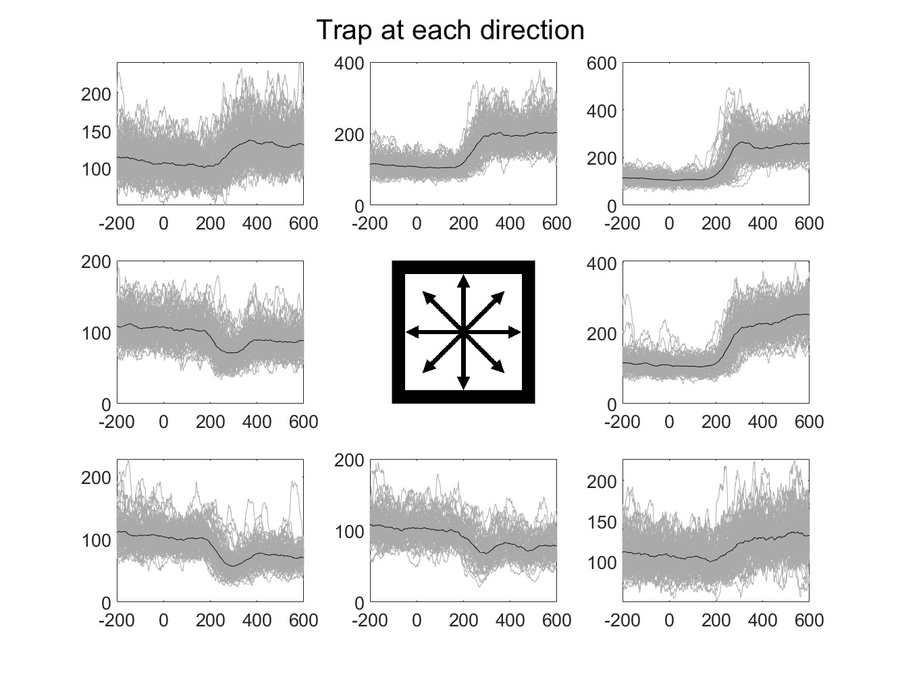
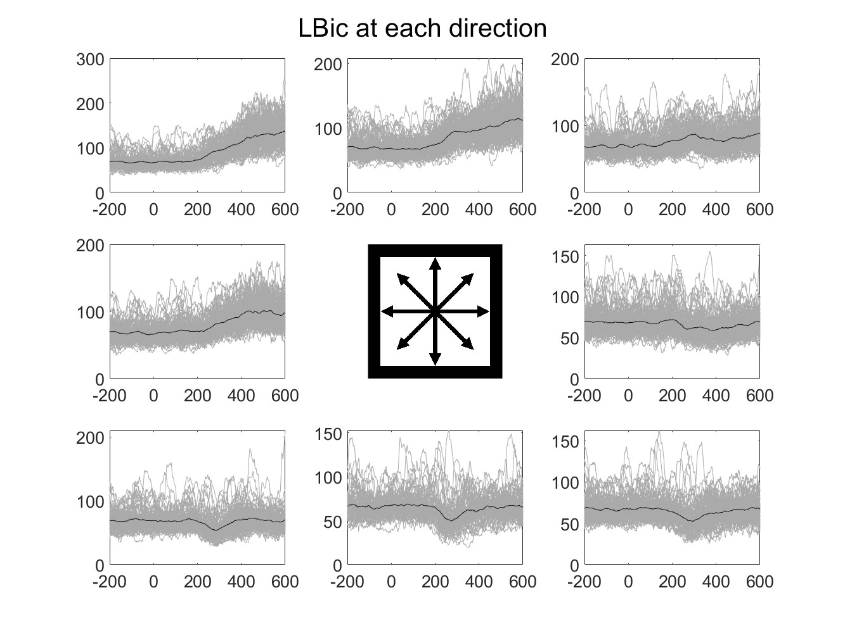
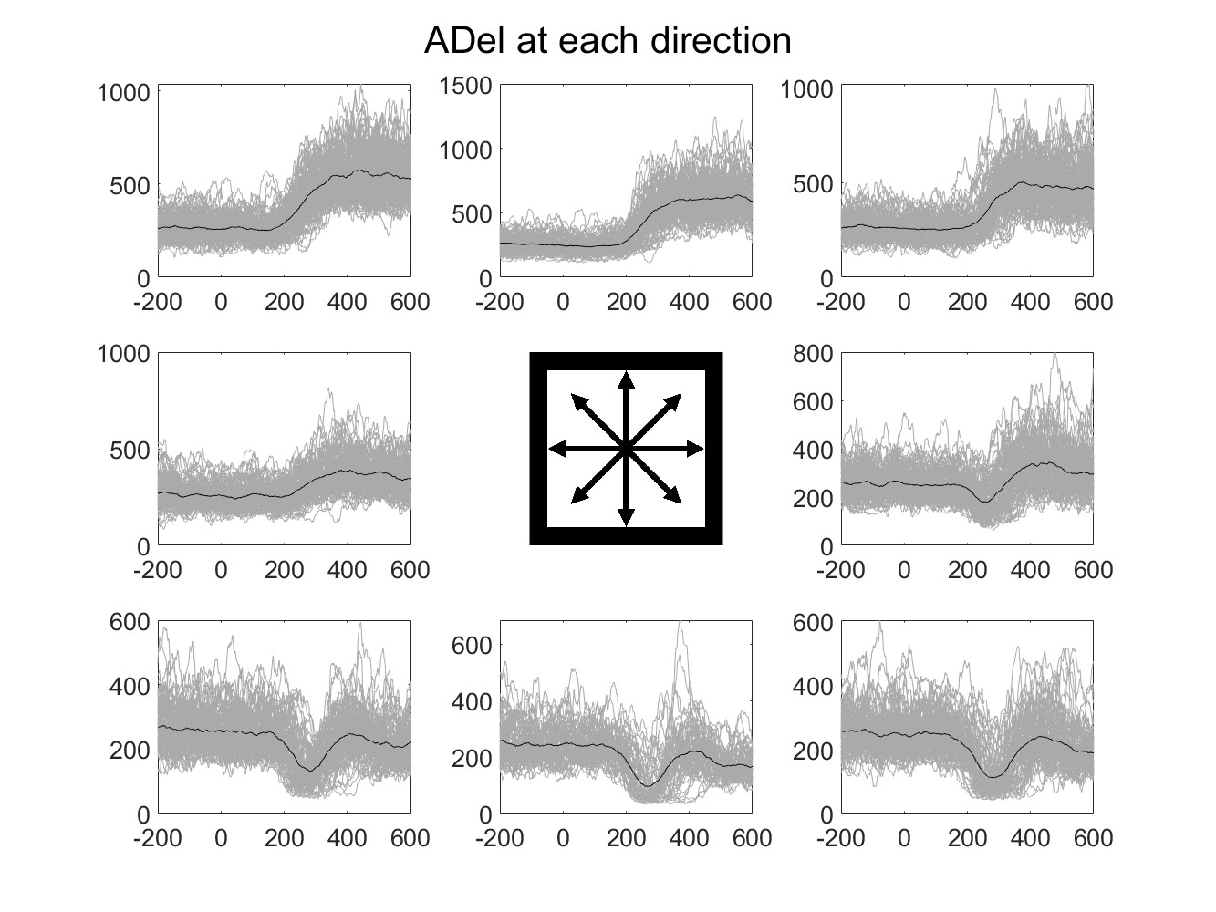
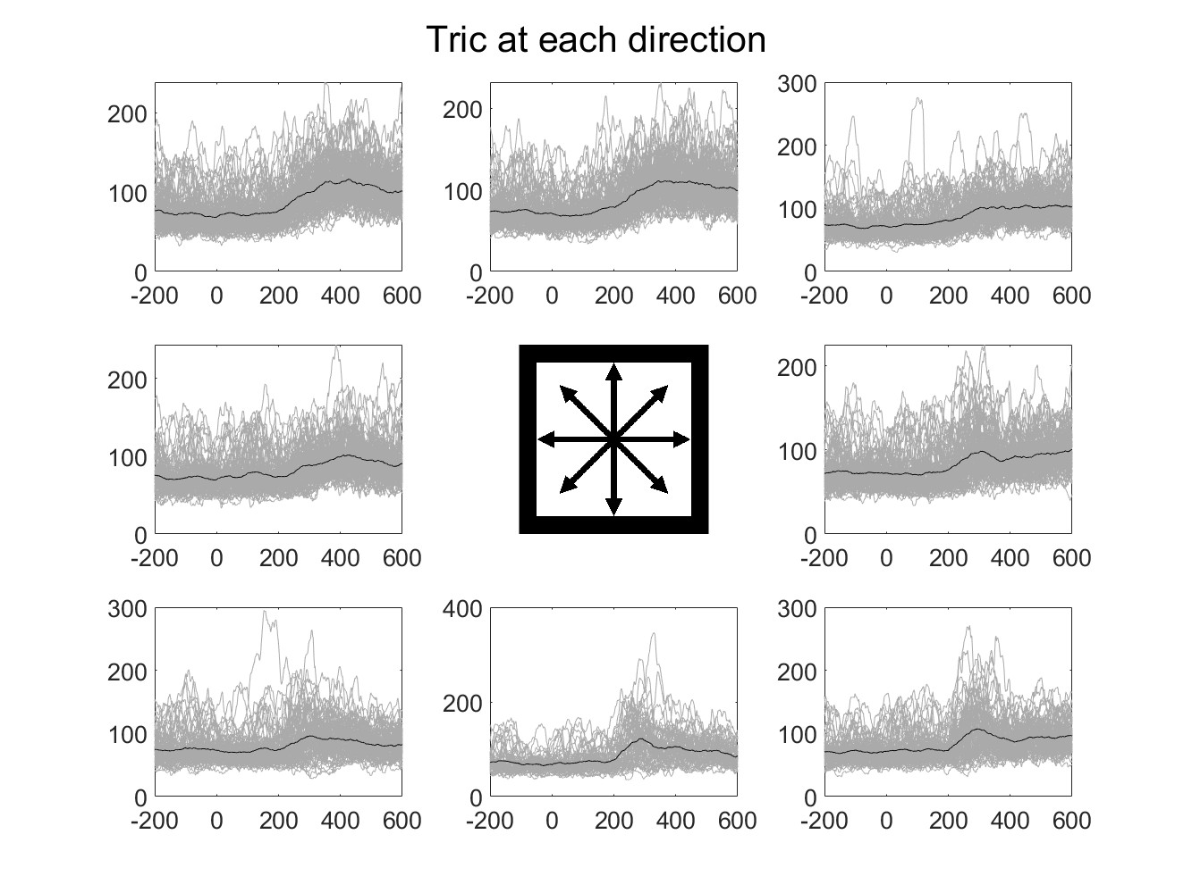
Relationship between EMG and direction
Methods
Use only succeeded trial EMG
Use EMG data around Go Cue (-200ms ~ +600ms)
Gray lines are each trials and black line is a mean value of all trial
Position of figure means direction

Slide 11
Relationship between EMG and direction
Methods
Use only succeeded trial EMG
Use EMG data around Go Cue (-200ms ~ +600ms)
Gray lines are each trials and black line is a mean value of all trial
Position of figure means direction

Slide 12
Relationship between EMG and direction
Methods
Use only succeeded trial EMG
Use EMG data around Go Cue (-200ms ~ +600ms)
Gray lines are each trials and black line is a mean value of all trial
Position of figure means direction

Slide 13
Relationship between EMG and direction
Methods
Use only succeeded trial EMG
Use EMG data around Go Cue (-200ms ~ +600ms)
Gray lines are each trials and black line is a mean value of all trial
Position of figure means direction

Slide 14
Visualization of EMG around Go Cue
Hypothesis
EMG signal and reach direction have a relationship during motion
Upper directions increase EMG
Lower directions decrease EMG
EMG and reward have a relationship at delay period

Slide 15
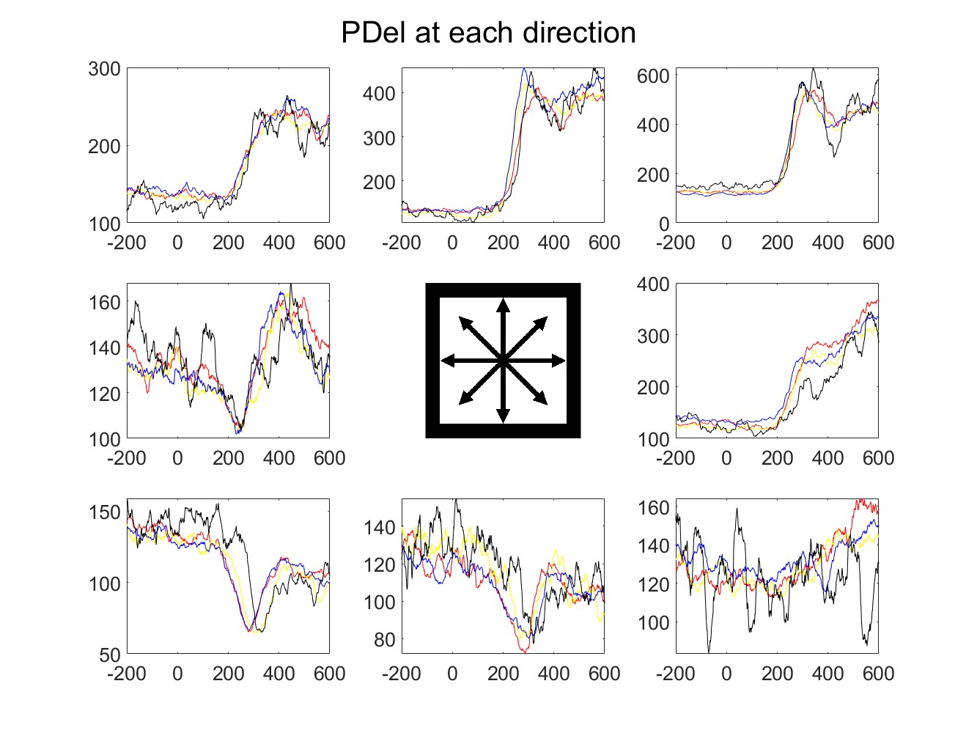
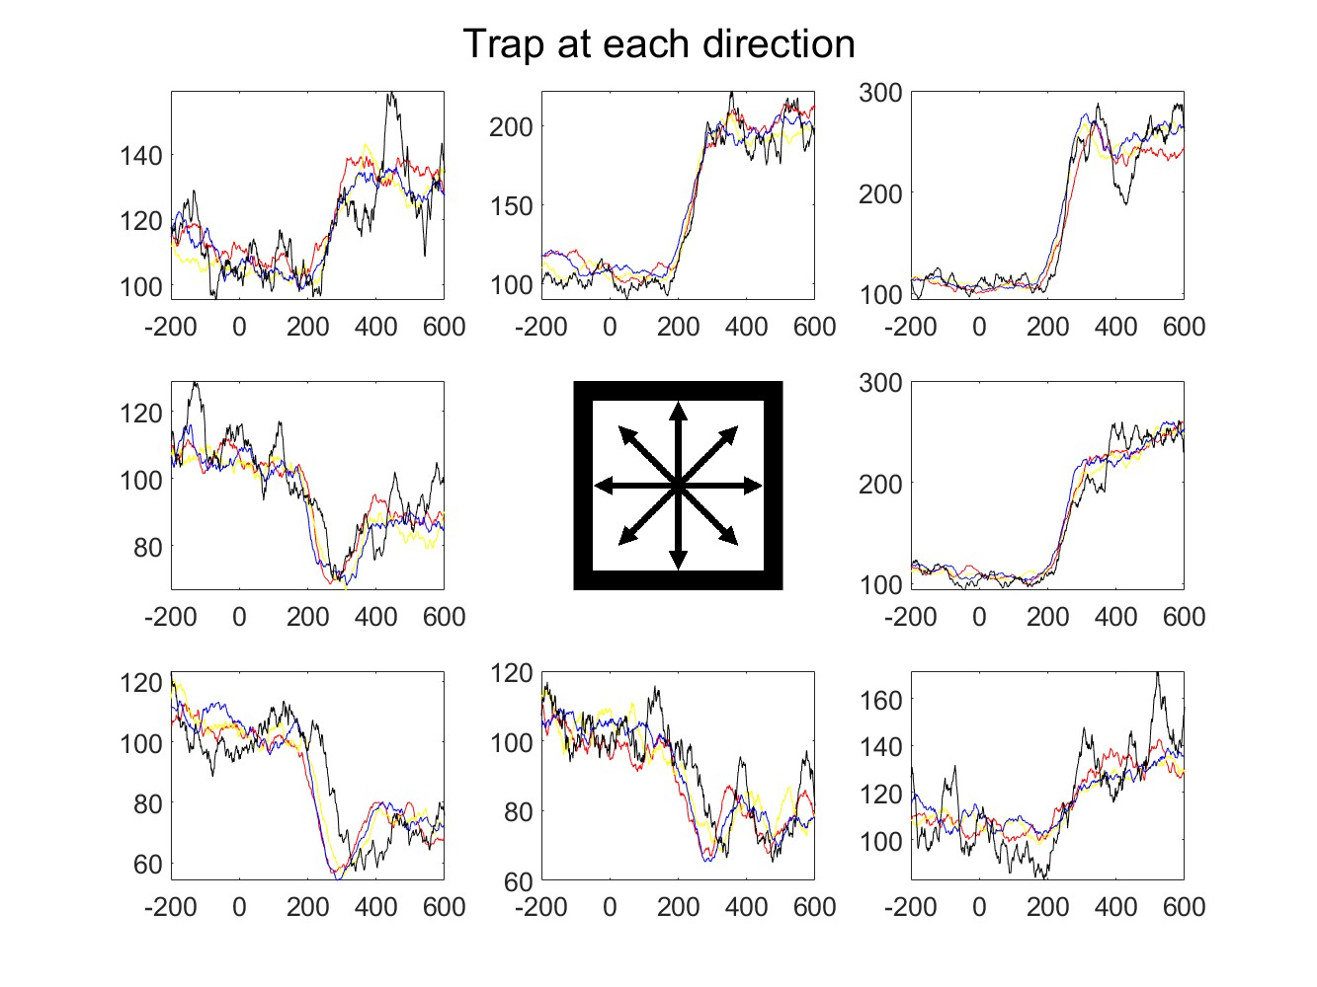
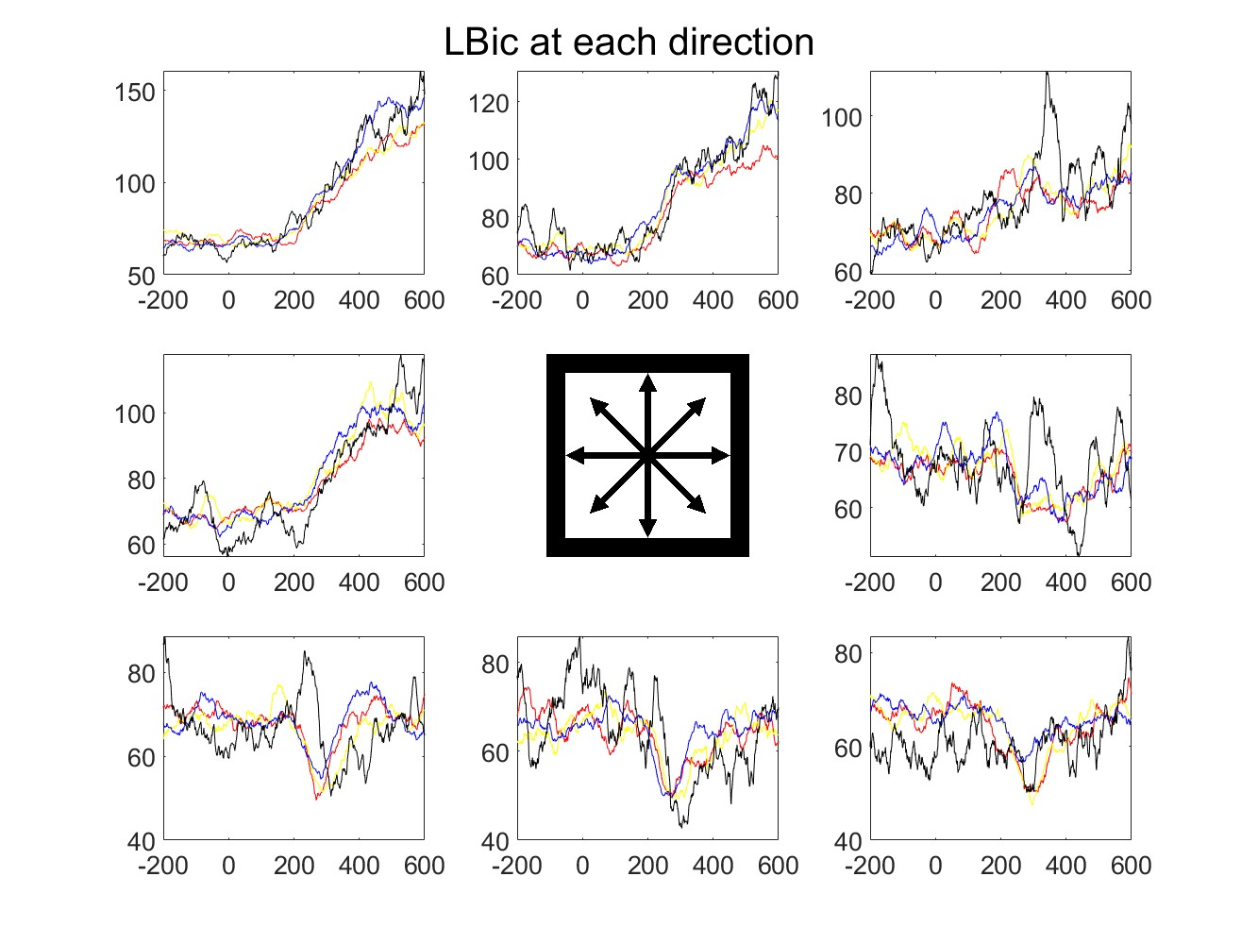
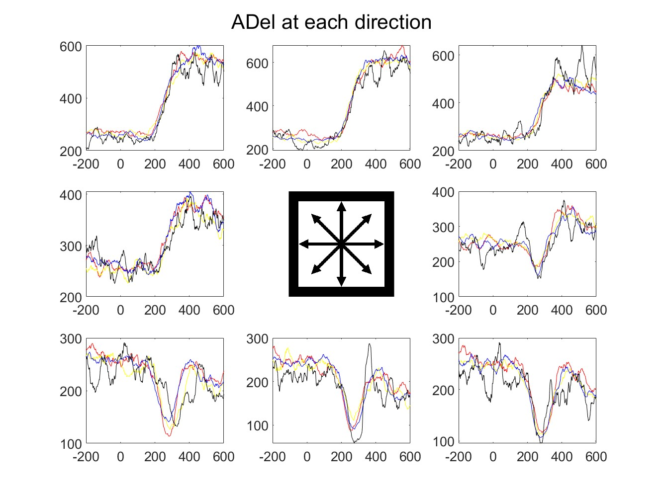
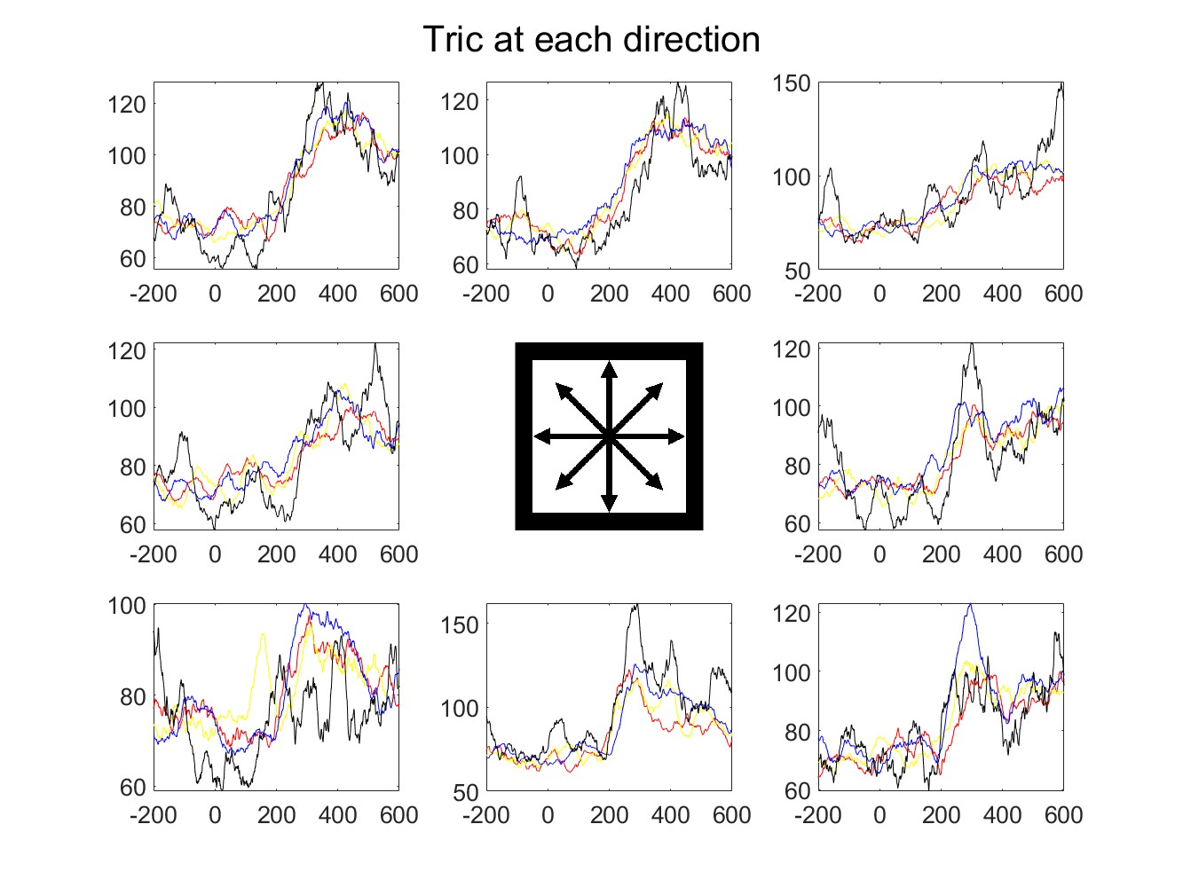
Relationship between EMG and direction
Methods
Use only succeeded trial EMG
Use EMG data around Go Cue (-200ms ~ +600ms)
Gray lines are each trials and black line is a mean value of all trial
Position of figure means direction

Slide 16
Relationship between EMG and direction
Methods
Use only succeeded trial EMG
Use EMG data around Go Cue (-200ms ~ +600ms)
Gray lines are each trials and black line is a mean value of all trial
Position of figure means direction

Slide 17
Relationship between EMG and direction
Methods
Use only succeeded trial EMG
Use EMG data around Go Cue (-200ms ~ +600ms)
Gray lines are each trials and black line is a mean value of all trial
Position of figure means direction

Slide 18
Visualization of EMG around Go Cue
Hypothesis
EMG signal and reach direction have a relationship during motion
Upper directions increase EMG
Lower directions decrease EMG
EMG and reward have a relationship at delay period

Slide 19
Table of Contents
Modification of Preprocessing of EMG signals
Visualization of EMG signals around Go Cue
Future Direction

Slide 20
What I’ll do
Continue EMG preprocessing?
Participate in focus task research?

Slide 21
Relationship between EMG and direction
Methods
Use only succeeded trial EMG
Use EMG data around Go Cue (-200ms ~ +600ms)
Gray lines are each trials and black line is a mean value of all trial
Position of figure means direction

Slide 22
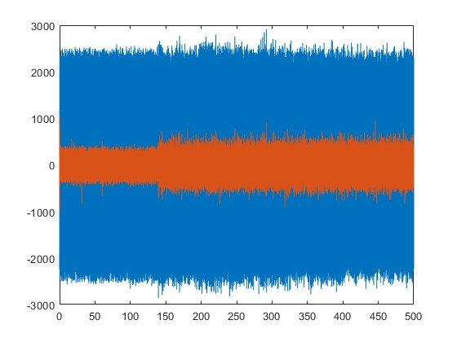
Check : the raw signals before preprocess
Raw Signal
Raw Signal
Voltage(mV)
Voltage(mV)
Time (second)
Time (second)
Noise level depends on the muscle area.
(Also varies from day to day)
Notes:
Best Caseの信号と最悪の信号を見せる

