Slide 1
20220902
Hiroo Miyata

Slide 2
Preprocess Flow
Notch Filter
(Baseline Noise remove)
Z-scored by tuning curve
Adaptive Filter
ECG remove
Remove abnormal data
Bandpass Filter
Unrelated signal remove
Concatenate across day
Rectification
Smoothing
(mean average of 50 ms time window)

Slide 3
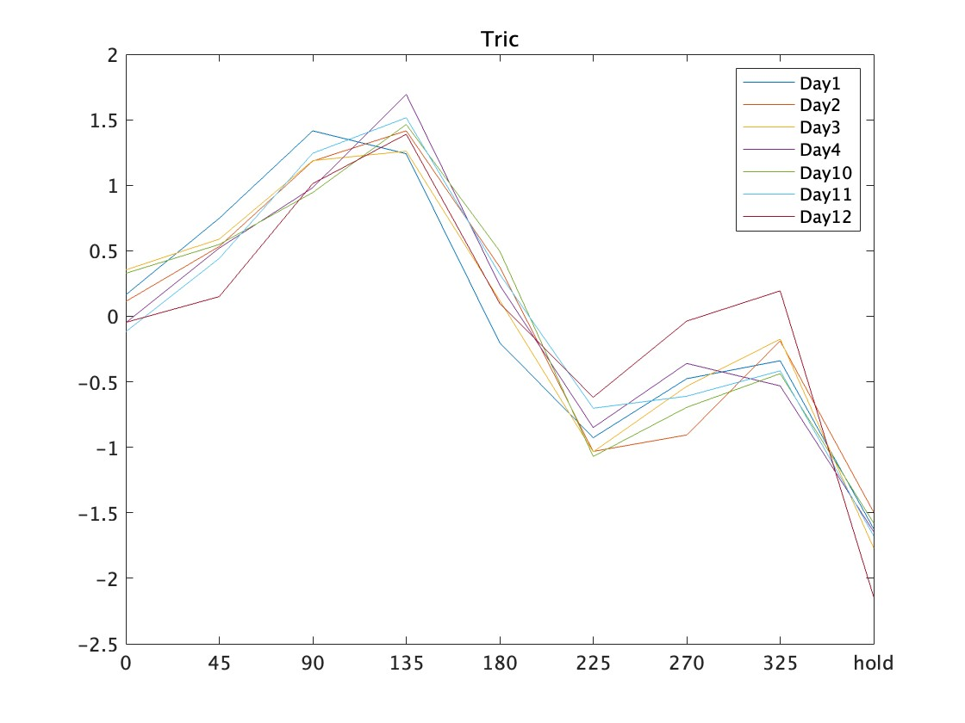
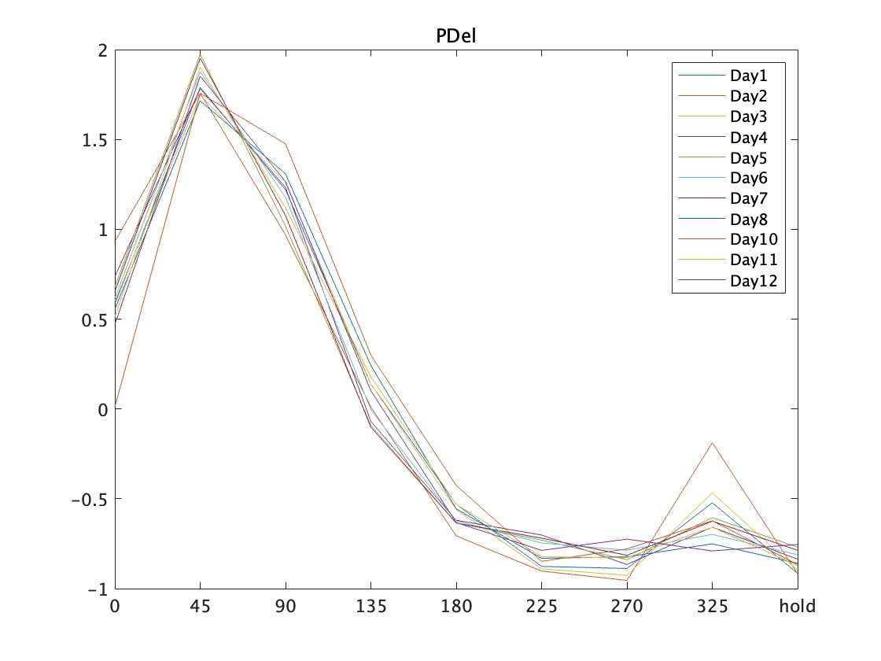
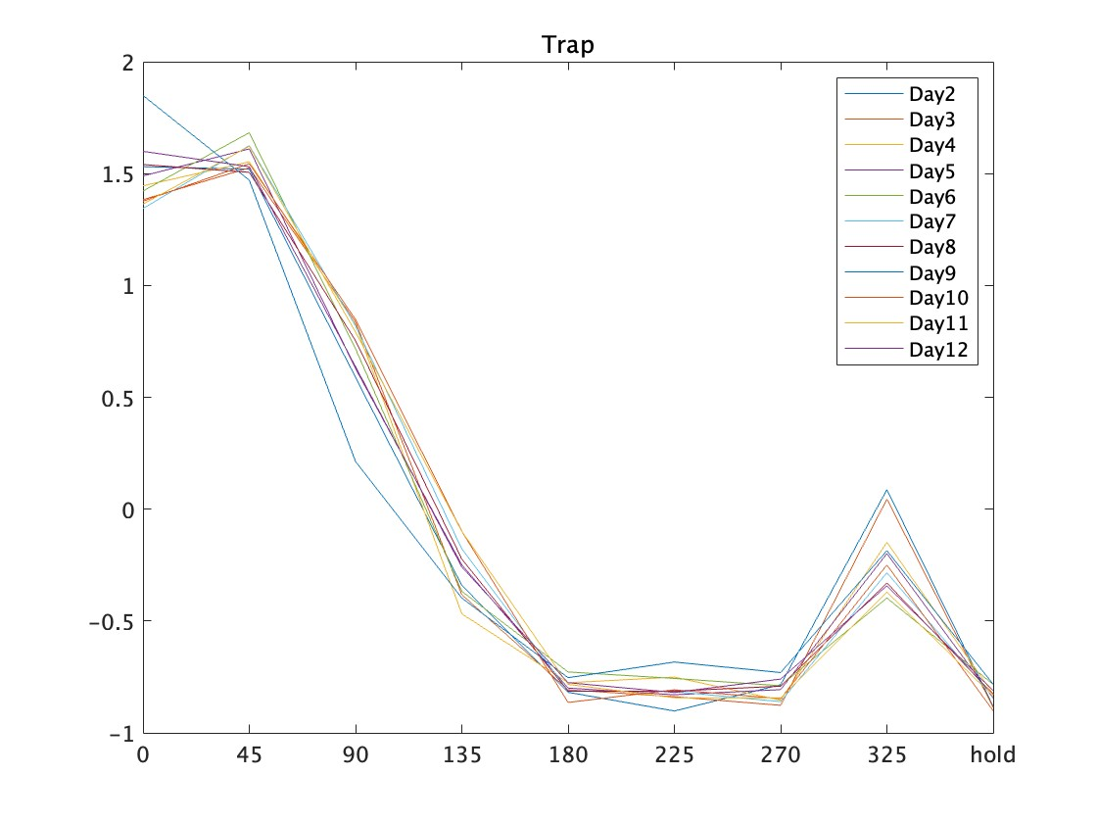
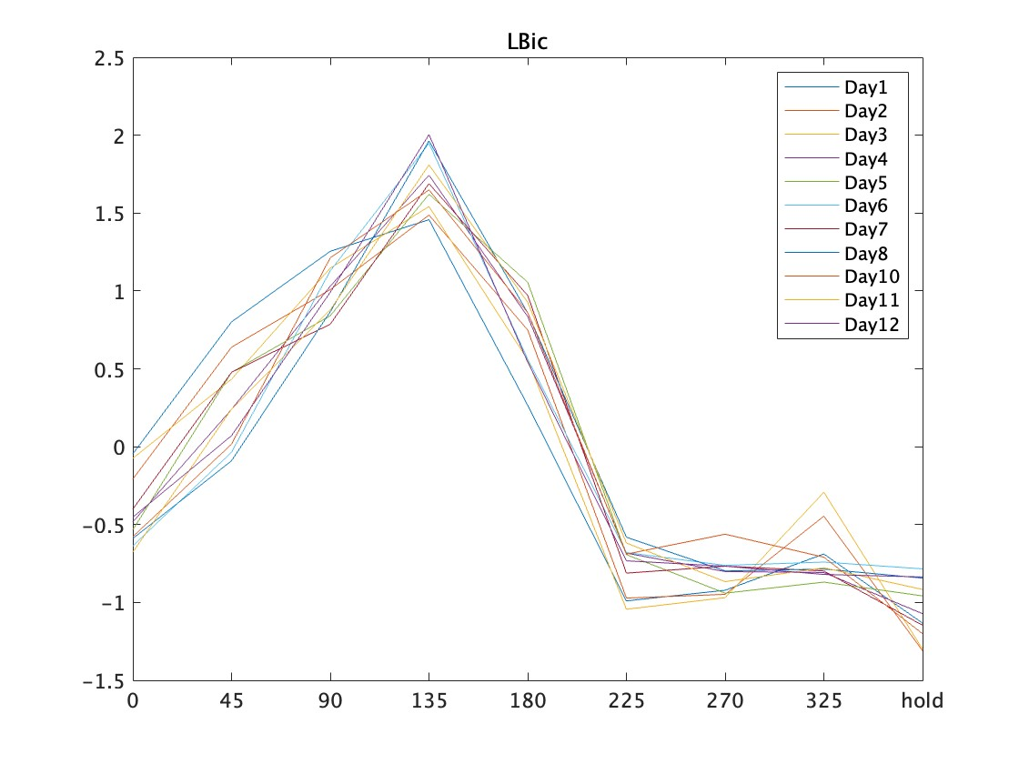
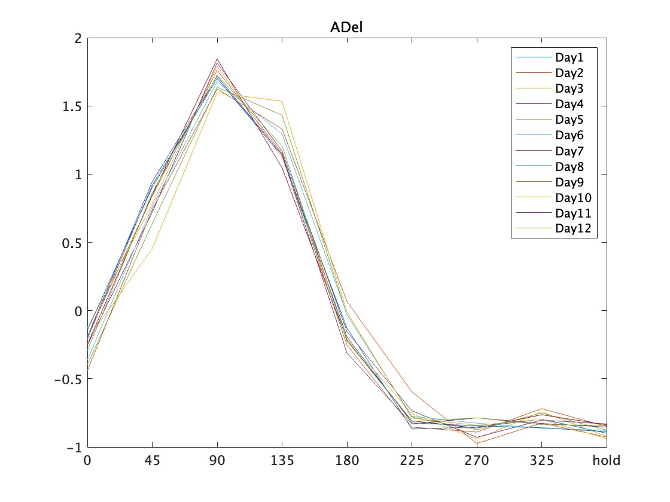
Z-indexed tuning curve each day
Tuning curve
8 datapoint: Peak value of mean EMG after Go Cue at each direction
1 datapoint: mean EMG at delay period
Hypothesis
These tuning curve are the same across day

Slide 4
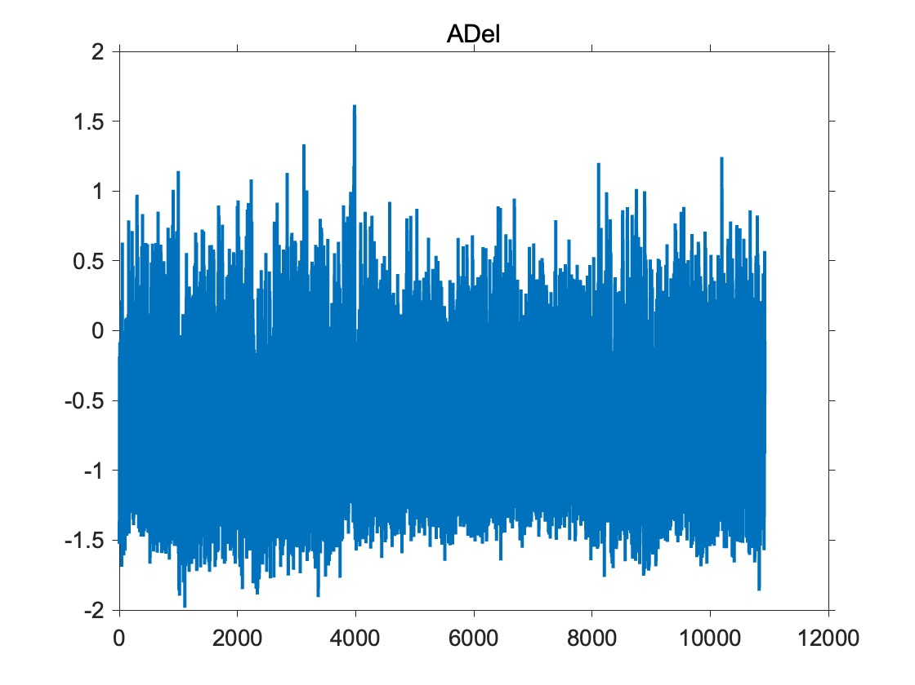
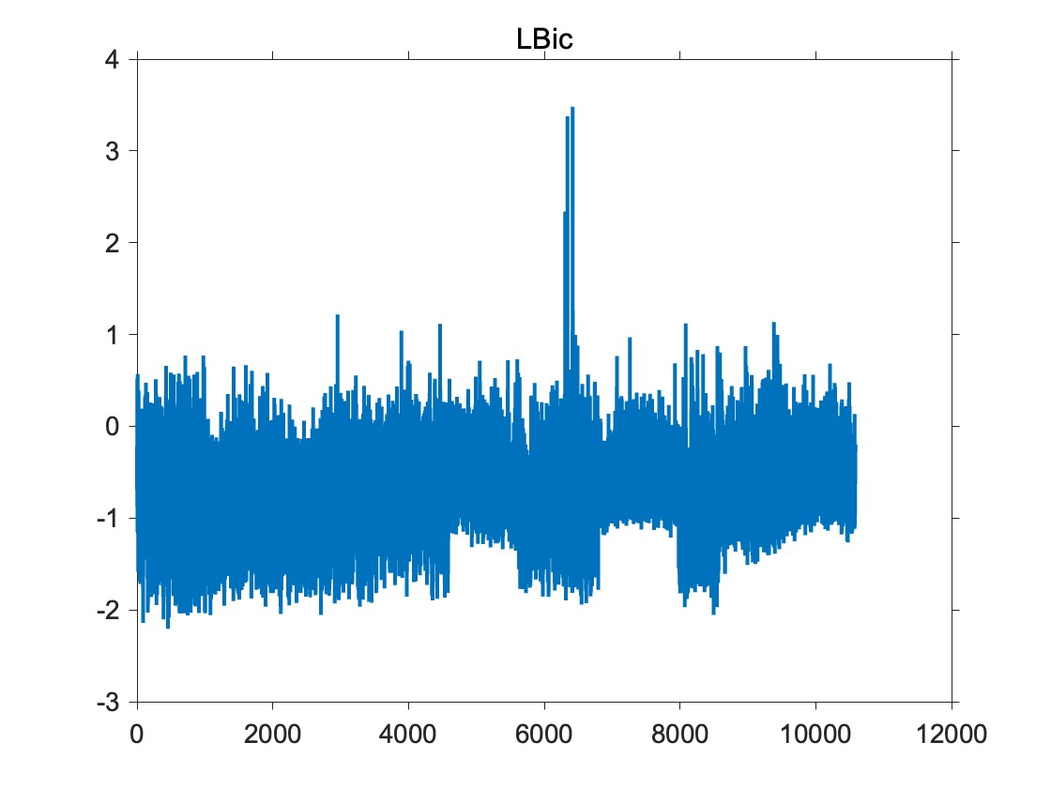
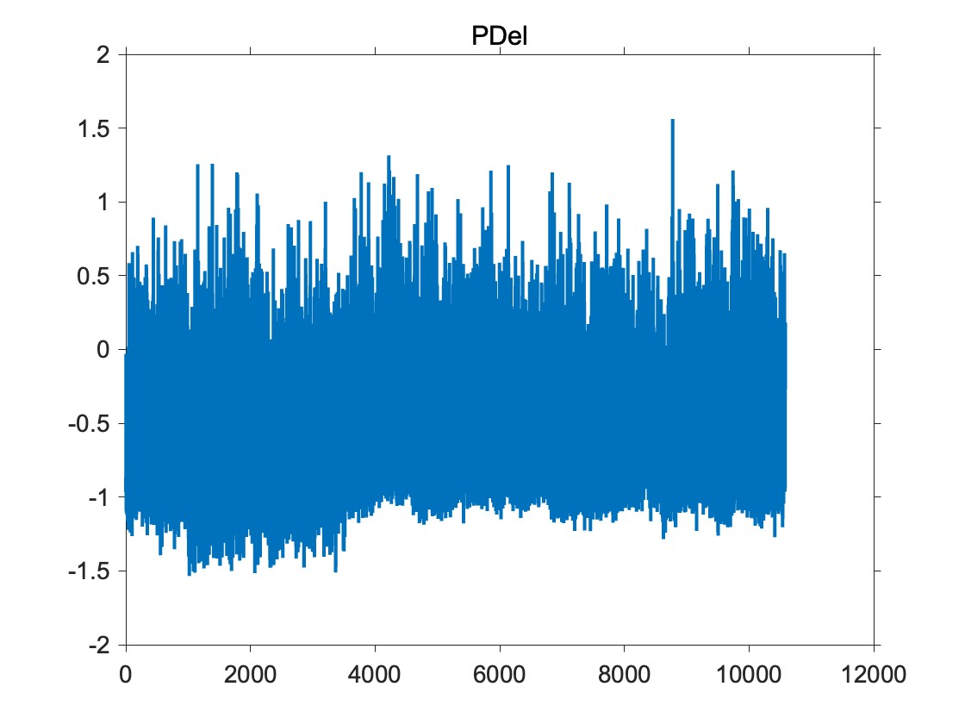
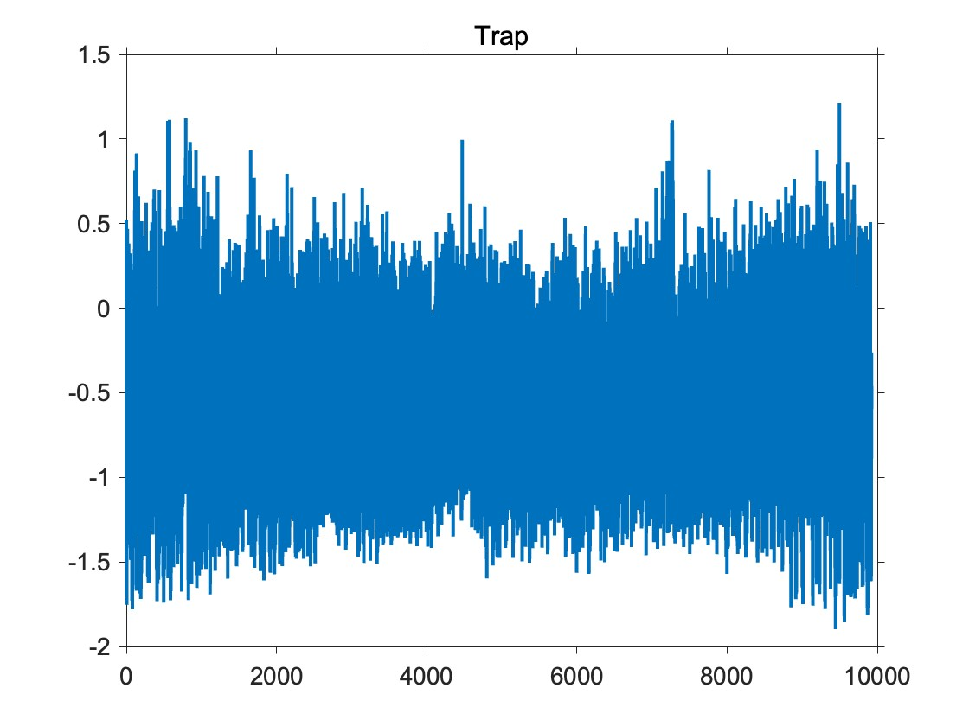
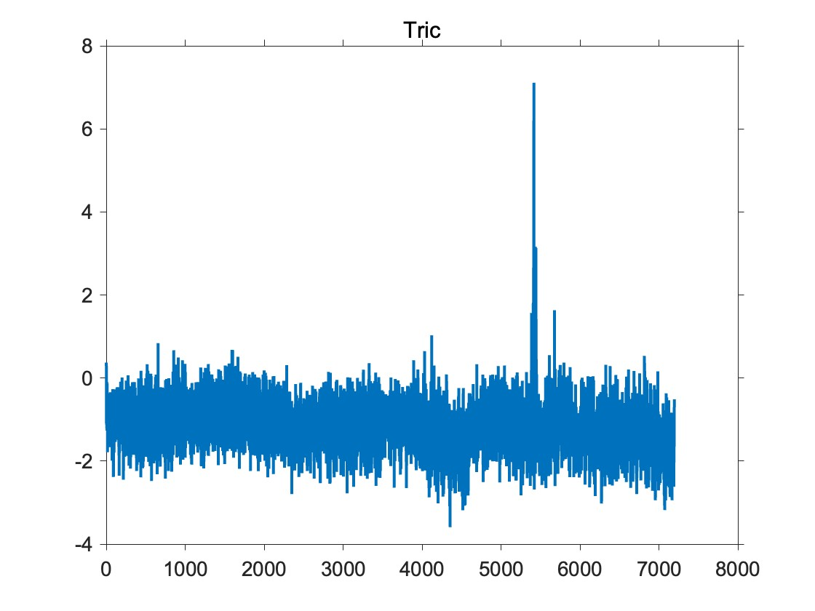
Updated meanEMG across days
Normalizing method
Adapt the params used in z-score to the entire EMG

Slide 5
EMG basis “Choking Under Pressure”
Questions
Reward Axis at holding time might be the result of co-contraction
Slower reach which cause undershoot might be related to EMG activation

Slide 6
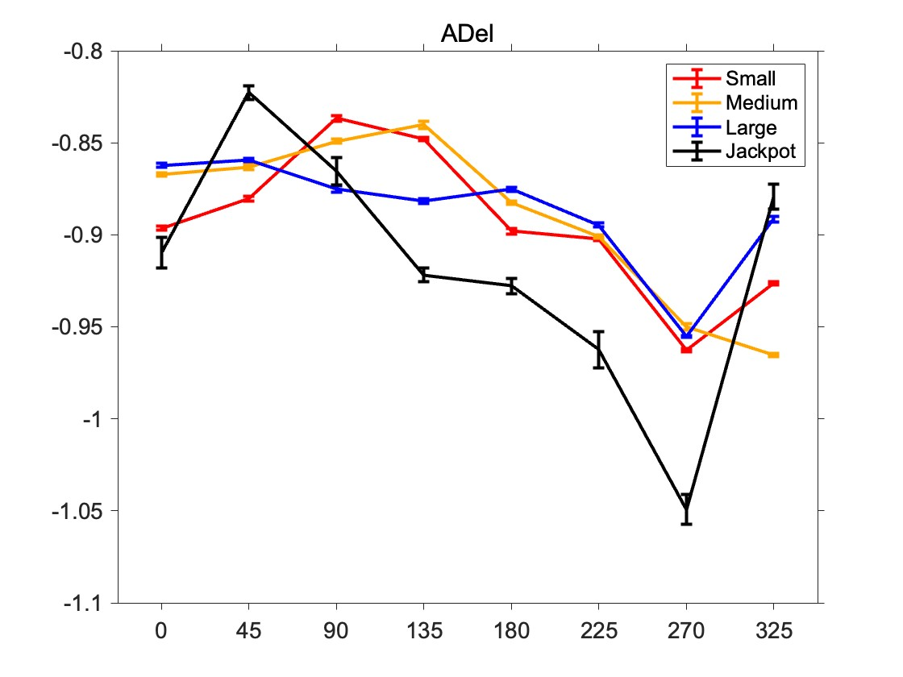
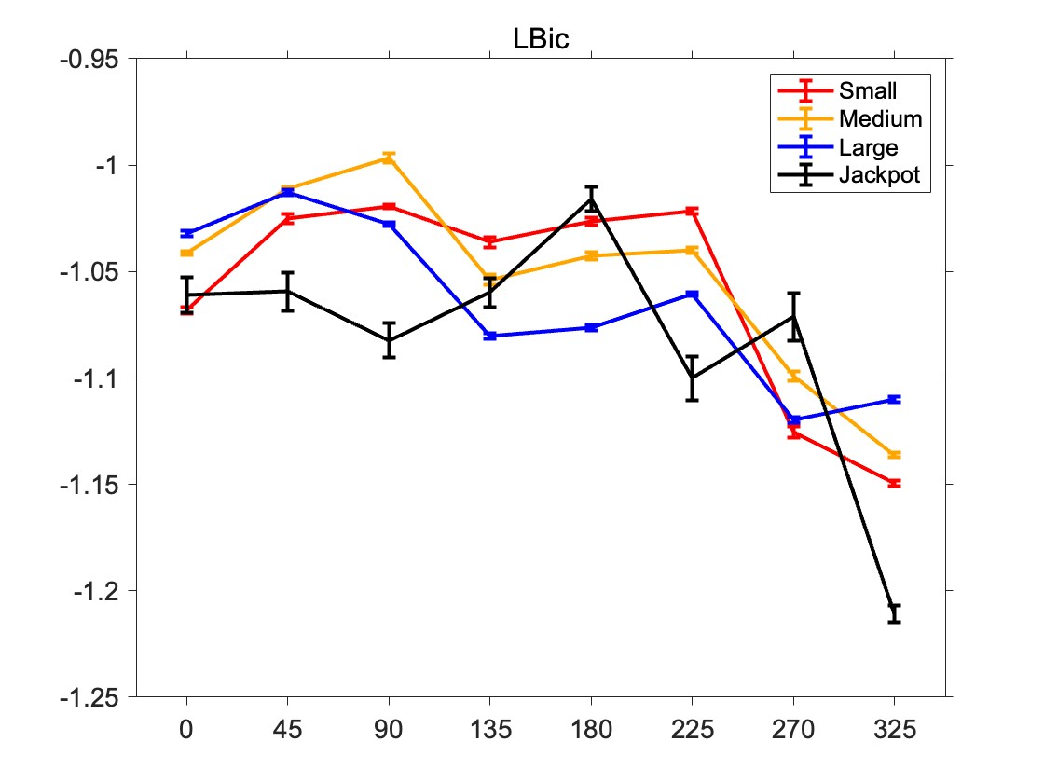
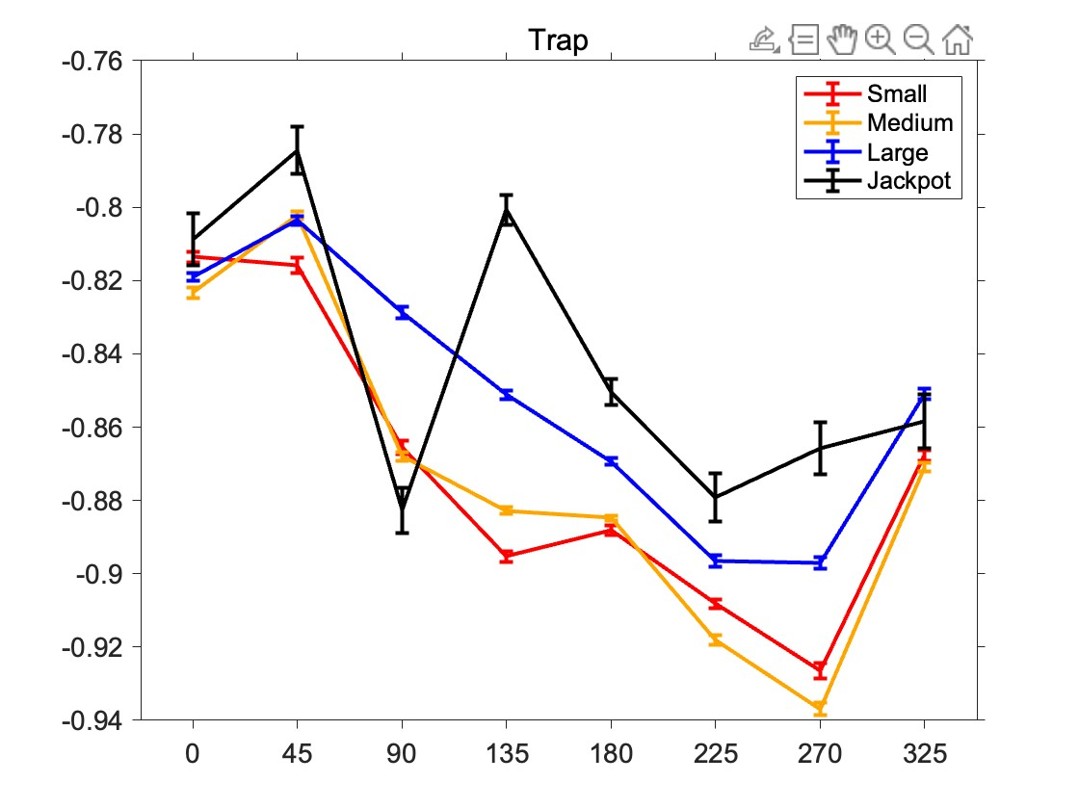
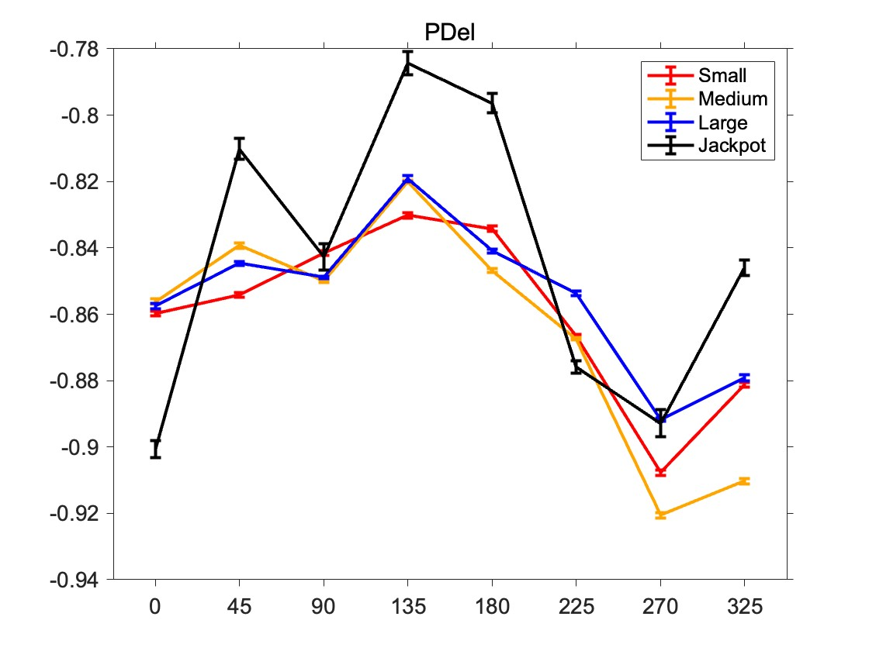
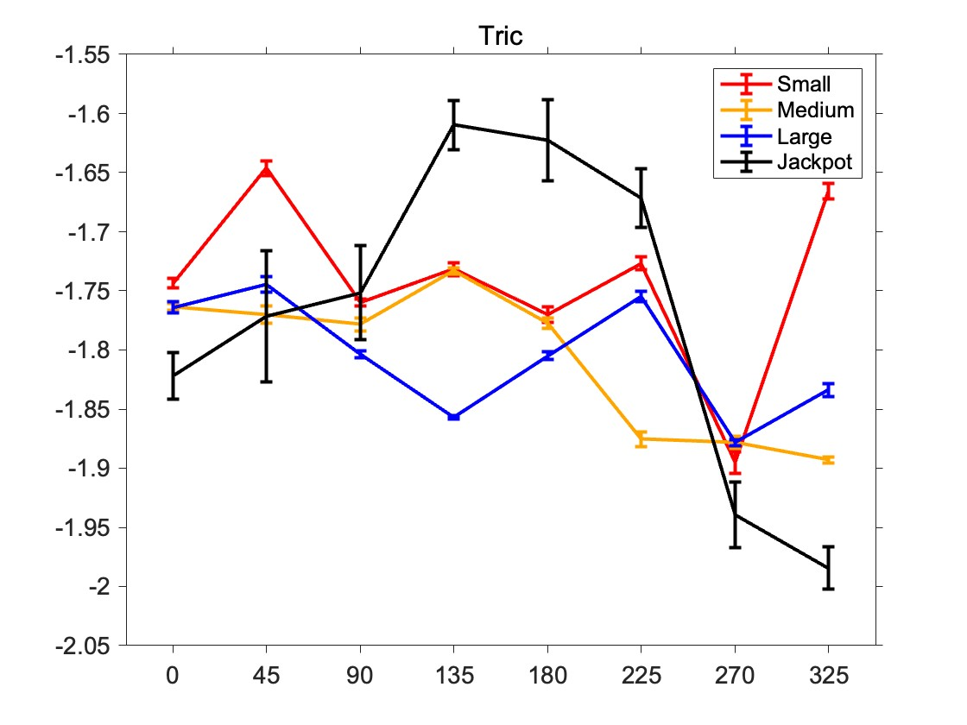
TC at holding time are different among muscles
Method
Normalize by successes
Abnormal Day is removed
Use both successes and failures for this visualization (failure: reach failure and hold failure)

Slide 7
EMG basis “Choking Under Pressure”
Questions
Reward Axis at holding time might be the result of co-contraction
Slower reach which cause undershoot might be related to EMG activation

Slide 8
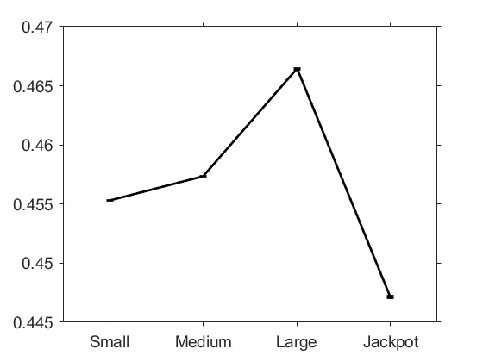
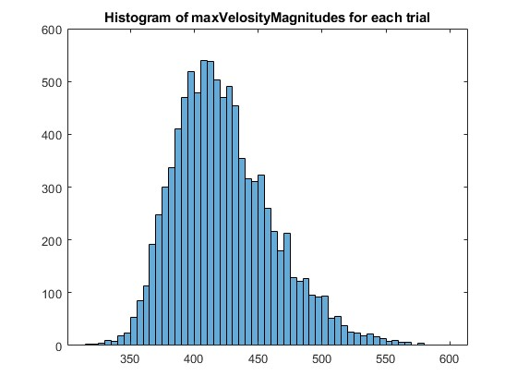
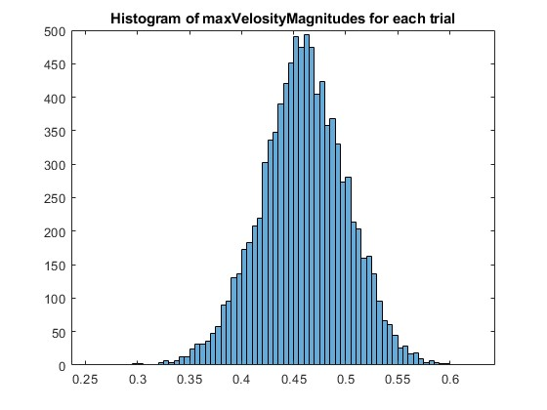
Methods for analyzing
Methods
Use only trials reached to the target
Successes also showed slow reach(right figure)
Remove overflowed velocities
Calculate the mean of EMG around peak time [Peak Time ± 100ms]
Average maxVelosity at each reward

Slide 9
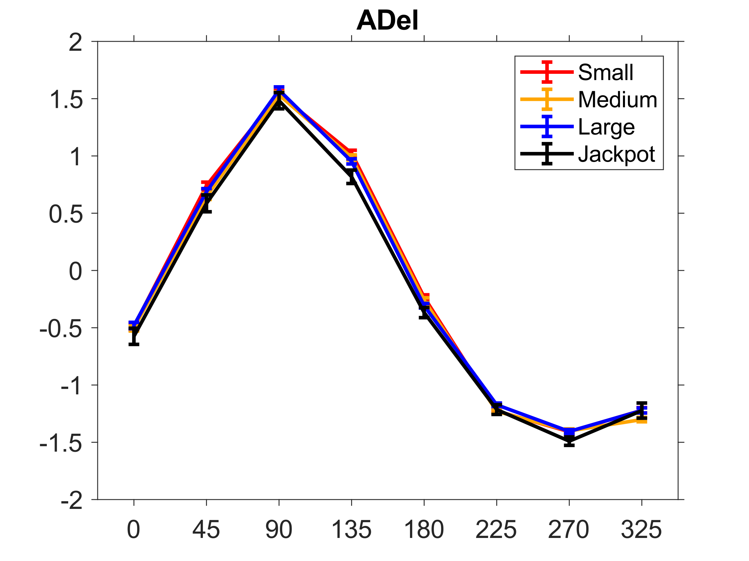
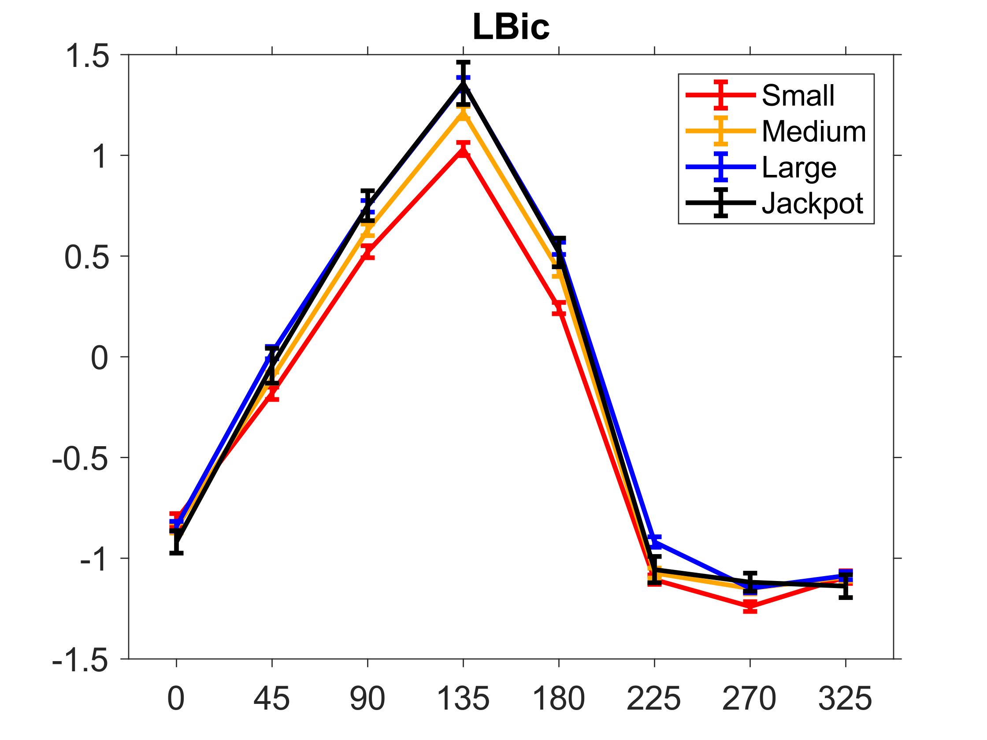
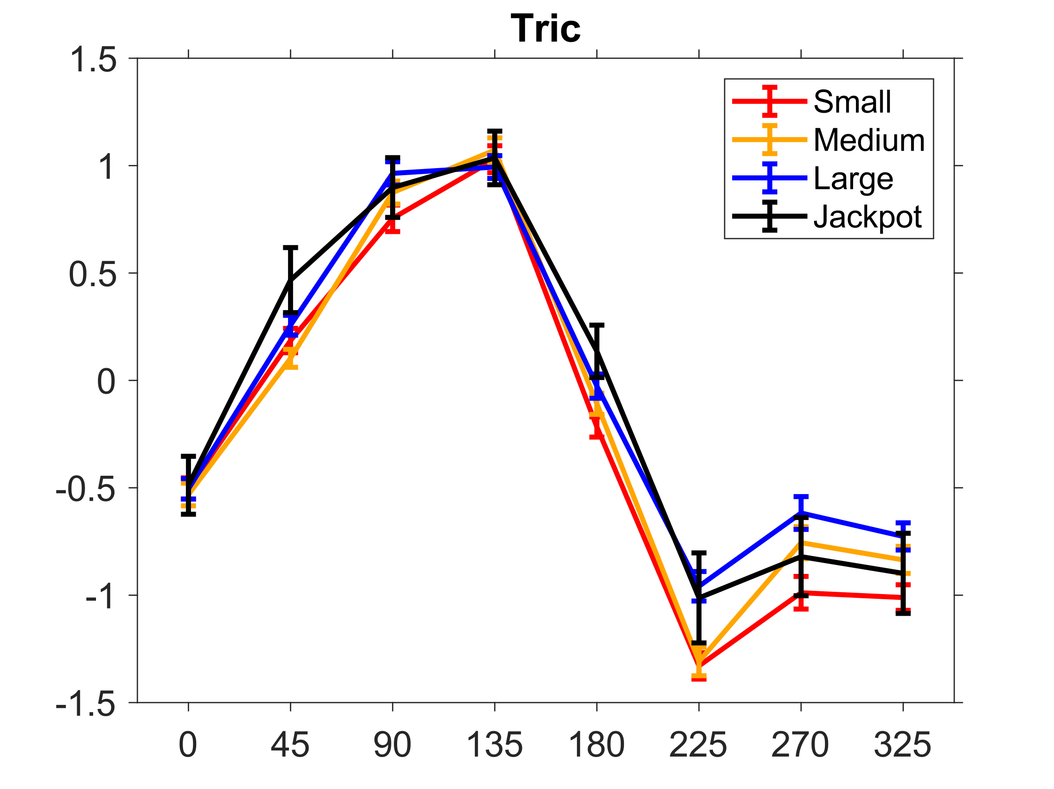
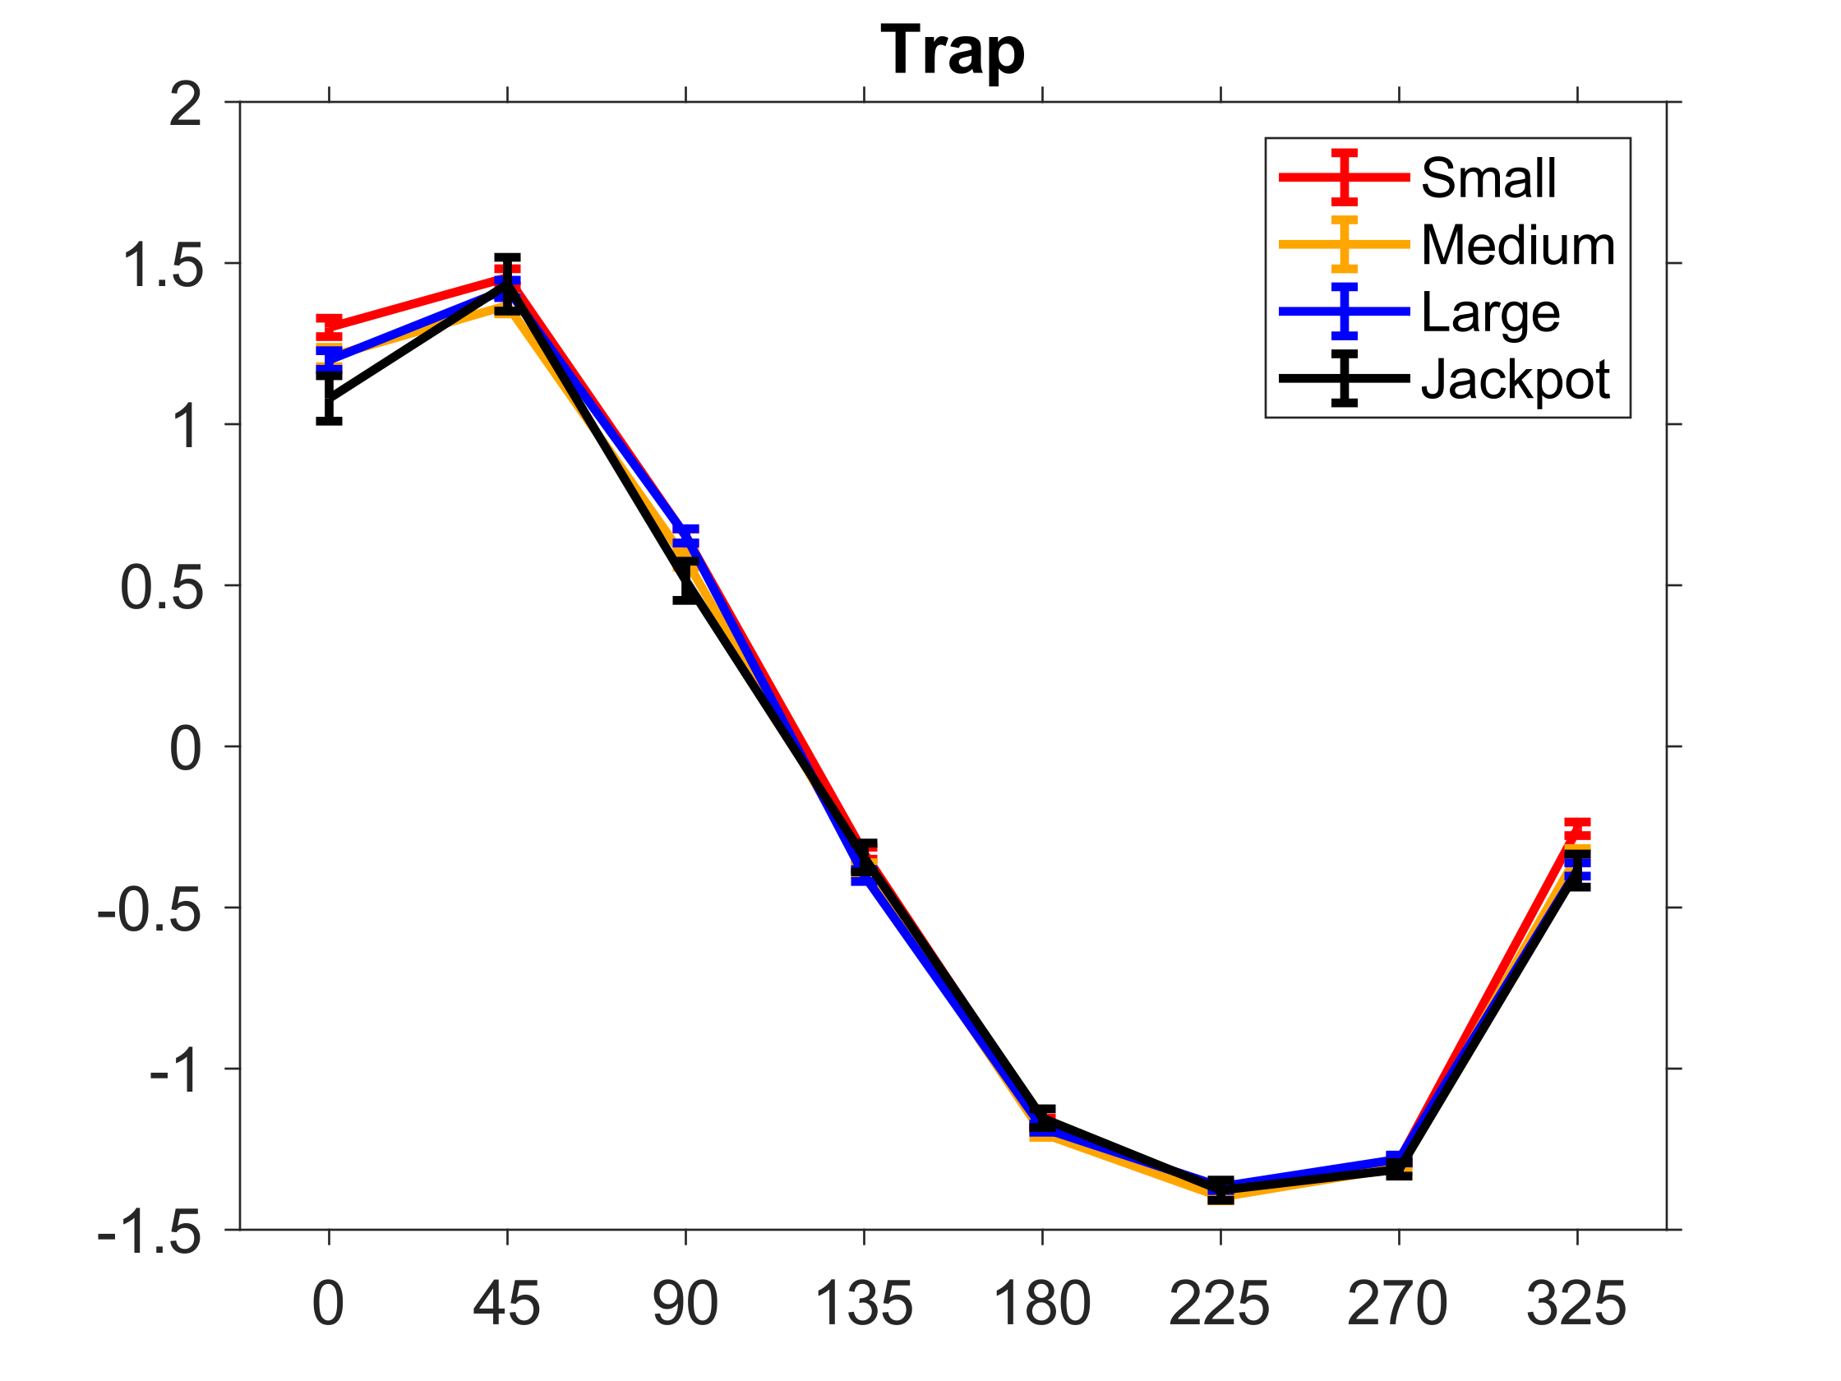
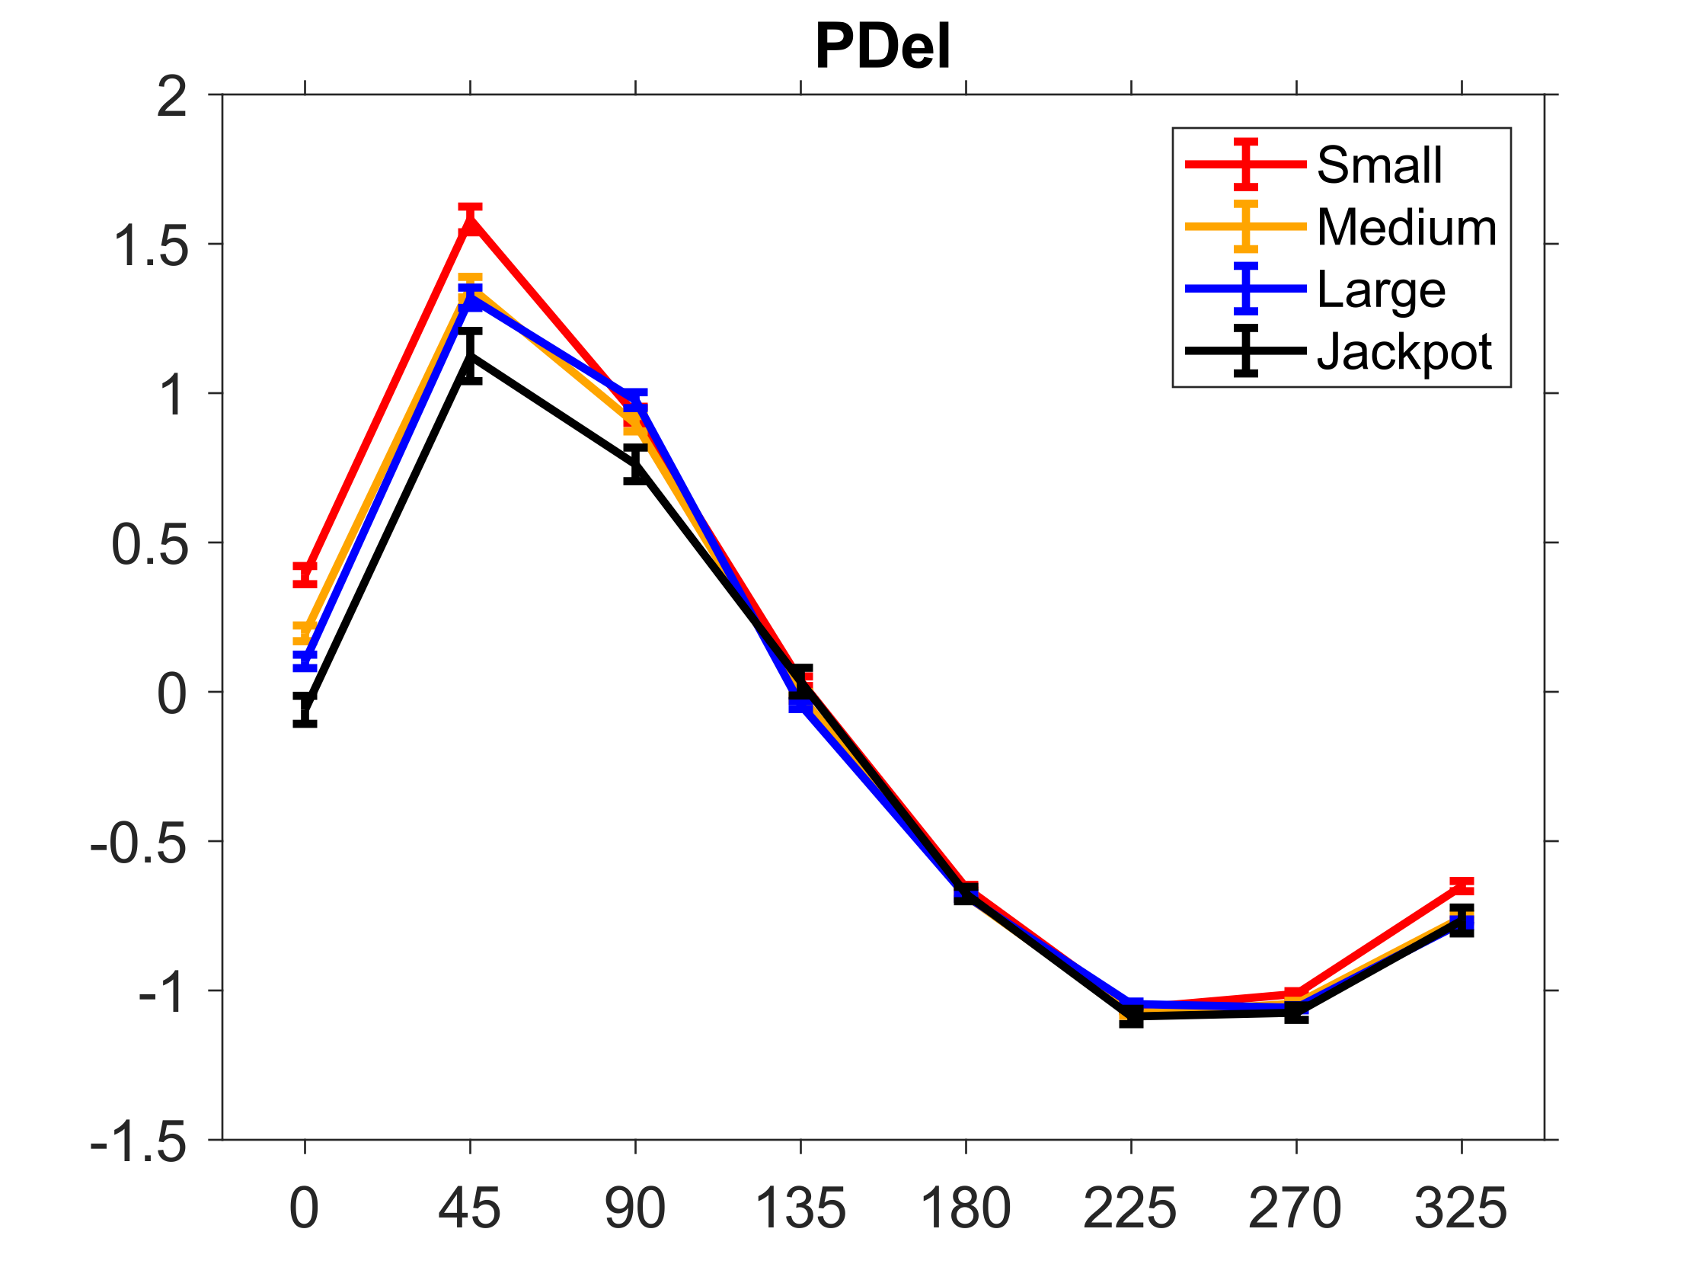
The EMG at top speed is not affected by choking

Slide 10
Appendix

Slide 11
The amount of datapoints of each condition
(When we didn’t remove any data)
 | 0 | 45 | 90 | 135 | 180 | 225 | 270 | 325
Small | 385 | 299 | 343 | 380 | 380 | 351 | 325 | 344
Medium | 381 | 406 | 389 | 413 | 385 | 359 | 304 | 355
Large | 377 | 406 | 409 | 410 | 405 | 395 | 371 | 406
Jackpot | 57 | 47 | 54 | 60 | 68 | 49 | 50 | 50

Slide 12
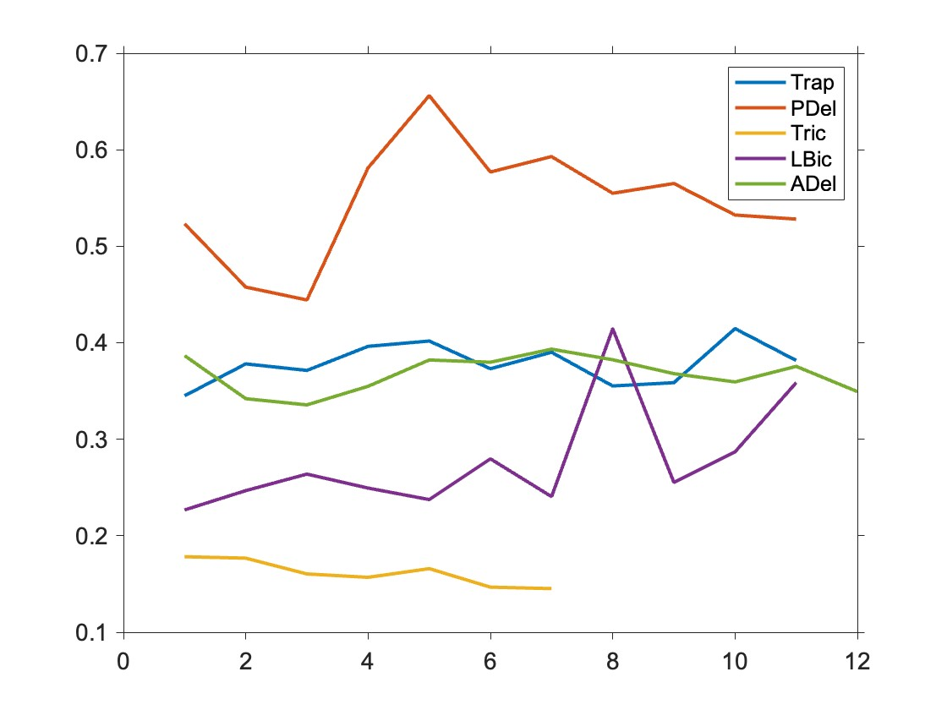
PDel should cause more co-contraction
Hypothesis:
The muscle which has bigger activation during the task should cause more co-contraction during holding time
↓
The bigger muscle activation, the bigger coefficient of variation
Coefficient of variation across Days before z-indexed:

Slide 13
Absolute value of

Slide 14
Successes Data

Slide 15
TC at holding time are different among muscles
Method
Normalize by successes
Abnormal Day is removed
Use both successes and failures for this visualization

Slide 16
The EMG at top speed is not affected by choking
Methods
Define EMG activation as
Abs(peak EMG – hold EMG)

Slide 17
What happen in total

Slide 18
Trash

Slide 19
Logic Tree
EMG basis “Choking Under Pressure”
Reward axis is not the result of co-contraction
The mean and standard error of mean at each reward and direction
The variance is because of few datapoint?: Show each data-point
Why the data is different across direction? Is there any relationship among them?
Lower: lose the muscle for preparation, Upper: opposite <= 45~135 is bigger?
The mean and standard error of mean at each reward
To answer the question what happen in total
The EMG intensity at top speed is also affected by choking
Show hypothesis and Method: slower reach might be related to EMG activation
Is there difference in the muscular activation as a function of reward: inverted-U or co-contraction?
Mean EMG around Peak value (-100 ~+100ms, or -50~+50ms)

Slide 20
やることリスト
ExceptionalRemovedEMGの変更
directionArrayとrewardArrayを廃止して、exceptionArrayを設ける。
emgデータも、全部残った状態にしておく。
構造
Data
emg
MuscleLabel
Signal N
exceptionArray N
directionArray N
RewardArray N
Kinematics
integratedVelosities 810 * N <= around GoCueの取得がNot Yet
PreprocessProp
NormalizedParam 2 * 5 * Days
DatapointEachDay Days
IntegratedVelosityがMaxになる時間を各データで算出: max(IV(201:end), [], 1)
その周辺-100~+100を取得
エラー処理を忘れないこと：Endを超えた回数をカウント。いくつかピックアップして、velosityを確認する
エラー予防として、-100~+100のtime windowで取得したデータY 201*Nを、meanと各trajectoryをplot(黒と灰)
その時間帯のmeanEMGを取得 N
exceptionArrayをかける

