Slide 1
20220902
Hiroo Miyata

Slide 2
Logic Tree
EMG basis “Choking Under Pressure”
Reward axis is not the result of co-contraction
The mean and standard error of mean at each reward and direction
The variance is because of few datapoint?: Show each data-point
Why the data is different across direction? Is there any relationship among them?
Lower: lose the muscle for preparation, Upper: opposite <= 45~135 is bigger?
The mean and standard error of mean at each reward
To answer the question what happen in total
The EMG intensity at top speed is also affected by choking
Show hypothesis and Method: slower reach might be related to EMG activation
Is there difference in the muscular activation as a function of reward: inverted-U or co-contraction?
Mean EMG around Peak value (-100 ~+100ms, or -50~+50ms)

Slide 3
EMG basis “Choking Under Pressure”
Questions
Reward Axis at holding time might be the result of co-contraction
Slower reach which cause undershoot might be related to EMG activation

Slide 4
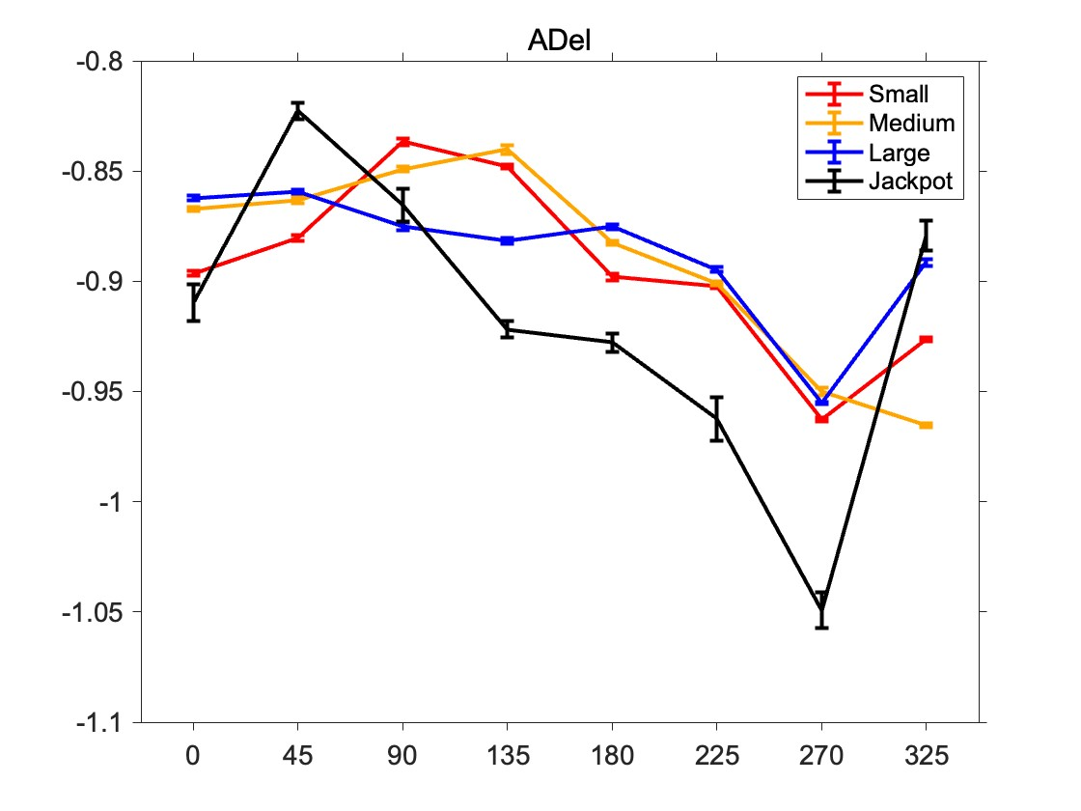
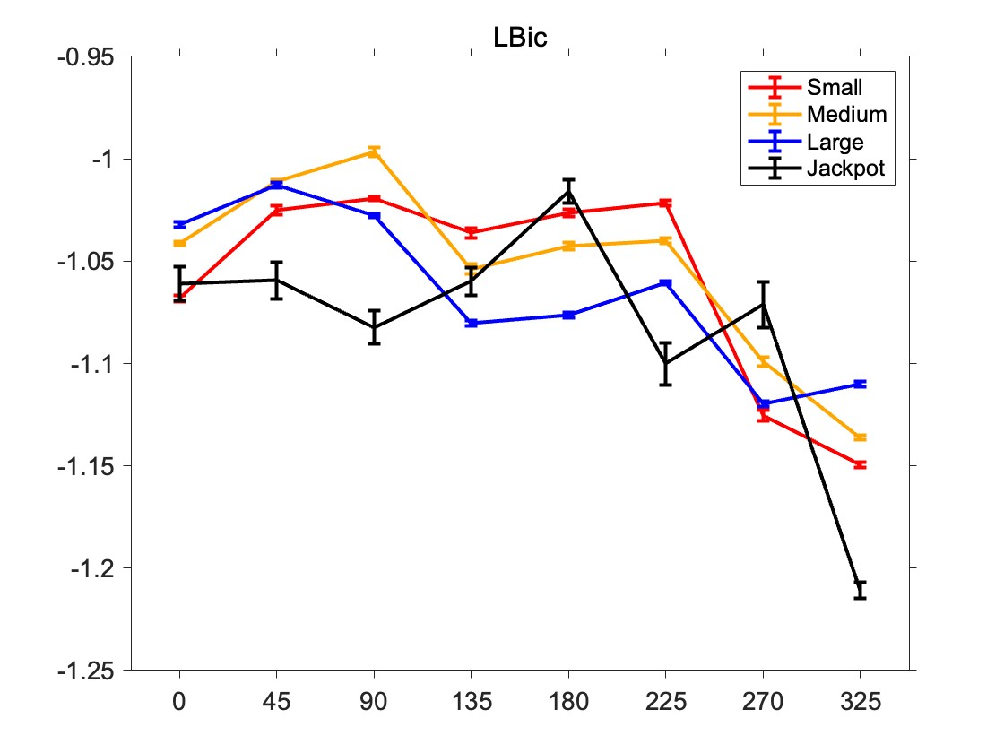
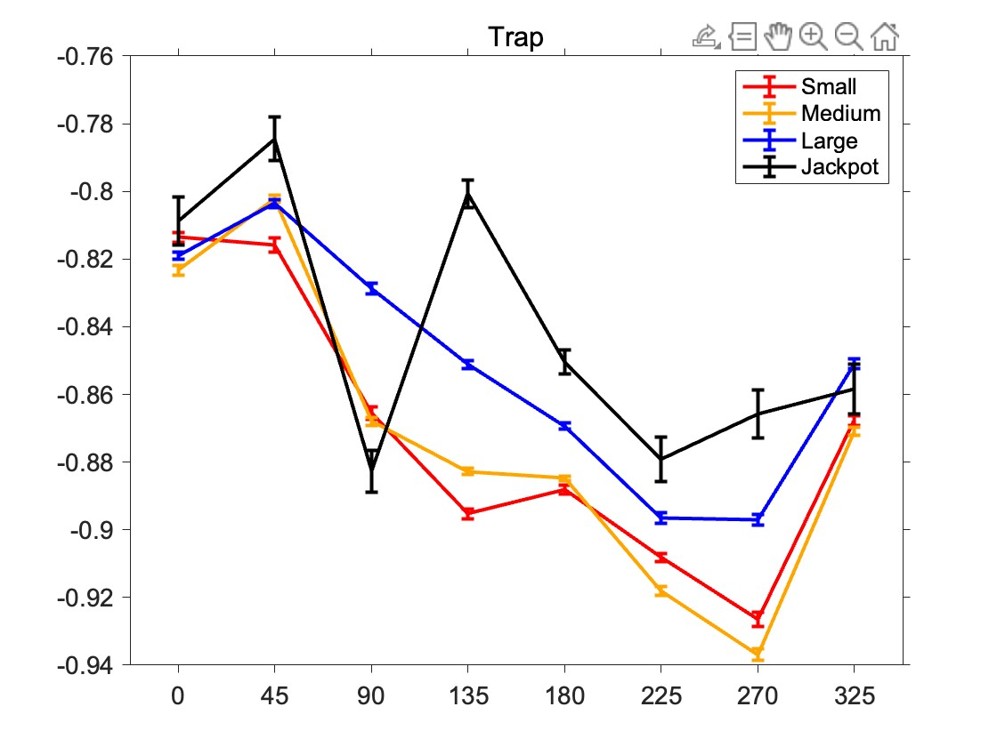
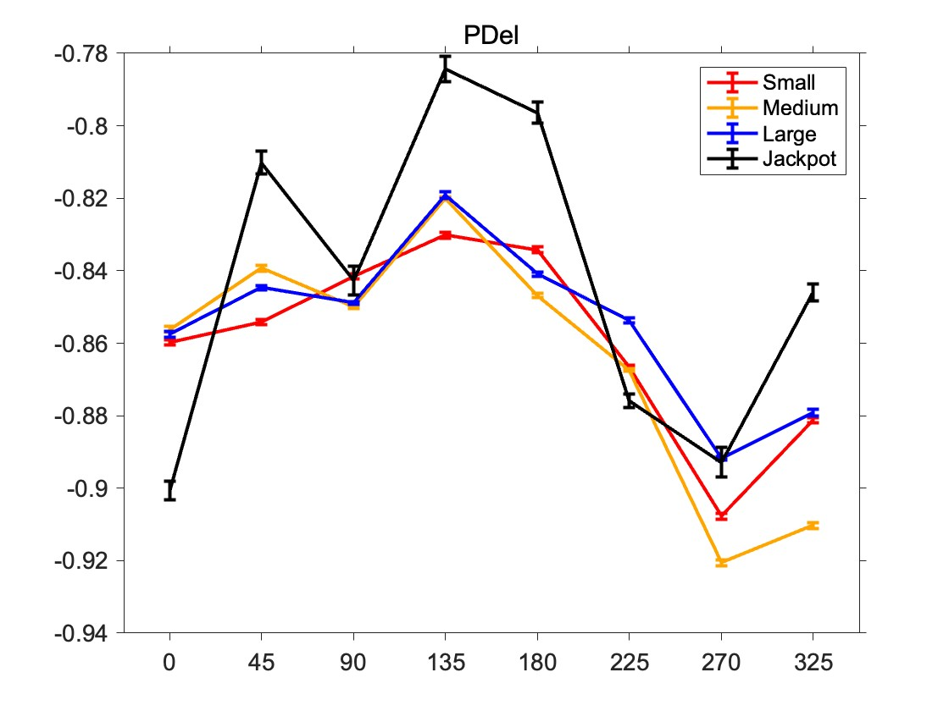
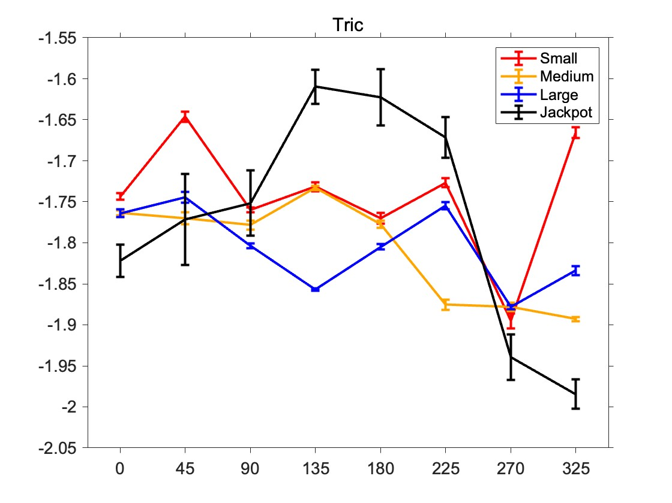
TC at holding time are different among muscles
Method
Normalize by successes
Abnormal Day is removed
Use both successes and failures for this visualization

Slide 5
What happen in total
統計量も追加

Slide 6
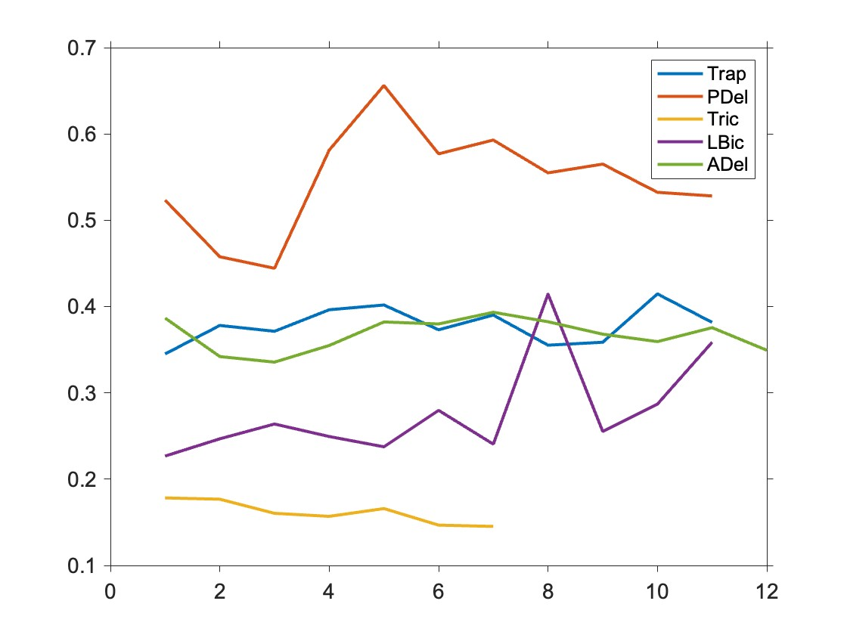
PDel should cause more co-contraction
Hypothesis:
The muscle which has bigger activation during the task should cause more co-contraction during holding time
↓
The bigger muscle activation, the bigger coefficient of variation
Coefficient of variation across Days before z-indexed:

Slide 7
Conclusion of Question1
There is not co-contraction at holding time

Slide 8
EMG basis “Choking Under Pressure”
Questions
Reward Axis at holding time might be the result of co-contraction
Slower reach which cause undershoot might be related to EMG activation

Slide 9
やることリスト
ExceptionalRemovedEMGの変更
directionArrayとrewardArrayを廃止して、exceptionArrayを設ける。
emgデータも、全部残った状態にしておく。
構造
Data
emg
MuscleLabel
Signal N
exceptionArray N
directionArray N
RewardArray N
Kinematics
integratedVelosities 810 * N
PreprocessProp
NormalizedParam 2 * 5 * Days
DatapointEachDay Days
IntegratedVelosityがMaxになる時間を各データで算出: max(IV(201:end), [], 1)
その周辺-100~+100を取得
エラー処理を忘れないこと：Endを超えた回数をカウント。いくつかピックアップして、velosityを確認する
エラー予防として、-100~+100のtime windowで取得したデータY 201*Nを、meanと各trajectoryをplot(黒と灰)
その時間帯のmeanEMGを取得 N
exceptionArrayをかける

Slide 10
The EMG at top speed is also affected by choking
Method

Slide 11
Why the data is different across direction?

Slide 12
Appendix

Slide 13
The amount of datapoints of each condition
(When we didn’t remove any data)
 | 0 | 45 | 90 | 135 | 180 | 225 | 270 | 325
Small | 385 | 299 | 343 | 380 | 380 | 351 | 325 | 344
Medium | 381 | 406 | 389 | 413 | 385 | 359 | 304 | 355
Large | 377 | 406 | 409 | 410 | 405 | 395 | 371 | 406
Jackpot | 57 | 47 | 54 | 60 | 68 | 49 | 50 | 50

Slide 14
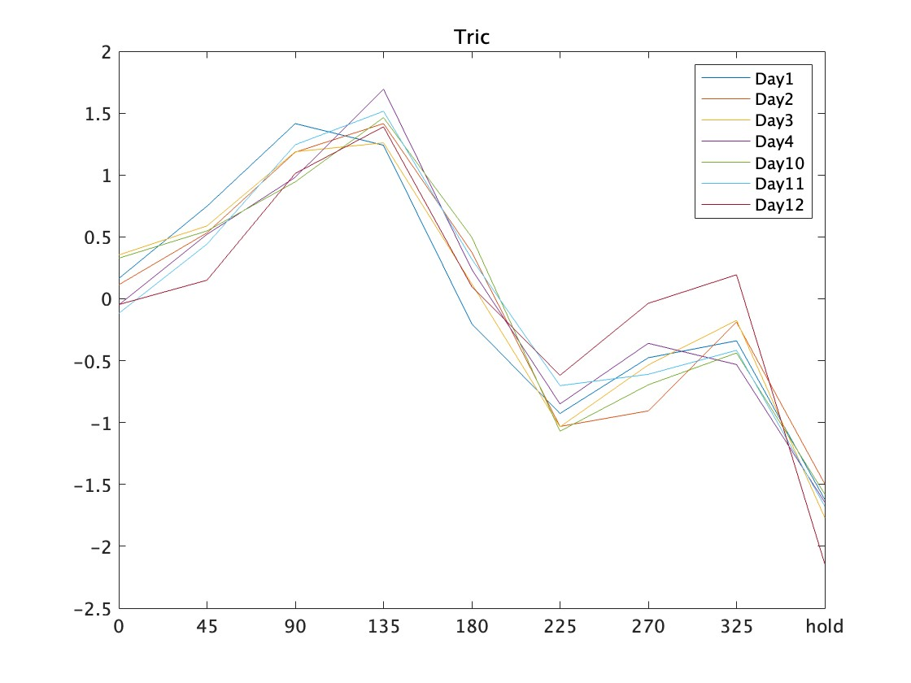
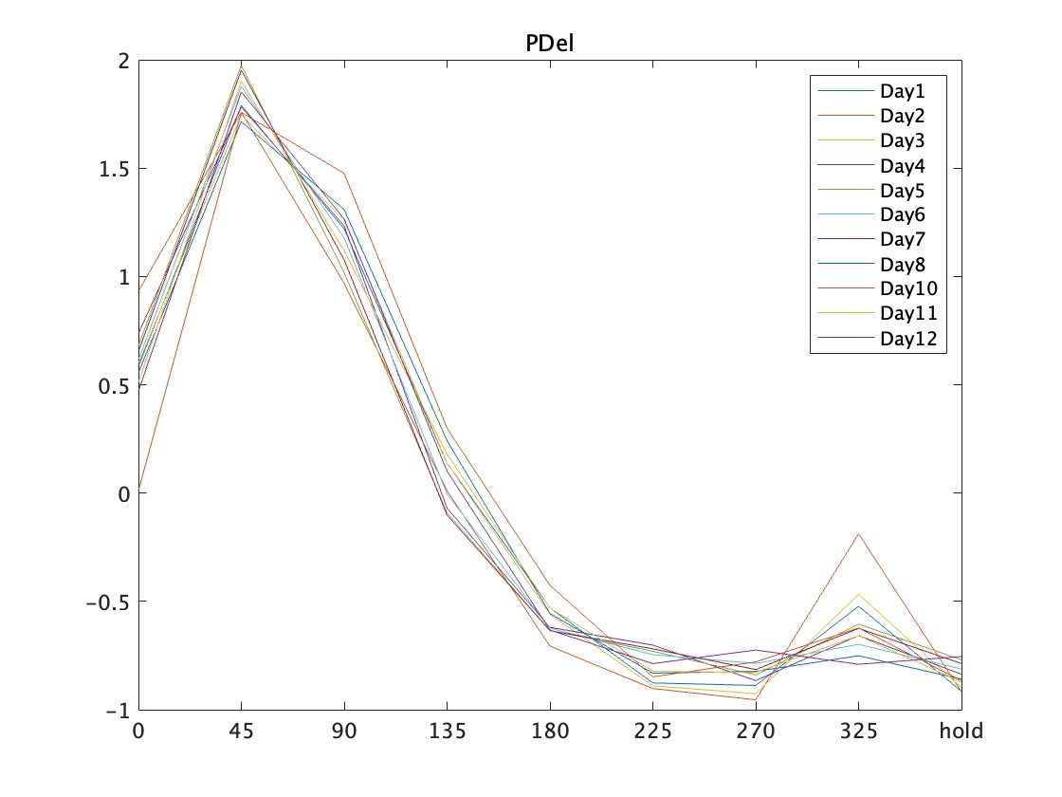
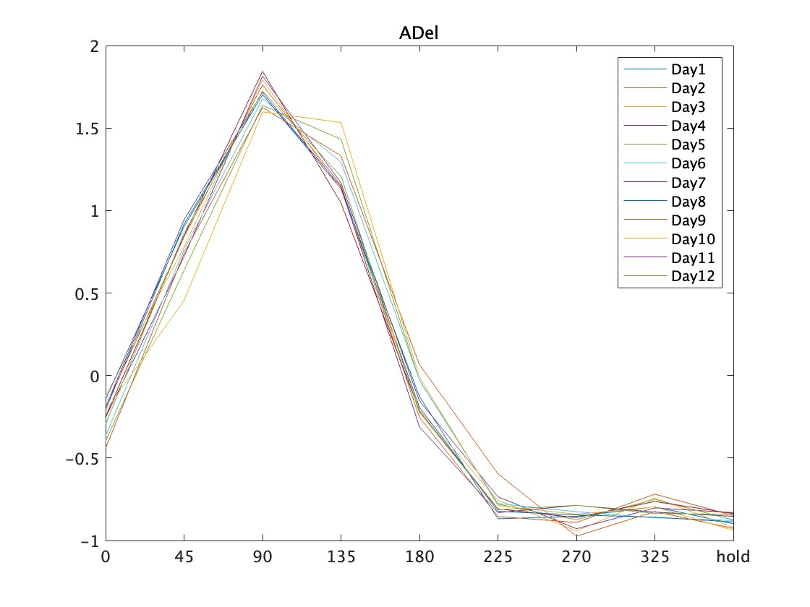
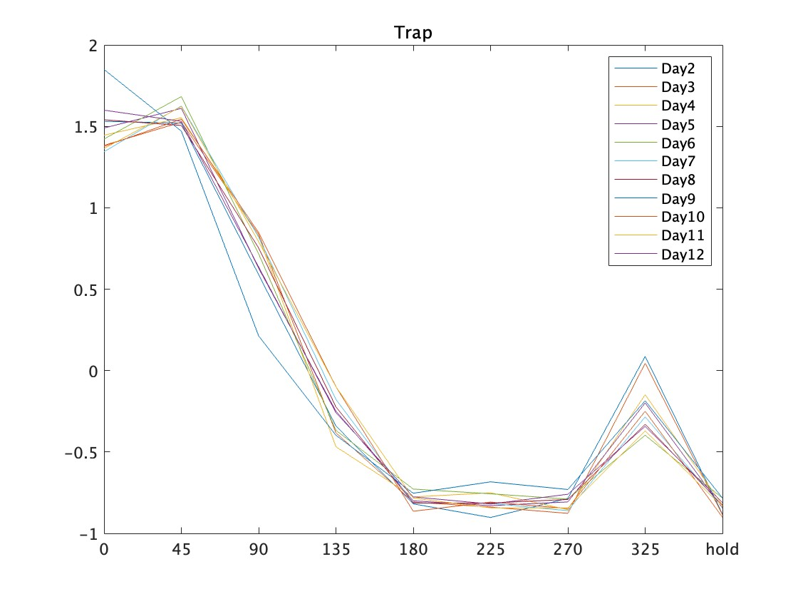
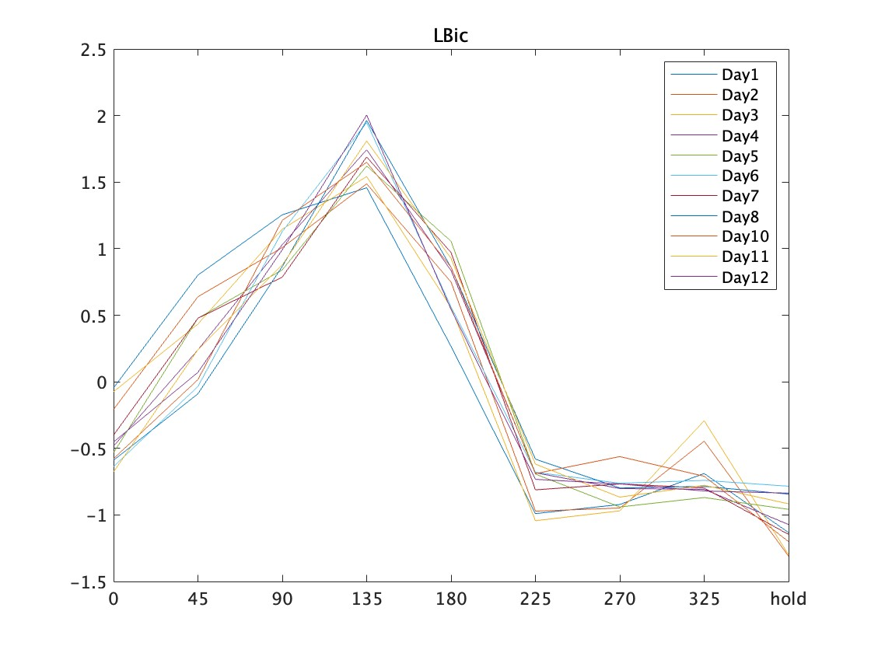
Z-indexed tuning curve each day

Slide 15
What happen in total

