Slide 1
2022/09/23
Hiroo Miyata

Slide 2
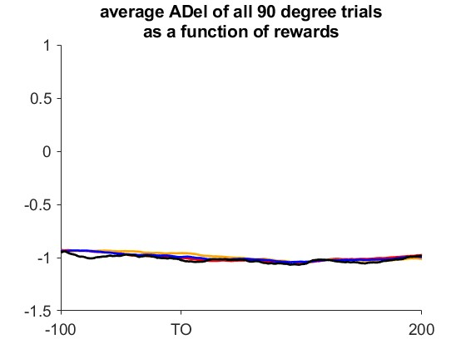
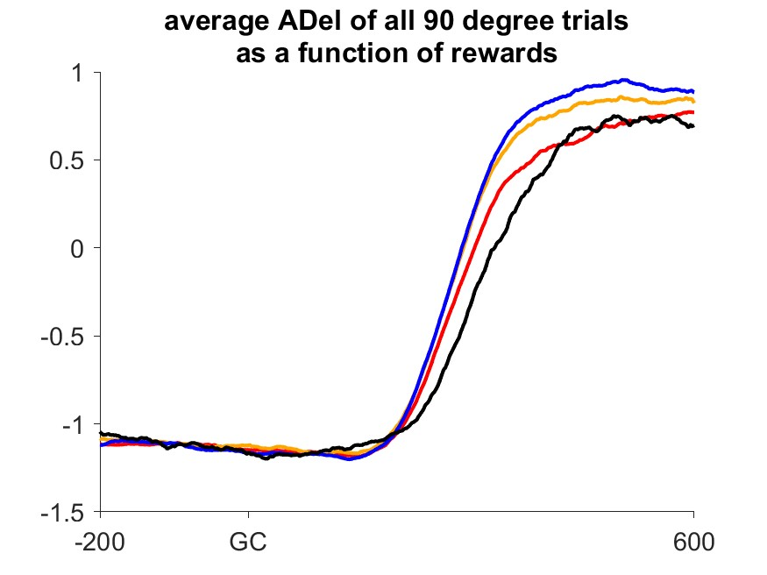
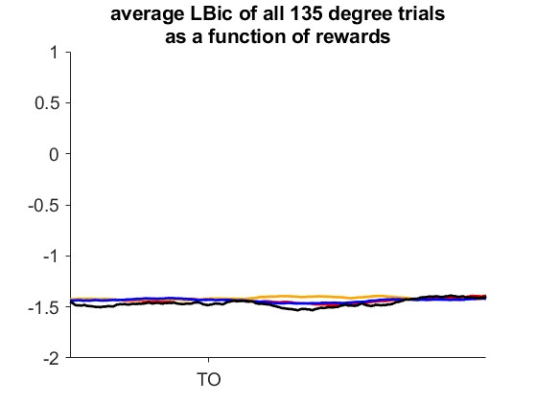
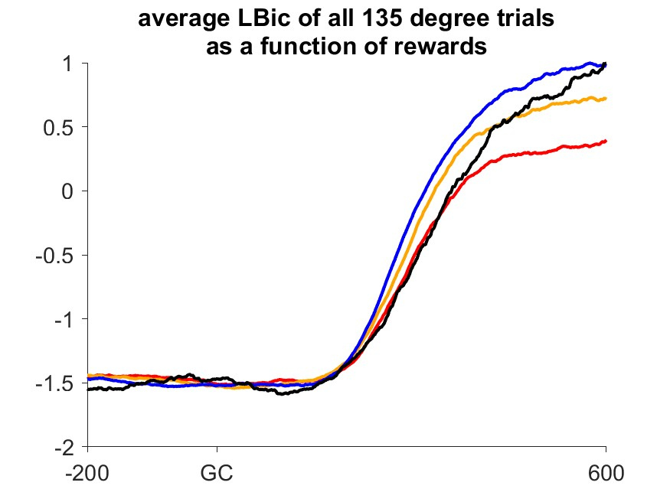

Slide 3
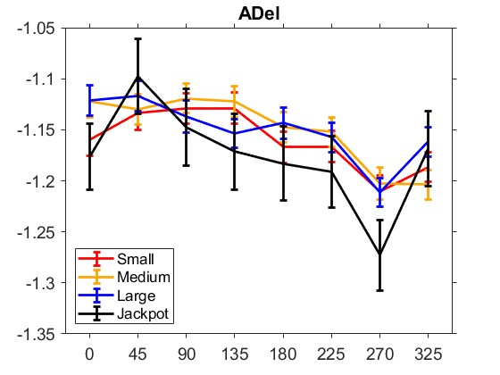
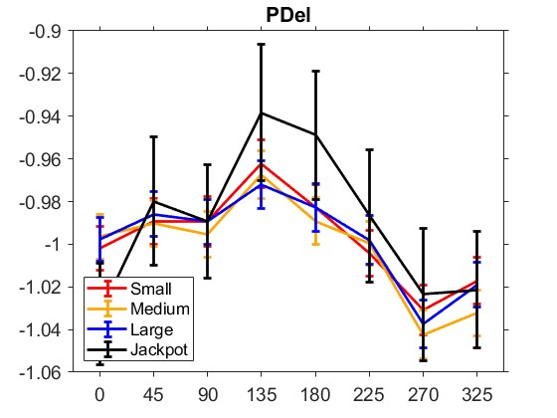
Modification of Tuning curve stuff
I calculated standard deviation from average EMG of each datapoint(-150~+50) Not each trial …!!

Slide 4
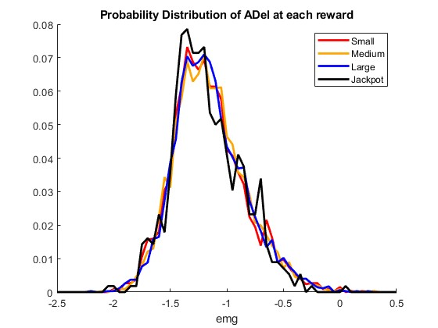
Probability Distributions are same

Slide 5
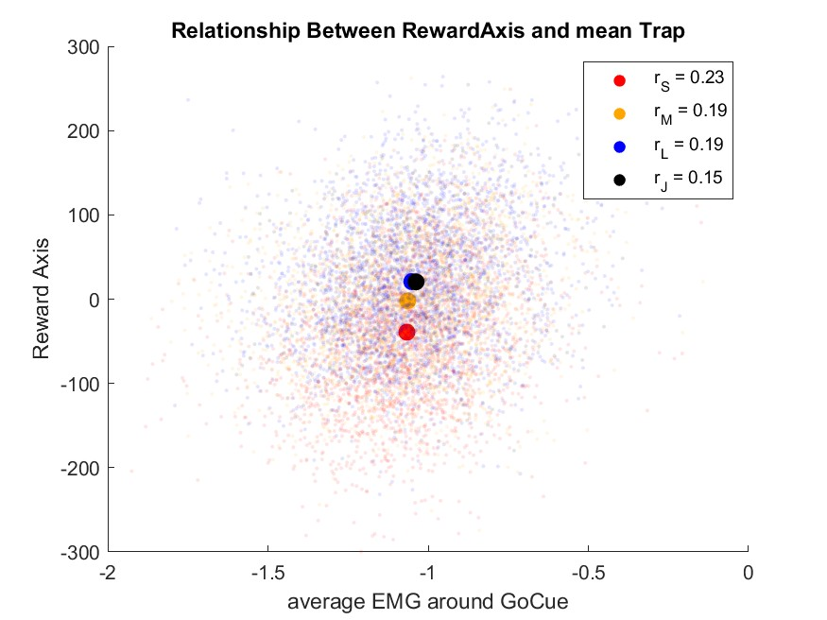
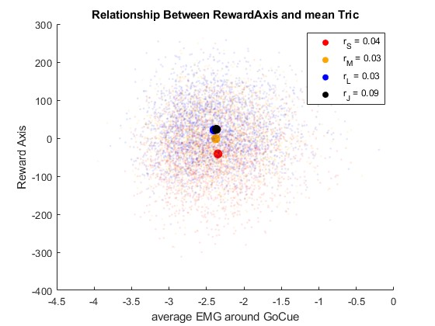
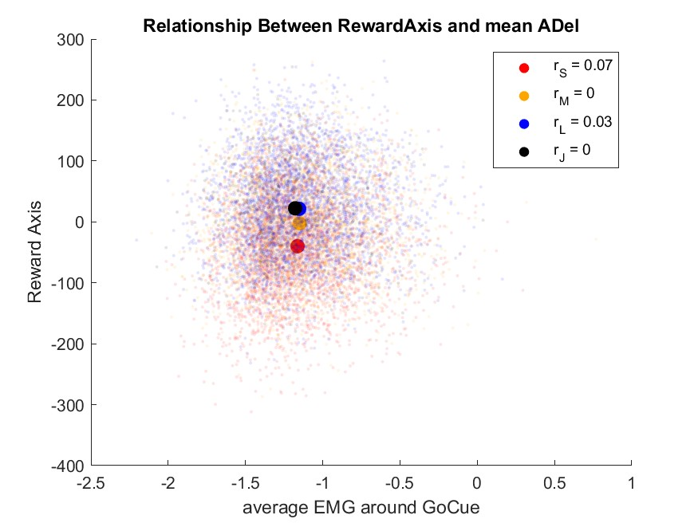
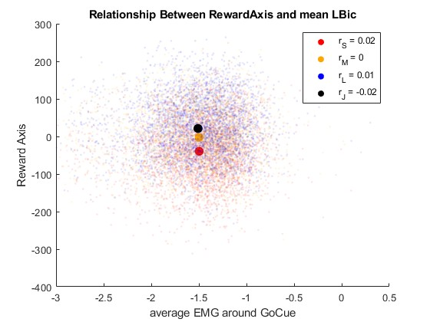
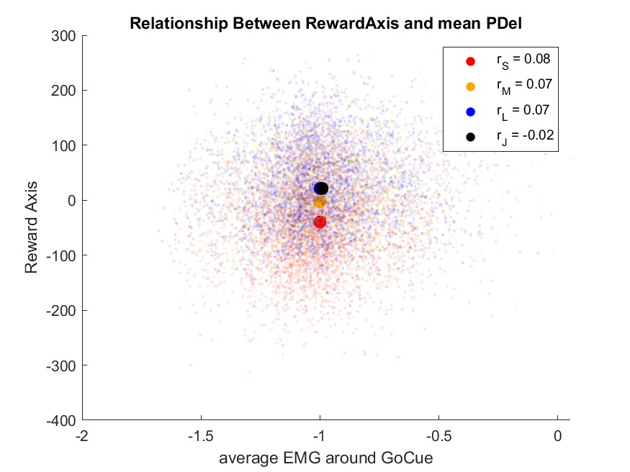
No correlation between RAxis and EMG
?

Slide 6
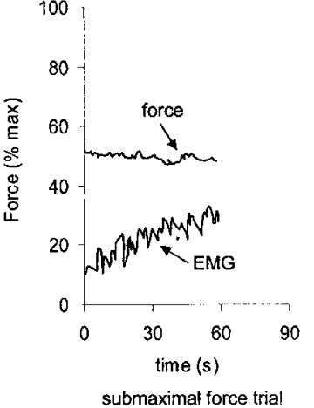
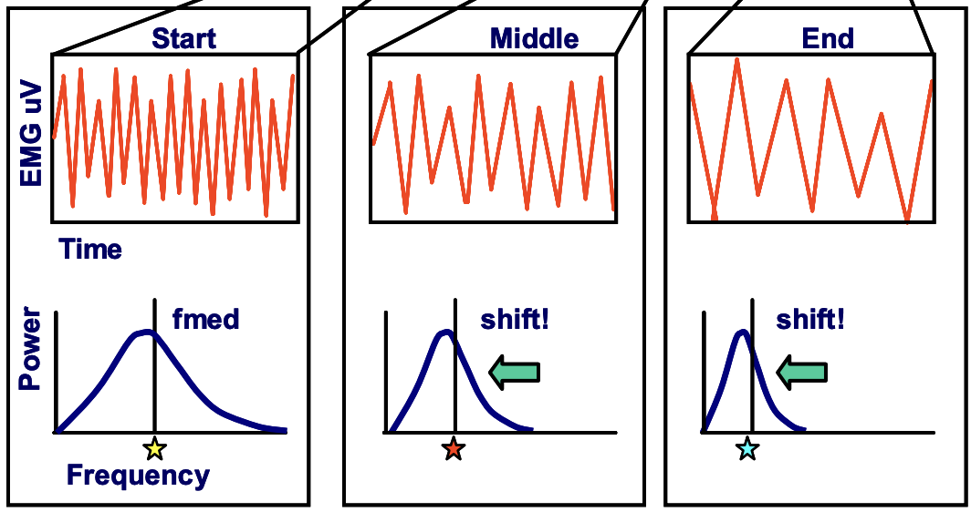
How fatigue affect to EMG
muscle fibers produce less force
muscle fiber conduction velocity become slower
motor units increase
amplitude increases
EMG signal frequencies become lower
Todd D. Royer, 2015, International Journal of Athletic Therapy and Training
ABC of EMG, P51, Does the muscle fatigue?

Slide 7
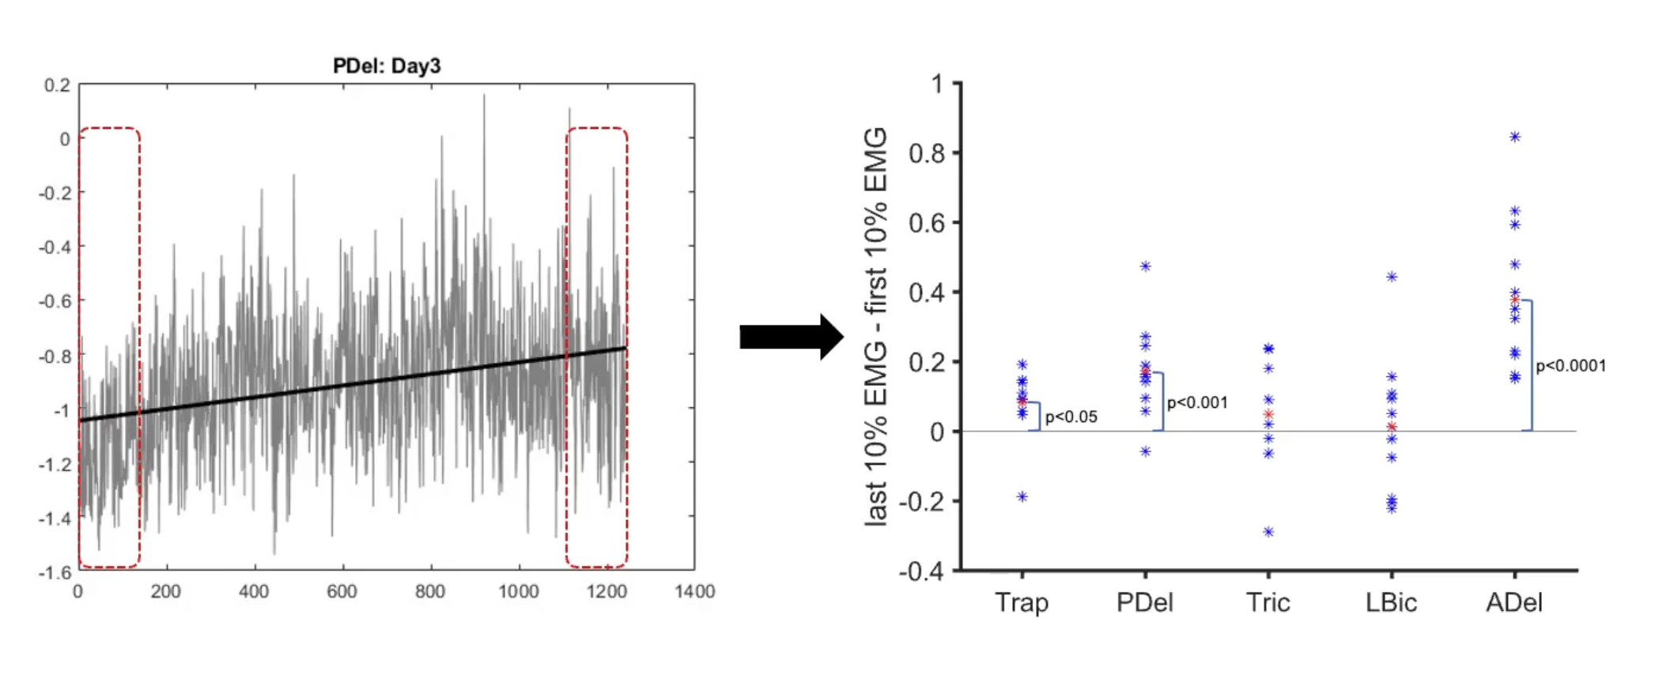
Peri-movement EMG change across session

Slide 8
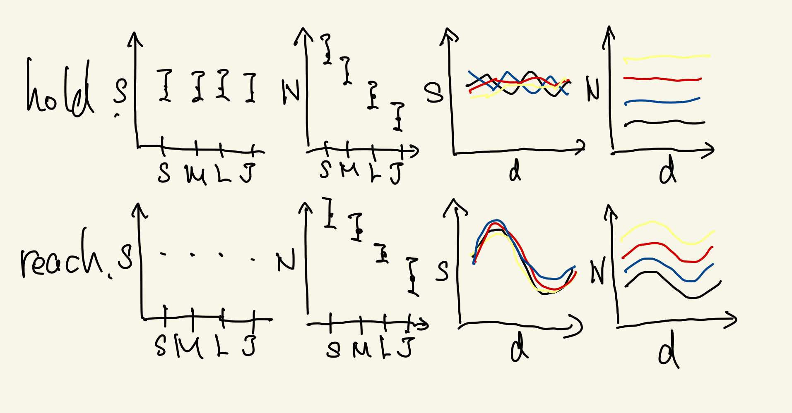
EMGの分布が報酬の関数としてどう変化するか

Slide 9
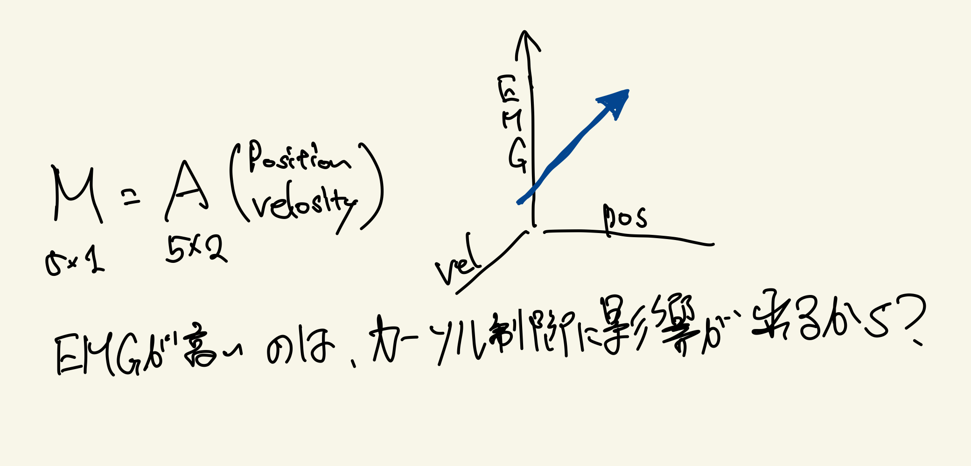
EMGの値はポジションの位置と関係しているのか

Slide 10
Fatigue References
https://www.nature.com/articles/s41598-020-68392-6
https://journals.humankinetics.com/view/journals/ijatt/10/4/article-p43.xml

