Slide 1
20230705

Slide 2
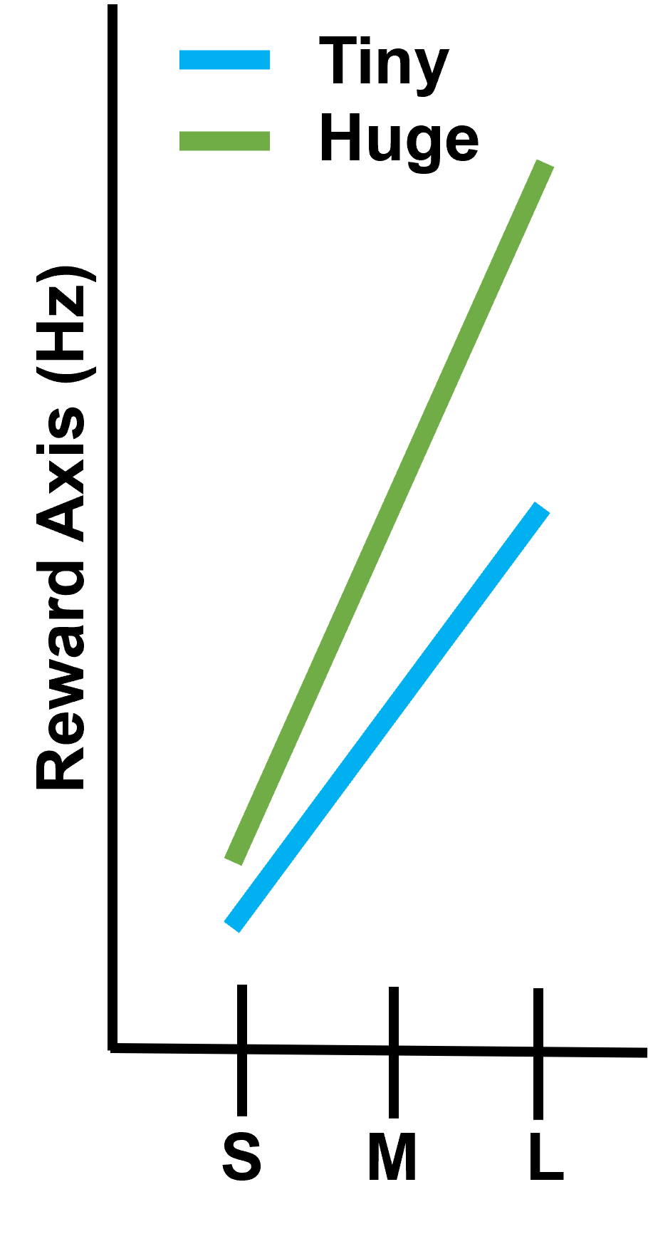
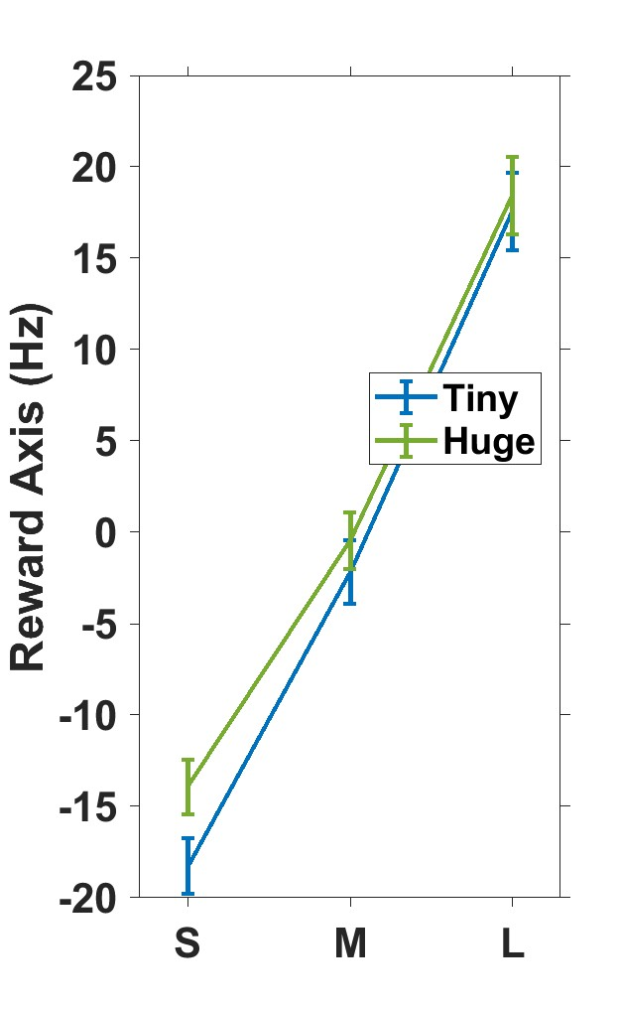
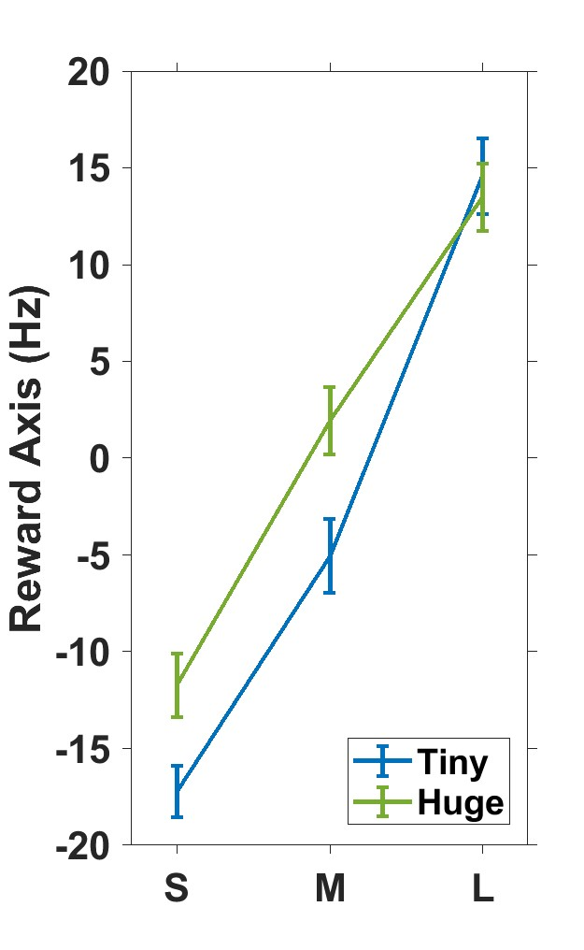
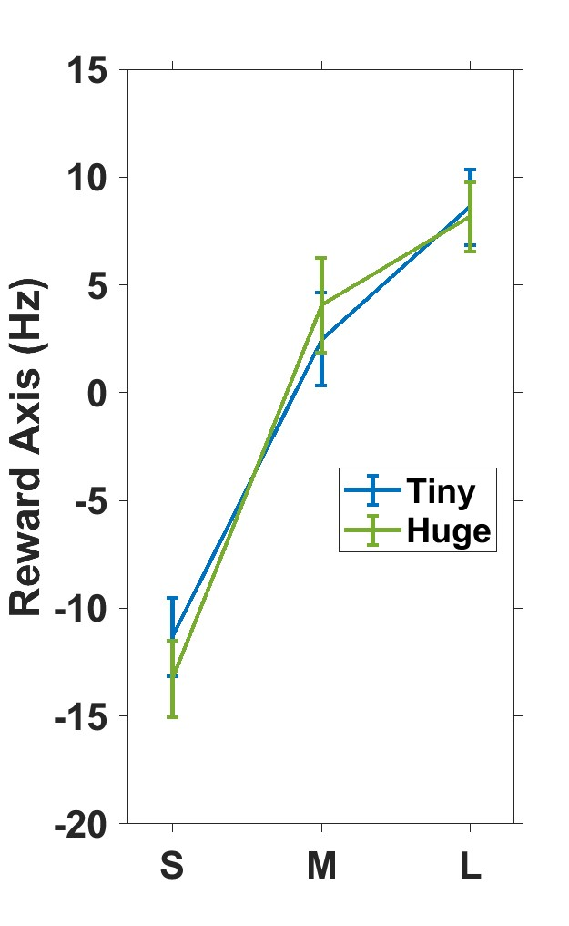
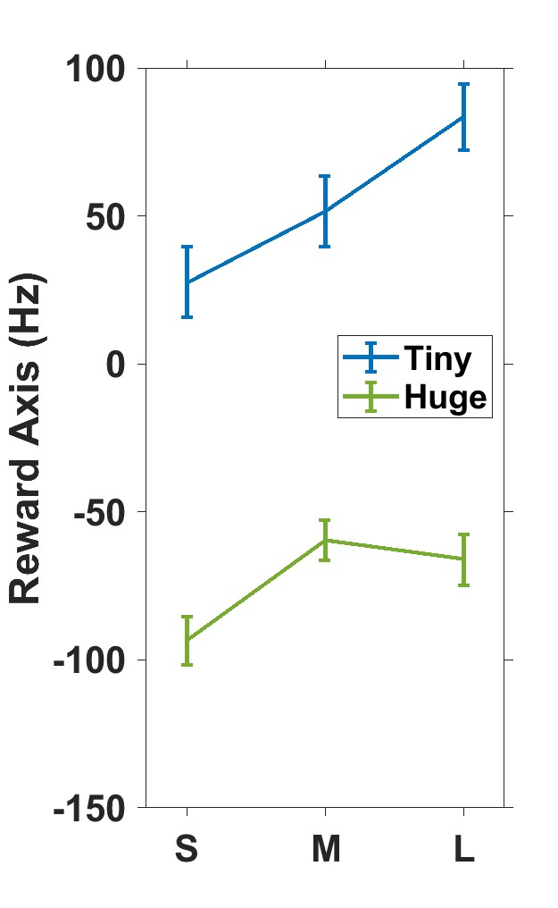
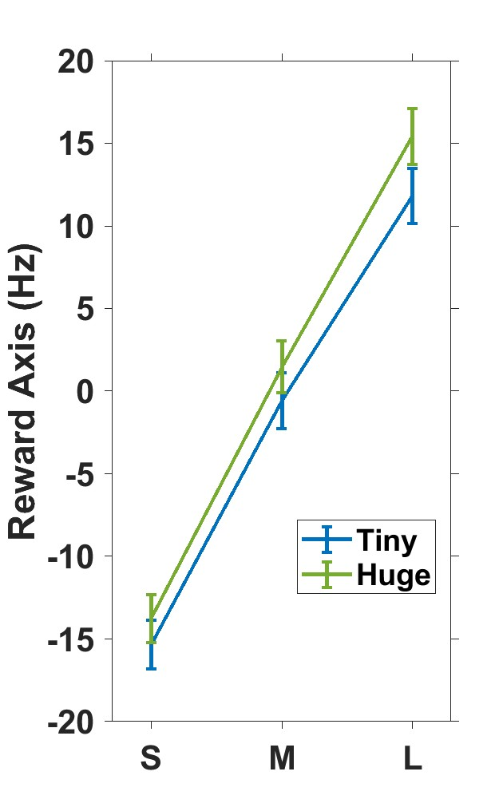
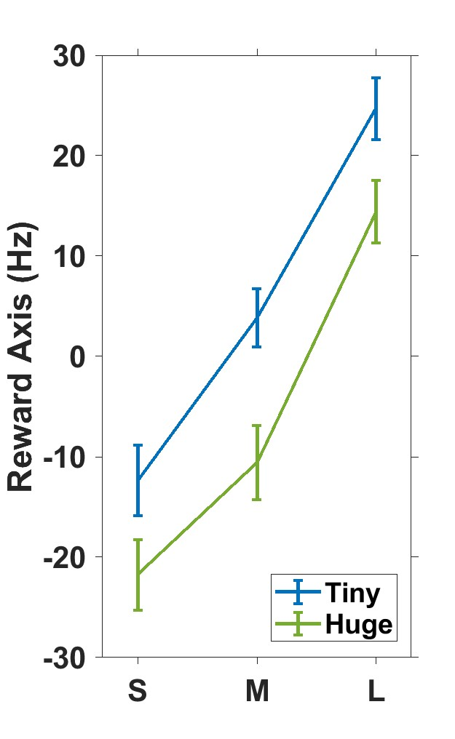
Does Reward Axis around GC show “stretching”?
Method
Get an average of firing rate in each reward condition (nneuron * nreward(3)) around GC [-150 +50]
Get reward Axis from them
We expect
Result
0216
0405
0414
0417
0418

Slide 3
20230426

Slide 4
Experiment
Interleaved Days
Experiment date : 20230216~20220414 (3 days)
Monkey : Satchel
Task type : Focus task: color change detection + delayed reach task (16% are catch trials)
Parameters
Direction : 8 directions
Reward : small (50ul) medium (150ul) large (400ul) rewards cued by shapes inside
Target size : either tiny (25mm rad) or huge (38mm rad)
Focus difficulty:
Delay length: 500~2000 ms
Data size: 2000 trials per day.
The data for my analysis: the trials which passed Go Cue and achieved to reach the target
How did Adi spike sort?

Slide 5
Motivation of the analysis
Does the task difficulty in focus task alter the M1 reward encoding in the same way we saw in Rocky’s data?
The preliminary results about Reward Axis around GC in Rocky’s data
Stretching
Would be happened if the success rates differ
Intersection in the middle
Wouldn’t be happened since Small reward is not 0 mL
Reward Axis and Difficulty Axis was orthogonal

Slide 6
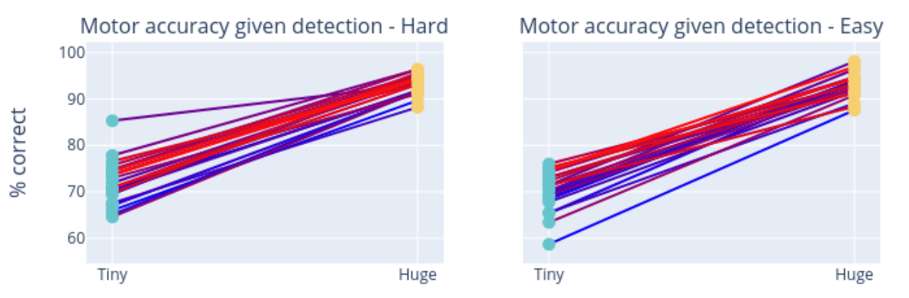
Target size clearly affects success rate

Slide 7
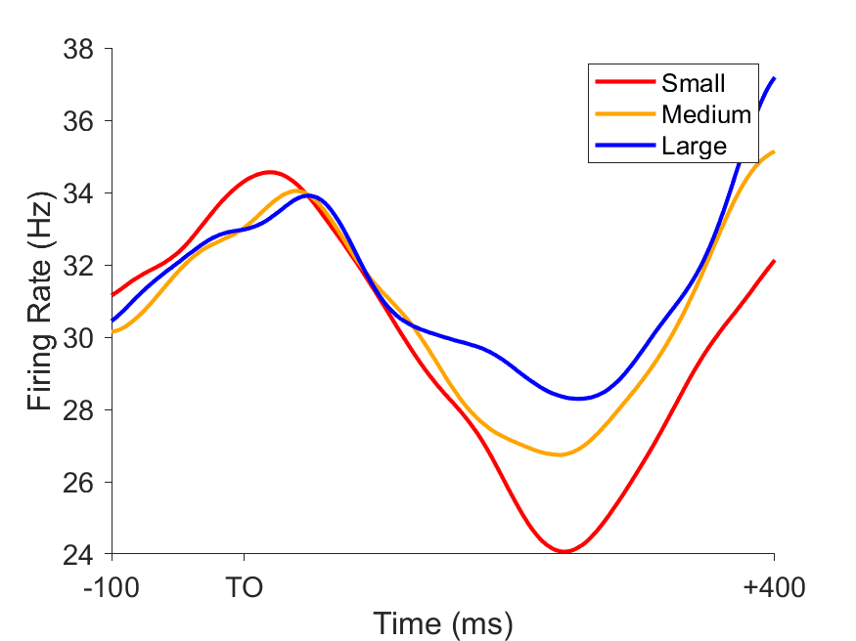
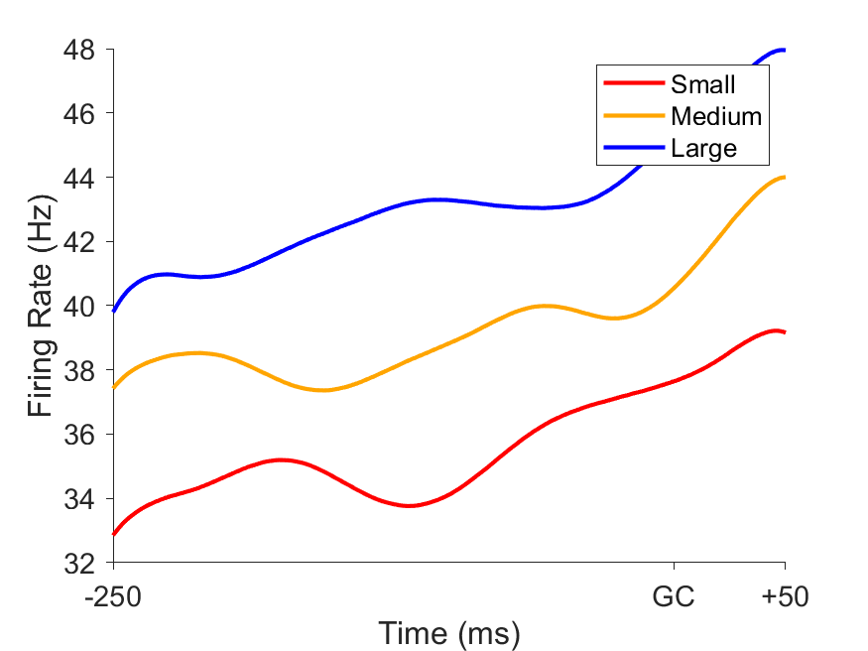
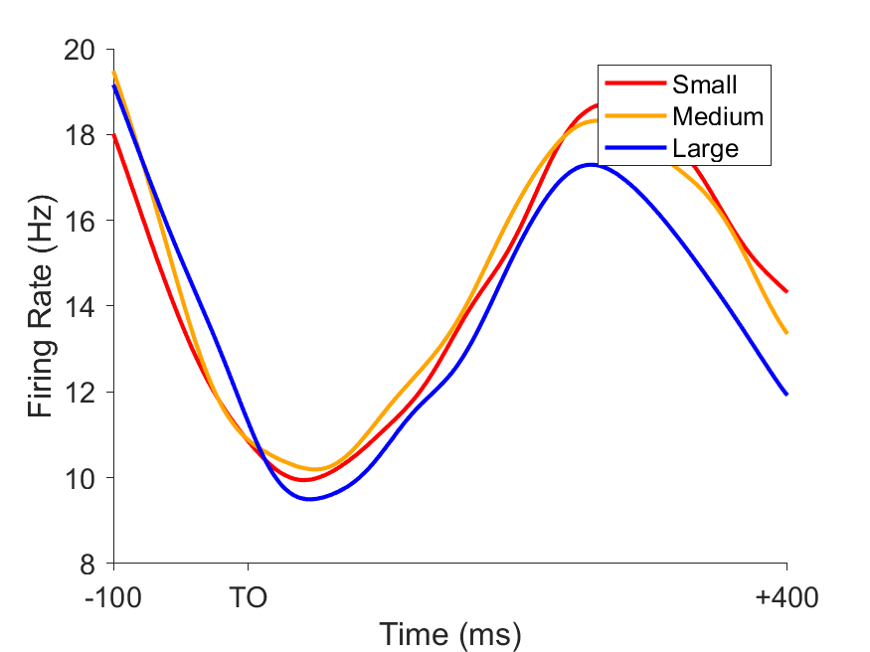
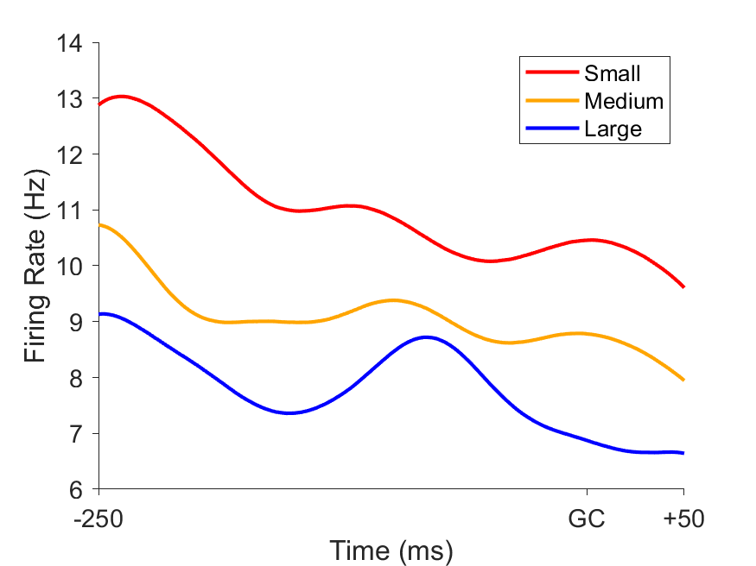
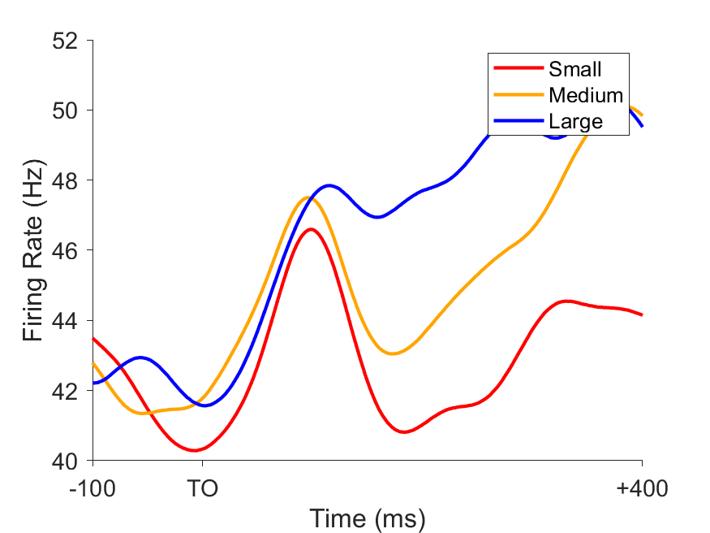
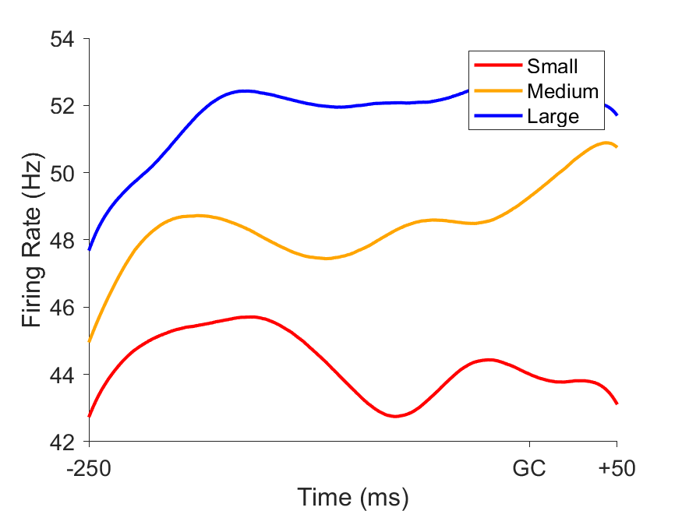
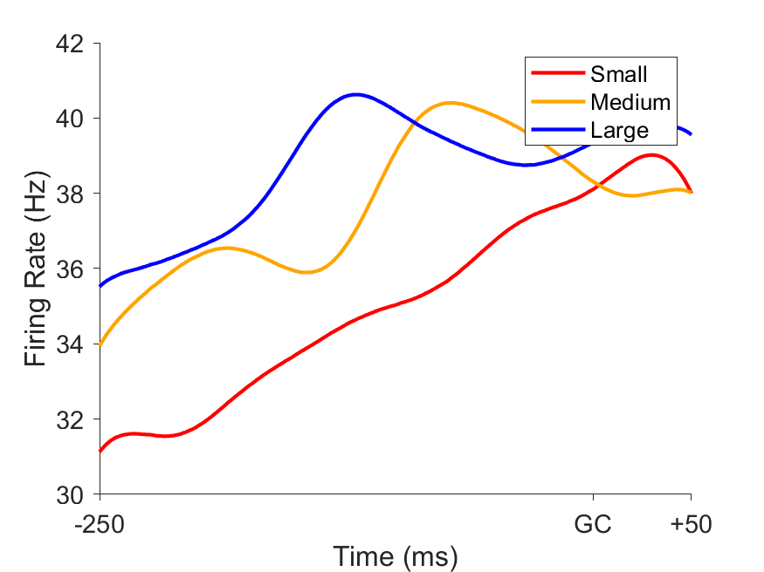
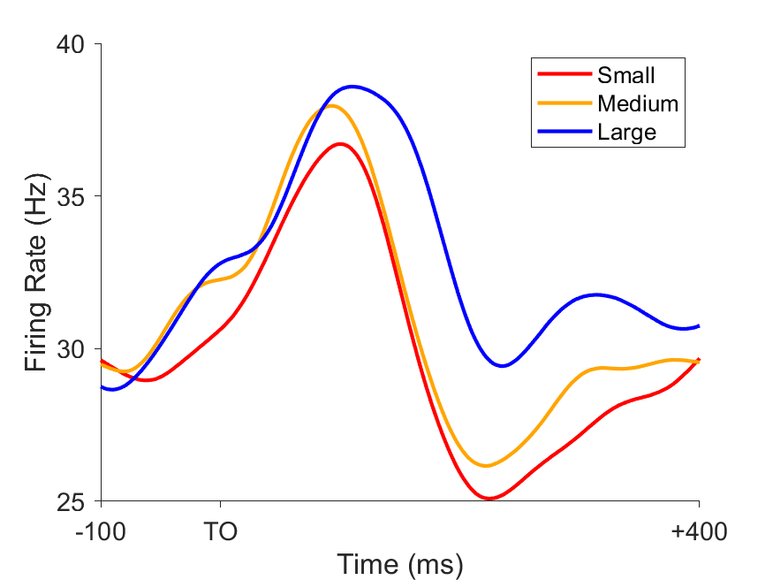
some PSTHs (after TO and around GC)
0216-neuron #7
0216-neuron #52
0405-neuron #37
0414-neuron #33

Slide 8
Are there enough neurons which is modulated by reward
Method
Get the average firing rate in each reward condition around GC [-250 +50]
Get the amount of monotonically modulated neurons
There are 4 types of neurons (S-M significant or not and M-L significant or not) (p < 0.05)
What I expect
Result
 | %(Num/All)
S-*-M-*-L | 6%(7/130)
S-*-M---L | 26%(33/130)
S---M-*-L | 6%(8/130)
S---M---L | 28%(37/130)
All | 66%(85/130)
 | 0216 (n=652) | 0405 (n=455) | 0414 (n=472)
S-*-M-*-L | 16%(15/96) | 9%(9/96) | 2%(2/96)
S-*-M---L | 10%(10/96) | 8%(8/96) | 8%(8/96)
S---M-*-L | 16%(15/96) | 14%(13/96) | 5%(5/96)
S---M---L | 25%(24/96) | 39%(37/96) | 31%(29/96)
All | 67%(64/96) | 70%(67/96) | 46%(44/96)
Day2 in Rocky’s data
(1100 trials)
Satchel’s data
(1500 trials)

Slide 9
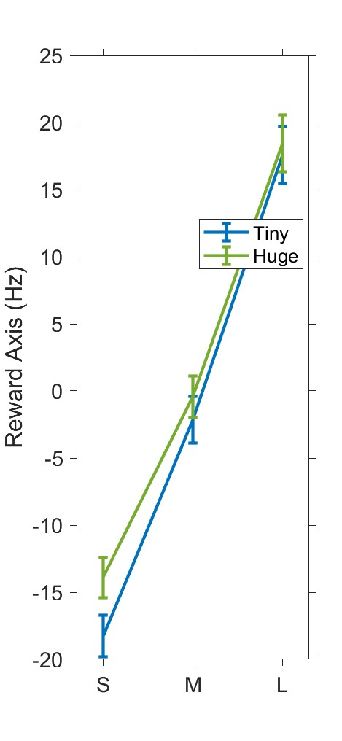
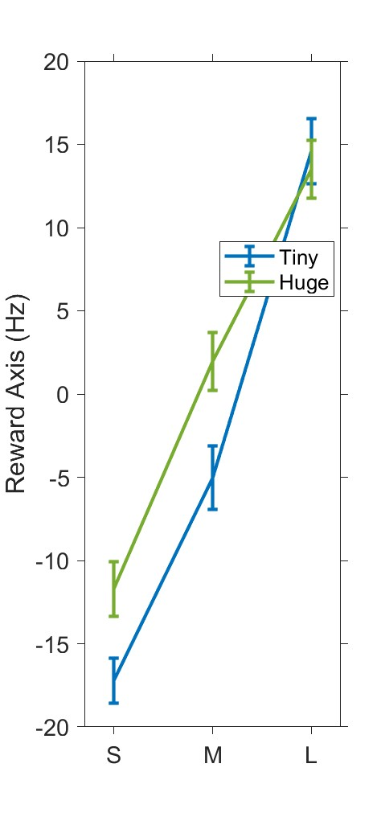
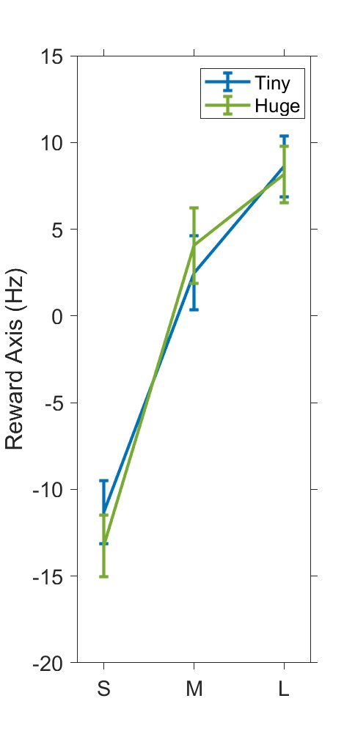
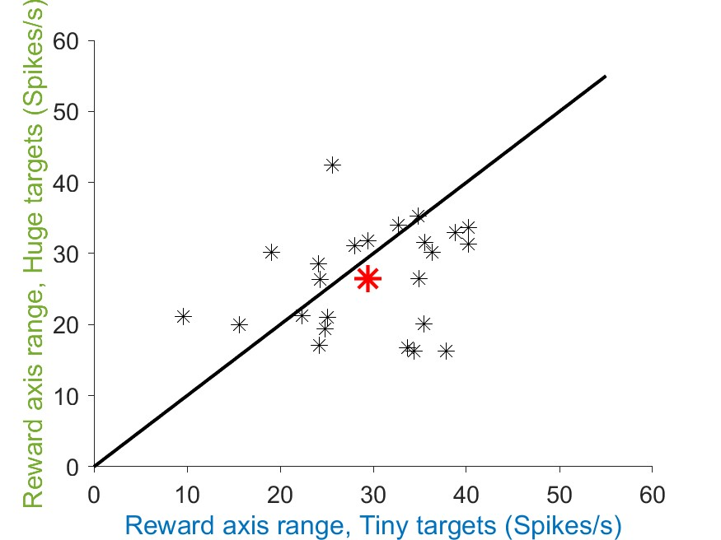
Does Reward Axis around GC show “stretching”?
Method
Get an average of firing rate in each reward condition (nneuron * nreward(3)) around GC [-150 +50]
Get reward Axis from them
We expect
Result
0216
0405
0414

Slide 10
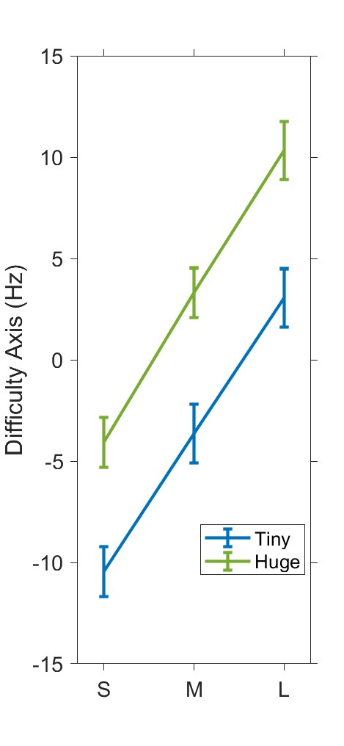
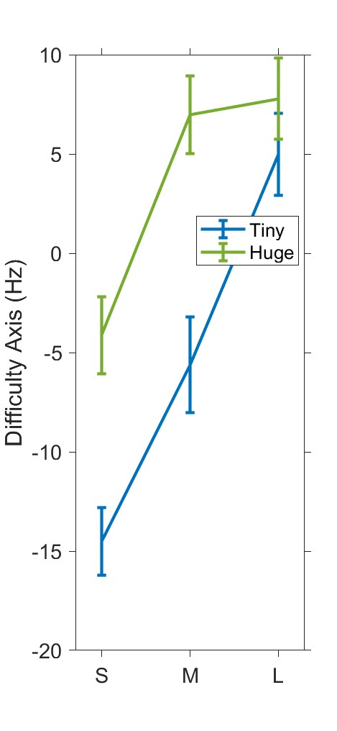
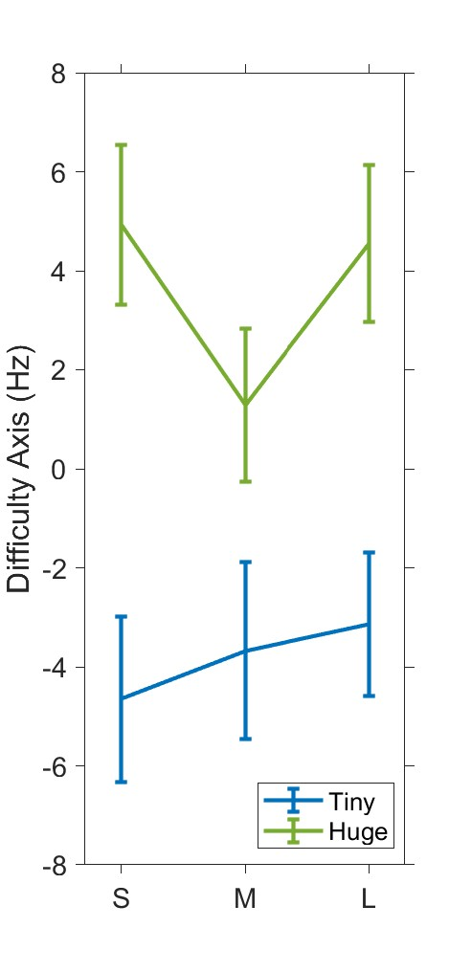
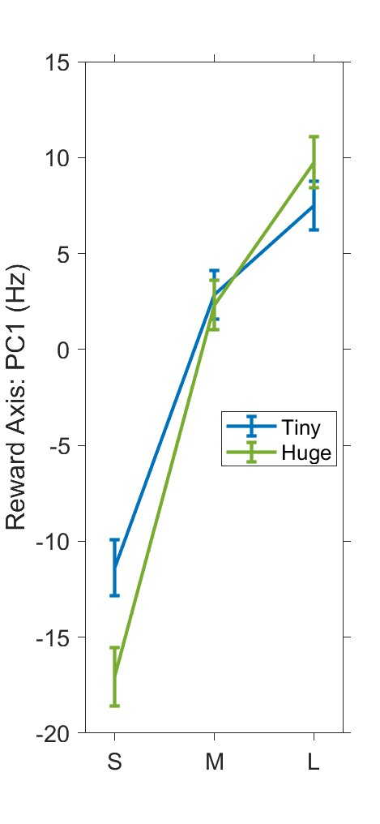
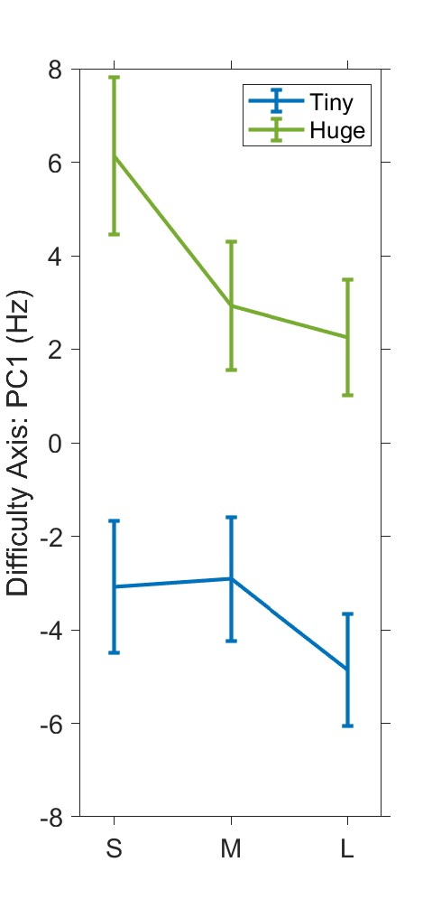
Is Reward Axis and Difficulty Axis orthogonal?
Method
Get an average of firing rate in each reward condition (nneuron * nreward(3)) around GC [-150 +50]
Get reward Axis from them
We expect
Result
Rocky data Day1 – 95.9 °
66.3°
61.0°
90.3°

Slide 11
Summary
Stretching
Couldn’t see
Reward Axis and Difficulty Axis was orthogonal
Couldn’t see
What causes the difference?
Focus difficulty affects? => How about in Trivial trials?
Was Small(0mL) special? => Rocky showed stretching b/w M and L?
Future work: Reconstruct the hypothesis

Slide 12
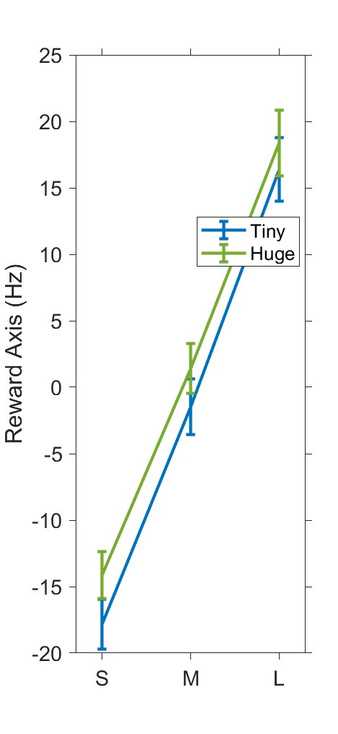
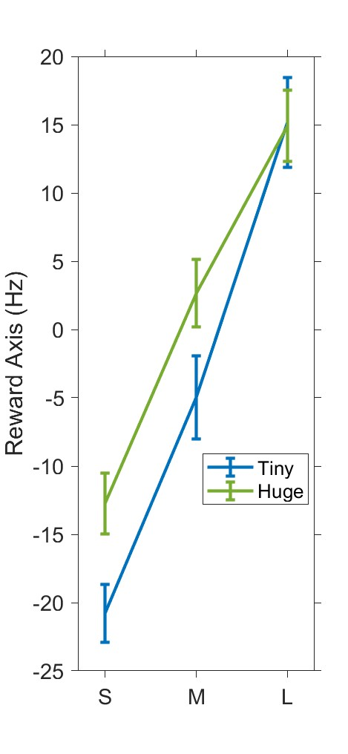
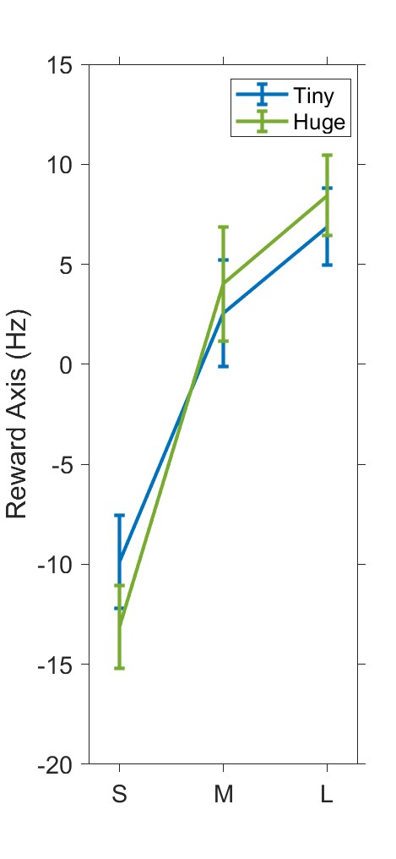
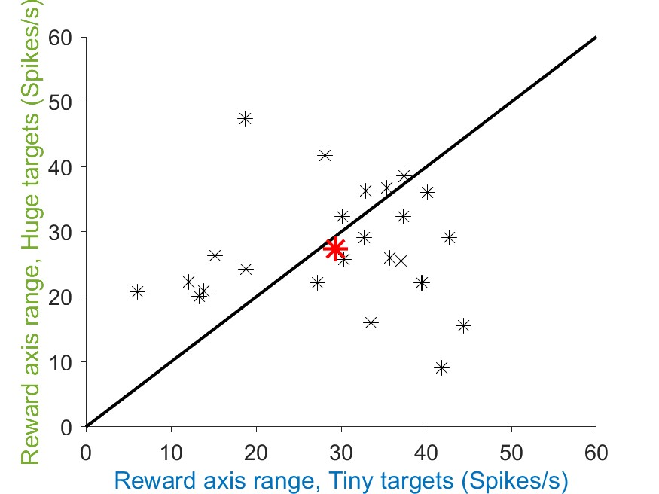
Does Reward Axis around GC show “stretching” in trivial task?
Method
Get an average of firing rate in each reward condition (nneuron * nreward(3)) around GC [-150 +50]
Use Focus difficulty is 3 or 4 ( there are 1,2,3,4 in focus level ( 1: hard, 4: easy)
We expect
Result
0216
0405
0414

Slide 13
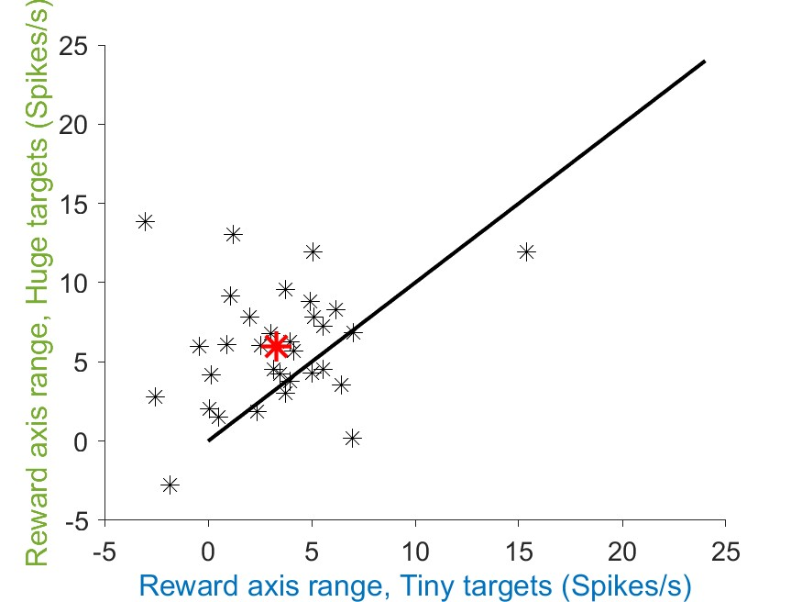
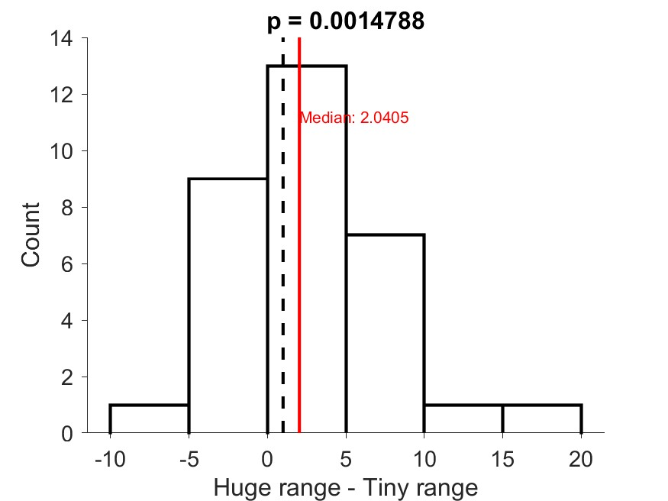
Rocky showed stretching b/w M and L?
Satchel’s data
Rocky’s data (Large – Medium)

Slide 14
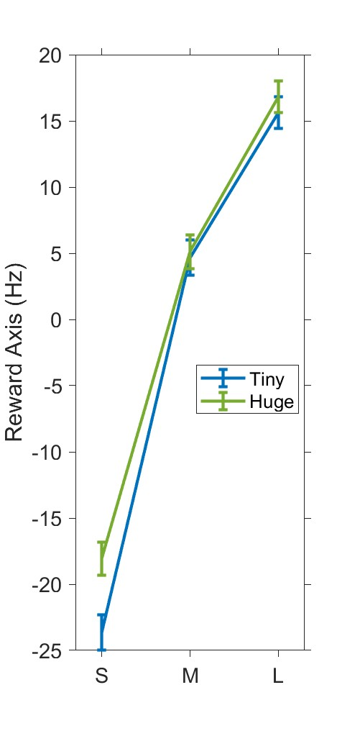
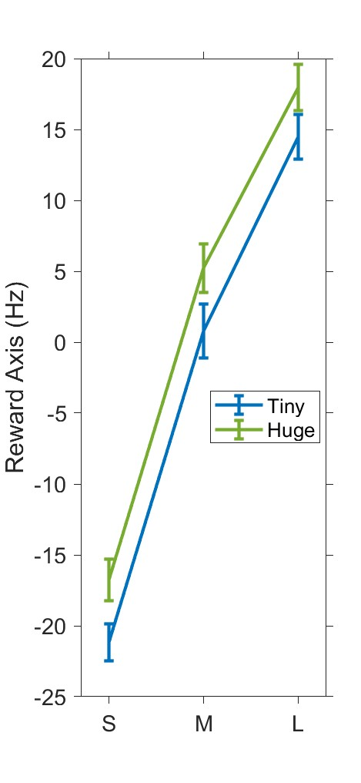
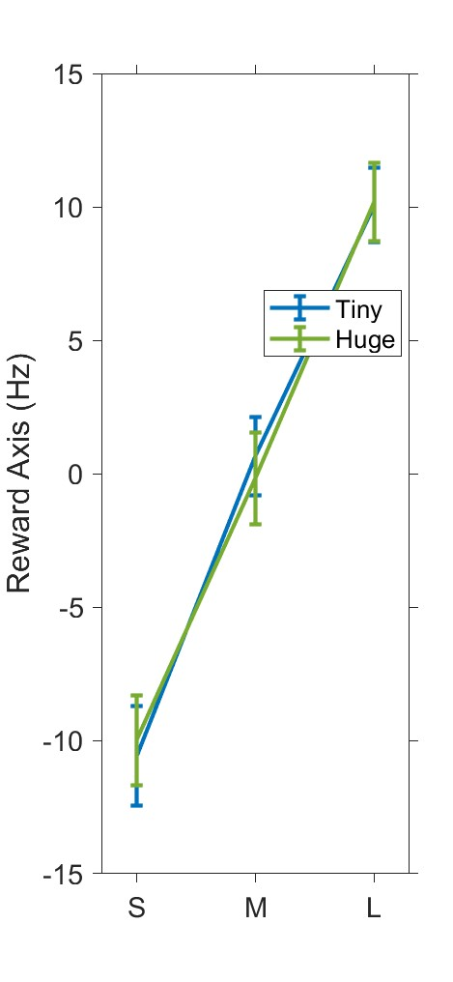
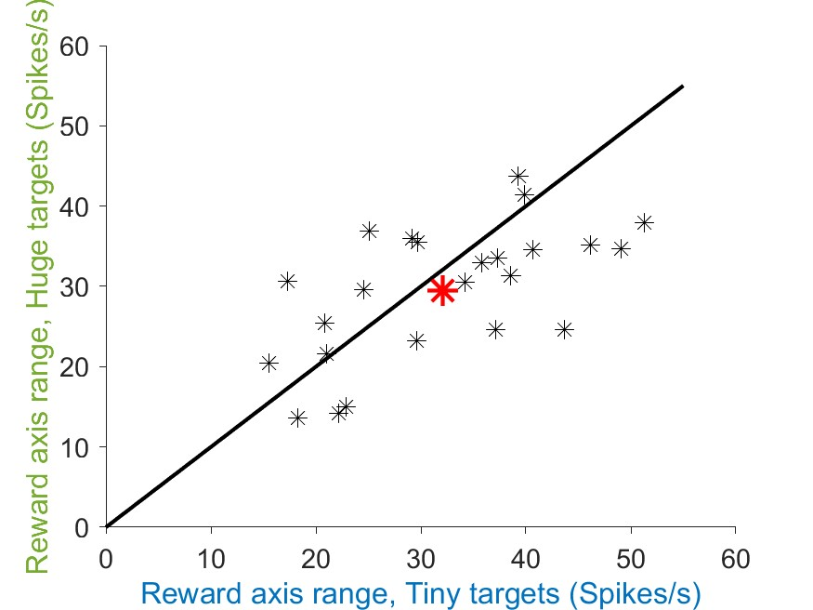
Does Reward Axis after TO show “stretching”?
Method
Get an average of firing rate in each reward condition (nneuron * nreward(3)) after TO[+200 +400]
Get reward Axis from them
We expect
Result
0216
0405
0414

