Slide 1
Experiment
Interleaved Days
Experiment date : 20230216~20220411 (4 days)
Monkey : Satchel
Task type : Focus task: color change detection + delayed reach task (16% are catch trials)
Parameters
Direction : 8 directions
Reward : small (50ul) medium (150ul) large (400ul) rewards cued by shapes inside
Target size : either tiny (25mm rad) or huge (38mm rad)
Focus difficulty:
Delay length: 500~2000 ms

Slide 2
Motivation of the analysis
Does the task difficulty in focus task alter the M1 reward encoding in the same way we saw in Rocky’s data?
The preliminary results
Stretching
Would be happened if the success rates differ
Intersection in the middle
Wouldn’t be happened since Small reward is not 0 mL
Stretching in Tiny condition after target hold period
Would be happened
Reward Axis and Difficulty Axis was orthogonal

Slide 3
Data change
downsampled from 30 kHz to 1 kHz
Remove noise spikes
How did Adi spike sort?

Slide 4
Do PSTH of the neurons show monotonic modulation by reward?
Method
Get PSTH in each reward condition around GC [-250 +50]
Get the amount of monotonically modulated neurons
There are 4 types of neurons (S-M significant or not and M-L significant or not) (p < 0.05)
What I expect
Result
 | %(Num/All)
S-*-M-*-L | 5%(5/96)
S-*-M---L | 7%(7/96)
S---M-*-L | 7%(7/96)
S---M---L | 11%(11/96)
All | 30%(30/96)
 | 0216 (n=652) | 0405 (n=455) | 0411 (n=472)
S-*-M-*-L | 16%(15/96) | 9%(9/96) | 2%(2/96)
S-*-M---L | 10%(10/96) | 8%(8/96) | 8%(8/96)
S---M-*-L | 16%(15/96) | 14%(13/96) | 5%(5/96)
S---M---L | 25%(24/96) | 39%(37/96) | 31%(29/96)
All | 67%(64/96) | 70%(67/96) | 46%(44/96)

Slide 5
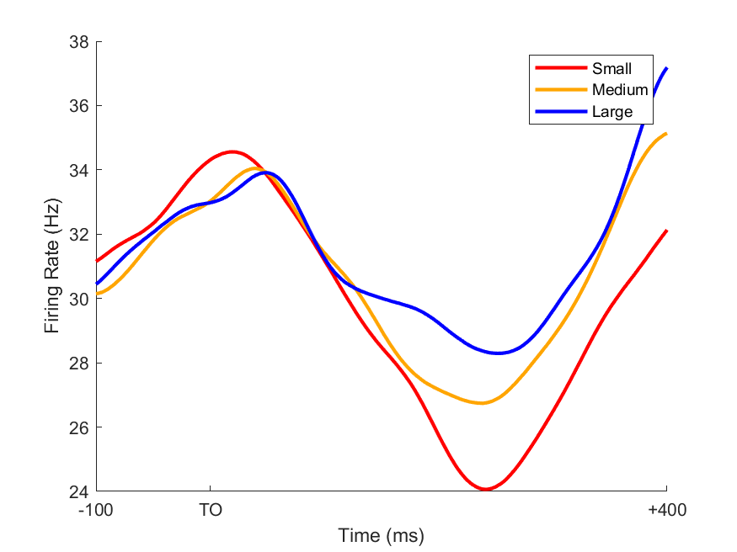
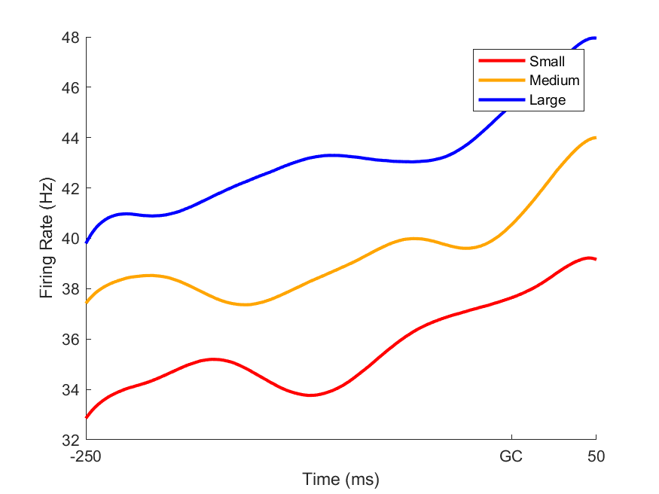
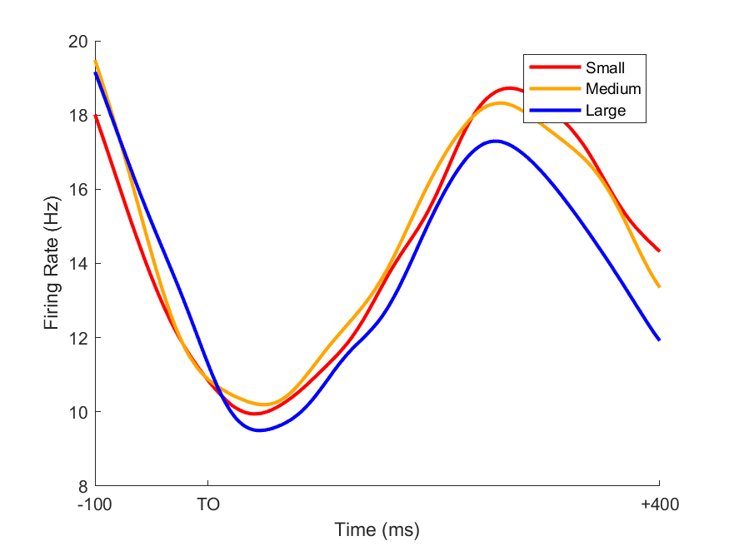
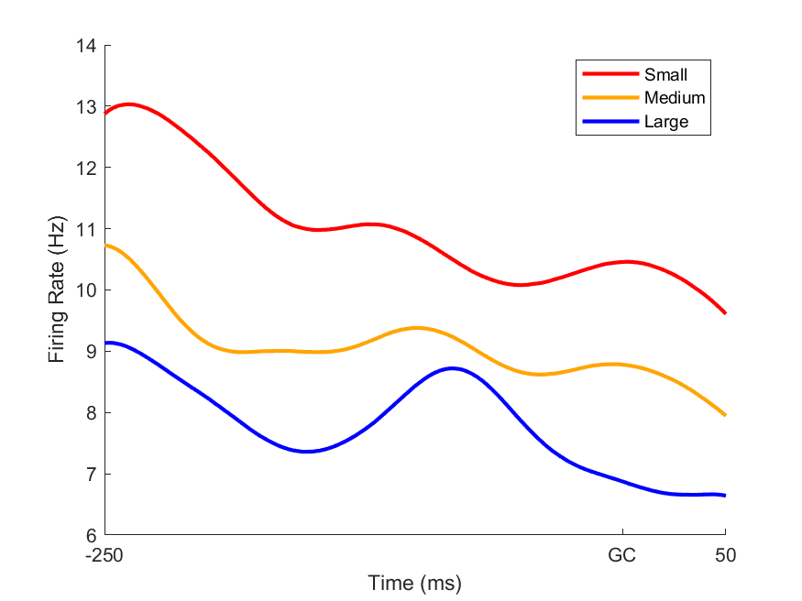
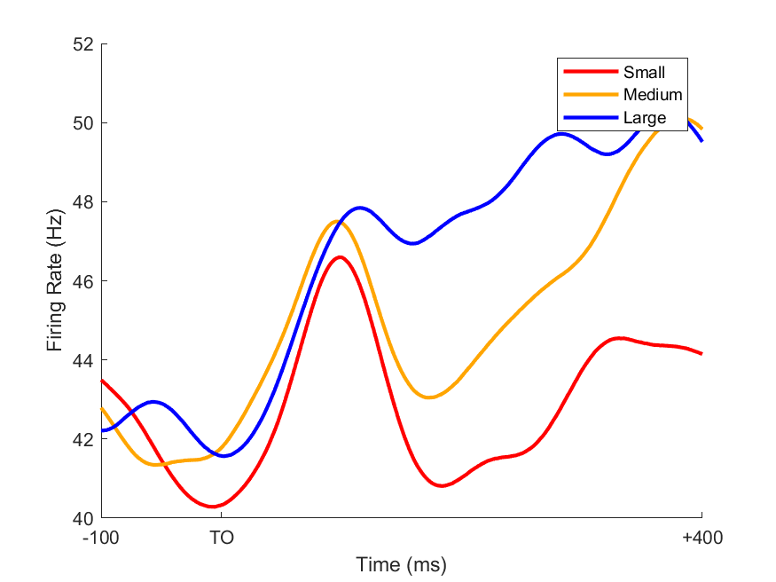
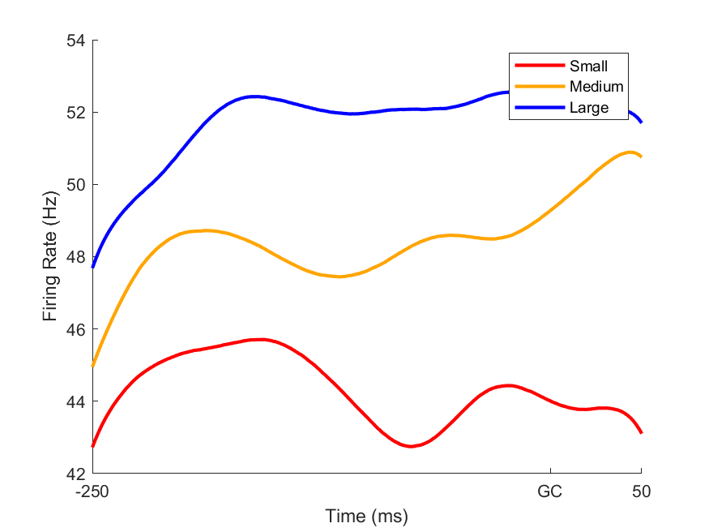
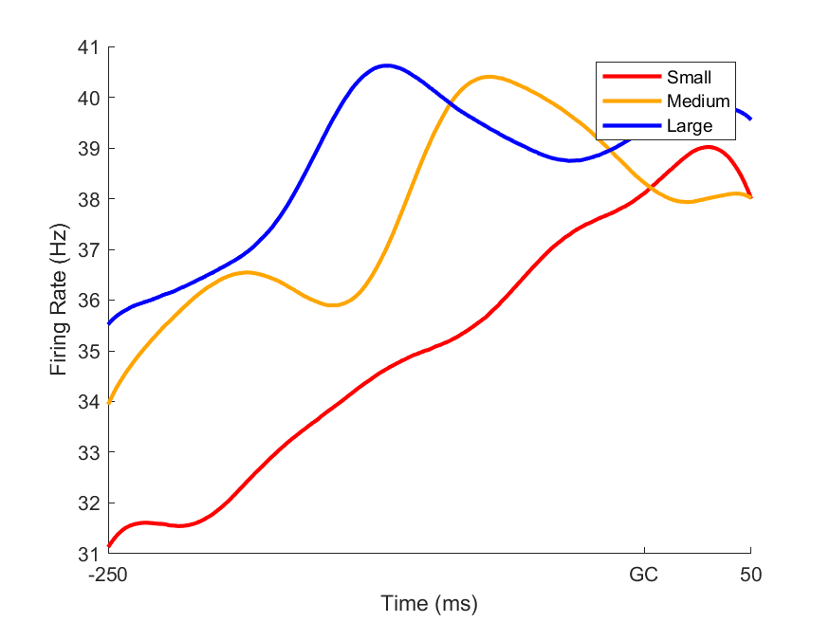
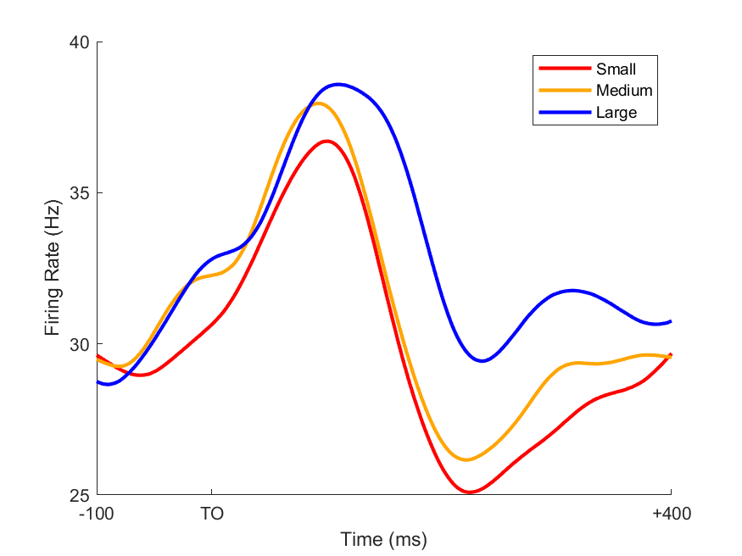
some PSTHs (after TO and around GC)
0216-neuron #7
0216-neuron #52
0405-neuron #37
0414-neuron #22

Slide 6
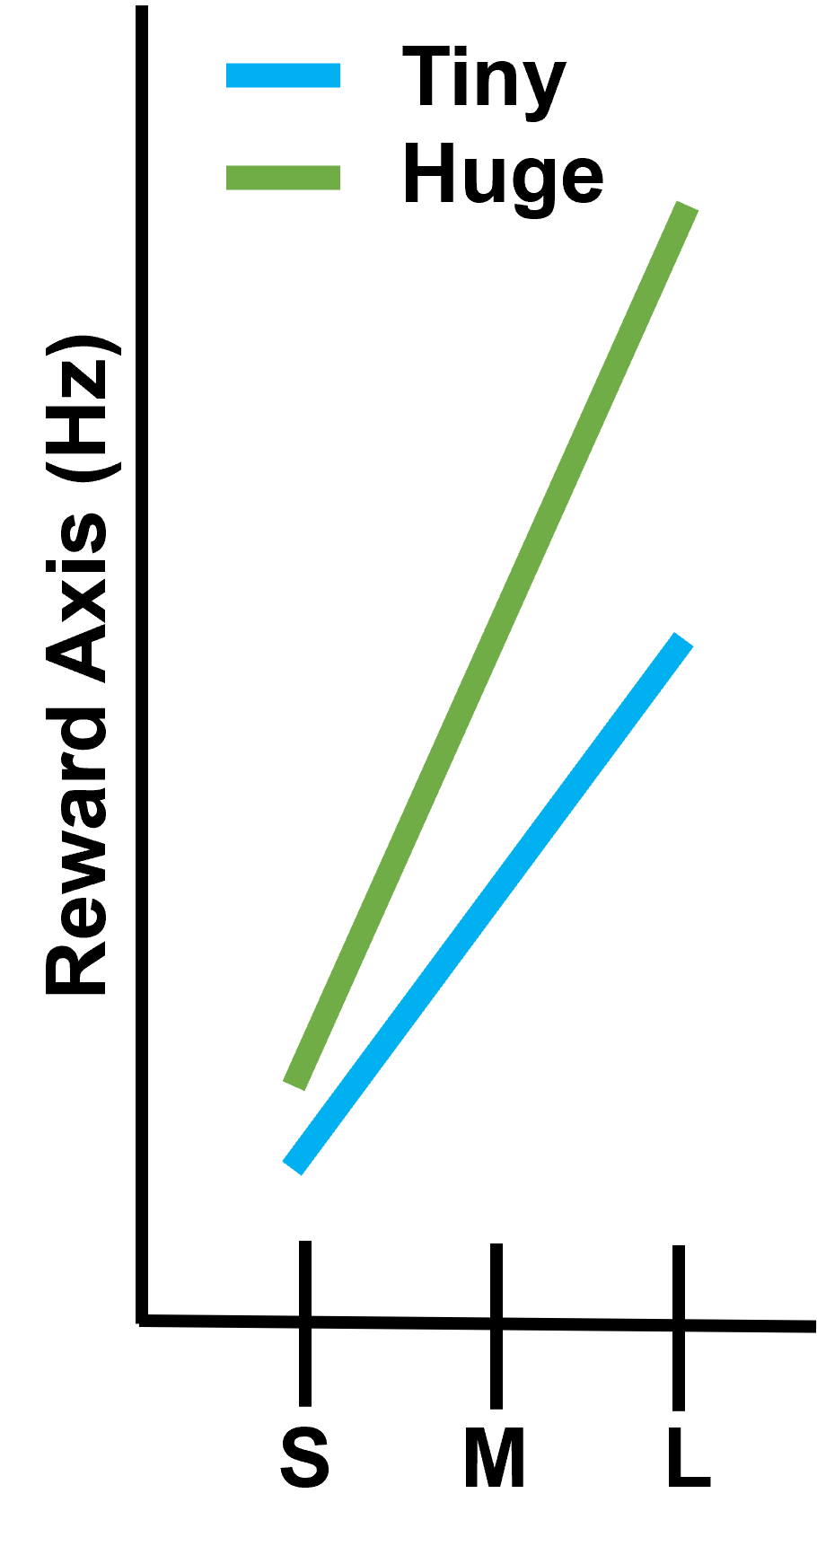
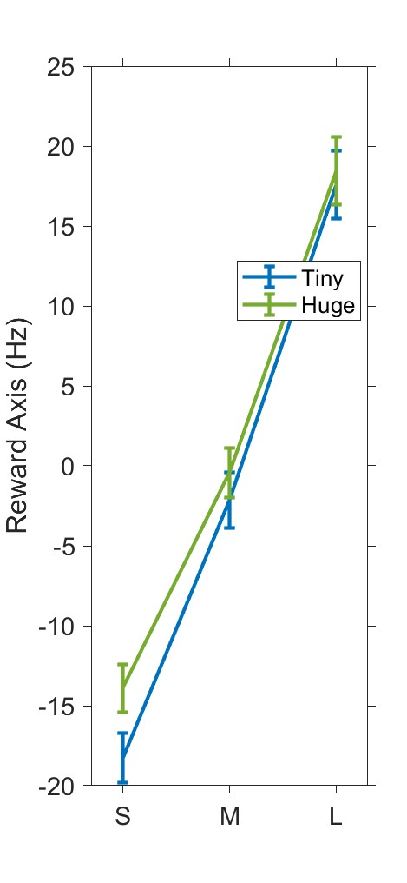
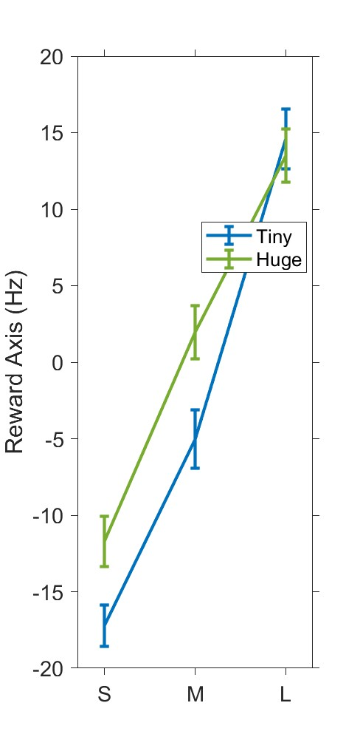
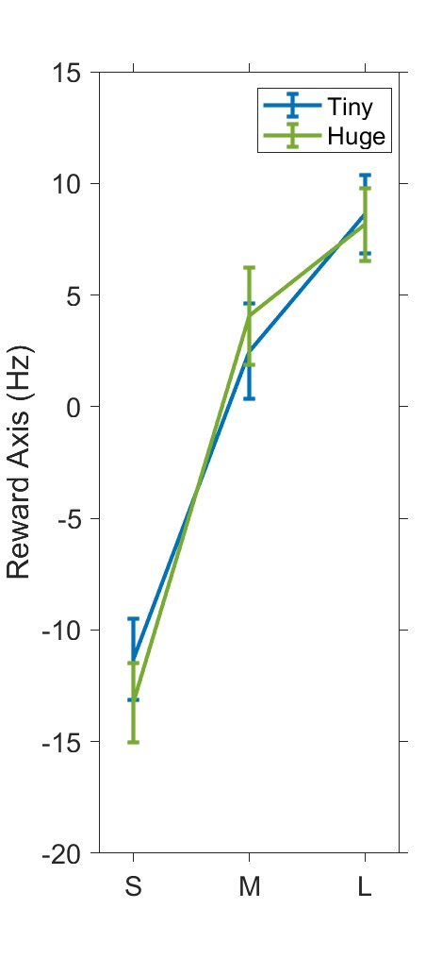
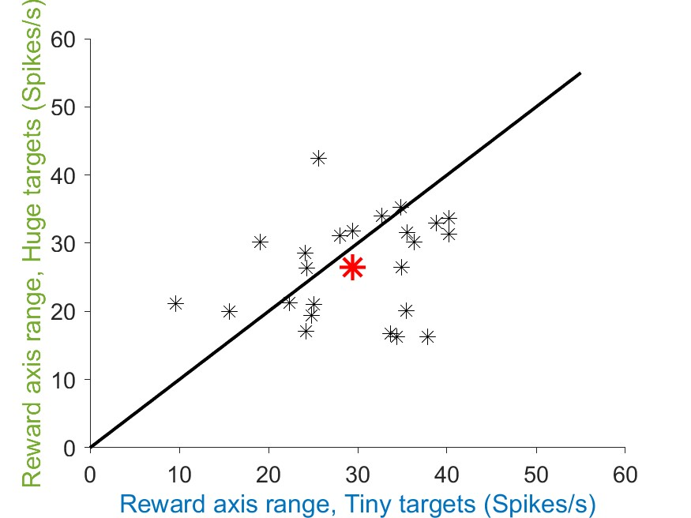
Does Reward Axis around GC show “stretching”?
Method
Get an average of firing rate in each reward condition (nneuron * nreward(3)) around GC [-200 +50]
Get reward Axis from them
We expect
Result
0216
0405
0411

Slide 7
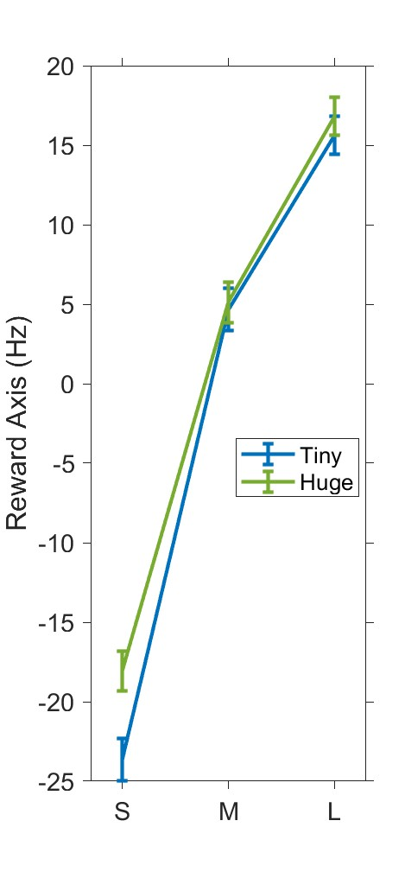
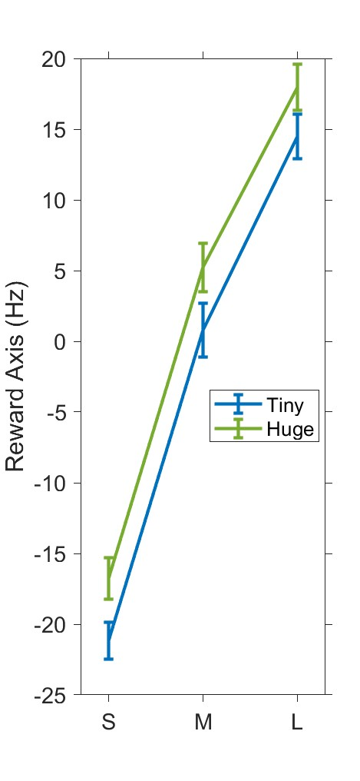
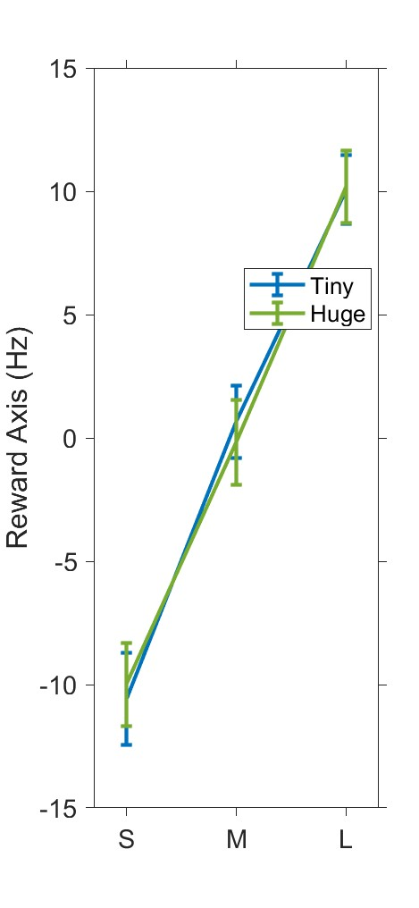
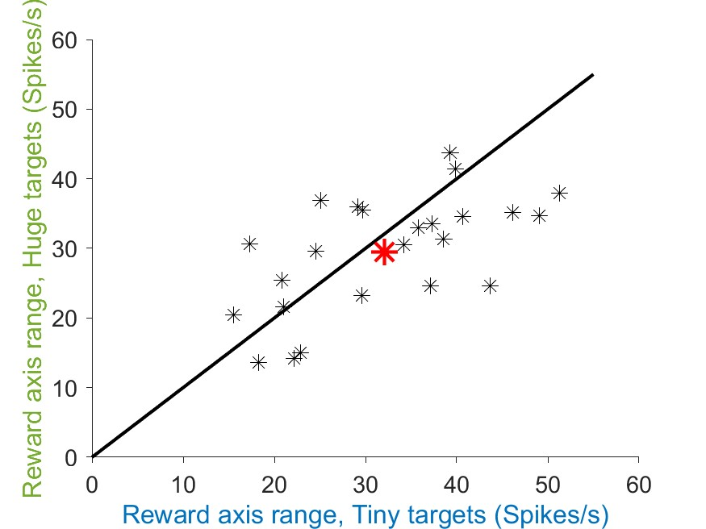
Does Reward Axis after TO show “stretching”?
Method
Get an average of firing rate in each reward condition (nneuron * nreward(3)) after TO[+200 +400]
Get reward Axis from them
We expect
Result
0216
0405
0411

Slide 8
Is Reward Axis and Difficulty Axis orthogonal?
Method
Get an average of firing rate in each reward condition (nneuron * nreward(3)) around GC [-200 +50]
Get reward Axis from them
We expect
Result

