Slide 1
Experiment
All Mixed Days
Experiment date : 20220407~20220413 (4 days)
Monkey : Rocky
Task type : delay reach task
Parameters
Direction : 8 directions
Reward : small (0ul) medium (220ul) large (440ul) rewards cued by shapes inside
Target size : either tiny (6mm rad) or huge (9mm rad)
Blocked Days
Experiment date : 20220414~20220420 (4 days)
Blocked
Tiny-only: 200 trials
Huge-only: 200 trials
Interleaved: 250 trials

Slide 2
Motivation of the analysis
Does the task difficulty in focus task alter the M1 reward encoding in the same way we saw in Rocky’s data?
The preliminary results
Stretching
Would be happened if the success rates differ
Intersection in the middle
Wouldn’t be happened since Small reward is not 0 mL
Stretching in Tiny condition after target hold period
Would be happened
Reward Axis and Difficulty Axis was orthogonal

Slide 3
Data change
downsampled from 30 kHz to 1 kHz
Remove noise spikes

Slide 4
Do PSTH of the neurons show monotonic modulation by reward?
Method
Get PSTH in each reward condition around GC [-250 +50]
Get the amount of monotonically modulated neurons
There are 4 types of neurons (S-M significant or not and M-L significant or not)
What I expect
Result
 | %(Num/All)
S-*-M-*-L | 5%(5/96)
S-*-M---L | 7%(7/96)
S---M-*-L | 7%(7/96)
S---M---L | 11%(11/96)
All | 30%(30/96)
 | 0216 | 0405 | 0411
S-*-M-*-L | 5%(5/96) | 5%(5/96) | 5%(5/96)
S-*-M---L | 7%(7/96) | 7%(7/96) | 7%(7/96)
S---M-*-L | 13%(12/96) | 13%(12/96) | 13%(12/96)
S---M---L | 15%(15/96) | 15%(15/96) | 15%(15/96)
All | 40%(39/96) | 40%(39/96) | 40%(39/96)

Slide 5
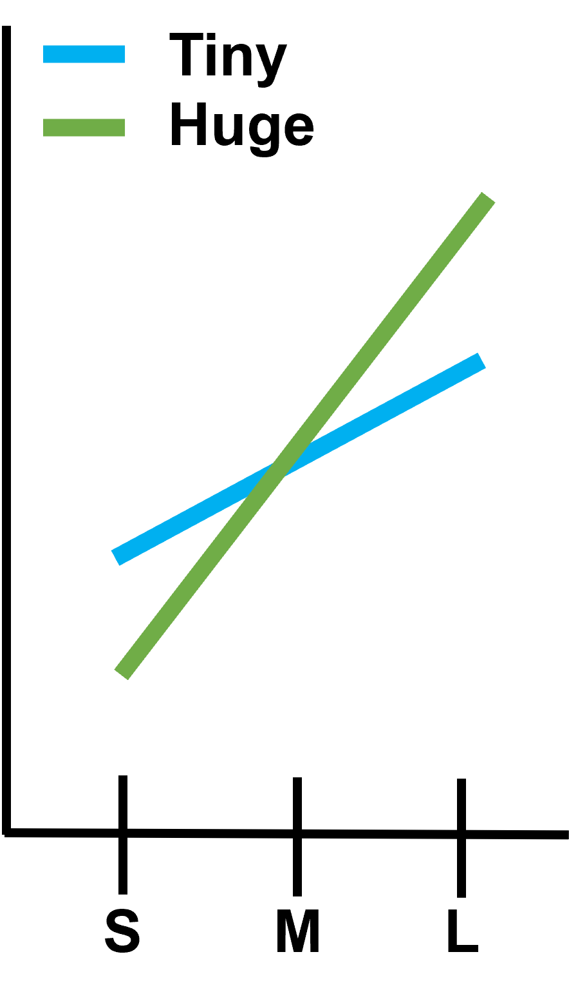
some PSTHs (after TO and around GC)

Slide 6
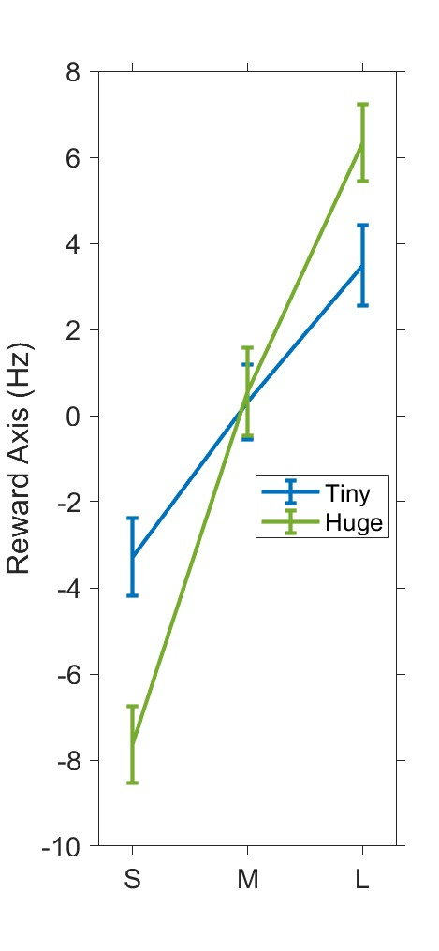
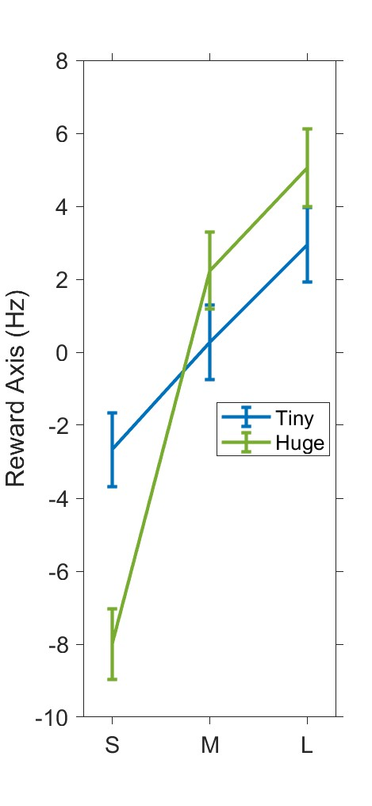
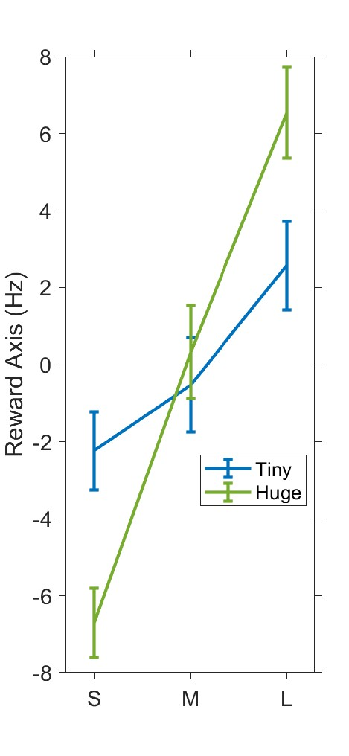
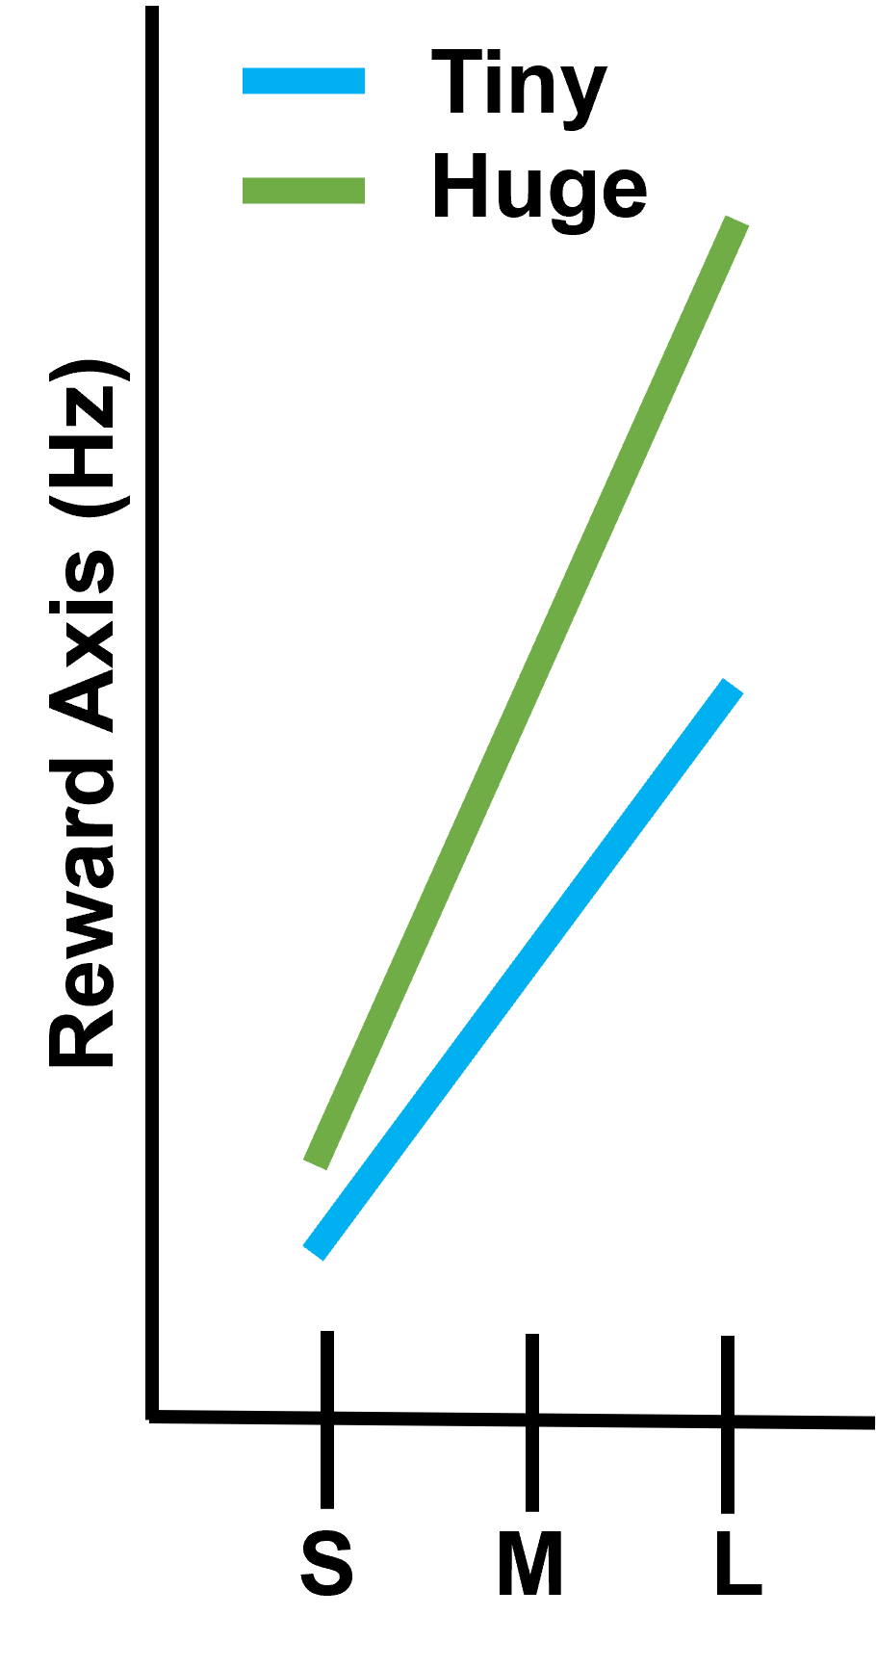
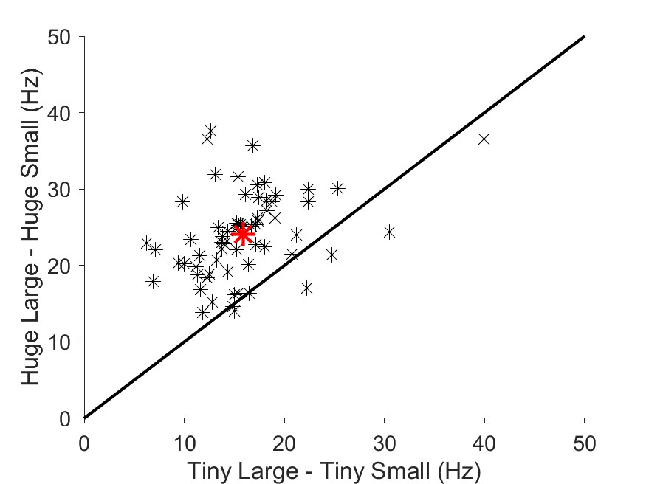
Does Reward Axis around GC show “stretching”?
Method
Get an average of firing rate in each reward condition (nneuron * nreward(3)) around GC [-200 +50]
Get reward Axis from them
We expect
Result
0216
0405
0411

Slide 7
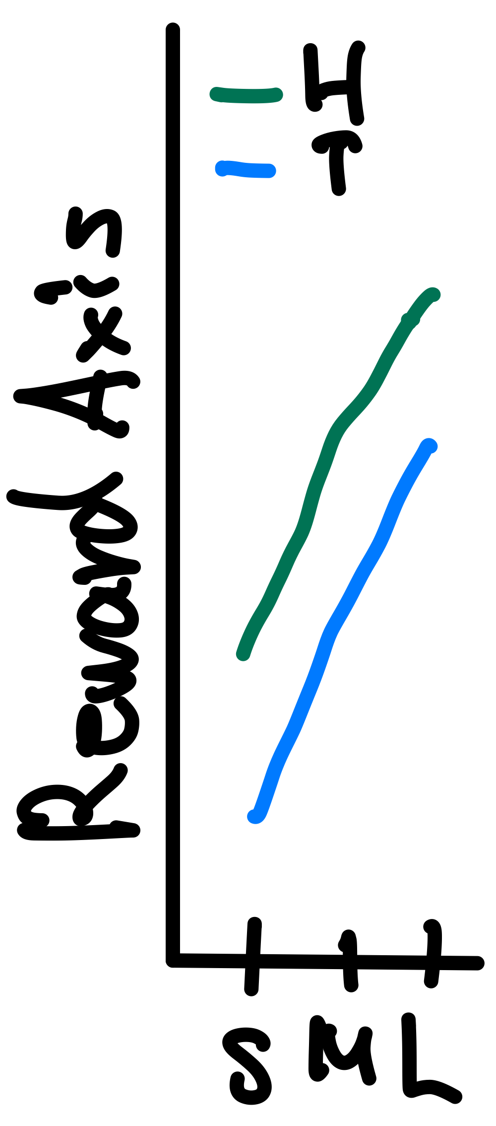
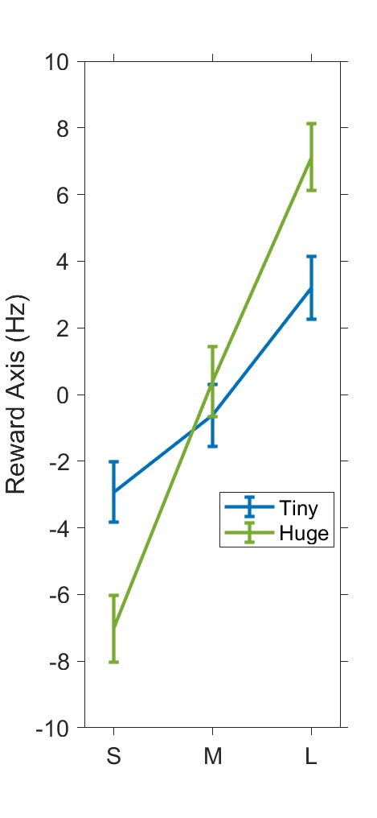
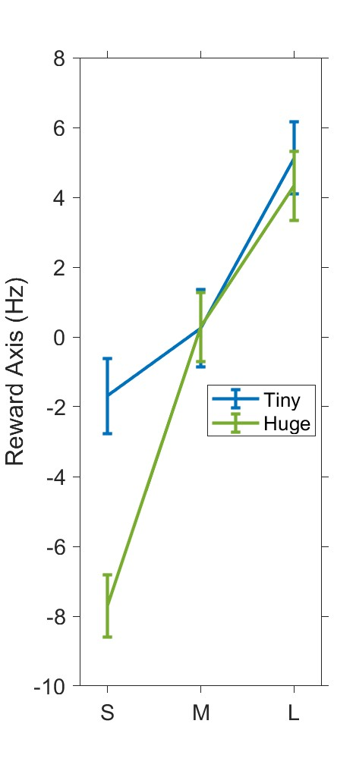
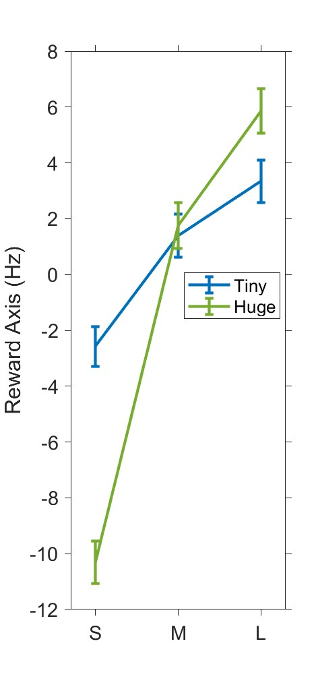
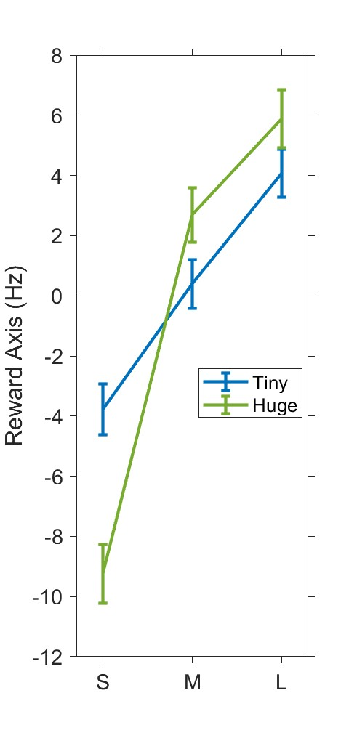
Is Reward Axis and Difficulty Axis orthogonal?
Method
Get an average of firing rate in each reward condition (nneuron * nreward(3)) after TO 150-350 ms
Get reward Axis from them
We expect
Result
0408
0412
0413
0414
0415
0419
0420
Conclusion: The slope is bigger in Easy Condition

