Slide 1
MSCIT 5210: Knowledge Discovery and Data Mining
Acknowledgement: Slides modified by Dr. Lei Chen based on the slides provided by Pang-Ning Tan,
Michael Steinbach,Vipin Kumar, Jiawei Han, Micheline Kamber, and Jian Pei

Slide 2
Chapter 12. Outlier Analysis
Outlier and Outlier Analysis
Outlier Detection Methods
Statistical Approaches
Proximity-Base Approaches
Clustering-Base Approaches
Classification Approaches
Outlier Detection in High Dimensional Data
Summary

Slide 3

What Are Outliers?
Outlier: A data object that deviates significantly from the normal objects as if it were generated by a different mechanism
  Ex.: Unusual credit card purchase, sports: Michael Jordon, Wayne Gretzky, ...
Outliers are different from the noise data
  Noise is random error or variance in a measured variable
  Noise should be removed before outlier detection
Outliers are interesting: It violates the mechanism that generates the normal data
Outlier detection vs. novelty detection: early stage, outlier; but later merged into the model
Applications:
  Credit card fraud detection
  Telecom fraud detection
  Customer segmentation
  Medical analysis

Slide 4
Types of Outliers (I)
Three kinds: global, contextual and collective outliers
Global outlier (or point anomaly)
  Object is O_{g} if it significantly deviates from the rest of the data set
  Ex. Intrusion detection in computer networks
  Issue: Find an appropriate measurement of deviation
Contextual outlier (or conditional outlier)
  Object is O_{c} if it deviates significantly based on a selected context
  Ex. 80º F in Urbana: outlier? (depending on summer or winter?)
  Attributes of data objects should be divided into two groups
    Contextual attributes: defines the context, e.g., time & location
    Behavioral attributes: characteristics of the object, used in outlier evaluation, e.g., temperature
  Can be viewed as a generalization of local outliers—whose density significantly deviates from its local area
  Issue: How to define or formulate meaningful context?
Global Outlier

Slide 5

Types of Outliers (II)
Collective Outliers
  A subset of data objects collectively deviate significantly from the whole data set, even if the individual data objects may not be outliers
  Applications: E.g., intrusion detection:
    When a number of computers keep sending denial-of-service packages to each other
Collective Outlier
  Detection of collective outliers
    Consider not only behavior of individual objects, but also that of groups of objects
    Need to have the background knowledge on the relationship among data objects, such as a distance or similarity measure on objects.
A data set may have multiple types of outlier
One object may belong to more than one type of outlier

Slide 6
Challenges of Outlier Detection
Modeling normal objects and outliers properly
  Hard to enumerate all possible normal behaviors in an application
  The border between normal and outlier objects is often a gray area
Application-specific outlier detection
  Choice of distance measure among objects and the model of relationship among objects are often application-dependent
  E.g., clinic data: a small deviation could be an outlier; while in marketing analysis, larger fluctuations
Handling noise in outlier detection
  Noise may distort the normal objects and blur the distinction between normal objects and outliers. It may help hide outliers and reduce the effectiveness of outlier detection
Understandability
  Understand why these are outliers: Justification of the detection
  Specify the degree of an outlier: the unlikelihood of the object being generated by a normal mechanism

Slide 7
Chapter 12. Outlier Analysis
Outlier and Outlier Analysis
Outlier Detection Methods
Statistical Approaches
Proximity-Base Approaches
Clustering-Base Approaches
Classification Approaches
Mining Contextual and Collective Outliers
Outlier Detection in High Dimensional Data
Summary

Slide 8
Outlier Detection I: Supervised Methods
Two ways to categorize outlier detection methods:
  Based on whether user-labeled examples of outliers can be obtained:
    Supervised, semi-supervised vs. unsupervised methods
  Based on assumptions about normal data and outliers:
    Statistical, proximity-based, and clustering-based methods
Outlier Detection I: Supervised Methods
  Modeling outlier detection as a classification problem
    Samples examined by domain experts used for training & testing
  Methods for Learning a classifier for outlier detection effectively:
    Model normal objects & report those not matching the model as outliers, or
    Model outliers and treat those not matching the model as normal
  Challenges
    Imbalanced classes, i.e., outliers are rare: Boost the outlier class and make up some artificial outliers
    Catch as many outliers as possible, i.e., recall is more important than accuracy (i.e., not mislabeling normal objects as outliers)

Slide 9
Outlier Detection II: Unsupervised Methods
Assume the normal objects are somewhat ``clustered'‘ into multiple groups, each having some distinct features
An outlier is expected to be far away from any groups of normal objects
Weakness: Cannot detect collective outlier effectively
  Normal objects may not share any strong patterns, but the collective outliers may share high similarity in a small area
Ex. In some intrusion or virus detection, normal activities are diverse
  Unsupervised methods may have a high false positive rate but still miss many real outliers.
  Supervised methods can be more effective, e.g., identify attacking some key resources
Many clustering methods can be adapted for unsupervised methods
  Find clusters, then outliers: not belonging to any cluster
  Problem 1: Hard to distinguish noise from outliers
  Problem 2: Costly since first clustering: but far less outliers than normal objects
    Newer methods: tackle outliers directly

Slide 10
Outlier Detection III: Semi-Supervised Methods
Situation: In many applications, the number of labeled data is often small: Labels could be on outliers only, normal objects only, or both
Semi-supervised outlier detection: Regarded as applications of semi-supervised learning
If some labeled normal objects are available
  Use the labeled examples and the proximate unlabeled objects to train a model for normal objects
  Those not fitting the model of normal objects are detected as outliers
If only some labeled outliers are available, a small number of labeled outliers may not cover the possible outliers well
  To improve the quality of outlier detection, one can get help from models for normal objects learned from unsupervised methods

Slide 11
Outlier Detection (1): Statistical Methods
Statistical methods (also known as model-based methods) assume that the normal data follow some statistical model (a stochastic model)
  The data not following the model are outliers.
Example (right figure): First use Gaussian distribution to model the normal data
  For each object y in region R, estimate g_{D}(y), the probability of y fits the Gaussian distribution
  If g_{D}(y) is very low, y is unlikely generated by the Gaussian model, thus an outlier
Effectiveness of statistical methods: highly depends on whether the assumption of statistical model holds in the real data
There are rich alternatives to use various statistical models
  E.g., parametric vs. non-parametric

Slide 12
Outlier Detection (2): Proximity-Based Methods
An object is an outlier if the nearest neighbors of the object are far away, i.e., the proximity of the object is significantly deviates from the proximity of most of the other objects in the same data set
Example (right figure): Model the proximity of an object using its 3 nearest neighbors
  Objects in region R are substantially different from other objects in the data set.
  Thus the objects in R are outliers
The effectiveness of proximity-based methods highly relies on the proximity measure.
In some applications, proximity or distance measures cannot be obtained easily.
Often have a difficulty in finding a group of outliers which stay close to each other
Two major types of proximity-based outlier detection
  Distance-based vs. density-based

Slide 13
Outlier Detection (3): Clustering-Based Methods
Normal data belong to large and dense clusters, whereas outliers belong to small or sparse clusters, or do not belong to any clusters
Example (right figure): two clusters
  All points not in R form a large cluster
  The two points in R form a tiny cluster, thus are outliers
Since there are many clustering methods, there are many clustering-based outlier detection methods as well
Clustering is expensive: straightforward adaption of a clustering method for outlier detection can be costly and does not scale up well for large data sets

Slide 14
Chapter 12. Outlier Analysis
Outlier and Outlier Analysis
Outlier Detection Methods
Statistical Approaches
Proximity-Base Approaches
Clustering-Base Approaches
Classification Approaches
Outlier Detection in High Dimensional Data
Summary

Slide 15
Statistical Approaches
Statistical approaches assume that the objects in a data set are generated by a stochastic process (a generative model)
Idea: learn a generative model fitting the given data set, and then identify the objects in low probability regions of the model as outliers
Methods are divided into two categories: parametric vs. non-parametric
Parametric method
  Assumes that the normal data is generated by a parametric distribution with parameter θ
  The probability density function of the parametric distribution f(x, θ) gives the probability that object x is generated by the distribution
  The smaller this value, the more likely x is an outlier
Non-parametric method
  Not assume an a-priori statistical model and determine the model from the input data
  Not completely parameter free but consider the number and nature of the parameters are flexible and not fixed in advance
  Examples: histogram and kernel density estimation

Slide 16




Parametric Methods I: Detection Univariate Outliers Based on Normal Distribution
Univariate data: A data set involving only one attribute or variable
Often assume that data are generated from a normal distribution, learn the parameters from the input data, and identify the points with low probability as outliers
Ex: Avg. temp.: {24.0, 28.9, 28.9, 29.0, 29.1, 29.1, 29.2, 29.2, 29.3, 29.4}
  Use the maximum likelihood method to estimate μ and σ
  Taking derivatives with respect to μ and σ², we derive the following maximum likelihood estimates
  For the above data with n = 10, we have
  Then (24 – 28.61) /1.51 = – 3.04 < –3, 24 is an outlier since

Slide 17

Outlier Discovery: Statistical Approaches
Assume a model underlying distribution that generates data set (e.g. normal distribution)
Use discordancy tests depending on
  data distribution
  distribution parameter (e.g., mean, variance)
  number of expected outliers
Drawbacks
  most tests are for single attribute
  In many cases, data distribution may not be known

Slide 18
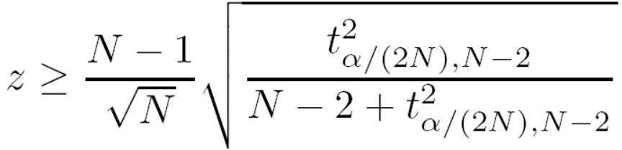

Parametric Methods I: The Grubb’s Test
Univariate outlier detection: The Grubb's test (maximum normed residual test) ─ another statistical method under normal distribution
  For each object x in a data set, compute its z-score: x is an outlier if
    where is the value taken by a t-distribution at a significance level of α/(2N), and N is the # of objects in the data set

Slide 19

Parametric Methods II: Detection of Multivariate Outliers
Multivariate data: A data set involving two or more attributes or variables
Transform the multivariate outlier detection task into a univariate outlier detection problem
Method 1. Compute Mahalaobis distance
  Let ō be the mean vector for a multivariate data set. Mahalaobis distance for an object o to ō is MDist(o, ō) = (o – ō )^{T} S ^{–1}(o – ō) where S is the covariance matrix
  Use the Grubb's test on this measure to detect outliers
Method 2. Use χ² –statistic:
  where E_{i} is the mean of the i-dimension among all objects, and n is the dimensionality
  If χ² –statistic is large, then object o_{i} is an outlier

Slide 20
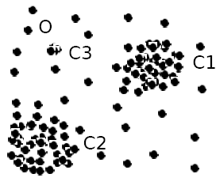
Parametric Methods III: Using Mixture of Parametric Distributions
Assuming data generated by a normal distribution could be sometimes overly simplified
Example (right figure): The objects between the two clusters cannot be captured as outliers since they are close to the estimated mean
To overcome this problem, assume the normal data is generated by two normal distributions. For any object o in the data set, the probability that o is generated by the mixture of the two distributions is given by
  where f_{θ1} and f_{θ2} are the probability density functions of θ₁ and θ₂
Then use EM algorithm to learn the parameters μ₁, σ₁, μ₂, σ₂ from data
An object o is an outlier if it does not belong to any cluster

Slide 21
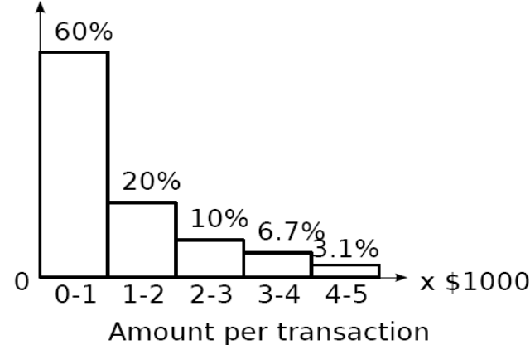
Non-Parametric Methods: Detection Using Histogram
The model of normal data is learned from the input data without any a priori structure.
Often makes fewer assumptions about the data, and thus can be applicable in more scenarios
Outlier detection using histogram:
  Figure shows the histogram of purchase amounts in transactions
  A transaction in the amount of $7,500 is an outlier, since only 0.2% transactions have an amount higher than $5,000
Problem: Hard to choose an appropriate bin size for histogram
  Too small bin size → normal objects in empty/rare bins, false positive
  Too big bin size → outliers in some frequent bins, false negative
Solution: Adopt kernel density estimation to estimate the probability density distribution of the data. If the estimated density function is high, the object is likely normal. Otherwise, it is likely an outlier.

Slide 22
Chapter 12. Outlier Analysis
Outlier and Outlier Analysis
Outlier Detection Methods
Statistical Approaches
Proximity-Base Approaches
Clustering-Base Approaches
Classification Approaches
Mining Contextual and Collective Outliers
Outlier Detection in High Dimensional Data
Summary

Slide 23
Proximity-Based Approaches: Distance-Based vs. Density-Based Outlier Detection
Intuition: Objects that are far away from the others are outliers
Assumption of proximity-based approach: The proximity of an outlier deviates significantly from that of most of the others in the data set
Two types of proximity-based outlier detection methods
  Distance-based outlier detection: An object o is an outlier if its neighborhood does not have enough other points
  Density-based outlier detection: An object o is an outlier if its density is relatively much lower than that of its neighbors

Slide 24
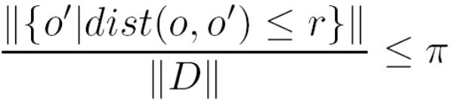

Distance-Based Outlier Detection
For each object o, examine the # of other objects in the r-neighborhood of o, where r is a user-specified distance threshold
An object o is an outlier if most (taking π as a fraction threshold) of the objects in D are far away from o, i.e., not in the r-neighborhood of o
An object o is a DB(r, π) outlier if
Equivalently, one can check the distance between o and its k-th nearest neighbor o_{k}, where . o is an outlier if dist(o, o_{k}) > r
Efficient computation: Nested loop algorithm
  For any object o_{i}, calculate its distance from other objects, and count the # of other objects in the r-neighborhood.
  If π∙n other objects are within r distance, terminate the inner loop
  Otherwise, o_{i} is a DB(r, π) outlier
Efficiency: Actually CPU time is not O(n²) but linear to the data set size since for most non-outlier objects, the inner loop terminates early

Slide 25
Outlier Discovery: Distance-Based Approach
Introduced to counter the main limitations imposed by statistical methods
  We need multi-dimensional analysis without knowing data distribution
Distance-based outlier: A DB(p, D)-outlier is an object O in a dataset T such that at least a fraction p of the objects in T lies at a distance greater than D from O
Algorithms for mining distance-based outliers [Knorr & Ng, VLDB’98]
  Index-based algorithm
  Nested-loop algorithm
  Cell-based algorithm

Slide 26
Index-based Algorithm [KN98]
Indexing Structures such as R-tree (R+-tree), K-D (K-D-B) tree are built for the multi-dimensional database
The index is used to search for neighbors of each object O within radius D around that object.
Once K (K = N(1-p)) neighbors of object O are found, O is not an outlier.
Worst-case computation complexity is O(K*n²), K is the dimensionality and n is the number of objects in the dataset.
Pros: scale well with K
Cons: the index construction process may cost much time

Slide 27
Nested-loop Algorithm [KN98]
Divides the buffer space into two halves (first and second arrays)
Break data into blocks and then feed two blocks into the arrays.
Directly computes the distance between each pair of objects, inside the array or between arrays
Decide the outlier.
Here comes an example:…
Same computational complexity as the index-based algorithm
Pros: Avoid index structure construction
Try to minimize the I/Os

Slide 28
Example – stage 1
Buffer
DB
A is the target block on stage 1
Load A into the first array (1R)
Load B into the second array (1R)
Load C into the second array (1R)
Load D into the second array (1R)
Total: 4 Reads
A
B
A | B
C | D
Starting Point of Stage 1
A
D
A | B
C | D
End Point of Stage 1

Slide 29
Example – stage 2
Example
Buffer
DB
D is the target block on stage 2
D is already in the buffer (no R)
A is already in the buffer (no R)
Load B into the first array (1R)
Load C into the first array (1R)
Total: 2 Reads
A
D
A | B
C | D
Starting Point of Stage 2
C
D
A | B
C | D
End Point of Stage 2

Slide 30
Example – stage 3
Buffer
DB
C is the target block on stage 3
C is already in the buffer (no R)
D is already in the buffer (no R)
Load A into the second array (1R)
Load B into the second array (1R)
Total: 2 Reads
C
D
A | B
C | D
Starting Point of Stage 3
C
B
A | B
C | D
End Point of Stage 3

Slide 31
Example – stage 4
Example
Buffer
DB
B is the target block on stage 4
B is already in the buffer (no R)
C is already in the buffer (no R)
Load A into the first array (1R)
Load D into the first array (1R)
Total: 2 Reads
Every block is ¼ of the DB. From stage 1-4, a grand total of 10 blocks are read, amounting to 10/4 passes over the entire dataset.
C
B
A | B
C | D
Starting Point of Stage 4
D
B
A | B
C | D
End Point of Stage 4

Slide 32

Cell-Based Algorithm [KN98]
Divide the dataset into cells with length
  K is the dimensionality, D is the distance
Define Layer-1 neighbors – all the intermediate neighbor cells. The maximum distance between a cell and its neighbor cells is D
Define Layer-2 neighbors – the cells within 3 cell of a certain cell. The minimum distance between a cell and the cells outside of Layer-2 neighbors is D
Criteria
  Search a cell internally. If there are M objects inside, all the objects in this cell are not outlier
  Search its layer-1 neighbors. If there are M objects inside a cell and its layer-1 neighbors, all the objects in this cell are not outlier
  Search its layer-2 neighbors. If there are less than M objects inside a cell, its layer-1 neighbor cells, and its layer-2 neighbor cells, all the objects in this cell are outlier
  Otherwise, the objects in this cell could be outlier, and then need to calculate the distance between the objects in this cell and the objects in the cells in the layer-2 neighbor cells to see whether the total points within D distance is more than M or not.
An example

Slide 33
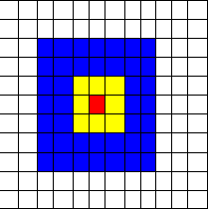
Example
Red – A certain cell
Yellow – Layer-1 Neighbor Cells
Blue – Layer-2 Neighbor Cells
Notes:
The maximum distance between a point in the red cell and a point In its layer-1 neighbor cells is D
The minimum distance between
A point in the red cell and a point outside its layer-2 neighbor cells is D

Slide 34
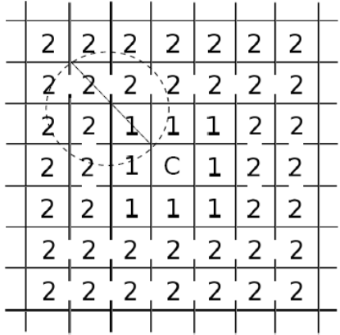
Distance-Based Outlier Detection: A Grid-Based Method
Why efficiency is still a concern? When the complete set of objects cannot be held into main memory, cost I/O swapping
The major cost: (1) each object tests against the whole data set, why not only its close neighbor? (2) check objects one by one, why not group by group?
Grid-based method (CELL): Data space is partitioned into a multi-D grid. Each cell is a hyper cube with diagonal length r/2
Pruning using the level-1 & level 2 cell properties:
  For any possible point x in cell C and any possible point y in a level-1 cell, dist(x,y) ≤ r
  For any possible point x in cell C and any point y such that dist(x,y) ≥ r, y is in a level-2 cell
Thus we only need to check the objects that cannot be pruned, and even for such an object o, only need to compute the distance between o and the objects in the level-2 cells (since beyond level-2, the distance from o is more than r)

Slide 35
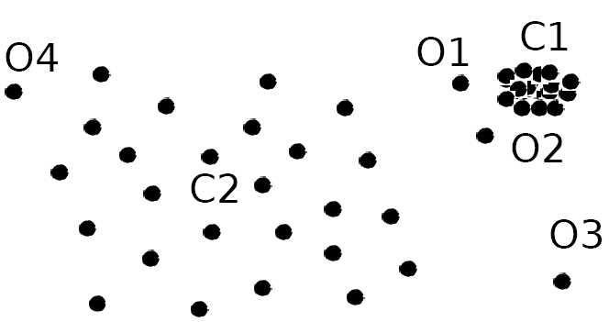
Density-Based Outlier Detection
Local outliers: Outliers comparing to their local neighborhoods, instead of the global data distribution
In Fig., o₁ and o2 are local outliers to C₁, o₃ is a global outlier, but o₄ is not an outlier. However, proximity-based clustering cannot find o₁ and o₂ are outlier (e.g., comparing with O₄).
Intuition (density-based outlier detection): The density around an outlier object is significantly different from the density around its neighbors
Method: Use the relative density of an object against its neighbors as the indicator of the degree of the object being outliers
k-distance of an object o, dist_{k}(o): distance between o and its k-th NN
k-distance neighborhood of o, N_{k}(o) = {o’| o’ in D, dist(o, o’) ≤ dist_{k}(o)}
  N_{k}(o) could be bigger than k since multiple objects may have identical distance to o

Slide 36
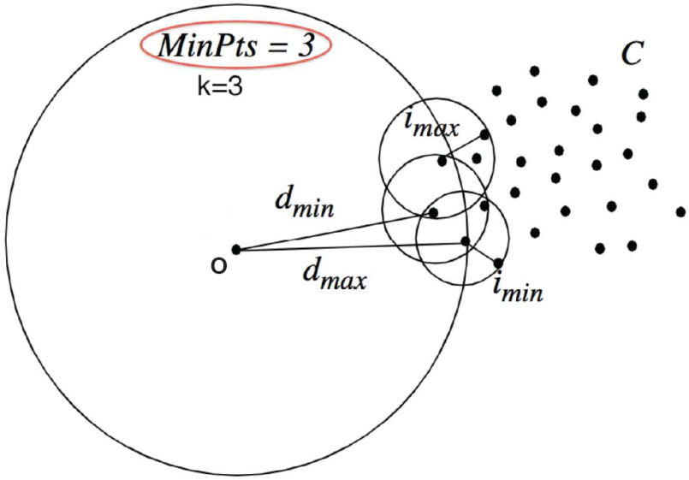
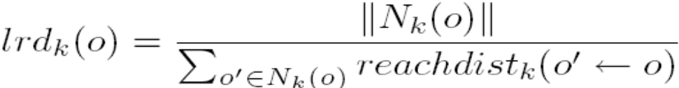
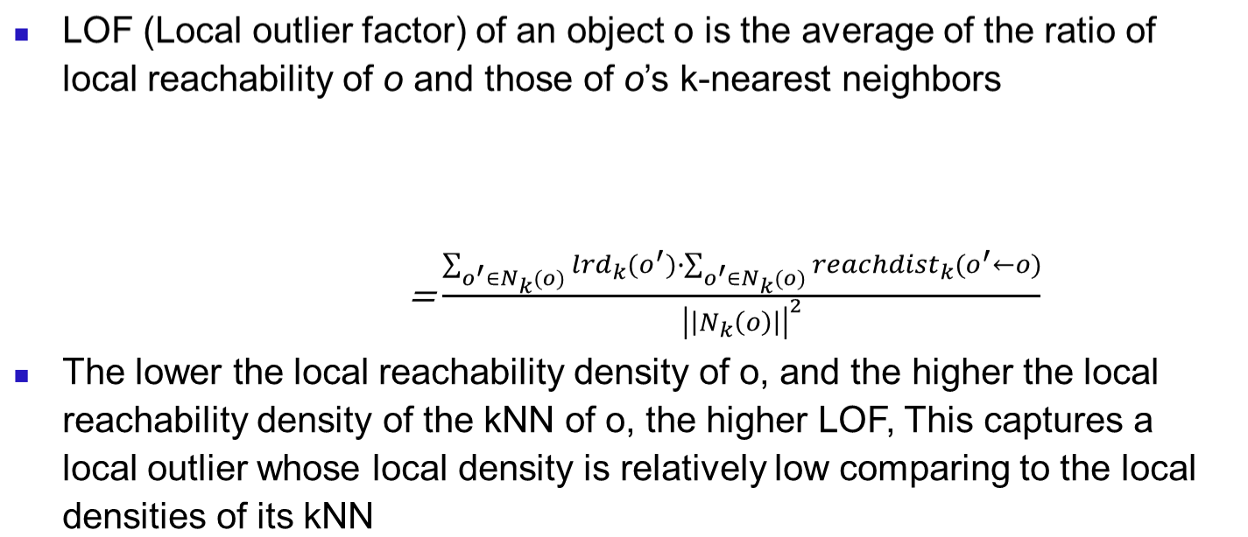
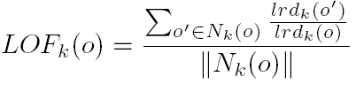
Local Outlier Factor: LOF
Reachability distance from o’ to o:
  where k is a user-specified parameter
Local reachability density of o:

Slide 37
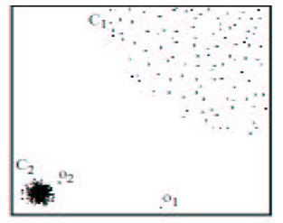
Density-Based Local Outlier Detection
M. M. Breunig, H.-P. Kriegel, R. Ng, J. Sander. LOF: Identifying Density-Based Local Outliers. SIGMOD 2000.
Distance-based outlier detection is based on global distance distribution
It encounters difficulties to identify outliers if data is not uniformly distributed
Ex. C₁ contains 400 loosely distributed points, C₂ has 100 tightly condensed points, 2 outlier points o₁, o₂
Distance-based method cannot identify o₂ as an outlier
Need the concept of local outlier
Local outlier factor (LOF)
  Assume outlier is not crisp
  Each point has a LOF

Slide 38
Chapter 12. Outlier Analysis
Outlier and Outlier Analysis
Outlier Detection Methods
Statistical Approaches
Proximity-Base Approaches
Clustering-Base Approaches
Classification Approaches
Mining Contextual and Collective Outliers
Outlier Detection in High Dimensional Data
Summary

Slide 39
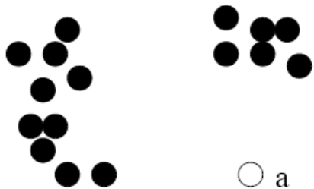
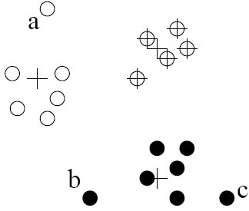
Clustering-Based Outlier Detection (1 & 2):
Not belong to any cluster, or far from the closest one
An object is an outlier if (1) it does not belong to any cluster, (2) there is a large distance between the object and its closest cluster , or (3) it belongs to a small or sparse cluster
Case I: Not belong to any cluster
  Identify animals not part of a flock: Using a density-based clustering method such as DBSCAN
Case 2: Far from its closest cluster
  Using k-means, partition data points of into clusters
  For each object o, assign an outlier score based on its distance from its closest center
    If dist(o, c_{o})/avg_dist(c_{o}) is large, likely an outlier
Ex. Intrusion detection: Consider the similarity between data points and the clusters in a training data set
  Use a training set to find patterns of “normal” data, e.g., frequent itemsets in each segment, and cluster similar connections into groups
  Compare new data points with the clusters mined—Outliers are possible attacks

Slide 40
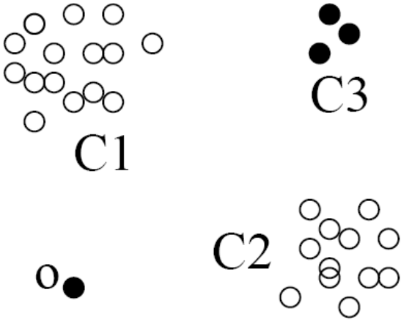
Clustering-Based Outlier Detection (3):
Detecting Outliers in Small Clusters
FindCBLOF: Detect outliers in small clusters
  Find clusters, and sort them in decreasing size
  To each data point, assign a cluster-based local outlier factor (CBLOF):
  If obj p belongs to a large cluster, CBLOF = cluster_size X similarity between p and cluster
  If p belongs to a small one, CBLOF = cluster size X similarity betw. p and the closest large cluster
Ex. In the figure, o is outlier since its closest large cluster is C₁, but the similarity between o and C₁ is small. For any point in C₃, its closest large cluster is C₂ but its similarity from C₂ is low, plus |C₃| = 3 is small

Slide 41
Clustering-Based Method: Strength and Weakness
Strength
  Detect outliers without requiring any labeled data
  Work for many types of data
  Clusters can be regarded as summaries of the data
  Once the cluster are obtained, need only compare any object against the clusters to determine whether it is an outlier (fast)
Weakness
  Effectiveness depends highly on the clustering method used—they may not be optimized for outlier detection
  High computational cost: Need to first find clusters
  A method to reduce the cost: Fixed-width clustering
    A point is assigned to a cluster if the center of the cluster is within a pre-defined distance threshold from the point
    If a point cannot be assigned to any existing cluster, a new cluster is created and the distance threshold may be learned from the training data under certain conditions

Slide 42
Chapter 12. Outlier Analysis
Outlier and Outlier Analysis
Outlier Detection Methods
Statistical Approaches
Proximity-Base Approaches
Clustering-Base Approaches
Classification Approaches
Outlier Detection in High Dimensional Data
Summary

Slide 43
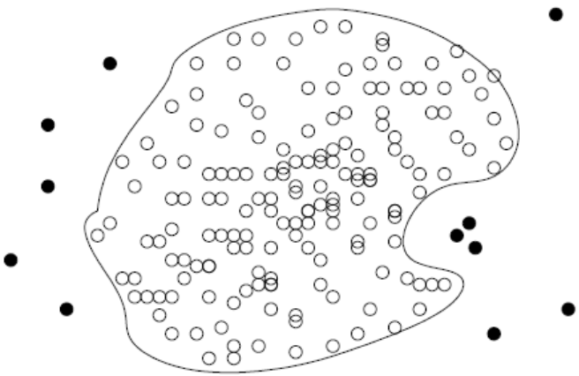
Classification-Based Method I: One-Class Model
Idea: Train a classification model that can distinguish “normal” data from outliers
A brute-force approach: Consider a training set that contains samples labeled as “normal” and others labeled as “outlier”
  But, the training set is typically heavily biased: # of “normal” samples likely far exceeds # of outlier samples
  Cannot detect unseen anomaly
One-class model: A classifier is built to describe only the normal class.
  Learn the decision boundary of the normal class using classification methods such as SVM
  Any samples that do not belong to the normal class (not within the decision boundary) are declared as outliers
  Adv: can detect new outliers that may not appear close to any outlier objects in the training set
  Extension: Normal objects may belong to multiple classes

Slide 44
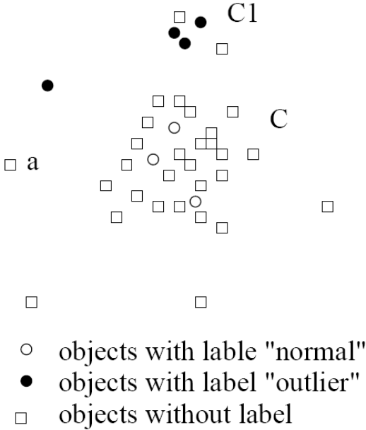
Classification-Based Method II: Semi-Supervised Learning
Semi-supervised learning: Combining classification-based and clustering-based methods
Method
  Using a clustering-based approach, find a large cluster, C, and a small cluster, C₁
  Since some objects in C carry the label “normal”, treat all objects in C as normal
  Use the one-class model of this cluster to identify normal objects in outlier detection
  Since some objects in cluster C₁ carry the label “outlier”, declare all objects in C₁ as outliers
  Any object that does not fall into the model for C (such as a) is considered an outlier as well
Comments on classification-based outlier detection methods
  Strength: Outlier detection is fast
  Bottleneck: Quality heavily depends on the availability and quality of the training set, but often difficult to obtain representative and high-quality training data

Slide 45
Chapter 12. Outlier Analysis
Outlier and Outlier Analysis
Outlier Detection Methods
Statistical Approaches
Proximity-Base Approaches
Clustering-Base Approaches
Classification Approaches
Outlier Detection in High Dimensional Data
Summary

Slide 46
Challenges for Outlier Detection in High-Dimensional Data
Interpretation of outliers
  Detecting outliers without saying why they are outliers is not very useful in high-D due to many features (or dimensions) are involved in a high-dimensional data set
  E.g., which subspaces that manifest the outliers or an assessment regarding the “outlier-ness” of the objects
Data sparsity
  Data in high-D spaces are often sparse
  The distance between objects becomes heavily dominated by noise as the dimensionality increases
Data subspaces
  Adaptive to the subspaces signifying the outliers
  Capturing the local behavior of data
Scalable with respect to dimensionality
  # of subspaces increases exponentially

Slide 47
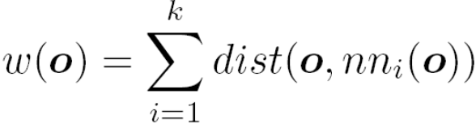
Approach I: Extending Conventional Outlier Detection
Method 1: Detect outliers in the full space, e.g., HilOut Algorithm
  Find distance-based outliers, but use the ranks of distance instead of the absolute distance in outlier detection
  For each object o, find its k-nearest neighbors: nn₁(o), . . . , nn_{k}(o)
  The weight of object o:
  All objects are ranked in weight-descending order
  Top-l objects in weight are output as outliers (l: user-specified parm)
  Employ space-filling curves for approximation: scalable in both time and space w.r.t. data size and dimensionality
Method 2: Dimensionality reduction
  Works only when in lower-dimensionality, normal instances can still be distinguished from outliers
  PCA: Heuristically, the principal components with low variance are preferred because, on such dimensions, normal objects are likely close to each other and outliers often deviate from the majority

Slide 48

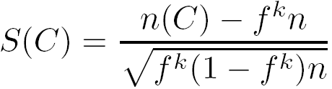
Approach II: Finding Outliers in Subspaces
Extending conventional outlier detection: Hard for outlier interpretation
Find outliers in much lower dimensional subspaces: easy to interpret why and to what extent the object is an outlier
  E.g., find outlier customers in certain subspace: average transaction amount >> avg. and purchase frequency << avg.
Ex. A grid-based subspace outlier detection method
  Project data onto various subspaces to find an area whose density is much lower than average
  Discretize the data into a grid with φ equi-depth (why?) regions
  Search for regions that are significantly sparse
    Consider a k-d cube: k ranges on k dimensions, with n objects
    If objects are independently distributed, the expected number of objects falling into a k-dimensional region is (1/ φ)^{k}n = f^{k}n,the standard deviation is
    The sparsity coefficient of cube C:
    If S(C) < 0, C contains less objects than expected
    The more negative, the sparser C is and the more likely the objects in C are outliers in the subspace

Slide 49
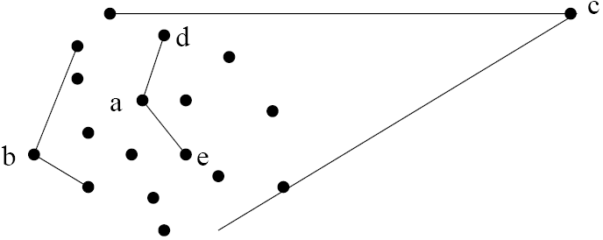
Approach III: Modeling High-Dimensional Outliers
Develop new models for high-dimensional outliers directly
Avoid proximity measures and adopt new heuristics that do not deteriorate in high-dimensional data
A set of points form a cluster except c (outlier)
Ex. Angle-based outliers: Kriegel, Schubert, and Zimek [KSZ08]
For each point o, examine the angle ∆xoy for every pair of points x, y.
  Point in the center (e.g., a), the angles formed differ widely
  An outlier (e.g., c), angle variable is substantially smaller
Use the variance of angles for a point to determine outlier
Combine angles and distance to model outliers
  Use the distance-weighted angle variance as the outlier score
  Angle-based outlier factor (ABOF):
  Efficient approximation computation method is developed
  It can be generalized to handle arbitrary types of data

Slide 50
Chapter 12. Outlier Analysis
Outlier and Outlier Analysis
Outlier Detection Methods
Statistical Approaches
Proximity-Base Approaches
Clustering-Base Approaches
Classification Approaches
Mining Contextual and Collective Outliers
Outlier Detection in High Dimensional Data
Summary

Slide 51
Summary
Types of outliers
  global, contextual & collective outliers
Outlier detection
  supervised, semi-supervised, or unsupervised
Statistical (or model-based) approaches
Proximity-base approaches
Clustering-base approaches
Classification approaches
Outlier detection in high dimensional data

Slide 52
References (I)
B. Abraham and G.E.P. Box. Bayesian analysis of some outlier problems in time series. Biometrika, 66:229–248, 1979.
M. Agyemang, K. Barker, and R. Alhajj. A comprehensive survey of numeric and symbolic outlier mining techniques. Intell. Data Anal., 10:521–538, 2006.
F. J. Anscombe and I. Guttman. Rejection of outliers. Technometrics, 2:123–147, 1960.
D. Agarwal. Detecting anomalies in cross-classified streams: a bayesian approach. Knowl. Inf. Syst., 11:29–44, 2006.
F. Angiulli and C. Pizzuti. Outlier mining in large high-dimensional data sets. TKDE, 2005.
C. C. Aggarwal and P. S. Yu. Outlier detection for high dimensional data. SIGMOD’01
R.J. Beckman and R.D. Cook. Outlier...s. Technometrics, 25:119–149, 1983.
I. Ben-Gal. Outlier detection. In Maimon O. and Rockach L. (eds.) Data Mining and Knowledge Discovery Handbook: A Complete Guide for Practitioners and Researchers, Kluwer Academic, 2005.
M. M. Breunig, H.-P. Kriegel, R. Ng, and J. Sander. LOF: Identifying density-based local outliers. SIGMOD’00
D. Barbar´a, Y. Li, J. Couto, J.-L. Lin, and S. Jajodia. Bootstrapping a data mining intrusion detection system. SAC’03
Z. A. Bakar, R. Mohemad, A. Ahmad, and M. M. Deris. A comparative study for outlier detection techniques in data mining. IEEE Conf. on Cybernetics and Intelligent Systems, 2006.
S. D. Bay and M. Schwabacher. Mining distance-based outliers in near linear time with randomization and a simple pruning rule. KDD’03
D. Barbara, N. Wu, and S. Jajodia. Detecting novel network intrusion using bayesian estimators. SDM’01
V. Chandola, A. Banerjee, and V. Kumar. Anomaly detection: A survey. ACM Computing Surveys, 41:1–58, 2009.
D. Dasgupta and N.S. Majumdar. Anomaly detection in multidimensional data using negative selection algorithm. In CEC’02

Slide 53
References (2)
E. Eskin, A. Arnold, M. Prerau, L. Portnoy, and S. Stolfo. A geometric framework for unsupervised anomaly detection: Detecting intrusions in unlabeled data. In Proc. 2002 Int. Conf. of Data Mining for Security Applications, 2002.
E. Eskin. Anomaly detection over noisy data using learned probability distributions. ICML’00
T. Fawcett and F. Provost. Adaptive fraud detection. Data Mining and Knowledge Discovery, 1:291–316, 1997.
V. J. Hodge and J. Austin. A survey of outlier detection methdologies. Artif. Intell. Rev., 22:85–126, 2004.
D. M. Hawkins. Identification of Outliers. Chapman and Hall, London, 1980.
Z. He, X. Xu, and S. Deng. Discovering cluster-based local outliers. Pattern Recogn. Lett., 24, June, 2003.
W. Jin, K. H. Tung, and J. Han. Mining top-n local outliers in large databases. KDD’01
W. Jin, A. K. H. Tung, J. Han, and W. Wang. Ranking outliers using symmetric neighborhood relationship. PAKDD’06
E. Knorr and R. Ng. A unified notion of outliers: Properties and computation. KDD’97
E. Knorr and R. Ng. Algorithms for mining distance-based outliers in large datasets. VLDB’98
E. M. Knorr, R. T. Ng, and V. Tucakov. Distance-based outliers: Algorithms and applications. VLDB J., 8:237–253, 2000.
H.-P. Kriegel, M. Schubert, and A. Zimek. Angle-based outlier detection in high-dimensional data. KDD’08
M. Markou and S. Singh. Novelty detection: A review—part 1: Statistical approaches. Signal Process., 83:2481–2497, 2003.
M. Markou and S. Singh. Novelty detection: A review—part 2: Neural network based approaches. Signal Process., 83:2499–2521, 2003.
C. C. Noble and D. J. Cook. Graph-based anomaly detection. KDD’03

Slide 54
References (1)
B. Abraham and G.E.P. Box. Bayesian analysis of some outlier problems in time series. Biometrika, 1979.
Malik Agyemang, Ken Barker, and Rada Alhajj. A comprehensive survey of numeric and symbolic outlier mining techniques. Intell. Data Anal., 2006.
Deepak Agarwal. Detecting anomalies in cross-classied streams: a bayesian approach. Knowl. Inf. Syst., 2006.
C. C. Aggarwal and P. S. Yu. Outlier detection for high dimensional data. SIGMOD'01.
M. M. Breunig, H.-P. Kriegel, R. T. Ng, and J. Sander. Optics-of: Identifying local outliers. PKDD '99
M. M. Breunig, H.-P. Kriegel, R. Ng, and J. Sander. LOF: Identifying density-based local outliers. SIGMOD'00.
V. Chandola, A. Banerjee, and V. Kumar. Anomaly detection: A survey. ACM Comput. Surv., 2009.
D. Dasgupta and N.S. Majumdar. Anomaly detection in multidimensional data using negative selection algorithm. Computational Intelligence, 2002.
E. Eskin, A. Arnold, M. Prerau, L. Portnoy, and S. Stolfo. A geometric framework for unsupervised anomaly detection: Detecting intrusions in unlabeled data. In Proc. 2002 Int. Conf. of Data Mining for Security Applications, 2002.
E. Eskin. Anomaly detection over noisy data using learned probability distributions. ICML’00.
T. Fawcett and F. Provost. Adaptive fraud detection. Data Mining and Knowledge Discovery, 1997.
R. Fujimaki, T. Yairi, and K. Machida. An approach to spacecraft anomaly detection problem using kernel feature space. KDD '05
F. E. Grubbs. Procedures for detecting outlying observations in samples. Technometrics, 1969.

Slide 55
References (2)
V. Hodge and J. Austin. A survey of outlier detection methodologies. Artif. Intell. Rev., 2004.
Douglas M Hawkins. Identification of Outliers. Chapman and Hall, 1980.
P. S. Horn, L. Feng, Y. Li, and A. J. Pesce. Effect of Outliers and Nonhealthy Individuals on Reference Interval Estimation. Clin Chem, 2001.
W. Jin, A. K. H. Tung, J. Han, and W. Wang. Ranking outliers using symmetric neighborhood relationship. PAKDD'06
E. Knorr and R. Ng. Algorithms for mining distance-based outliers in large datasets. VLDB’98
M. Markou and S. Singh.. Novelty detection: a review| part 1: statistical approaches. Signal Process., 83(12), 2003.
M. Markou and S. Singh. Novelty detection: a review| part 2: neural network based approaches. Signal Process., 83(12), 2003.
S. Papadimitriou, H. Kitagawa, P. B. Gibbons, and C. Faloutsos. Loci: Fast outlier detection using the local correlation integral. ICDE'03.
A. Patcha and J.-M. Park. An overview of anomaly detection techniques: Existing solutions and latest technological trends. Comput. Netw., 51(12):3448{3470, 2007.
W. Stefansky. Rejecting outliers in factorial designs. Technometrics, 14(2):469{479, 1972.
X. Song, M. Wu, C. Jermaine, and S. Ranka. Conditional anomaly detection. IEEE Trans. on Knowl. and Data Eng., 19(5):631{645, 2007.
Y. Tao, X. Xiao, and S. Zhou. Mining distance-based outliers from large databases in any metric space. KDD '06:
N. Ye and Q. Chen. An anomaly detection technique based on a chi-square statistic for detecting intrusions into information systems. Quality and Reliability Engineering International, 2001.

