Slide 1
How Investors Interpret Past Fund Returns

Slide 2
Summary
Academic literatures has shown empirical results on the asymmetric flow-response pattern in mutual fund investments
There is a small (large) positive relation between flows and past bad (good) returns
This literature
builds a model to explain for the empirical results with taking into account the investment advisor’s option
conducts empirical test to support implications from the model

Slide 3
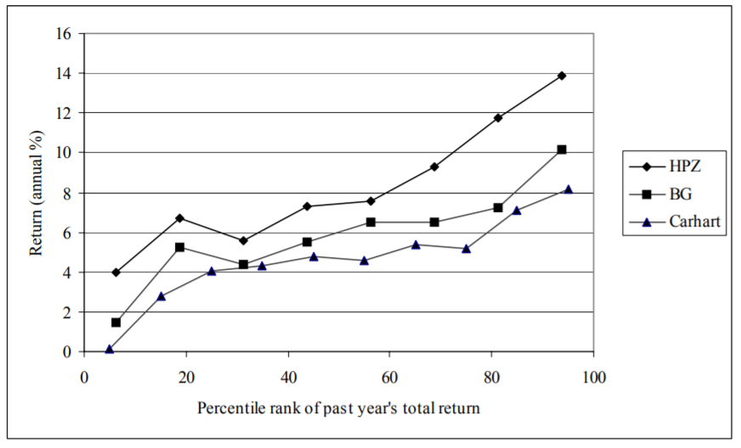
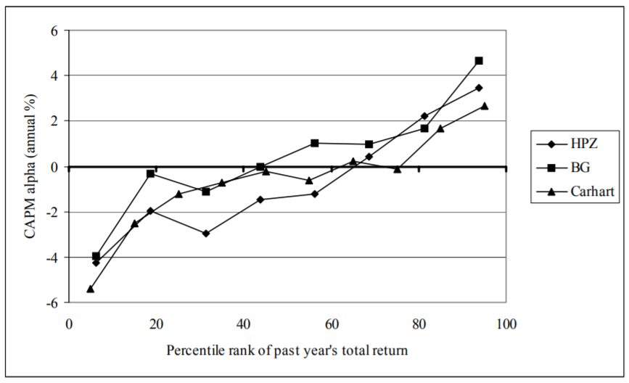
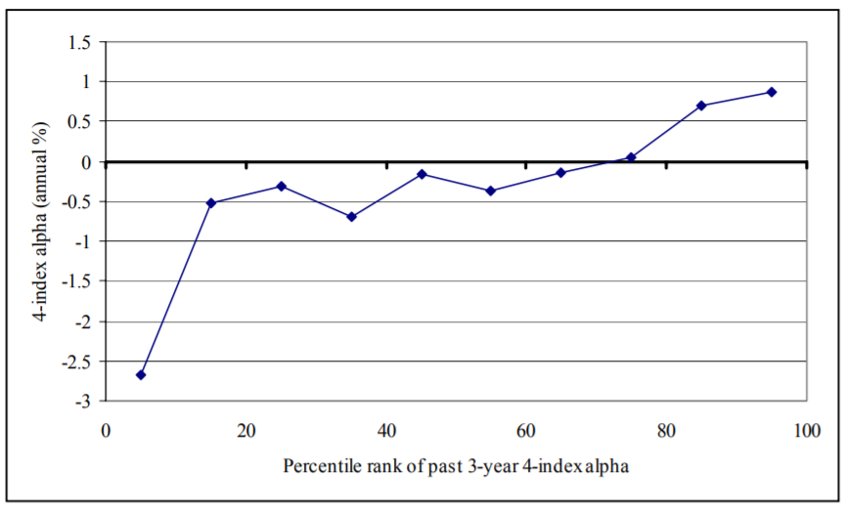
Background１
The asymmetric flow-response pattern is consistent with a relation between past and future performance with a convex shape (small positive slope in lower region and large slope in higher region).
Although there is the notable exception of the very worst funds, this literature do not attempt to resolve it.
Figure 1. Mean future returns net of risk-free rate. HPZ is the first row of
Table III, Panel C of that paper, times four; BG is the first row of Table VII,
Panel A of that paper; and, Carhart is from the first column of Table III of
that paper, times twelve.
Figure 2. Mean future returns net of market risk. HPZ is the sixth row of
Table III, Panel C of that paper, times four; BG is the fourth row of Table VII,
Panel A of that paper; and, Carhart is from the third column of Table III of
that paper, times twelve.
Figure 3. Relationship between past and future monthly four-index alphas.
From Gruber (1996); last column of Table II of that paper, times twelve..

Slide 4
Background２
The source of the asymmetry by same logic as in Heinkel and Stoughton(HS: 1994)
Retail investors can expect that the investment advisor(IA) will retain exactly those managers whose performance is “good enough”
If a fund’s past return is below the retention threshold, investors know the next return will reflect a new manager so it hardly matters just how bad the past return was. → Expected future returns, and the net new flows less sensitive
If the return signals that last period’s manager will be next period’s manager, then it does matter. → Expected future returns, and the net new flows more sensitive

Slide 5
The Model
This literature model not only the IA’s decision but also manager’s decision between retaining and replacing his asset-selection algorithm which is also affected by the past returns.

Slide 6
Fund Flow

Slide 7
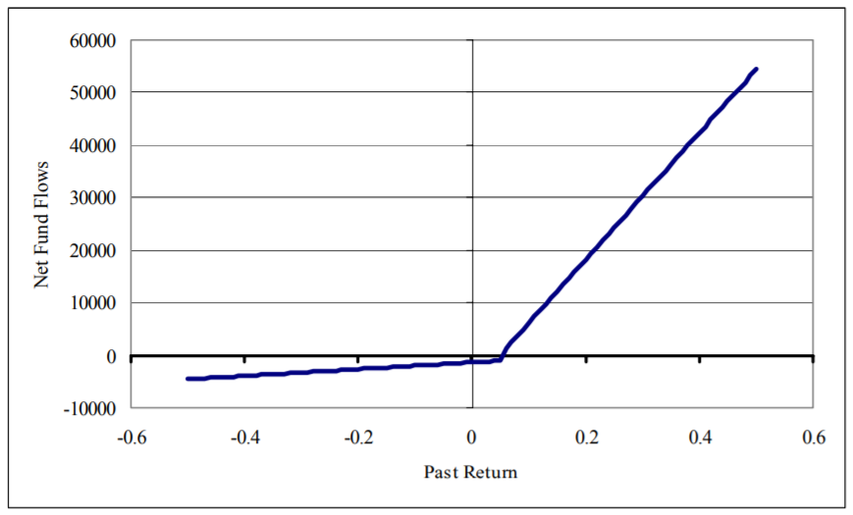
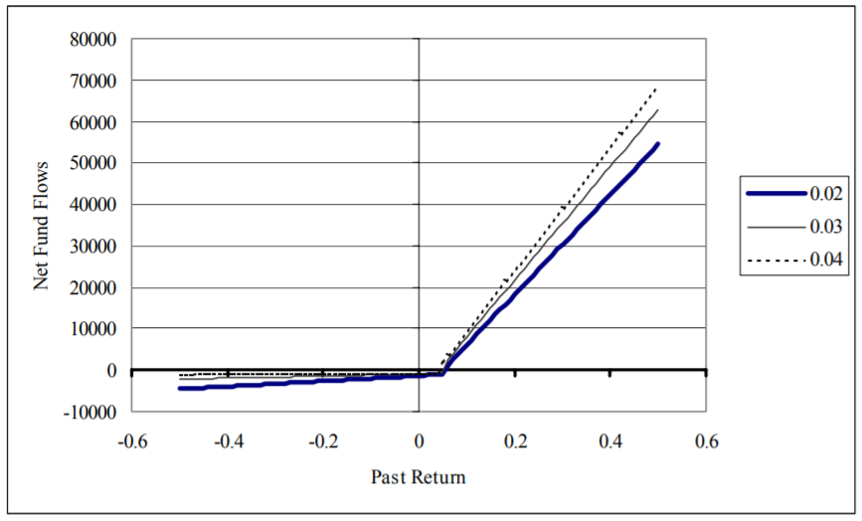
Numerical Example
The model generates Figure 4 which shows asymmetric flow-past return relation
The vertical jog represents R＊
Figure 5 shows the effect on the relation by increasing σ_{s}
Convexity increases as the slope on the below-R* side flattens and the slope on the above-R* side steepens.
Figure 4. Fund flows as a function of past return. Flow/performance relation predicted by the model with α=0.0001, δ=0.01, µ0=0.08, σ2 a=0.005, σ2 s=0.02
and σ2 p=0.025.
Figure 5. Effect of strategy-specific portion on fund-flow response. Flow/performance relation predicted by the model with α=0.0001, δ=0.01, µ0=0.08, σ2 a=0.005, σ2 p=0.025, and the three indicated values for σ2 s.

Slide 8
Empirical Test

Slide 9
Data

Slide 10
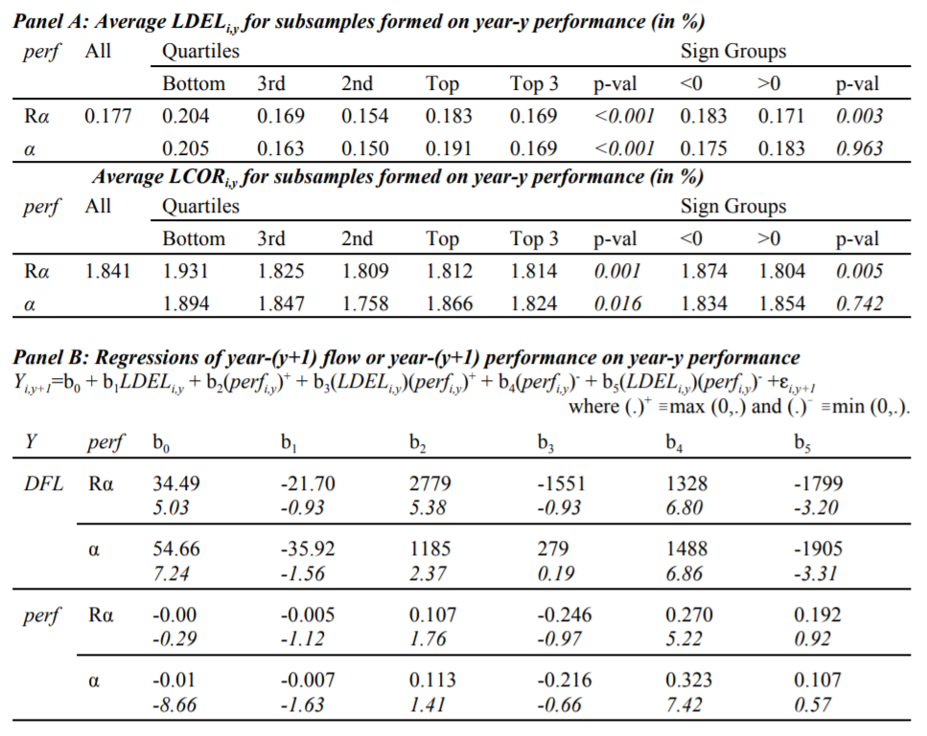
Empirical Results１

Slide 11
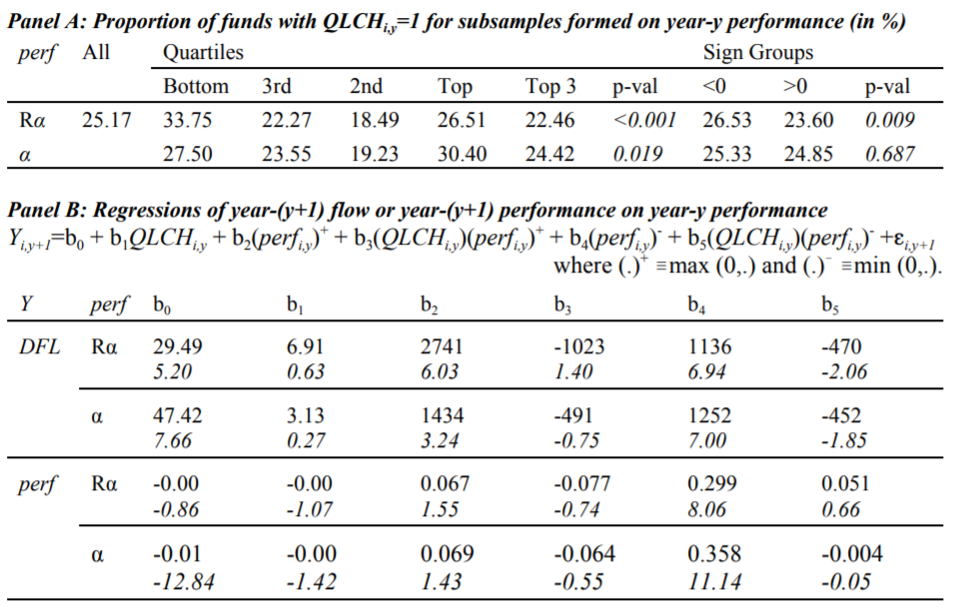
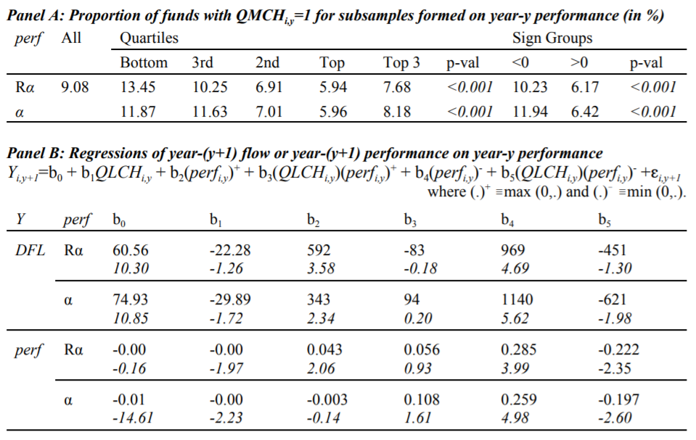
Empirical Results２

Slide 12
Conclusion

