Slide 1
XGBoost: A Scalable Tree Boosting System

Slide 2
Summary
XGBoost is one of the implementations of GBT

Slide 3

Regularized Learning Objective
This literature adds a regularization term to the traditional gradient tree boosting
l is a differentiable convex loss function that measures the difference between the prediction ˆyi and the target y
The additional regularization term helps to smooth the final learnt weights to avoid over-fitting
T is the number of leaves in the tree
Each fk corresponds to an independent tree structure q and leaf weights w
→ With larger γ and λ, the second term makes the size of tree and leaf weights smaller

Slide 4



Gradient Tree Boosting
Second order approximation can be used to quickly optimize the objective at step t
The constant term can be removed to obtain the following simplified objective
are first and second order gradient statistics on the loss function

Slide 5
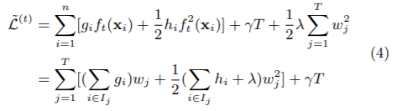


The optimal weight
Eq(3) can be rewritten below
For a fixed structure q(x), optimal weight w* can be computed by differentiating Eq(4) with respect to wj
And the corresponding optimal value can be computed using Eq(4) and Eq(5)

Slide 6
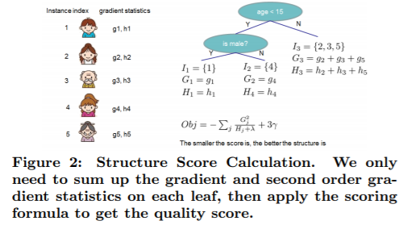

Loss reduction after split
Eq(3) can be rewritten below
For a fixed structure q(x), optimal weight w* can be computed by differentiating Eq(4) with respect to wj

Slide 7
Shrinkage and Column Subsampling

Slide 8
Split Finding Algorithm

Slide 9
Weighted Quantile Sketch

Slide 10
Sparse Aware Algorithm

