Slide 1
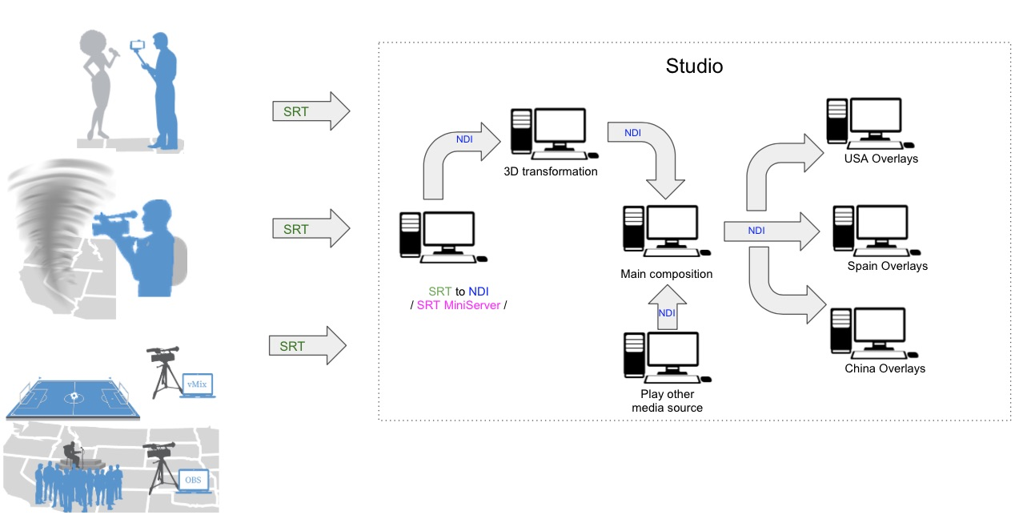



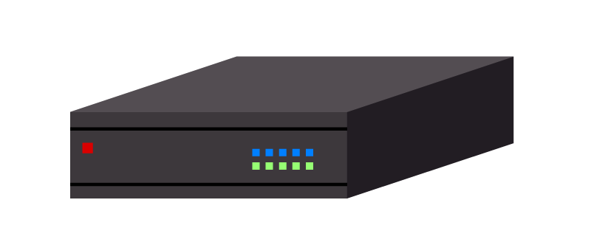
Consept of NDI on SRT
https://srtminiserver.com/blog_ndi_srt/#:~:text=NDI is glue for build production workflow inside,task%3A low-latency delivery of data (not only video).
Movie
NDI
NDI
NDI
Wide Area
Network
header
header
NDI
NDI
NDI
SRT
SRT
caller(or listener)
NDI
listener(or caller)
pack
NDI → SRT
unpack
SRT → NDI
NDI
NDI

Slide 2
Structure of NDI on SRT
+0
+1
+2
+3
+4
+5
+6
+7
SRT packet
NDI Type:
0 = Video
1 = Audio
2 = Metadata
3 = GenLock
4 = Tally
-1 = Unknown
“NDIonSRT”
header packet
char[8]
32 Bytes
Major Ver.
Minor Ver.
NDI Type
Frame Counter
int8_t
int16_t
int8_t
uint32_t
(reserved)
uint8_t[8]
NDI data Size (excluding this header size = 32)
data packet #1
1316 Bytes
uint64_t
NDI data
(M = NDI data Size)
data packet #2
1316 Bytes
data packet #3
1316 Bytes
uint8_t[M]
data packet #N
1316 Bytes or less

Slide 3
Structure of NDI data : Video
+0
+1
+2
+3
+4
+5
+6
+7
typedef struct NDIlib_video_frame_v2_t
{
// The resolution of this frame
int xres, yres;
// What FourCC describing the type of data for this frame
NDIlib_FourCC_video_type_e FourCC;
// What is the frame-rate of this frame.
// For instance NTSC is 30000,1001 = 30000/1001 = 29.97fps
int frame_rate_N, frame_rate_D;
// What is the picture aspect ratio of this frame.
// For instance 16.0/9.0 = 1.778 is 16:9 video
// 0 means square pixels
float picture_aspect_ratio;
// Is this a fielded frame, or is it progressive
NDIlib_frame_format_type_e frame_format_type;
// The timecode of this frame in 100ns intervals
int64_t timecode;
// The video data itself
uint8_t* p_data;
union
{
// If the FourCC is not a compressed type, then this will be the inter-line stride of the video data
// in bytes. If the stride is 0, then it will default to sizeof(one pixel)*xres.
int line_stride_in_bytes;
// If the FourCC is a compressed type, then this will be the size of the p_data buffer in bytes.
int data_size_in_bytes;
};
// Per frame metadata for this frame. This is a NULL terminated UTF8 string that should be in XML format.
// If you do not want any metadata then you may specify NULL here.
const char* p_metadata; // Present in >= v2.5
// This is only valid when receiving a frame and is specified as a 100ns time that was the exact moment
// that the frame was submitted by the sending side and is generated by the SDK. If this value is
// NDIlib_recv_timestamp_undefined then this value is not available and is NDIlib_recv_timestamp_undefined.
int64_t timestamp; // Present in >= v2.5
} NDIlib_video_frame_v2_t;
xres
yres
int32_t
int32_t
FourCC
frame_rate_N
uint32_t
int32_t
frame_rate_D
picture_aspect_ratio
int32_t
float
frame_format_type
timecode ...
uint32_t
int64_t ...
… timecode
data_size_in_bytes
… int64_t
int32_t
timestamp
int64_t
metadata
char[M]
NULL
data
uint8_t[N]
N = data_size_in_bytes

