Slide 1
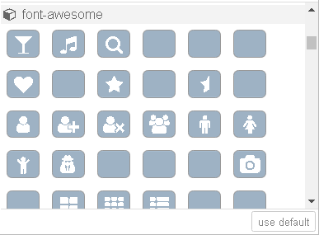
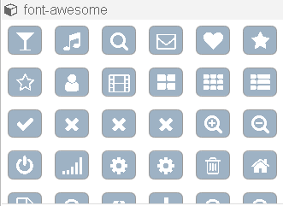
Font-Awesome for node icon
config.json generated by Fontello
Option1
This is because the font name of some of icons is different between font-awesome and Fontello. (e.g. fa-envelope-square and fa-mail-square)
font-awesome. min.css
JSON data
Option2
extract & generate json
# | Question
Q1 | Is it OK to proceed the development with option 2?
Q2 | Is it OK to allow node developers to use font-awesome icon?

