Slide 1
Node Settings UI Generation Feature for Function Node/Template Widget
Hiroyasu Nishiyama

Slide 2
Adding Node Settings UI Generation Feature
Currently, Function Node/Template Widget Node do not provide means for customizing each instance of nodes except directly modifying JavaScript/HTML code.
This causes following problems:
Node settings UI as provides by other nodes is easy to understood but modifying JavaScript/HTML code is not easy and error prone.
For novice users, directly editing JavaScript/HTML codes is difficult.
Directly editing codes causes problems after updating original codes if we have multiple instances of function/template code.
Thus, we would like to propose adding feature for adding node setting UI generation for Function Node/Template Widget Node. Prototype implementation has been already developed for Function node.
With this feature (and Node Icon Specification, Node Description UI [+Color, Category Specification]), we may be able to define exportable/importable node format for simple nodes similar to the flow JSON format.

Slide 3
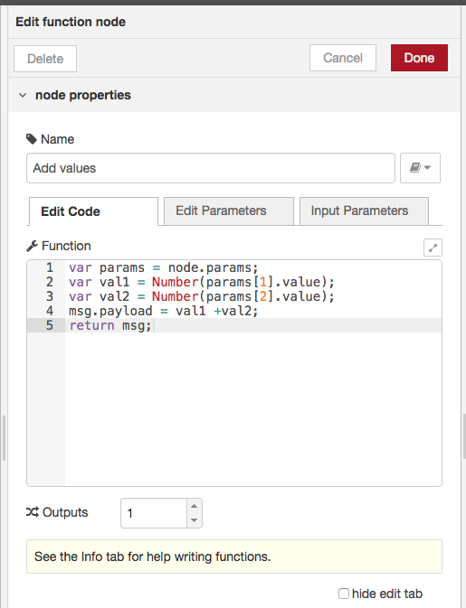
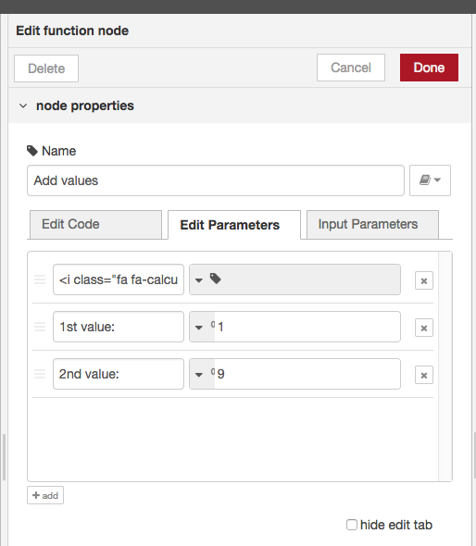
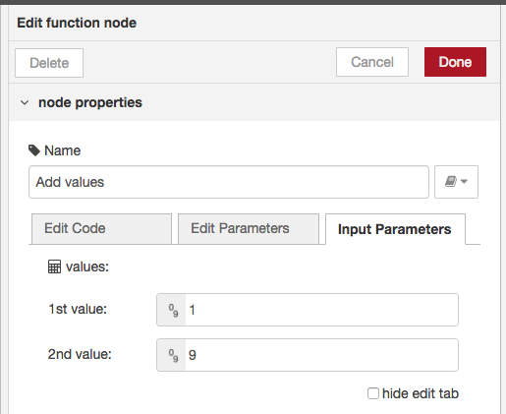
Proposal: Simple UI Generation Interface
Add tabs 'Edit Code', 'Edit Parameters', 'Input Parameters' to Function/Widget node:
- Edit Code: edit JavaScript/HTML code as of current implementation
- Edit Parameters: define UI for setting node parameters
- Input Parameters: input parameters using UI defined by "Edit Parameters"
"Edit Code" and "Edit Parameters" can be hidden by checking checkbox at bottom
tab to select functions
define horizontal UI item
type selector
checkbox to hide
editing tabs
generated settings UI
item label
initial value

Slide 4
Proposal: Accessing Settings Input Parameters
Input parameter values and related information are passed in node.params field. It is an array of information for each UI item.
Each item of the array contains following information:
- index: index of UI item
- type: type of UI item
- value: input value of UI item
- items: array of items (menu item only)
array of parameter info
input value of 3rd item

Slide 5
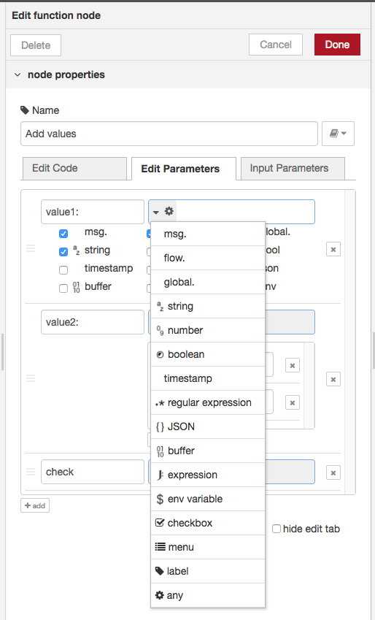
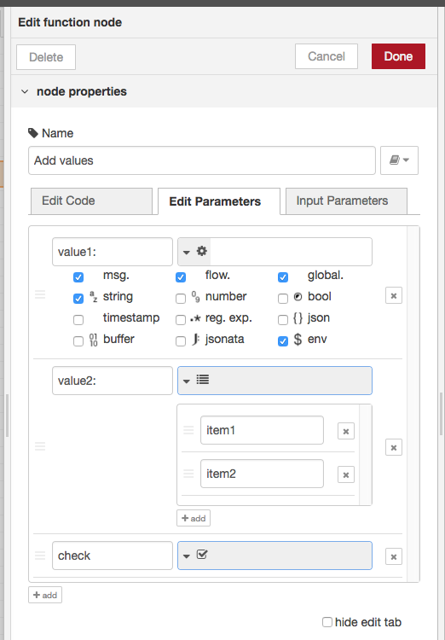
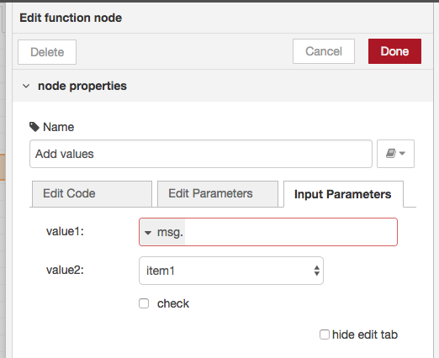
Proposal: Defining UI items
UI items are defined by "Edit Parameters" tab
An UI item can be added by "add" button at bottom. It can define label, type, and initial value (if any).
UI item input type can be specified using TypedInput interface. In addition to specific input types (e.g. msg., string, JSONata expression, ...), following special type is provided:
- checkbox, menu, label (no input), any (input from selected types)
item type selector
any type
generated settings UI
menu type
checkbox type

