Slide 1
Guideline
8/30/2018
Yu Nakata
Connectivity Research Department
Center for Technology Innovation - Electronics

Slide 2
Guideline
[Background]
We have published Node-RED flow and node development guidelines for Hitachi developers on Hitachi’s intra Web site.
Contents are
Effective and preferable ways to develop flows and nodes
E.g., design of flow’s structure, visual style, test, design patterns
(A little more details are on the next slide)
[Proposal]
We think these contents are useful not only for Hitachi developers but also all Node-RED users.
[Discussion]
How do you think about contribution of guidelines?
Certainly, it may depend on contents of guidelines.
Where can we proceed and discuss about contributing guideline?
Slack channel, design note or new GitHub project for guideline

Slide 3
Guideline’s contents
Effective and preferable ways in respect of evolvability, reusability, readability...
Following list is a small part of our guidelines
Flow development guideline
Design of msg to relax dependency among nodes
Using proper node rather than function node
Clear arrangement of nodes in flows
Node development guideline
Overall processes to create a node
Effective naming rule of nodes and categories
Process and perspectives of test
Privacy and security to share node
We have not prepared English version yet. After preparing English version, we’d like to deeply discuss the contribution of guideline.

Slide 4
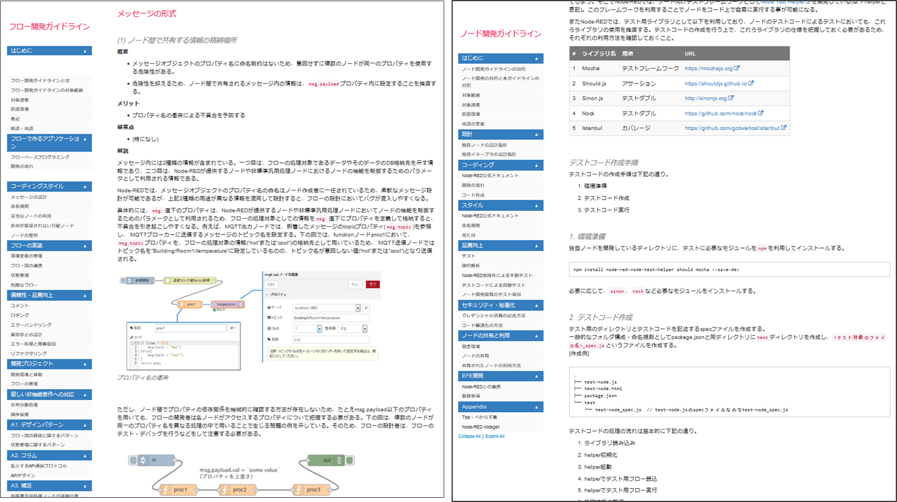
Our guideline (capture image)

