Slide 1
Node description property

Slide 2
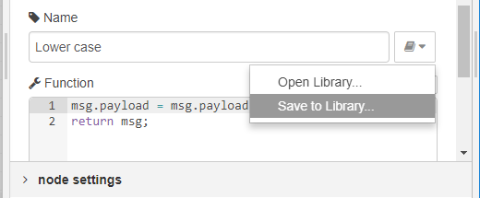
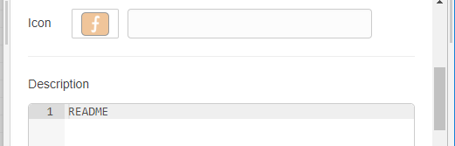
Node description property
# | Question
1 | Could you accept the pull request (#1856) to add node description property?
2 | I suggest that the exported js file from function node includes node property information (info, color, icon and port labels). Can I add the functionality to library code?
If exported js file has node property information, Node-RED users can use the information in loaded nodes from library.
// name: Lower case
// outputs: 1
// info: README
// color: red
// icon: icon.png
// inputLabels: input
// outputLabels: output
msg.payload = msg.payload.toLowerCase();
return msg;
Save to library
Exported js file
(~/.node-red/lib/function/Lower-case.js)
property UI of function node

Slide 3
Node generator

Slide 4
Status of Node generator project
June: v0.0.1 (the first release)
August: Documentation of Node generator v0.0.2 (maintenance release)
September- (tentative):
- Node description property support in function node template
- Node-RED core integration
- Node color option and Node icon option in command line
Future (tentative): - Subflow node template,
- Service Broker support in Swagger node template

Slide 5
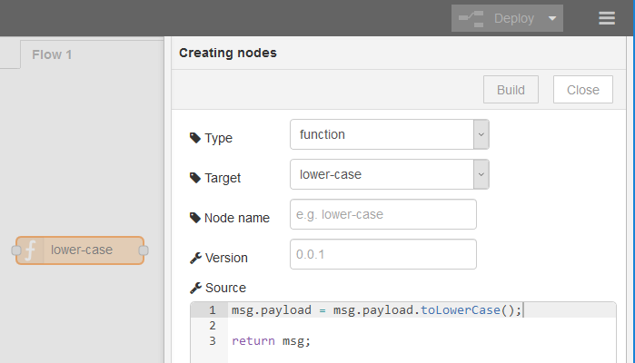
Node-RED core integration
# | Question
1 | Could you review the pull request (#1705)?
2 | Should I add additional functionality to realize it?
Results of Hursley meeting in June
Node generator UI will be add-on of Node-RED.
Nick-san will review the pull request (#1705) at first.
Node generator UI

Slide 6


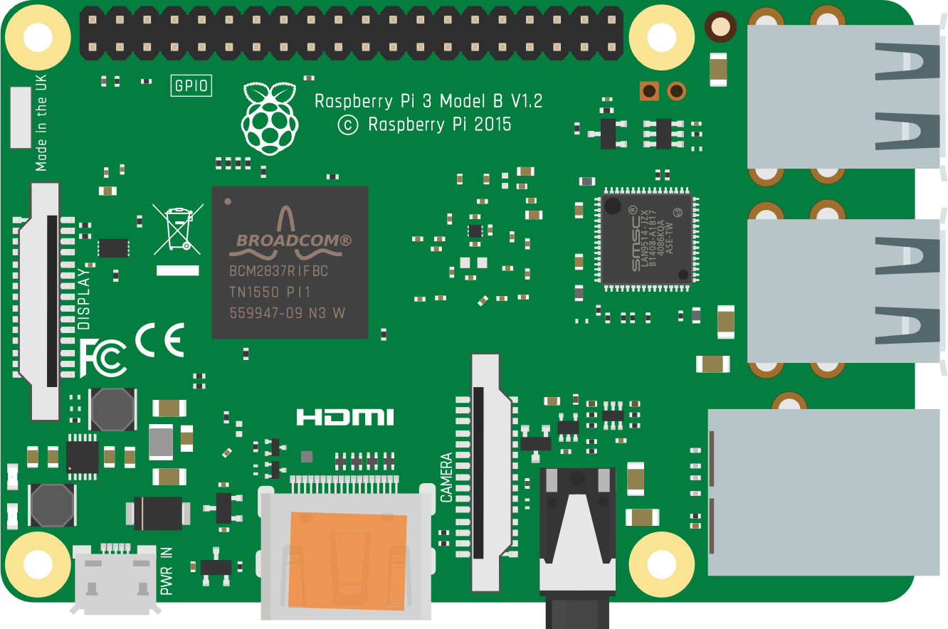
Service Broker support in swagger node template
# | Question
1 | Can I start to write the design note on Node generator wiki?
Use case1: Connection to cloud service from local Node-RED
(6) Access to API using credential
(5) Set credential
Cloud
Controller
REST API
Service
(1) Create service
(2) Create service
node
(4) Get credential
(3) Get credential
Cloud Controller API
Open Service Broker API
Cloud Foundry
Use case2: Using service from Node-RED on container
(6) Access to API using credential
(5) Set credential
Environment
variable
REST API
Service
Service
Catalog
(1) Create service
node
(3) Bind credential
and start container
(2) Get credential
Container
Open Service Broker API
Kubernetes

