Slide 1









$$m^{t}$$
$$m^{t}$$
MH naming game
$$s_{A}^{t}$$
$$s_{B}^{t}$$
$$r_{m}^{t}$$
A
$$r_{A}^{t}$$
$$r_{B}^{t}$$
B
Critic
Critic
$$a_{A}^{t}$$
Environment
$$a_{B}^{t}$$
Actor
Actor

Slide 2
$$m^{t}$$
$$m^{t}$$
MH naming game
$$s_{A}^{t}$$
$$s_{B}^{t}$$
$$r_{m}^{t}$$
A
$$r_{A}^{t}$$
$$r_{B}^{t}$$
B
Critic
Critic
$$a_{A}^{t}$$
Environment
$$a_{B}^{t}$$
Actor
Actor
Notes:
元の図

Slide 3
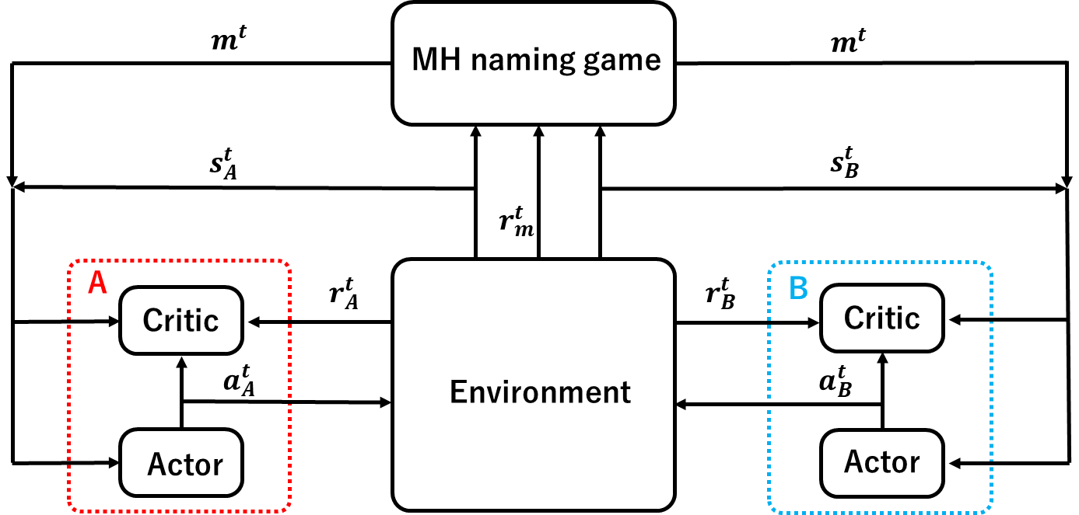

Slide 5
