Slide 1
Simulation Paper
Skype meeting - 06.19.19

Slide 2
Manuscript overview
Determine the impact of structural variants in genomic prediction performance using simulations.
Simulate QTNs and traits
Run genomic prediction model
Validate results

Slide 3
Genotypic dataset
There are three options:
Diversity panel
RIL population
Hybrids

Slide 4
Diversity panel
No good available dataset
If we simulate SVs, we won’t know the population structure, allele frequency on panel, etc.
Not very useful in a breeding perspective
Notes:
Available datasets: CGH, calls based on read depth, not enough lines

Slide 5
RIL population
Available dataset → ours!
SVs (being) called for inbred parents → can project SVs from parents onto RILs
Useful in a breeding perspective
Notes:
Meet with Patrick to see when SV calls will be done.
Would have to do inputation anyways.
More like what Martin was drawing in the board, I believe.

Slide 6
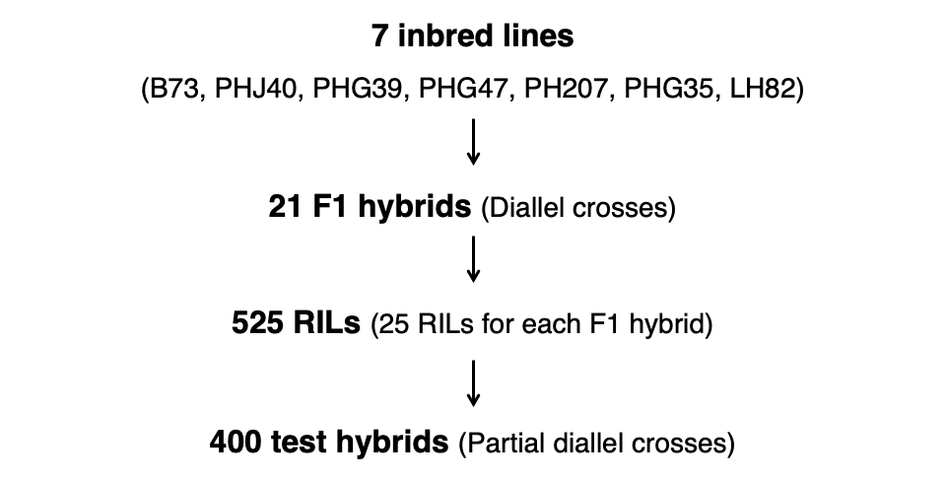
Notes:
Meet with Patrick to see when SV calls will be done.
Would have to do inputation anyways.

Slide 7
Hybrids
Genotypes can be simulated from RIL genotypes
But, need to simulate dominance effects (not currently implemented in Sam’s script?)
Notes:
Confirm dominance not being implemented in script.

Slide 8
Genotypic dataset
Use our RIL genotypic dataset (50k SNPs, >500 lines).
Simulate traits only with additive effects on this RIL population.
Notes:
We would then be able to use the real data (once we get it) to validate the simulation results.

Slide 9
Trait simulation
Number of traits:
Only one trait in one location.

Slide 10
Trait simulation
QTN type:
All phenotypic variation attributed to SNPs only.
All phenotypic variation attributed to SVs only.
Phenotypic variation attributed to both SNPs and SVs.

Slide 11
Trait simulation
Number of QTNs:
Low number → 3?
Medium number → 25?
High number → 75?

Slide 12
Trait simulation
Heritability:
Low → 0.2?
Medium → 0.5?
High → 0.9?

Slide 13
Trait simulation
Effect of QTN:
One large effect, and rest with small effects (values between 0 and 1).

Slide 14
Trait simulation
There are 27 different traits at one location. Each experiment will be replicated 50 times.
Notes:
NEED TO QC THE RIL MARKER DATA

Slide 15
Genomic prediction
What markers to use in the GS model:
All SNPs (All polymorphic, 1K form the polymorphic, 50 from the polymorphic SNPs) - check if different subsets have a lot of variation in results
Only SNPs (1K and 50 SNPs) in LD with SVs.
Only SNPs with varying LD with SVs.
Only SVs.
All SNPs and SVs.
Notes:
(1) What is currently done; (2 and 3) test impact of SVs using only SNP data; (4) test impact of SVs using the actual SVs as markers (hasn’t being done yet).

Slide 16
Genomic prediction
Validation of performance prediction using RILs:
k-fold cross validation (5 fold)

Slide 17
Future work
Hybrids
Simulate genotypes from RILs
Simulate traits with dominance effects
Estimate GCA / SCA
Perform T0, T1, T2 validation

Slide 18
Future work
GxE
Simulate traits for multiple environments
Real data
Validate simulation results using real data

Slide 19
Simulation test results
(Toy dataset)

Slide 20
Real data
Simulated SV
 | Line A | Line B | Line C | Line D
SNP 1 | 0 | 2 | 2 | 2
SNP 2 | 2 | 2 | 2 | 2
SNP 3 | 2 | 2 | 2 | 2
SNP 4 | 2 | 2 | 2 | 2
SNP 5 | 2 | 0 | 1 | 2
SNP 6 | 0 | 0 | 0 | 0
SNP 7 | 0 | 0 | 0 | 0
SNP 8 | 0 | 0 | 0 | 0
SNP 9 | 0 | 1 | 2 | 2
 | Line A | Line B | Line C | Line D
SNP 1 | 0 | 2 | 2 | 2
SNP 2 | 2 | 2 | 2 | 2
SNP 3 | 2 | 2 | 2 | 2
SNP 4 | 2 | 2 | 2 | 2
SNP 5 | 5 | 1 | 3 | 5
SNP 6 | 0 | 0 | 0 | 0
SNP 7 | 0 | 0 | 0 | 0
SNP 8 | 0 | 0 | 0 | 0
SNP 9 | 1 | 3 | 5 | 5
Notes:
280 diverse lines
55k SNPs total
2k SNPs transformed to SV

Slide 21
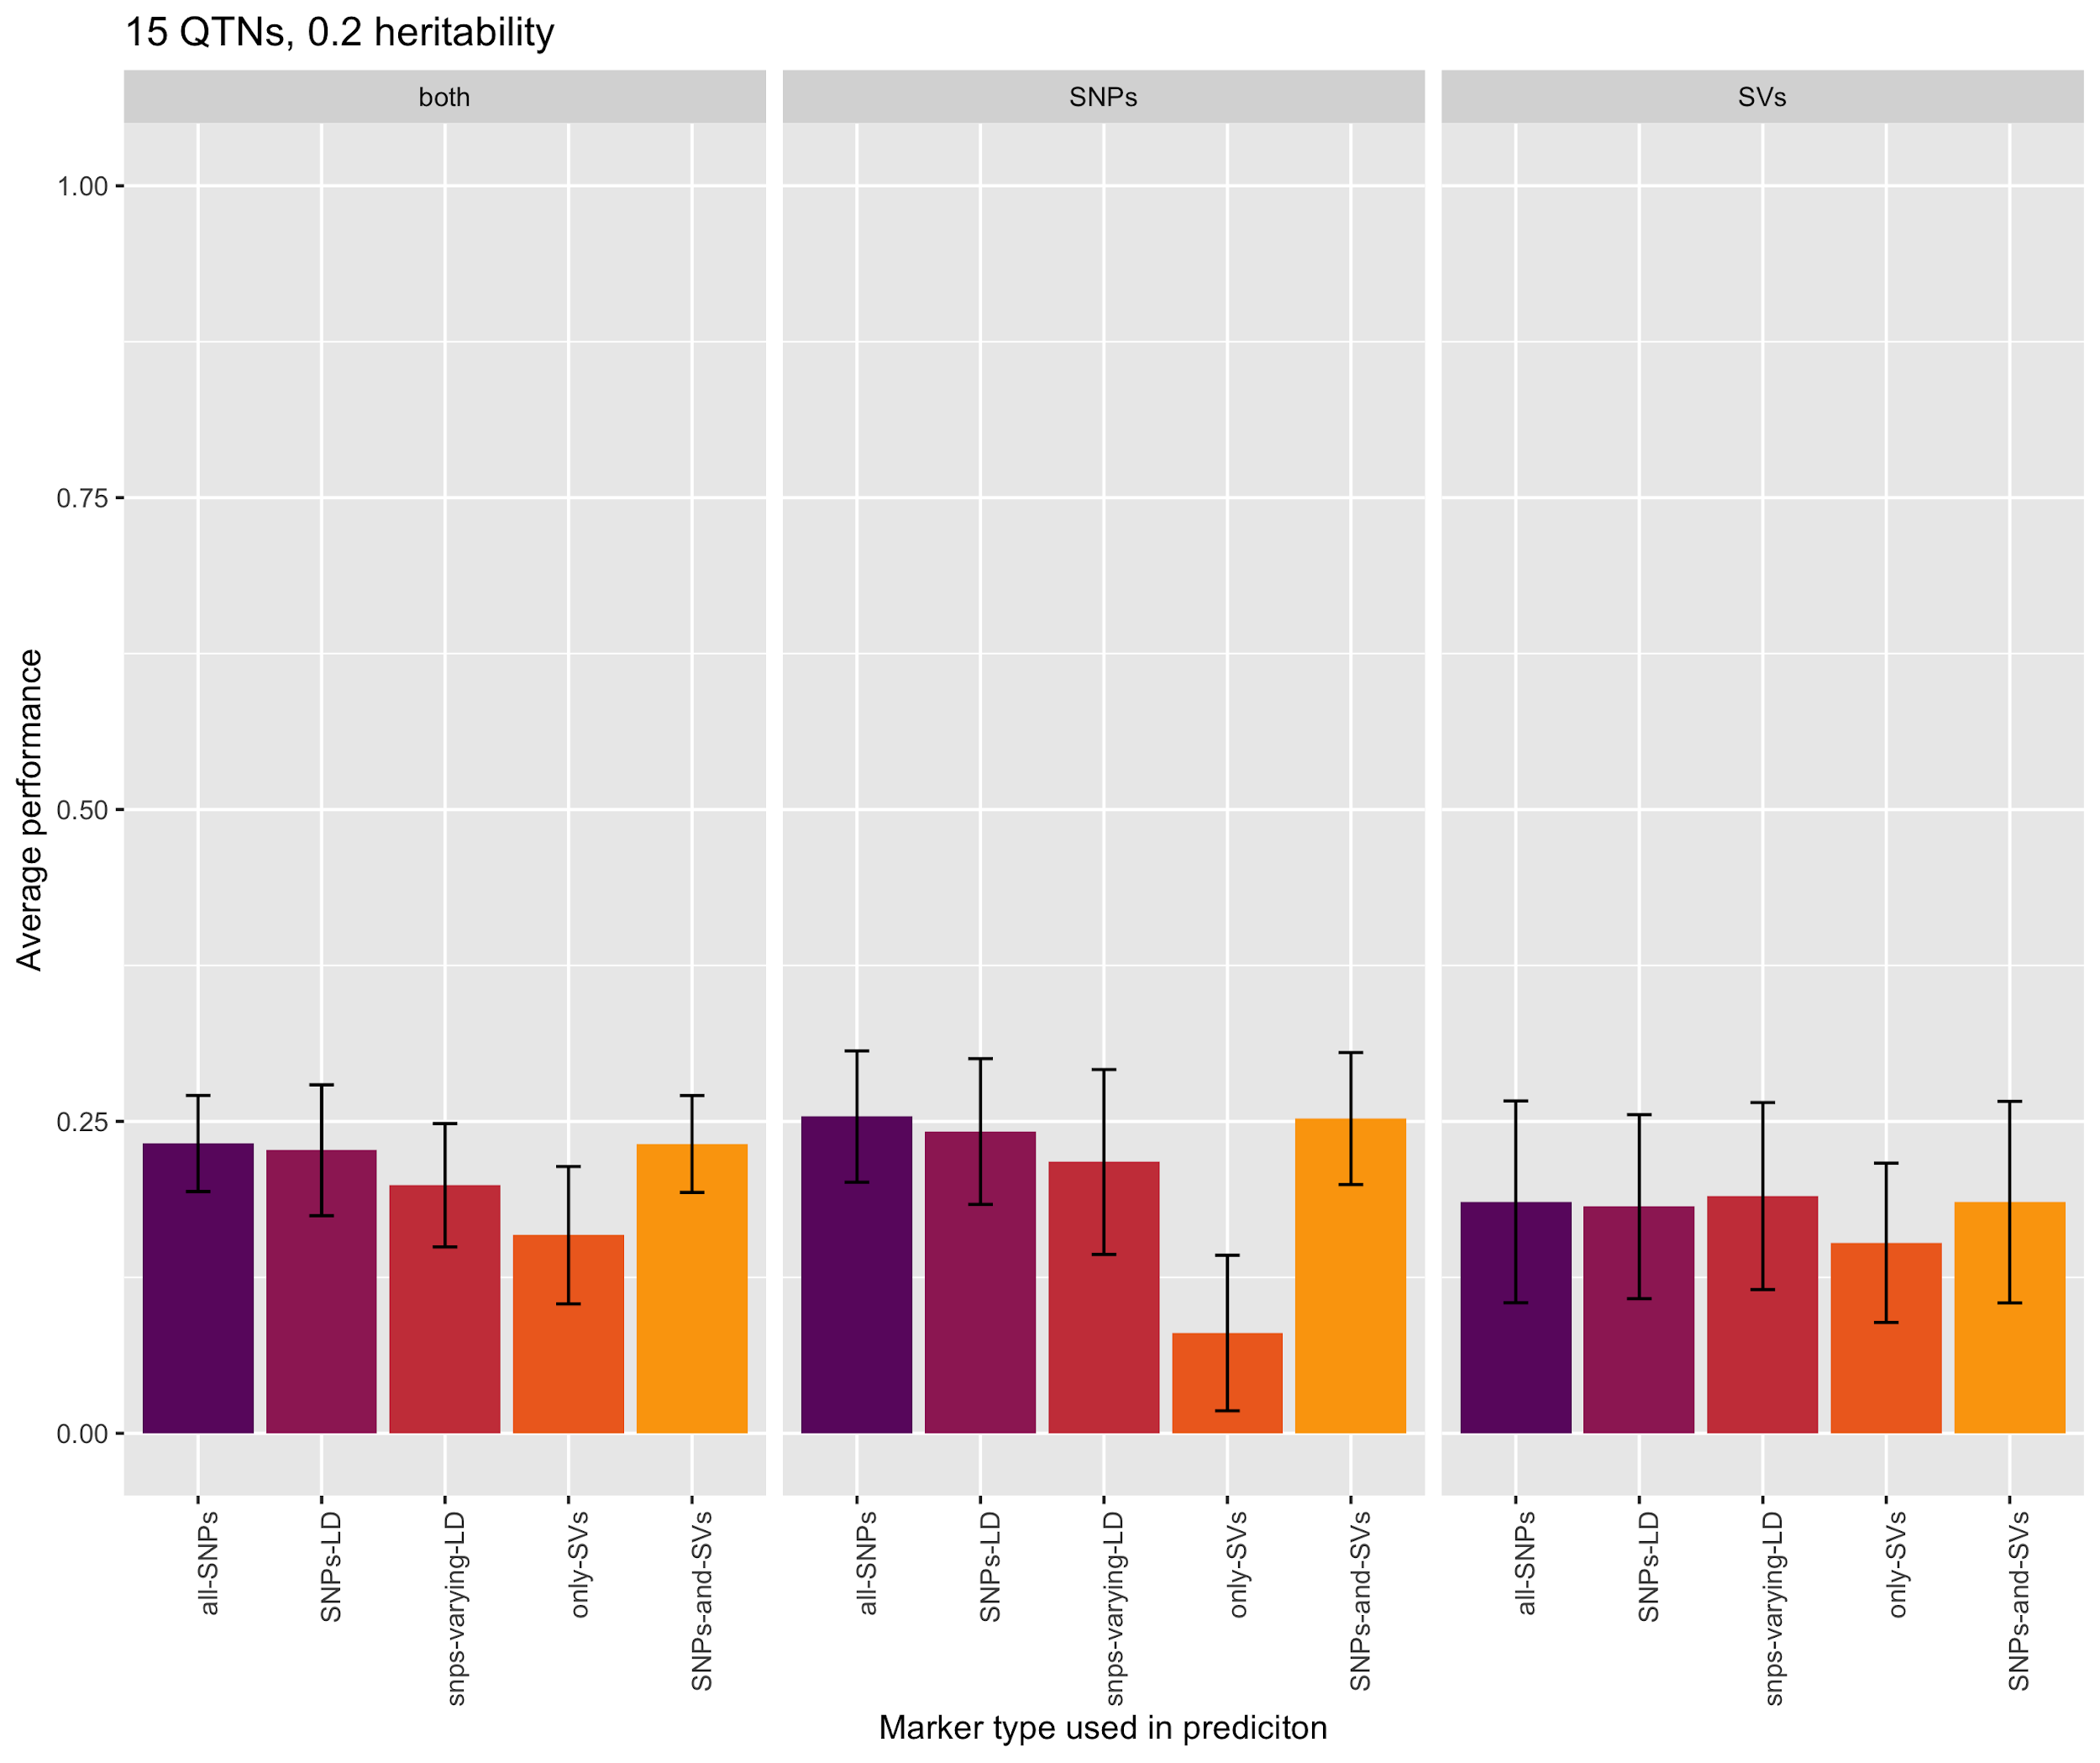
Notes:
Average of 3 replicates only

Slide 22
Notes:
Average of 3 replicates only

Slide 23
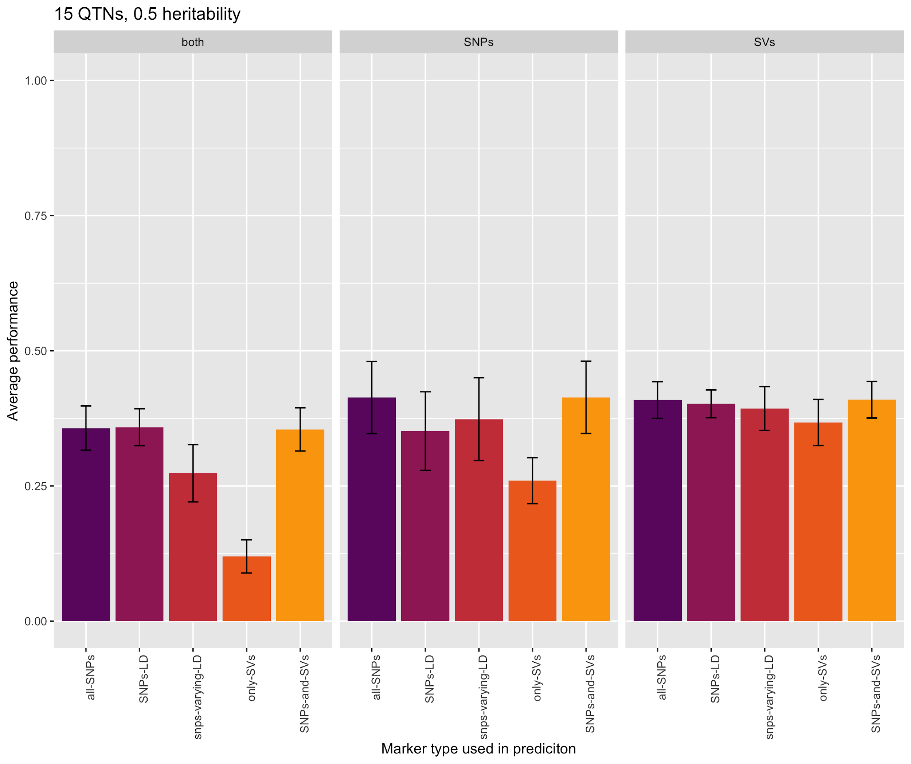
Notes:
Average of 3 replicates only

Slide 24
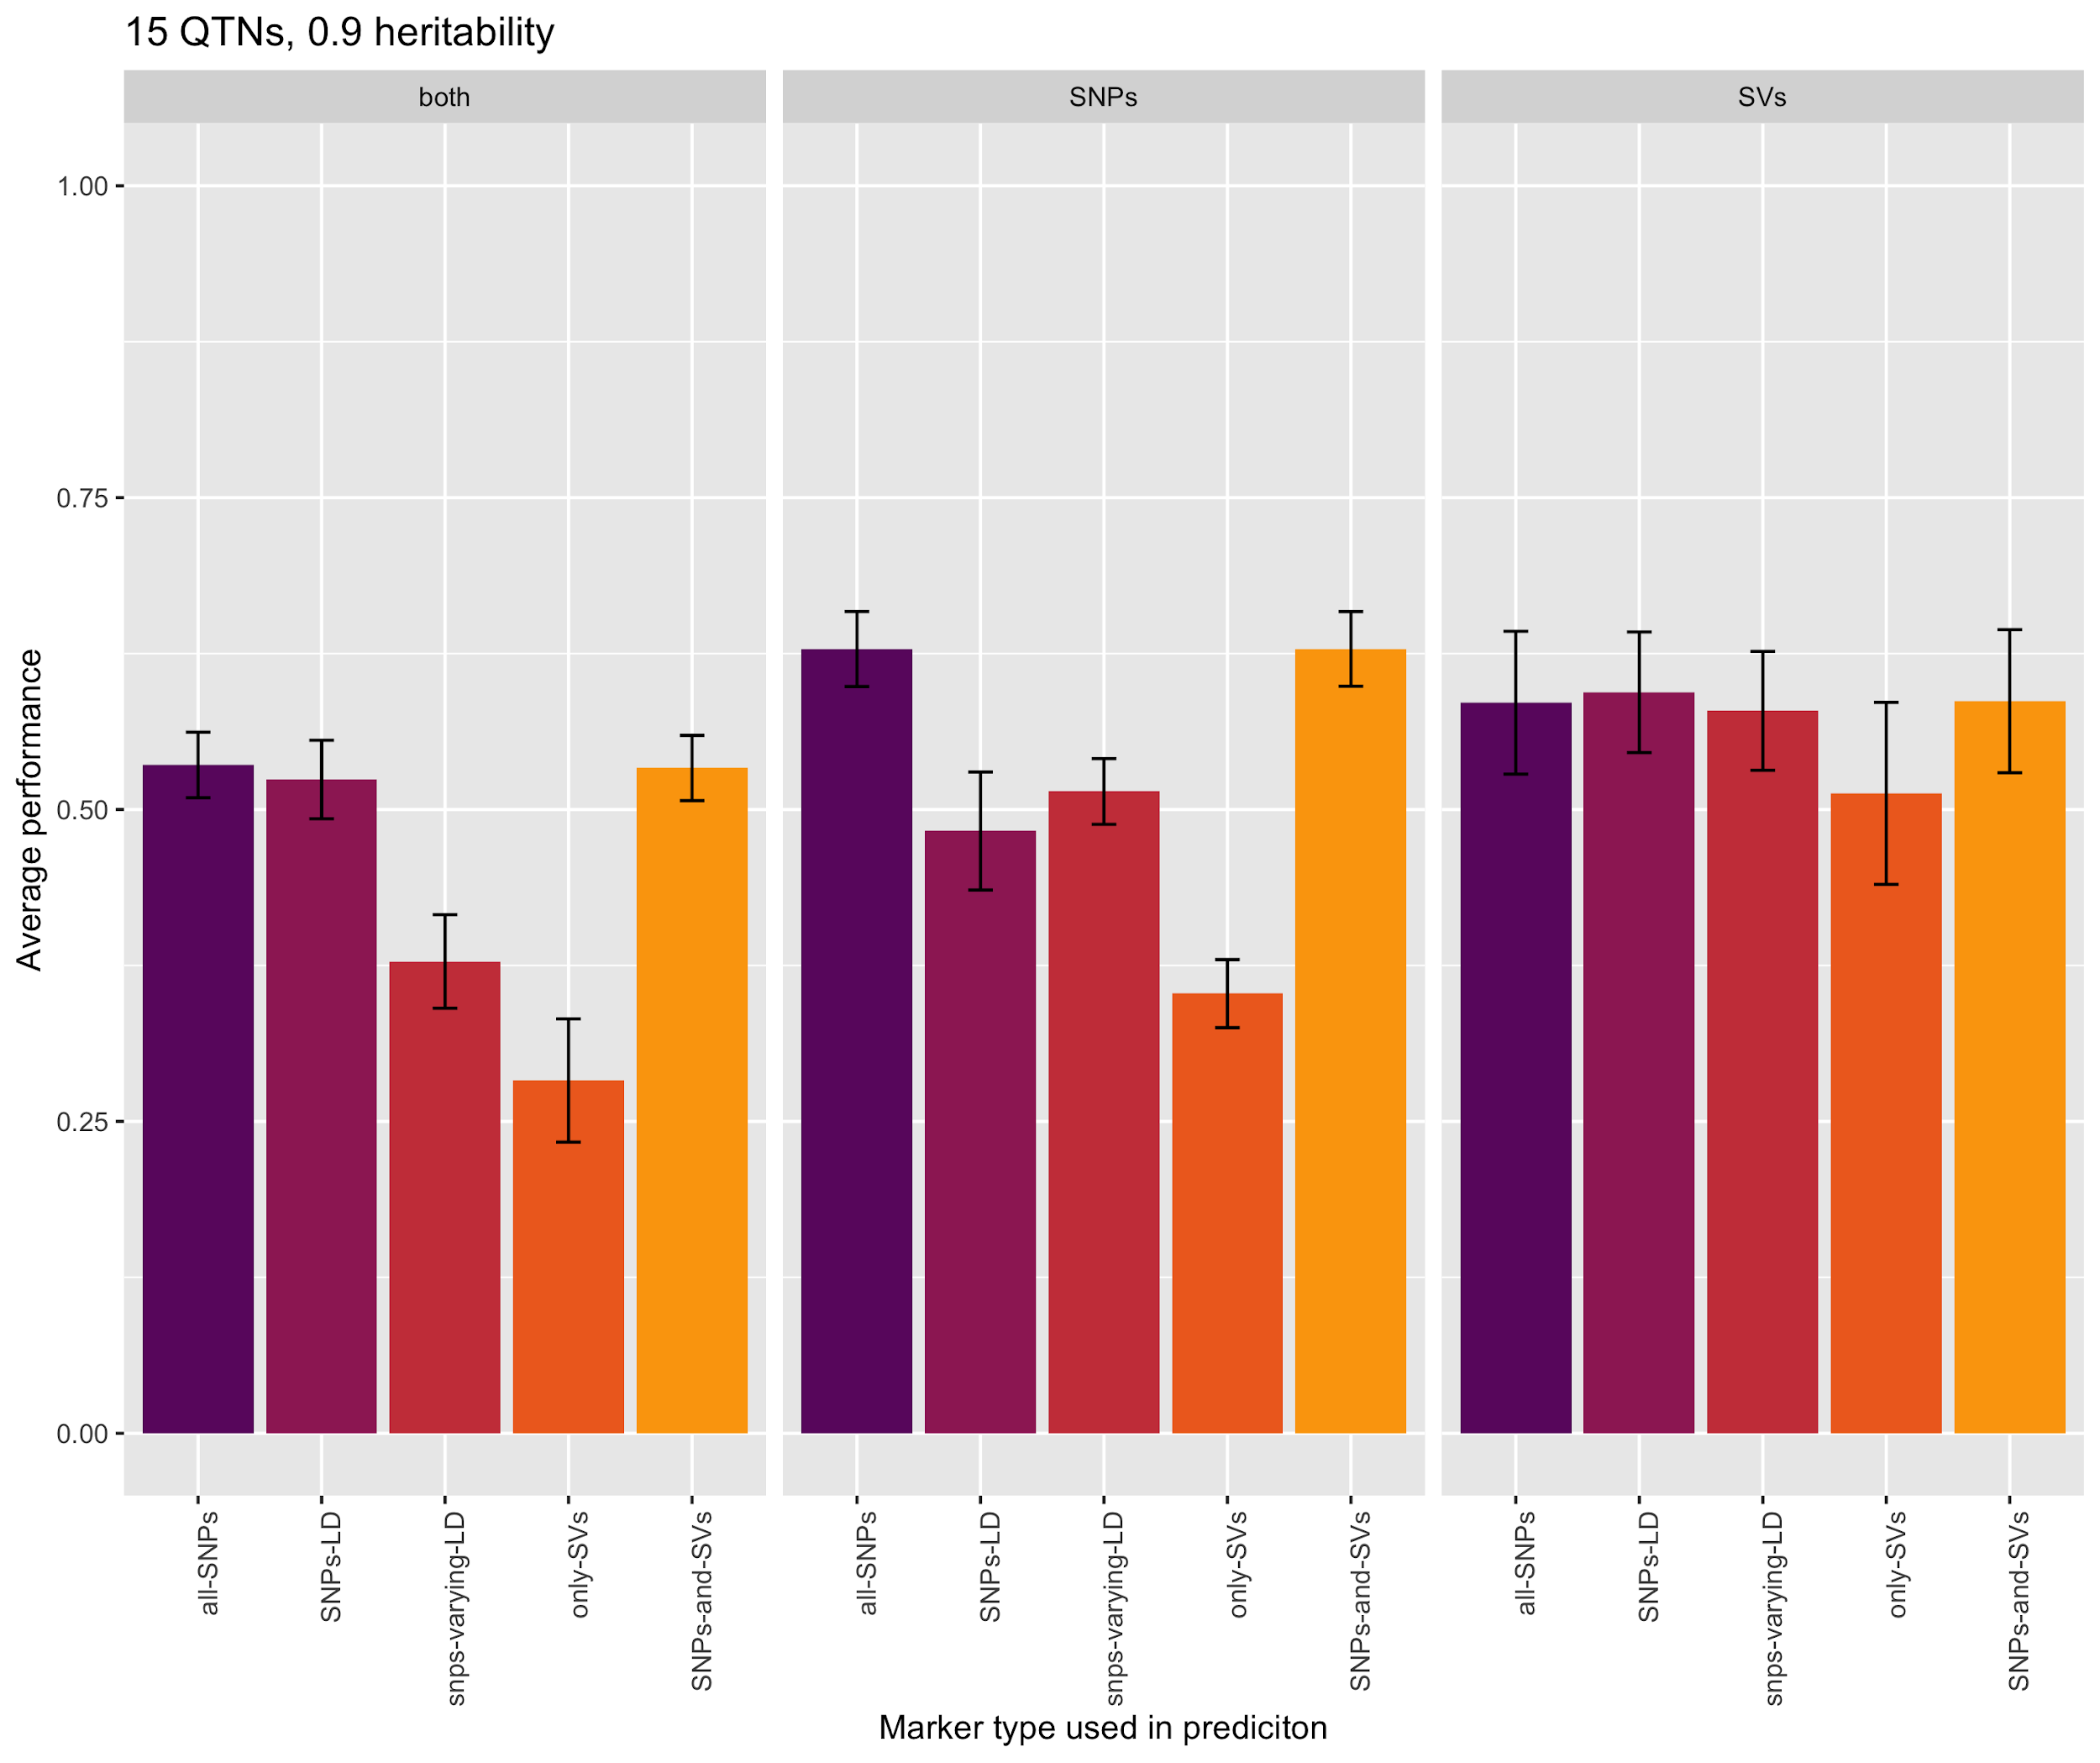
Notes:
Average of 3 replicates only

Slide 25
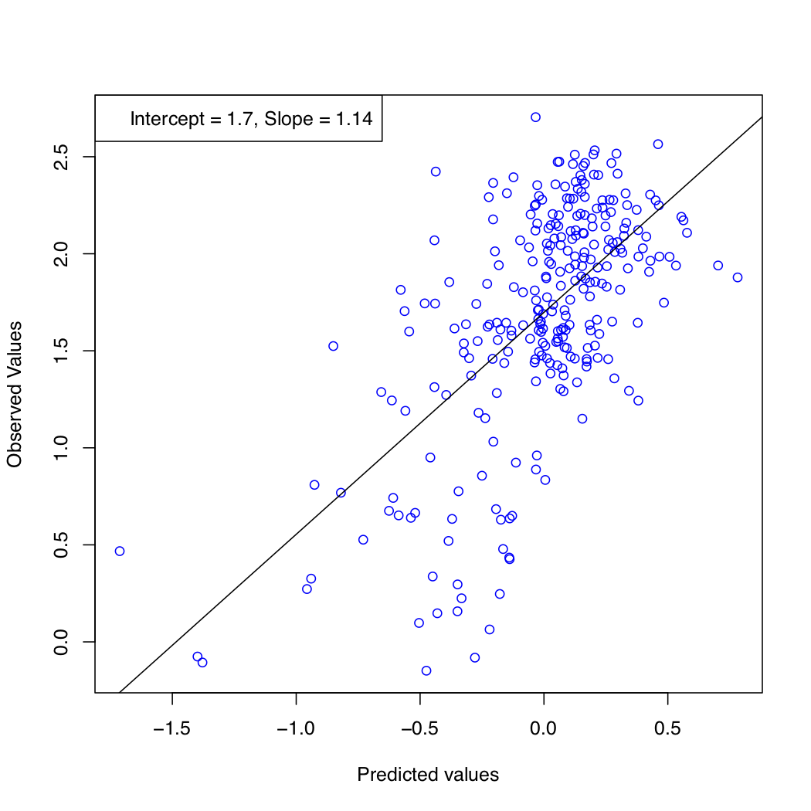
Source of variation: SNPs
Markers used in GS: SNPs
Notes:
15 QTNs, 0.9 heritability, one replicate

Slide 26
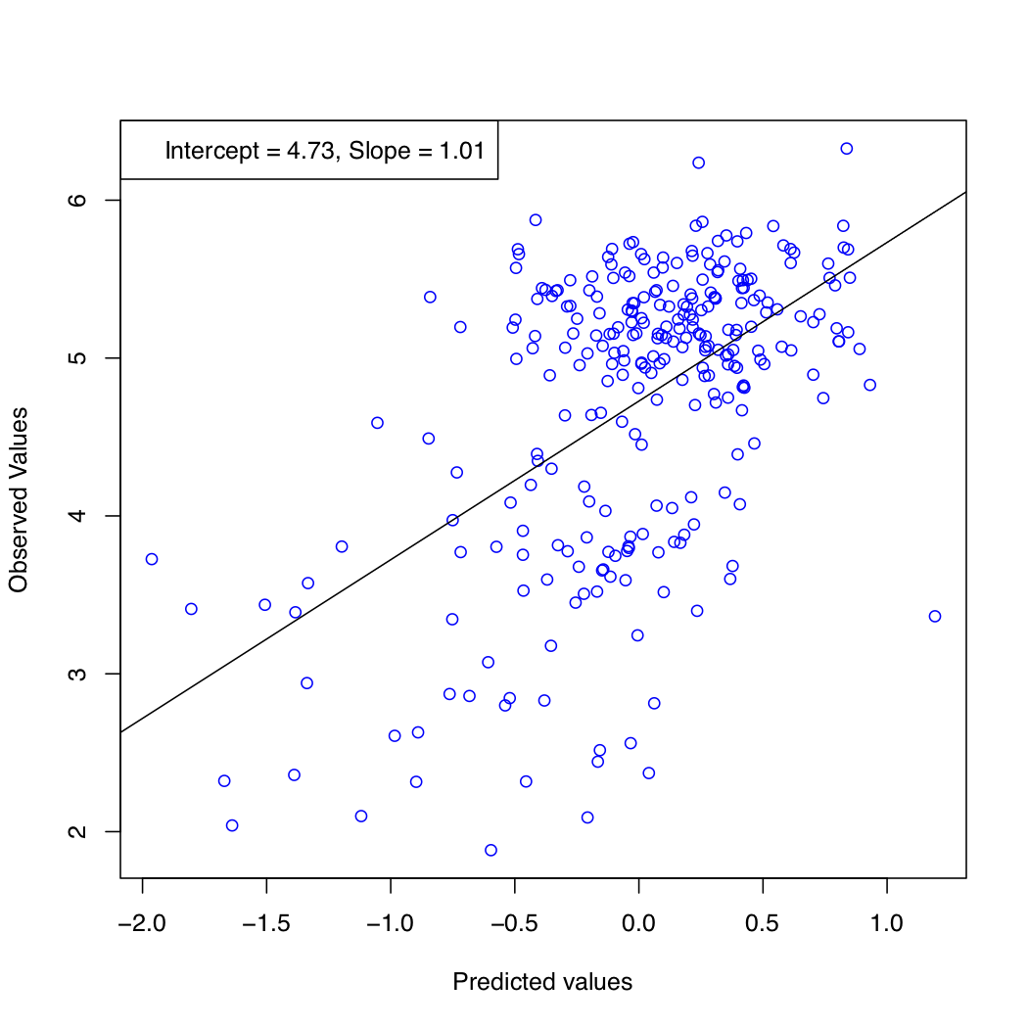
Source of variation: SNPs
Markers used in GS: SNPs
Source of variation: SVs
Markers used in GS: SVs
Notes:
15 QTNs, 0.9 heritability, one replicate

Slide 27
Simulation test results
(USDA RILs dataset)
Notes:
1672 RILs in the file on dropbox (which ones are the 525 RILs from our dataset?).
22k SNPs.
Transformed data to hapmap format, so it’s ready to be implemented in the script.

Slide 28
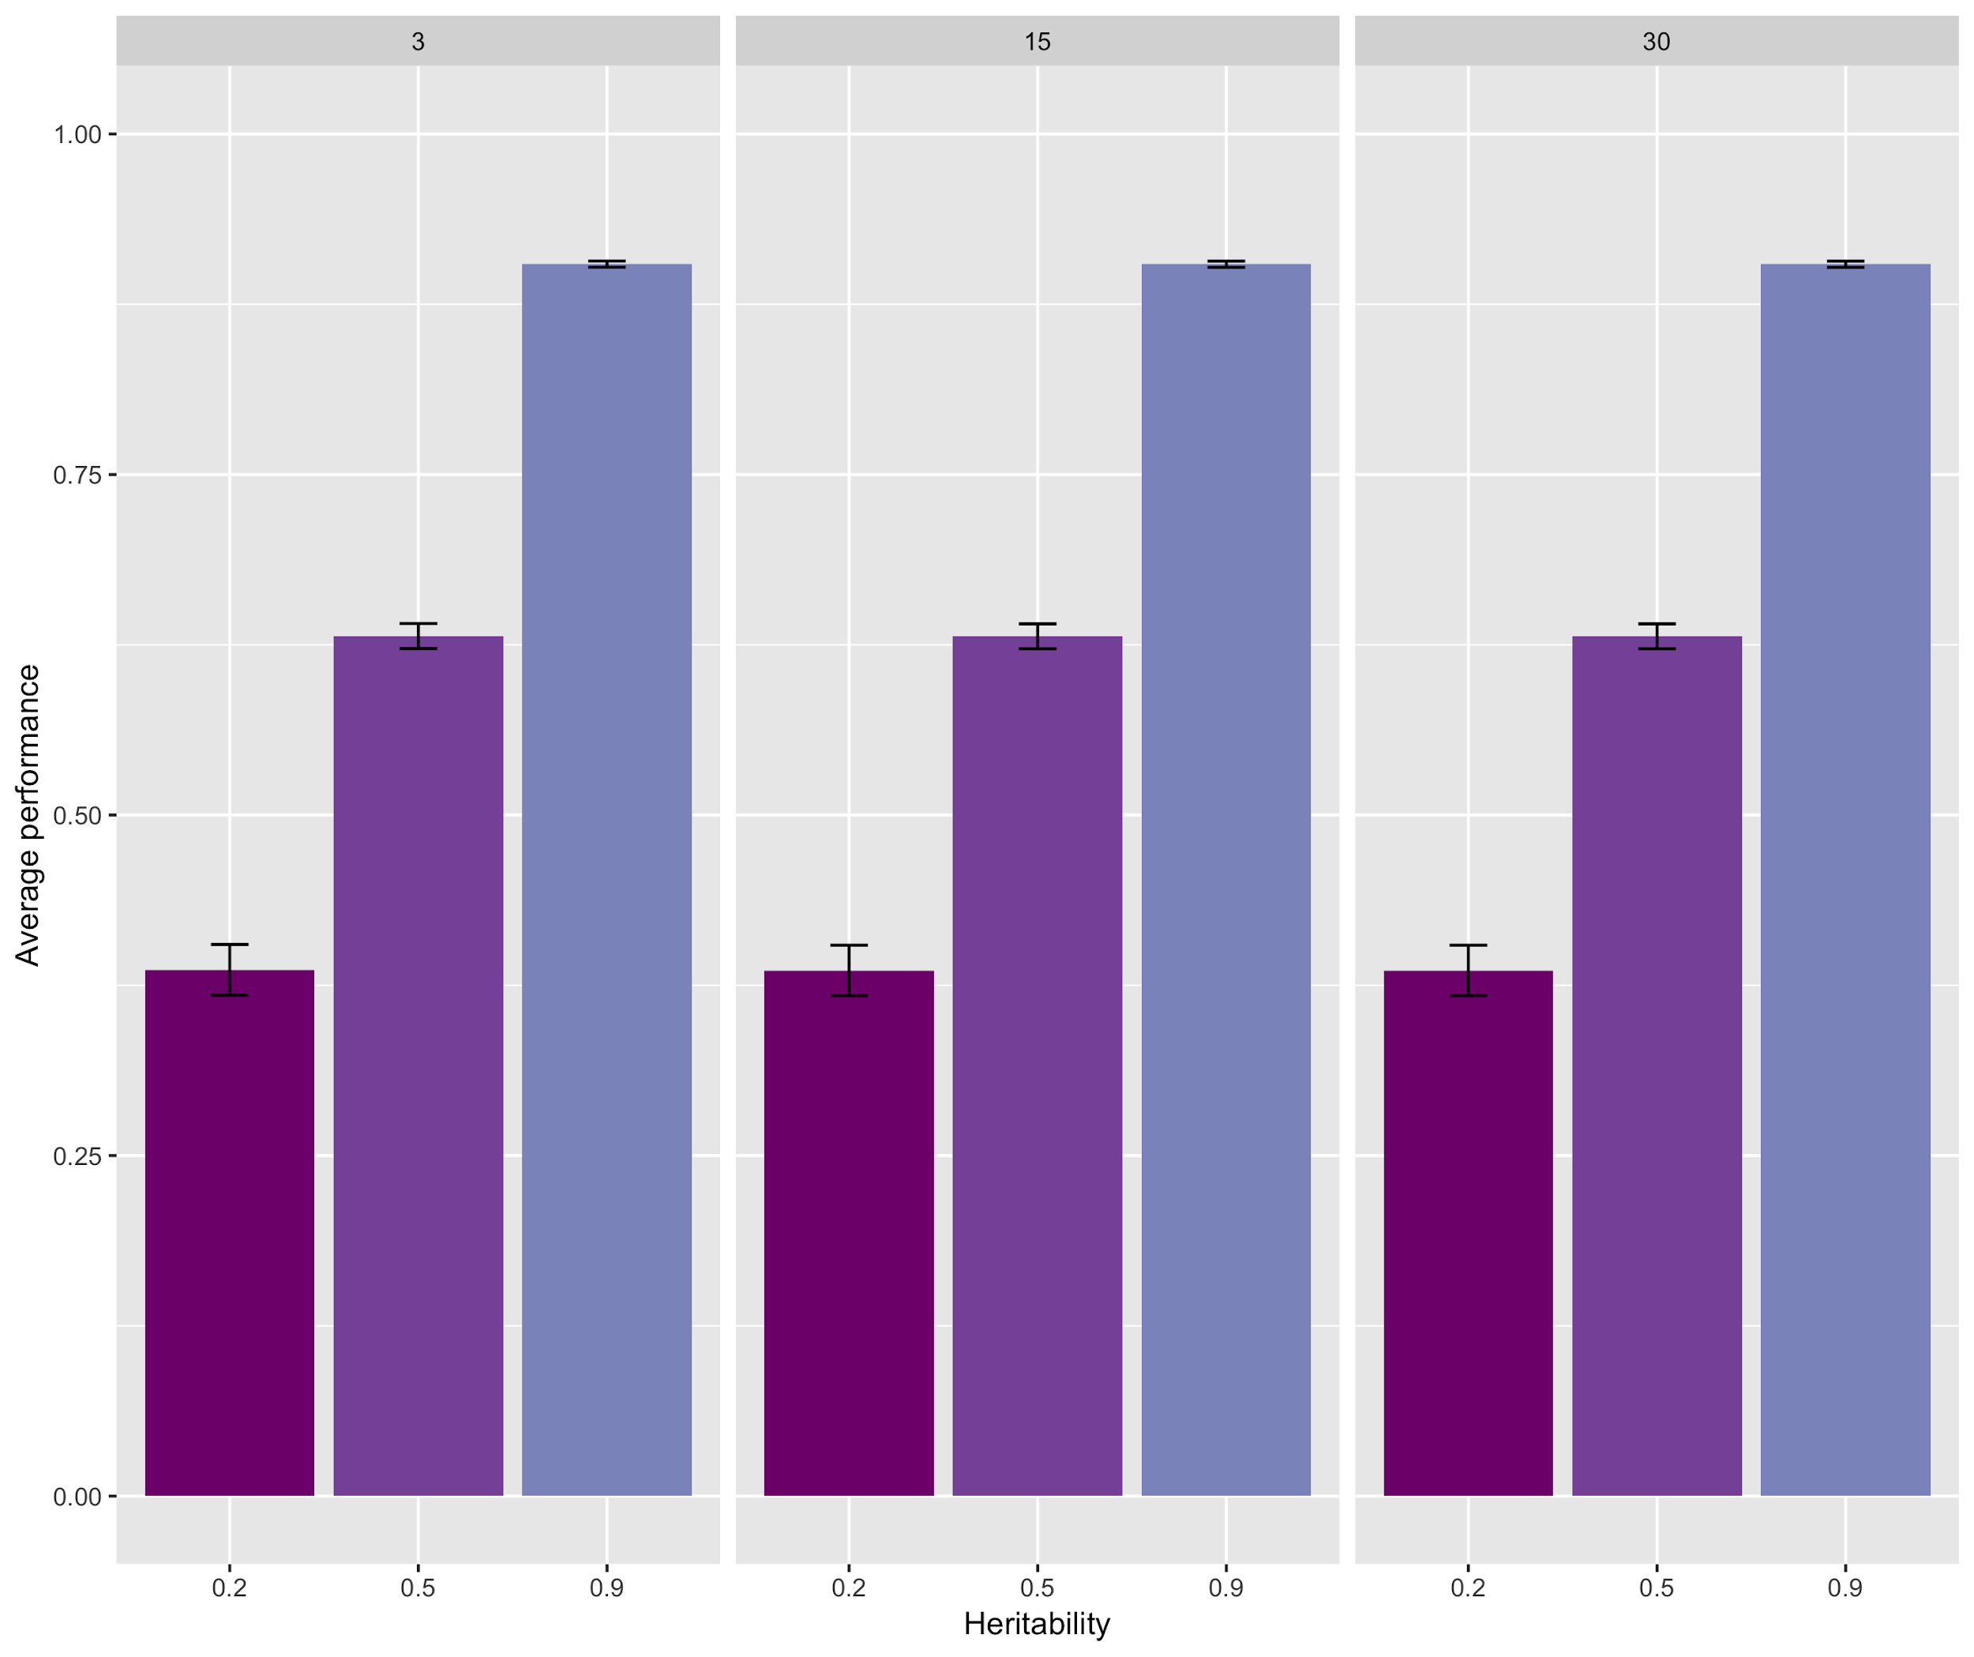
Notes:
Average of 3 replicates only
Source of trait variation: SNPs
Markers used in GS: SNPs
525 RILs were used.

Slide 29
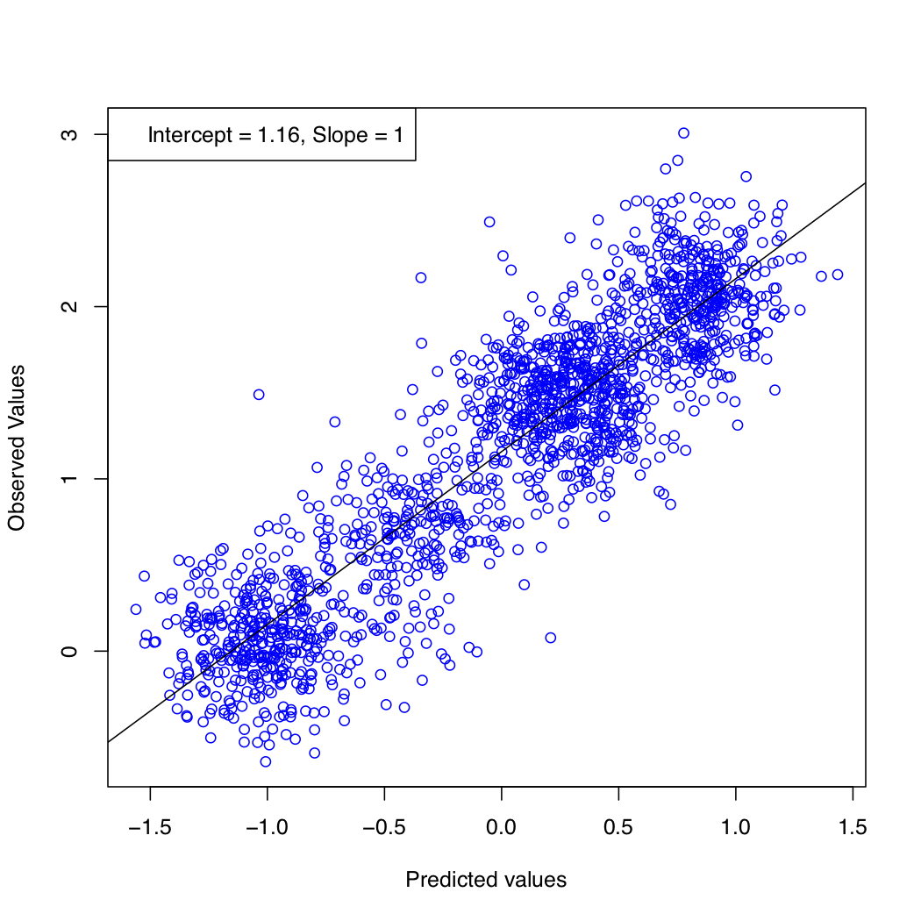
Source of variation: SNPs
Markers used in GS: SNPs
Notes:
15 QTNs, 0.9 heritability, one replicate

