Slide 1
Projection of SVs into RILs

Slide 2
vcf2hapmap.py
rs | alleles | chrom | pos | … | B73 | LH82 | PH207 | PHG35 | PHG39 | PHG47 | PHJ40
del.128335 | A/T | 1 | 687754 |  | AA | AA | TT | AA | TT | AA | AA
del.128340 | A/T | 1 | 1019148 |  | AA | TT | TT | TT | TT | AA | TT
del.128361 | A/T | 1 | 1844797 |  | AA | AA | AA | AA | AA | AA | AA
…
dup.217115 | A/T | 1 | 3978900 |  | AA | AA | TT | AA | AA | AA | AA
…

Slide 3
vcf2hapmap.py
rs | alleles | chrom | pos | … | B73 | LH82 | PH207 | PHG35 | PHG39 | PHG47 | PHJ40
del.128335 | A/T | 1 | 687754 |  | AA | AA | TT | AA | TT | AA | AA
del.128340 | A/T | 1 | 1019148 |  | AA | TT | TT | TT | TT | AA | TT
del.128361 | A/T | 1 | 1844797 |  | AA | AA | AA | AA | AA | AA | AA
…
dup.217115 | A/T | 1 | 3978900 |  | AA | AA | TT | AA | AA | AA | AA
…

Slide 4
vcf2hapmap.py
rs | alleles | chrom | pos | … | B73 | LH82 | PH207 | PHG35 | PHG39 | PHG47 | PHJ40
del.128335 | A/T | 1 | 687754 |  | AA | AA | TT | AA | TT | AA | AA
del.128340 | A/T | 1 | 1019148 |  | AA | TT | TT | TT | TT | AA | TT
del.128361 | A/T | 1 | 1844797 |  | AA | AA | AA | AA | AA | AA | AA
…
dup.217115 | A/T | 1 | 3978900 |  | AA | AA | TT | AA | AA | AA | AA
…
[middle point]

Slide 5

merge_SNPs_SVs_hapmaps.R
 | B73 | LH82 | PH207 | …
SNP | 0 | 0 | 0
SNP | 0 | 2 | 0
SV | 0 | 2 | 0
SNP | 0 | 2 | 2
SV | 0 | 0 | 2
SNP | 0 | 0 | 0
…
+
SNPs.hmp
SVs.hmp
(~20k)
(~10k)

Slide 6
FILLIN (TASSEL 5)
Separate RILs into respective populations
Generate haplotypes from parents
Project haplotypes into RIL missing data

Slide 7
Projection of SVs
 | B73xLH82 | B73xPH207 | B73xPHG39 | B73xPHG47 | LH82xPH207 | LH82xPHG39 | LH82xPHG47
*Accuracy | 0.81 | 0.83 | 0.83 | 0.63 | 0.72 | 0.78 | 0.78
 | PH207xPHG47 | PHG39xPHG47 | B73xPHG35 | LH82xPHG35 | PHG35xPHG39 | PHG35xPHG47
*Accuracy | 0.8 | 0.81 | 0.44 | 0.27 | 0.26 | 0.35
* Shady accuracy determined by TASSEL

Slide 8
More QC on SNP data

Slide 9
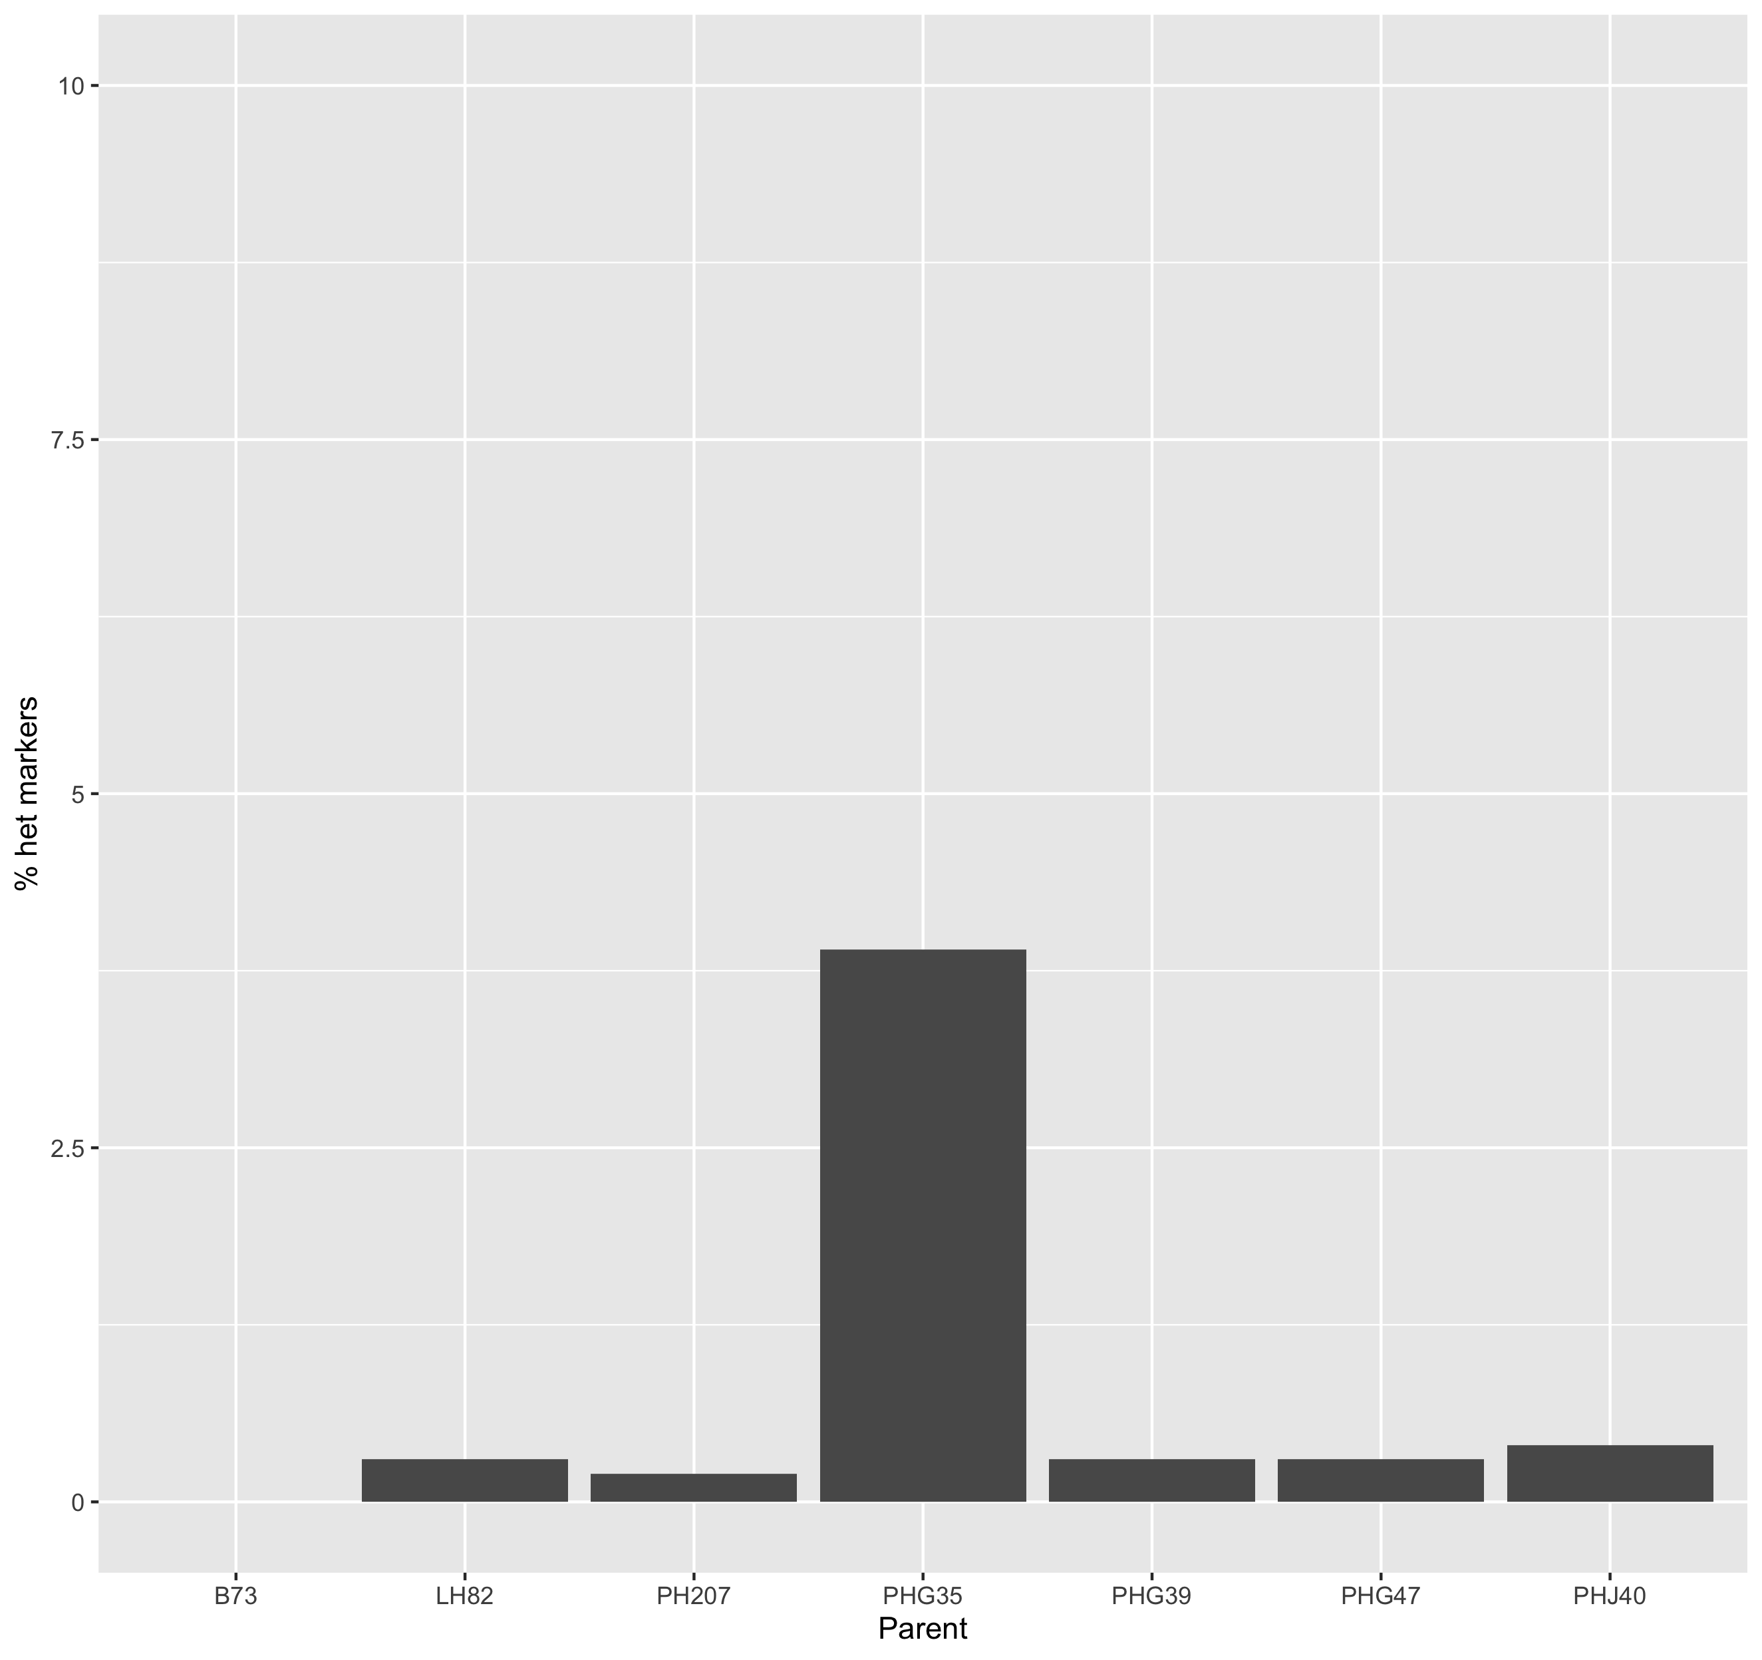
Heterozygous markers
in parents

Slide 10
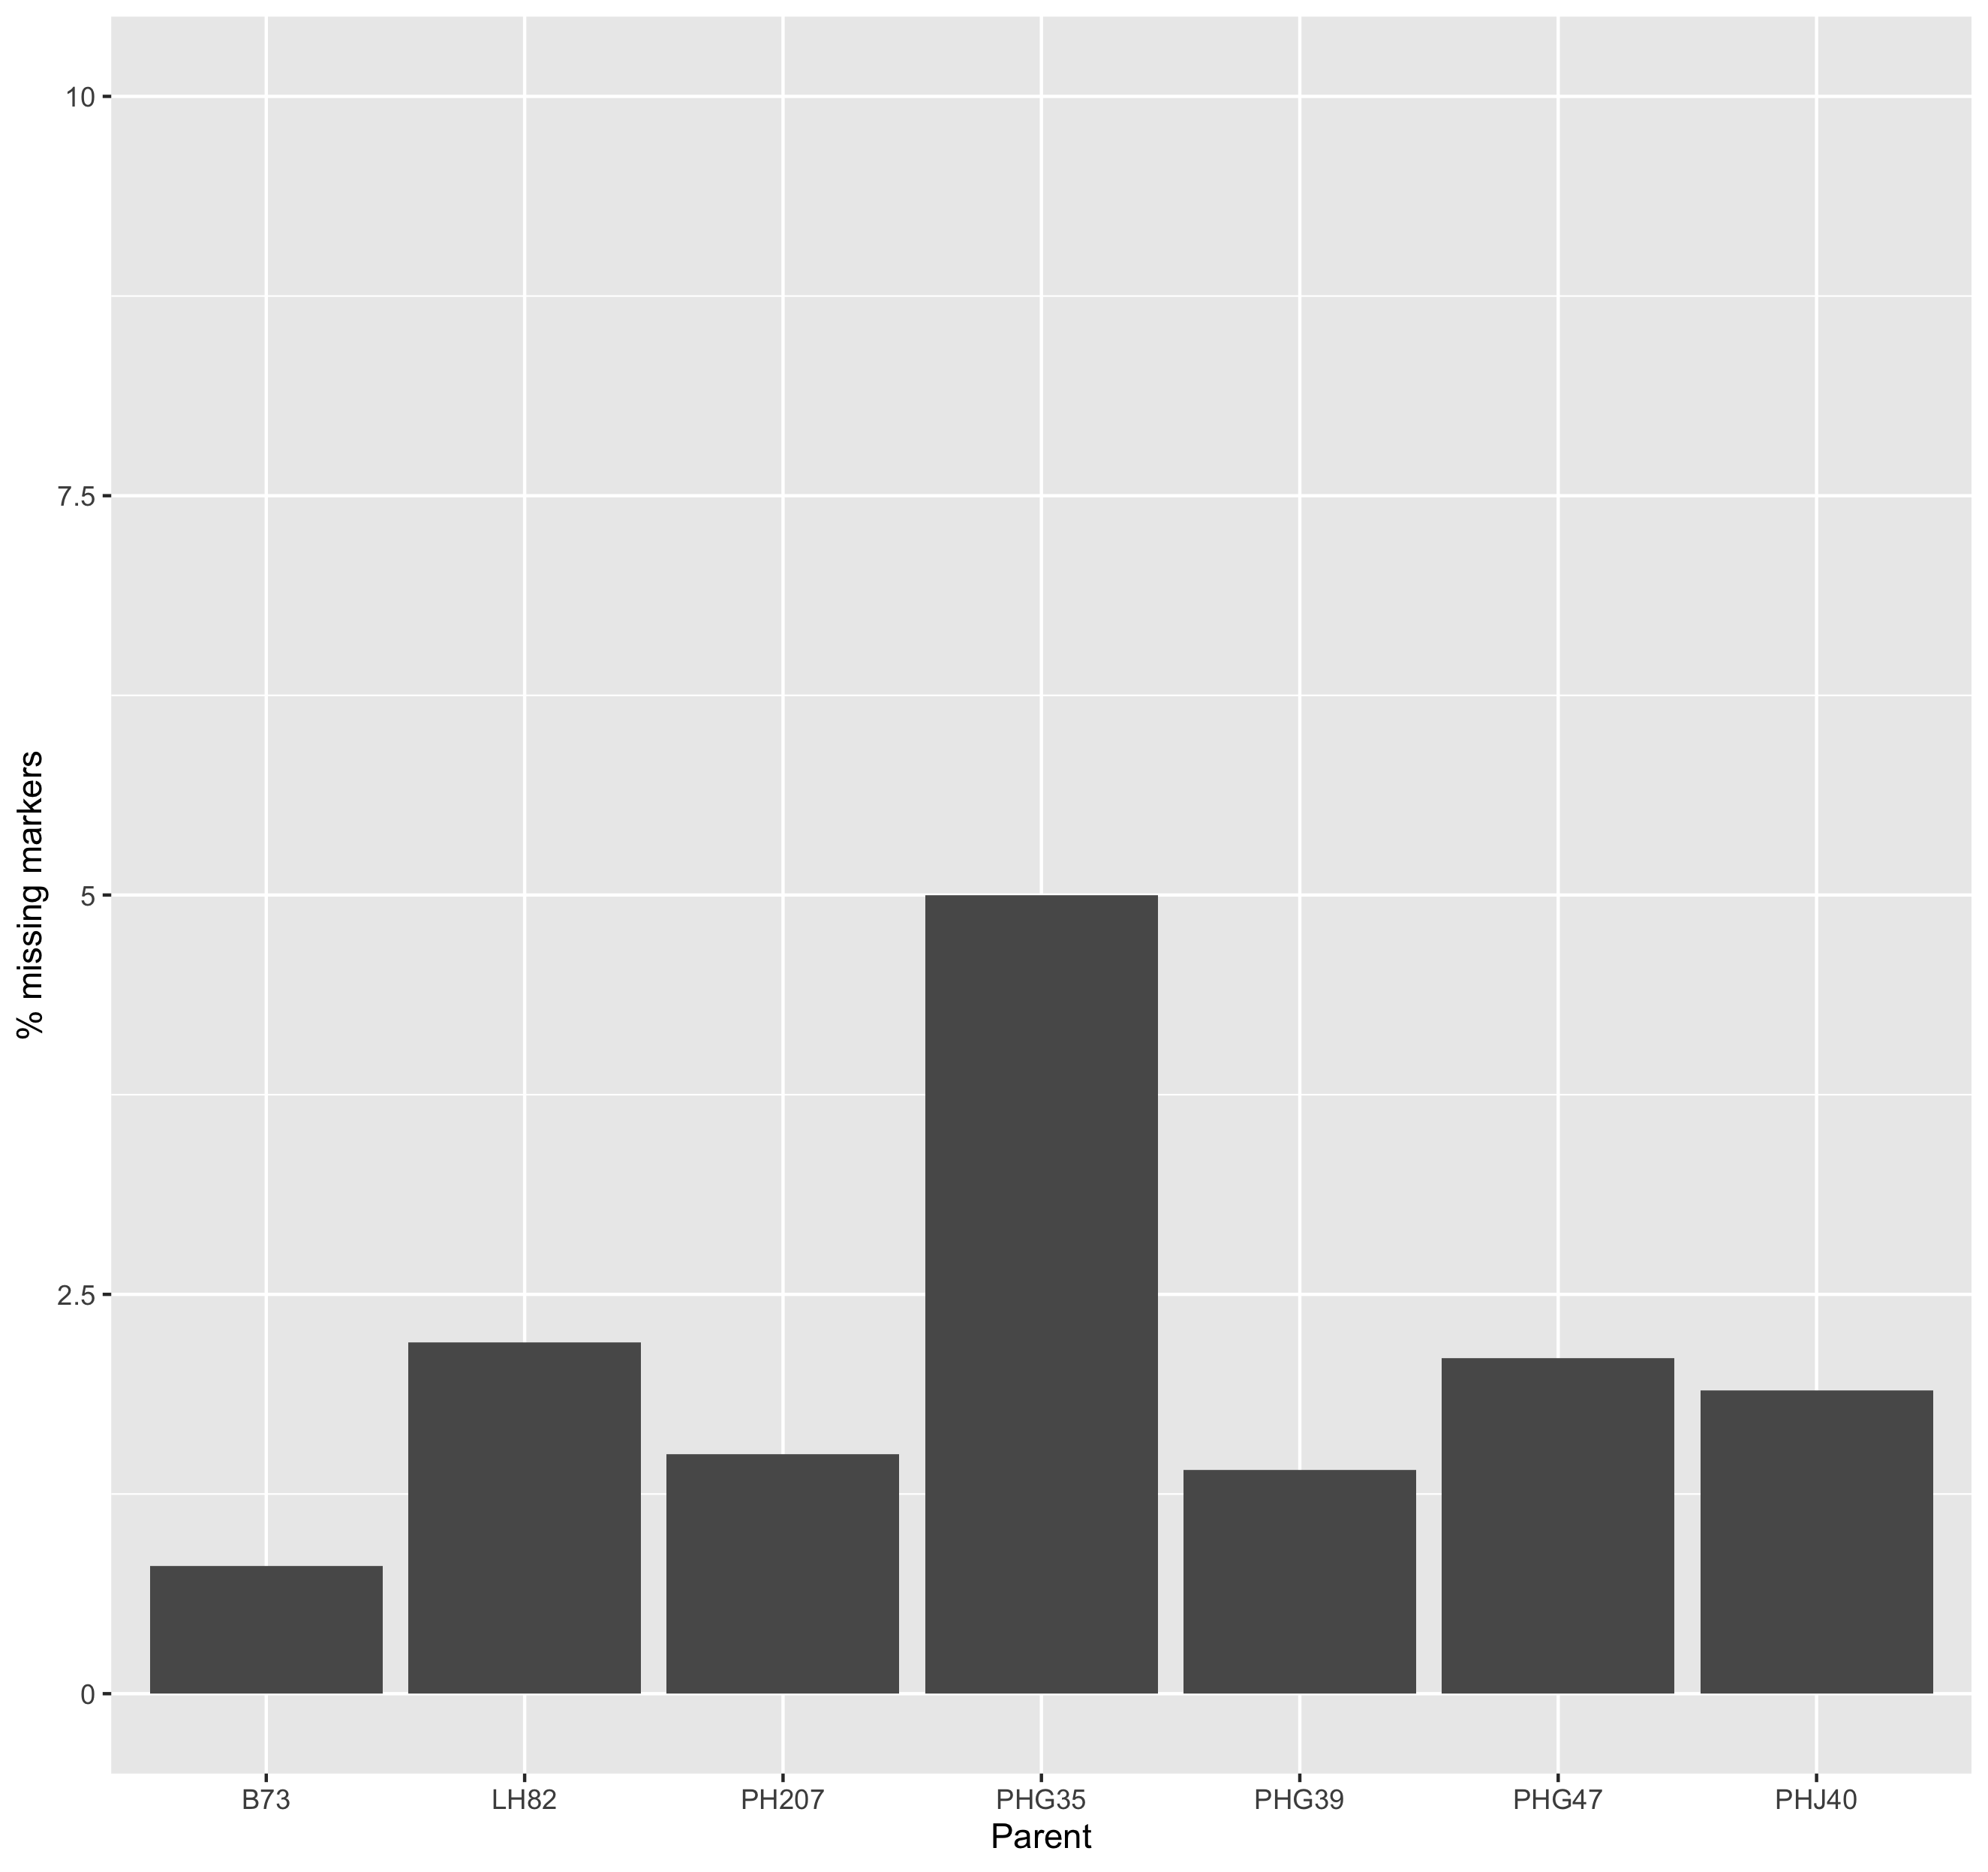
Missing markers
in parents

Slide 11
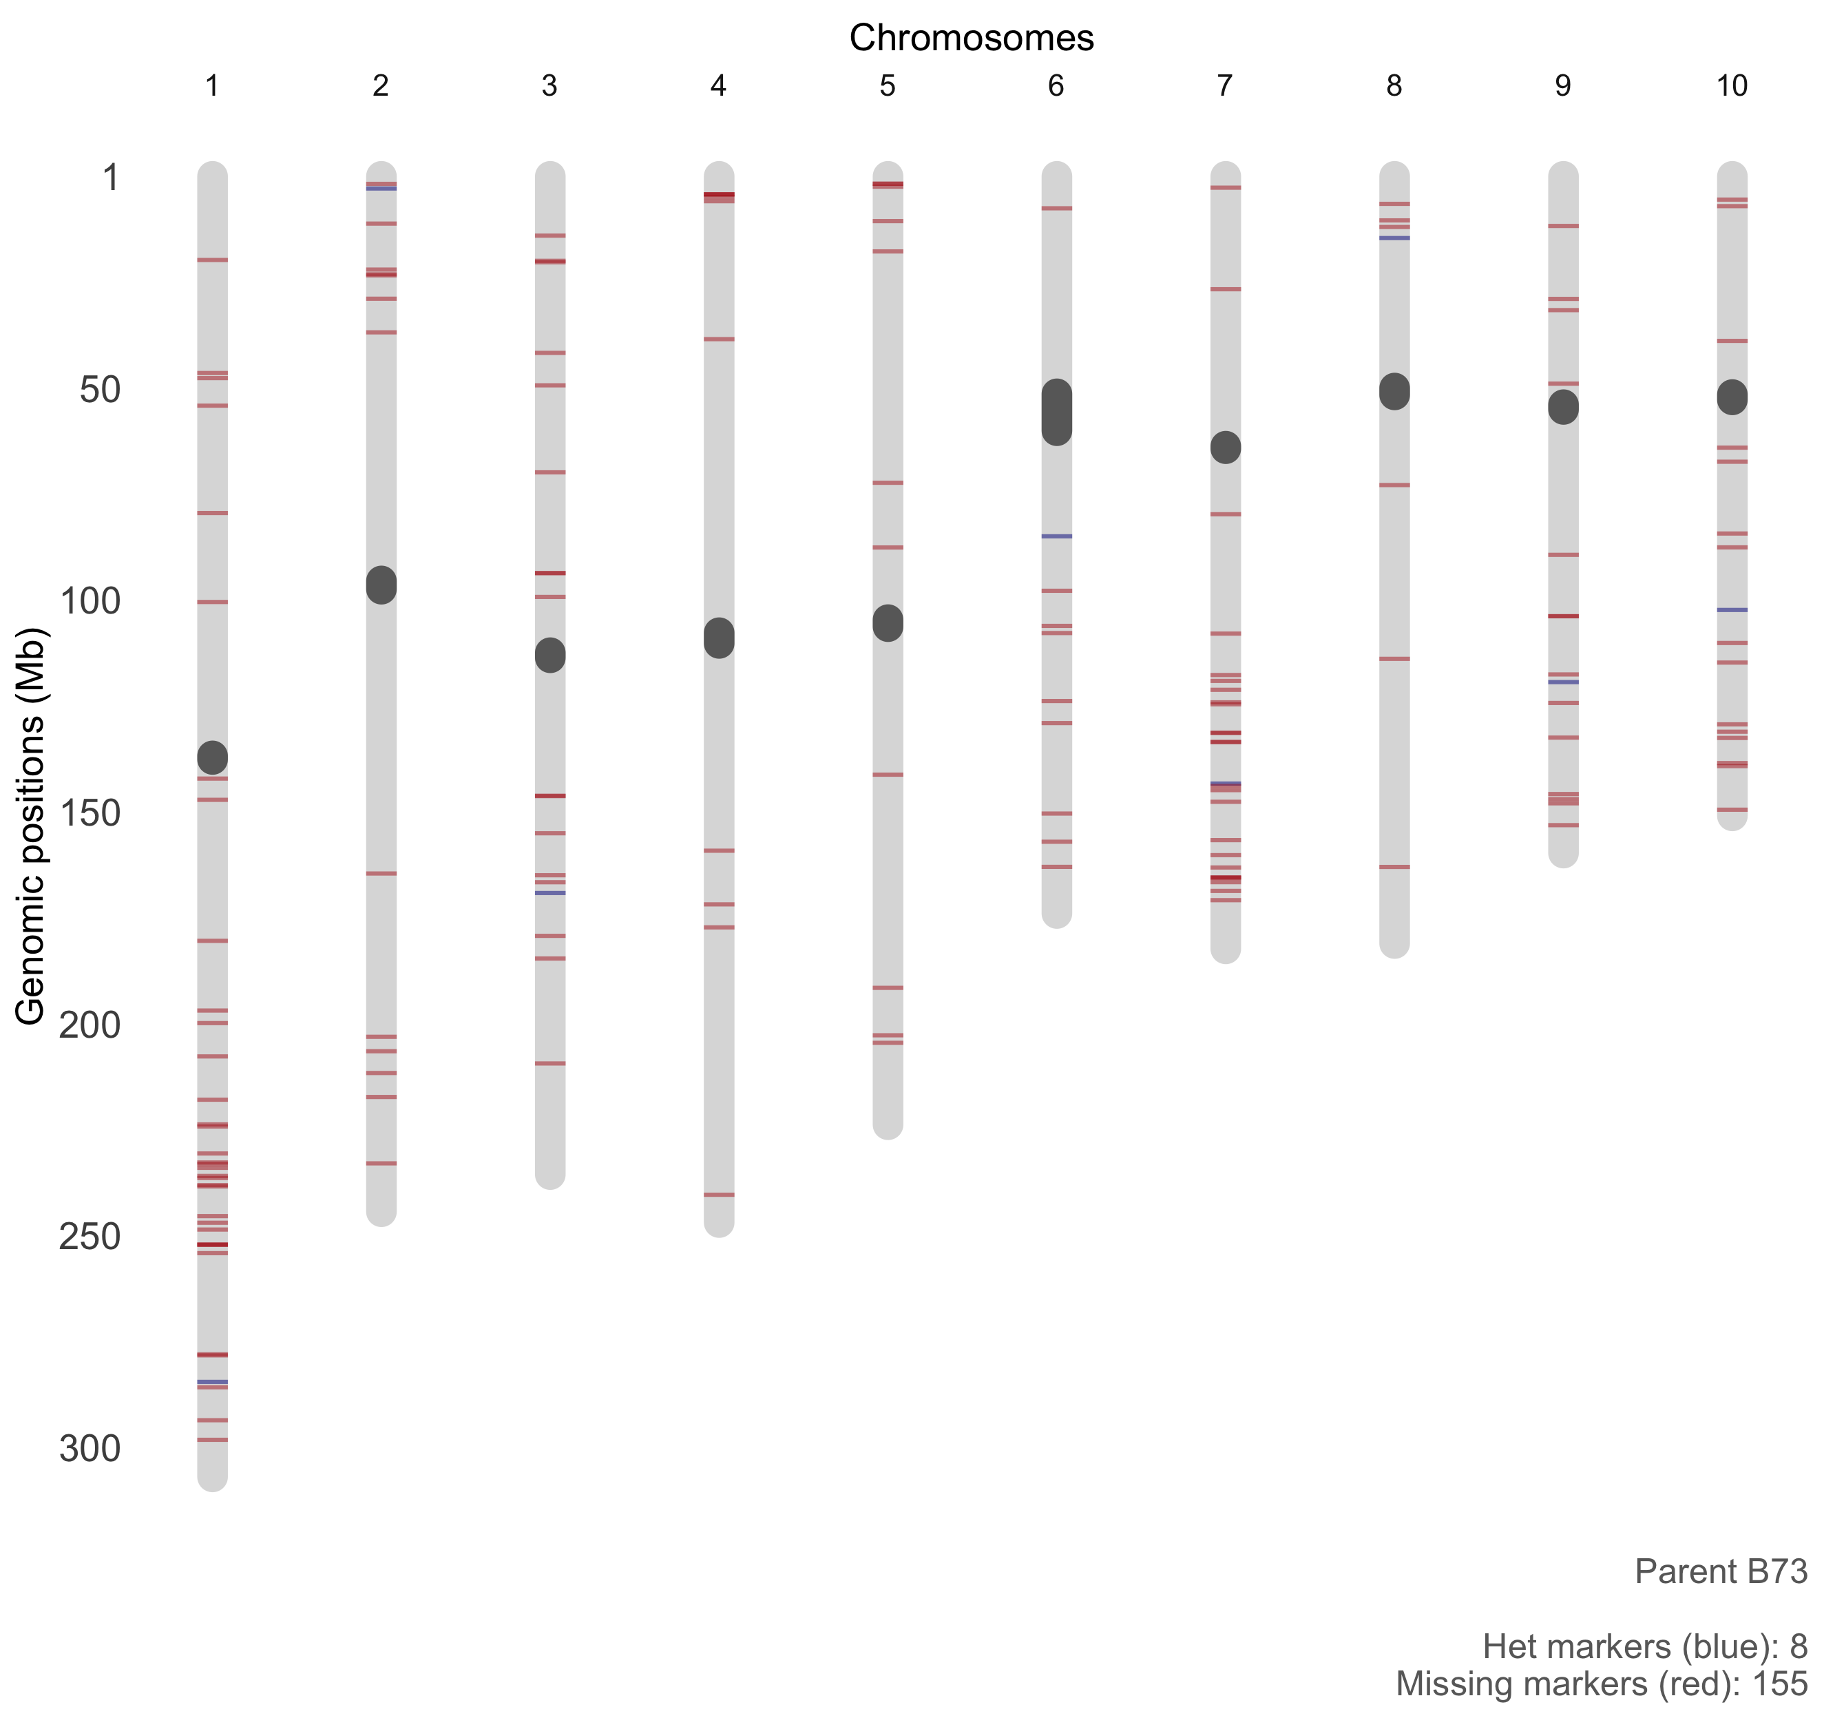

Slide 12
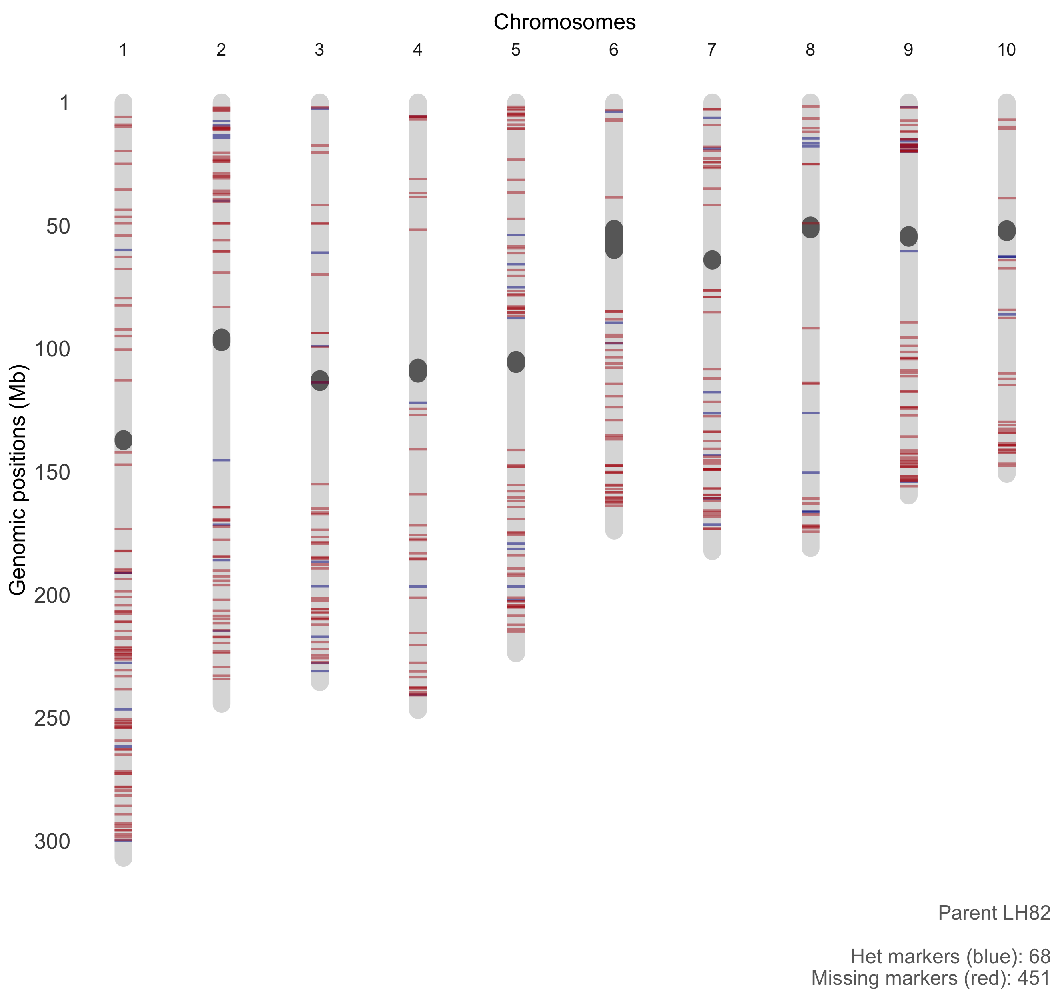

Slide 13
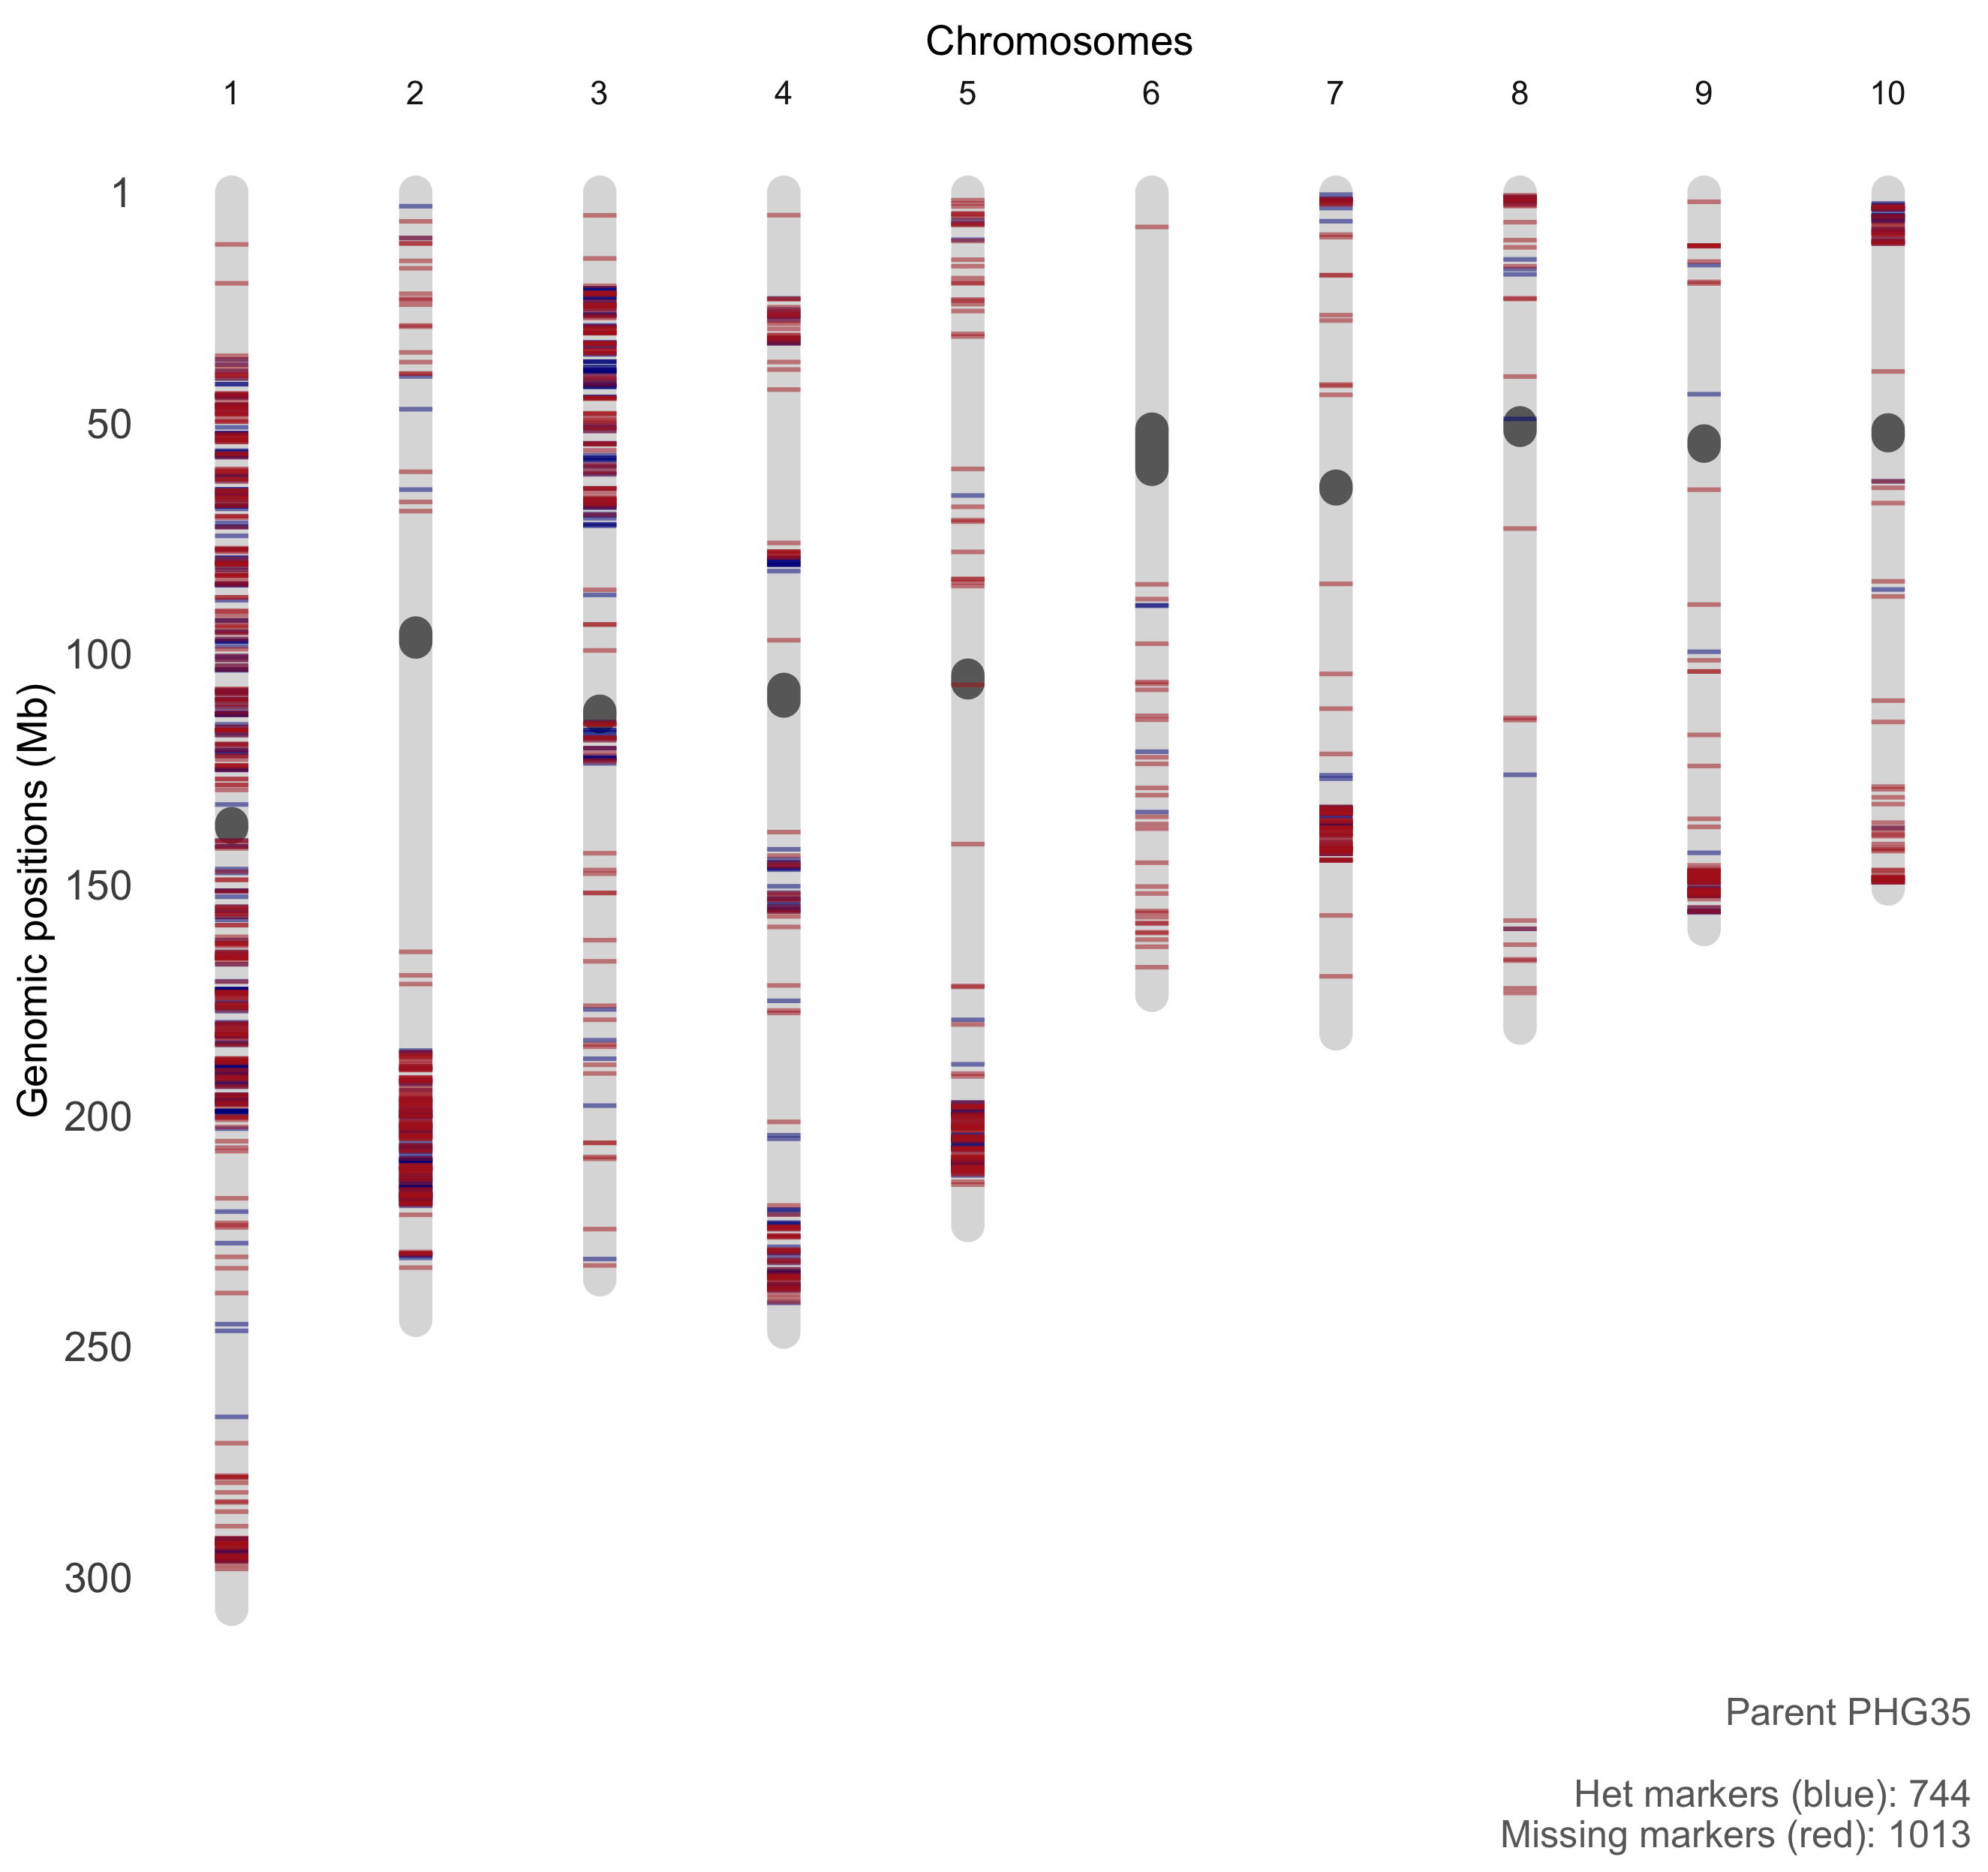

Slide 14
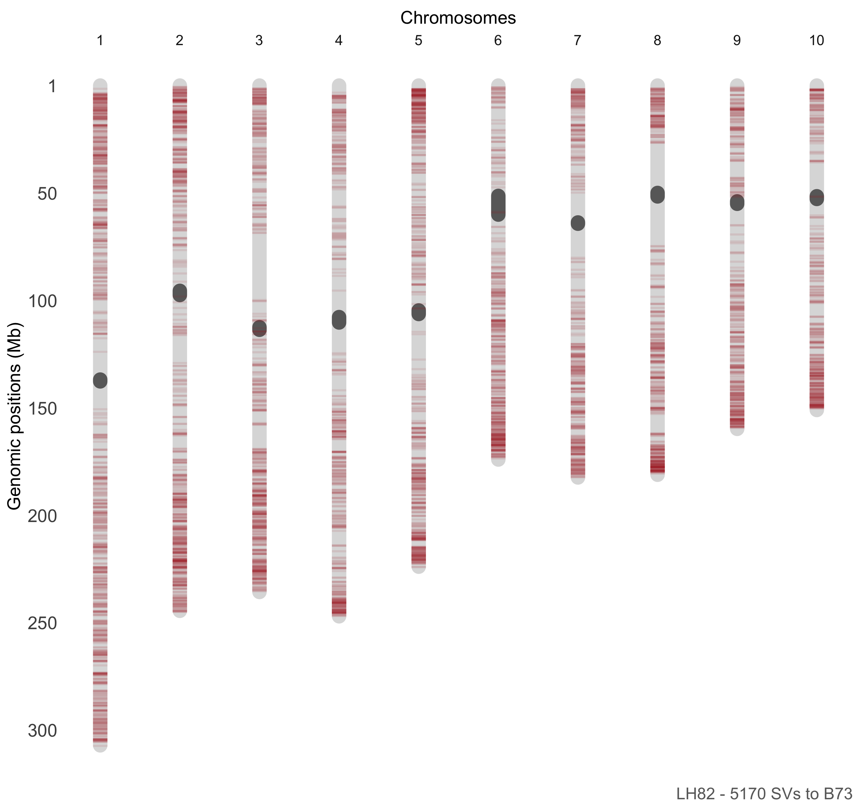

Slide 15
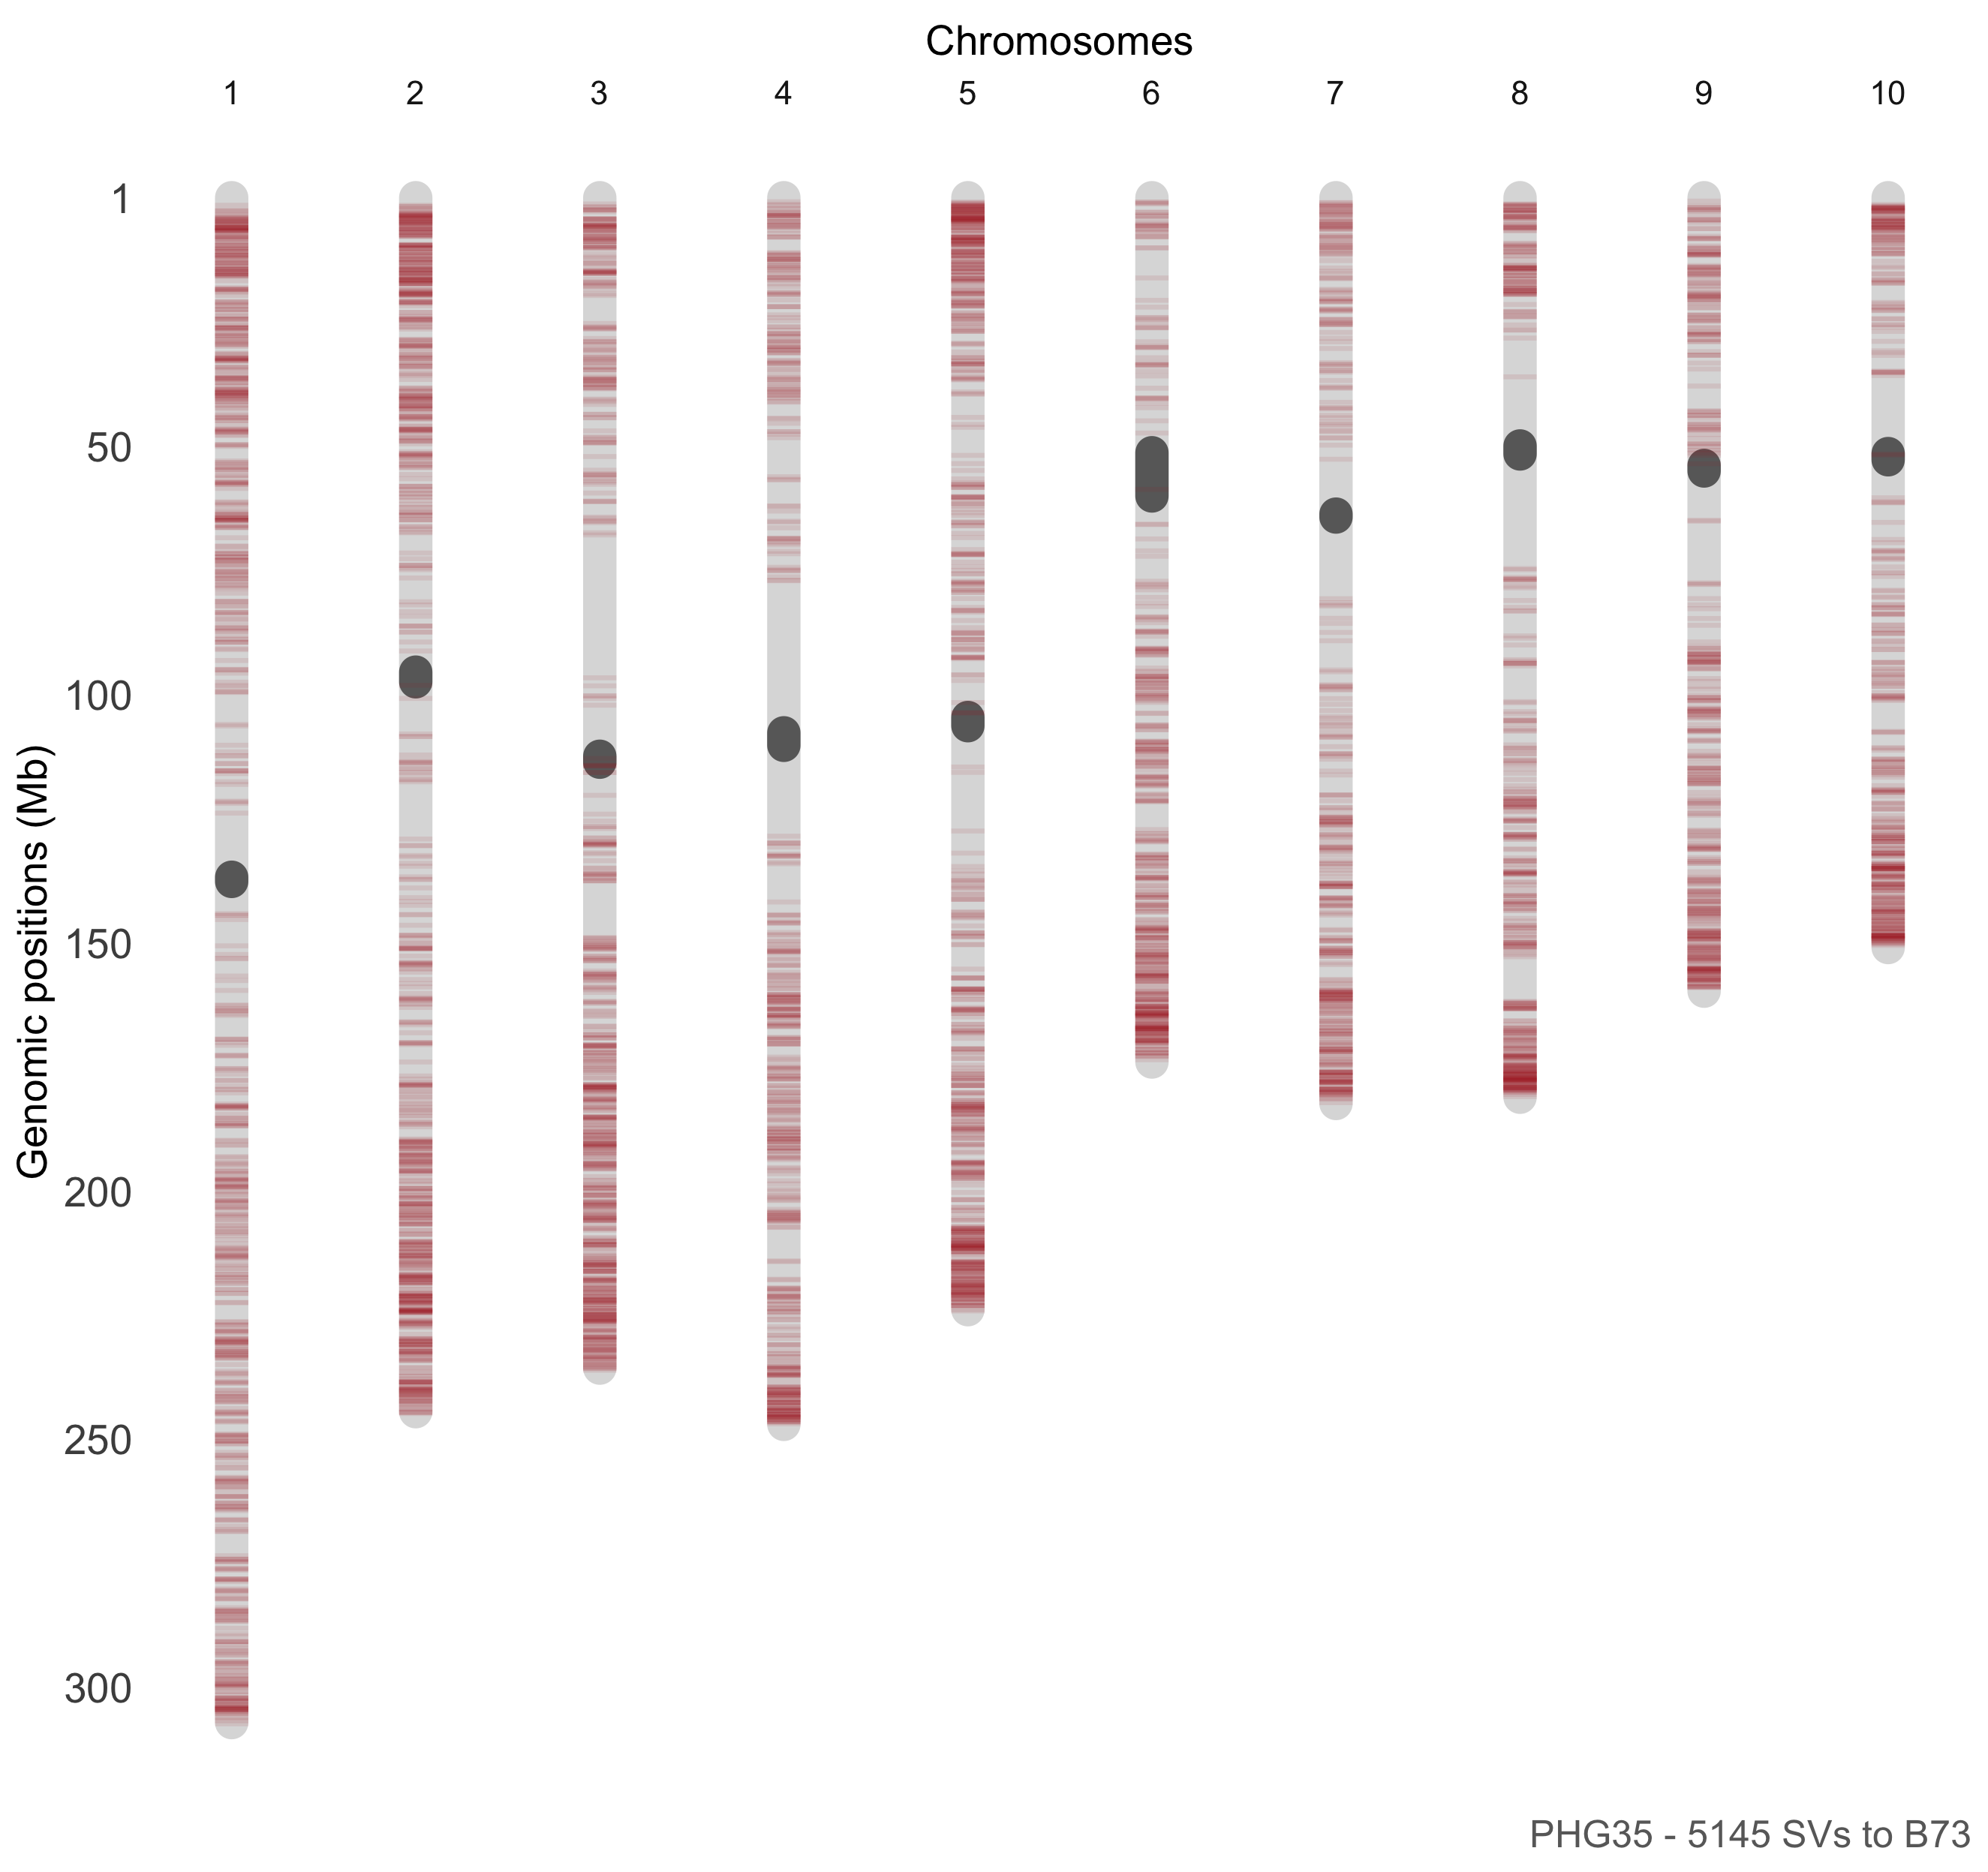

Slide 16
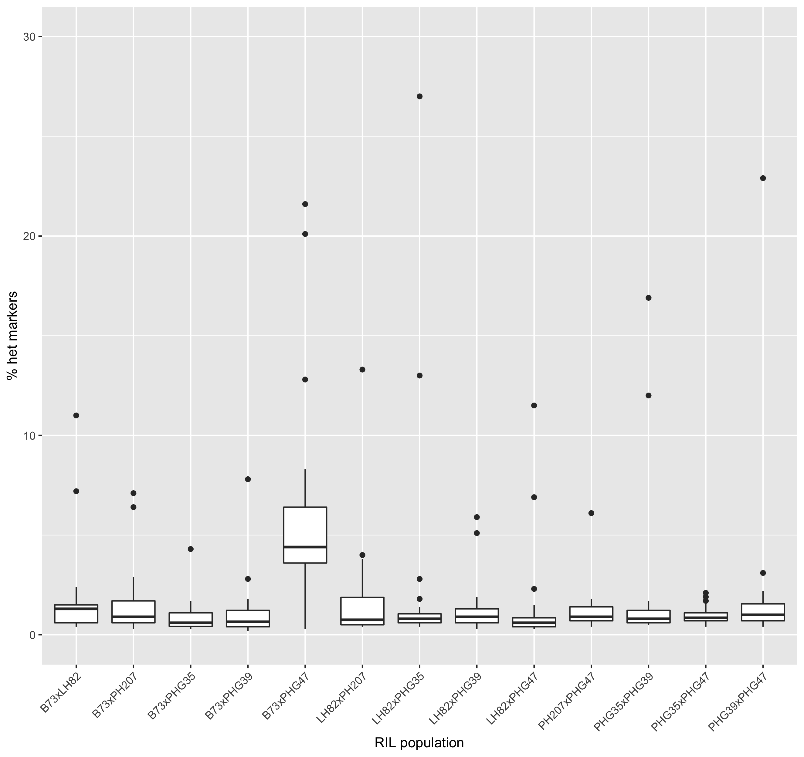
Heterozygous markers per cross

Slide 17
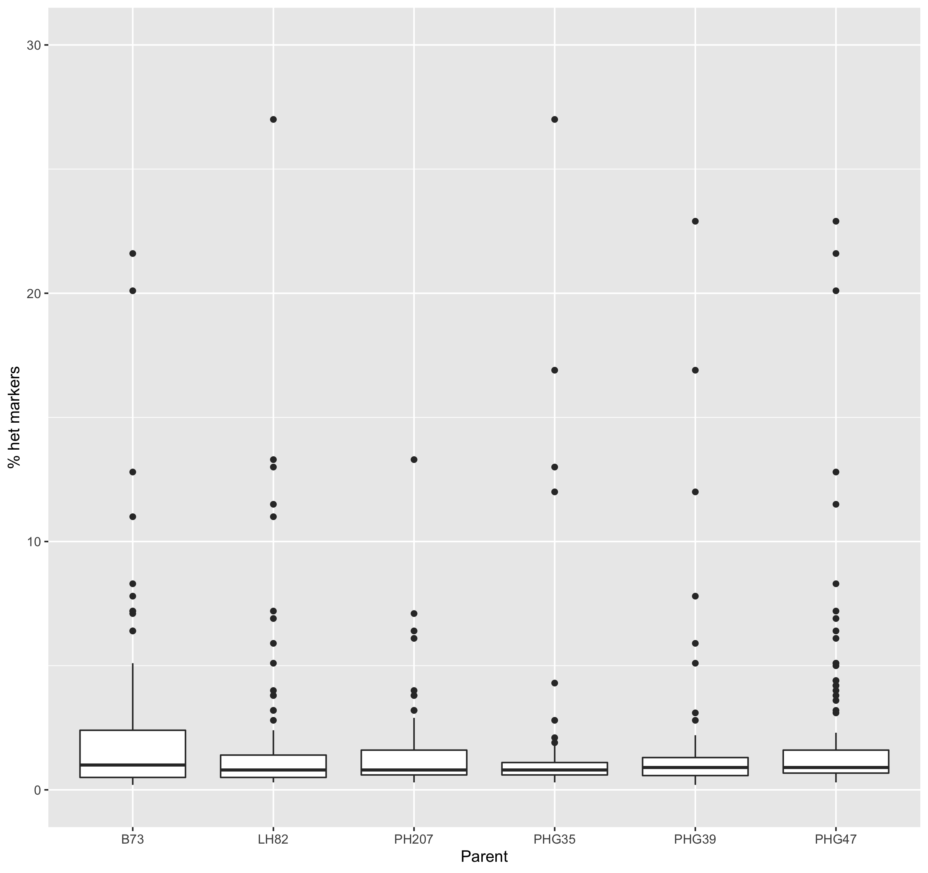
Heterozygous markers per parent

Slide 18
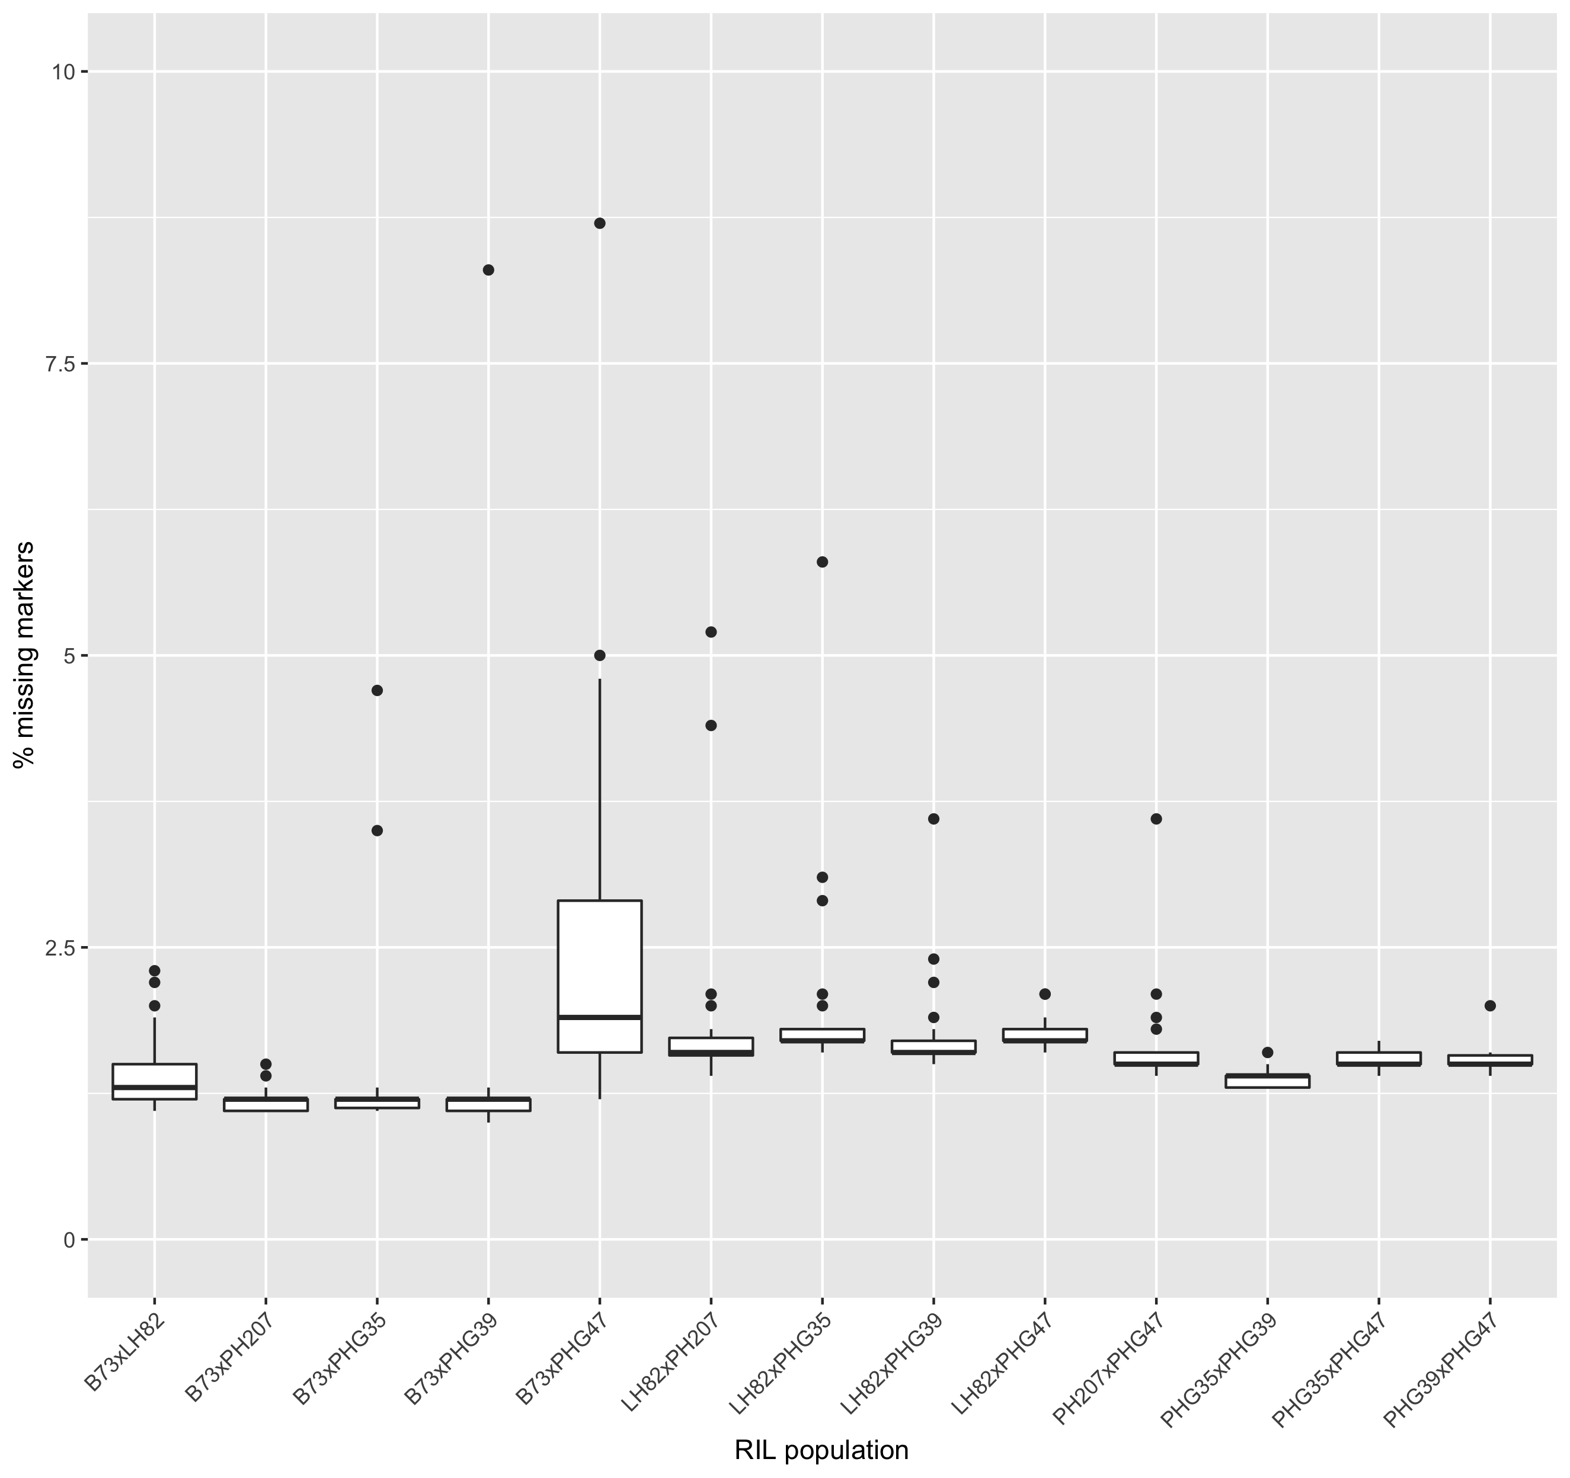
Missing markers per cross

Slide 19
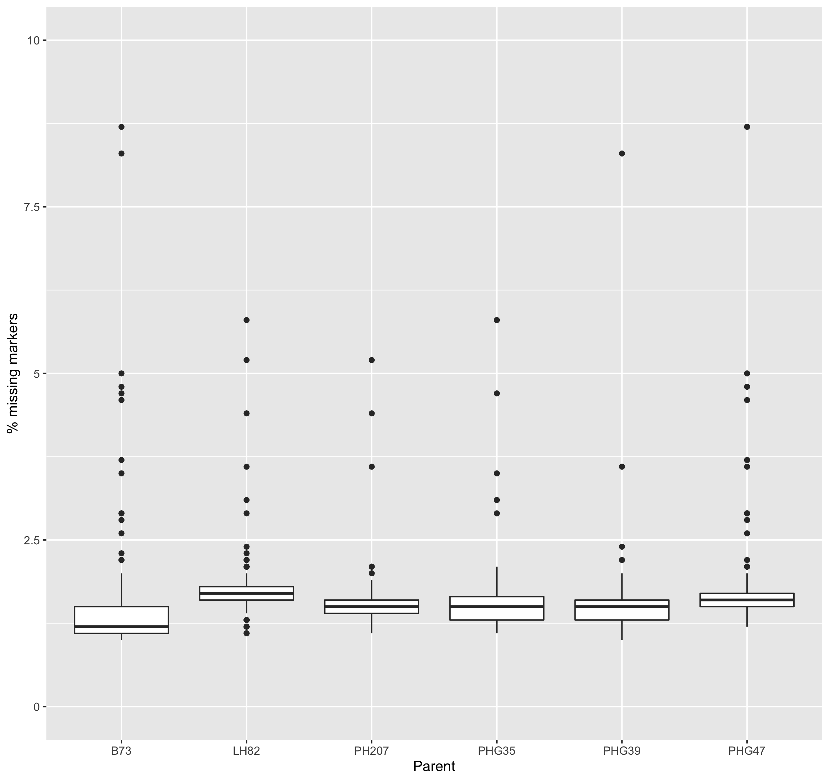
Missing markers per parent

Slide 20
Projecting SNP data parents to RILs
parameters | correct projection | not imputed | other mismatches
all markers, 1% masked | 97.13% | 0.84% | 2.03%
all markers, 10% masked | 94% | 3.50% | 2.50%
all markers, 50% masked | 74.31% | 22.44% | 3.25%
only homo, 1% masked | 99.12% | 0.39% | 0.49%
only homo, 10% masked | 96.33% | 1.79% | 1.88%
only homo, 50% masked | 81.73% | 14.65% | 3.62%

Slide 21
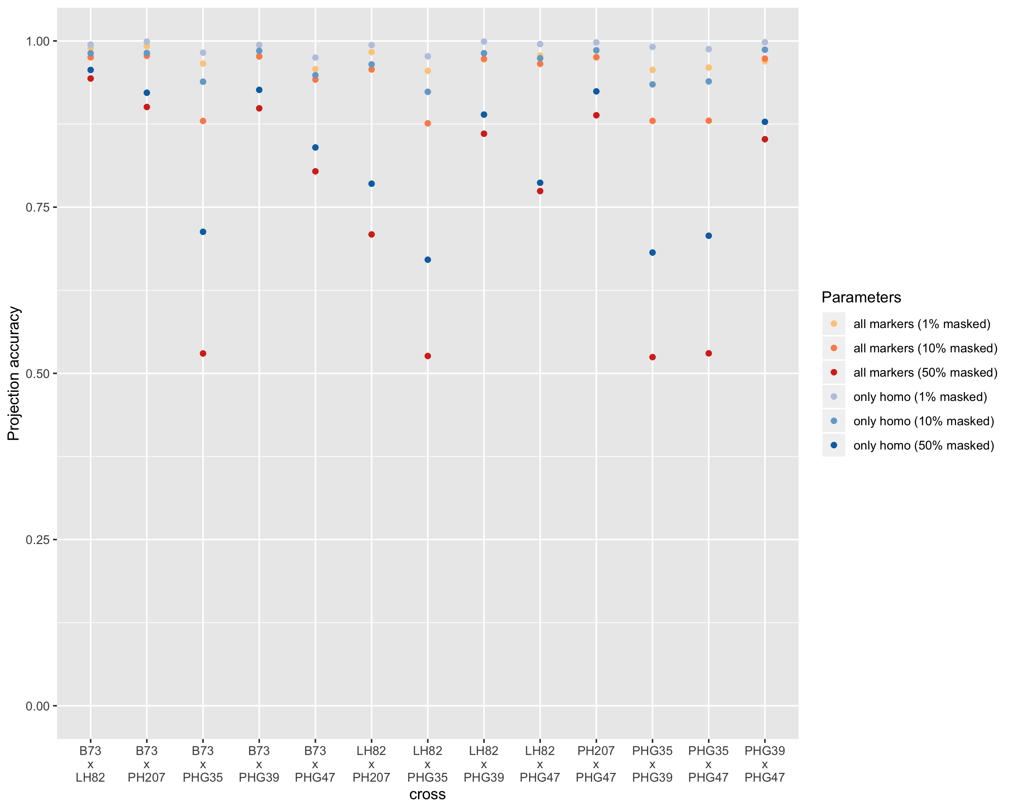

Slide 22
TO DO:
Map SNPs from v2 to v4
Filter out SNPs that fall inside boundaries of SV

