Slide 1

TWO-AXIS ROBOTIC ARM FOR SURFACE MAPPING
VENKATA NAGARJUN
HIRSHIK RAM

Slide 2
PROJECT OVERVIEW
The goal of the project is to map an unknown surface and store it as Point Cloud Data.
The surface is to be mapped using a LIDAR sensor mounted on a two-axis robotic arm.
The arm is driven by stepper motors while the LIDAR sensor interfaces with microcontroller.
The data collected is sent to a PC for Point Cloud Data generation.

Slide 3
PROJECT SETUP
Two-axis arm setup
Stepper motors
LIDAR sensor
Arduino UNO
HMI
Computer System for LIDAR data storage and processing

Slide 4
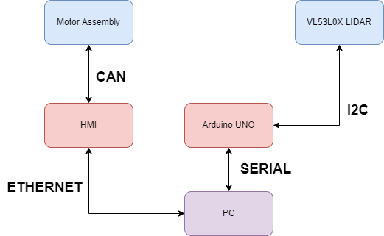
BLOCK DIAGRAM

Slide 5

PROGRESS – 1 – LIDAR Data Collection
Communication is established between Arduino UNO and LIDAR sensor through I2C protocol.
The distance data measured by the LIDAR is sent to the Arduino every 1 second.
Serial communication is established between Arduino and PC.
Arduino send the data as a custom dataframe.
Python script is used to log the serial data as a CSV file onto the PC for further processing.

Slide 6
PROGRESS – 2 – Data Processing
Validity of every dataframe is verified by checking the length of the dataframe and it’s starting and ending character.
The sequence number, distance, and the motor count values are picked for further processing.
Motor angle is calculated using count values.
Given the joint data and the LIDAR measurement, kinematics is used to generate the Point Cloud Data which is plotted.

Slide 7
Thank you

