Slide 1


GenAI-Based Intelligent Insurance Application Processing System
INTERNAL FACULTY GUIDE
Dr.S.T. Padmapriya
Assistant Professor,
Thiagarajar College of Engineering,
Madurai.
EXTERNAL INDUSTRY GUIDE
Mr. Aravinthan Vivekanandan
Principal Engineer (Team Lead),
D3minds Cyber Solutions,
Madurai.
PRESENTED BY:
NAME : HIRTHICK S
REG.NO : (917721S011)
Semester : Xth Msc(DataScience)
Department : Applied Mathematics and Computational Science

Slide 2


About the Organization :
Established in 2018, D3minds Cyber Solution Private Limited operates as an innovative digital transformation partner specializing in Industry 4.0 and enterprise software development. The organization focuses on building high-quality products that enhance productivity and safety through cutting-edge technologies like Cloud Computing, Artificial Intelligence, and Cyber Security.
Diverse Domain Expertise: They serve various industries including manufacturing, supply chain, and fintech by delivering scalable solutions such as warehouse management and execution systems.
Customer-Centric Innovation: The company prioritizes speed and agility in deployment to help clients stay ahead of the technology curve while maintaining competitive pricing.
Comprehensive Security Focus: D3minds provides robust cyber security services, including vulnerability assessments and cloud security across major platforms like AWS and Azure.
Talent-Driven Culture: They foster a collaborative and skill-oriented work environment that encourages continuous learning and professional development for its team of experts.

Slide 3
Introduction
The insurance industry processes thousands of applications every day, relying heavily on manual methods that take 5–7 days per application and result in 15–20% data entry errors. This delay and inaccuracy negatively impact underwriting efficiency and customer satisfaction.
Insurance application documents are largely unstructured, including handwritten medical histories, free-form questionnaires, scanned forms, PDFs, and email attachments. The lack of standardization across document formats makes automated data extraction complex and unreliable using traditional systems.
To address these challenges, this project proposes a GenAI-Based Intelligent Insurance Application Processing System using Microsoft Azure cloud services. The system combines OCR and Generative AI to understand and extract meaningful information from unstructured insurance documents.
The automated pipeline digitizes documents using Azure Form Recognizer, extracts key details using GPT-4, validates the data, and integrates it with insurance systems via APIs. This approach reduces processing time by 99%, improves accuracy to over 95%, and enables scalable processing of more than 1000 applications per hour.

Slide 4
Abstract
Digital Transformation Need : Modern insurance operations require faster and more reliable document handling to meet growing customer expectations and regulatory requirements. Traditional manual workflows fail to scale during peak volumes, leading to delays in underwriting and policy issuance.
Intelligent Automation Approach : This project introduces an AI-driven automation framework that combines OCR, cloud computing, and Generative AI to interpret insurance documents contextually. The system can understand both structured fields and free-text content without manual intervention.
End-to-End System Workflow : The system operates as a seamless pipeline from document ingestion to structured data output. Using cloud-based services such as Azure for OCR and AI processing, stages like digitization, intelligent extraction, validation, and integration are fully automated for consistency and traceability.
Business and Operational Value : By automating document understanding, the system significantly improves turnaround time and reduces dependency on manual labor. This results in faster decision-making, consistent data quality, enhanced customer experience, and improved operational scalability.

Slide 5
Proposed System
System Overview : The proposed system is a cloud-native, end-to-end automation solution designed to replace manual and error-prone insurance application processing. It intelligently converts unstructured insurance documents into structured, actionable data using AI-driven techniques.
Modular and Scalable Architecture : The system follows a modular architecture with distinct layers for input handling, OCR processing, GenAI intelligence, validation, integration, and presentation. This layered design ensures scalability, reliability, easy maintenance, and seamless system expansion.
Intelligent Processing and Automation : Insurance applications from multiple sources are digitized using OCR and analyzed using Generative AI to extract applicant, medical, and policy information. The extracted data is validated, mapped to predefined schemas, and prepared for automated system integration.
Integration, Monitoring, and Benefits : Validated structured data is automatically posted to insurance management systems through secure APIs, while dashboards provide real-time monitoring and quality checks. The system improves operational efficiency, data accuracy, scalability, and compliance while reducing cost and manual effort.

Slide 6
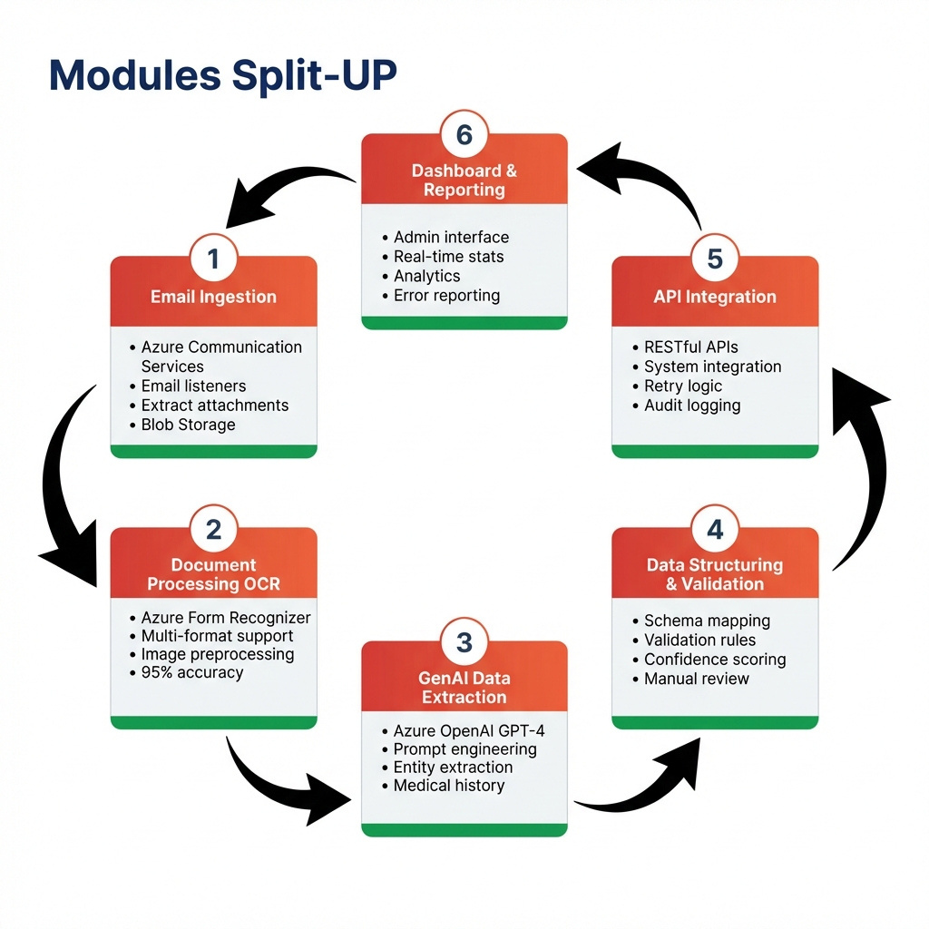
Proposed System

Slide 7
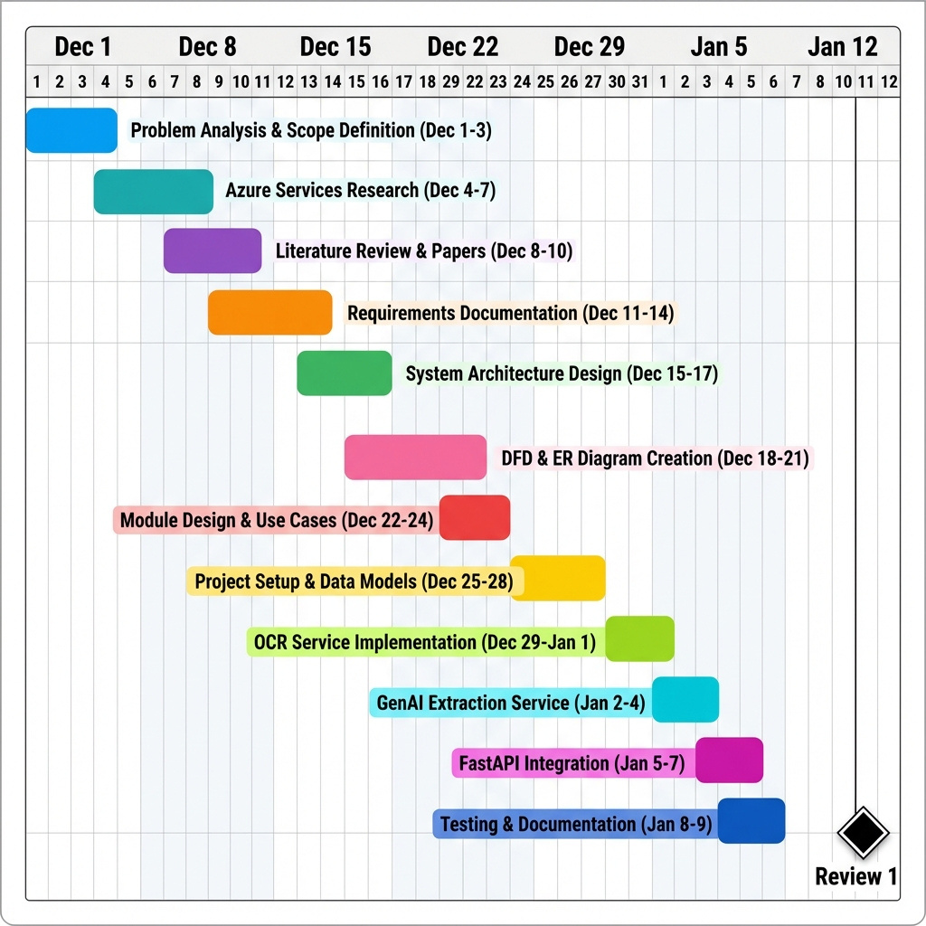
Gantt chart

Slide 8
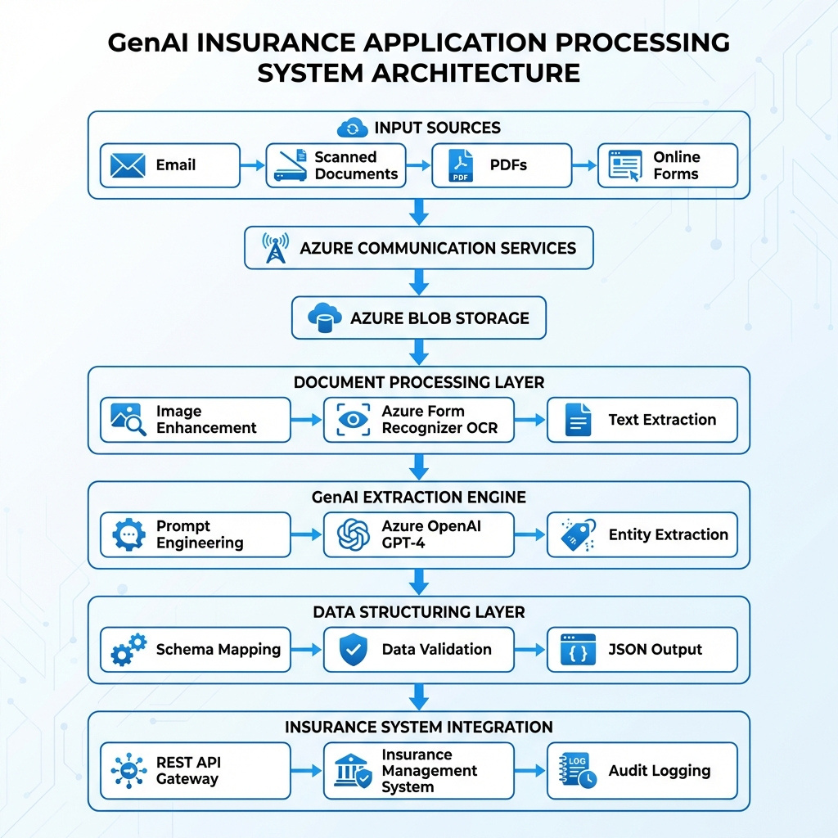
Architectural Design for Proposed System

Slide 9
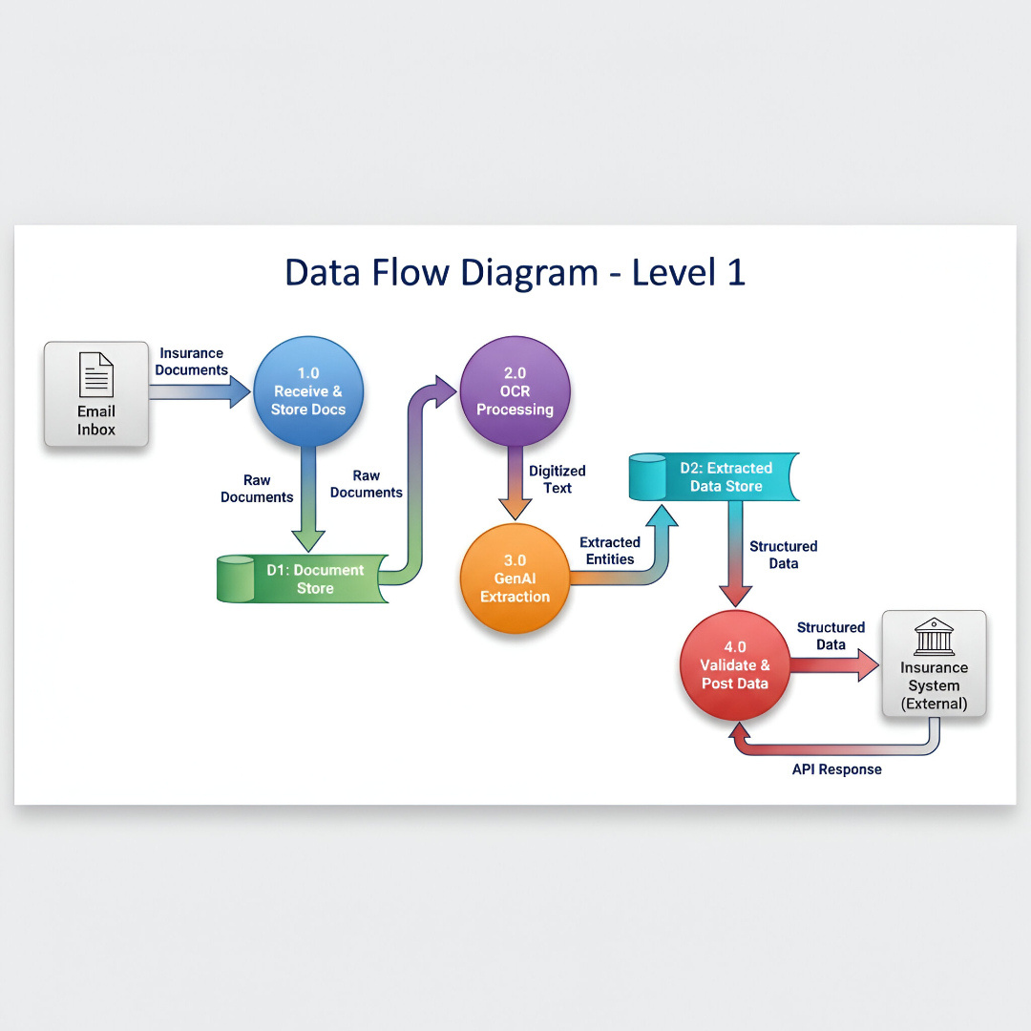

Slide 10
Algorithms / Techniques Used
OCR & Document Processing : OCR techniques are used to convert scanned insurance documents, PDFs, and images into machine-readable text. Image pre-processing methods such as grayscale conversion, noise removal, thresholding, and deskewing improve text extraction accuracy.
Generative AI & NLP Techniques : Generative AI models are used to understand unstructured insurance data and extract key entities such as applicant details, medical history, and policy information. Prompt engineering and structured JSON outputs ensure accurate and consistent data extraction.
Data Validation & Confidence Scoring : Rule-based validation techniques are applied to verify formats, mandatory fields, and business constraints. Confidence scoring is used to assess extraction reliability and flag low-confidence applications for manual review.
Backend & API Integration : RESTful APIs are developed using Python frameworks to automate data flow between processing modules and insurance systems. Logging, error handling, and audit trails ensure reliability and traceability.

Slide 11
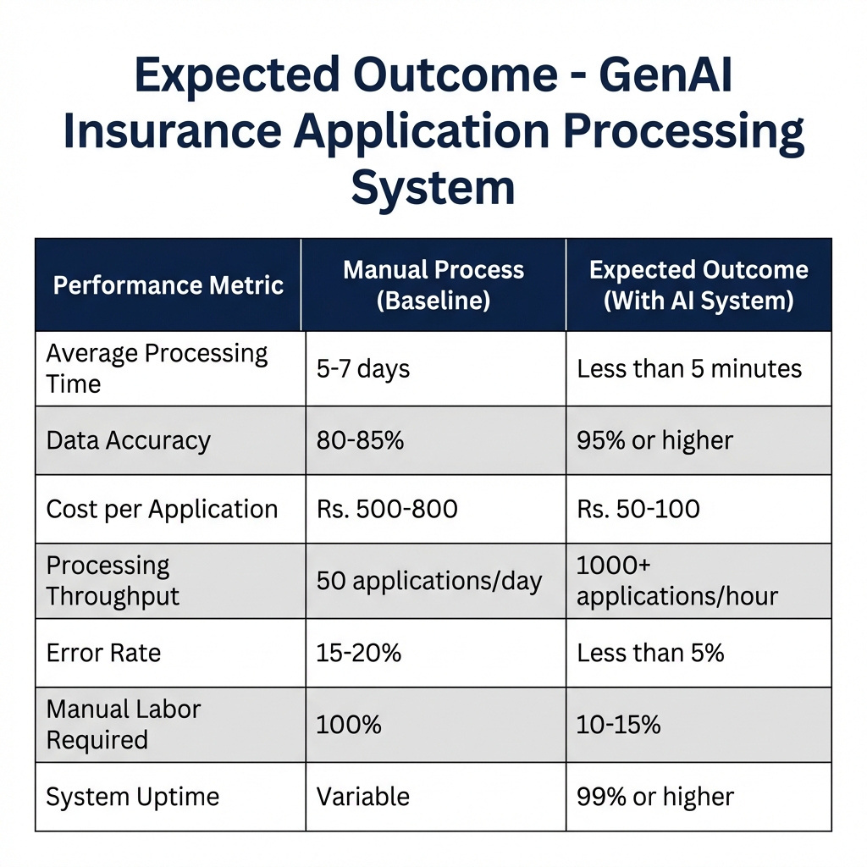
Expected outcomes

Slide 12
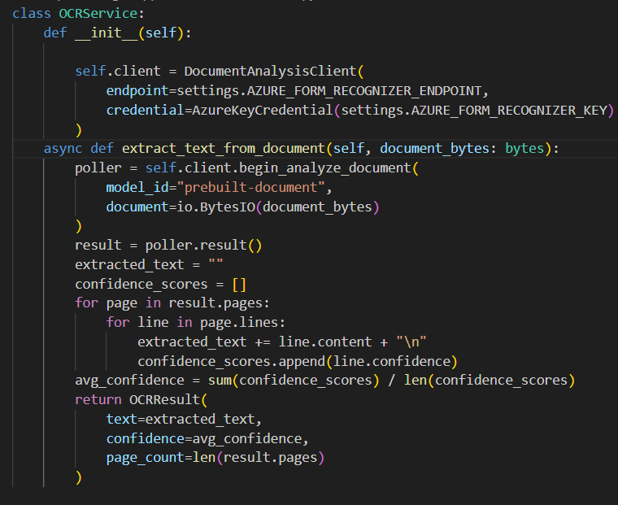
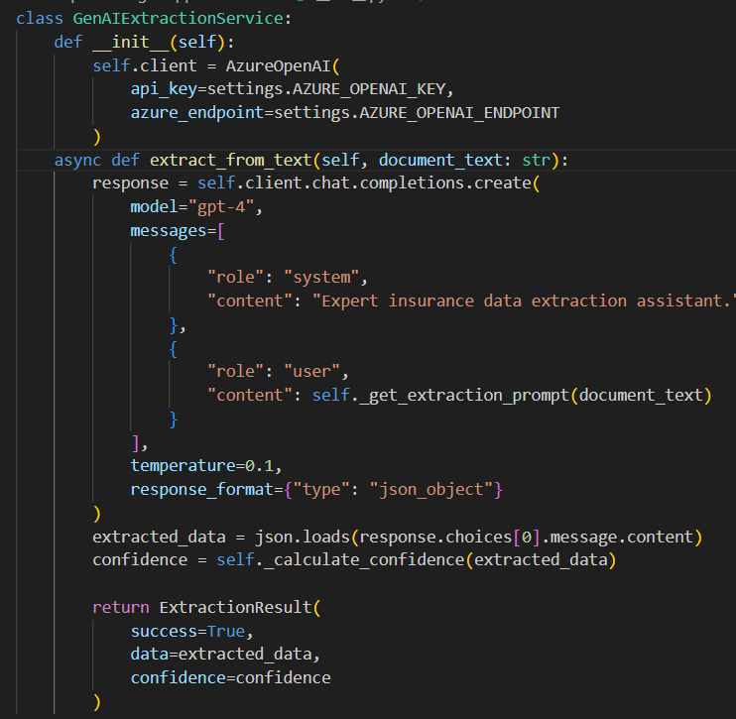
Code implementation
OCR Service (Azure Form Recognizer)
GenAI Extraction Service (GPT-4)

Slide 13
References
T. Brown et al., “Language Models are Few-Shot Learners,” Advances in Neural Information Processing Systems (NeurIPS), vol. 33, pp. 1877–1901, 2020. https://arxiv.org/abs/2005.14165
OpenAI, “GPT-4 Technical Report,” arXiv preprint arXiv:2303.08774, 2023.https://arxiv.org/abs/2303.08774
A. Ly, B. Uthayasooriyar, and T. Wang, “A Survey on Natural Language Processing Applications in the Insurance Industry,” arXiv preprint arXiv:2010.00462, 2020. https://arxiv.org/abs/2010.00462
S. Mahadevkar, “Exploring AI-Driven Approaches for Unstructured Document Processing,” Journal of Big Data, vol. 11, no. 1, pp. 1–18, 2024. https://link.springer.com/article/10.1186/s40537-024-00948-z
R. Smith, “An Overview of the Tesseract OCR Engine,” Proc. Int. Conf. on Document Analysis and Recognition (ICDAR), pp. 629–633, 2007. https://ieeexplore.ieee.org/document/4376991
Y. Xu et al., “LayoutLM: Pre-training of Text and Layout for Document Image Understanding,” Proc. ACM SIGKDD, pp. 1192–1200, 2020. https://arxiv.org/abs/1912.13318
J. Hedberg, “Automated Extraction of Insurance Policy Information Using NLP Techniques,” Master’s Thesis, Uppsala University, Sweden, 2023. https://www.diva-portal.org/smash/get/diva2:1774296/FULLTEXT01.pdf

Slide 14
Thank You

