Slide 1

AuraLearn — Progress presentation 2
Concise progress for students, lecturers, and EdTech stakeholders

Slide 2

Problem, Stakeholders & Pain Points
Stakeholders
Information overload
University students · Lecturers/instructors · Ed-Tech platforms
Students struggle to filter exam‑relevant content from voluminous lecture materials
Misinformation (hallucinations)
Ignored emotional states
AI tutors sometimes deliver unverified or incorrect answers during high‑stakes prep
Scheduling ignores fatigue, confusion and cognitive burnout — lowers effectiveness

Slide 3
Panel Feedback — Responses
Student ID & Name | Panel Comments | How we addressed them
IT22120120(Sonal Dilmith) | Time management in presentation; clarify confidence score; risk from wrong uploaded PDFs affecting confidence. | Practiced presentation rehearsals; defined RAG + uncertainty estimation and ML-based grounding ;
IT22224552(K.K.G.Y. Mihiraj) | Time management; need correct approach definition; confidence score confusion; PDF effects. | Practiced presentation rehearsals; Created a manual dataset by taking students inputs and sent to an expert for validation.
IT22371690(W.H.H. Thathsara) | Collected 32‑student dataset; oversampled and trained, but predictions need expert validation. | Practiced presentation rehearsals; Created a manual dataset by taking students inputs and sent to an expert for validation.
IT22187178(T.G.K.G. Vijithapala) | Need comparison vs generic LLMs to prove superiority of objective‑aware summaries. | Built comparative evaluation framework (semantic alignment) vs baseline LLMs to quantify syllabus alignment gains.
Table: panel comments (left) and concrete actions (right)

Slide 4
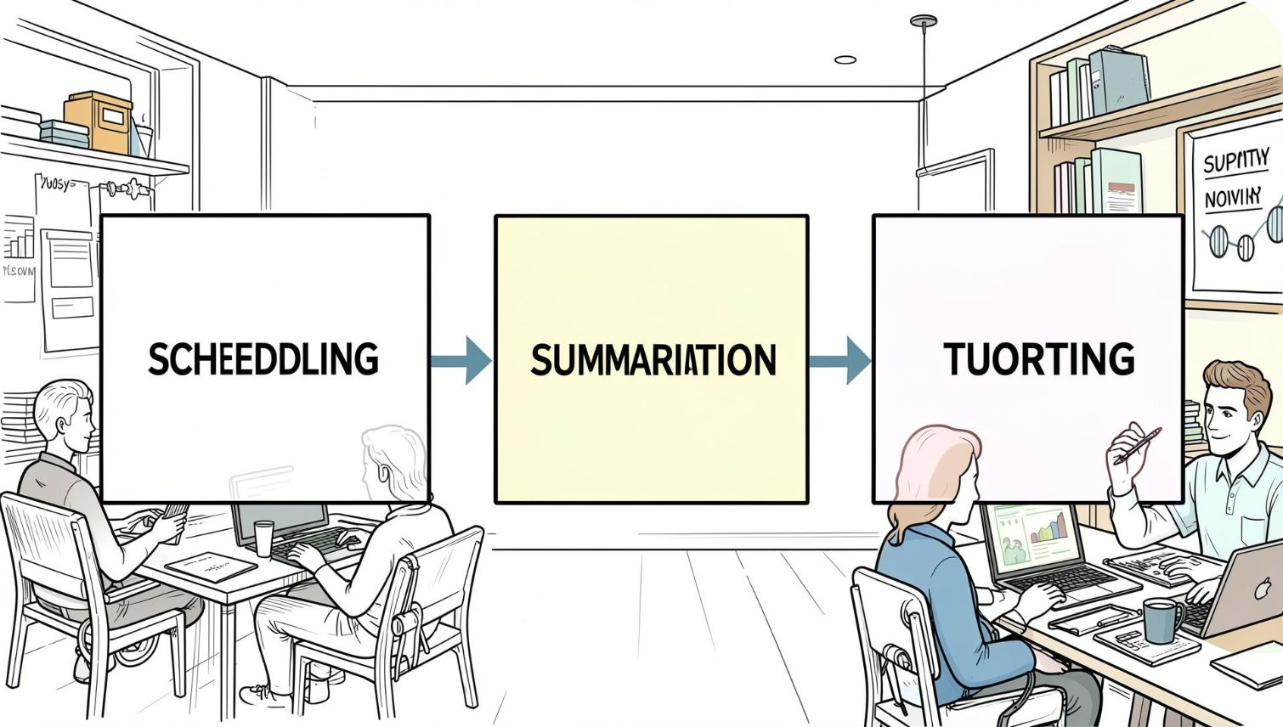
Research Gap, Objectives & Strands
Research gap: Tools are disjoint — lack emotion‑aware scheduling, hallucination control, and curriculum‑mapped summaries.
System objective
Research strand
Development strand
End‑to‑end Smart Study Assistant: grounded tutoring, objective‑aligned flashcards, emotion‑aware scheduling.
LLM uncertainty estimation · affective computing + memory decay · semantic curriculum alignment
RAG vector DB engineering (FAISS/Chroma) · MediaPipe optimization for low‑spec laptops · RL scheduler via FastAPI microservices

Slide 5
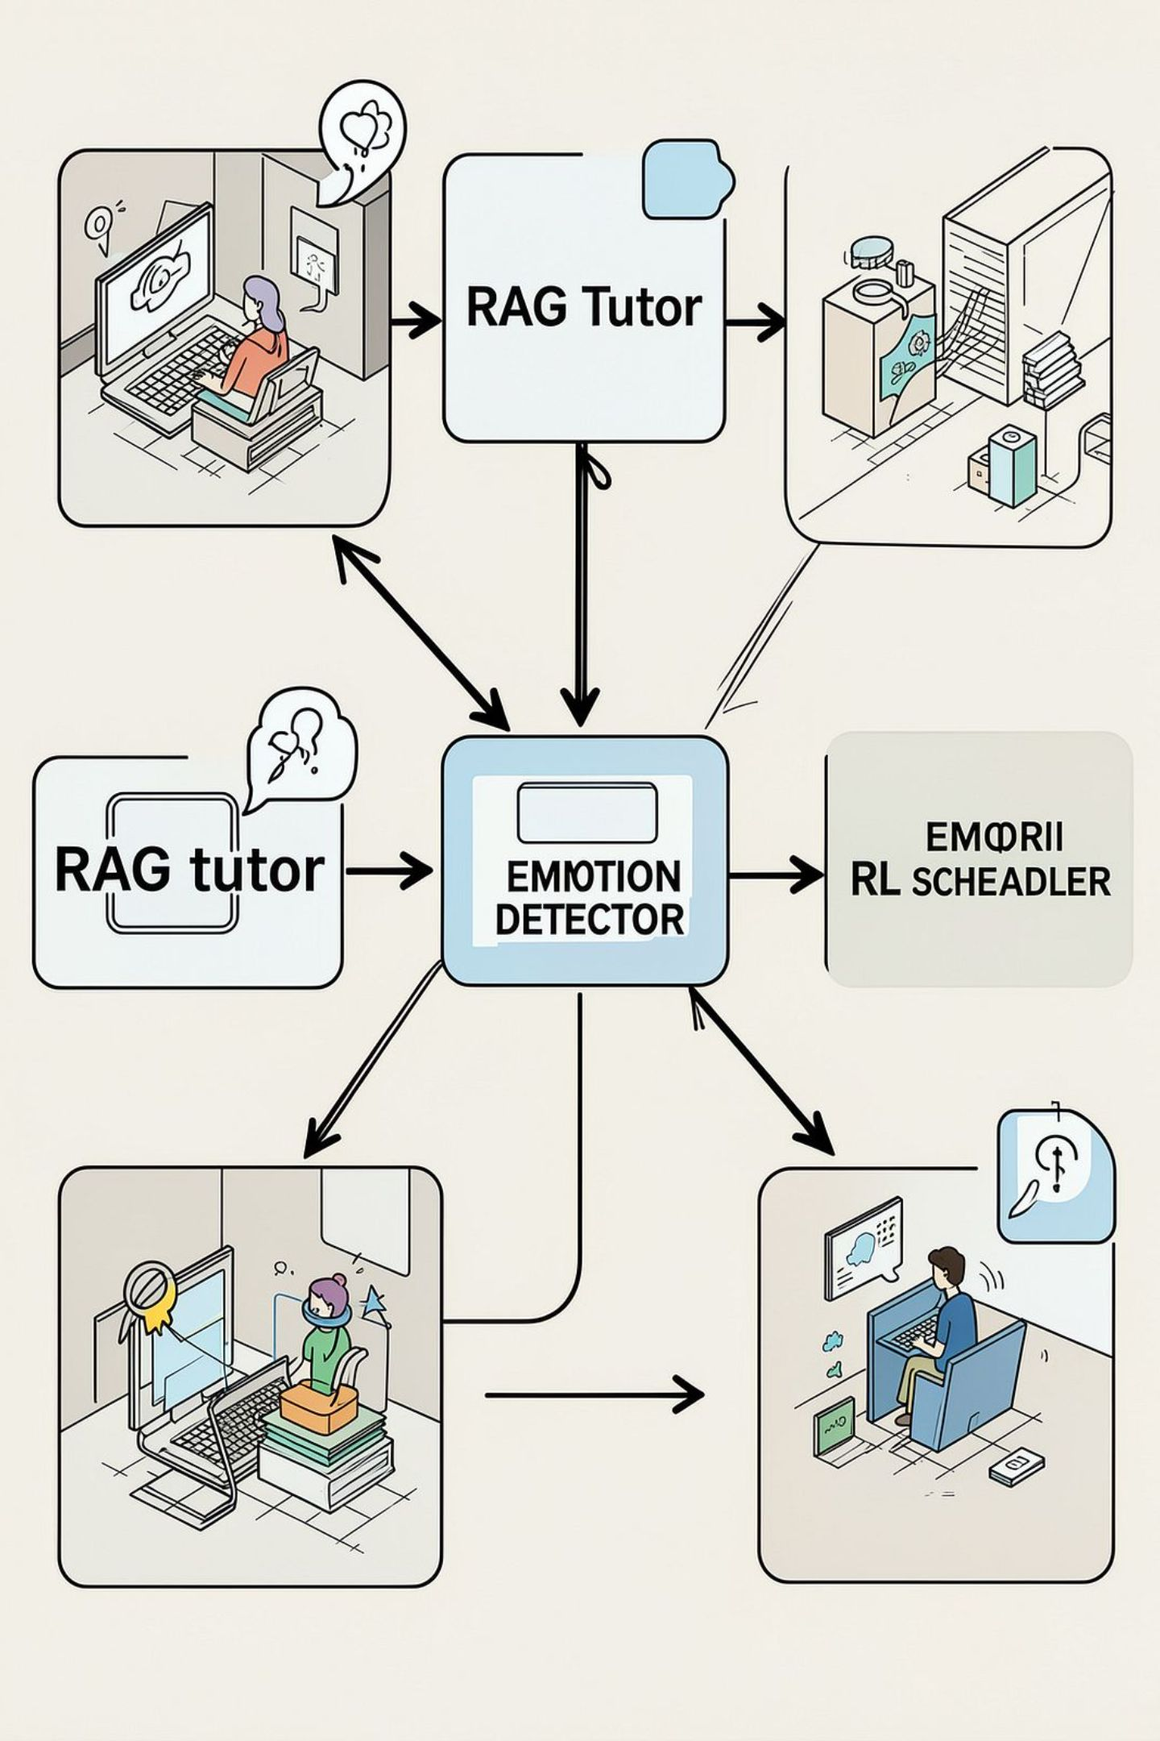
Solution Overview & Architecture
Hallucination‑Controlled Tutor (Sonal)
RAG pipeline + FAISS/ChromaDB + uncertainty estimation to ground answers and flag low‑confidence replies.
Objective‑Aware Summarization (Vijithapala)
BART/T5 semantic extraction to produce syllabus‑aligned summaries and flashcards.
Affect & Attention Detection (Mihiraj)
MediaPipe Face Mesh → EAR metric; lightweight, in‑memory, privacy preserving.
Adaptive Scheduler (Thathsara)
Contextual bandit RL fusing SM‑2 memory decay + emotion embeddings to time reviews and breaks.

Slide 6
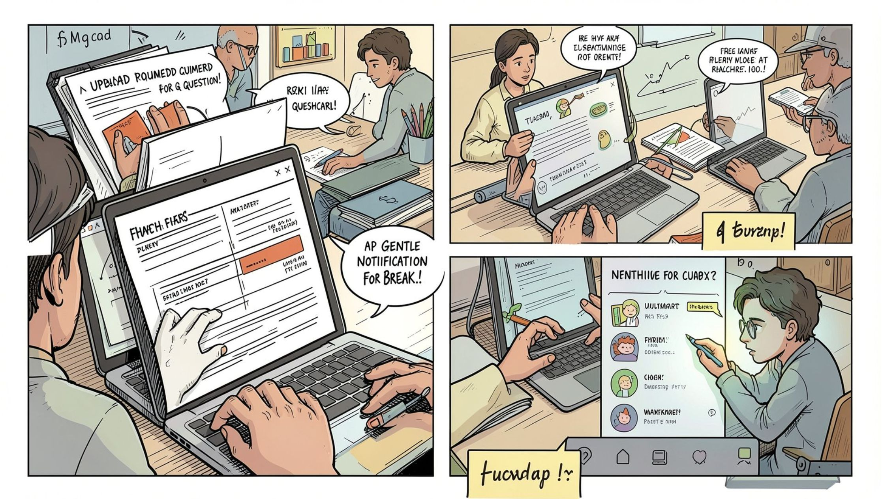
Integration & Completion Status
Input — upload: objective‑aligned summaries & flashcards (Vijithapala)
Interaction — question → grounded RAG answer with confidence tag (Sonal)
Monitoring — silent facial mesh → fatigue/attention embedding (Mihiraj)
Adaptation — RL scheduler uses progress + emotion to schedule reviews or breaks (Thathsara)
Status: ML models trained · microservices linked · end‑to‑end in validation/testing phase

Slide 7
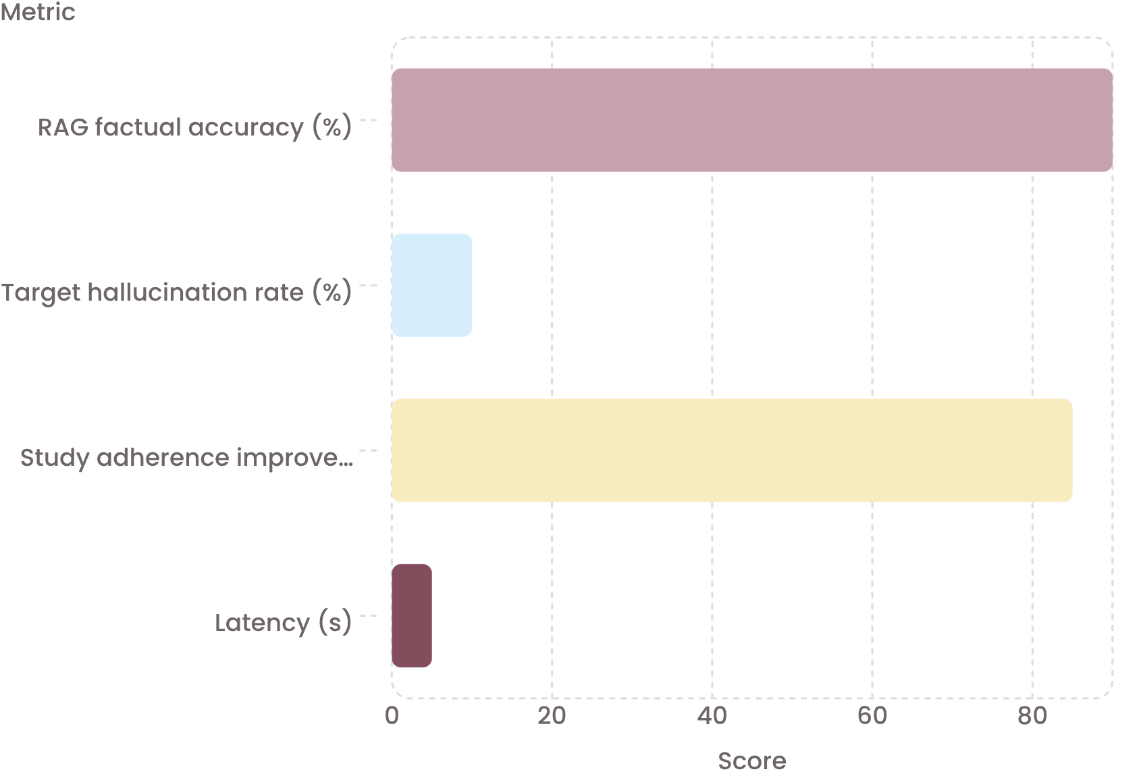
Evaluation Evidence, NFRs & Commercial Roadmap
Privacy & Performance
GDPR compliant · no raw images saved · 30 frames/min on low‑spec laptops
Market & Revenue
B2B SaaS for universities + EdTech integrations. premium B2C with premium analytics; institutional licensing for LMS (Moodle/Canvas).
Roadmap
Beta finalisation → University pilot → Patent filing for RL‑Emotion scheduling
Key evidence: >90% factual accuracy; emotion‑aware scheduling → target +85% adherence; responses & scheduling <5s.

