Slide 1

AI-Enabled Intelligent Study Assistant to Enhance Student Learning Outcomes
Research Proposal - Group R26-SE-022
Sri Lanka Institute of Information Technology (SLIIT)
Presentation
Supervisor & Co‑Supervisor overview
Focus
Confidence‑aware tutoring + Learning‑objective summarization + Attention-Aware Emotion Detection + Emotion-Aware Adaptive Study Reminder

Slide 2
Group Details
I.H. Sonal Dilmith
T.G.K.G. Vijithapala
K.K.G.Y. Mihiraj
W.H.H. Thathsara
IT22120120
IT22187178
IT22224552
IT22371690
Mrs. Suriya Kumari
Supervisor
Mr. Ravi Supunya
Co‑Supervisor
R26-SE-022

Slide 3




Users and Stakeholders
Our AI-enabled intelligent study assistant is designed with multiple user groups and stakeholders in mind, ensuring a comprehensive impact on the educational ecosystem.
University Students
Lecturers / Academic Staff
Primary users seeking efficient revision and personalised learning support to manage large volumes of lecture materials.
Provide course materials and guidance, benefiting from tools that improve student engagement and learning outcomes.
University IT Department
Other Stakeholders
Responsible for deploying and maintaining digital learning systems, requiring scalable and secure AI platforms.
Includes educational institutions, EdTech platforms, and future student cohorts who will benefit from enhanced learning tools.
R26-SE-022

Slide 4
Impact of the Problem on Stakeholders
Our proposed AI-enabled intelligent study assistant addresses critical challenges faced by various stakeholders in the educational ecosystem.
Impact on Students
Impact on Lecturers
Impact on Universities
Information overload from lecture slides and study materials
Difficulty identifying important exam concepts
Lack of personalised tutoring support
Academic stress and reduced study efficiency
Limited time to provide individual academic support
Difficulty monitoring student learning progress
Increasing demand for advanced learning technologies
Need to improve student performance and engagement
R26-SE-022

Slide 5

Existing Solutions and Their Limitations
Current Solutions
Key Limitations
AI tutoring systems (ChatGPT, AI assistants)
Flashcard applications (Anki, Quizlet)
Lecture summarisation tools
Learning Management Systems (LMS)
AI tutors may generate incorrect or hallucinated answers
Summaries often not aligned with course learning objectives
Systems do not consider student emotional or cognitive state
Study reminders are static and not personalised
Most tools work independently without integration
R26-SE-022

Slide 6

Proposed Solution and System Novelty
AI-Enabled Intelligent Study Assistant
An integrated platform designed to improve student learning efficiency and engagement through cutting-edge AI technologies.
Confidence-Aware LLM Tutoring System
Learning-Objective-Aware Lecture Summarisation & Flashcards
Affect & Attention-Aware Emotion Detection Module
Emotion-Aware Adaptive Study Reminder System
System Specialty
Expected Benefits
Reduces hallucinated AI responses
Generates exam-focused summaries
Detects student emotional and attention states
Provides adaptive study scheduling
Integrates multiple AI technologies
Improved learning outcomes
Personalised study support
Reduced cognitive overload
Enhanced student engagement
R26-SE-022

Slide 7

Component 1 - Confidence‑Aware Hallucination‑Controlled LLM Tutoring
Problem
Novelty
Objectives
LLM tutors can hallucinate
Incorrect academic explanations risk learning outcomes
Confidence‑aware responses
Adaptive response control
Course‑grounded RAG explanations
Reduce hallucination rate
Improve reliability
Ground answers in course materials
IT22120120 | Dilmith I.H.S. | R26-SE-022

Slide 8

Confidence‑Aware Hallucination‑Controlled LLM Tutoring
Methodology
01
Retrieval
RAG with FAISS / ChromaDB
02
Uncertainty Estimation
Log‑prob scoring · Entropy analysis · Self‑consistency
03
Response Control
Adaptive output: answer, hint, or clarification
04
Tech Stack
Python · FastAPI · HuggingFace · PyTorch · FAISS/ChromaDB
IT22120120 | Dilmith I.H.S. | R26-SE-022

Slide 9

Confidence‑Aware Hallucination‑Controlled LLM Tutoring
Validation & Ethics
Evaluation Metrics
Hallucination rate
Answer accuracy
Response reliability
Student feedback
Data Sources
Lecture slides
Textbooks
Course learning outcomes
Ethics
Academic materials only
No student personal data collected
IT22120120 | Dilmith I.H.S. | R26-SE-022

Slide 10

Confidence‑Aware Hallucination‑Controlled LLM Tutoring
Implementation Overview
Student Question
Vector Retrieval
Confidence Eval
Adaptive Response
Adaptive decision thresholds map confidence scores to response strategies. High confidence → direct; Medium → hint; Low → clarification.
IT22120120 | Dilmith I.H.S. | R26-SE-022

Slide 11

Component 2 -Learning‑Objective‑Aware Lecture Summarisation & Flashcards
Problem
Limitations (Current Tools)
Students struggle to revise large lecture volumes
Generic summaries
Misaligned with objectives
Weak exam prep support
Novelty & Objectives
Objective‑aware summaries
Exam‑oriented AI flashcards
Identify key concepts & active‑recall prompts
IT22187178 | Vijithapala T.G.K.G. | R26-SE-022

Slide 12





Learning‑Objective‑Aware Lecture Summarization & Flashcards
Methodology
Slide & Transcript Processing
Summarization Models
Slide extraction
OCR
Transcript cleaning
Transformer models (BART / T5) tuned for academic text
Flashcards
Alignment
QA pair generation focused on active recall
Semantic similarity
Embedding comparisons to objectives
IT22187178 | Vijithapala T.G.K.G. | R26-SE-022

Slide 13




Learning‑Objective‑Aware Lecture Summarization & Flashcards
Validation & Ethics
Evaluation Metrics
Summary quality
Flashcard usefulness
Revision efficiency
Datasets
Lecture slides · Course syllabi · Transcripts
Ethics
Academic materials only
No student private data
IT22187178 | Vijithapala T.G.K.G. | R26-SE-022

Slide 14

Learning‑Objective‑Aware Lecture Summarization & Flashcards
Implementation Overview
Text Extraction
Flashcard Generation
Transformer Summarization
Outputs: objective‑aligned summaries + active‑recall flashcards to boost revision efficiency and exam readiness.
Next Steps
Contact
Prototype RAG tutor
Build summariser & flashcard generator
User studies with students
Group R26‑SE‑022 — SLIIT
IT22187178 | Vijithapala T.G.K.G. | R26-SE-022

Slide 15

Component 3 - Affect and Attention-Aware Emotion Detection Module
Problem
Impact
Current study tools ignore student emotional and cognitive states.
Reduced concentration
Cognitive fatigue
Poor learning engagement
Novelty
Research Objectives
Privacy-preserving emotion detection
Multimodal analysis (facial expression + eye behaviour)
Detect emotional states
Monitor student attention
Enable adaptive learning support
IT22224552 | K.K.G.Y. Mihiraj | R26-SE-022

Slide 16




Affect and Attention-Aware Emotion Detection Module
Methodology
Our emotion and attention detection module uses a multi-stage pipeline, processing visual data to infer student states without collecting personal identifying information.
Webcam Input (30 frames per second)
Feature Extraction
Facial & eye tracking
MediaPipe Face Mesh & Eye Aspect Ratio(EAR)
State Classification
Adaptive Feedback
Random Forest / SVM
System adjustments
Key techniques include facial landmark detection via MediaPipe Face Mesh and Eye Aspect Ratio (EAR) for quantifying eye openness. Extracted features like blink rate, eye openness, and head tilt are fed into robust machine learning classifiers (Random Forest or Support Vector Machines) to identify emotional states and attention levels.
IT22224552 | K.K.G.Y. Mihiraj | R26-SE-022

Slide 17

Affect and Attention-Aware Emotion Detection Module
Validation & Ethics
Our ethical design principles for the emotion detection module prioritise student privacy, ensuring no raw biometric data is ever stored, and all processing focuses on aggregated, non-identifying features.
EVALUATION
Validation Metrics
Emotion classification accuracy
Attention detection reliability
Processing latency
DATA
Datasets Utilised
FER-2013 (Facial Expression Recognition)
RAF-DB (Real-world Affective Faces Database)
AffectNet (Large-scale facial expression dataset)
MPIIGaze (Gaze tracking dataset)
PRINCIPLES
Ethical Design
No storage of raw images
Feature embeddings only
Privacy-preserving architecture
IT22224552 | K.K.G.Y. Mihiraj | R26-SE-022

Slide 18






Learning‑Objective‑Aware Lecture Summarization & Flashcards
Implementation Overview
Our privacy-preserving module processes visual data through a multi-stage pipeline to infer student emotional and attentional states, generating embeddings for adaptive feedback.
Webcam Input
Emotion Classification
Continuous video stream capture.
Inferring states (e.g., focused, confused, bored).
Face Landmark Detection
Emotion Embeddings
Identifying key facial points (MediaPipe Face Mesh).
Creating numerical representations of states.
Feature Extraction
Module Integration
Eye Aspect Ratio, blink rate, head pose, etc.
Providing insights to other system components.
This pipeline ensures real-time analysis for adaptive learning interventions while strictly adhering to privacy protocols by never storing raw biometric data.
IT22224552 | K.K.G.Y. Mihiraj | R26-SE-022

Slide 19

Component 4 - Emotion and Progress-Aware Adaptive Study Reminder System
Problem
Impact
Existing reminder tools ignore emotional readiness.
Poor adherence to study schedules
Cognitive overload from poorly timed reminders
Reduced knowledge retention
Novelty
Research Objectives
Emotion-aware reminder scheduling
Reinforcement learning-based adaptive reminders
Optimize study scheduling for individual students
Increase student adherence to study plans
Reduce cognitive fatigue caused by inappropriate reminders
IT22371690 | Thathsara W.H.H. | R26-SE-022

Slide 20
Emotion and Progress-Aware Adaptive Study Reminder System
Methodology
Our adaptive study reminder system integrates learning science with AI to tailor study interventions, ensuring optimal timing and effectiveness based on each student's unique learning state.
Spaced Repetition Model
Utilises an extended SM-2 algorithm to dynamically adjust review intervals, optimising knowledge retention and recall efficiency.
Emotion Fusion
Combines real-time emotional embeddings with learning progress data to generate a comprehensive student 'Readiness Score'.
Reinforcement Learning Agent
Leverages the Readiness Score to make adaptive decisions: send, delay, or skip study reminders to maximise learning engagement.
This multi-faceted approach ensures that students receive timely and contextually relevant support, preventing cognitive overload and fostering sustained study habits.
IT22371690 | Thathsara W.H.H. | R26-SE-022

Slide 21

Emotion and Progress-Aware Adaptive Study Reminder System
Validation & Ethics
This multi-faceted approach ensures that students receive timely and contextually relevant support, preventing cognitive overload and fostering sustained study habits.
EVALUATION
User Study & Metrics
User Study: 30 SLIIT students
Metrics:
  Adherence rate
  Knowledge retention
  Cognitive fatigue
  System usability score
PRINCIPLES
Ethical Design
Anonymized interaction logs for research
No biometric data storage (facial/eye)
User consent for data utilisation
Option to disable adaptive features
IT22371690 | Thathsara W.H.H. | R26-SE-022

Slide 22
Emotion and Progress-Aware Adaptive Study Reminder System
Implementation Overview
01
Emotion embeddings received
Affect embeddings from Emotion Detection Module via Shared Context Layer
02
Readiness Score computed
Fuses valence, arousal & attention → High / Medium / Low tier
03
Memory decay modelled
Extended SM-2 algorithm → per-item retention priority queue
04
RL agent selects action
Contextual bandit → send · delay · skip
05
Reminder delivered & feedback collected
Web Push / in-app alert → student response updates RL reward
IT22371690 | Thathsara W.H.H. | R26-SE-022

Slide 23
Commercialization
Our commercialization strategy focuses on key markets and customer segments, leveraging our unique value proposition and protected intellectual property.
1
2
Target Market
Customer Profile
Universities
E-learning platforms
Online learning systems
Undergraduate students
Educational institutions
3
4
Value Proposition
Intellectual Property
AI-powered intelligent study assistant
Personalised learning support
AI models
System architecture
Algorithms
R26-SE-022

Slide 24
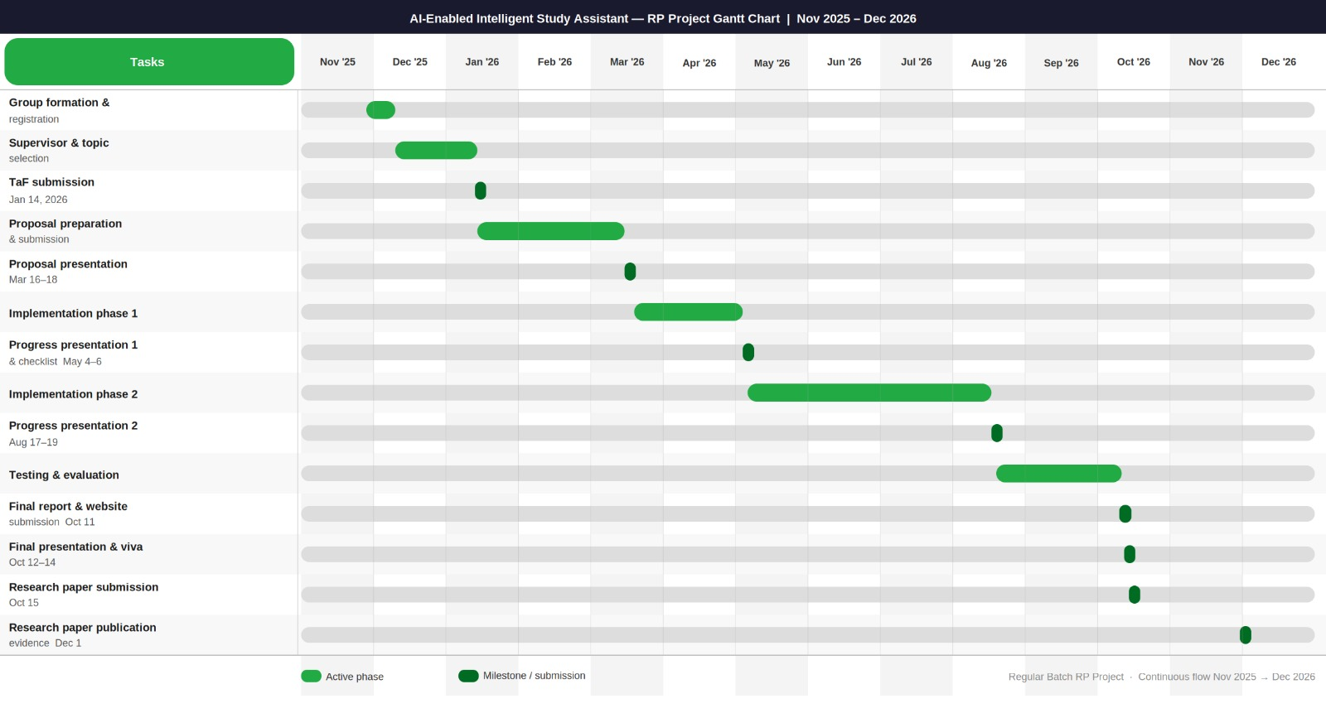
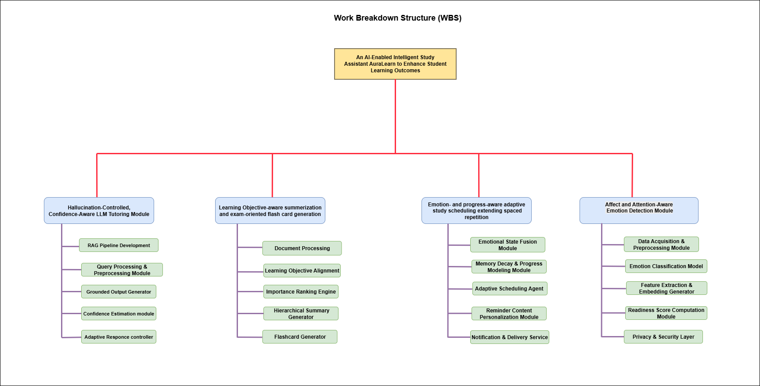
Project Plan
Our project plan outlines the key phases and work breakdown structure, ensuring a systematic approach to development and delivery.
This timeline provides a high-level overview of the project's progression, from initial research to final deployment, allocating sufficient time for each critical stage. The total estimated project duration is approximately 20-25 weeks, allowing for sequential and overlapping tasks.
R26-SE-022

Slide 25

Thank You
Questions?
AI-Enabled Intelligent Study Assistant
R26-SE-022

