Slide 1

AuraLearn — Final presentation
Concise progress for students, lecturers, and EdTech stakeholders

Slide 2

Problem, Stakeholders & Pain Points
Stakeholders
Information overload
University students · Lecturers/instructors · EdTech platforms
Students struggle to filter exam‑relevant content from voluminous lecture materials
Misinformation (hallucinations)
Ignored emotional states
AI tutors sometimes deliver unverified or incorrect answers during high‑stakes prep
Scheduling ignores fatigue, confusion and cognitive burnout — lowers effectiveness

Slide 3
Panel Feedback — Responses
Student ID & Name | Panel Comments | How we addressed them
IT22120120(Sonal Dilmith) | Need to have a specific idea about the RAG module for the component and how can make changes according to your requirements. | Analyzed the RAG module in more detail and refined the process in which the rag module is used and created separate files for this process for easier definition of responsibilities.
IT22224552(K.K.G.Y. Mihiraj) | Think of how you validate that a predicted state is educationally meaningful rather than only visually correlated with an expression. | Rather than predicting every emotion that the system identifies only considered the meaning emotions that are necessary for the project and got those emotions monitored and validated by the clinical psychologist. Also removed the emotion monitoring frame from being displayed to the user rather it run in the background.
IT22371690(W.H.H. Thathsara) | Should validate the output with the industry expert when coming to the final presentation. | Validated the projects output through a clinical psychologist and got his view , ideas and approval to go ahead in this project.
IT22187178(T.G.K.G. Vijithapala) | Flashcards should be evaluated for correctness, difficulty, duplication, and etc. Not even with chatGPT use other LLMs for evalyuare the current model. | Flash cards were evaluated by the supervisor for their educational effectiveness. Already checked with other models for the results and confirmed it

Slide 4
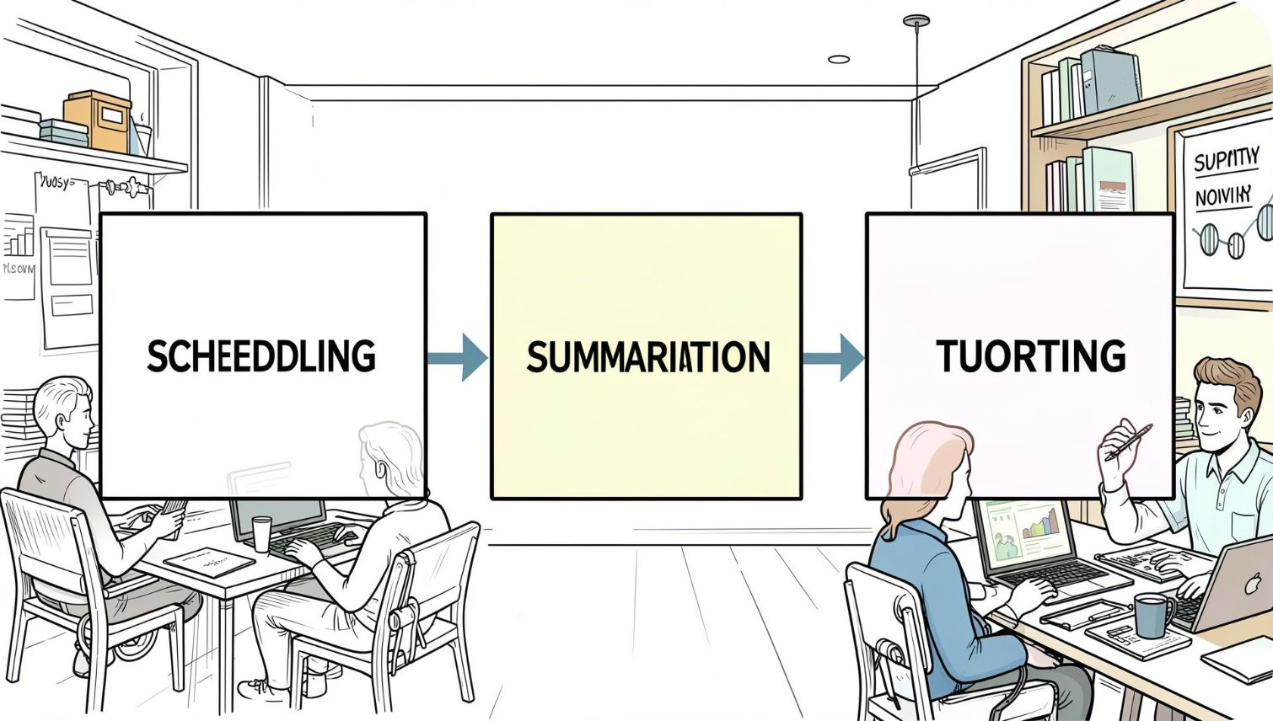
Research Gap, Objectives & Strands
Research gap: Tools are disjoint — lack emotion‑aware scheduling, hallucination control, and curriculum‑mapped summaries.
System objective
Research strand
Development strand
End‑to‑end Smart Study Assistant: grounded tutoring, objective‑aligned flashcards, emotion‑aware scheduling.
LLM uncertainty estimation · affective computing + memory decay · semantic curriculum alignment
RAG vector DB engineering (FAISS/Chroma) · MediaPipe optimization for low‑spec laptops · RL scheduler via FastAPI microservices

Slide 5


Clinical Psychologist Evaluation
Evaluator
Supportive follow-up regarding AuraLearn system
[Dinuka Sandeepa Subasigha-psychological counselor
What was validated
The System's Reporting Capability
The Usefulness of the Output Data
The System's Role as a Support Tool
Video: [Clinical psychologist feedback on detected emotion states · duration]

Slide 6
Supervisor & Student Evaluation
Supervisors’ comments
Student feedback
“
AuraLearn shows strong technical progress. The four components are well integrated, with models trained and linked end to end.
The summaries kept what I needed for exams and saved me hours.
— SLIIT student
— Supervisor
The flashcards were clear, and the tutor told me when it was not sure.
“
— SLIIT student
Evaluating the flashcards for educational effectiveness and cross-checking them with other LLMs strengthened the quality of the output.
Break reminders came at the right time, when I was getting tired.
— Supervisor
— SLIIT student
The camera runs quietly in the background and nothing is saved.
“
Running emotion monitoring in the background and validating the emotion states with a clinical psychologist addressed the panel’s concerns well.
— SLIIT student
Easy to use — it felt like one tool, not four separate apps.
— Co-supervisor
— SLIIT student

Slide 7
How We Used AI in AuraLearn
AI supported the team across the whole project, from code to documents.
1
Efficient code
2
Time and resources
3
Higher-quality documents
Helped refactor, debug and optimise code, including for low-spec laptops.
Faster prototyping and less boilerplate, saving effort and compute.
Helped draft, structure and proofread reports and proposals.
4
Research and learning
5
Testing and validation
6
Design and presentation
Summarised papers, explained concepts and compared methods.
Generated test cases and cross-checked outputs with other LLMs.
Supported UI ideas, diagrams and slide content.
Human in the loop: every AI output was reviewed, tested and verified by the team before use.

Slide 8
Evidence, NTRs & Validations
Use of evidence
NTRs
Validations
Model accuracy: [above 75%]
Factual accuracy: >90%
Self-collected dataset: 32 students
Response time: <5 s
Publication: pending Approval(ICAC2026)
Planning to apply for future conventions
Clinical psychologist — verified for the general usage
Supervisor — educational effectiveness
Students — [10] participants
Cross-LLM evaluation
Status: [Complete ]
Status: [Submitted / Planned]
Status: [Complete]

Slide 9
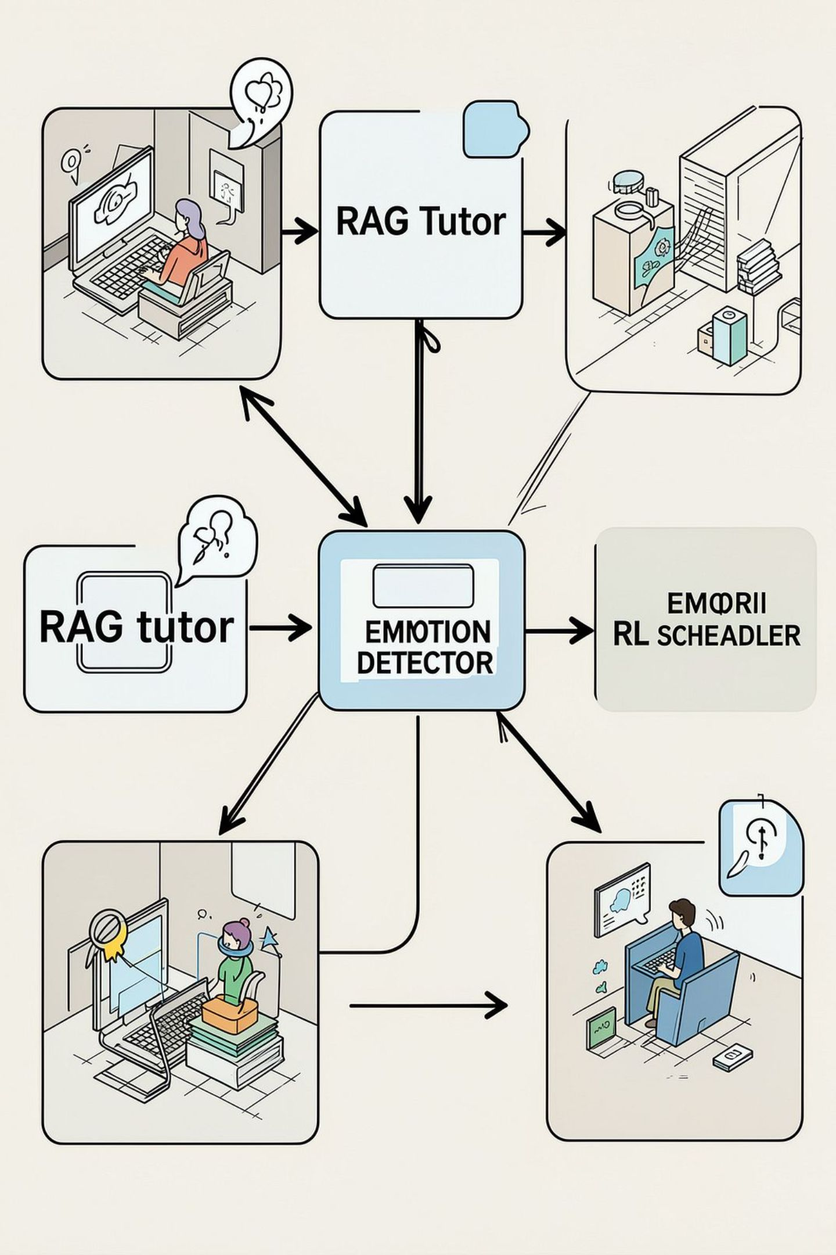
Solution Overview & Architecture
Hallucination‑Controlled Tutor (Sonal)
RAG pipeline + FAISS/ChromaDB + uncertainty estimation to ground answers and flag low‑confidence replies.
Objective‑Aware Summarization (Vijithapala)
BART/T5 semantic extraction to produce syllabus‑aligned summaries and flashcards.
Affect & Attention Detection (Mihiraj)
MediaPipe Face Mesh → EAR metric; lightweight, in‑memory, privacy preserving.
Adaptive Scheduler (Thathsara)
Contextual bandit RL fusing SM‑2 memory decay + emotion embeddings to time reviews and breaks.

Slide 10
Commercial Impact
The commercial case for AuraLearn across the whole education ecosystem.
1
Growing demand
2
Multiple revenue streams
3
Scalable at low cost
Rising need for personalised, AI-enabled study support in education.
B2B SaaS, freemium B2C with premium analytics, and LMS licensing.
Lightweight models and microservices run on low-spec laptops.
4
Measurable outcomes
5
Easy to adopt
6
Protectable advantage
Targets of +85% study adherence and >90% factual accuracy.
Moodle / Canvas integration and privacy-first, GDPR-aligned design.
Patent filing planned for RL-Emotion scheduling.
Who benefits: students · educational institutes · parents of learning-age students

