Slide 1

AI-Enabled Intelligent Study Assistant to Enhance Student Learning Outcomes[AuraLearn]
Progress presentation 1 - Group R26-SE-022
Sri Lanka Institute of Information Technology (SLIIT)
Focus
Confidence‑aware tutoring + Learning‑objective summarization + Attention-Aware Emotion Detection + Emotion-Aware Adaptive Study Reminder

Slide 2




AuraLearn
Group Details
I.H. Sonal Dilmith
T.G.K.G. Vijithapala
K.K.G.Y. Mihiraj
W.H.H. Thathsara
IT22120120
IT22187178
IT22224552
IT22371690
Mrs. Suriya Kumari
Supervisor
Mr. Ravi Supunya
Co‑Supervisor
R26-SE-022

Slide 3
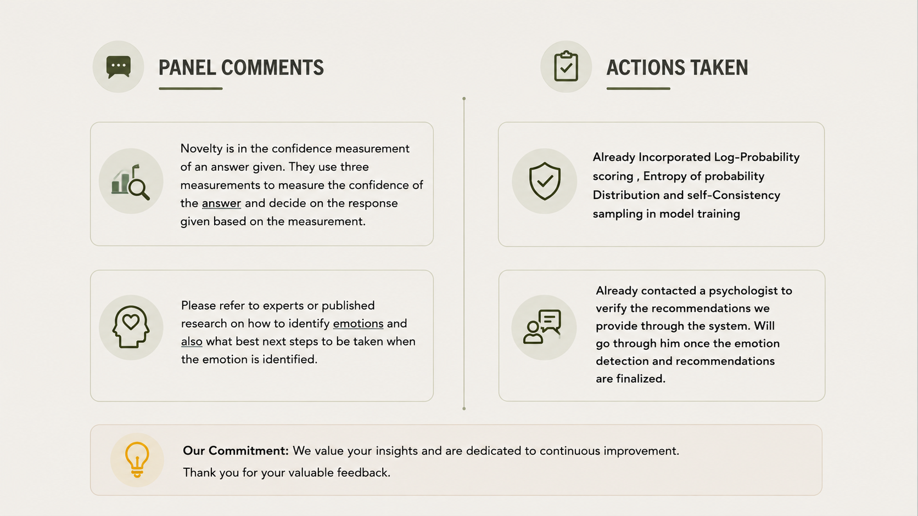
AuraLearn
R26-SE-022

Slide 4
AuraLearn
Impact of the Problem on Stakeholders
Our proposed solution addresses critical challenges faced by various stakeholders in the educational ecosystem. Like access to accurate information , having a less distractive environment and a tool to monitor your academic progress along with mental health of students
Impact on Students
Impact on Lecturers
Impact on Universities
Information overload from lecture slides and study materials
Difficulty identifying important exam concepts
Lack of personalised tutoring support
Academic stress and reduced study efficiency
Limited time to provide individual academic support
Difficulty monitoring student learning progress
Increasing demand for advanced learning technologies
Need to improve student performance and engagement
R26-SE-022

Slide 5

AuraLearn

Slide 6


IT22120120
Dilmith I.H.S.
Component 1 - Confidence-Aware RAG Academic Tutoring Module
SE specialization
IT22120120 | Dilmith I.H.S. | R26-SE-022

Slide 7
Confidence‑Aware Hallucination‑Controlled LLM Tutoring
How the Solution Addresses the Sub-Problem
The Sub-Problem:
  Standard LLMs frequently generate “hallucinations” (factually incorrect answers) and provide direct responses even when uncertain, which is dangerous in academic settings.
The Architectural Solution:
  Confidence-Aware RAG Pipeline: Combines a Vector Database (FAISS/ChromaDB) with uncertainty estimation (log-probability, entropy) to verify model certainty before answering.
  Multi-Tier Adaptive Response: Instead of always answering, the system intelligently chooses between a Direct Answer, a Guided Hint, or a Clarification Request based on confidence levels.
  Strict Grounding Enforcement: All responses are anchored to indexed course materials (slides, textbooks), ensuring every claim is traceable to a verified academic source.
IT22120120 | Dilmith I.H.S. | R26-SE-022

Slide 8
Confidence‑Aware Hallucination‑Controlled LLM Tutoring
User Requirements Addressed by the Solution
Reliability & Accuracy (FR4 & FR6): Guarantees that direct answers are grounded in course materials, maintaining a hallucination rate of less than 10%.
Pedagogical Adaptivity (FR5): Supports deep learning by providing guided hints instead of only full solutions, preventing students from bypassing the learning process.
  Real-Time Responsiveness (NFR-A): Optimized to deliver grounded and validated academic explanations within 3–5 seconds.
  Privacy & Transparency (NFR-D & NFR-F): Ensures zero storage of personal student data and clearly indicates when the system is uncertain through transparency indicators.
IT22120120 | Dilmith I.H.S. | R26-SE-022

Slide 9
Confidence‑Aware Hallucination‑Controlled LLM Tutoring
Design Excellence & Key Contributions
The Hybrid Uncertainty Mechanism (Core Contribution): Combines probabilistic analysis (log-probabilities) with logic-based self-consistency checks to detect model failure before it occurs.
  Impact: Bridges the research gap where existing RAG systems use “static prompting” by introducing a dynamic response controller that adapts to the model’s self-assessed reliability.
Course-Specific Authoritative Grounding: Transforms generic AI into a specialized academic tutor by indexing local institutional knowledge as the “Authoritative Source of Truth”.
Contribution to SDG 4: Directly promotes high-quality education by providing a scalable, reliable, and trustworthy AI tutor that supports self-directed learning.
IT22120120 | Dilmith I.H.S. | R26-SE-022

Slide 10


IT22187178
Vijithapala T.G.K.G.
Component 1 - Learning‑Objective‑Aware Lecture Summarization & Flashcards
SE specialization
IT22187178 | Vijithapala T.G.K.G. | R26-SE-022

Slide 11

Learning‑Objective‑Aware Lecture Summarization & Flashcards
How the Solution Addresses the Sub-Problem
The Sub-Problem: Unlike general-purpose summarization tools, this system ingests module-specific course syllabi, learning objectives, and keyword configurations alongside lecture materials to create a domain-aware knowledge filter tailored to SLIIT modules..
The Architectural Solution:
  Context-Aware Processing: Ingests module syllabi, learning objectives, and keywords alongside lecture materials to create a domain-specific knowledge filter tailored to SLIIT modules.
  ML-Based Extraction: Uses a trained RandomForest classifier with 221 features (TF-IDF + structural signals) to score and rank sentences by their academic importance.
  Direct Mapping: Applies a blended scoring pipeline to select and map the most valuable sentences for summaries and flashcards.
IT22187178 | Vijithapala T.G.K.G. | R26-SE-022

Slide 12
Learning‑Objective‑Aware Lecture Summarization & Flashcards
User Requirements Addressed by the Solution
Revision Efficiency : Automates the extraction of key sentences from SLIIT lecture PDFs and PPTX files, transforming raw lecture content into structured summaries and revision-ready flashcards — reducing student study time significantly.
Contextual Accuracy : Ensures output is not just a generic summary, but a module-aligned ranked guide filtered through learning objectives and module-specific keyword configurations relevant to what will actually be assessed.
Performance & Usability : Designed to process standard lecture documents in under 5 seconds through an intuitive drag-and-drop web interface with instant visual feedback.
IT22187178 | Vijithapala T.G.K.G. | R26-SE-022

Slide 13
Learning‑Objective‑Aware Lecture Summarization & Flashcards
Design Excellence & Key Contributions
The Structural Labeling Engine: Uses 22 hand-crafted linguistic rules to automatically annotate 4,476 training sentences — eliminating the need for any manual human labeling.
Impact: Solves the "domain mismatch" problem in general AI summarizers by training exclusively on real SLIIT lecture PDFs with zero reliance on external datasets.
End-to-End Study Assistant: A seamless pipeline from raw PDF/PPTX upload → sentence scoring → ranked summary → LO-tagged flashcard generation, delivered in a single REST API call.
Contribution to SDG 4: Provides high-quality, personalized academic support tools for SLIIT students in Sri Lanka, improving equitable access to smart, AI-driven active recall learning.
IT22187178 | Vijithapala T.G.K.G. | R26-SE-022

Slide 14

IT22224552
K.K.G.Y.Mihiraj
Component 3 - Affect and Attention-Aware Emotion Detection Module
SE specialization
IT22224552 | K.K.G.Y. Mihiraj | R26-SE-022

Slide 15
Affect and Attention-Aware Emotion Detection Module
How the Solution Addresses the Sub-Problem
The Sub-Problem: Existing emotion detection systems use continuous video processing (heavy computational load) and store raw facial images, causing severe privacy concerns
The Architectural Solution: Periodic Sampling: Captures webcam frames periodically (30 frames/min) instead of continuous heavy video streaming .
Geometric Feature Extraction: Uses MediaPipe Face Mesh to map 468 landmarks, condensing the face into a lightweight 4-dimensional numerical vector (Eye Openness, Head Tilt, Mouth Opening, Eyebrow Distance) .
Learning-Relevant Focus: Moves away from generic emotions (Happy/Sad) to educational states: Focused, Confused, Frustrated, Bored, and Neutral .
.
IT22224552 | K.K.G.Y. Mihiraj | R26-SE-022

Slide 16
Affect and Attention-Aware Emotion Detection Module
User Requirements Addressed by the Solution
Privacy & Ethical Compliance (Zero Image Storage): Implements a strict "Privacy-by-Design" architecture. Images are processed purely in-memory and immediately discarded. Only non-identifiable numerical embeddings are sent to the main system .
Low Computational Overhead (FR1): Operates silently in the background without causing lag or disrupting the student’s digital learning workflow .
Real-Time Engagement Tracking (FR3 & FR5): Calculates Eye Aspect Ratio (EAR) and facial geometry to accurately monitor fatigue, attention drops, and cognitive states in real-time .
Robustness in Sub-Optimal Conditions: Utilizes CLAHE (Contrast Limited Adaptive Histogram Equalization) to ensure the system works accurately even in low-light environments typical of student dorms or bedrooms.
.
IT22224552 | K.K.G.Y. Mihiraj | R26-SE-022

Slide 17
Affect and Attention-Aware Emotion Detection Module
Design Excellence & Key Contributions
The Hybrid Fusion Mechanism (Core Contribution): Combines Probabilistic ML (CNN/Random Forest) with Deterministic Mathematical Logic (MediaPipe EAR/Tilt limits).
Impact: Successfully overcomes the common AI limitation of confusing "Neutral" and "Bored" states by physically overriding predictions based on exact eyelid and head geometry.
Domain-Specific Dataset Adaptation: * Filtered and mapped the generic FER-2013 dataset into an education-specific dataset.
Translated expressions like "Surprise" to "Confused" and "Sad" to "Bored" to perfectly align with the pedagogical goals of the Smart Study Assistant.
Highly Optimized Inference Pipeline: * Condensing 35,000+ images into pristine numerical feature vectors, achieving an ultra-low inference time (<2ms) while maintaining high precision for "Confused" (67%) and "Focused" (58%) states.
.
IT22224552 | K.K.G.Y. Mihiraj | R26-SE-022

Slide 18


IT22371690
Thathsara W.H.H.
Component 4 - Emotion and Progress-Aware Adaptive Study Reminder System
SE specialization
IT22371690 | Thathsara W.H.H. | R26-SE-022
Notes:
Title slide. My individual component is the Emotion and Progress-Aware Adaptive Study Reminder System. It is the reminder scheduling intelligence layer of the Smart Study Assistant.

Slide 19
Emotion and Progress-Aware Adaptive Study Reminder System
How the Solution Addresses the Sub-Problem
Sub-Problem: Fixed study reminders ignore emotional readiness, forgetting risk, and cognitive fatigue.
Prototype Solution:
  Emotion Label → Readiness Level
  Study History → Memory Priority
  Readiness + Priority → Send / Delay / Skip
  Student State → Recall / Review / Rest
IT22371690 | Thathsara W.H.H. | R26-SE-022
Notes:
This slide explains how the solution addresses the sub-problem. Existing study reminder tools normally depend on fixed times or quiz history only. My prototype uses the emotion label from the emotion detection component and the current time to estimate readiness. It also uses an extended SM-2 memory decay model to estimate retention and priority. These two outputs are then combined by the adaptive scheduler to decide whether to send, delay, or skip a reminder. The system can also recommend the most suitable activity type such as active recall, guided review, passive reading, or rest.

Slide 20

Emotion and Progress-Aware Adaptive Study Reminder System
User Requirements Addressed by the Solution
Cold-Start Support: New users can start with emotion + time only; personalization improves after feedback and quiz history are collected.
Requirement Coverage:
  Readiness Detection
  Memory Decay Modeling
  Adaptive Reminder Scheduling
  Content-Type Recommendation
  Feedback-Ready Design
.
IT22371690 | Thathsara W.H.H. | R26-SE-022
Notes:
This slide explains the user requirements addressed by the solution. The prototype covers readiness detection, memory decay modeling, adaptive reminder scheduling, content-type recommendation, and feedback-ready design. A key point is cold-start handling. A new user has no previous response history or study streak, so the first version uses emotion and time only. Later, quiz scores, accept/snooze/dismiss feedback, study streak, and interaction history can be added for personalization.

Slide 21
Emotion and Progress-Aware Adaptive Study Reminder System
Design Excellence & Key Contributions
Core Contribution: Combines emotion-aware readiness, memory retention, and scheduling decisions in one adaptive reminder pipeline.
Design Strengths:
  Modular: built separately and ready to integrate with Mihiraj’s emotion output.
  Explainable: uses Random Forest + SM-2 + rule-based scheduling.
  Human-Centered: avoids reminders during low readiness.
Next Phase: Use accept / snooze / dismiss feedback to train a contextual bandit or reinforcement learning scheduler.
.
IT22371690 | Thathsara W.H.H. | R26-SE-022
Notes:
This slide explains the design excellence and contribution. The main contribution is the integration of emotion-aware readiness, memory retention, and scheduling decisions into one adaptive reminder pipeline. The design is modular, so it can be integrated with Mihiraj's component later by accepting the current emotion label. It is explainable because it uses Random Forest, extended SM-2, and rule-based scheduling rather than an unclear black-box system at PP1. The future phase is to collect feedback and train a contextual bandit or reinforcement learning scheduler.

Slide 22
AuraLearn
AuraLearn
Commercialization & Sustainability Strategy
Transforming academic research into a scalable AI-powered EdTech platform.
🎯
Target Market
👩‍🎓
Customer Persona
💡
Value Proposition
• Universities & higher education institutes
• LMS and e-learning providers
• Online tutoring ecosystems
• "Nethmi" — undergraduate student
• Needs grounded academic answers
• Emotion-aware reminders improve focus
• Uses AI summaries & flashcards
• AI-powered adaptive learning assistant
• Emotion-aware study scheduling
• Grounded tutoring with fewer hallucinations
• Smart summaries & flashcards
🛡️
Intellectual Property
💰
Revenue Model
📈
Growth & Sustainability
• RL scheduling logic
• Emotion-readiness fusion methodology
• AI tutoring architecture
• Privacy-preserving framework
• Institutional LMS licensing
• Freemium student access
• Premium AI Tutor features
• Open-source stack lowers cost
• RL retention improves long-term usage
• Cloud-ready scalable architecture
R26-SE-022 | SLIIT Faculty of Computing

Slide 23

Thank You
Questions?
AI-Enabled Intelligent Study Assistant
R26-SE-022

