Slide 1

Ethics Case Study: Microsoft Corporation
Group 06

Slide 2

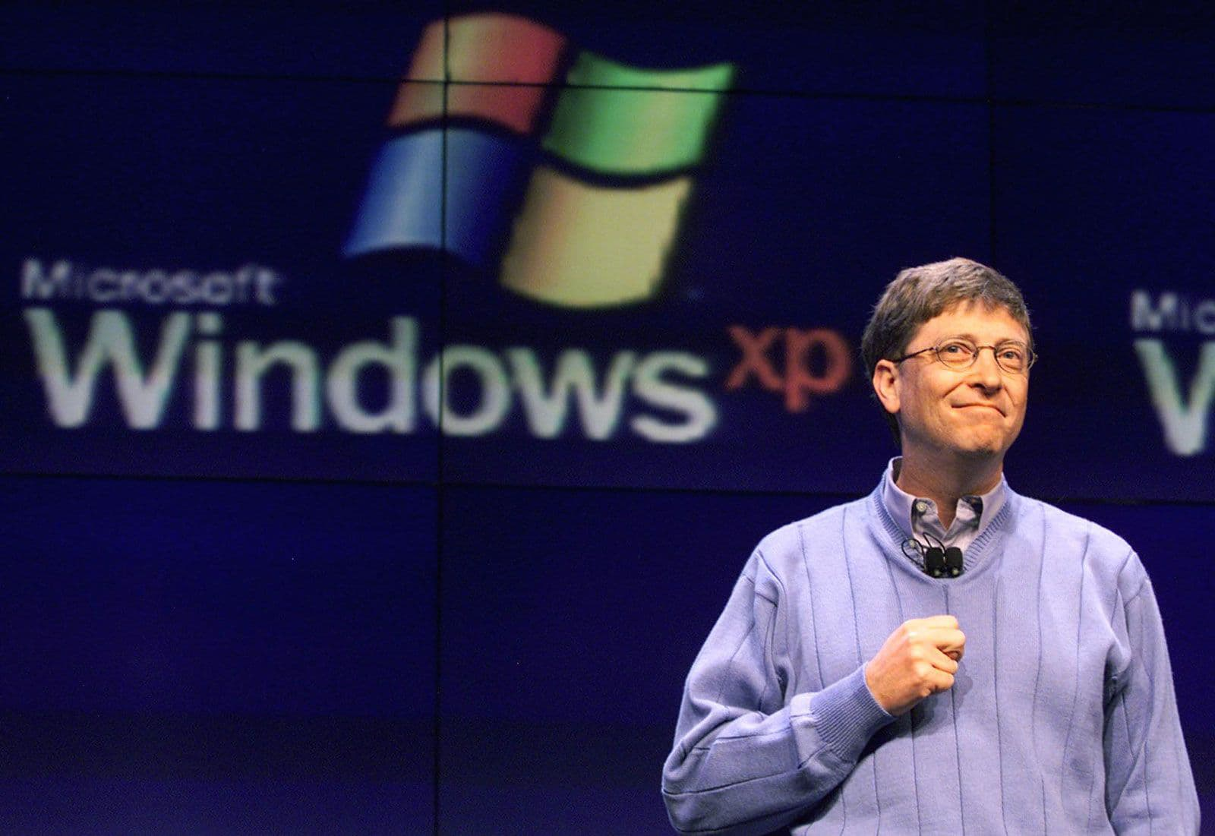
Company Overview
Microsoft Corporation, founded on April 4, 1975, by Bill Gates and Paul Allen, has grown into one of the world's most influential technology companies. Headquartered in Redmond, Washington, USA, Microsoft offers a vast array of services and products that touch nearly every aspect of digital life.
From its ubiquitous Windows operating system and Office suite to cloud services like Azure, social platforms like LinkedIn, and cutting-edge AI tools, Microsoft's global impact is undeniable. The company operates in over 190 countries, shaping how businesses function and individuals interact with technology daily.
Name: Microsoft Corporation
Founded: April 4, 1975 by Bill Gates and Paul Allen
Headquarters: Redmond, Washington, USA
Services: Windows, Office, Azure, GitHub, LinkedIn, AI tools
Global Impact: Operates in 190+ countries

Slide 3
Key Ethical Focus Areas
Microsoft's commitment to ethical conduct is reflected in several key areas that guide its operations and interactions. These pillars ensure the company upholds its responsibilities to customers, employees, and society at large.
1
Code of Conduct and Values
Establishing fundamental principles for all employees.
2
Privacy & Data Protection
Safeguarding user data and ensuring transparency.
3
Intellectual Property
Protecting innovation while fostering collaboration.
4
Corporate Social Responsibility
Contributing positively to global communities.
5
Environmental Sustainability
Minimizing environmental footprint and promoting green practices.
6
Workplace Ethics & Diversity
Fostering an inclusive and respectful work environment.

Slide 4

1.Code of Conduct and Values
Microsoft's ethical foundation is anchored in a robust Code of Conduct and a clear set of values: integrity, accountability, and respect. These principles guide every aspect of the company's operations, from product development to customer interactions.
The Standards of Business Conduct (SBC) provide detailed guidelines, ensuring employees understand their responsibilities and expected behaviors. Compliance is reinforced through mandatory, regular ethics training for all employees, fostering a culture where ethical considerations are paramount in decision-making.
Integrity
Acting honestly and transparently.
Accountability
Taking responsibility for actions.
Respect
Treating others with dignity.

Slide 5

2.Privacy, Data Protection & Cybersecurity
In an era of increasing digital interconnectedness, Microsoft places a high premium on privacy, data protection, and cybersecurity. The company adheres to global regulations such as GDPR and CCPA, demonstrating a commitment to user rights.
GDPR, CCPA compliance: Adherence to leading global data protection regulations, ensuring user rights are upheld.
Microsoft Privacy Dashboard: A centralized portal allowing users to manage their data and privacy settings transparently.
Azure Security, Microsoft Defender: Robust security measures embedded in cloud services and endpoint protection to safeguard against cyber threats.
Transparency through reports: Regular publication of reports detailing data requests from governments and other entities.
The Microsoft Privacy Dashboard empowers users with control over their data, while robust security measures like Azure Security and Microsoft Defender protect against cyber threats. Transparency reports further underscore Microsoft's dedication to open practices in data handling.

Slide 6



3.Intellectual Property Practices
Microsoft's approach to intellectual property balances robust protection of its innovations with a commitment to fostering technological advancement. This dual strategy ensures the company's proprietary assets are secure while also contributing to the broader tech ecosystem.
Strong Protections
Anti-Piracy Initiatives
Open-Source Support
Microsoft maintains a vast portfolio of patents and copyrights to protect its software, hardware, and innovative technologies, safeguarding its research and development investments globally.
The company actively combats software piracy through legal action, educational campaigns, and technological safeguards, aiming to protect its intellectual property and ensure fair market competition.
Despite its proprietary roots, Microsoft has become a significant supporter of open-source projects, notably through its acquisition of GitHub. This demonstrates a commitment to community collaboration and shared innovation.

Slide 7

4.Corporate Social Responsibility
Microsoft's commitment to corporate social responsibility extends beyond its core business, aiming to create positive societal impact through various initiatives. This includes fostering digital literacy and supporting vulnerable communities worldwide.
Digital skills and education initiatives: Providing access to technology education for underserved communities globally, empowering individuals with essential digital literacy.
Microsoft Philanthropies: The dedicated arm of Microsoft that focuses on social impact, investing in non-profits and supporting various humanitarian efforts.
Over $1B in donations annually: Significant financial contributions to non-profit organizations and community programs around the world, addressing pressing social issues.
Accessibility and inclusion support: Developing products and features that are accessible to people with disabilities, promoting digital inclusion for all.
Microsoft Philanthropies, the company's dedicated social impact arm, channels over $1 billion in annual donations to non-profits. This funding supports diverse causes, including accessibility and inclusion, ensuring technology benefits everyone.

Slide 8
5.Environmental Sustainability
Microsoft is deeply committed to addressing climate change and minimizing its environmental footprint. The company has set ambitious goals to achieve carbon negativity and transition to renewable energy sources, leading by example in the tech industry.
2030
100%
Zero
Carbon Negative Goal
Renewable Energy
Waste Data Centers
Microsoft aims to be carbon negative by 2030, meaning it will remove more carbon from the atmosphere than it emits, covering all emissions historically and currently.
By 2025, Microsoft aims to power 100% of its operations with renewable energy, investing heavily in green energy projects and power purchase agreements.
The company is working towards achieving zero waste operations for its data centers and campuses by 2030, focusing on circular economy principles for materials and equipment.
Investments in renewable energy and the development of eco-friendly data centers are central to this mission. Transparency is maintained through regular Sustainability Reports, detailing progress and challenges.

Slide 9

6.Workplace Ethics & Diversity
Microsoft recognizes that a diverse and inclusive workforce is essential for innovation and ethical conduct. The company fosters an environment where all employees feel valued and respected, free from discrimination.
Annual D&I Reports: Publicly available reports detailing workforce demographics, progress on diversity goals, and initiatives to foster inclusion.
Anti-discrimination policies: Strict policies and procedures in place to prevent and address discrimination based on race, gender, sexual orientation, religion, disability, and other protected characteristics.
Employee resource groups (ERGs): Networks for employees with shared identities or interests, providing support, fostering community, and contributing to company culture.
Inclusive hiring programs: Initiatives designed to attract and recruit talent from diverse backgrounds, ensuring a wide range of perspectives within the workforce.
Annual Diversity and Inclusion (D&I) Reports provide accountability, while comprehensive anti-discrimination policies and numerous employee resource groups reinforce a culture of fairness and equity. Inclusive hiring programs are vital for attracting diverse talent and perspectives.

Slide 10




Ethical Challenges & Solutions
Like any large corporation, Microsoft has faced its share of ethical challenges. However, its response to these incidents demonstrates a commitment to learning, adapting, and reinforcing its ethical framework.
PRISM Program (2013)
Harassment Allegations (2019)
Faced scrutiny over participation in government surveillance. Microsoft responded by increasing transparency through privacy reports and advocating for clearer legal frameworks.
Internal allegations led to investigations and significant reforms in HR policies, including improving complaint processes and promoting a more respectful workplace culture.
JEDI Contract (2020)
Copilot IP Issues (2022)
The controversial military cloud contract raised ethical questions. Microsoft reiterated its commitment to ethical AI principles and responsible government technology use, while respecting legal obligations.
Concerns arose regarding the intellectual property implications of its AI coding assistant. Microsoft updated its policies, offering indemnification for copyright infringement claims and enhancing transparency in AI model training.

Slide 11
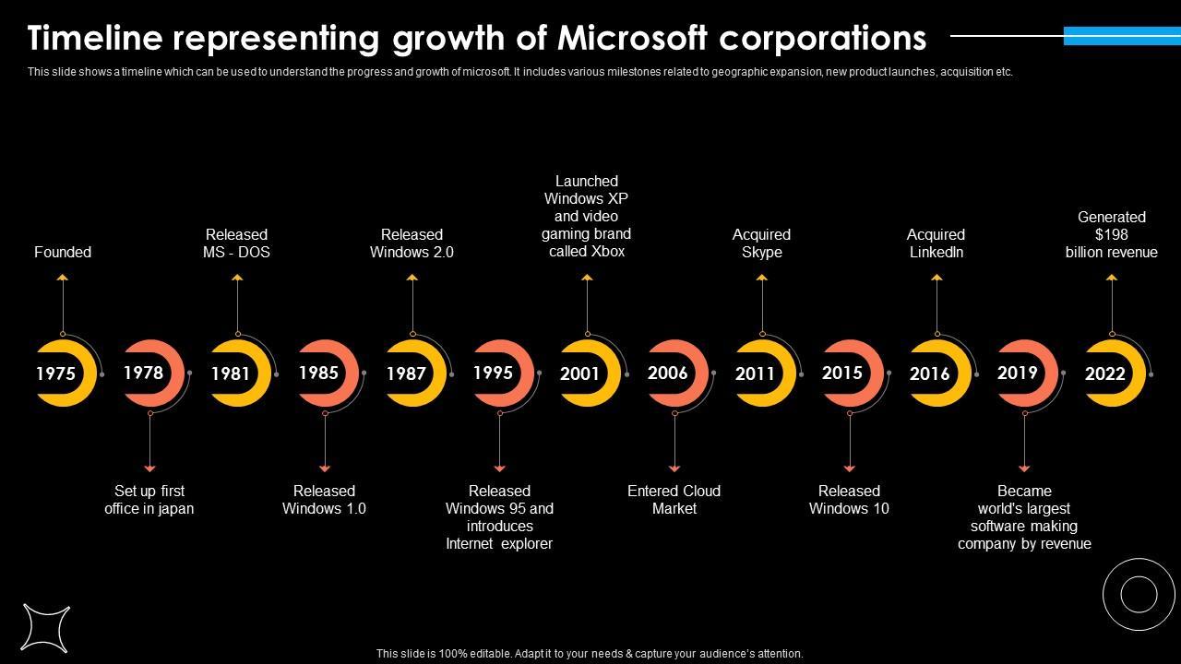
Growth Of Microsoft Corporation

Slide 12
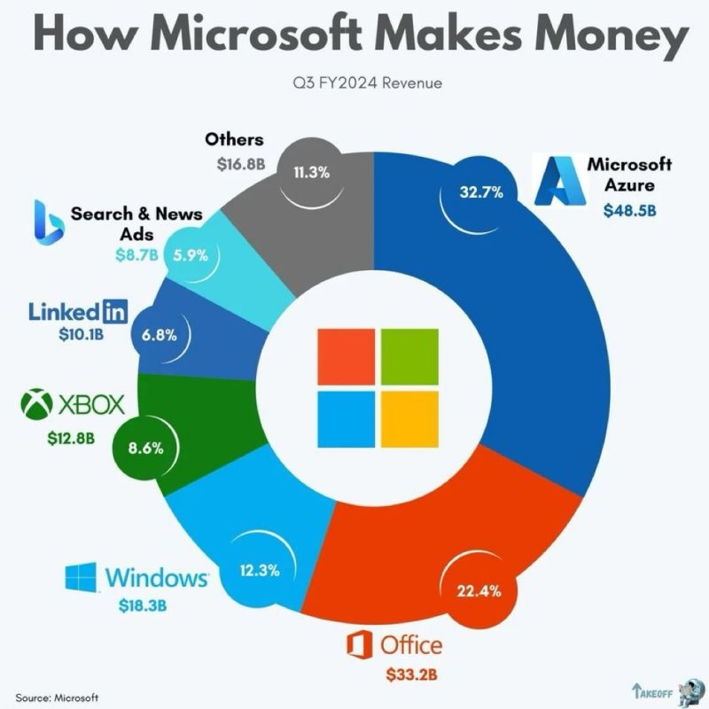

Slide 13
Conclusion
Is the organization ethically responsible? Why or why not?
Yes, Microsoft is ethically responsible.
They follow strong values like honesty, respect, and fairness in how they run the company.
🔹 Clear Rules and Training: They have a clear code of conduct, and all employees get ethics training.
🔹 Privacy and Safety: They protect user data and follow rules like GDPR. They are open about how they use data.
🔹 Helping Society: They support education, donate to charities, and make technology more accessible to everyone.
🔹 Caring for the Environment: They aim to reduce pollution and use clean energy.
🔹 Diversity and Fairness: They support equal opportunities and respect for all employees.
🔹 Learning from Mistakes: When problems happen, like privacy or workplace issues, Microsoft investigates and improves their policies.
Why?

Slide 14
Group 06
Group Members:-
2020/ICTS/12 - J.H.A.Jayalath
2020/ICTS/14 - N.G.H.A.Weerasinghe
2020/ICTS/23-D.M.D.Danthanarayana
2020/ICTS/42 - W.M.M. Tharaka
2020/ICTS/44 – K.A.R.Deshani
2020/ICTS/47 - B.T.S. Hansana
2020/ICTS/50 - R.M.R.R.Gunasundara
2020/ICTS/57 - M.A.K.D.Alahendra
2020/ICTS/61 - S.A.C. Jayanga
2020/ICTS/113- K.A.A.V.N.Kahadawa
2020/ICTS/127-J.M.T.H.Jayasundara
2020/ICTS/147 - R.M.P.G.V.S. Dissanayake

