Slide 1

Unit-2 Views, Functions & Procedures
Database Management Systems-II (DBMS-II)
DU # 2304CS422
Prof. Hemang R Chath
Computer Science & Engineering Department
hemang.chath@darshan.ac.in
8200834776

Slide 2

Outline
Introduction to Views
Types of View
Updating, Deleting, Renaming & Dropping Views
Advantages and Disadvantages of View
Table Vs View
Introduction to PL/SQL
Advantages of PL/SQL
Stored Procedures
User Defined Functions
Function Vs Procedure
Looping

Slide 3
Introduction to Views
Section – 1

Slide 4

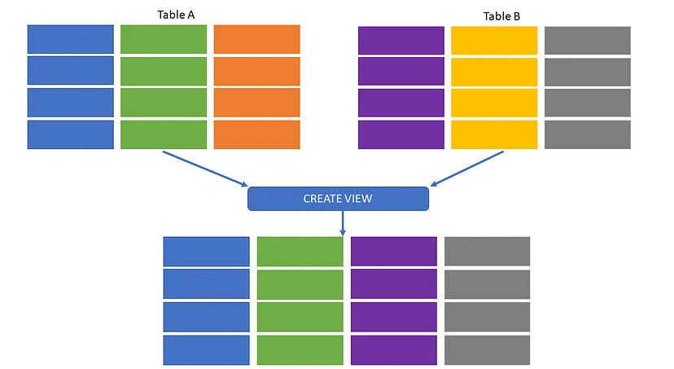
Introduction to Views
Every column and row of table should not be visible to everyone.
View is a virtual or logical table that allows to view the parts of the table.
Views are virtual tables that are compiled at runtime.
View is derived from one or more than one table, those tables are known as Base Tables.
View is the result set of a stored query.
The data associated with views are not physically stored in the view, but it is stored in the base tables of the view.
Generally, we put those columns in view that we need to retrieve again and again.
Once you have created the view, you can query view like as table.
View is mapped, to a SELECT sentence.
Base Tables

Slide 5
Types of View
Section – 1.1

Slide 6
Types of View
Types of View
System Defined View
User Defined View

Slide 7
System Defined View
The System Defined Views are predefined views that already exist in the SQL Server database, such as Tempdb, Master, and temp.
System Defined Views will be automatically attached to all User Defined databases.

Slide 8
User Defined View
Types of User Defined View
Simple View
Complex View
When we create a view on a single table
When we create a view on more than one table

Slide 9
Simple View
Simple views can only contain a single table or can be created only from one table. Group functions such as MAX(), COUNT(), etc., cannot be used here, and it does not contain groups of data.
In Simple View, DML operations can be performed. Insert, delete, and update are directly possible, but Simple View does not contain group by clause.
Insert operation are perform on simple view only if we have primary key and all not null fields in the view.

Slide 10
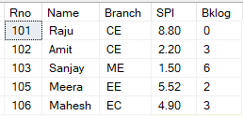
Create a simple View
Syntax to create a simple view
Create a view Student_Details having columns Name, Branch & SPI.
Student
CREATE
[OR ALTER]
VIEW
View_name
AS
SELECT
Columns
FROM
Table_name
WHERE
Condition
;
Example-1
CREATE
VIEW
Student_Details
AS
SELECT
Name,
Branch,
SPI
FROM
Student
;

Slide 11
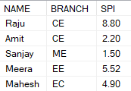
Display Simple View
Syntax to Display view
SELECT
Columns
FROM
View_name
WHERE
Condition
;
To display Student_Details view
SELECT
*
FROM
Student_Details
;
Output (View)
Student_Details

Slide 12

Simple View [Examples]
Example-2
Create a view STUDENT_BKLOG having all columns but students whose backlog more than 2.
SELECT * FROM STUDENT_BKLOG;
CREATE
VIEW
STUDENT_BKLOG
AS
SELECT
*
FROM
Student
WHERE
BKLOG>2
;
Output (VIEW)

Slide 13
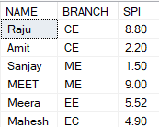
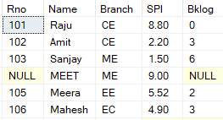
Simple View [Examples]
Example-3
Insert a new record to VIEW Student_Details . (Meet, ME, 9)
SELECT * FROM Student_Details;
INSERT
INTO
Student_Details
VALUES
('MEET','ME',9)
;
Output (VIEW)
Output (Base Table)
SELECT * FROM STUDENT

Slide 14
Complex View
When we create a view on more than one table, it is called complex view.
We can only update data in complex view.
You can't insert data in complex view.
In particular, complex views can contain: join conditions, a group by clause, an order by clause etc.

Slide 15
Complex View [Example-1]
Consider the following table Branch and Faculty having the following records.
Create a view that contain branch id, branch name, HOD, faculty id and faculty name from Branch and Faculty table:
Now, you can query Faculty_Info in similar way as you query an actual table.
Following is the example: SELECT * FROM Faculty_Info;
Branch
Faculty
Example:-
CREATE VIEW Faculty_Info
AS
SELECT B.BID, B.BNAME, B.HOD, F.FID, F.FNAME
FROM Branch B Inner Join Faculty F
ON B.BID = F.BID;
BID | BName | HOD
1 | CE | Shah
2 | ME | Patel
FID | FName | BID
101 | Raj | 1
103 | Meet | 2
Output
BID | Bname | HOD | FID | FName
1 | CE | Shah | 101 | Raj
2 | ME | Patel | 103 | Meet

Slide 16
Complex View [Examples-2]
Consider the following table Student and Result having the following records.
Student
Result
Example:-
CREATE VIEW Avg_Result
AS
SELECT S.Branch, AVG(R.SPI) As Avg_Spi
FROM Student S INNER JOIN Result R
ON S.Rno = R.Rno
GROUP BY S.Branch;
RNo | Name | Branch
101 | Raju | CE
102 | Amit | CE
103 | Sanjay | ME
104 | Neha | ME
RNo | SPI
101 | 8.8
102 | 9.2
103 | 7.6
104 | 8.4
Create a view that displays average result of each branch.
Output
Branch | Avg_Spi
CE | 9
ME | 8

Slide 17
Complex View [Example-3]
Consider the following table Student and Result having the following records.
Example:-
CREATE VIEW StuResult_Order
AS
SELECT TOP 100 PERCENT S.Rno, S.Name, S.Branch, R.SPI
FROM Student S INNER JOIN Result R
ON S.Rno = R.Rno
ORDER BY S.Name;
Student
Result
RNo | Name | Branch
101 | Mina | CE
102 | Amit | CE
103 | Sanjay | ME
RNo | SPI
101 | 8.8
102 | 9.2
103 | 7.6
Create a view that displays student information with result order by customer name.
Output
RNO | Name | Branch | SPI
102 | Amit | CE | 9.2
101 | Mina | CE | 8.8
103 | Sanjay | ME | 7.6

Slide 18
Updating, Deleting, Renaming and Dropping Views
Section – 1.2

Slide 19
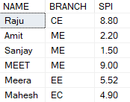
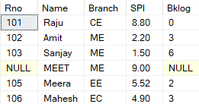
Updating a View [Examples]
A view can be update using UPDATE command as we updated the normal table.
Update the branch of Amit from CE to ME in Student_Details view.
SELECT * FROM Student_Details;
Student
UPDATE
Student_Details
SET
BRANCH='ME'
WHERE
NAME='AMIT'
;
Output (VIEW)
Output (Base Table)
SELECT * FROM STUDENT

Slide 20
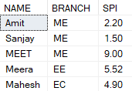
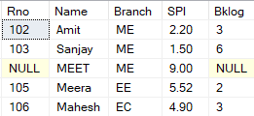
Deleting a View [Examples]
A view can be delete with DELETE command as we deleted the normal table.
Delete from Student_Details view whose name is ‘Raju’.
SELECT * FROM Student_Details;
Student
DELETE
FROM
Student_Details
WHERE
NAME=‘Raju'
;
Output (VIEW)
Output (Base Table)
SELECT * FROM STUDENT

Slide 21
Renaming a View
There isn't a query in SQL Server that can rename a view directly.
The sp_rename is a system stored procedure in SQL that can be used to rename view.
Syntax to rename view
EXEC
sp_rename
'old_view_name'
,
'new_view_name'
;
Example
EXEC
sp_rename
‘CUSTOMERS_VIEW'
,
‘VIEW_ CUSTOMERS '
;

Slide 22
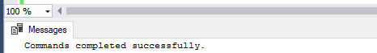
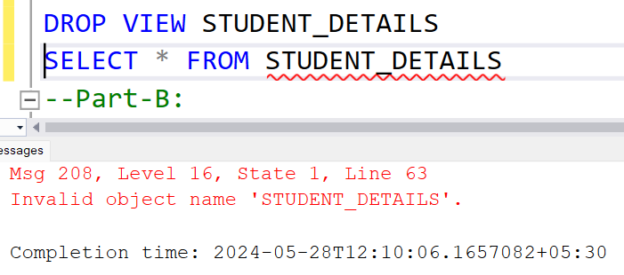
Dropping a view
A view is drop by using the DROP VIEW statement.
The base table will not be affected if a view is destroyed.
After Successfully drop the view if we try to access the view it will throw an error.
Syntax to drop a view :
DROP
VIEW
View_name
;
Example:
Output:
DROP
VIEW
Student_Details
;
ERROR !!!

Slide 23
Simple View Vs Complex View
Sr.No. | Simple View | Complex View
1 | It contains only one single base table or is created from only one table. | Contains more than one base table or is created from more than one table.
2 | In Simple View, We cannot use group functions like MAX(), COUNT(), etc. | In Complex View We can use various group functions.
3 | In Simple View, DML operations could easily be performed. | In Complex view, DML operations could not always be performed.
4 | As mentioned in above point due to DML operations INSERT, DELETE and UPDATE are directly possible on a simple view. | In Complex view, we cannot apply INSERT, DELETE and UPDATE directly.

Slide 24
Simple View [Exercise]
Consider the Customer table having the following fields and solve given queries:
Create a view ‘Emp_Pattern’ that contain employee id, name and salary of all the employees whose first name is start with ‘a’ and end with ’k’ from Customer table.
Create a view ‘Emp_Dept’ that displays all the information of employee works in ‘HR’ department.
Create a view ‘Emp_Age’ that retrieves employees with an age between 25 to 35.
Delete data from a ‘Emp_Age’ view whose age is greater than 29.
Update department ‘HR’ to ‘Human Resource’ in ‘Emp_Dept’ view.
Destroy ‘Emp_Age’ view from the database.
Rename view ‘Emp_Pattern’ to ‘Emp_Like’.
Employee
EID | FirstName | LastName | Age | Department | Salary

Slide 25
Complex View [Exercise]
Consider the Customer and Order table having the following fields and solve given queries:
Create a view that displays all the customer information along with their order from Customer and Order tables.
Create a view that displays all the information of customers who place their order after 25th of August, 2021.
Create a view ‘Cust_Order’ that retrieves customers whose order id between 103 to 108 and order amount exceeds 25000.
Create a view ‘Cust_TotalOrder’ that displays total number of orders for each customers.
Create a view ‘Cust_OrderByName’ that displays customer information with its order amount in ascending order by customer name.
Customer
Order
CustID | CustName | Email
OrderID | CustID | OrderDate | OrderAmount

Slide 26
Advantages and Disadvantages of View
Section – 1.3

Slide 27
Advantages of View
We are getting the following advantages of using Views in SQL Server.
Hiding the complexity: In SQL Server, we can use the Views to reduce the complexity of the database schema for non-IT users. View hides the complexity of SQL Server Joins. Now, the Non-IT users find this view easy to query rather than writing the complex joins.
Query Simplicity: A view can draw data from several different tables and present it as a single table, turning multi-table queries into single-table queries.
Security: Each user can be given permission to access the database only through a small set of views that contain the specific data the user is authorized to see, thus restricting the user's access to stored all data.
Presenting the Aggregated data by Hiding Detailed data: Views can act as aggregated tables, where the database engine aggregates data (sum, average, etc.) and presents the calculated results as part of the data.
Views take very little space to store: The database contains only the definition of a view, not a copy of all the data that it presents.

Slide 28
Disadvantages of View / Limitation
Views provide an abstraction layer to underlying data, simplifying data access. However there are certain limitations for SQL Server views. These limitations include:
You cannot pass parameters to SQL Server views
Cannot use an Order By clause with views without specifying TOP, OFFSET or FOR XML
Views cannot be created on Temporary Tables

Slide 29
Update View (Point To Keep in Mind)
If the user insert/update/delete any record/s in view, it will also affect its base table.
If a user tries to insert any record in view then at that time, the base table’s PRIMARY KEY column and NOT NULL column constraints must be fulfil.
We only modify data using view if it affects only one base table.
Common Restriction on Updatable View
It can not include:
Aggregate functions
DISTINCT, GROUP BY or HAVING clause
Sub queries
UNION, INTERSECTION or MINUS clause

Slide 30
Table vs View
Section – 2

Slide 31
Table Vs View
Sr.No | Table | View
1 | A table consists of rows and columns used to organize data to store and display records in a structured format. | A view is a virtual / logical table used to view or manipulate parts of the table.
2 | We need three things to create a table: Table name Columns / Fields name Datatypes / definitions for each field | We can create the columns of the view from one or more tables. Its content is based on base tables.
3 | The table is an independent database object. | Views are usually depending on the table.
4 | The table is an actual or real table that exists in physical locations. | Views are the virtual or logical table that does not exist in any physical location.

Slide 32
Table Vs View
Sr.No. | Table | View
5 | Table is a physical entity that means data is actually stored in the table. | The view is a virtual entity, which means data is not actually stored in the table.
6 | Table is used stored the data. | View is used to extract data from the table.
7 | It generates a fast result. | The view generates a slow result because it renders the information from the base table every time we query it.

Slide 33
Introduction to PL/SQL
Section – 3

Slide 34
Introduction to PL/SQL
PL/SQL is a procedural language extension to Structured Query Language (SQL). The purpose of PL/SQL is to combine database language and procedural programming language.

Slide 35
Advantages of PL/SQL
Section – 4

Slide 36
Advantages of PL/SQL
Block structure:
PL/SQL consist of block of code, which can be nested within each other.
Each block forms a unit of a task or a logical module.
PL/SQL blocks can be stored in the database and reused.
Procedural language capability:
PL/SQL consist of procedural constructs such as conditional statements (if, if else, nested if, else if ladder) and loops (for, while, do while).
Better performance:
PL/SQL engine processes multiple SQL statements simultaneously as a single block, thereby reducing network traffic.
Error handling:
PL/SQL handles errors or exceptions effectively during the execution of PL/SQL program.
Once an exception is caught, specific action can be taken depending upon the type of the exception or it can be displayed to the user with message.

Slide 37
Stored procedure
Section – 5

Slide 38
Stored procedure (SP)
A stored procedure is a prepared SQL code that you can save, so the code can be reused again whenever needed.
A procedure has two parts, header and body.
The header consists of the name of the procedure and the parameters passed to the procedure.
The body consists of declaration section, execution section and exception section.
A procedure may or may not return any value. A procedure may return more than one value.
Syntax of Creating a Stored Procedure
1
2
3
4
5
6
CREATE OR ALTER PROCEDURE Procedure_Name
-- List of Parameters with datatype
AS
BEGIN
-- SQL statements OR Body
END

Slide 39
Explanation of Syntax of Stored procedure (SP)
Create :-It will create a procedure.
Alter :- It will re-create a procedure if it already exists.
We can pass parameters to the procedures in three ways.
IN-parameters :- These types of parameters are used to send values to stored procedures.
OUT-parameters :- These types of parameters are used to get values from stored procedures. This is similar to a return type in functions but procedure can return values for more than one parameters.
IN OUT-parameters :- This type of parameter allows us to pass values into a procedure and get output values from the procedure.
AS indicates the beginning of the body of the procedure.
sql_statement contains the SQL query. (select, insert, update or delete)
By using CREATE OR ALTER together the procedure is created if it does not exist and if it exists then it is replaced with the current code.

Slide 40
How to execute a stored procedure?
There are two ways to execute a procedure.
From the SQL prompt
Syntax: EXECUTE [or EXEC] procedure_name (parameter);
Within another procedure: simply use the procedure name.
Syntax: procedure_name (parameter);

Slide 41
Example of Stored procedure (SP) without parameter [Select All]
Create Procedure
Customer
1
2
3
CREATE PROCEDURE PR_Customer_SelectAll
AS
SELECT * FROM Customer
CstID | Name | Age | City | Balance
101 | Nilesh | 32 | Rajkot | 10000
102 | Mayur | 35 | Jamnagar | 25000
103 | Hardik | 38 | Ahmedabad | 15000
104 | Ajay | 42 | Surat | 20000
Execute Procedure
1
2
3
EXEC PR_Customer_SelectAll
OR
EXECUTE PR_Customer_SelectAll
Output
CstID | Name | Age | City | Balance
101 | Nilesh | 32 | Rajkot | 10000
102 | Mayur | 35 | Jamnagar | 25000
103 | Hardik | 38 | Ahmedabad | 15000
104 | Ajay | 42 | Surat | 20000

Slide 42
Example of Stored procedure (SP) with one parameter [Select PK]
Create Procedure
Customer
1
2
3
4
5
CREATE PROCEDURE PR_Customer_SelectByPK
@CstID int
AS
SELECT Name, Age, City, Balance FROM Customer
WHERE CstID = @CstID;
CstID | Name | Age | City | Balance
101 | Nilesh | 32 | Rajkot | 10000
102 | Mayur | 35 | Jamnagar | 25000
103 | Hardik | 38 | Ahmedabad | 15000
104 | Ajay | 42 | Surat | 20000
105 | Nayan | 45 | Rajkot | 25000
Execute Procedure
1
2
3
EXEC PR_Customer_SelectByPK 103
OR
EXECUTE PR_Customer_SelectByPK 103
Output
Name | Age | City | Balance
Hardik | 38 | Ahmedabad | 15000

Slide 43
Example of Stored procedure (SP) with multiple parameters
Create Procedure
Customer
1
2
3
4
5
6
CREATE PROCEDURE PR_Customer_SelectByPK
@CstID int,
@City varchar(50)
AS
SELECT Name, Age, City, Balance FROM Customer
WHERE CstID < @CstID AND City = @City;
CstID | Name | Age | City | Balance
101 | Nilesh | 32 | Rajkot | 10000
102 | Mayur | 35 | Jamnagar | 25000
103 | Hardik | 38 | Ahmedabad | 15000
104 | Ajay | 42 | Surat | 20000
105 | Nayan | 45 | Rajkot | 25000
Execute Procedure
1
2
3
EXEC PR_Customer_SelectByPK 104, 'Rajkot'
OR
EXECUTE PR_Customer_SelectByPK 104, 'Rajkot'
Output
Name | Age | City | Balance
Nilesh | 32 | Rajkot | 10000

Slide 44
Example of Stored procedure (SP) [Insert]
Create Procedure
Customer
1
2
3
4
5
6
7
8
9
10
CREATE PROCEDURE PR_Customer_Insert
@CstID int,
@Name varchar(20),
@Age int,
@City varchar(20),
@Balance decimal(10,2)
AS
INSERT INTO Customer
VALUES
(@CstID, @Name, @Age, @City, @Balance);
CstID | Name | Age | City | Balance
101 | Nilesh | 32 | Rajkot | 10000
102 | Mayur | 35 | Jamnagar | 25000
103 | Hardik | 38 | Ahmedabad | 15000
104 | Ajay | 42 | Surat | 20000
105 | Nayan | 45 | Rajkot | 25000
106 | Raj | 30 | Morbi | 20000
Execute Procedure
1
2
3
EXEC PR_Customer_Insert 106, ‘Raj’, 30, ‘Morbi’, 20000
OR
EXEC PR_Customer_Insert @CstID=106, @Name=‘Raj’, @Age=30, @City=‘Morbi’, @Balance=20000

Slide 45
Example of Stored procedure (SP) [Update]
Create Procedure
Customer
1
2
3
4
5
6
7
8
9
10
11
12
13
14
CREATE PROCEDURE PR_Customer_Update
@CstID int,
@Name varchar(20),
@Age int,
@City varchar(20),
@Balance decimal(10,2)
AS
UPDATE Customer
SET
Name = @Name,
Age = @Age,
City = @City,
Balance =@Balance
WHERE CstID = @CstID
CstID | Name | Age | City | Balance
101 | Nilesh | 32 | Rajkot | 10000
102 | Mayur | 35 | Jamnagar | 25000
103 | Hardik | 38 | Ahmedabad | 15000
104 | Ajay | 42 | Surat | 20000
105 | Nayan | 45 | Rajkot | 25000
106 | Raj | 30 | Morbi | 20000
106 | Dilip | 25 | Rajkot | 15000
Execute Procedure
EXEC PR_Customer_Update 106, ‘Dilip’, 25, ‘Rajkot’, 15000

Slide 46
Example of Stored procedure (SP) [Delete]
Create Procedure
Customer
1
2
3
4
5
CREATE PROCEDURE PR_Customer_Delete
@CstID int
AS
DELETE FROM Customer
WHERE CstID = @CstID;
CstID | Name | Age | City | Balance
101 | Nilesh | 32 | Rajkot | 10000
102 | Mayur | 35 | Jamnagar | 25000
103 | Hardik | 38 | Ahmedabad | 15000
104 | Ajay | 42 | Surat | 20000
105 | Nayan | 45 | Rajkot | 25000
106 | Dilip | 25 | Rajkot | 15000
Execute Procedure
1
EXEC PR_Customer_Delete 106

Slide 47
Stored Procedure Important Error Messages [Remember]
If you try to create the stored procedure and it already exists you will get an error message.
Error When Parameter Is Not Passed
If you try to supply other datatype for the parameter
Msg 2714, Level 16, State 3, Procedure PR_Person_SelectPersonID, Line 1
There is already an object named 'PR_Person_SelectPersonID' in the database.
Msg 201, Level 16, State 4, Procedure dbo.PR_Person_SelectPersonID, Line 0 Procedure or function 'PR_Person_SelectPersonID' expects parameter '@WorkerID', which was not supplied.
Msg 8114, Level 16, State 5, Procedure dbo.PR_Person_SelectPersonID, Line 0 Error converting data type varchar to int.

Slide 48
Advantages of Stored Procedures
Security: - We can improve security by giving rights to selected persons only.
Faster Execution: - It is precompiled so compilation of procedure is not required every time you call it.
Sharing of code: - Once procedure is created and stored, it can be used by more than one user.
Productivity: - Code written in procedure is shared by all programmers. This eliminates redundant coding by multiple programmers so overall improvement in productivity.

Slide 49
User Defined Functions
Section – 6

Slide 50
Introduction to User Defined Functions
UDF is a programming construct that accepts parameters, does actions and returns the result of that action.
The result either is a scalar value or result set.
UDFs can be used in scripts, Stored Procedures, triggers and other UDFs within a database.
Benefits
UDFs support modular programming.
Once you create a UDF and store it in a database then you can call it any number of times.
You can modify the UDF independent of the source code.

Slide 51
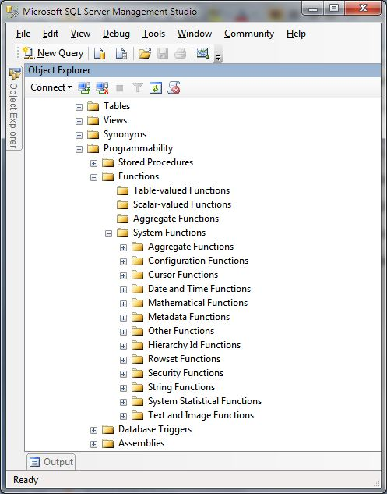
How to create function?
Syntax : User-defined Function
1
2
3
4
5
6
7
8
9
10
11
12
13
14
15
16
CREATE OR ALTER FUNCTION function_name
(
@parameter1 datatype,
@parameter2 datatype,
.,
.,
.,
@parametern datatype
)
RETURNS return_datatype
AS
BEGIN
[declaration_section]
[executable_section]
RETURN return_value
END;
You can find all functions, go to your
Database → Programmability → Functions
in SQL Server

Slide 52
Important note for UDF !
Function must have a name and a function name can never start with a special character such as @, $, #, and so on.
Functions compile every time.
Functions must return a value or result.
Functions only work with input parameters.
Function is not used to Insert, Update, Delete data in a database table(s).
User Defined Function can't return XML Data Type.
User Defined Function doesn't support exception handling, try and catch statements are not used in functions.

Slide 53
Example : UDF
Scalar Valued Function
1
2
3
4
5
6
7
8
9
10
--Scalar Valued function (always returns single value)
CREATE FUNCTION fun_AddNumber(@num1 INT,@num2 INT)
RETURNS INT
AS
BEGIN
RETURN @num1+@num2
END
--To execute the function
SELECT dbo.fun_AddNumber (2,3)
--Answer
5

Slide 54
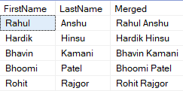
Example : UDF
Concat Two Strings
1
2
3
4
5
6
7
8
9
CREATE FUNCTION fun_JoinPersonInfo
(
@FirstName VARCHAR(150),
@LastName VARCHAR(500)
)
RETURNS VARCHAR(500)
AS
BEGIN RETURN(SELECT @FirstName+ ' ' +@LastName)
END
--To execute the function
SELECT FirstName,LastName,dbo.fun_JoinPersonInfo (FirstName,LastName) AS Merged FROM Person
Output

Slide 55
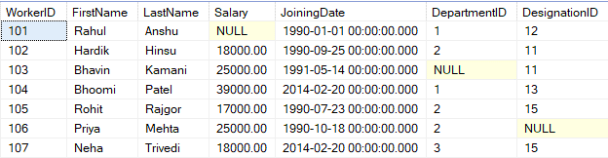
Example : UDF
Table Valued Function
1
2
3
4
CREATE FUNCTION Fun_PersonInformation()
RETURNS TABLE
AS
RETURN (SELECT * FROM Person)
--To execute the function
SELECT * FROM Fun_PersonInformation()
Output

Slide 56
Example : UDF
Table Valued Function
1
2
3
4
5
6
7
8
9
10
11
12
13
14
15
16
17
18
--Create a table-valued function that returns a list of products including product name, model year and the price for a specific model year.
CREATE FUNCTION udfProductInYear
(
@model_year INT
)
RETURNS TABLE
AS
RETURN
SELECT
ProductName,
ModelYear,
Price
FROM
Products
WHERE
ModelYear = @model_year;
--To execute the function
SELECT * FROM udfProductInYear(2017);

Slide 57
Advantages of User Defined Functions
The SQL Server User defined functions prevent us from writing the same logic multiple times.
Within the Database, you can create the method once and call it n number of times.
They reduce the compilation time of queries by catching the execution plan and reusing them.
This UDF can help us to separate the complex calculations from the regular query so that we can understand and debug the query quicker and better.
It reduces the network traffic because of its cache plan.
They are also used in the WHERE Clause as well. By this, we can limit the number of rows sent to the client.

Slide 58
Function v/s Procedure
Section – 7

Slide 59
Function v/s Procedure
Difference
Parameters | Functions | Procedures
Basics | Functions calculate the results of a program on the basis of the given input. | Procedures perform certain tasks in a particular order on the basis of the given inputs.
Try-Catch Blocks | Functions do not provide support for the try-catch Blocks. | Procedures provide support for the try-catch Blocks.
SQL Query | We can call a function in a SQL Query. | We cannot call a procedure in a SQL Query.
SELECT | The SELECT statements can have function calls. | The SELECT statements can never have procedure calls.
Return | A function would return the returning value/control to the code or calling function. | A procedure, on the other hand, would return the control, but would not return any value to the calling function or the code.
DML Statements | We cannot use the DML statements in a function, (functions such as Update, Delete, and Insert). | We can always use the DML statements in the case of a procedure.

Slide 60
Function v/s Procedure (Cont..)
Difference
Parameters | Function | Procedure
Call | A function can be called using a procedure. | A procedure cannot be called using any function.
Compilation | The compilation of a function occurs when we call them in a program. | The compilation of the procedures needs to occur once, and in case it is necessary, these can be called repeatedly, and we don’t have to compile them every single time.
Expression | A function must deal with expressions. | A procedure need not deal with expressions.
Explicit Transaction Handling | Functions cannot have explicit transaction handling. | Explicit transaction handling exists in the case of a procedure.

Slide 61
Frequently asked Questions in Exam
Define View. Describe types of view in brief.
How to create a simple view? Explain with suitable example.
How to create a complex view? Explain with suitable example.
Compare Simple View Vs Complex View.
Discuss Updating, Deleting, Renaming and Dropping a view.
Compare Table and View.
List out the advantages and disadvantages of view.
List and explain advantages of PL/SQL.
Write a short note on Stored Procedures.
Discuss how to update, drop and rename stored procedures.
Discuss advantages of stored procedures.
What is User Defined Function? Explain types of UDF in brief.

Slide 62
Frequently asked Questions in Exam
Discuss Scalar Valued Function with suitable example.
Discuss Table Valued Function with suitable example.
Discuss how to update, drop and rename user defined functions.
Discuss advantages of user defined functions.
List out advantages of User Defined Functions and Stored Procedures.

Slide 63
Database Management Systems-II (DBMS-II)
DU # 2304CS422
Prof. Hemang R Chath
Computer Science & Engineering Department
hemang.chath@darshan.ac.in
8200834776

