Slide 1
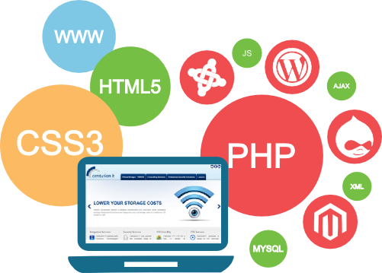

Unit-02 Functions and Regular Expressions
Client Side Scripting using Javascript (CSJS) (2304CS431)
Prof. Chirag K Sakhrani
Computer Engineering Department
chirag.sakhrani@darshan.ac.in
8401191184

Slide 2

Outline
User Defined Functions
Pop up boxes
Inbuilt functions
Validations
Validations using Regular Expressions
Looping

Slide 3
Functions
A JavaScript function is a block of code designed to perform a particular task.
A JavaScript function is executed when "something" invokes it.
A JavaScript function is defined with the function keyword, followed by a name, followed by parentheses ().
The parentheses may include parameter names separated by commas: (parameter1, parameter2, ...)
The code to be executed, by the function, is placed inside curly brackets.
Example :
Code
function myFunction(p1, p2) {
return p1 * p2;
}

Slide 4
Functions (Cont.)
When JavaScript reaches a return statement, the function will stop executing.
If the function was invoked from a statement, JavaScript will "return" to execute the code after the invoking statement.
The code inside the function will execute when "something" invokes (calls) the function:
When an event occurs (when a user clicks a button)
When it is invoked (called) from JavaScript code
Automatically (self invoked)

Slide 5
Pop up Boxes
Popup boxes can be used to raise an alert, or to get confirmation on any input or to have a kind of input from the users.
JavaScript supports three types of popup boxes.
Alert box
Confirm box
Prompt box

Slide 6
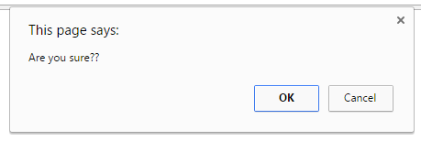
Confirm Box
A confirm box is used if you want the user to accept something.
When a confirm box pops up, the user will have to click either "OK" or "Cancel" to proceed, If the user clicks "OK", the box returns true. If the user clicks "Cancel", the box returns false.
Example :
Code
<script>
var a = confirm(“Are you sure??");
if(a==true) {
alert(“User Accepted”);
}
else {
alert(“User Cancled”);
}
</script>

Slide 7
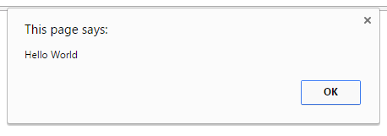
Alert Box
An alert box is used if you want to make sure information comes through to the user.
When an alert box pops up, the user will have to click "OK" to proceed.
It can be used to display the result of validation.
Code
<html>
<head>
<title>Alert Box</title>
</head>
<body>
<script>
alert("Hello World");
</script>
</body>
</html>

Slide 8
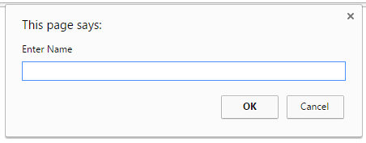
Prompt Box
A prompt box is used if you want the user to input a value.
When a prompt box pops up, user have to click either "OK" or "Cancel" to proceed, If the user clicks "OK" the box returns the input value, If the user clicks "Cancel" the box returns null.
Example:
Code
<script>
var a = prompt(“Enter Name");
alert(“User Entered ” + a);
</script>

Slide 9
Inbuilt Functions
A built-in function is a function that is already available in a programming language, application, or another tool that can be accessed by end users.
JavaScript provides large number of inbuilt functions some of them are:
eval()
isFinite()
isNaN()
Number()
parseInt()
parseFloat()
String()
Console.log(), etc.

Slide 10
Validation
Validation is the process of checking data against a standard or requirement.
Form validation normally used to occur at the server, after client entered necessary data and then pressed the Submit button.
If the data entered by a client was incorrect or was simply missing, the server would have to send all the data back to the client and request that the form be resubmitted with correct information.
This was really a lengthy process which used to put a lot of burden on the server.
JavaScript provides a way to validate form's data on the client's computer before sending it to the web server.

Slide 11
Validation (Cont.)
Form validation generally performs two functions.
Basic Validation
Emptiness
Confirm Password
Length Validation etc……
Data Format Validation
The data that is entered must be checked for correct form and value.
Email Validation
Mobile Number Validation
Enrolment Number Validation etc….

Slide 12
Validation using RegExp
A regular expression is an object that describes a pattern of characters.
Regular expressions are used to perform pattern-matching and "search-and-replace" functions on text.
example:
var pattern = "^[\\w]+$"; // will allow only words in the string
var regex = new RegExp(pattern);
If(regex.test(testString)){
//Valid
} else {
//Invalid
}

Slide 13
Validation using RegExp
Regular Expression Modifiers
Regular Expression Brackets
Expressions | Description
g | Find the character globally
i | Find a character with case-insensitive matching
m | Find multiline matching
Expressions | Description
[abc] | Find any of the characters inside the brackets
[^abc] | Find any character, not inside the brackets
[0-9] | Find any of the digits between the brackets 0 to 9
[^0-9] | Find any digit not in between the brackets
(x | y) | Find any of the alternatives between x or y separated with |

Slide 14
RegExp (Cont.) (Metacharacters)
To find word characters in the string we can use \w
We can also use [a-zA-Z0-9_] for the same
To find non-word characters in the string we can use \W
to find digit characters in the string we can use \d
We can also use [0-9] for the same
To find non-digit characters in the string we can use \D
We can use \n for new line and \t for tab

Slide 15
RegExp (Cont.) (Metacharacters)
Expressions | Description
\. | Search single characters, except line terminator or newline
\w | Find the word character i.e. characters from a to z, A to Z, 0 to 9
\d | Find a digit
\D | Search non-digit characters all the characters except digits
\s | Find a whitespace character
\S | Find the non-whitespace characters
\t | Find the tab character
\0 | Find the NULL character

Slide 16
RegExp (Cont.) (Quantifiers)
Quantifier | Description
n+ | Matches any string that contains at least one n
n* | Matches any string that contains zero or more occurrences of n
n? | Matches any string that contains zero or one occurrences of n
n$ | Matches any string with n at the end of it
^n | Matches any string with n at the beginning of it
n{X} | Matches any string that contains a sequence of X n's
n{X,Y} | Matches any string that contains a sequence of X to Y n's
n{X,} | Matches any string that contains a sequence of at least X n's

Slide 17
Basic Name Validation
A simple regular expression for matching a basic name:
/^[a-zA-Z0-9]+$/
Maches: chirag123, ChiragSakhrani, CHIRAGSAKHRANI
Not Matches: Chirag Sakhrani, Chirag_Sakhrani, Chirag-Sakhrani
Component | Explanation
/ | Delimiters that indicate the start and end of the regular expression
^ | Anchors the match to the start of the string
[a-zA-Z0-9] | This is a character class that matches: a-z: Any lowercase letter from a to z A-Z: Any uppercase letter from A to Z 0-9: Any digit from 0 to 9
+ | Quantifier for "one or more occurrences"
$ | Anchors the match to the end of the string

Slide 18
Name Validation Using RegExp
JavaScript
<script>
var a = "Chirag-Sakhrani";
var regex = /^[a-zA-Z0-9]+$/;
if (regex.test(a)){
alert("Valid");
}
else{
alert("Invalid");
}
</script>

Slide 19
Phone Number Validation
A simple regular expression for matching a phone number:
/^\d{3}-\d{3}-\d{4}$/
Maches: 123-456-7890
Not Matches: 123-45-67890, 1234567890, 123-456-78a0
Component | Explanation
/ | Delimiters that indicate the start and end of the regular expression
^ | Anchors the match to the start of the string
\d{3} | Matches exactly three digits (0-9)
- | Matches the literal hyphen (-) character, which separates parts of the phone number
\d{4} | Matches exactly four digits (0-9), representing the last part of the phone number
$ | Anchors the match to the end of the string

Slide 20
Phone Number Validation Using RegExp
JavaScript
<script>
var a = "123-456-7890";
var regex = /^\d{3}-\d{3}-\d{4}$/;
if (regex.test(a)){
alert("Valid");
}
else{
alert("Invalid");
}
</script>

Slide 21
Email Address Validation
A simple regular expression for matching a email address:
/^([a-zA-Z0-9._%+-]+)@([a-zA-Z0-9.-]+\.[a-zA-Z]{2,})$/
Maches: user123@example.com, john.doe@sub.example.org, user+name@domain.co.uk
Component | Explanation
/ | Delimiters that indicate the start and end of the regular expression
^ | Anchors the match to the start of the string
([a-zA-Z0-9._%+-]+) | Matches the local part of the email (before the @). [a-zA-Z0-9._%+-] : Allows alphanumeric characters (a-z, A-Z, 0-9) and special characters (., _, %, +, -). + : Ensures one or more characters in the local part.
([a-zA-Z0-9.-]+\.[a-zA-Z]{2,}) | Matches the domain part of the email (after the @). [a-zA-Z0-9.-]+ : Allows alphanumeric characters (a-z, A-Z, 0-9), dots (.), and hyphens (-). \. : Ensures the presence of a dot separator in the domain. [a-zA-Z]{2,} : Requires a top-level domain with at least 2 letters (e.g., .com, .org, .io).
$ | Anchors the match to the end of the string

Slide 22
Email Validation Using RegExp
JavaScript
<script>
var a = "chiragsakhrani@gmail.com";
var regex = /^([a-zA-Z0-9._%+-]+)@([a-zA-Z0-9.-]+\.[a-zA-Z]{2,})$/;
if (regex.test(a)){
alert("Valid");
}
else{
alert("Invalid");
}
</script>

Slide 23
Email Validation Using RegExp
JavaScript
<script>
function checkMail()
{
var a = document.getElementById("myText").value;
var pattern ="^[\\w-_\.]*[\\w-_\.]\@[\\w]\.+[\\w]+[\\w]$”;
var regex = new RegExp(pattern);
if(regex.test(a))
{
alert("Valid");
}
else
{
alert("Invalid");
}
}
</script>

Slide 24

Client Side Scripting using Javascript (CSJS) (2304CS431)
Prof. Chirag K Sakhrani
Computer Engineering Department
chirag.sakhrani@darshan.ac.in
8401191184

