Slide 1
Linear Algebra
Lecturer: Xia Liao
Email: xliao@hqu.edu.cn
Homepage: https://hirzebruch.github.io/main.html
Time: every Tuesday 1-2, Thursday 3-4

Slide 2
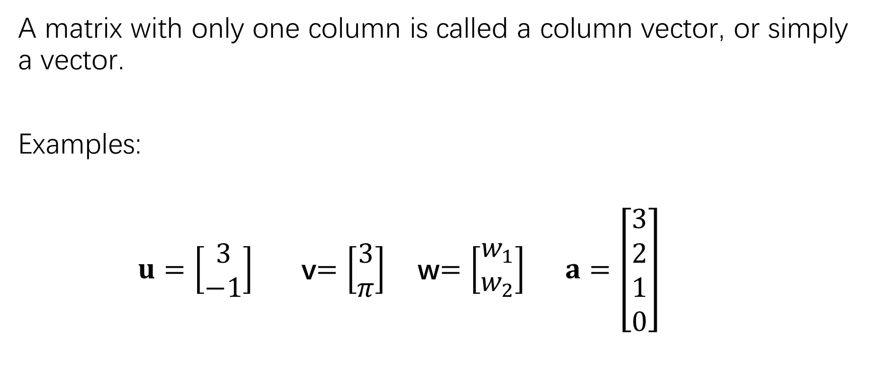
Vectors
A matrix with only one column is called a column vector, or simply a vector.
Examples:
$u=\left[\begin{matrix}3 \\ −1\end{matrix}\right]$ v$=\left[\begin{matrix}3 \\ π\end{matrix}\right]$ w$=\left[\begin{matrix}w_{1} \\ w_{2}\end{matrix}\right]$ $a=\left[\begin{matrix}3 \\ 2 \\ 1 \\ 0\end{matrix}\right]$

Slide 3
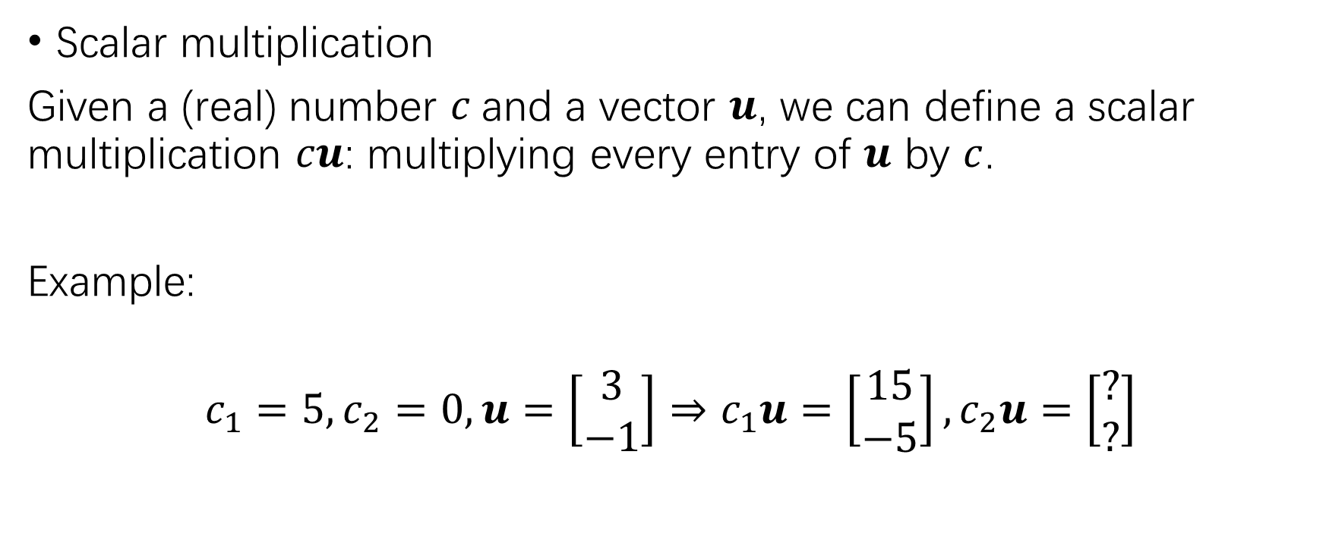
operations
Scalar multiplication
Given a (real) number $c$and a vector $u$, we can define a scalar multiplication $cu$: multiplying every entry of $u$ by $c$.
Example:
$$c_{1}=5,c_{2}=0,u=\left[\begin{matrix}3 \\ −1\end{matrix}\right]⇒c_{1}u=\left[\begin{matrix}15 \\ −5\end{matrix}\right],c_{2}u=\left[\begin{matrix}? \\ ?\end{matrix}\right]$$

Slide 4
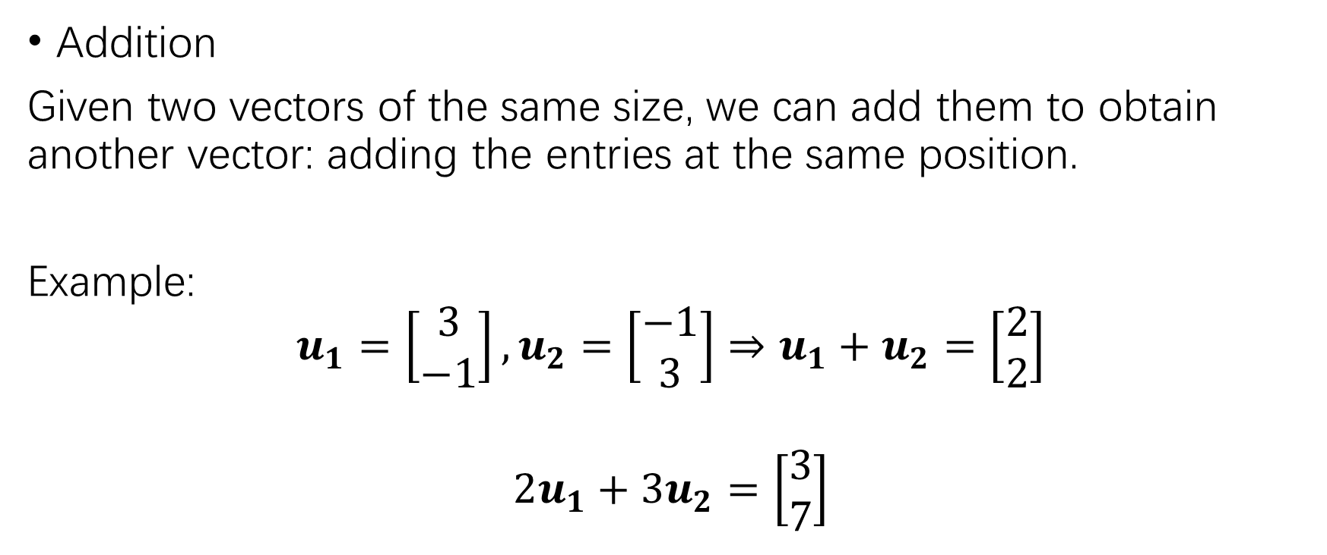
operations
Addition
Given two vectors of the same size, we can add them to obtain another vector: adding the entries at the same position.
Example:
$$u_{1}=\left[\begin{matrix}3 \\ −1\end{matrix}\right],u_{2}=\left[\begin{matrix}−1 \\ 3\end{matrix}\right]⇒u_{1}+u_{2}=\left[\begin{matrix}2 \\ 2\end{matrix}\right]$$
$$2u_{1}+3u_{2}=\left[\begin{matrix}3 \\ 7\end{matrix}\right]$$

Slide 5

Geometric descriptions of $ℝ^{2}$
Fix a coordinate system, a vector can be identified with a point on the coordinate plane, or with an arrow in the plane.

Slide 6
Parallelogram rule for addition

Slide 7
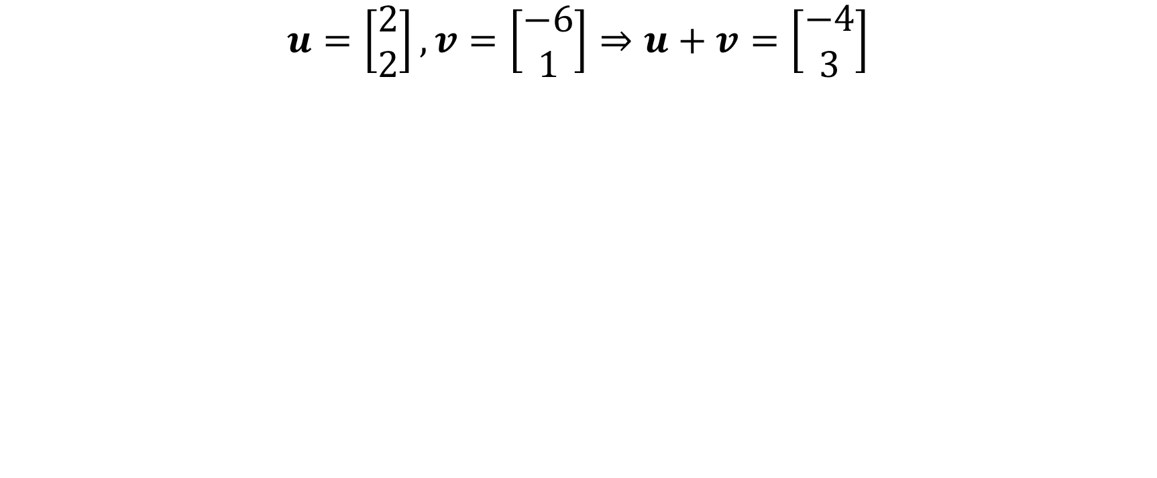
Parallelogram rule for addition
$$u=\left[\begin{matrix}2 \\ 2\end{matrix}\right],v=\left[\begin{matrix}−6 \\ 1\end{matrix}\right]⇒u+v=\left[\begin{matrix}−4 \\ 3\end{matrix}\right]$$

Slide 8
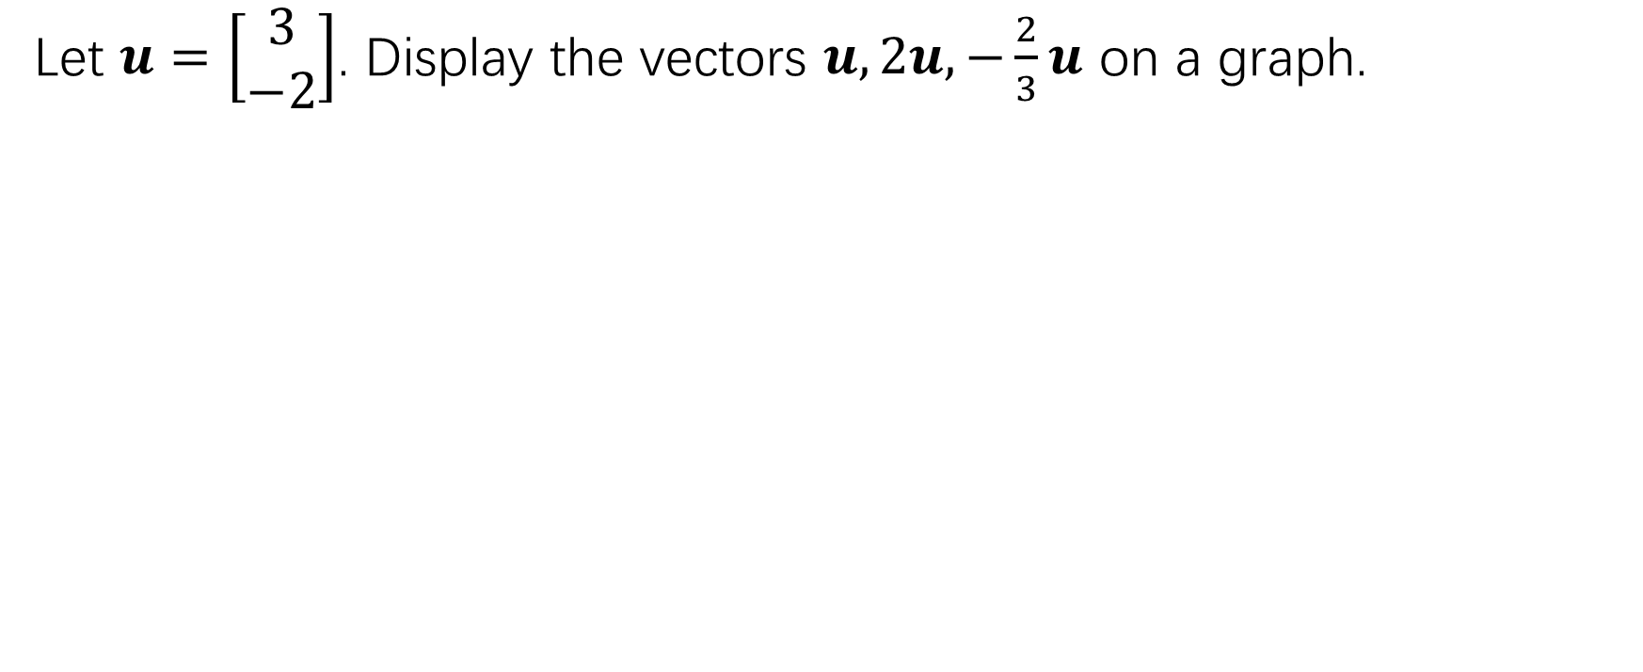
Parallelogram rule for addition
Let $u=\left[\begin{matrix}3 \\ −2\end{matrix}\right]$. Display the vectors $u,2u,−\frac{2}{3}u$ on a graph.

Slide 9
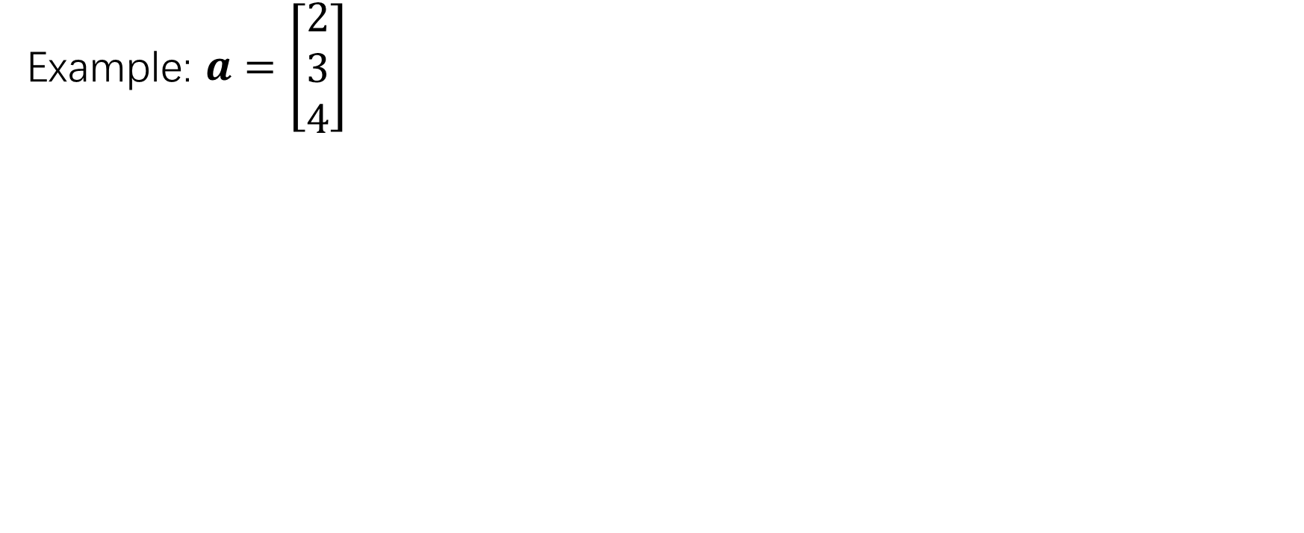

Vectors in $ℝ^{3}$
Example: $a=\left[\begin{matrix}2 \\ 3 \\ 4\end{matrix}\right]$

Slide 10
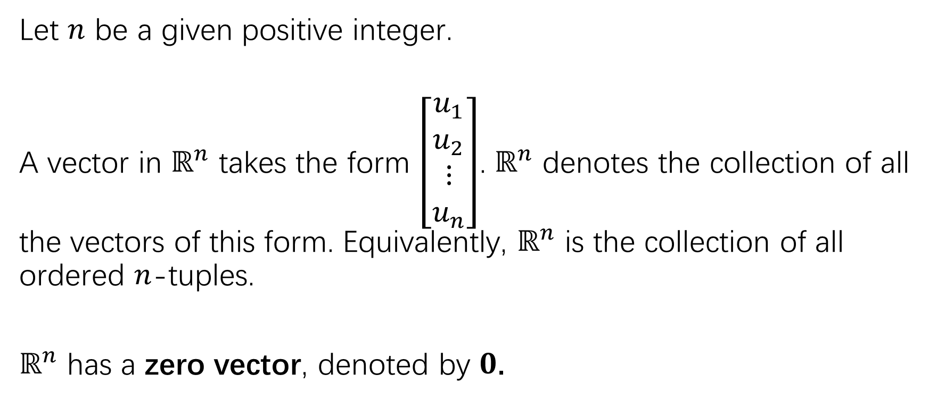

Vectors in $ℝ^{n}$
Let $n$ be a given positive integer.
A vector in $ℝ^{n}$ takes the form $\left[\begin{matrix}u_{1} \\ u_{2} \\ ⋮ \\ u_{n}\end{matrix}\right]$. $ℝ^{n}$ denotes the collection of all the vectors of this form. Equivalently, $ℝ^{n}$ is the collection of all ordered $n$-tuples.
$ℝ^{n}$ has a zero vector, denoted by $0$.

Slide 11
Laws for algebraic operations
Laws of commutativity, association, distribution, and the existence of unit.

Slide 12
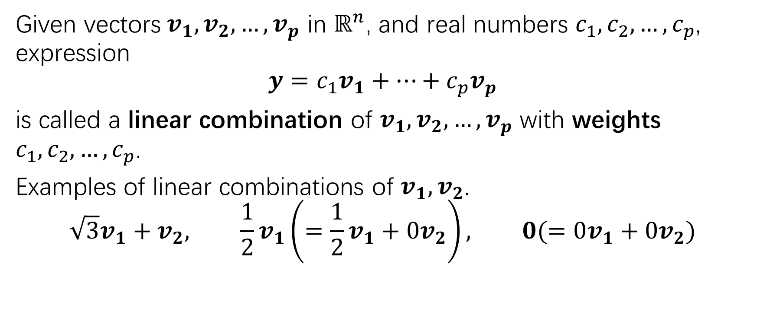
Linear combinations
Given vectors$v_{1},v_{2},…,v_{p}$ in $ℝ^{n}$, and real numbers $c_{1},c_{2},…,c_{p}$, expression
$$y=c_{1}v_{1}+…+c_{p}v_{p}$$
is called a linear combination of $v_{1},v_{2},…,v_{p}$ with weights $c_{1},c_{2},…,c_{p}$.
Examples of linear combinations of $v_{1},v_{2}$.
$$\sqrt{3}v_{1}+v_{2}, \frac{1}{2}v_{1}\left(=\frac{1}{2}v_{1}+0v_{2}\right), 0(=0v_{1}+0v_{2})$$

Slide 13
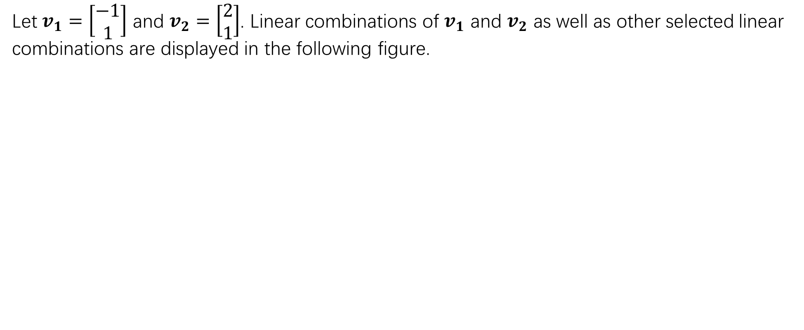
Linear combinations
Let $v_{1}=\left[\begin{matrix}−1 \\ 1\end{matrix}\right]$ and $v_{2}=\left[\begin{matrix}2 \\ 1\end{matrix}\right]$. Linear combinations of $v_{1}$ and $v_{2}$ as well as other selected linear combinations are displayed in the following figure.

Slide 14
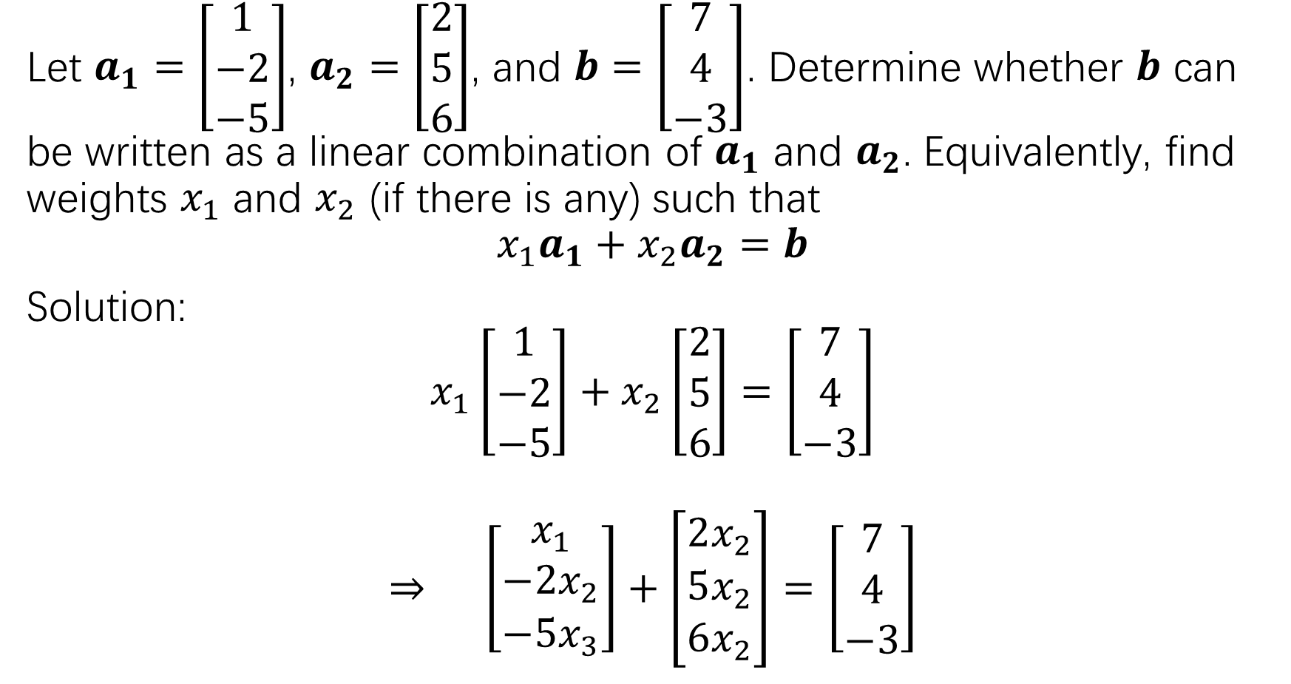
Let $a_{1}=\left[\begin{matrix}1 \\ −2 \\ −5\end{matrix}\right]$, $a_{2}=\left[\begin{matrix}2 \\ 5 \\ 6\end{matrix}\right]$, and $b=\left[\begin{matrix}7 \\ 4 \\ −3\end{matrix}\right]$. Determine whether $b$ can be written as a linear combination of $a_{1}$ and $a_{2}$. Equivalently, find weights $x_{1}$ and $x_{2}$ (if there is any) such that
$$x_{1}a_{1}+x_{2}a_{2}=b$$
Solution:
$$x_{1}\left[\begin{matrix}1 \\ −2 \\ −5\end{matrix}\right]+x_{2}\left[\begin{matrix}2 \\ 5 \\ 6\end{matrix}\right]=\left[\begin{matrix}7 \\ 4 \\ −3\end{matrix}\right]$$
$$⇒ \left[\begin{matrix}x_{1} \\ {−2x}_{2} \\ −5x_{3}\end{matrix}\right]+\left[\begin{matrix}2x_{2} \\ 5x_{2} \\ 6x_{2}\end{matrix}\right]=\left[\begin{matrix}7 \\ 4 \\ −3\end{matrix}\right]$$

Slide 15
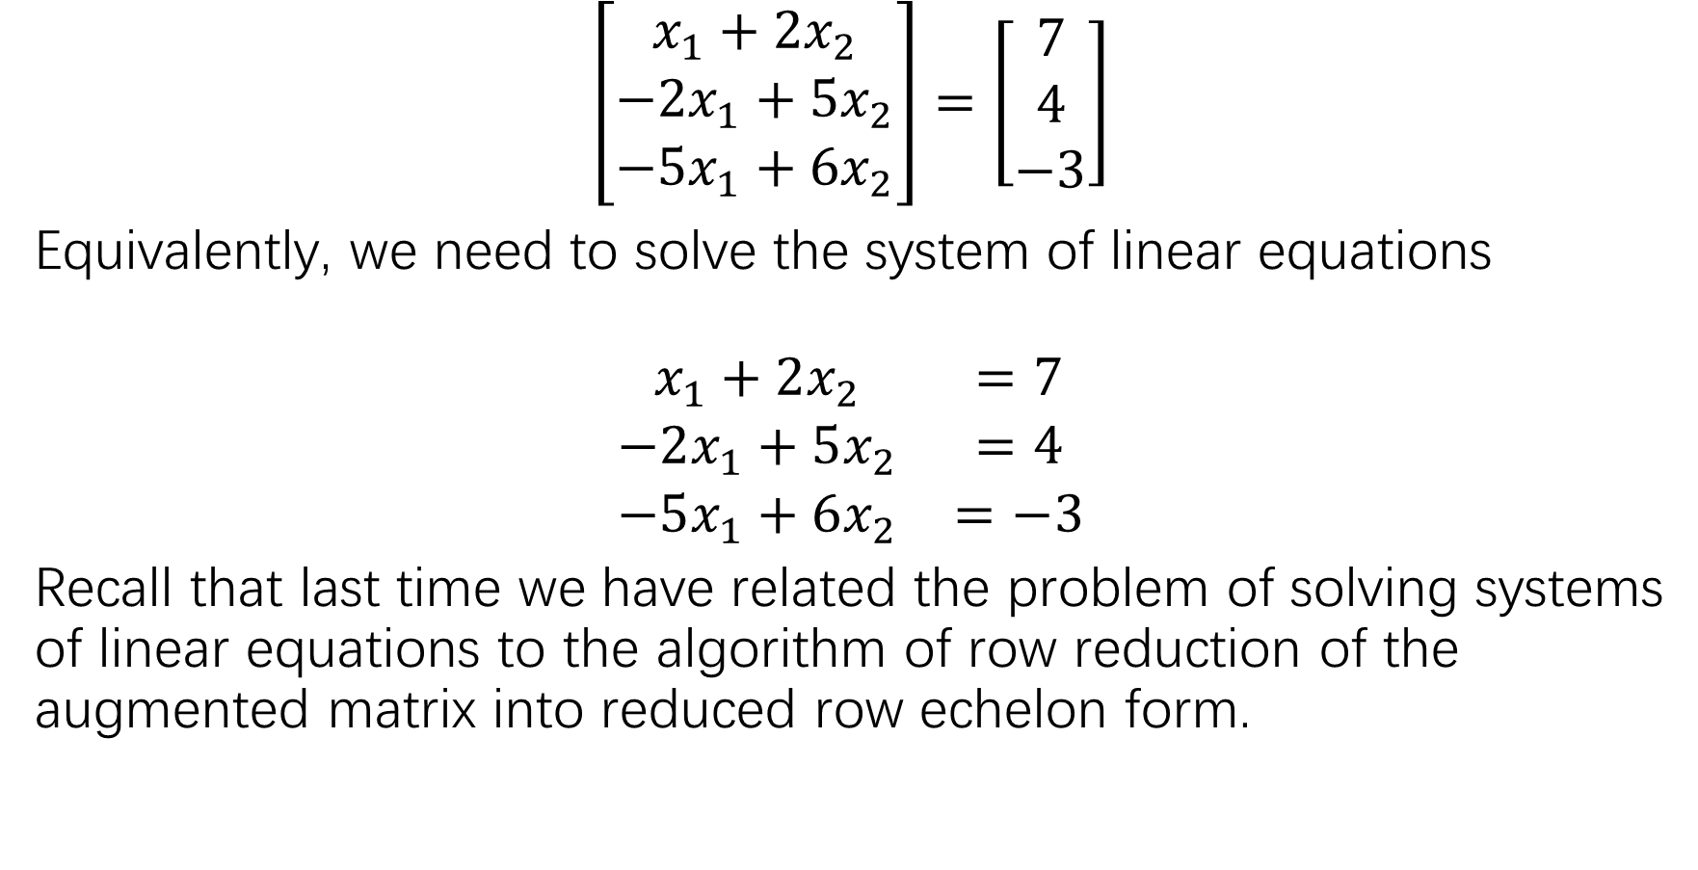
$$\left[\begin{matrix}x_{1}+2x_{2} \\ −2x_{1}+5x_{2} \\ −5x_{1}+6x_{2}\end{matrix}\right]=\left[\begin{matrix}7 \\ 4 \\ −3\end{matrix}\right]$$
Equivalently, we need to solve the system of linear equations
$$\begin{matrix}x_{1}+2x_{2} & =7 \\ −2x_{1}+5x_{2} & =4 \\ −5x_{1}+6x_{2} & =−3\end{matrix}$$
Recall that last time we have related the problem of solving systems of linear equations to the algorithm of row reduction of the augmented matrix into reduced row echelon form.

Slide 16
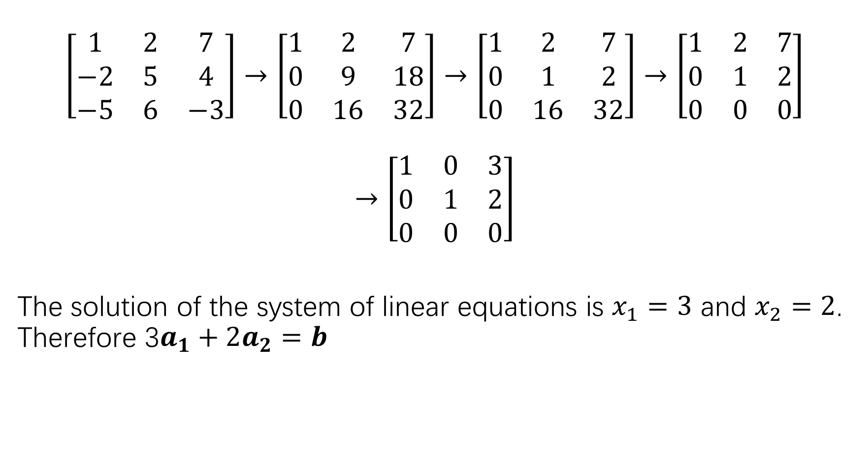
$$\left[\begin{matrix}1 & 2 & 7 \\ −2 & 5 & 4 \\ −5 & 6 & −3\end{matrix}\right]→\left[\begin{matrix}1 & 2 & 7 \\ 0 & 9 & 18 \\ 0 & 16 & 32\end{matrix}\right]→\left[\begin{matrix}1 & 2 & 7 \\ 0 & 1 & 2 \\ 0 & 16 & 32\end{matrix}\right]→\left[\begin{matrix}1 & 2 & 7 \\ 0 & 1 & 2 \\ 0 & 0 & 0\end{matrix}\right]$$
$$→\left[\begin{matrix}1 & 0 & 3 \\ 0 & 1 & 2 \\ 0 & 0 & 0\end{matrix}\right]$$
The solution of the system of linear equations is $x_{1}=3$ and $x_{2}=2$. Therefore 3$a_{1}+2a_{2}=b$

Slide 17
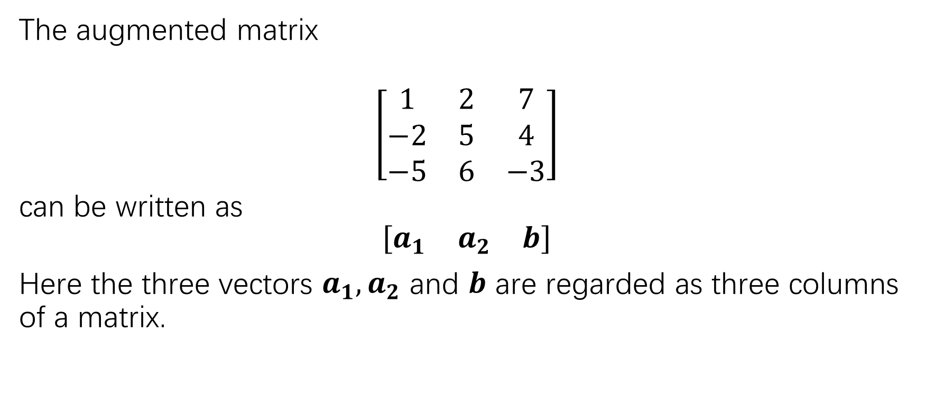
From vector equation to matrix
The augmented matrix
$$\left[\begin{matrix}1 & 2 & 7 \\ −2 & 5 & 4 \\ −5 & 6 & −3\end{matrix}\right]$$
can be written as
$$\left[\begin{matrix}a_{1} & a_{2} & b\end{matrix}\right]$$
Here the three vectors $a_{1},a_{2}$ and $b$ are regarded as three columns of a matrix.

Slide 18
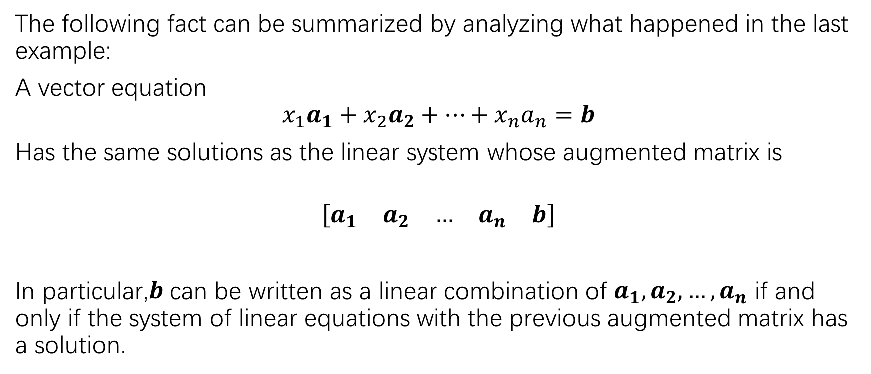
From vector equation to matrix
The following fact can be summarized by analyzing what happened in the last example:
A vector equation
$$x_{1}a_{1}+x_{2}a_{2}+…+x_{n}a_{n}=b$$
Has the same solutions as the linear system whose augmented matrix is
$$\left[\begin{matrix}a_{1} & a_{2} & … & a_{n} & b\end{matrix}\right]$$
In particular,$b$ can be written as a linear combination of $a_{1},a_{2},…,a_{n}$ if and only if the system of linear equations with the previous augmented matrix has a solution.

Slide 19
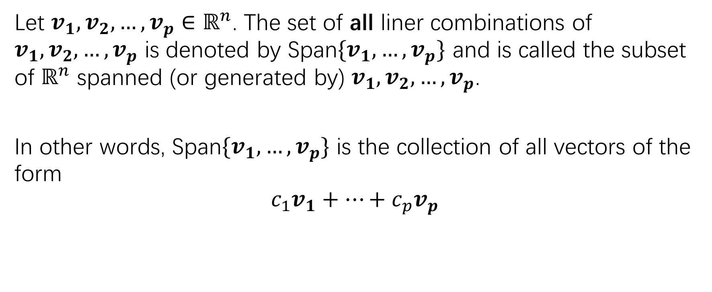
span
Let $v_{1},v_{2},…,v_{p}∈ℝ^{n}$. The set of all liner combinations of $v_{1},v_{2},…,v_{p}$ is denoted by Span$\{v_{1},…,v_{p}\}$ and is called the subset of $ℝ^{n}$ spanned (or generated by) $v_{1},v_{2},…,v_{p}$.
In other words, Span$\{v_{1},…,v_{p}\}$ is the collection of all vectors of the form
$$c_{1}v_{1}+…+c_{p}v_{p}$$

Slide 20
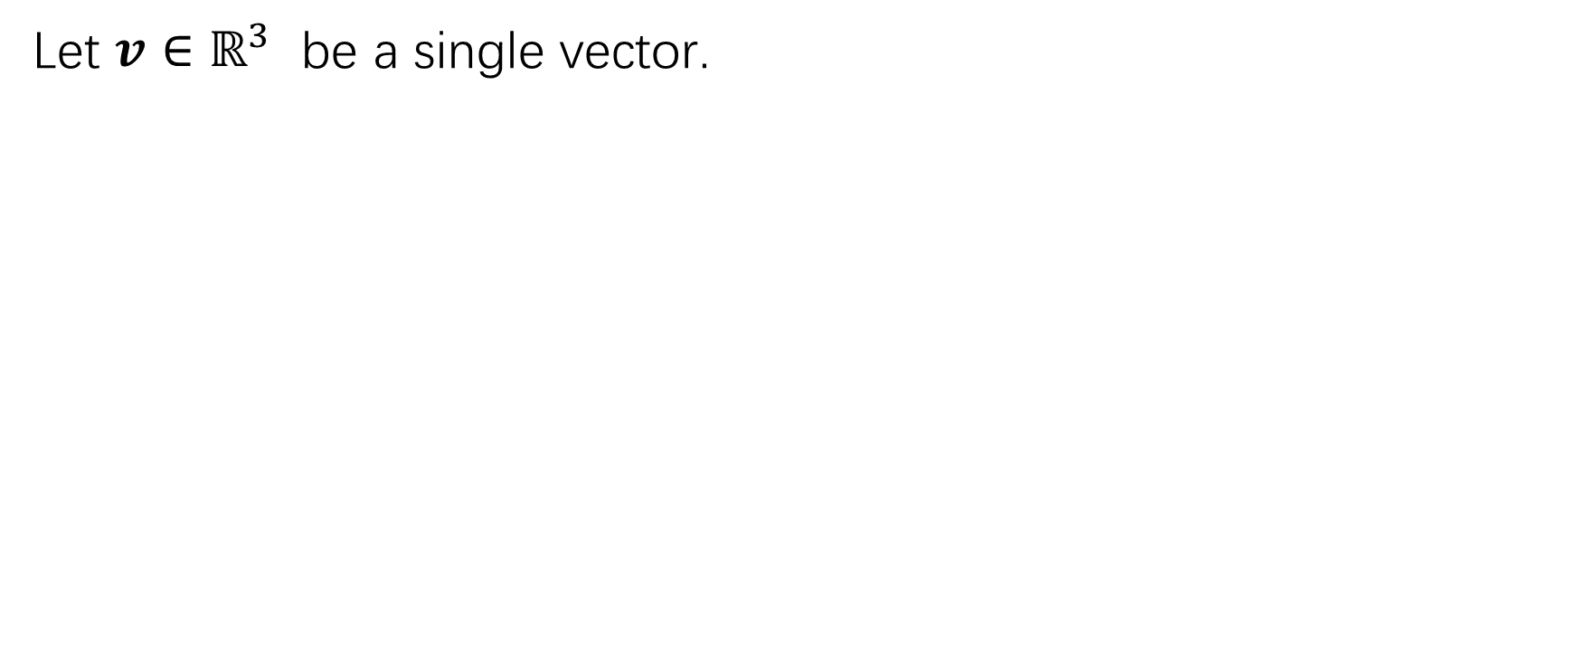
Geometric description of Span{v}
Let $v∈ℝ^{3}$ be a single vector.

Slide 21
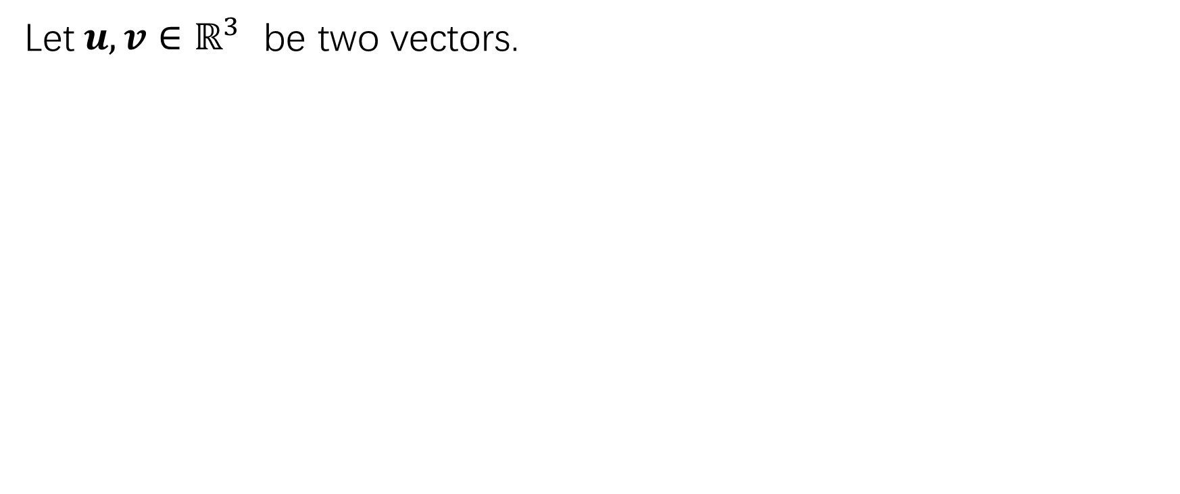
Geometric description of Span{u,v}
Let$u,v∈ℝ^{3}$ be two vectors.

Slide 22
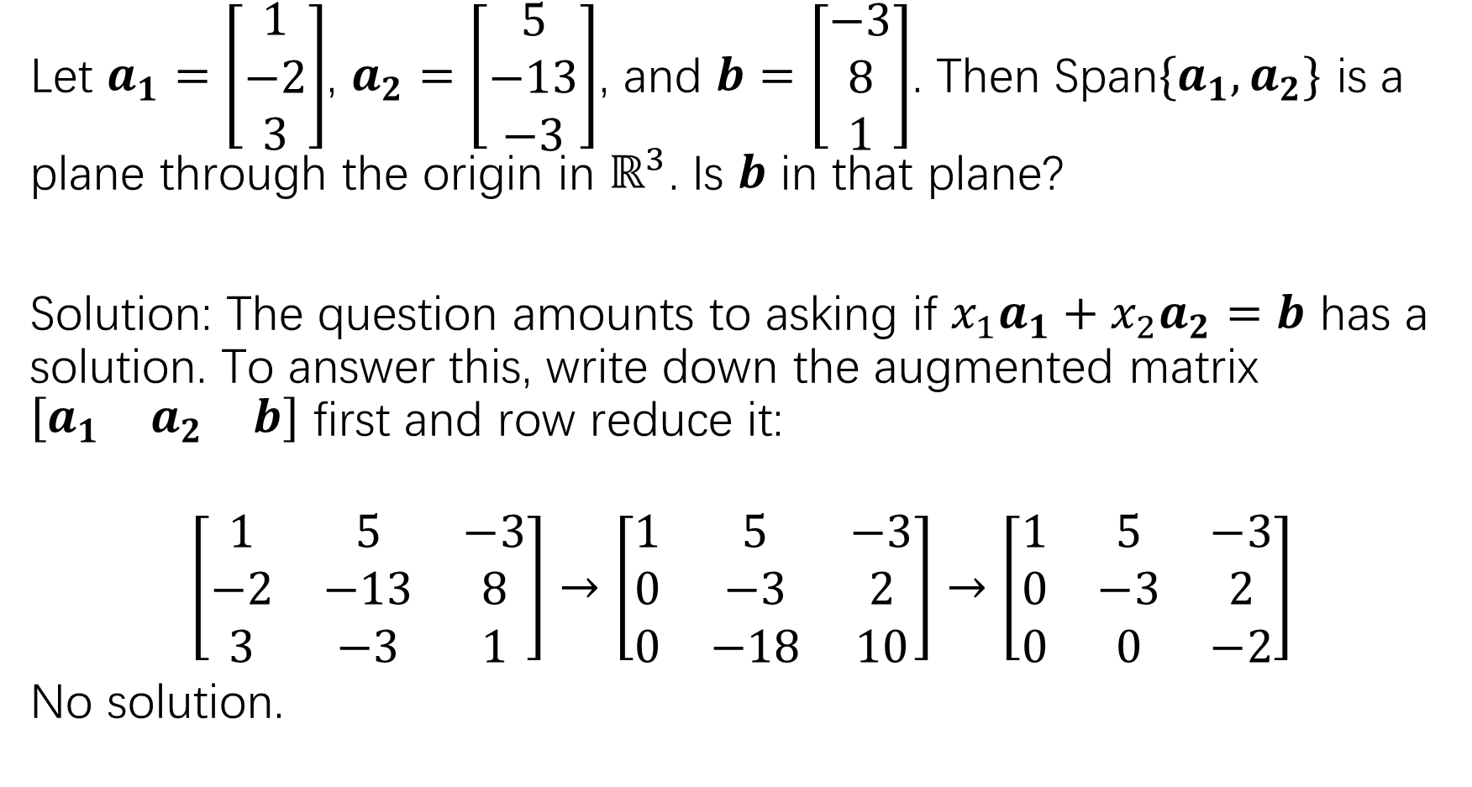
Let $a_{1}=\left[\begin{matrix}1 \\ −2 \\ 3\end{matrix}\right]$, $a_{2}=\left[\begin{matrix}5 \\ −13 \\ −3\end{matrix}\right]$, and $b=\left[\begin{matrix}−3 \\ 8 \\ 1\end{matrix}\right]$. Then Span$\{a_{1},a_{2}\}$ is a plane through the origin in $ℝ^{3}$. Is $b$ in that plane?
Solution: The question amounts to asking if $x_{1}a_{1}+x_{2}a_{2}=b$ has a solution. To answer this, write down the augmented matrix $\left[\begin{matrix}a_{1} & a_{2} & b\end{matrix}\right]$ first and row reduce it:
$$\left[\begin{matrix}1 & 5 & −3 \\ −2 & −13 & 8 \\ 3 & −3 & 1\end{matrix}\right]→\left[\begin{matrix}1 & 5 & −3 \\ 0 & −3 & 2 \\ 0 & −18 & 10\end{matrix}\right]→\left[\begin{matrix}1 & 5 & −3 \\ 0 & −3 & 2 \\ 0 & 0 & −2\end{matrix}\right]$$
No solution.

Slide 23
Exercise:
Practice problem 2, page 31
Page 32: 13,14,15,16,23
Page 33: 24,25,26

