Slide 1
Linear Algebra
Lecturer: Xia Liao
Email: xliao@hqu.edu.cn
Homepage: https://hirzebruch.github.io/main.html
Time: every Tuesday 1-2, Thursday 3-4

Slide 2
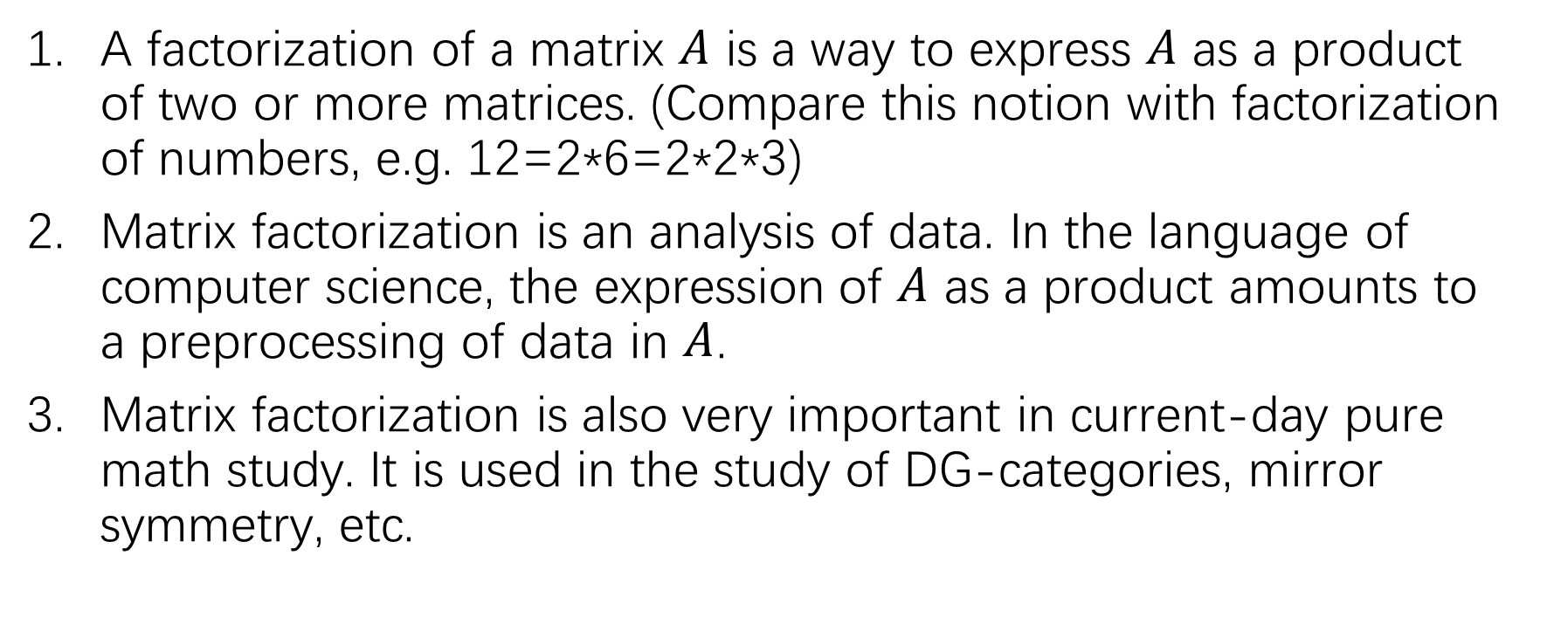
Matrix factorization
A factorization of a matrix $A$ is a way to express $A$ as a product of two or more matrices. (Compare this notion with factorization of numbers, e.g. 12=2*6=2*2*3)
Matrix factorization is an analysis of data. In the language of computer science, the expression of $A$ as a product amounts to a preprocessing of data in $A$.
Matrix factorization is also very important in current-day pure math study. It is used in the study of DG-categories, mirror symmetry, etc.

Slide 3
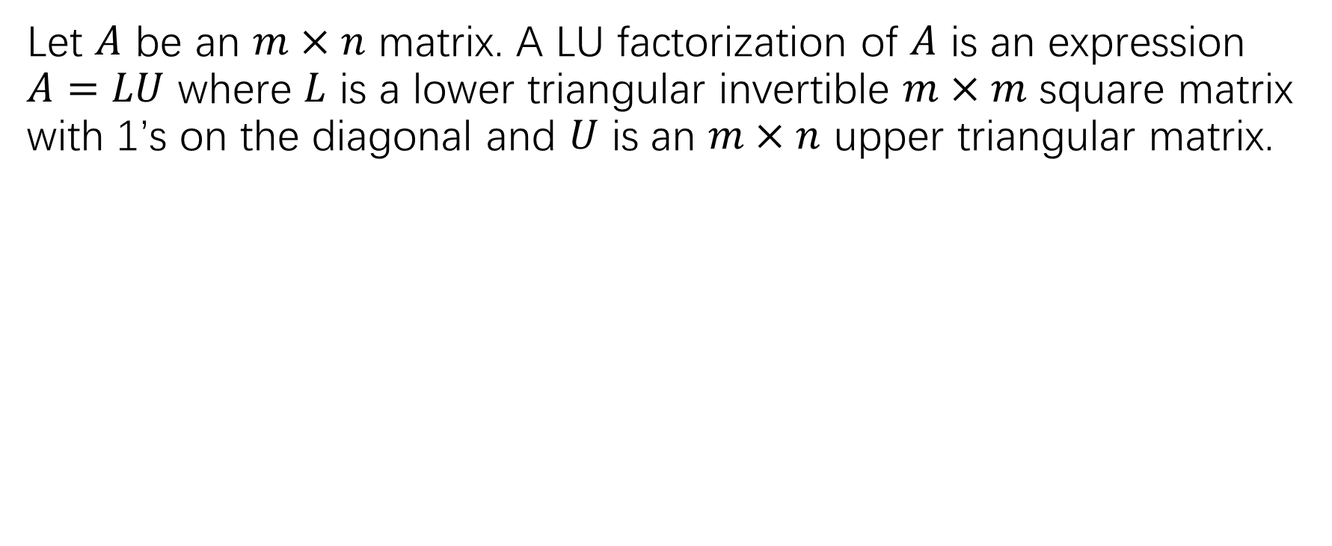
LU factorization
Let $A$ be an $m×n$ matrix. A LU factorization of $A$ is an expression $A=LU$ where $L$ is a lower triangular invertible $m×m$ square matrix with 1’s on the diagonal and $U$ is an $m×n$ upper triangular matrix.

Slide 5
LU factorization and solving systems of linear equations

Slide 6
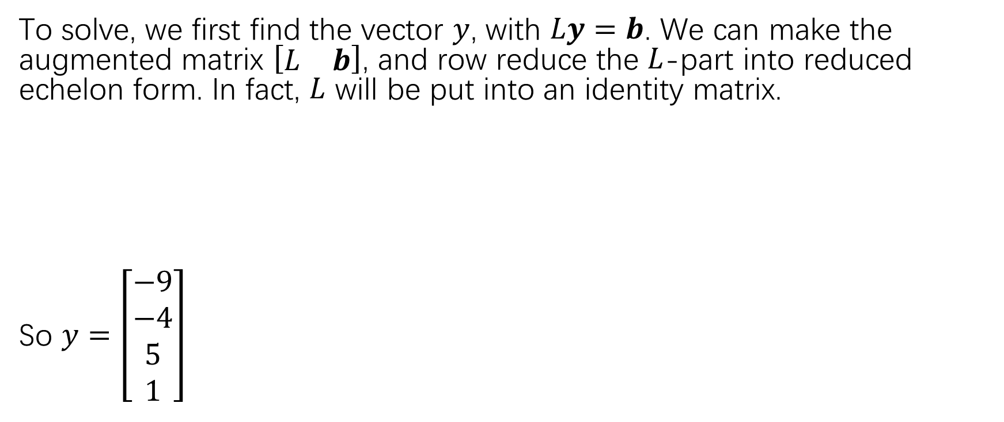
LU factorization and solving systems of linear equations
To solve, we first find the vector $y$, with $Ly=b$. We can make the augmented matrix $\left[\begin{matrix}L & b\end{matrix}\right]$, and row reduce the $L$-part into reduced echelon form. In fact, $L$ will be put into an identity matrix.
So $y=\left[\begin{matrix}−9 \\ −4 \\ 5 \\ 1\end{matrix}\right]$

Slide 7
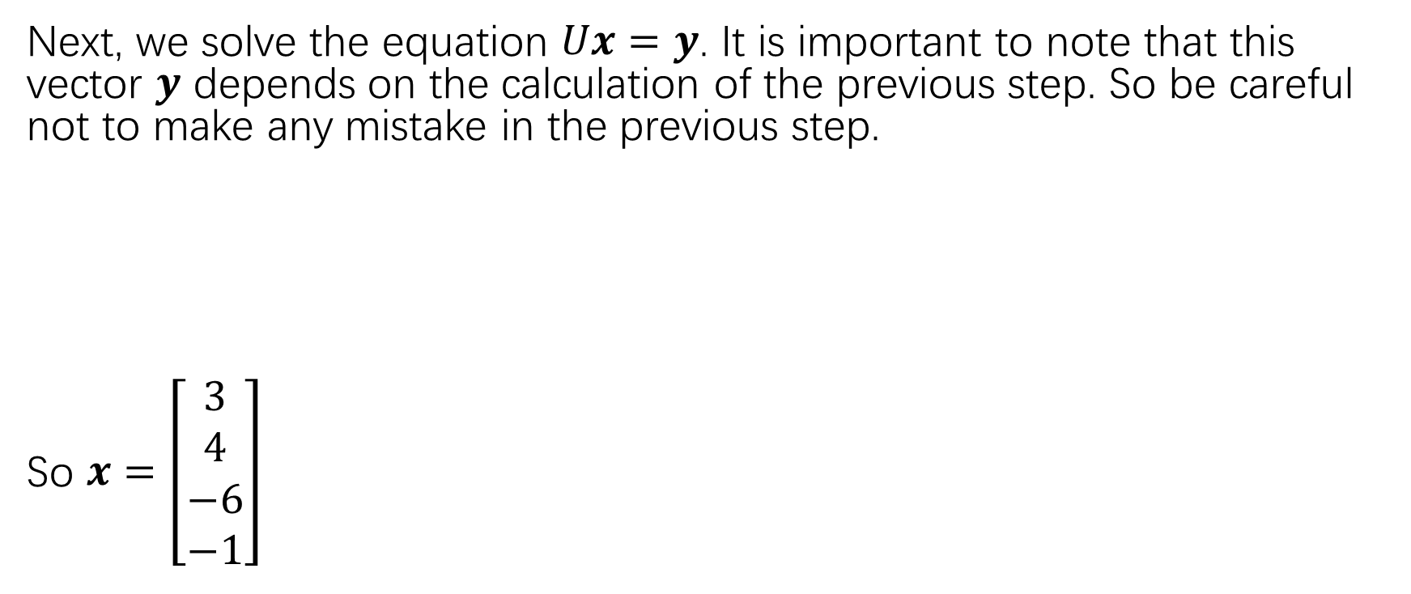
LU factorization and solving systems of linear equations
Next, we solve the equation $Ux=y$. It is important to note that this vector $y$ depends on the calculation of the previous step. So be careful not to make any mistake in the previous step.
So $x=\left[\begin{matrix}3 \\ 4 \\ −6 \\ −1\end{matrix}\right]$

Slide 8
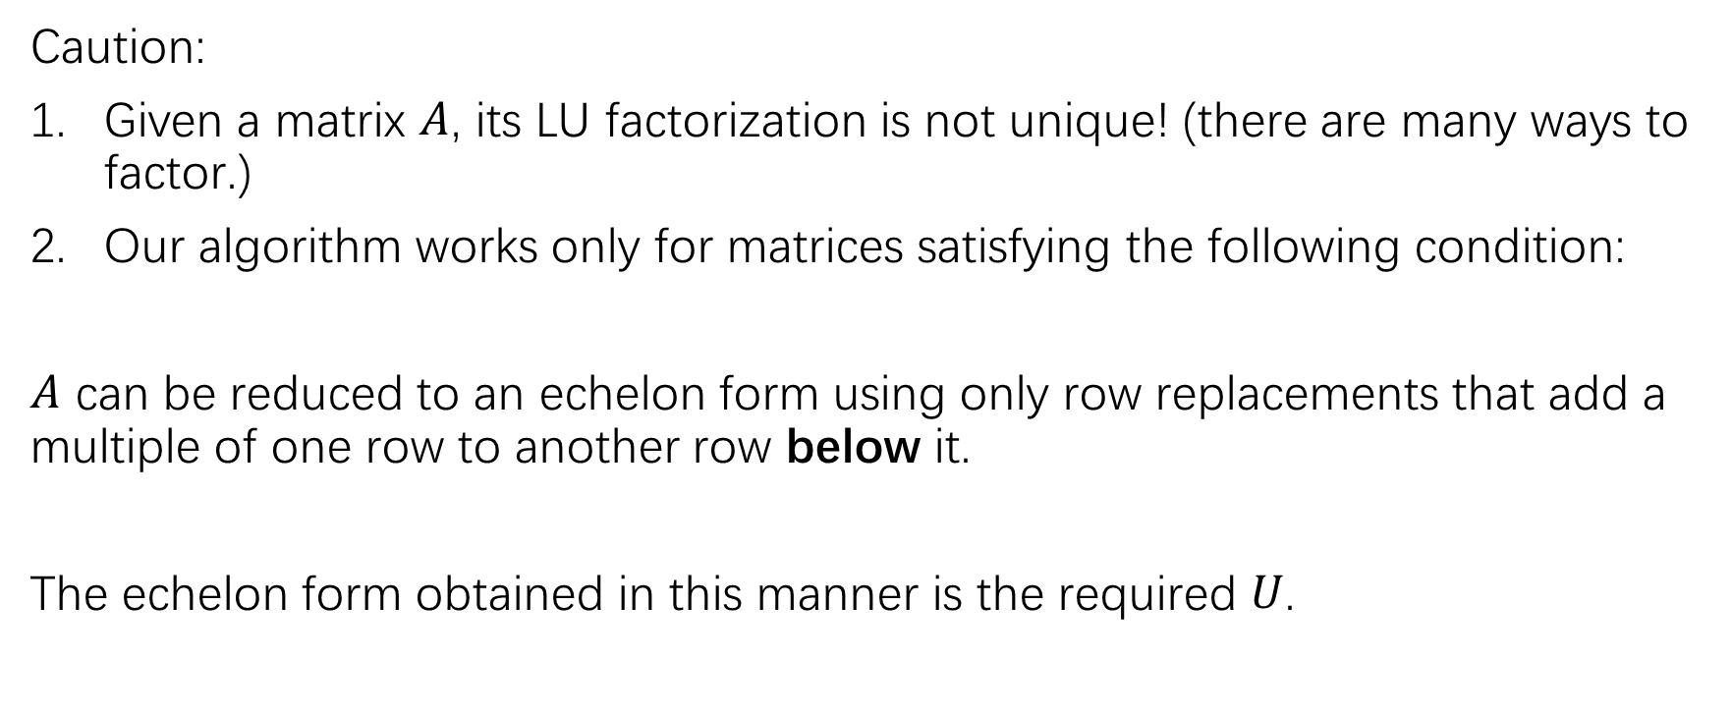
An LU factorization algorithm
Caution:
Given a matrix $A$, its LU factorization is not unique! (there are many ways to factor.)
Our algorithm works only for matrices satisfying the following condition:
$A$ can be reduced to an echelon form using only row replacements that add a multiple of one row to another row below it.
The echelon form obtained in this manner is the required $U$.

Slide 9
An LU factorization algorithm

Slide 10
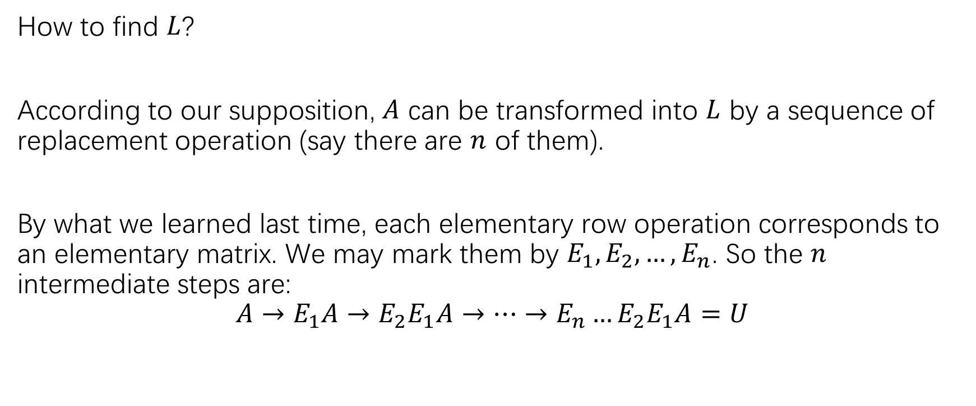
An LU factorization algorithm
How to find $L$?
According to our supposition, $A$ can be transformed into $L$ by a sequence of replacement operation (say there are $n$ of them).
By what we learned last time, each elementary row operation corresponds to an elementary matrix. We may mark them by $E_{1},E_{2},…,E_{n}$. So the $n$ intermediate steps are:
$$A→E_{1}A→E_{2}E_{1}A→…→E_{n}…E_{2}E_{1}A=U$$

Slide 11
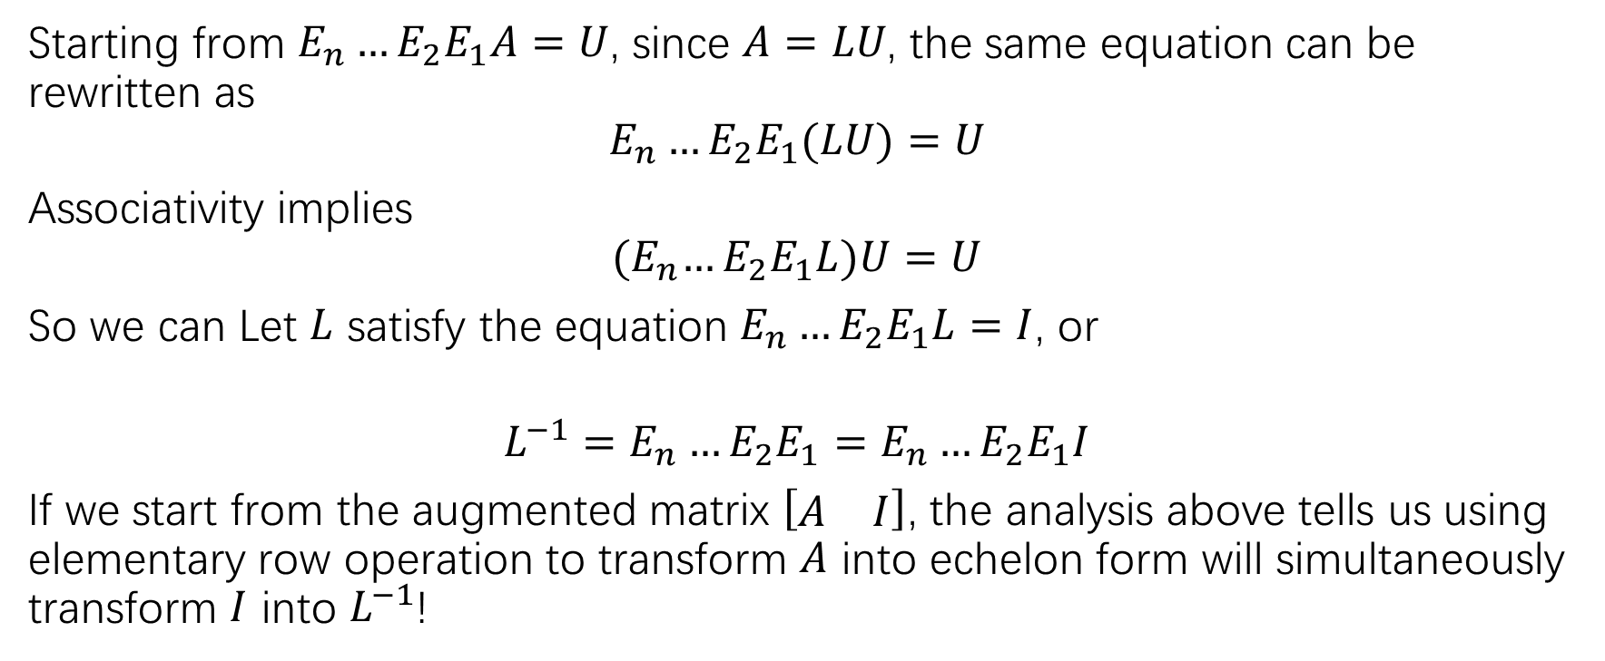
An LU factorization algorithm
Starting from $E_{n}…E_{2}E_{1}A=U$, since $A=LU$, the same equation can be rewritten as
$$E_{n}…E_{2}E_{1}(LU)=U$$
Associativity implies
$${(E}_{n}…E_{2}E_{1}L)U=U$$
So we can Let $L$ satisfy the equation $E_{n}…E_{2}E_{1}L=I$, or
$$L^{−1}=E_{n}…E_{2}E_{1}=E_{n}…E_{2}E_{1}I$$
If we start from the augmented matrix $\left[\begin{matrix}A & I\end{matrix}\right]$, the analysis above tells us using elementary row operation to transform $A$ into echelon form will simultaneously transform $I$ into $L^{−1}$!

Slide 12
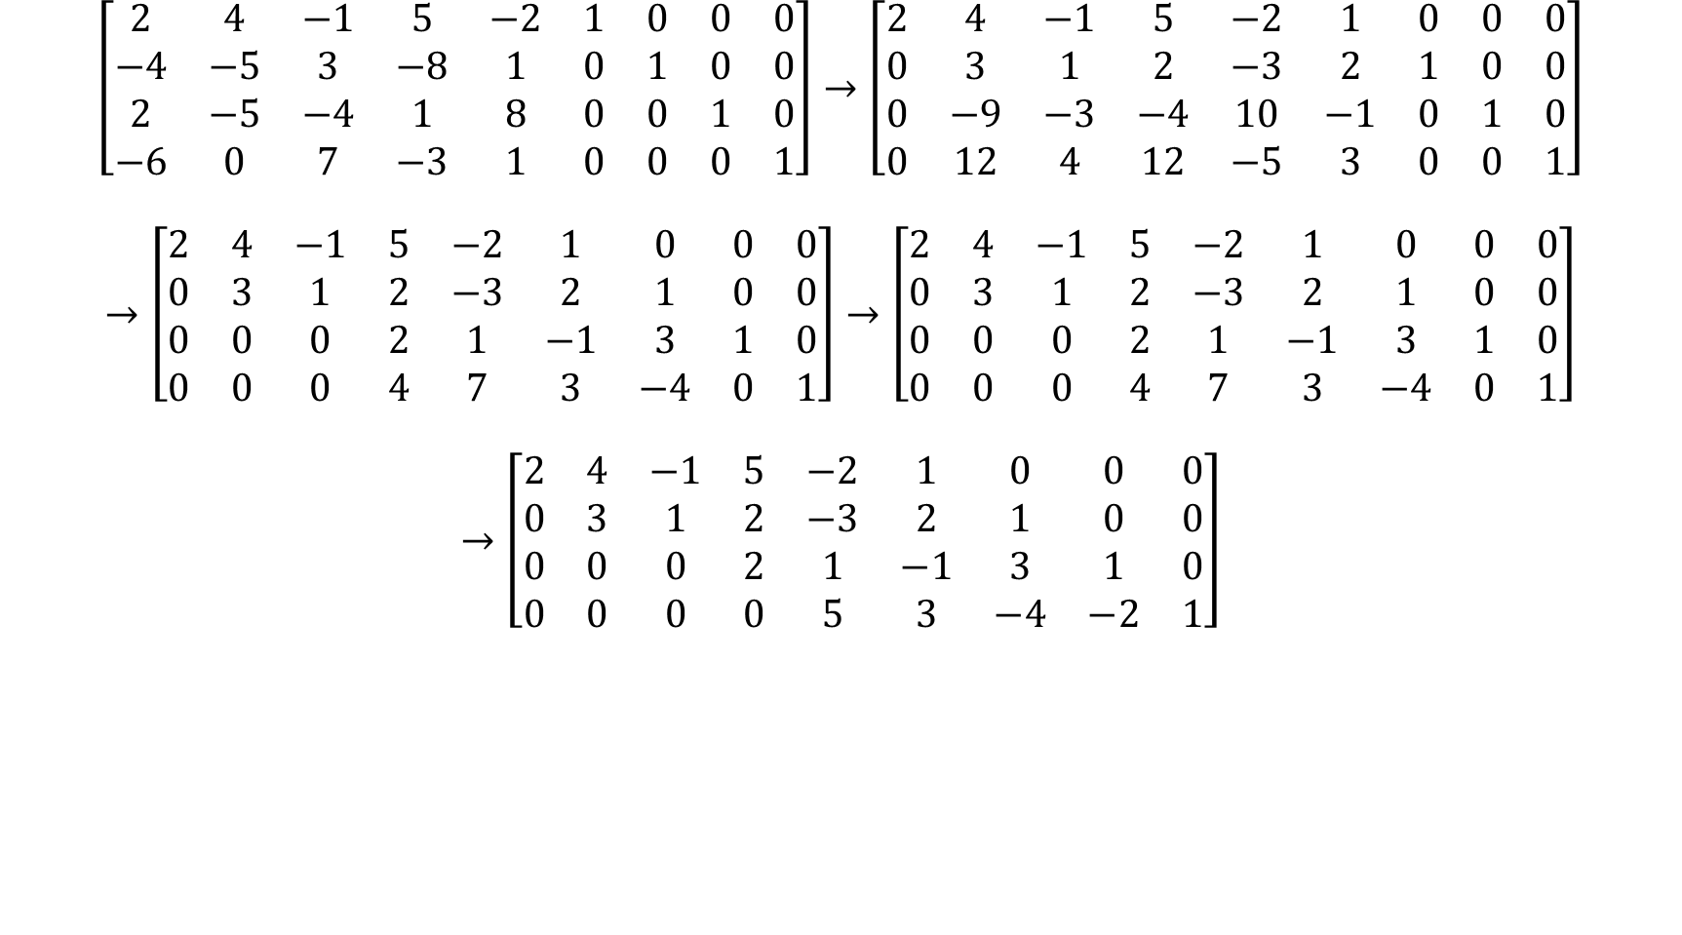
$$\left[\begin{matrix}2 & 4 & −1 & 5 & −2 & 1 & 0 & 0 & 0 \\ −4 & −5 & 3 & −8 & 1 & 0 & 1 & 0 & 0 \\ 2 & −5 & −4 & 1 & 8 & 0 & 0 & 1 & 0 \\ −6 & 0 & 7 & −3 & 1 & 0 & 0 & 0 & 1\end{matrix}\right]→\left[\begin{matrix}2 & 4 & −1 & 5 & −2 & 1 & 0 & 0 & 0 \\ 0 & 3 & 1 & 2 & −3 & 2 & 1 & 0 & 0 \\ 0 & −9 & −3 & −4 & 10 & −1 & 0 & 1 & 0 \\ 0 & 12 & 4 & 12 & −5 & 3 & 0 & 0 & 1\end{matrix}\right]$$
$$→\left[\begin{matrix}2 & 4 & −1 & 5 & −2 & 1 & 0 & 0 & 0 \\ 0 & 3 & 1 & 2 & −3 & 2 & 1 & 0 & 0 \\ 0 & 0 & 0 & 2 & 1 & −1 & 3 & 1 & 0 \\ 0 & 0 & 0 & 4 & 7 & 3 & −4 & 0 & 1\end{matrix}\right]→\left[\begin{matrix}2 & 4 & −1 & 5 & −2 & 1 & 0 & 0 & 0 \\ 0 & 3 & 1 & 2 & −3 & 2 & 1 & 0 & 0 \\ 0 & 0 & 0 & 2 & 1 & −1 & 3 & 1 & 0 \\ 0 & 0 & 0 & 4 & 7 & 3 & −4 & 0 & 1\end{matrix}\right]$$
$$→\left[\begin{matrix}2 & 4 & −1 & 5 & −2 & 1 & 0 & 0 & 0 \\ 0 & 3 & 1 & 2 & −3 & 2 & 1 & 0 & 0 \\ 0 & 0 & 0 & 2 & 1 & −1 & 3 & 1 & 0 \\ 0 & 0 & 0 & 0 & 5 & 3 & −4 & −2 & 1\end{matrix}\right]$$

Slide 13
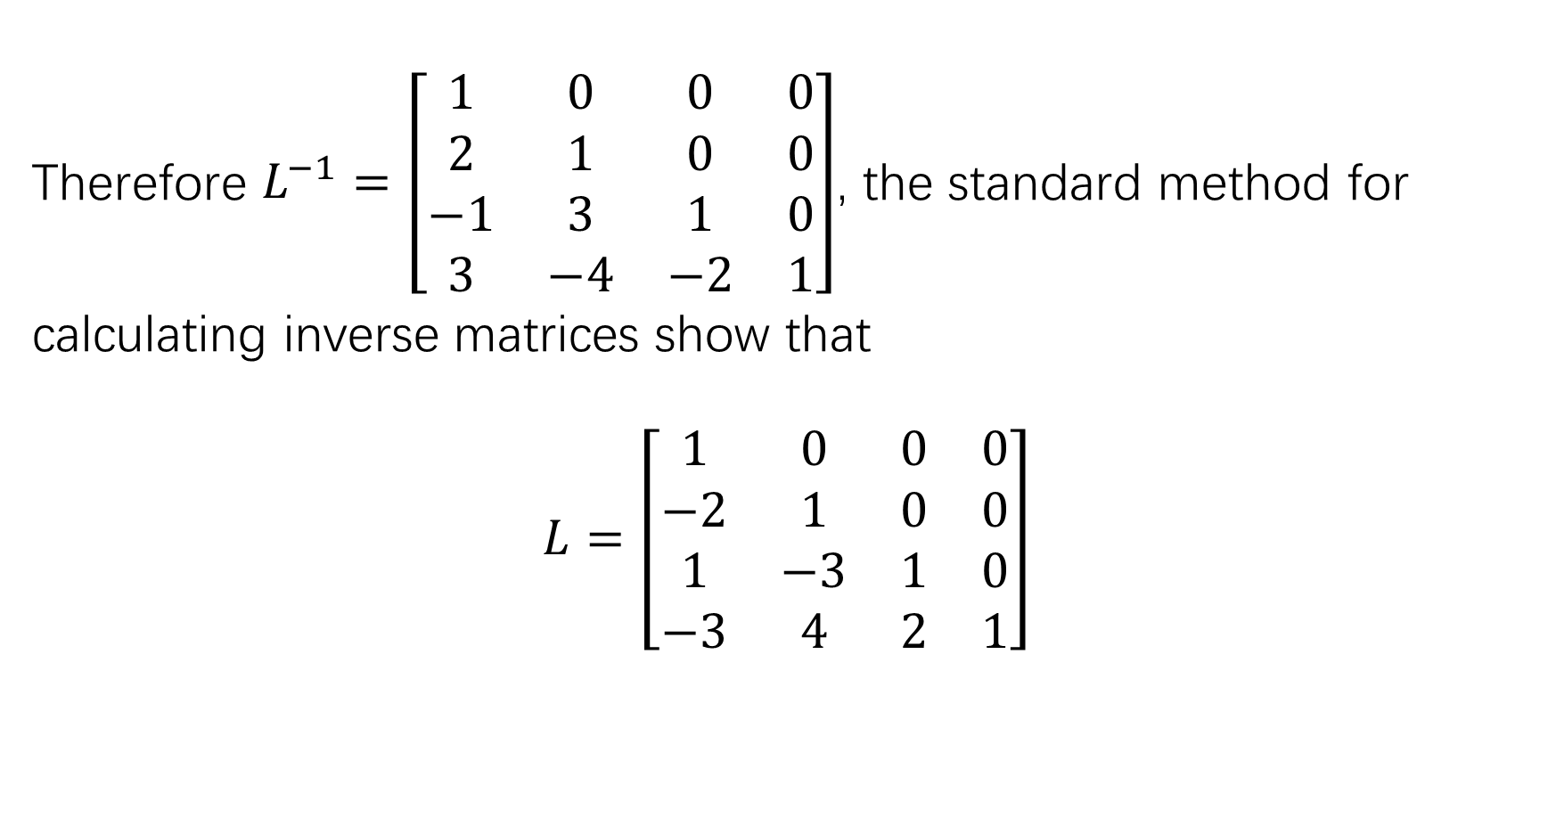
Therefore $L^{−1}=\left[\begin{matrix}1 & 0 & 0 & 0 \\ 2 & 1 & 0 & 0 \\ −1 & 3 & 1 & 0 \\ 3 & −4 & −2 & 1\end{matrix}\right]$, the standard method for
calculating inverse matrices show that
$$L=\left[\begin{matrix}1 & 0 & 0 & 0 \\ −2 & 1 & 0 & 0 \\ 1 & −3 & 1 & 0 \\ −3 & 4 & 2 & 1\end{matrix}\right]$$

Slide 14
Exercise/HW:
P128:7-12

