Slide 1
Linear Algebra
Lecturer: Xia Liao
Email: xliao@hqu.edu.cn
Homepage: https://hirzebruch.github.io/main.html
Time: every Tuesday 1-2, Thursday 3-4

Slide 2

Subspaces of $ℝ^{n}$

Slide 3
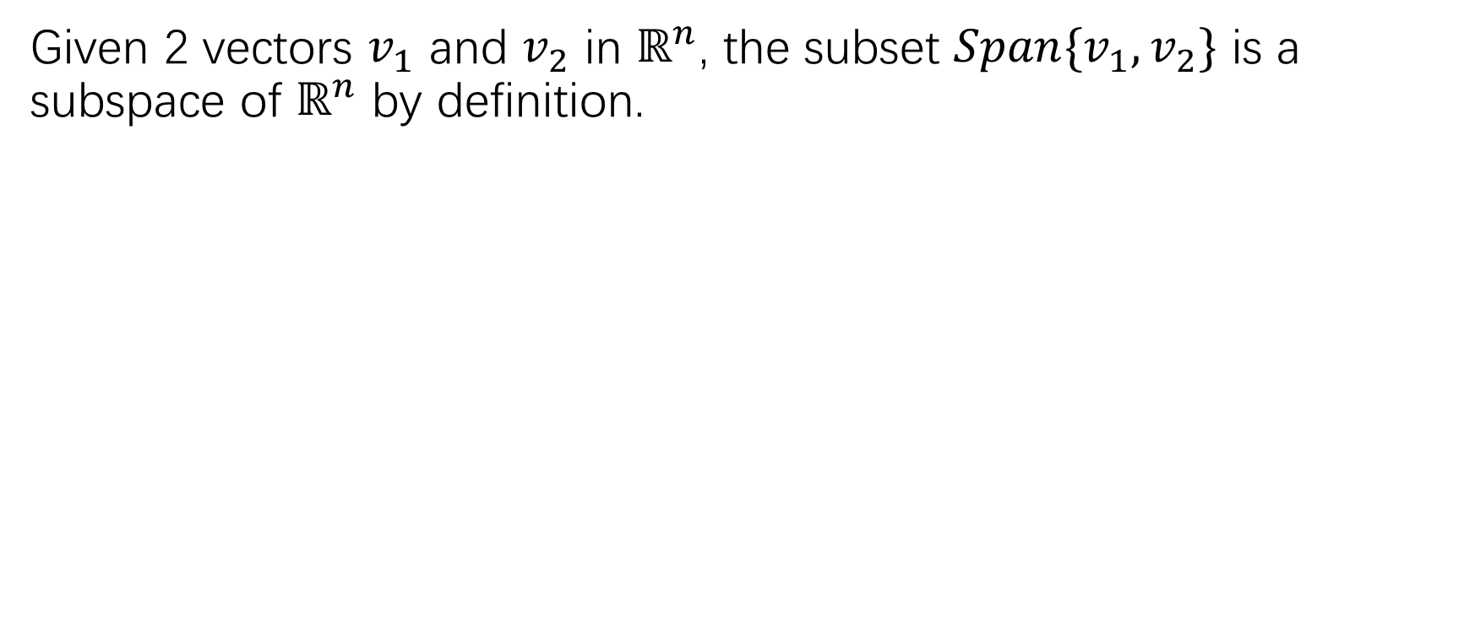
Subspaces of $ℝ^{n}$
Given 2 vectors $v_{1}$ and $v_{2}$ in $ℝ^{n}$, the subset $Span\{v_{1},v_{2}\}$ is a subspace of $ℝ^{n}$ by definition.

Slide 4
proof

Slide 5
Geometric interpretation

Slide 7

Span{$v_{1},v_{2},…,v_{p}$}$⊂ℝ^{n}$ is also a subspace

Slide 8
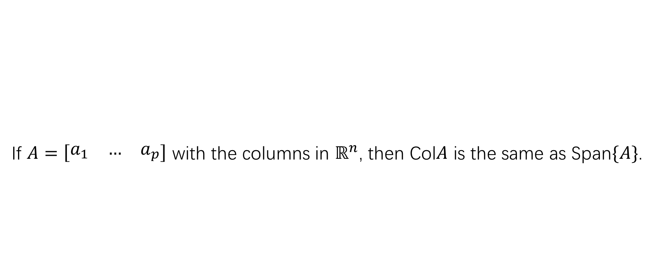
Column space of a matrix
If $A=\left[\begin{matrix}a_{1} & … & a_{p}\end{matrix}\right]$ with the columns in $ℝ^{n}$, then Col$A$ is the same as Span$\{A\}$.

Slide 10

A remark on the column space of $A$

Slide 11
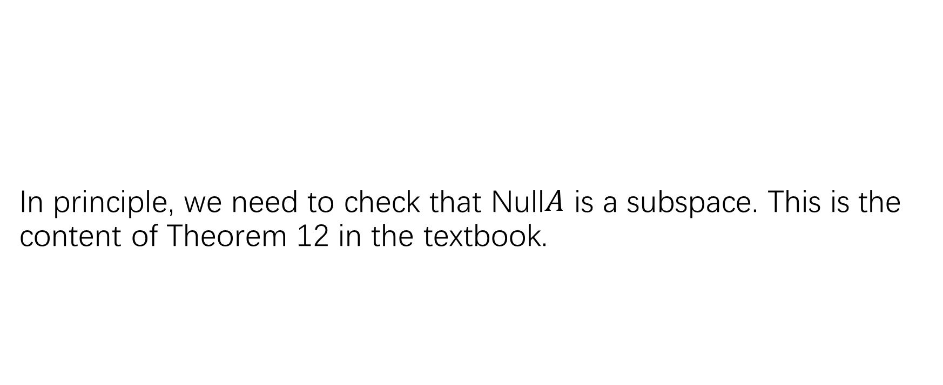

The null space of a matrix $A$
In principle, we need to check that Null$A$ is a subspace. This is the content of Theorem 12 in the textbook.

Slide 12
Theorem 12

Slide 13
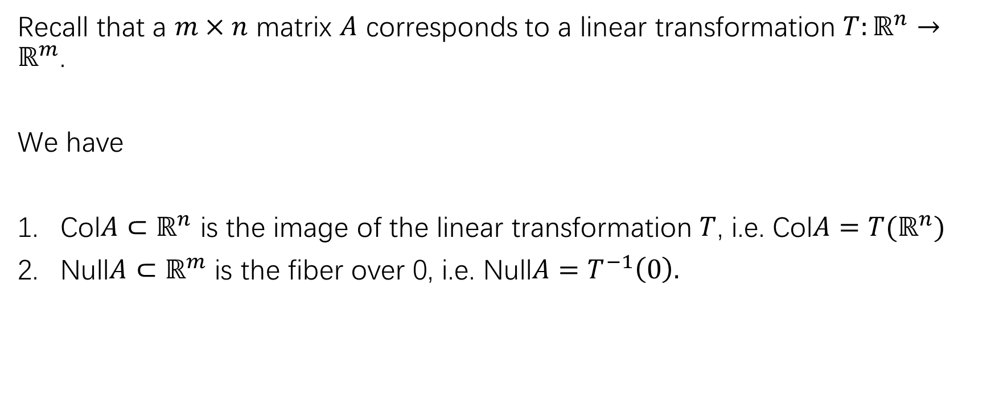
Relation with linear transformations
Recall that a $m×n$ matrix $A$ corresponds to a linear transformation $T:ℝ^{n}→ℝ^{m}$.
We have
Col$A⊂ℝ^{n}$ is the image of the linear transformation $T$, i.e. Col$A=T(ℝ^{n})$
Null$A⊂ℝ^{m}$ is the fiber over 0, i.e. Null$A=T^{−1}\left(0\right).$

Slide 14
Basis for a subspace

Slide 15
An application of inverse matrix theorem (p120)

Slide 16
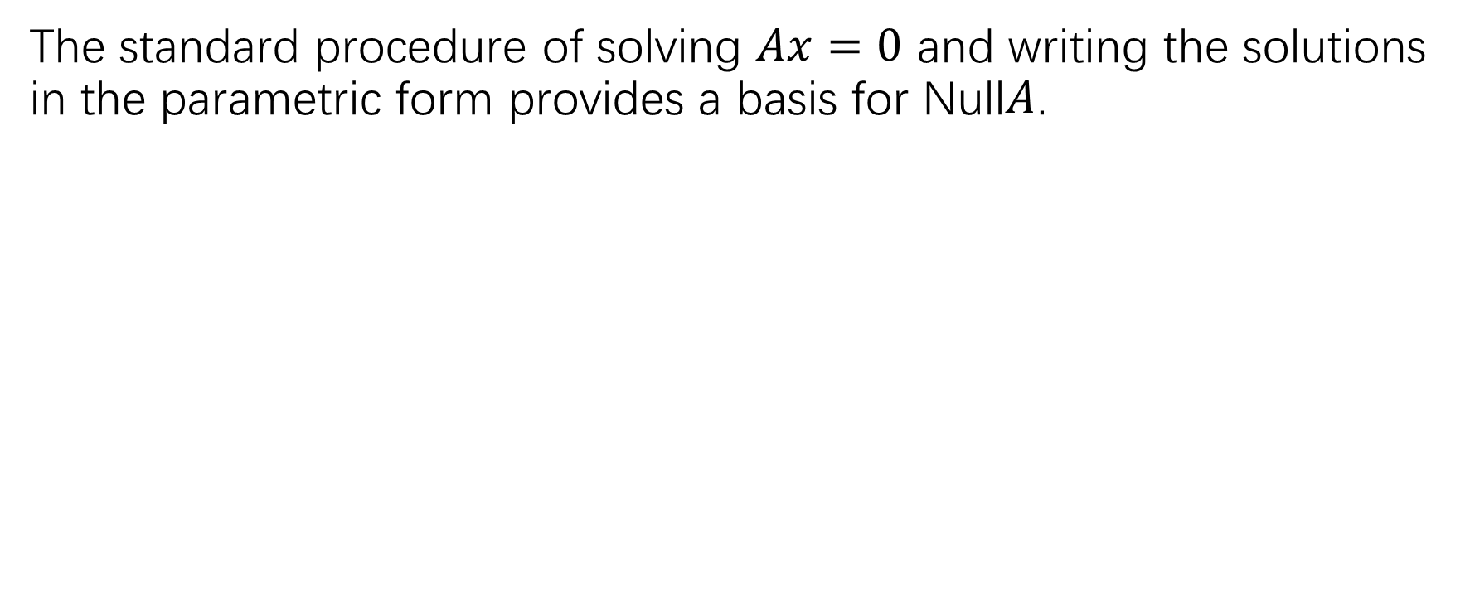

Finding a basis for Null$A$
The standard procedure of solving $Ax=0$ and writing the solutions in the parametric form provides a basis for Null$A$.

Slide 19
p158: Practice problems 1-3
P159:1-12, 15-20
P160: 23-26

