Slide 1
Linear Algebra
Lecturer: Xia Liao
Email: xliao@hqu.edu.cn
Homepage: https://hirzebruch.github.io/main.html
Time: every Tuesday 1-2, Thursday 3-4

Slide 2
Null space of a matrix

Slide 5
The column space of a matrix

Slide 6
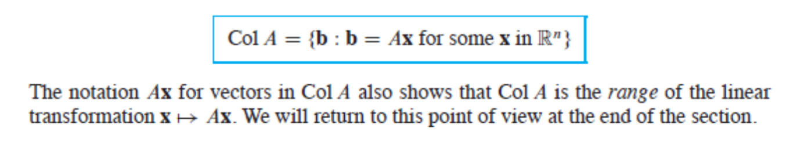
Other descriptions of col A
The meaning of the word ‘range’ was explained on page 63 and page 75. Very often, the word range is replaced by ‘image’ in mathematics.

Slide 7
Representing a subspace as the column space of a matrix

Slide 8
The contrast between null A and col A

Slide 11
Linear transformation

Slide 12
Kernel and range

Slide 13
Solving differential equations as find the null space

Slide 14
Solving differential equations as find the null space

Slide 15
Exercise:
P222:5,15,25,26
P223: 31,32,33

