Slide 1
Linear Algebra
Lecturer: Xia Liao
Email: xliao@hqu.edu.cn
Homepage: https://hirzebruch.github.io/main.html
Time: every Tuesday 1-2, Thursday 3-4

Slide 2
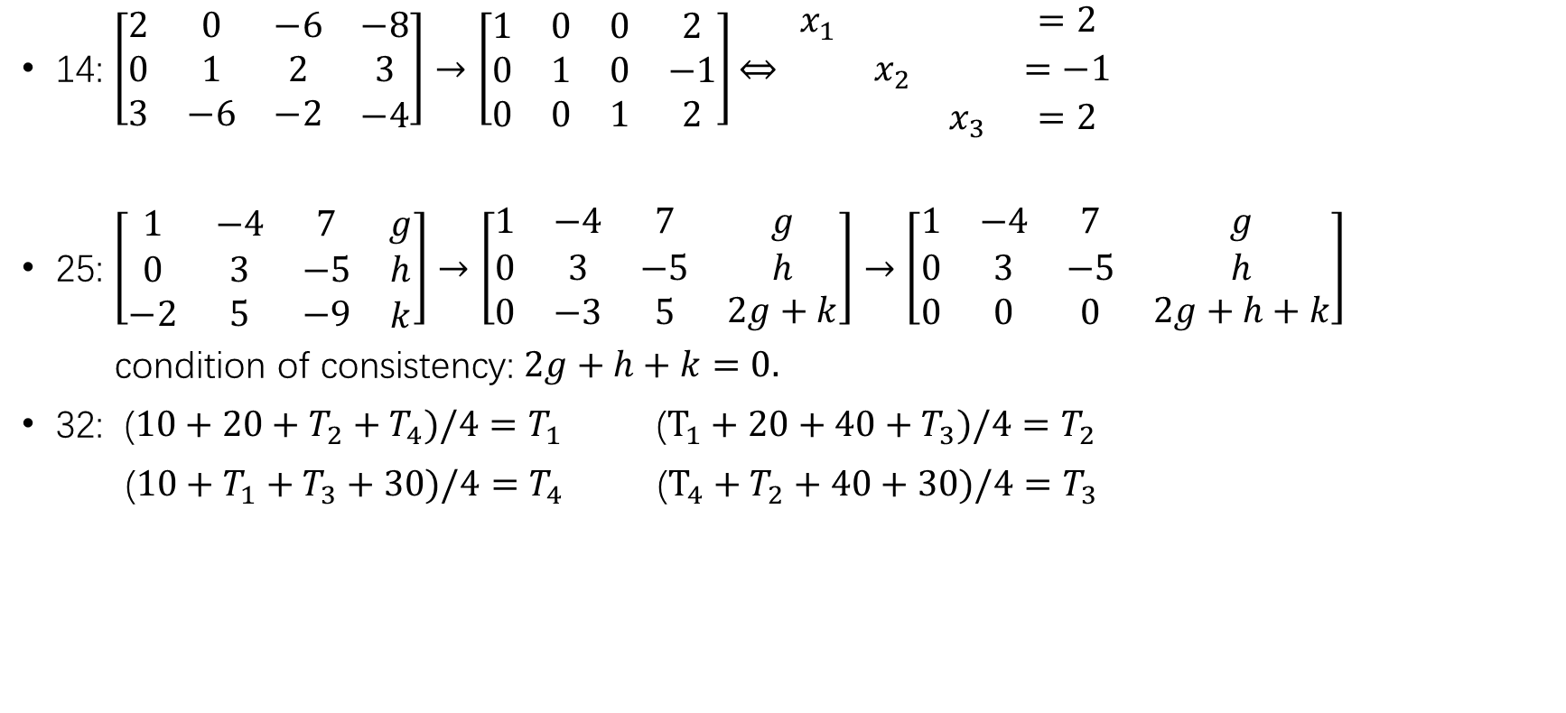
Solution of homework
14: $\left[\begin{matrix}2 & 0 & −6 & −8 \\ 0 & 1 & 2 & 3 \\ 3 & −6 & −2 & \begin{aligned}−4\end{aligned}\end{matrix}\right]→\left[\begin{matrix}1 & 0 & 0 & 2 \\ 0 & 1 & 0 & −1 \\ 0 & 0 & 1 & 2\end{matrix}\right]\underset{⇔}{} \begin{matrix}x_{1} & & & =2 \\ & x_{2} & & =−1 \\ & & x_{3} & =2\end{matrix}$
25: $\left[\begin{matrix}1 & −4 & 7 & g \\ 0 & 3 & −5 & h \\ −2 & 5 & −9 & \begin{aligned}k\end{aligned}\end{matrix}\right]→\left[\begin{matrix}1 & −4 & 7 & g \\ 0 & 3 & −5 & h \\ 0 & −3 & 5 & \begin{aligned}2g+k\end{aligned}\end{matrix}\right]→\left[\begin{matrix}1 & −4 & 7 & g \\ 0 & 3 & −5 & h \\ 0 & 0 & 0 & \begin{aligned}2g+h+k\end{aligned}\end{matrix}\right]$
condition of consistency: $2g+h+k=0.$
32: ($10+20+T_{2}+T_{4})/4=T_{1}$ ($T_{1}+20+40+T_{3})/4=T_{2}$
($10+T_{1}+T_{3}+30)/4=T_{4}$ ($T_{4}+T_{2}+40+30)/4=T_{3}$

Slide 3

Echelon form
A rectangular matrix is in echelon form if it has the following three properties.
All nonzero rows are above any rows of all zeros.
Each leading entry of a row is in a column to the right of the leading entry of the row above it.
All entries in a column below a leading entry are zeros.
$$\left[\begin{matrix}2 & −3 & 2 & 1 \\ 0 & 1 & −4 & 8 \\ 0 & 0 & 0 & 5/2\end{matrix}\right] \left[\begin{matrix}• & ∗ & ∗ & ∗ \\ 0 & • & ∗ & ∗ \\ 0 & 0 & 0 & 0 \\ 0 & 0 & 0 & 0\end{matrix}\right] \left[\begin{matrix}0 & • & ∗ & ∗ & ∗ & ∗ & ∗ & ∗ & ∗ & ∗ \\ 0 & 0 & 0 & • & ∗ & ∗ & ∗ & ∗ & ∗ & ∗ \\ 0 & 0 & 0 & 0 & • & ∗ & ∗ & ∗ & ∗ & ∗ \\ 0 & 0 & 0 & 0 & 0 & • & ∗ & ∗ & ∗ & ∗ \\ 0 & 0 & 0 & 0 & 0 & 0 & 0 & 0 & • & ∗\end{matrix}\right]$$
The positions of the red dot entries are called pivot positions.

Slide 4
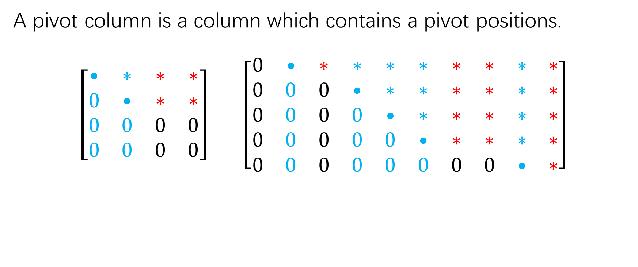
Echelon form
A pivot column is a column which contains a pivot positions.
$$\left[\begin{matrix}• & ∗ & ∗ & ∗ \\ 0 & • & ∗ & ∗ \\ 0 & 0 & 0 & 0 \\ 0 & 0 & 0 & 0\end{matrix}\right] \left[\begin{matrix}0 & • & ∗ & ∗ & ∗ & ∗ & ∗ & ∗ & ∗ & ∗ \\ 0 & 0 & 0 & • & ∗ & ∗ & ∗ & ∗ & ∗ & ∗ \\ 0 & 0 & 0 & 0 & • & ∗ & ∗ & ∗ & ∗ & ∗ \\ 0 & 0 & 0 & 0 & 0 & • & ∗ & ∗ & ∗ & ∗ \\ 0 & 0 & 0 & 0 & 0 & 0 & 0 & 0 & • & ∗\end{matrix}\right]$$

Slide 5
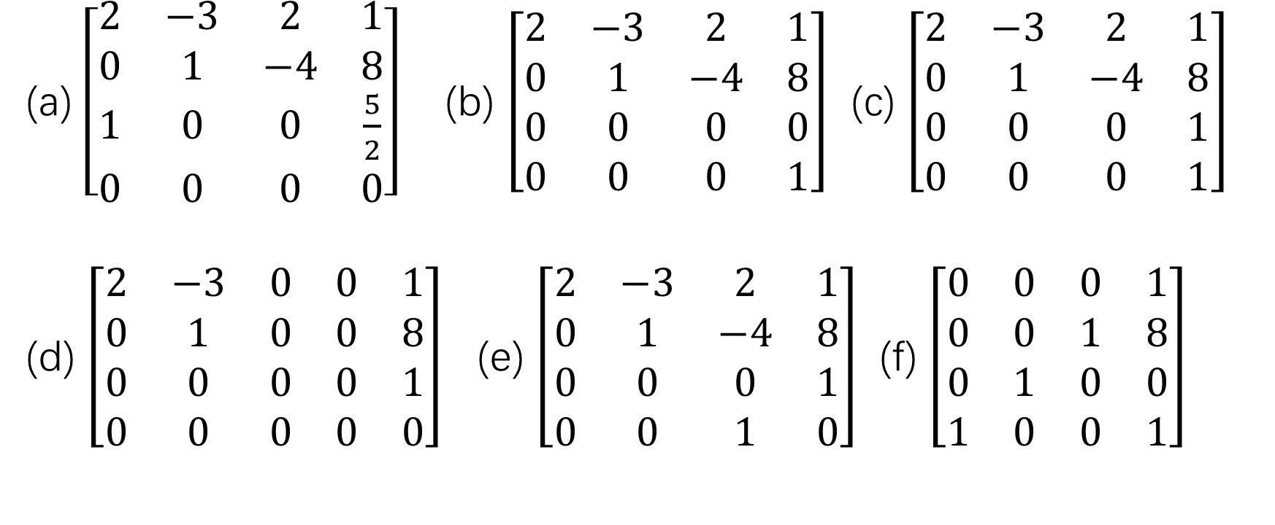
Which of the following matrices are in echelon form?
(a) $\left[\begin{matrix}2 & −3 & 2 & 1 \\ 0 & 1 & −4 & 8 \\ 1 & 0 & 0 & \frac{5}{2} \\ 0 & 0 & 0 & 0\end{matrix}\right]$ (b) $\left[\begin{matrix}2 & −3 & 2 & 1 \\ 0 & 1 & −4 & 8 \\ 0 & 0 & 0 & 0 \\ 0 & 0 & 0 & 1\end{matrix}\right]$ (c) $\left[\begin{matrix}2 & −3 & 2 & 1 \\ 0 & 1 & −4 & 8 \\ 0 & 0 & 0 & 1 \\ 0 & 0 & 0 & 1\end{matrix}\right]$
(d) $\left[\begin{matrix}2 & −3 & 0 & 0 & 1 \\ 0 & 1 & 0 & 0 & 8 \\ 0 & 0 & 0 & 0 & 1 \\ 0 & 0 & 0 & 0 & 0\end{matrix}\right]$ (e) $\left[\begin{matrix}2 & −3 & 2 & 1 \\ 0 & 1 & −4 & 8 \\ 0 & 0 & 0 & 1 \\ 0 & 0 & 1 & 0\end{matrix}\right]$ (f) $\left[\begin{matrix}0 & 0 & 0 & 1 \\ 0 & 0 & 1 & 8 \\ 0 & 1 & 0 & 0 \\ 1 & 0 & 0 & 1\end{matrix}\right]$

Slide 6
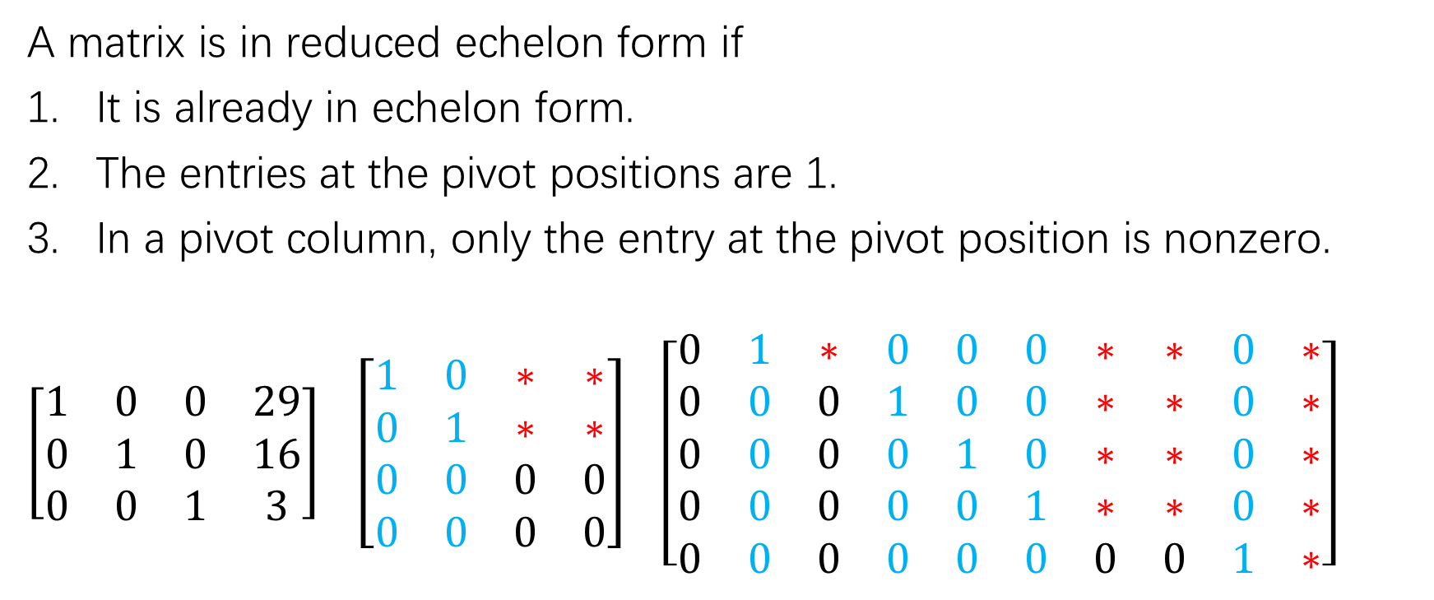
Reduced echelon form
A matrix is in reduced echelon form if
It is already in echelon form.
The entries at the pivot positions are 1.
In a pivot column, only the entry at the pivot position is nonzero.
$\left[\begin{matrix}1 & 0 & 0 & 29 \\ 0 & 1 & 0 & 16 \\ 0 & 0 & 1 & 3\end{matrix}\right]$ $\left[\begin{matrix}1 & 0 & ∗ & ∗ \\ 0 & 1 & ∗ & ∗ \\ 0 & 0 & 0 & 0 \\ 0 & 0 & 0 & 0\end{matrix}\right]$ $\left[\begin{matrix}0 & 1 & ∗ & 0 & 0 & 0 & ∗ & ∗ & 0 & ∗ \\ 0 & 0 & 0 & 1 & 0 & 0 & ∗ & ∗ & 0 & ∗ \\ 0 & 0 & 0 & 0 & 1 & 0 & ∗ & ∗ & 0 & ∗ \\ 0 & 0 & 0 & 0 & 0 & 1 & ∗ & ∗ & 0 & ∗ \\ 0 & 0 & 0 & 0 & 0 & 0 & 0 & 0 & 1 & ∗\end{matrix}\right]$

Slide 7
Practice
Page 21: Exercise 1, 2

Slide 8
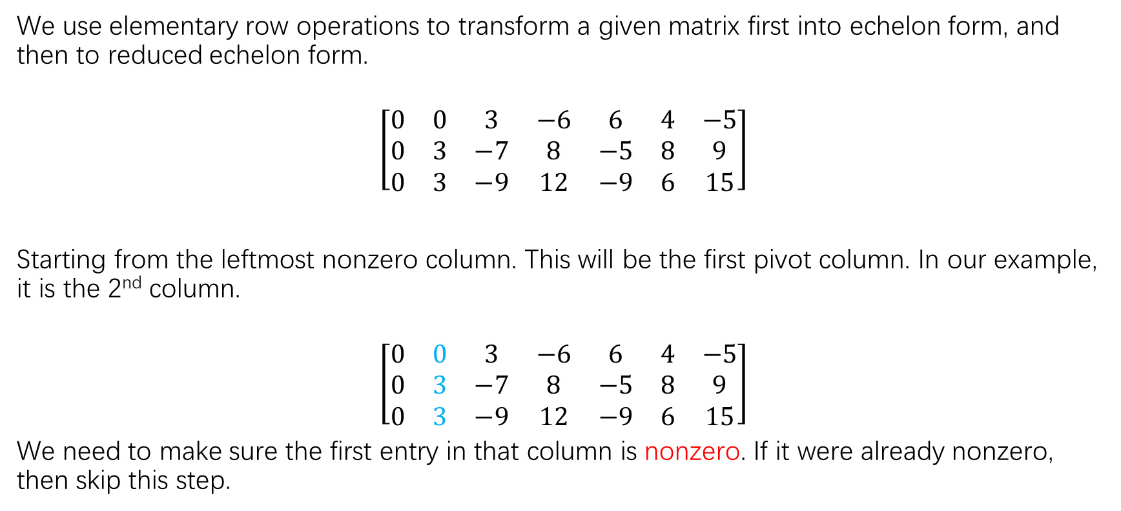
Row reduction algorithm
We use elementary row operations to transform a given matrix first into echelon form, and then to reduced echelon form.
$$\left[\begin{matrix}0 & 0 & 3 & −6 & 6 & 4 & −5 \\ 0 & 3 & −7 & 8 & −5 & 8 & 9 \\ 0 & 3 & −9 & 12 & −9 & 6 & 15\end{matrix}\right]$$
Starting from the leftmost nonzero column. This will be the first pivot column. In our example, it is the 2nd column.
$$\left[\begin{matrix}0 & 0 & 3 & −6 & 6 & 4 & −5 \\ 0 & 3 & −7 & 8 & −5 & 8 & 9 \\ 0 & 3 & −9 & 12 & −9 & 6 & 15\end{matrix}\right]$$
We need to make sure the first entry in that column is nonzero. If it were already nonzero, then skip this step.

Slide 9
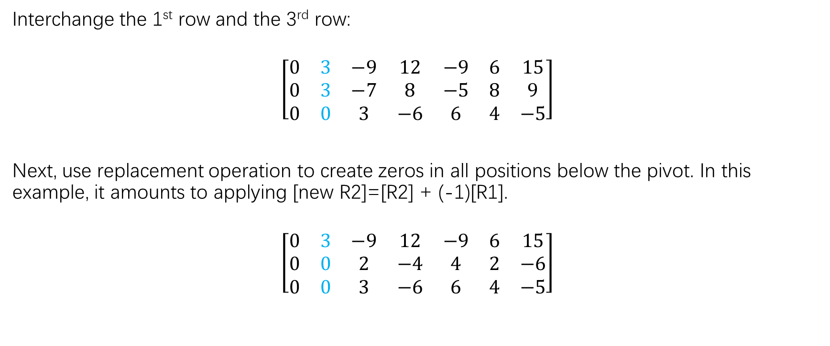
Row reduction algorithm
Interchange the 1st row and the 3rd row:
$$\left[\begin{matrix}0 & 3 & −9 & 12 & −9 & 6 & 15 \\ 0 & 3 & −7 & 8 & −5 & 8 & 9 \\ 0 & 0 & 3 & −6 & 6 & 4 & −5\end{matrix}\right]$$
Next, use replacement operation to create zeros in all positions below the pivot. In this example, it amounts to applying [new R2]=[R2] + (-1)[R1].
$$\left[\begin{matrix}0 & 3 & −9 & 12 & −9 & 6 & 15 \\ 0 & 0 & 2 & −4 & 4 & 2 & −6 \\ 0 & 0 & 3 & −6 & 6 & 4 & −5\end{matrix}\right]$$

Slide 10
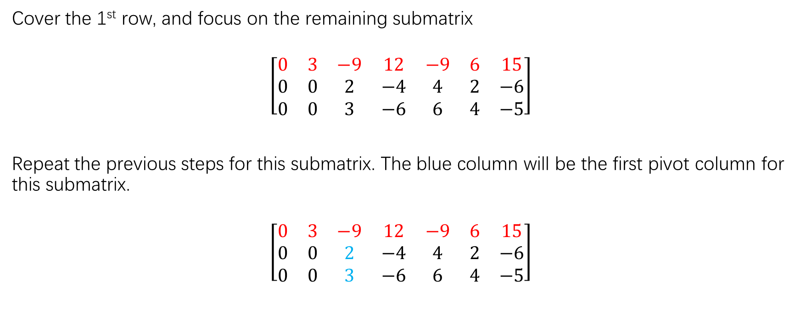
Row reduction algorithm
Cover the 1st row, and focus on the remaining submatrix
$$\left[\begin{matrix}0 & 3 & −9 & 12 & −9 & 6 & 15 \\ 0 & 0 & 2 & −4 & 4 & 2 & −6 \\ 0 & 0 & 3 & −6 & 6 & 4 & −5\end{matrix}\right]$$
Repeat the previous steps for this submatrix. The blue column will be the first pivot column for this submatrix.
$$\left[\begin{matrix}0 & 3 & −9 & 12 & −9 & 6 & 15 \\ 0 & 0 & 2 & −4 & 4 & 2 & −6 \\ 0 & 0 & 3 & −6 & 6 & 4 & −5\end{matrix}\right]$$

Slide 11
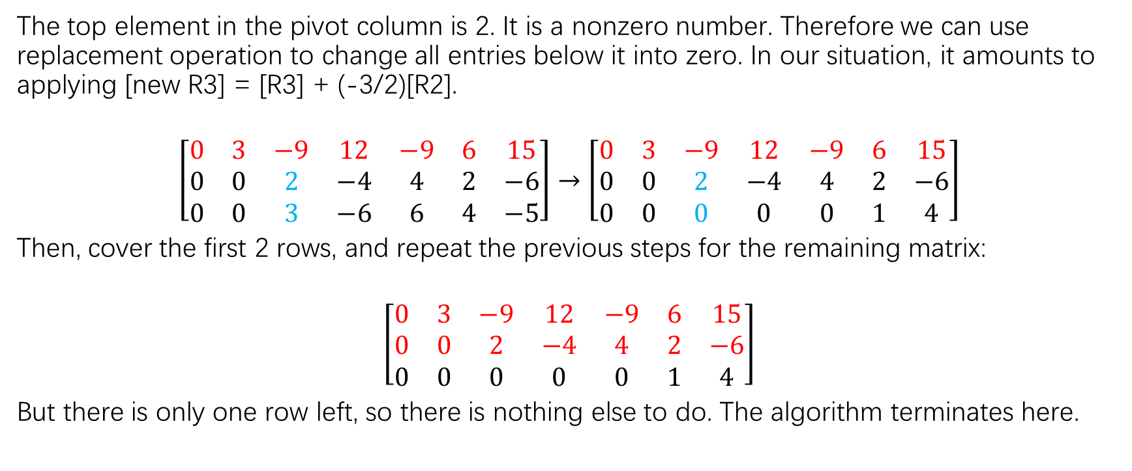
Row reduction algorithm
The top element in the pivot column is 2. It is a nonzero number. Therefore we can use replacement operation to change all entries below it into zero. In our situation, it amounts to applying [new R3] = [R3] + (-3/2)[R2].
$$\left[\begin{matrix}0 & 3 & −9 & 12 & −9 & 6 & 15 \\ 0 & 0 & 2 & −4 & 4 & 2 & −6 \\ 0 & 0 & 3 & −6 & 6 & 4 & −5\end{matrix}\right]→\left[\begin{matrix}0 & 3 & −9 & 12 & −9 & 6 & 15 \\ 0 & 0 & 2 & −4 & 4 & 2 & −6 \\ 0 & 0 & 0 & 0 & 0 & 1 & 4\end{matrix}\right]$$
Then, cover the first 2 rows, and repeat the previous steps for the remaining matrix:
$$\left[\begin{matrix}0 & 3 & −9 & 12 & −9 & 6 & 15 \\ 0 & 0 & 2 & −4 & 4 & 2 & −6 \\ 0 & 0 & 0 & 0 & 0 & 1 & 4\end{matrix}\right]$$
But there is only one row left, so there is nothing else to do. The algorithm terminates here.

Slide 12
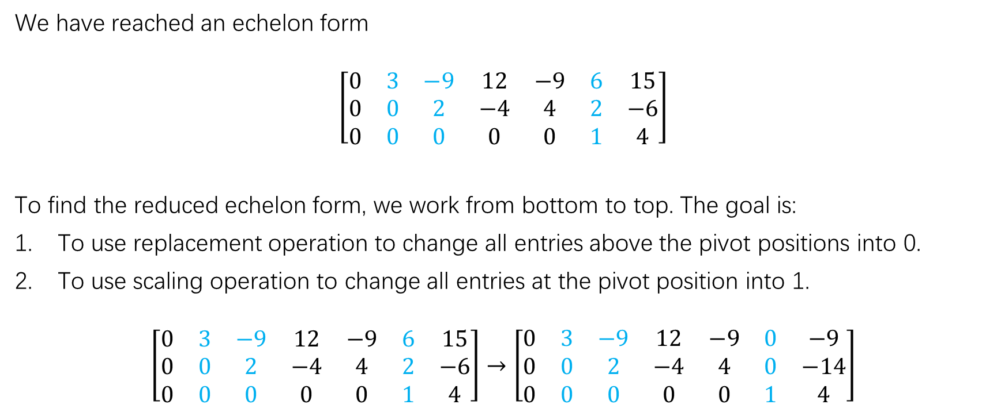
Row reduction algorithm
We have reached an echelon form
$$\left[\begin{matrix}0 & 3 & −9 & 12 & −9 & 6 & 15 \\ 0 & 0 & 2 & −4 & 4 & 2 & −6 \\ 0 & 0 & 0 & 0 & 0 & 1 & 4\end{matrix}\right]$$
To find the reduced echelon form, we work from bottom to top. The goal is:
To use replacement operation to change all entries above the pivot positions into 0.
To use scaling operation to change all entries at the pivot position into 1.
$$\left[\begin{matrix}0 & 3 & −9 & 12 & −9 & 6 & 15 \\ 0 & 0 & 2 & −4 & 4 & 2 & −6 \\ 0 & 0 & 0 & 0 & 0 & 1 & 4\end{matrix}\right]→\left[\begin{matrix}0 & 3 & −9 & 12 & −9 & 0 & −9 \\ 0 & 0 & 2 & −4 & 4 & 0 & −14 \\ 0 & 0 & 0 & 0 & 0 & 1 & 4\end{matrix}\right]$$

Slide 13
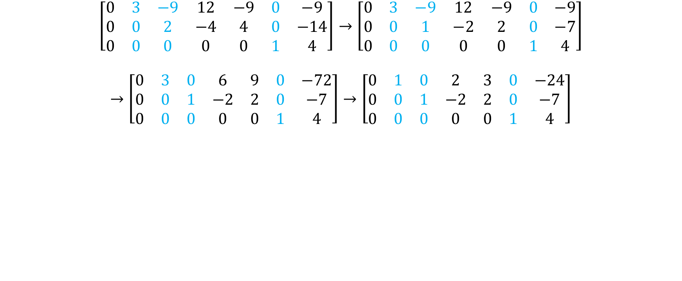
Row reduction algorithm
$$\left[\begin{matrix}0 & 3 & −9 & 12 & −9 & 0 & −9 \\ 0 & 0 & 2 & −4 & 4 & 0 & −14 \\ 0 & 0 & 0 & 0 & 0 & 1 & 4\end{matrix}\right]→\left[\begin{matrix}0 & 3 & −9 & 12 & −9 & 0 & −9 \\ 0 & 0 & 1 & −2 & 2 & 0 & −7 \\ 0 & 0 & 0 & 0 & 0 & 1 & 4\end{matrix}\right]$$
$$→\left[\begin{matrix}0 & 3 & 0 & 6 & 9 & 0 & −72 \\ 0 & 0 & 1 & −2 & 2 & 0 & −7 \\ 0 & 0 & 0 & 0 & 0 & 1 & 4\end{matrix}\right]→\left[\begin{matrix}0 & 1 & 0 & 2 & 3 & 0 & −24 \\ 0 & 0 & 1 & −2 & 2 & 0 & −7 \\ 0 & 0 & 0 & 0 & 0 & 1 & 4\end{matrix}\right]$$

Slide 14
Practice
Page 22: Exercise 3, 4

Slide 15
Solving systems of linear equations
Method:
Given a system of linear equations, we first write down its augmented matrix, and then perform the row reduction algorithm to transform it into reduced echelon form.
Once the augmented matrix is in reduced echelon form, we can read off the solutions immediately.

Slide 16
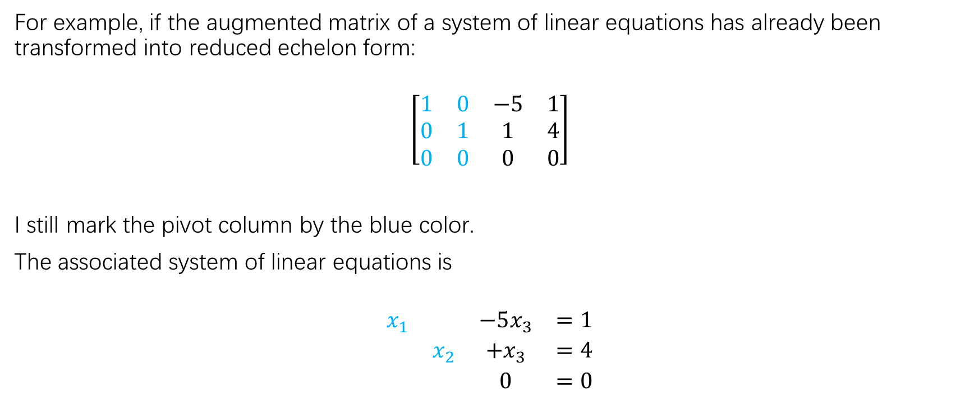
Solving systems of linear equations
For example, if the augmented matrix of a system of linear equations has already been transformed into reduced echelon form:
$$\left[\begin{matrix}1 & 0 & −5 & 1 \\ 0 & 1 & 1 & 4 \\ 0 & 0 & 0 & 0\end{matrix}\right]$$
I still mark the pivot column by the blue color.
The associated system of linear equations is
$$\begin{matrix}x_{1} & & −5x_{3} & =1 \\ & x_{2} & +x_{3} & =4 \\ & & 0 & =0\end{matrix}$$

Slide 17
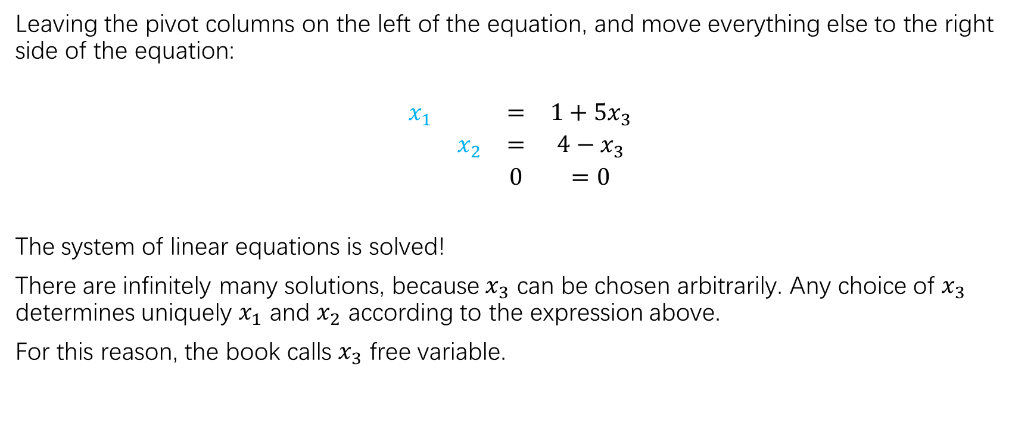
Solving systems of linear equations
Leaving the pivot columns on the left of the equation, and move everything else to the right side of the equation:
$$\begin{matrix}x_{1} & & = & 1+5x_{3} \\ & x_{2} & = & 4−x_{3} \\ & & 0 & =0\end{matrix}$$
The system of linear equations is solved!
There are infinitely many solutions, because $x_{3}$ can be chosen arbitrarily. Any choice of $x_{3}$ determines uniquely $x_{1}$ and $x_{2}$ according to the expression above.
For this reason, the book calls $x_{3}$ free variable.

Slide 18
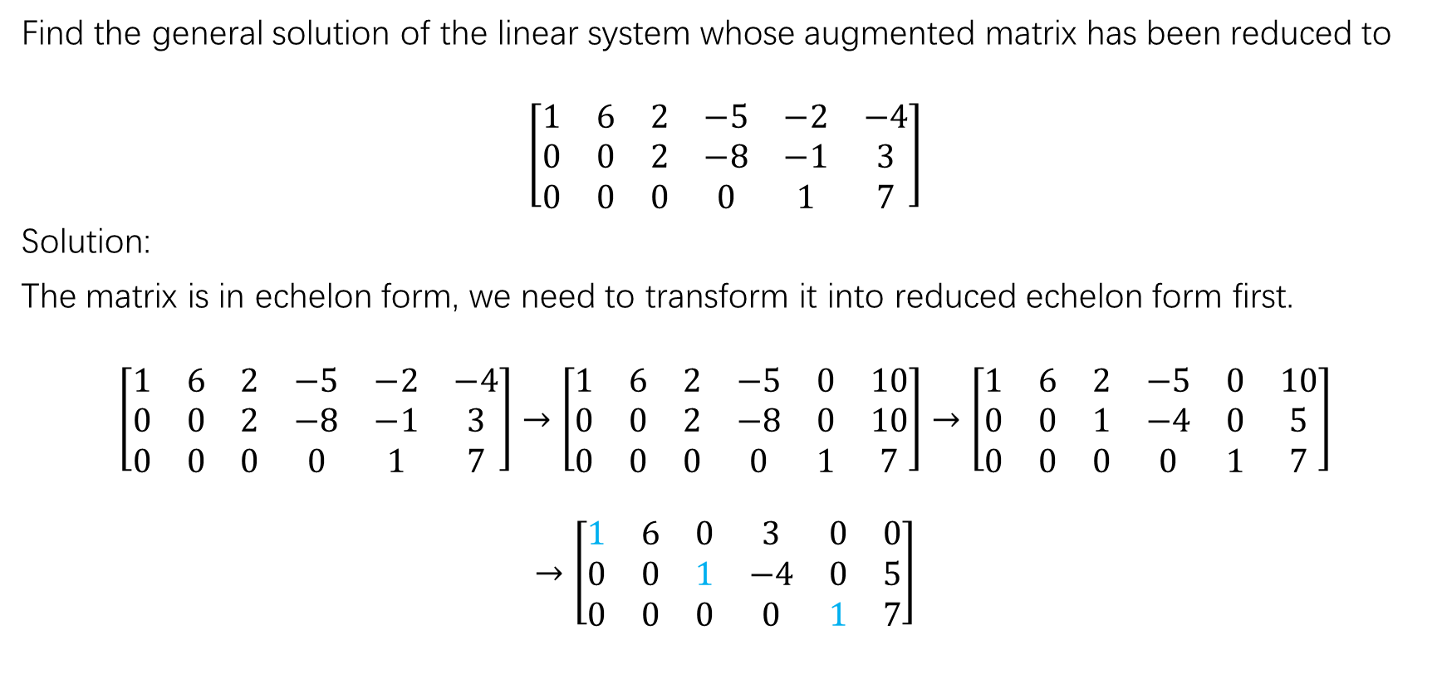
Solving systems of linear equations
Find the general solution of the linear system whose augmented matrix has been reduced to
$$\left[\begin{matrix}1 & 6 & 2 & −5 & −2 & −4 \\ 0 & 0 & 2 & −8 & −1 & 3 \\ 0 & 0 & 0 & 0 & 1 & 7\end{matrix}\right]$$
Solution:
The matrix is in echelon form, we need to transform it into reduced echelon form first.
$$\left[\begin{matrix}1 & 6 & 2 & −5 & −2 & −4 \\ 0 & 0 & 2 & −8 & −1 & 3 \\ 0 & 0 & 0 & 0 & 1 & 7\end{matrix}\right]→\left[\begin{matrix}1 & 6 & 2 & −5 & 0 & 10 \\ 0 & 0 & 2 & −8 & 0 & 10 \\ 0 & 0 & 0 & 0 & 1 & 7\end{matrix}\right]→\left[\begin{matrix}1 & 6 & 2 & −5 & 0 & 10 \\ 0 & 0 & 1 & −4 & 0 & 5 \\ 0 & 0 & 0 & 0 & 1 & 7\end{matrix}\right]$$
$$→\left[\begin{matrix}1 & 6 & 0 & 3 & 0 & 0 \\ 0 & 0 & 1 & −4 & 0 & 5 \\ 0 & 0 & 0 & 0 & 1 & 7\end{matrix}\right]$$

Slide 19
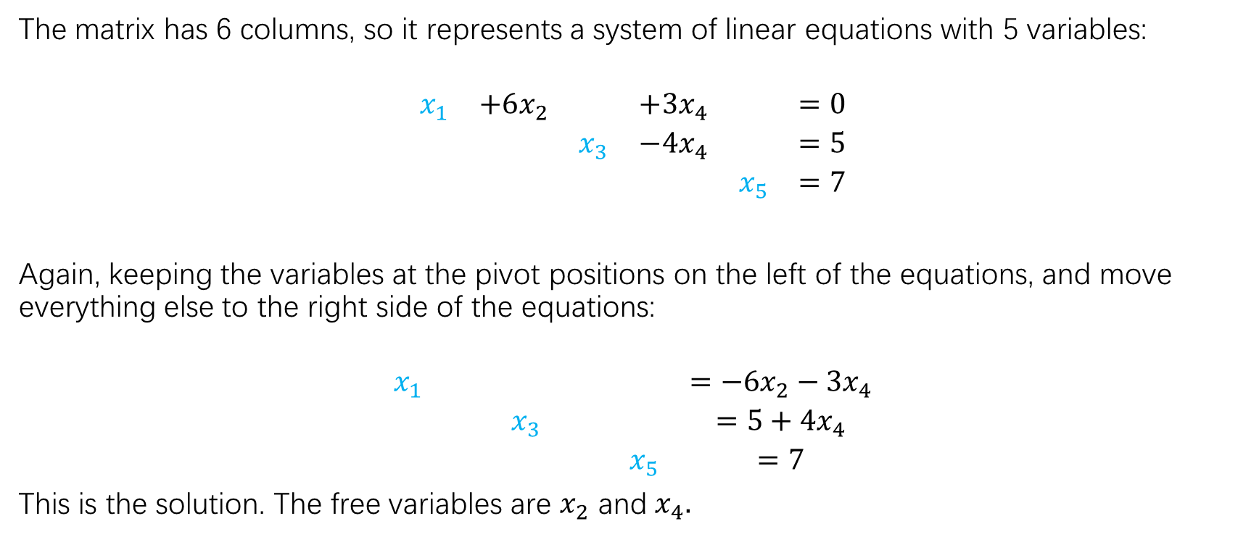
Solving systems of linear equations
The matrix has 6 columns, so it represents a system of linear equations with 5 variables:
$$\begin{matrix}x_{1} & +6x_{2} & & +3x_{4} & & =0 \\ & & x_{3} & −4x_{4} & & =5 \\ & & & & x_{5} & =7\end{matrix}$$
Again, keeping the variables at the pivot positions on the left of the equations, and move everything else to the right side of the equations:
$$\begin{matrix}x_{1} & & & & & =−6x_{2}−3x_{4} \\ & & x_{3} & & & =5+4x_{4} \\ & & & & x_{5} & =7\end{matrix}$$
This is the solution. The free variables are $x_{2}$ and $x_{4}.$

Slide 20
Practice
Page 21: practice problems 1,2
Page 22: 7,9,11,13
Page 22: 15,16,21

