Slide 1
Linear Algebra
Lecturer: Xia Liao
Email: xliao@hqu.edu.cn
Homepage: https://hirzebruch.github.io/main.html
Time: every Tuesday 1-2, Thursday 3-4

Slide 2
Characteristic equations
Recall from last section that once we know the eigenvalues of a matrix, it is then easy to find the eigenspaces.
There is an easy way to find all the eigenvalues of a given matrix, and it has to do with characteristic equations.

Slide 4
Recap of determinants

Slide 5
The characteristic equation

Slide 7
Characteristic polynomials and algebraic multiplicities

Slide 9
Complex eigenvalues

Slide 10
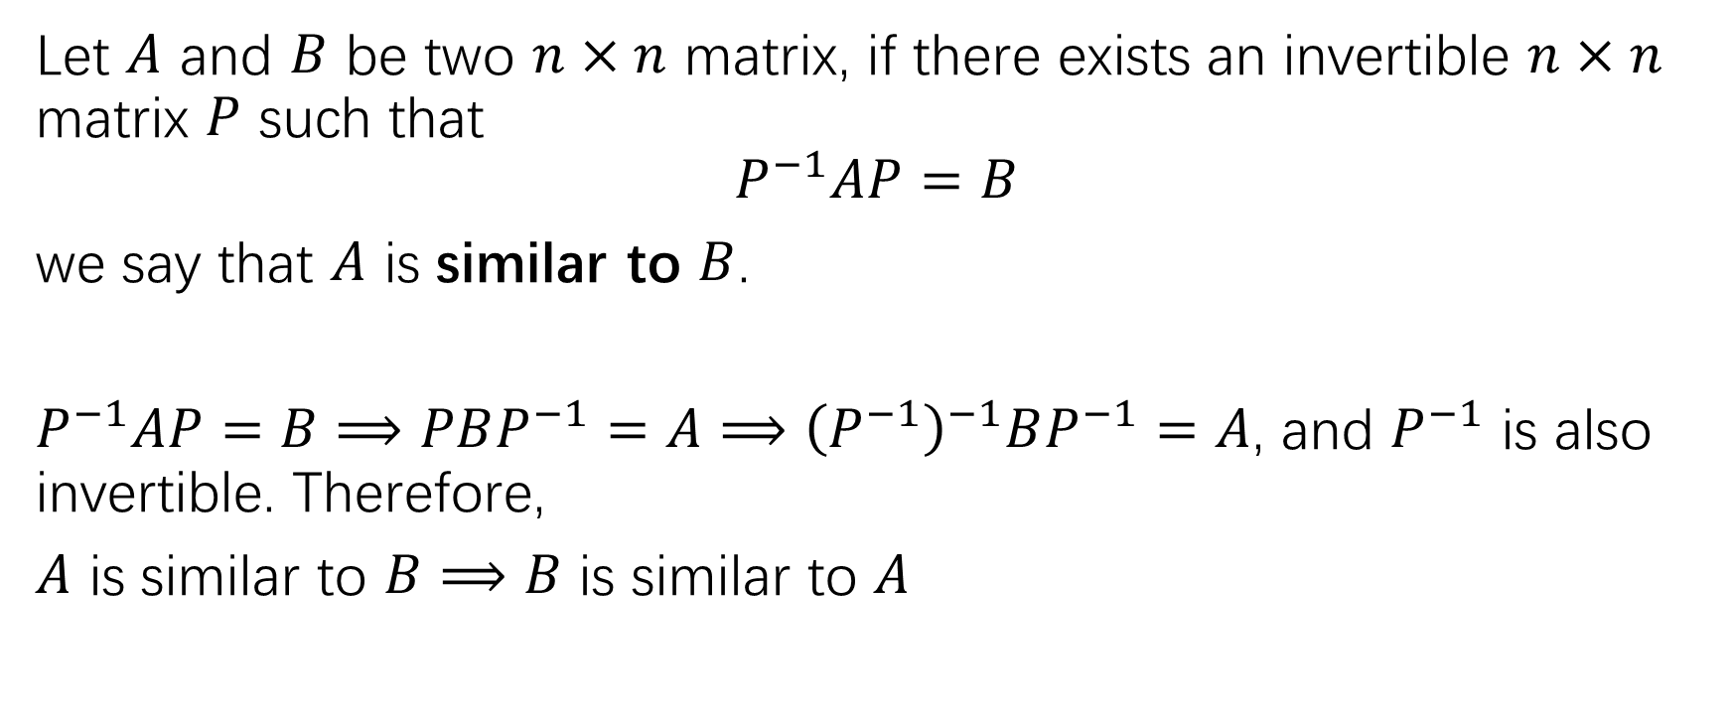
similarity
Let $A$ and $B$ be two $n×n$ matrix, if there exists an invertible $n×n$ matrix $P$ such that
$$P^{−1}AP=B$$
we say that $A$ is similar to $B$.
$P^{−1}AP=B⟹PBP^{−1}=A⟹{\left(P^{−1}\right)}^{−1}BP^{−1}=A$, and $P^{−1}$ is also invertible. Therefore,
$A$ is similar to $B$ $⟹$ $B$ is similar to $A$

Slide 11
Similar matrices have the same eigenvalues

Slide 12
2 warnings
Matrices having the same eigenvalues are not necessarily similar.
Similarity and row equivalences are different equivalence relations. Elementary row operations usually change matrix eigenvalues.

Slide 13
Application to dynamic systems
Eigenvalues and eigenvectors find important applications in solving discrete dynamic systems such as computing the time evolution of the number of spotted owls mentioned in the introduction.

Slide 14
Step1: finding eigenvalues and eigenvectors

Slide 15
Step2: expressing the initial value as a linear combination of the eigenvectors

Slide 16
Step3: solving the evolution problem by induction

Slide 17
Step4: analyzing the long-term behavior of the system by taking limit

Slide 18
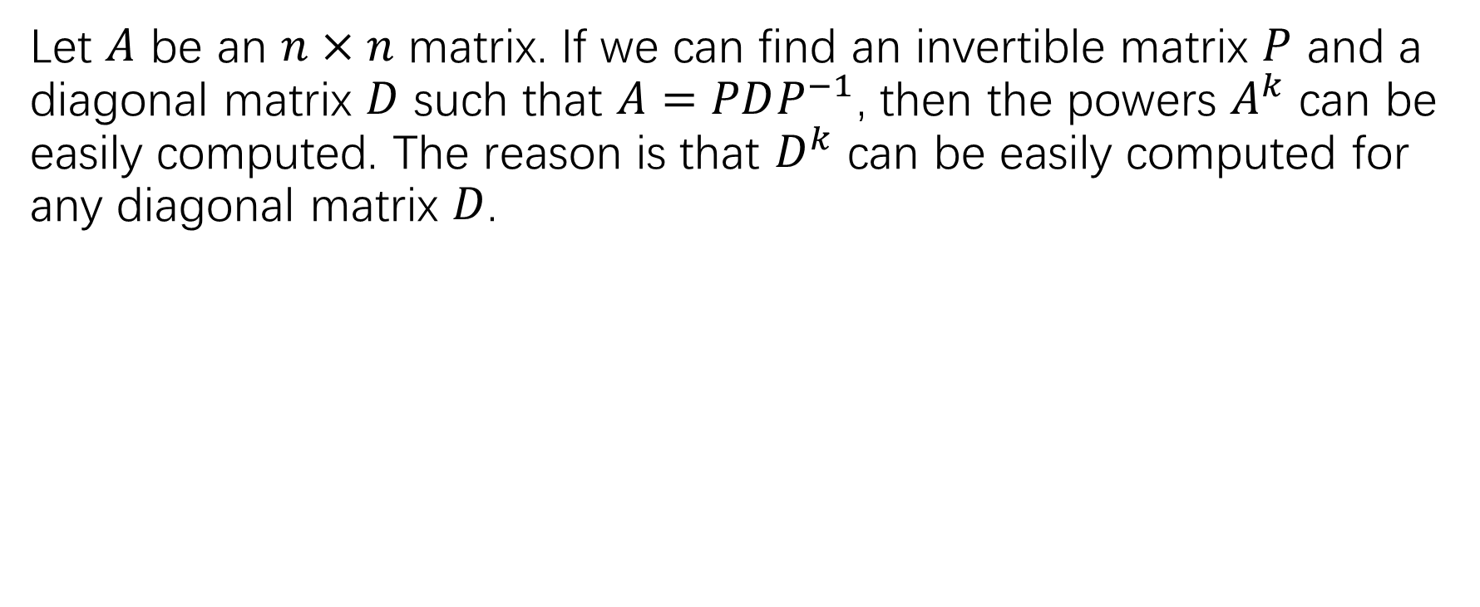
Computing the powers of a matrix
Let $A$ be an $n×n$ matrix. If we can find an invertible matrix $P$ and a diagonal matrix $D$ such that $A=PDP^{−1}$, then the powers $A^{k}$ can be easily computed. The reason is that $D^{k}$ can be easily computed for any diagonal matrix $D$.

Slide 21
The diagonalization theorem

Slide 22
Diagonalizing matrices

Slide 25
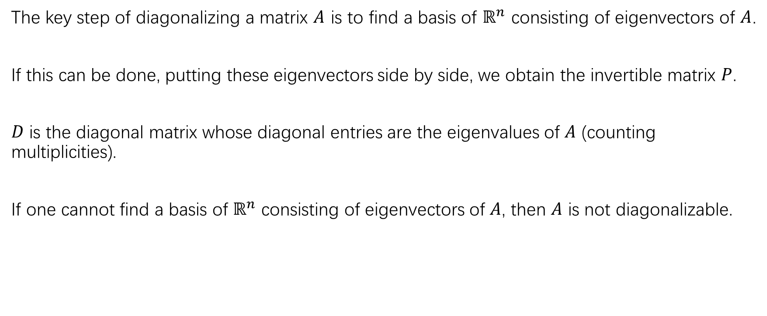
summary
The key step of diagonalizing a matrix $A$ is to find a basis of $ℝ^{n}$ consisting of eigenvectors of $A$.
If this can be done, putting these eigenvectors side by side, we obtain the invertible matrix $P$.
$D$ is the diagonal matrix whose diagonal entries are the eigenvalues of $A$ (counting multiplicities).
If one cannot find a basis of $ℝ^{n}$ consisting of eigenvectors of $A$, then $A$ is not diagonalizable.

Slide 29
A sufficient condition for a matrix to be invertible

Slide 31
HW
P302: 9,15,18,25
P308: 1,3,5,11,15,17

