Slide 1
Linear Algebra
Lecturer: Xia Liao
Email: xliao@hqu.edu.cn
Homepage: https://hirzebruch.github.io/main.html
Time: every Tuesday 1-2, Thursday 3-4

Slide 2
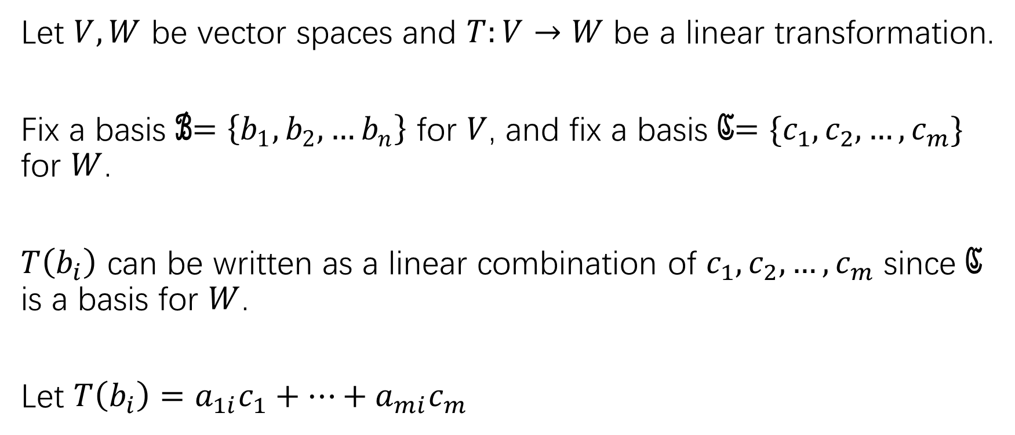
The matrix of a linear transformation
Let $V,W$ be vector spaces and $T:V→W$ be a linear transformation.
Fix a basis ℬ$=\left\{b_{1},b_{2},…b_{n}\right\}$ for $V$, and fix a basis ℭ$=\{c_{1},c_{2},…,c_{m}\}$ for $W$.
$T\left(b_{i}\right)$ can be written as a linear combination of $c_{1},c_{2},…,c_{m}$ since ℭ is a basis for $W$.
Let $T\left(b_{i}\right)=a_{1i}c_{1}+…+a_{mi}c_{m}$

Slide 3
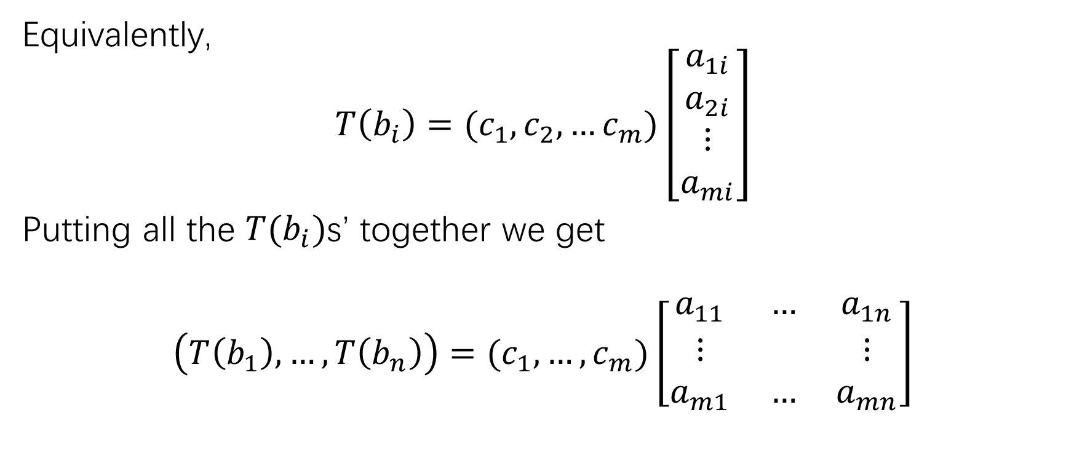
The matrix of a linear transformation
Equivalently,
$$T\left(b_{i}\right)=(c_{1},c_{2},…c_{m})\left[\begin{matrix}a_{1i} \\ a_{2i} \\ ⋮ \\ a_{mi}\end{matrix}\right]$$
Putting all the $T(b_{i})$s’ together we get
$$\left(T\left(b_{1}\right),…,T\left(b_{n}\right)\right)=(c_{1},…,c_{m})\left[\begin{matrix}a_{11} & … & a_{1n} \\ ⋮ & & ⋮ \\ a_{m1} & … & a_{mn}\end{matrix}\right]$$

Slide 4
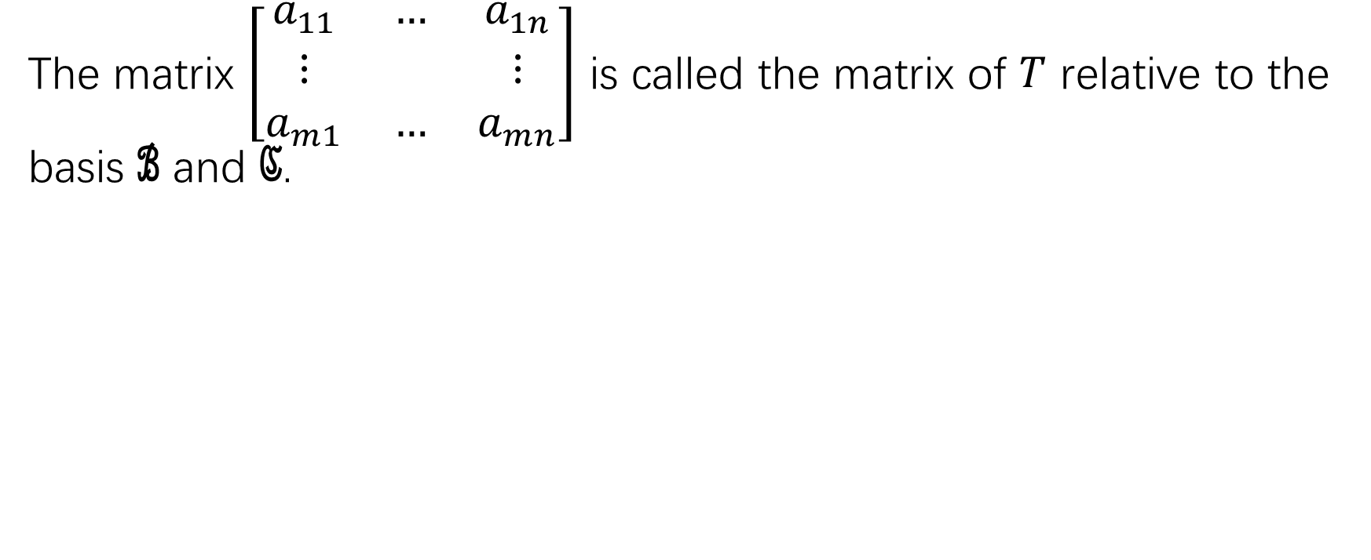
The matrix of a linear transformation
The matrix $\left[\begin{matrix}a_{11} & … & a_{1n} \\ ⋮ & & ⋮ \\ a_{m1} & … & a_{mn}\end{matrix}\right]$ is called the matrix of $T$ relative to the basis ℬ and ℭ.

Slide 5
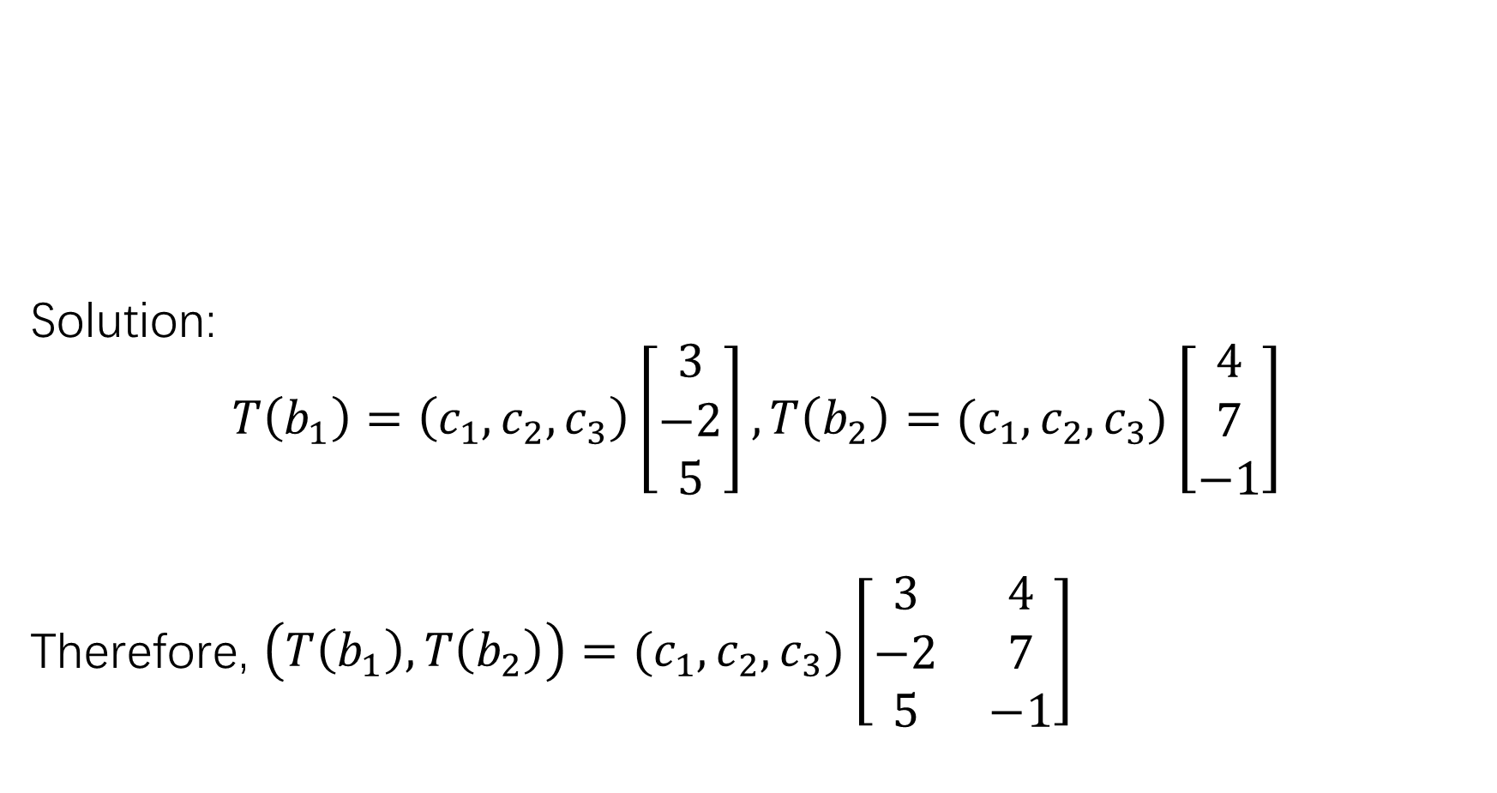
Solution:
$$T\left(b_{1}\right)=\left(c_{1},c_{2},c_{3}\right)\left[\begin{matrix}3 \\ −2 \\ 5\end{matrix}\right], T\left(b_{2}\right)=(c_{1},c_{2},c_{3})\left[\begin{matrix}4 \\ 7 \\ −1\end{matrix}\right]$$
Therefore, $\left(T\left(b_{1}\right),T\left(b_{2}\right)\right)=(c_{1},c_{2},c_{3})\left[\begin{matrix}3 & 4 \\ −2 & 7 \\ 5 & −1\end{matrix}\right]$

Slide 6
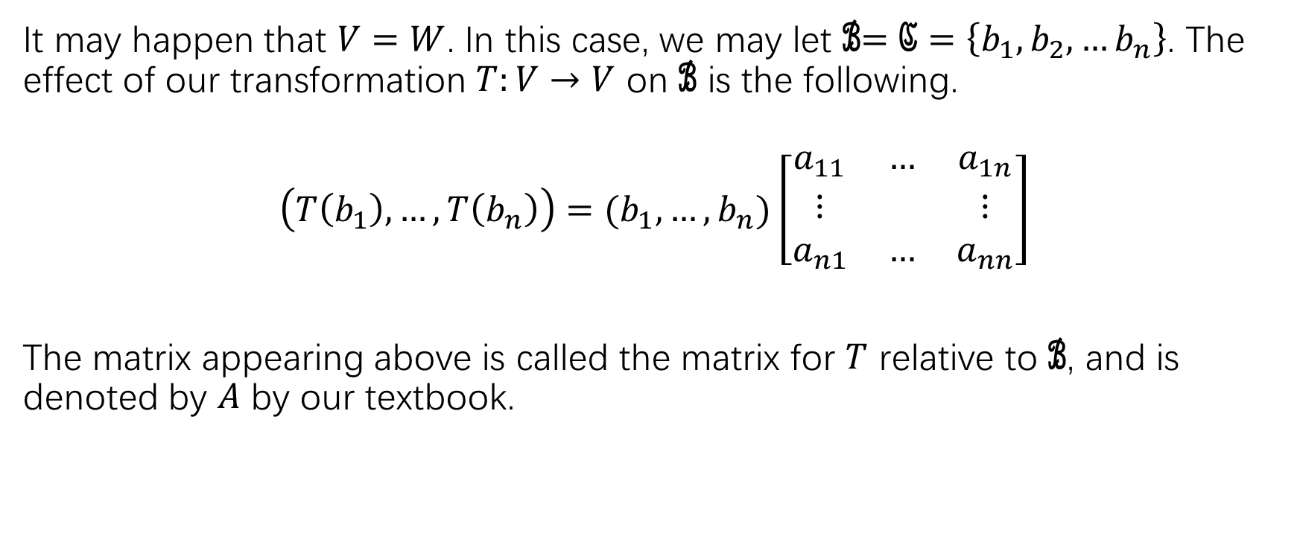

Linear transformations from $V$ to itself
It may happen that $V=W$. In this case, we may let ℬ$=\text{ℭ}=\left\{b_{1},b_{2},…b_{n}\right\}$. The effect of our transformation $T:V→V$ on ℬ is the following.
$$\left(T\left(b_{1}\right),…,T\left(b_{n}\right)\right)=(b_{1},…,b_{n})\left[\begin{matrix}a_{11} & … & a_{1n} \\ ⋮ & & ⋮ \\ a_{n1} & … & a_{nn}\end{matrix}\right]$$
The matrix appearing above is called the matrix for $T$ relative to ℬ, and is denoted by $A$ by our textbook.

Slide 7
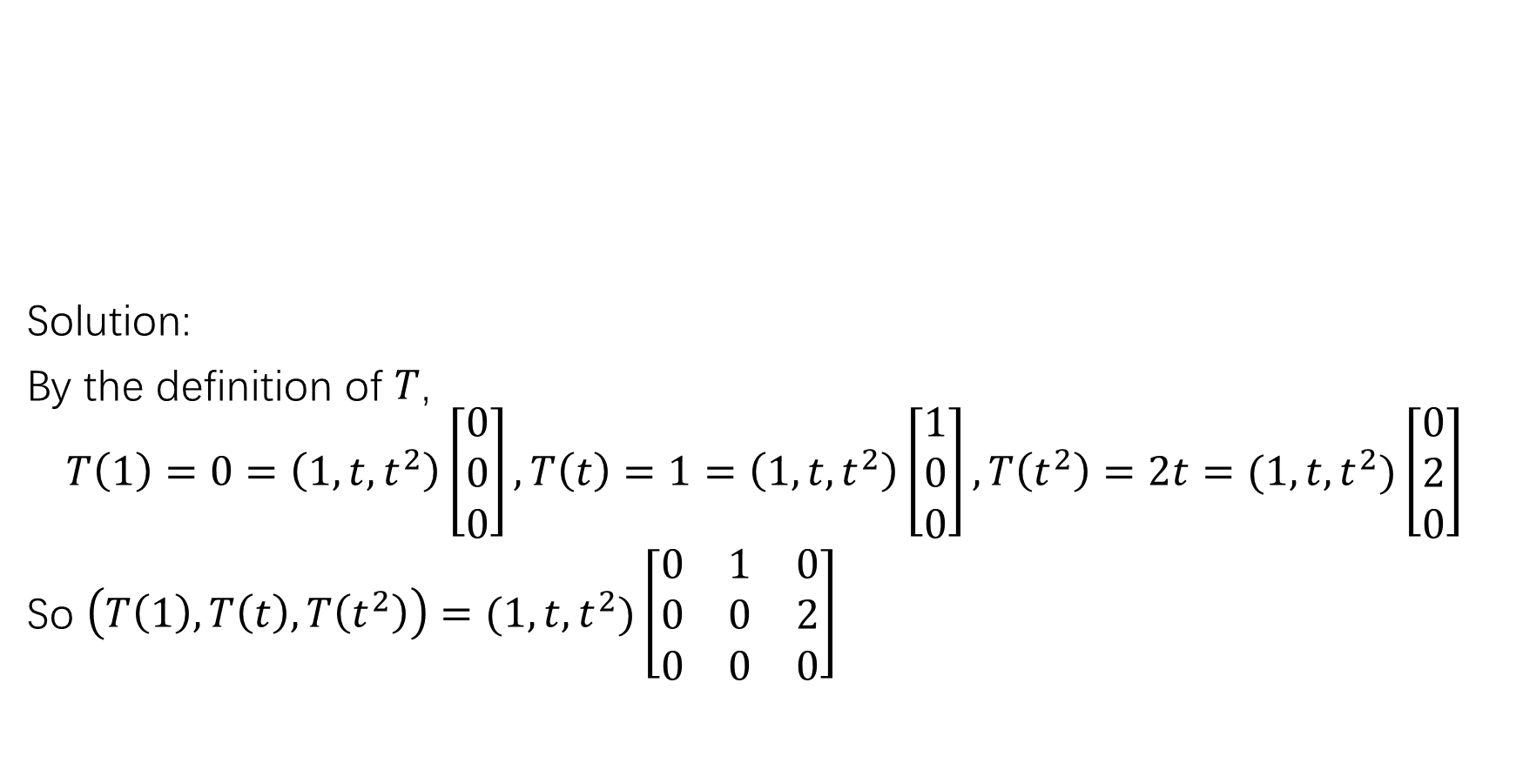
Solution:
By the definition of $T$,
$$T\left(1\right)=0=\left(1,t,t^{2}\right)\left[\begin{matrix}0 \\ 0 \\ 0\end{matrix}\right], T\left(t\right)=1=\left(1,t,t^{2}\right)\left[\begin{matrix}1 \\ 0 \\ 0\end{matrix}\right], T\left(t^{2}\right)=2t=(1,t,t^{2})\left[\begin{matrix}0 \\ 2 \\ 0\end{matrix}\right]$$
So $\left(T\left(1\right),T\left(t\right),T\left(t^{2}\right)\right)=(1,t,t^{2})\left[\begin{matrix}0 & 1 & 0 \\ 0 & 0 & 2 \\ 0 & 0 & 0\end{matrix}\right]$

Slide 8
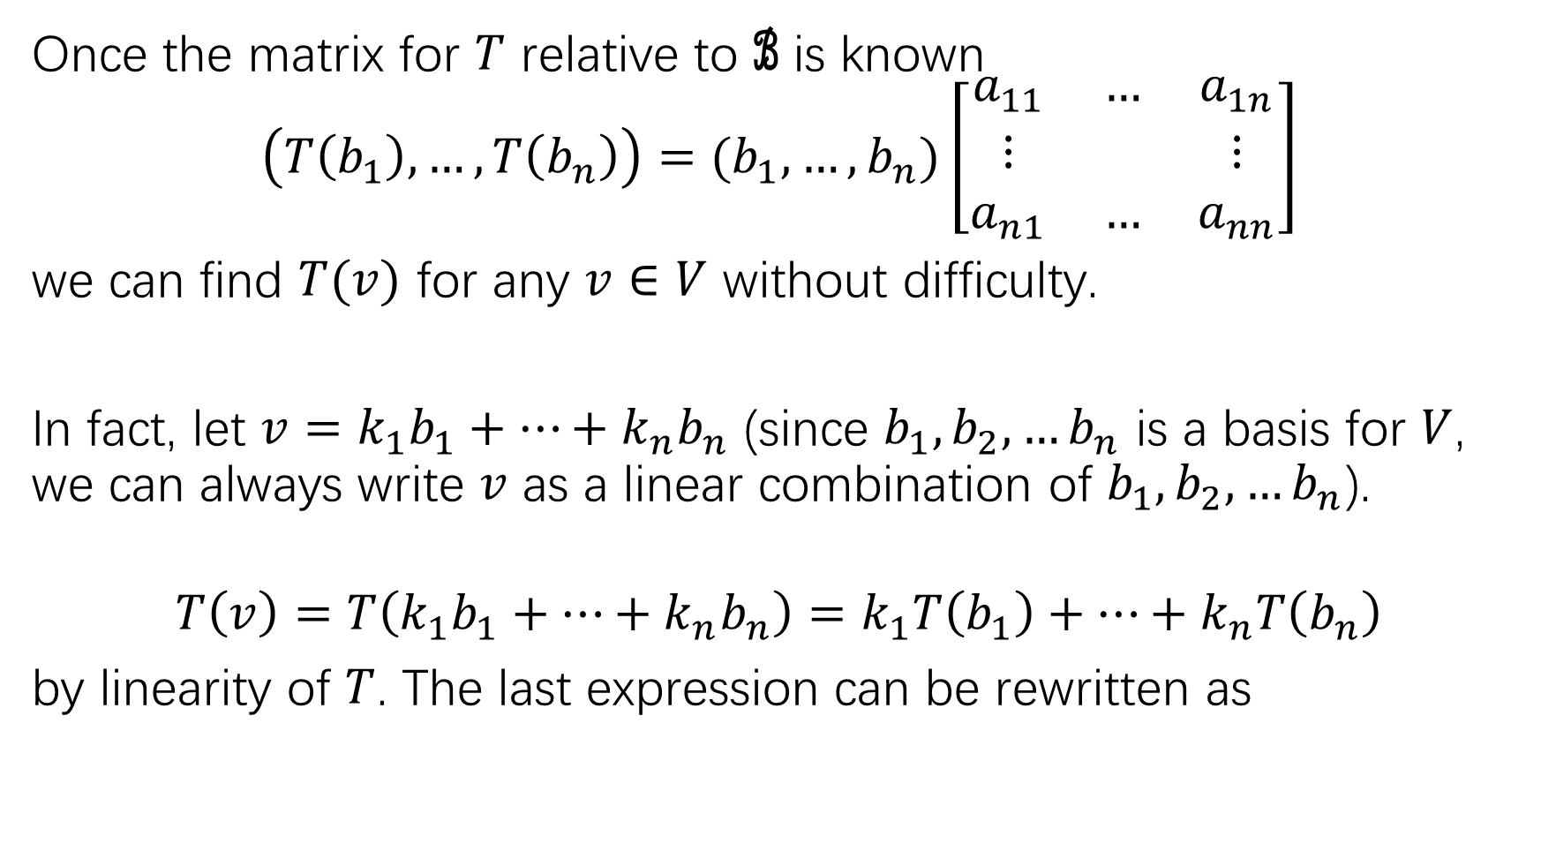
Once the matrix for $T$ relative to ℬ is known
$$\left(T\left(b_{1}\right),…,T\left(b_{n}\right)\right)=(b_{1},…,b_{n})\left[\begin{matrix}a_{11} & … & a_{1n} \\ ⋮ & & ⋮ \\ a_{n1} & … & a_{nn}\end{matrix}\right]$$
we can find $T(v)$ for any $v∈V$ without difficulty.
In fact, let $v=k_{1}b_{1}+…+k_{n}b_{n}$ (since $b_{1},b_{2},…b_{n}$ is a basis for $V$, we can always write $v$ as a linear combination of $b_{1},b_{2},…b_{n}$).
$$T\left(v\right)=T\left(k_{1}b_{1}+…+k_{n}b_{n}\right)=k_{1}T\left(b_{1}\right)+…+k_{n}T\left(b_{n}\right)$$
by linearity of $T$. The last expression can be rewritten as

Slide 9
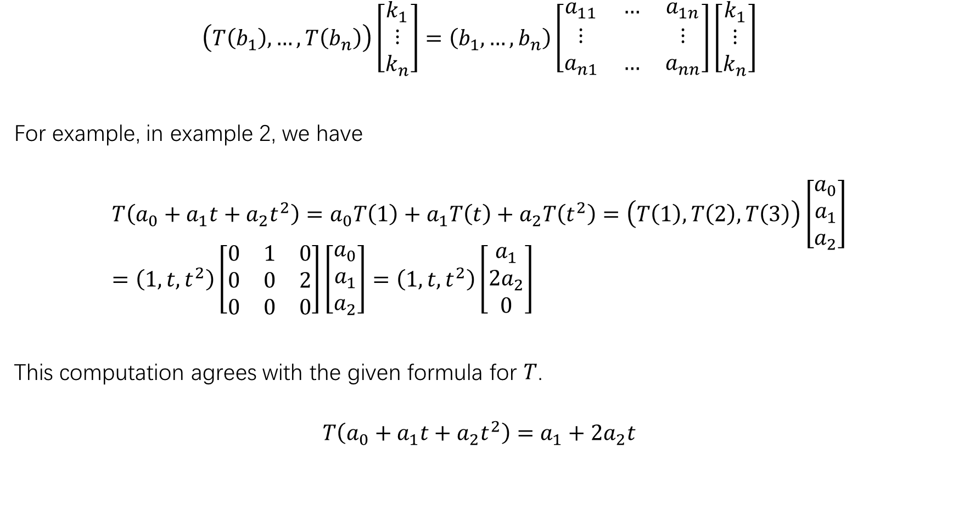
$$\left(T\left(b_{1}\right),…,T\left(b_{n}\right)\right)\left[\begin{matrix}k_{1} \\ ⋮ \\ k_{n}\end{matrix}\right]=\left(b_{1},…,b_{n}\right)\left[\begin{matrix}a_{11} & … & a_{1n} \\ ⋮ & & ⋮ \\ a_{n1} & … & a_{nn}\end{matrix}\right]\left[\begin{matrix}k_{1} \\ ⋮ \\ k_{n}\end{matrix}\right]$$
For example, in example 2, we have
$$T\left(a_{0}+a_{1}t+a_{2}t^{2}\right)=a_{0}T\left(1\right)+a_{1}T\left(t\right)+a_{2}T\left(t^{2}\right)=\left(T\left(1\right),T\left(2\right),T\left(3\right)\right)\left[\begin{matrix}a_{0} \\ a_{1} \\ a_{2}\end{matrix}\right]=\left(1,t,t^{2}\right)\left[\begin{matrix}0 & 1 & 0 \\ 0 & 0 & 2 \\ 0 & 0 & 0\end{matrix}\right]\left[\begin{matrix}a_{0} \\ a_{1} \\ a_{2}\end{matrix}\right]=\left(1,t,t^{2}\right)\left[\begin{matrix}a_{1} \\ {2a}_{2} \\ 0\end{matrix}\right]$$
This computation agrees with the given formula for $T$.
$$T\left(a_{0}+a_{1}t+a_{2}t^{2}\right)=a_{1}+2a_{2}t$$

Slide 10
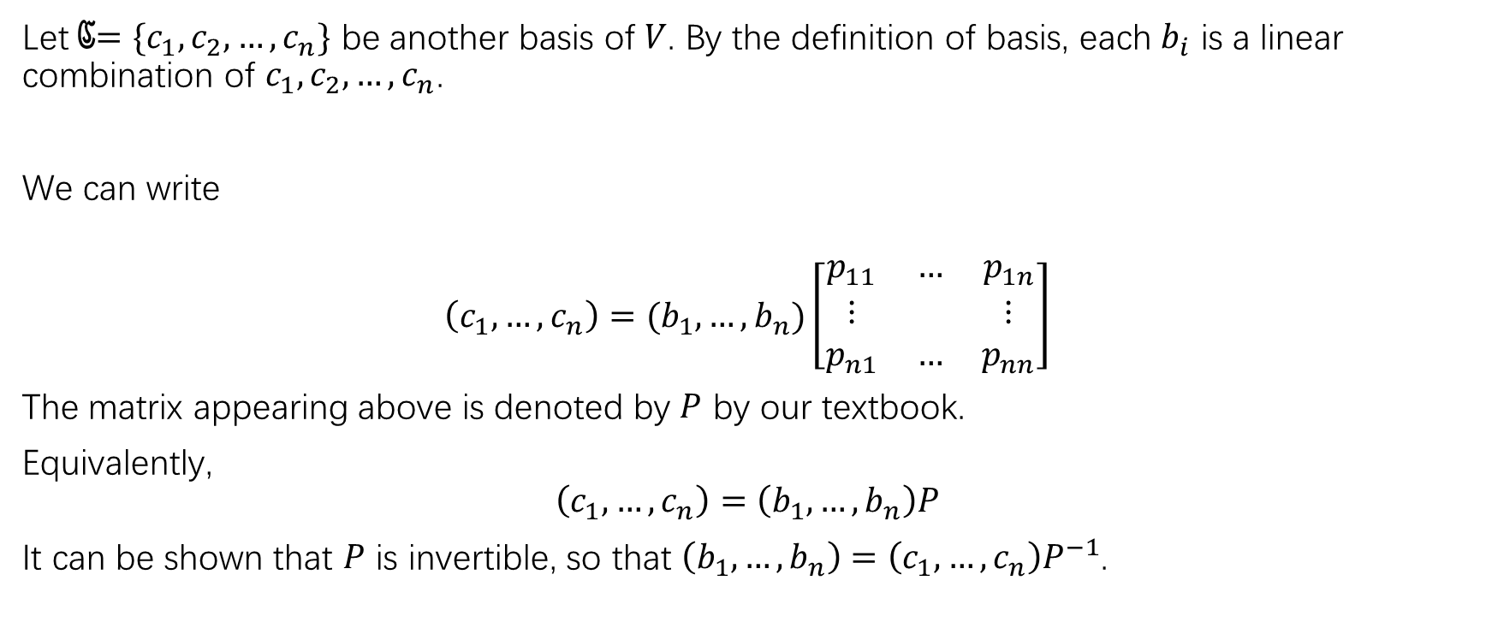
Change of basis
Let ℭ$=\{c_{1},c_{2},…,c_{n}\}$ be another basis of $V$. By the definition of basis, each $b_{i}$ is a linear combination of $c_{1},c_{2},…,c_{n}$.
We can write
$$\left(c_{1},…,c_{n}\right)=(b_{1},…,b_{n})\left[\begin{matrix}p_{11} & … & p_{1n} \\ ⋮ & & ⋮ \\ p_{n1} & … & p_{nn}\end{matrix}\right]$$
The matrix appearing above is denoted by $P$ by our textbook.
Equivalently,
$$\left(c_{1},…,c_{n}\right)=\left(b_{1},…,b_{n}\right)P$$
It can be shown that $P$ is invertible, so that $\left(b_{1},…,b_{n}\right)=$ $\left(c_{1},…,c_{n}\right)P^{−1}$.

Slide 11
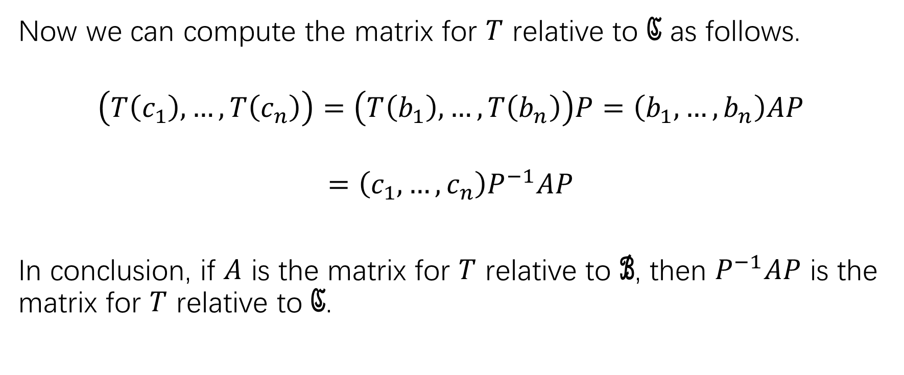

The matrix for $T$ relative to ℭ
Now we can compute the matrix for $T$ relative to ℭ as follows.
$$\left(T\left(c_{1}\right),…,T\left(c_{n}\right)\right)=\left(T\left(b_{1}\right),…,T\left(b_{n}\right)\right)P=\left(b_{1},…,b_{n}\right)AP$$
$$=\left(c_{1},…,c_{n}\right)P^{−1}AP$$
In conclusion, if $A$ is the matrix for $T$ relative to ℬ, then $P^{−1}AP$ is the matrix for $T$ relative to ℭ.

Slide 12
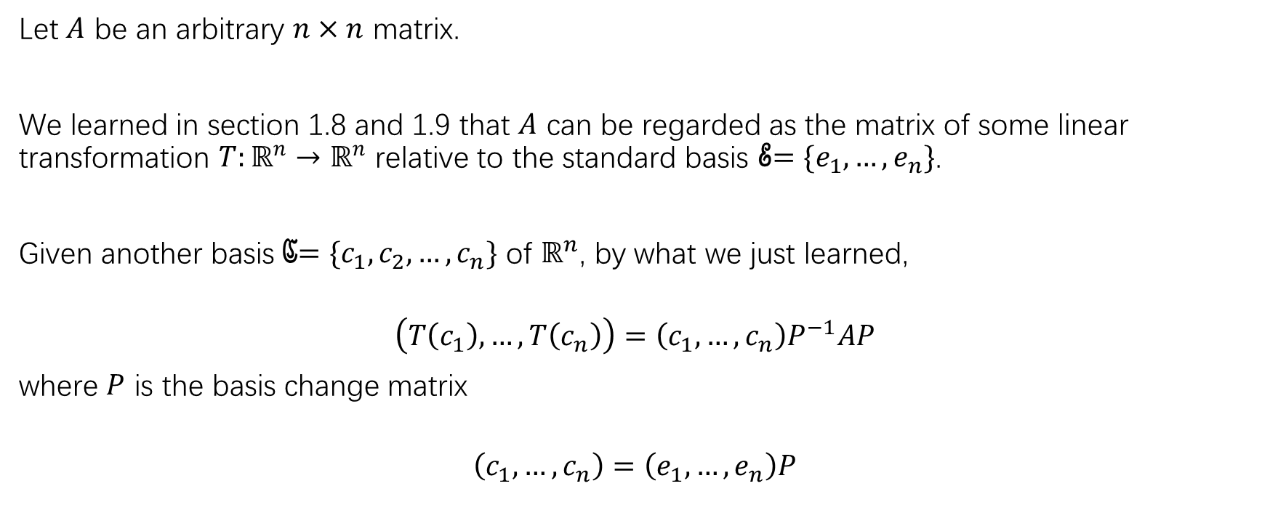
The essence of diagonalization problem
Let $A$ be an arbitrary $n×n$ matrix.
We learned in section 1.8 and 1.9 that $A$ can be regarded as the matrix of some linear transformation $T:ℝ^{n}→ℝ^{n}$ relative to the standard basis ℰ$=\{e_{1},…,e_{n}\}$.
Given another basis ℭ$=\{c_{1},c_{2},…,c_{n}\}$ of $ℝ^{n}$, by what we just learned,
$$\left(T\left(c_{1}\right),…,T\left(c_{n}\right)\right)=\left(c_{1},…,c_{n}\right)P^{−1}AP$$
where $P$ is the basis change matrix
$$\left(c_{1},…,c_{n}\right)=\left(e_{1},…,e_{n}\right)P$$

Slide 13
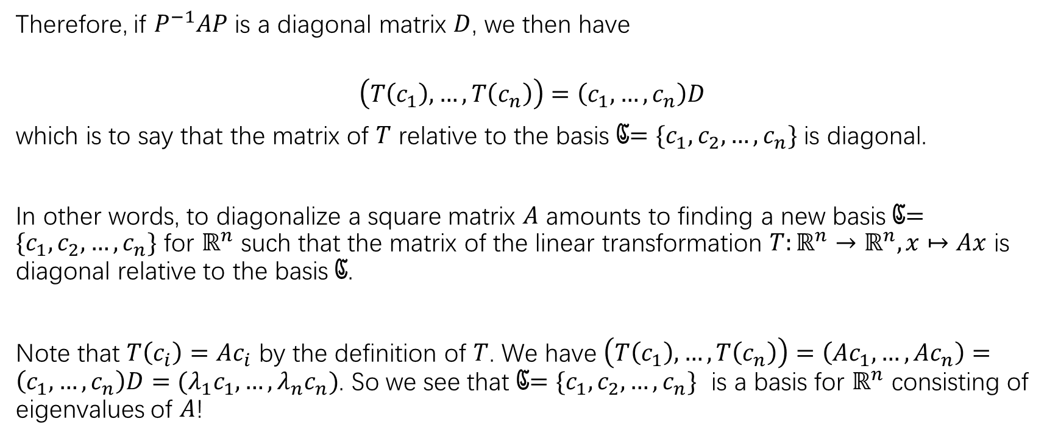
The essence of diagonalization problem
Therefore, if $P^{−1}AP$ is a diagonal matrix $D$, we then have
$$\left(T\left(c_{1}\right),…,T\left(c_{n}\right)\right)=\left(c_{1},…,c_{n}\right)D$$
which is to say that the matrix of $T$ relative to the basis ℭ$=\{c_{1},c_{2},…,c_{n}\}$ is diagonal.
In other words, to diagonalize a square matrix $A$ amounts to finding a new basis ℭ$=\{c_{1},c_{2},…,c_{n}\}$ for $ℝ^{n}$ such that the matrix of the linear transformation $T:ℝ^{n}→ℝ^{n}, x↦Ax$ is diagonal relative to the basis ℭ.
Note that $T\left(c_{i}\right)=Ac_{i}$ by the definition of $T$. We have $\left(T\left(c_{1}\right),…,T\left(c_{n}\right)\right)=\left(Ac_{1},…,Ac_{n}\right)=\left(c_{1},…,c_{n}\right)D=(λ_{1}c_{1},…,λ_{n}c_{n})$. So we see that ℭ$=\{c_{1},c_{2},…,c_{n}\}$ is a basis for $ℝ^{n}$ consisting of eigenvalues of $A$!

Slide 14
The essence of diagonalization problem

Slide 15
Exercise/HW
P315: practice problem 1
P315: 1,2,3(a)(c), 4-14

