Slide 1
Linear Algebra
Lecturer: Xia Liao
Email: xliao@hqu.edu.cn
Homepage: https://hirzebruch.github.io/main.html
Time: every Tuesday 1-2, Thursday 3-4

Slide 2
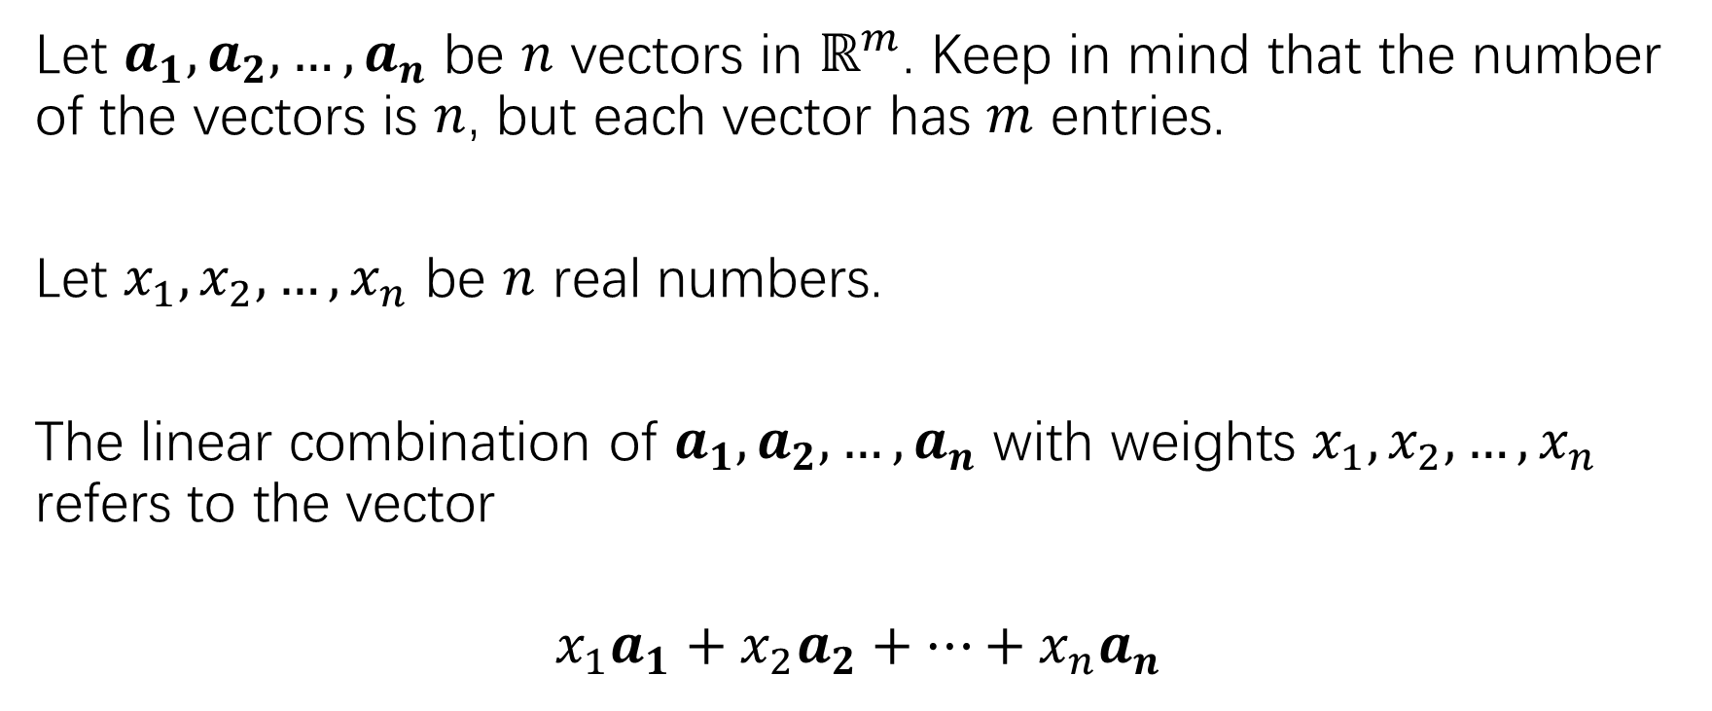
Review of linear combination
Let $a_{1},a_{2},…,a_{n}$ be $n$ vectors in $ℝ^{m}$. Keep in mind that the number of the vectors is $n$, but each vector has $m$ entries.
Let $x_{1},x_{2},…,x_{n}$ be $n$ real numbers.
The linear combination of $a_{1},a_{2},…,a_{n}$ with weights $x_{1},x_{2},…,x_{n}$ refers to the vector
$$x_{1}a_{1}+x_{2}a_{2}+…+x_{n}a_{n}$$

Slide 3
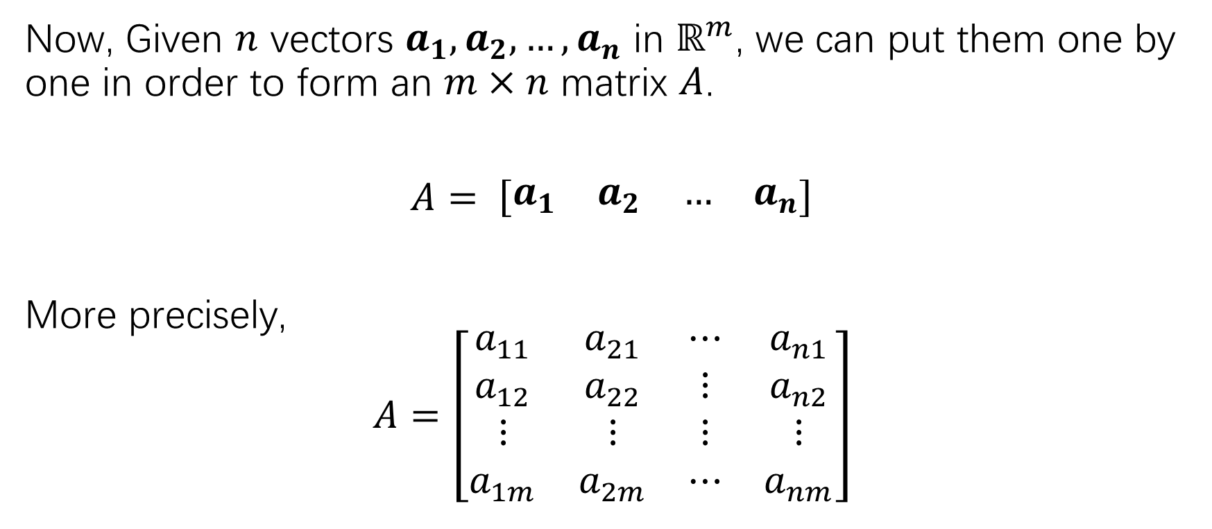
Matrix as a collection of column vectors
Now, Given $n$ vectors $a_{1},a_{2},…,a_{n}$ in $ℝ^{m}$, we can put them one by one in order to form an $m×n$ matrix $A$.
$A= \left[\begin{matrix}a_{1} & a_{2} & … & a_{n}\end{matrix}\right]$
More precisely,
$$A=\left[\begin{matrix}a_{11} & a_{21} & ⋯ & a_{n1} \\ a_{12} & a_{22} & ⋮ & a_{n2} \\ ⋮ & ⋮ & ⋮ & ⋮ \\ a_{1m} & a_{2m} & ⋯ & a_{nm}\end{matrix}\right]$$

Slide 4
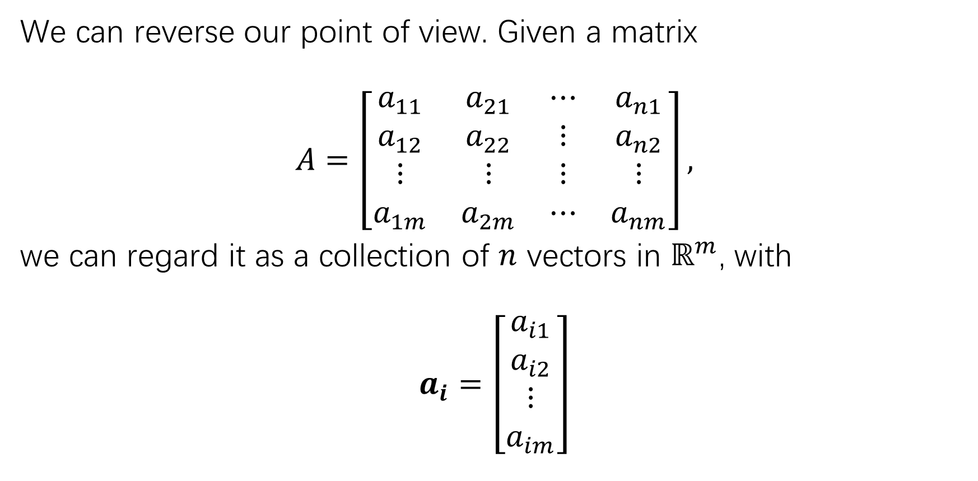
Matrix as a collection of column vectors
We can reverse our point of view. Given a matrix
$$A=\left[\begin{matrix}a_{11} & a_{21} & ⋯ & a_{n1} \\ a_{12} & a_{22} & ⋮ & a_{n2} \\ ⋮ & ⋮ & ⋮ & ⋮ \\ a_{1m} & a_{2m} & ⋯ & a_{nm}\end{matrix}\right],$$
we can regard it as a collection of $n$ vectors in $ℝ^{m}$, with
$$a_{i}=\left[\begin{matrix}a_{i1} \\ a_{i2} \\ ⋮ \\ a_{im}\end{matrix}\right]$$

Slide 5
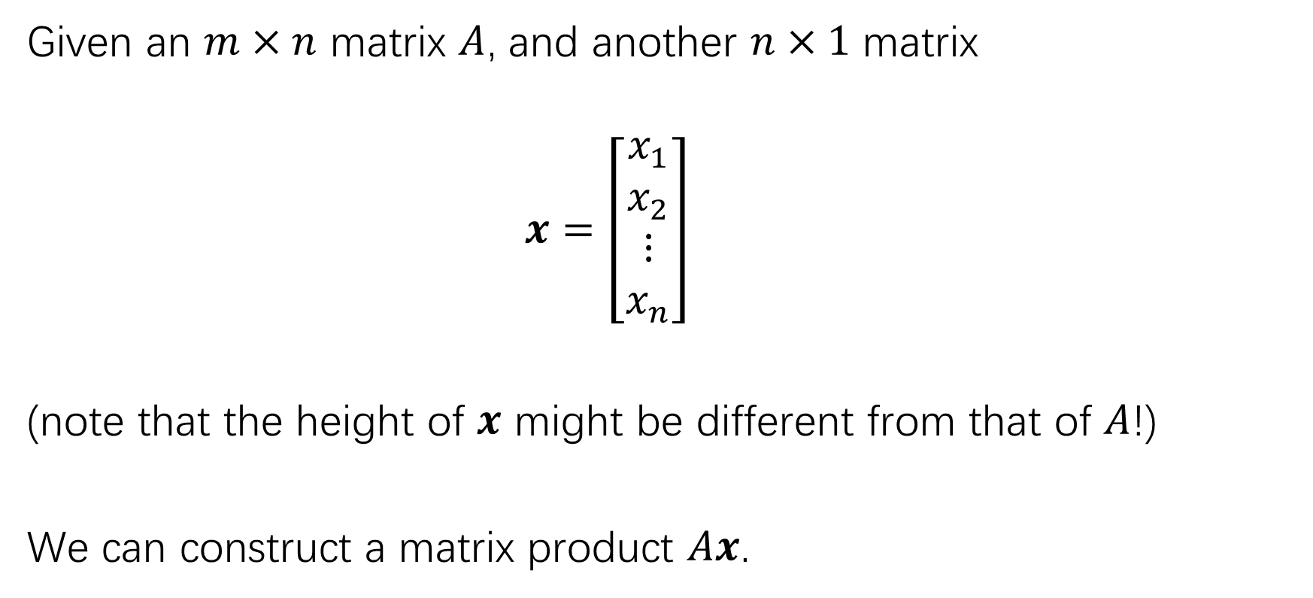
product
Given an $m×n$ matrix $A$, and another $n×1$ matrix
$x=\left[\begin{matrix}x_{1} \\ x_{2} \\ ⋮ \\ x_{n}\end{matrix}\right]$
(note that the height of $x$ might be different from that of $A$!)
We can construct a matrix product $Ax$.

Slide 6
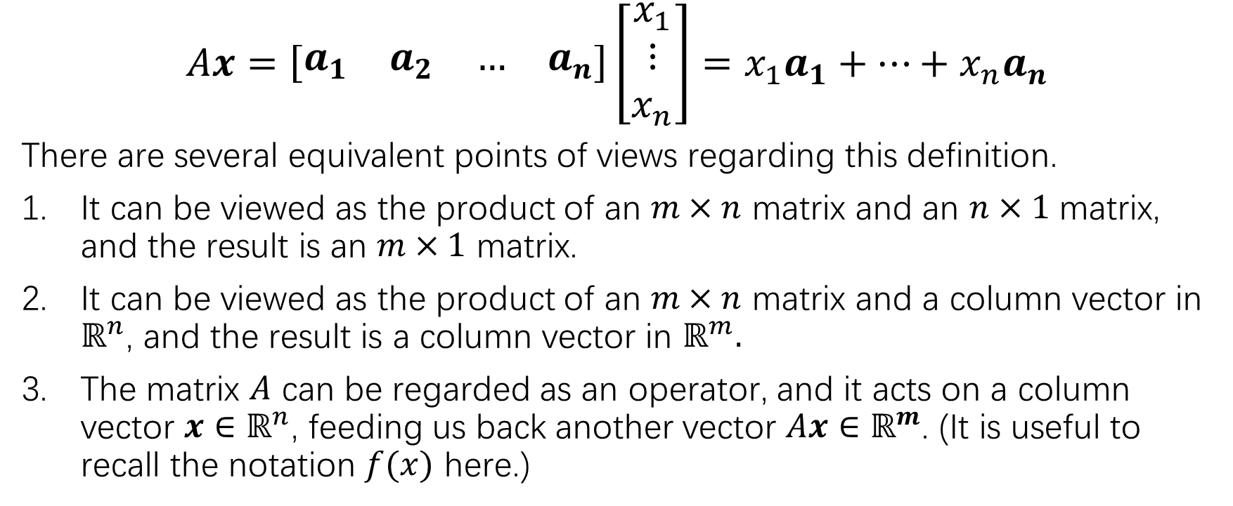
product
$$Ax=\left[\begin{matrix}a_{1} & a_{2} & … & a_{n}\end{matrix}\right]\left[\begin{matrix}x_{1} \\ ⋮ \\ x_{n}\end{matrix}\right]=x_{1}a_{1}+…+x_{n}a_{n}$$
There are several equivalent points of views regarding this definition.
It can be viewed as the product of an $m×n$ matrix and an $n×1$ matrix, and the result is an $m×1$ matrix.
It can be viewed as the product of an $m×n$ matrix and a column vector in $ℝ^{n}$, and the result is a column vector in $ℝ^{m}.$
The matrix $A$ can be regarded as an operator, and it acts on a column vector ${x∈ℝ}^{n}$, feeding us back another vector $Ax∈ℝ^{m}$. (It is useful to recall the notation $f(x)$ here.)

Slide 9
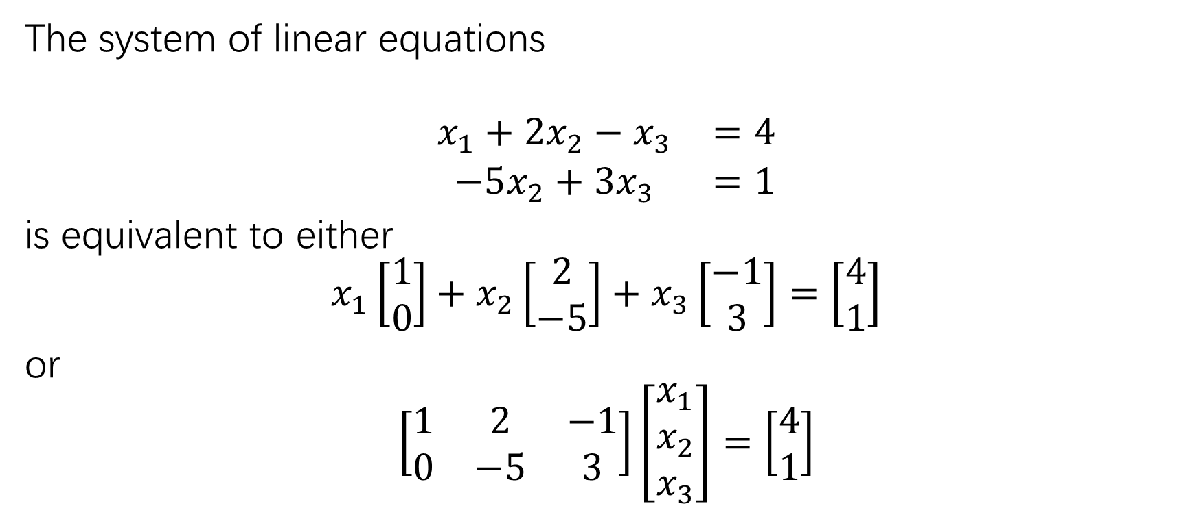
Three equivalent ways to express a system of linear equations
The system of linear equations
$$\begin{matrix}x_{1}+2x_{2}−x_{3} & =4 \\ −5x_{2}+3x_{3} & =1\end{matrix}$$
is equivalent to either
$$x_{1}\left[\begin{matrix}1 \\ 0\end{matrix}\right]+x_{2}\left[\begin{matrix}2 \\ −5\end{matrix}\right]+x_{3}\left[\begin{matrix}−1 \\ 3\end{matrix}\right]=\left[\begin{matrix}4 \\ 1\end{matrix}\right]$$
or
$$\left[\begin{matrix}1 & 2 & −1 \\ 0 & −5 & 3\end{matrix}\right]\left[\begin{matrix}x_{1} \\ x_{2} \\ x_{3}\end{matrix}\right]=\left[\begin{matrix}4 \\ 1\end{matrix}\right]$$

Slide 10
Three equivalent ways to express a system of linear equations
In the future, we will switch frequently and freely among the following 3 types of mathematical objects:
Systems of linear equations
Vector equations
Matrix equations
Note also that the matrix appearing in c) is nothing but the coefficient matrix of the system in a).

Slide 11
Three equivalent ways to express a system of linear equations
Since the 3 types of the mathematical objects are equivalent, they have the same set of solutions.

Slide 12
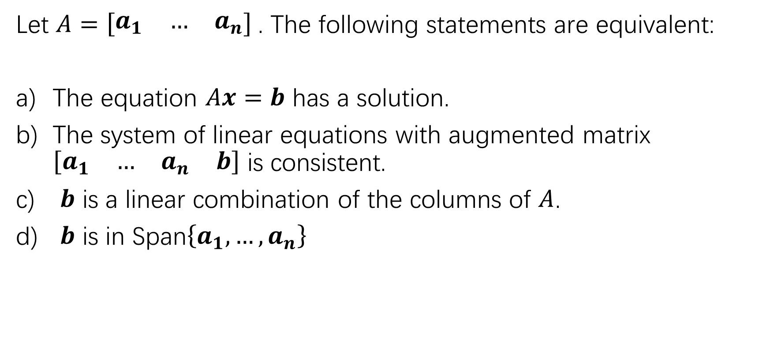
Existence of solutions
Let $A=\left[\begin{matrix}a_{1} & … & a_{n}\end{matrix}\right]$. The following statements are equivalent:
The equation $Ax=b$ has a solution.
The system of linear equations with augmented matrix $\left[\begin{matrix}a_{1} & … & a_{n} & b\end{matrix}\right]$ is consistent.
$b$ is a linear combination of the columns of $A$.
$b$ is in Span$\left\{a_{1},…,a_{n}\right\}$

Slide 14
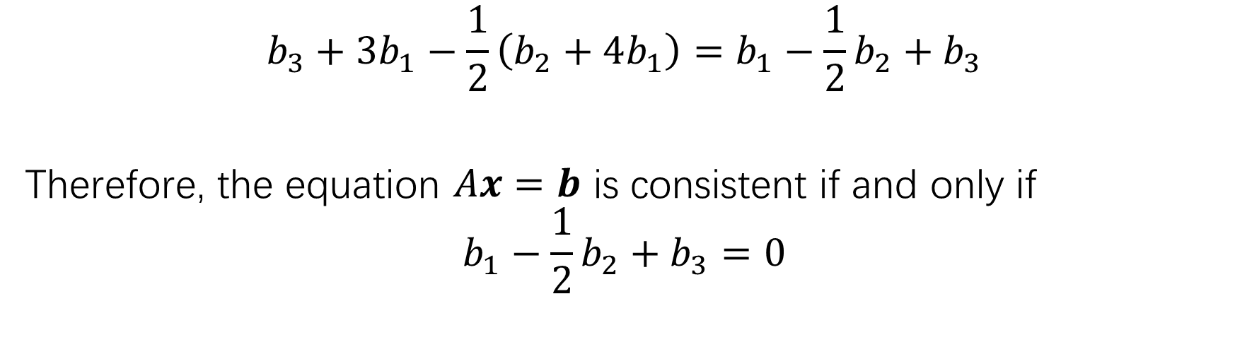
Consistency and span
$$b_{3}+3b_{1}−\frac{1}{2}\left(b_{2}+4b_{1}\right)=b_{1}−\frac{1}{2}b_{2}+b_{3}$$
Therefore, the equation $Ax=b$ is consistent if and only if
$$b_{1}−\frac{1}{2}b_{2}+b_{3}=0$$

Slide 15
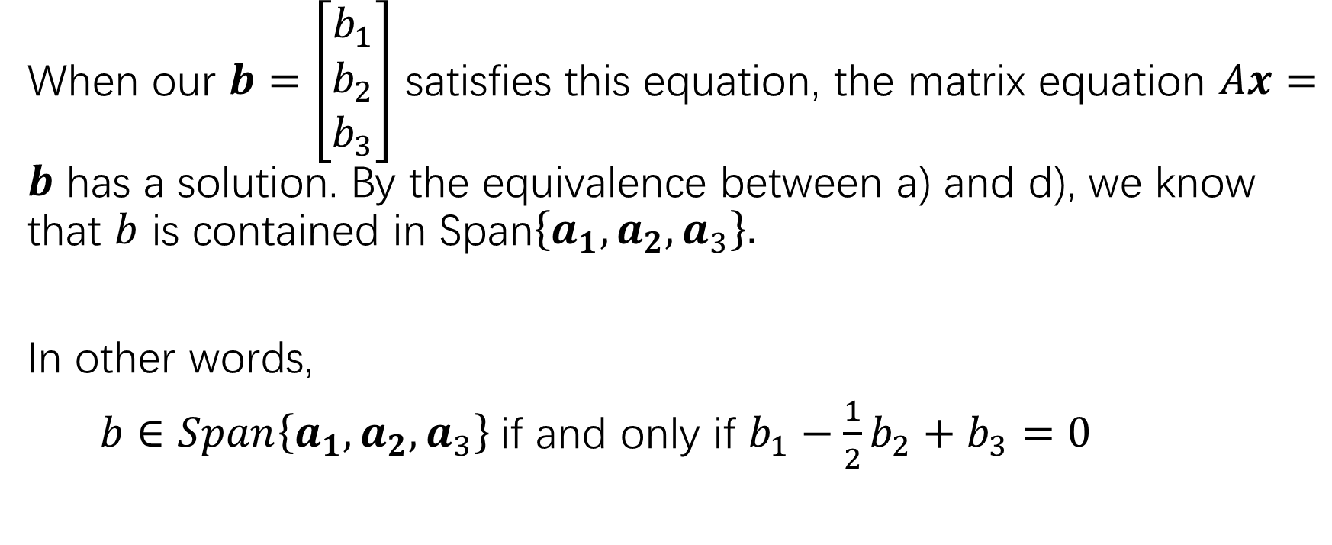
Consistency and span
When our $b=\left[\begin{matrix}b_{1} \\ b_{2} \\ b_{3}\end{matrix}\right]$ satisfies this equation, the matrix equation $Ax=b$ has a solution. By the equivalence between a) and d), we know that $b$ is contained in Span$\left\{a_{1},a_{2},a_{3}\right\}.$
In other words,
$b∈Span\left\{a_{1},a_{2},a_{3}\right\}$if and only if $b_{1}−\frac{1}{2}b_{2}+b_{3}=0$

Slide 16
Consistency and span

Slide 17
Consistency and span

Slide 18
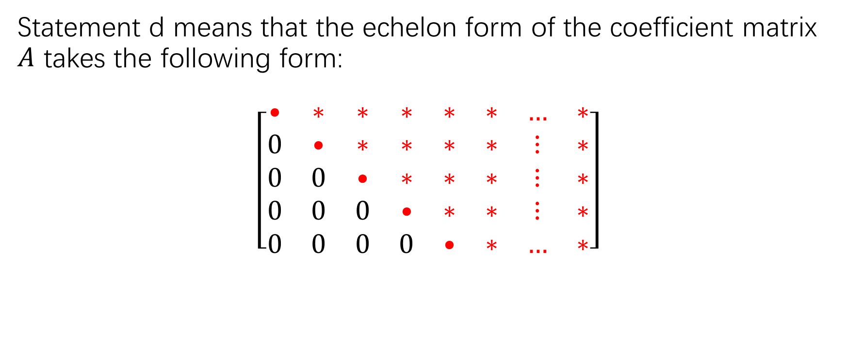
Consistency and span
Statement d means that the echelon form of the coefficient matrix $A$ takes the following form:
$$\left[\begin{matrix}• & ∗ & ∗ & ∗ & ∗ & ∗ & … & ∗ \\ 0 & • & ∗ & ∗ & ∗ & ∗ & ⋮ & ∗ \\ 0 & 0 & • & ∗ & ∗ & ∗ & ⋮ & ∗ \\ 0 & 0 & 0 & • & ∗ & ∗ & ⋮ & ∗ \\ 0 & 0 & 0 & 0 & • & ∗ & … & ∗\end{matrix}\right]$$

Slide 19
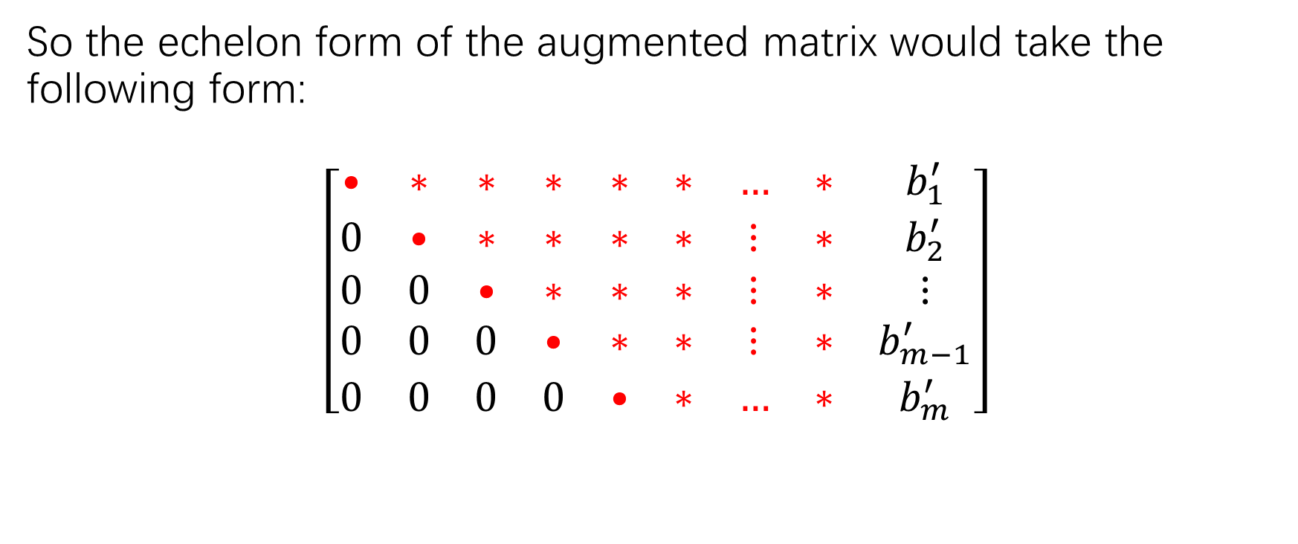
Consistency and span
So the echelon form of the augmented matrix would take the following form:
$$\left[\begin{matrix}• & ∗ & ∗ & ∗ & ∗ & ∗ & … & ∗ & b_{1}^{′} \\ 0 & • & ∗ & ∗ & ∗ & ∗ & ⋮ & ∗ & b_{2}^{′} \\ 0 & 0 & • & ∗ & ∗ & ∗ & ⋮ & ∗ & ⋮ \\ 0 & 0 & 0 & • & ∗ & ∗ & ⋮ & ∗ & b_{m−1}^{′} \\ 0 & 0 & 0 & 0 & • & ∗ & … & ∗ & b_{m}^{′}\end{matrix}\right]$$

Slide 20
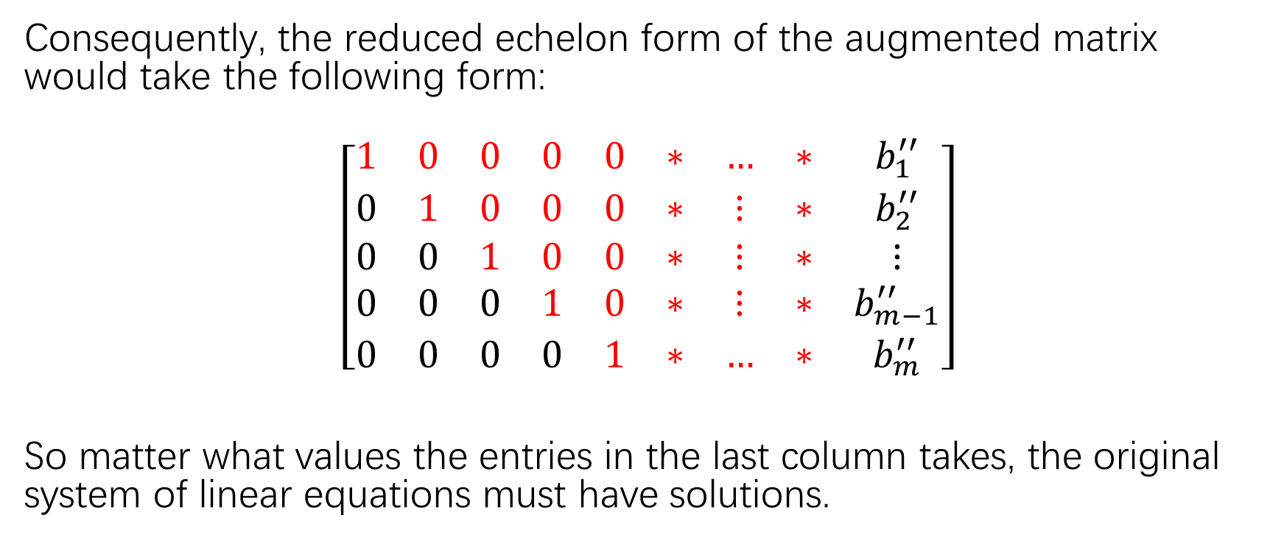
Consistency and span
Consequently, the reduced echelon form of the augmented matrix would take the following form:
$$\left[\begin{matrix}1 & 0 & 0 & 0 & 0 & ∗ & … & ∗ & b_{1}^{′′} \\ 0 & 1 & 0 & 0 & 0 & ∗ & ⋮ & ∗ & b_{2}^{′′} \\ 0 & 0 & 1 & 0 & 0 & ∗ & ⋮ & ∗ & ⋮ \\ 0 & 0 & 0 & 1 & 0 & ∗ & ⋮ & ∗ & b_{m−1}^{′′} \\ 0 & 0 & 0 & 0 & 1 & ∗ & … & ∗ & b_{m}^{′′}\end{matrix}\right]$$
So matter what values the entries in the last column takes, the original system of linear equations must have solutions.

Slide 21
An effective way to compute the matrix product

Slide 22
An effective way to compute the matrix product

Slide 23
An effective way to compute the matrix product

Slide 24
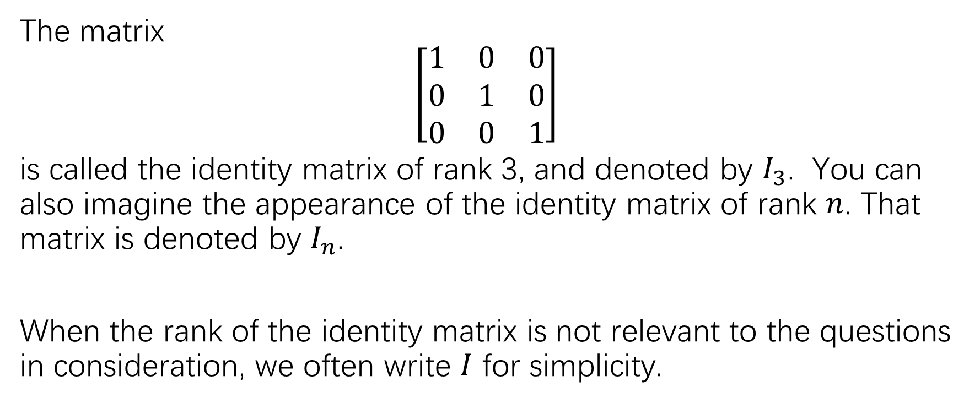
An effective way to compute the matrix product
The matrix
$$\left[\begin{matrix}1 & 0 & 0 \\ 0 & 1 & 0 \\ 0 & 0 & 1\end{matrix}\right]$$
is called the identity matrix of rank 3, and denoted by $I_{3}$. You can also imagine the appearance of the identity matrix of rank $n$. That matrix is denoted by $I_{n}$.
When the rank of the identity matrix is not relevant to the questions in consideration, we often write $I$ for simplicity.

Slide 25
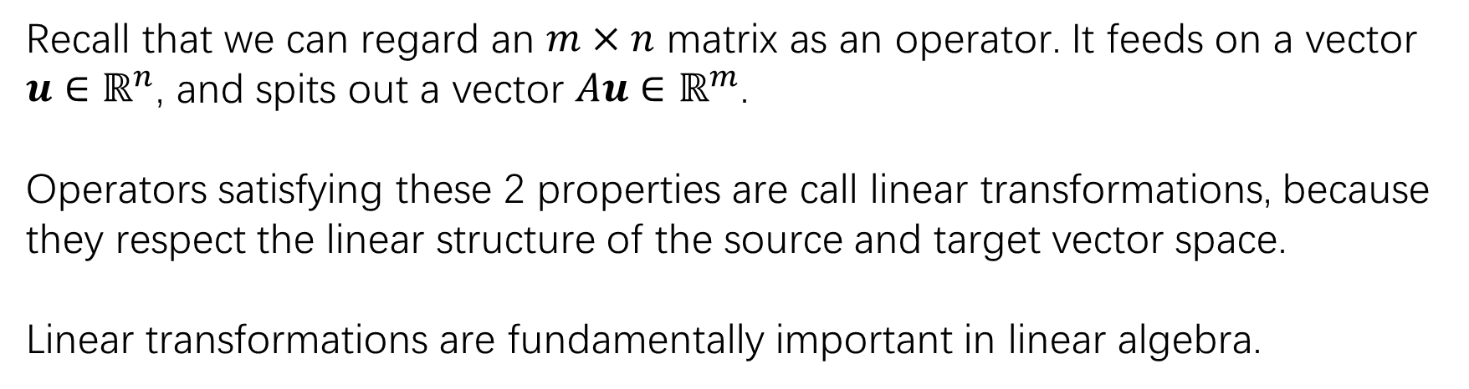
Properties of matrix-vector product
Recall that we can regard an $m×n$ matrix as an operator. It feeds on a vector $u∈ℝ^{n}$, and spits out a vector $Au∈ℝ^{m}$.
Operators satisfying these 2 properties are call linear transformations, because they respect the linear structure of the source and target vector space.
Linear transformations are fundamentally important in linear algebra.

Slide 26
Exercise
Page 40: 1-4, 13
Page 41: 15,16,23,24,25,26

Slide 29
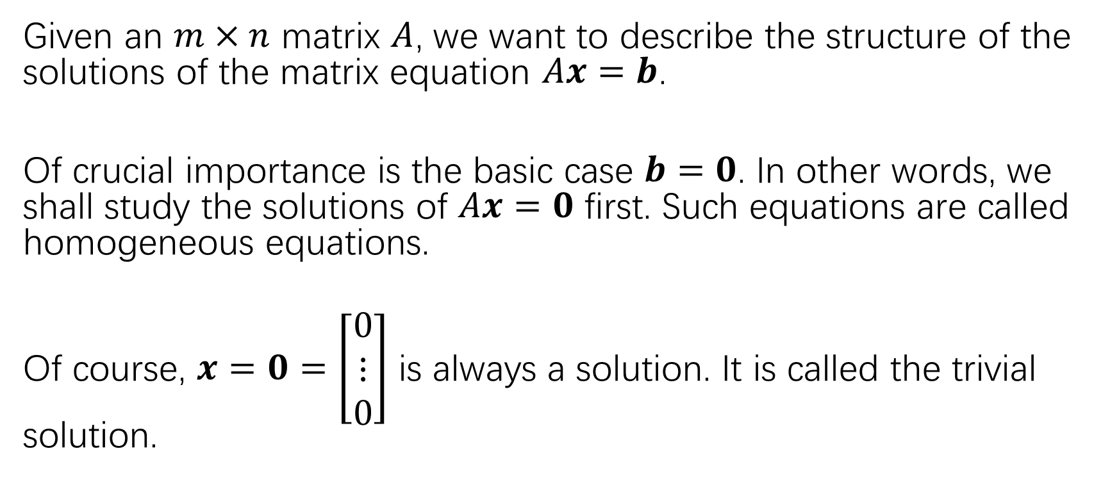
Solution sets of linear systems
Given an $m×n$ matrix $A$, we want to describe the structure of the solutions of the matrix equation $Ax=b$.
Of crucial importance is the basic case $b=0$. In other words, we shall study the solutions of $Ax=0$ first. Such equations are called homogeneous equations.
Of course, $x=0=\left[\begin{matrix}0 \\ ⋮ \\ 0\end{matrix}\right]$ is always a solution. It is called the trivial solution.

Slide 30
It is clear that the system is consistent, as it should be. (Since homogeneous equations always have a solution.) To solve the system, we need to move on to find the reduced echelon form of the matrix.

Slide 31
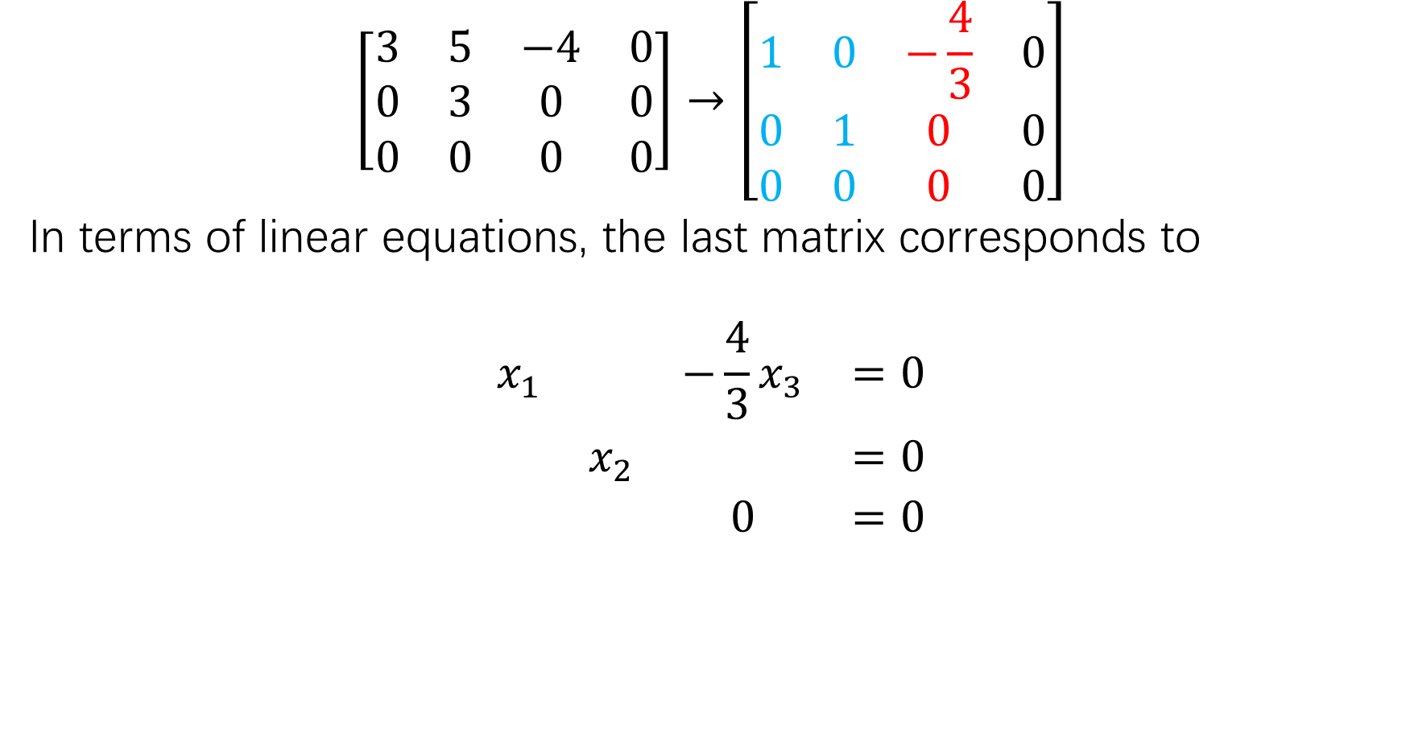
$$\left[\begin{matrix}3 & 5 & −4 & 0 \\ 0 & 3 & 0 & 0 \\ 0 & 0 & 0 & 0\end{matrix}\right]→\left[\begin{matrix}1 & 0 & −\frac{4}{3} & 0 \\ 0 & 1 & 0 & 0 \\ 0 & 0 & 0 & 0\end{matrix}\right]$$
In terms of linear equations, the last matrix corresponds to
$$\begin{matrix}x_{1} & & −\frac{4}{3}x_{3} & =0 \\ & x_{2} & & =0 \\ & & 0 & =0\end{matrix}$$

Slide 32
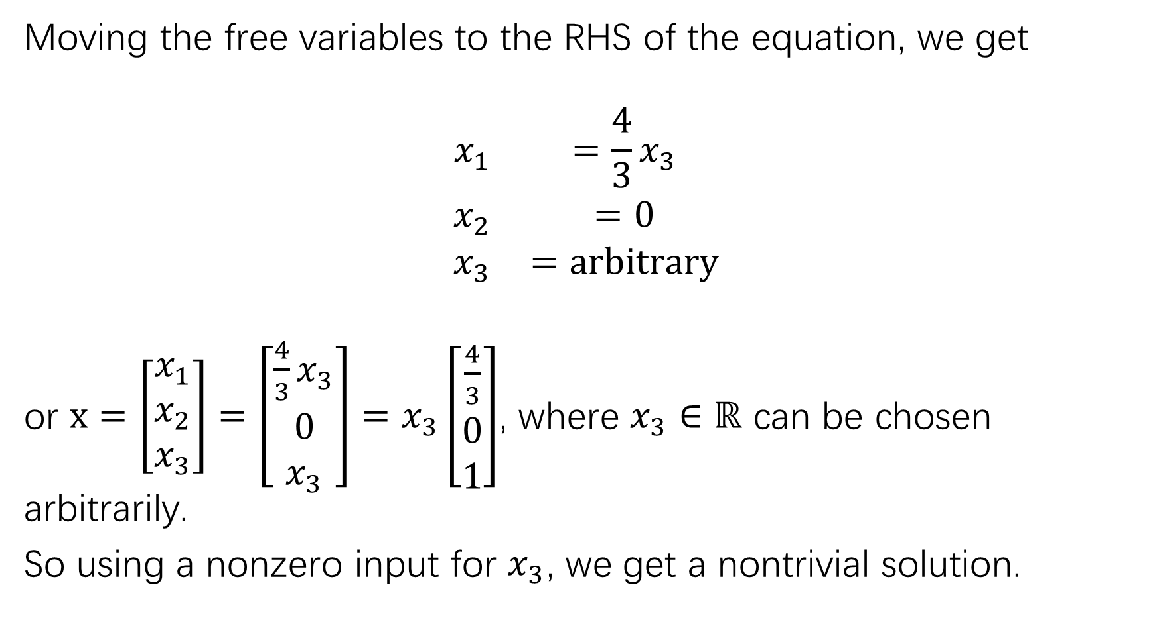
Moving the free variables to the RHS of the equation, we get
$$\begin{matrix}x_{1} & =\frac{4}{3}x_{3} \\ x_{2} & =0 \\ x_{3} & =arbitrary\end{matrix}$$
or $x=\left[\begin{matrix}x_{1} \\ x_{2} \\ x_{3}\end{matrix}\right]=\left[\begin{matrix}\frac{4}{3}x_{3} \\ 0 \\ x_{3}\end{matrix}\right]=x_{3}\left[\begin{matrix}\frac{4}{3} \\ 0 \\ 1\end{matrix}\right]$, where $x_{3}∈ℝ$ can be chosen arbitrarily.
So using a nonzero input for $x_{3}$, we get a nontrivial solution.

Slide 33
Solutions of homogeneous linear system
Reviewing the procedure of solving homogeneous systems, the following theorem is almost immediate:

