Slide 1
Linear Algebra
Lecturer: Xia Liao
Email: xliao@hqu.edu.cn
Homepage: https://hirzebruch.github.io/main.html
Time: every Tuesday 1-2, Thursday 3-4

Slide 2
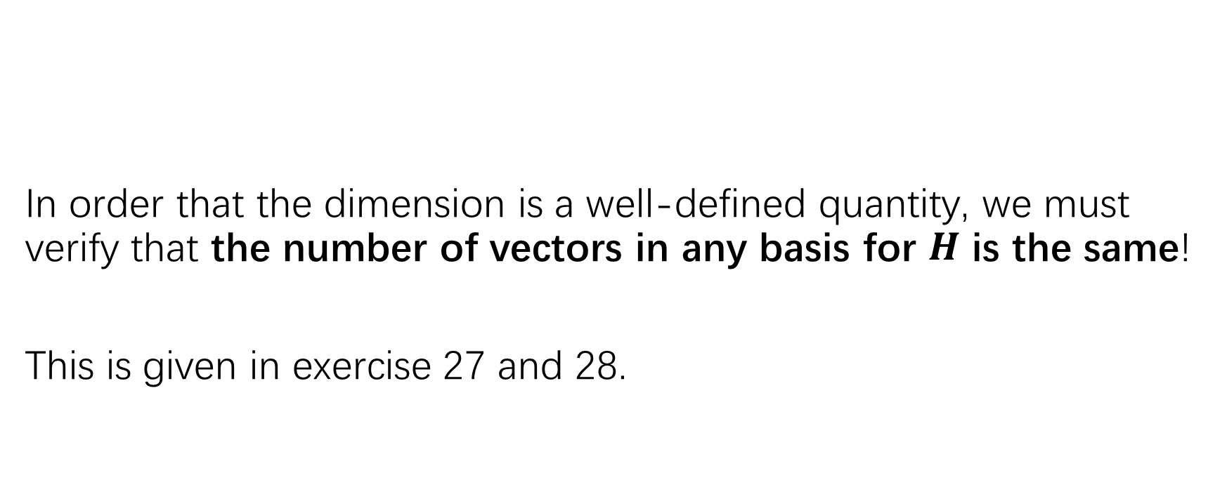
The dimension of a subspace
In order that the dimension is a well-defined quantity, we must verify that the number of vectors in any basis for $H$ is the same!
This is given in exercise 27 and 28.

Slide 3
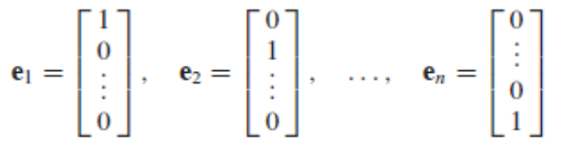
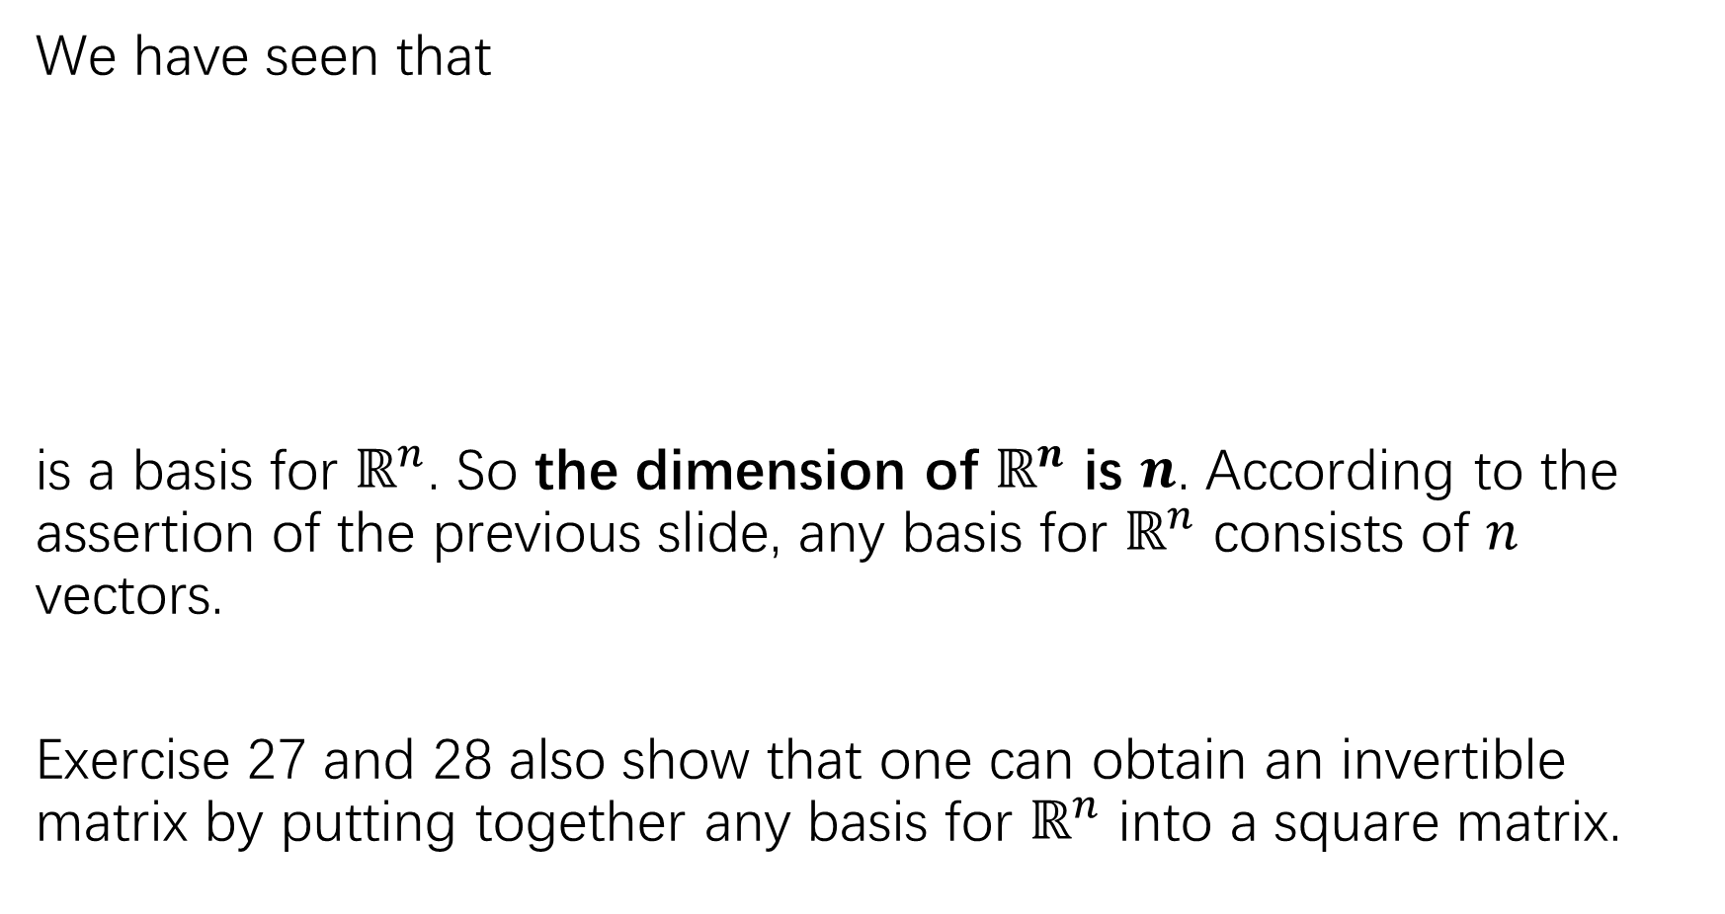
We have seen that
is a basis for $ℝ^{n}$. So the dimension of $ℝ^{n}$ is $n$. According to the assertion of the previous slide, any basis for $ℝ^{n}$ consists of $n$ vectors.
Exercise 27 and 28 also show that one can obtain an invertible matrix by putting together any basis for $ℝ^{n}$ into a square matrix.

Slide 4
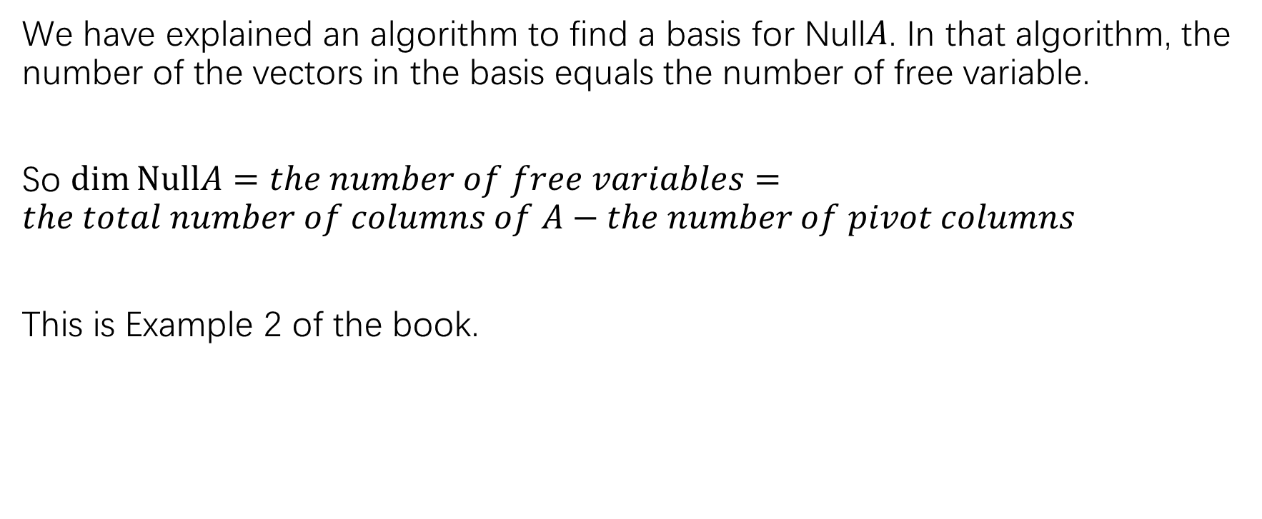

The dimension of Null$A$
We have explained an algorithm to find a basis for Null$A$. In that algorithm, the number of the vectors in the basis equals the number of free variable.
So $\dim{NullA}=the number of free variables=the total number of columns of A−the number of pivot columns$
This is Example 2 of the book.

Slide 5
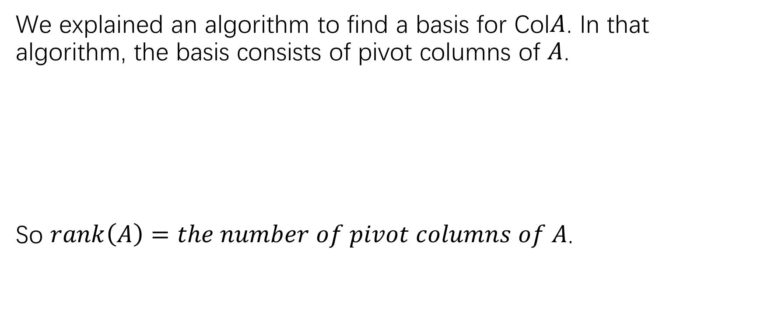

The dimension of Col$A$
We explained an algorithm to find a basis for Col$A$. In that algorithm, the basis consists of pivot columns of $A$.
So $rank\left(A\right)=the number of pivot columns of A$.

Slide 7
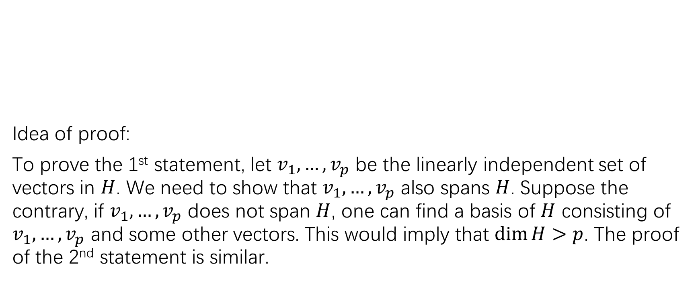
The Rank theorem
Idea of proof:
To prove the 1st statement, let $v_{1},…,v_{p}$ be the linearly independent set of vectors in $H$. We need to show that $v_{1},…,v_{p}$ also spans $H$. Suppose the contrary, if $v_{1},…,v_{p}$ does not span $H$, one can find a basis of $H$ consisting of $v_{1},…,v_{p}$ and some other vectors. This would imply that $\dim{H>p}$. The proof of the 2nd statement is similar.

Slide 8
Rank and the invertible matrix theorem
To test if a matrix is invertible, the most frequently used criterion is (c) (p).

Slide 9
Practice:
P166:15-18
P167: 19-24

Slide 10
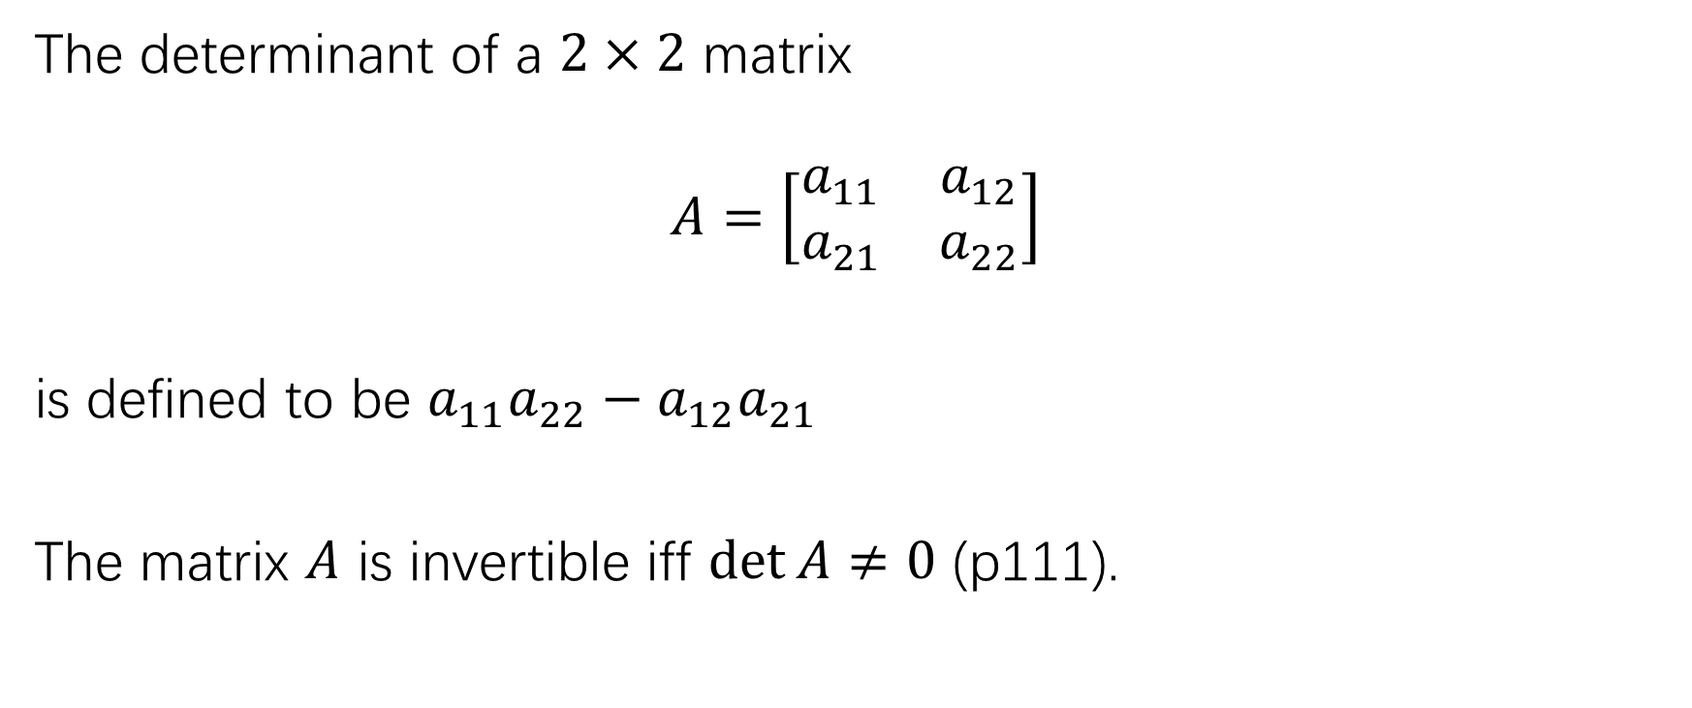

Determinant of a $2×2$ matrix
The determinant of a $2×2$ matrix
$$A=\left[\begin{matrix}a_{11} & a_{12} \\ a_{21} & a_{22}\end{matrix}\right]$$
is defined to be $a_{11}a_{22}−a_{12}a_{21}$
The matrix $A$ is invertible iff $\det{A≠0}$ (p111).

Slide 11
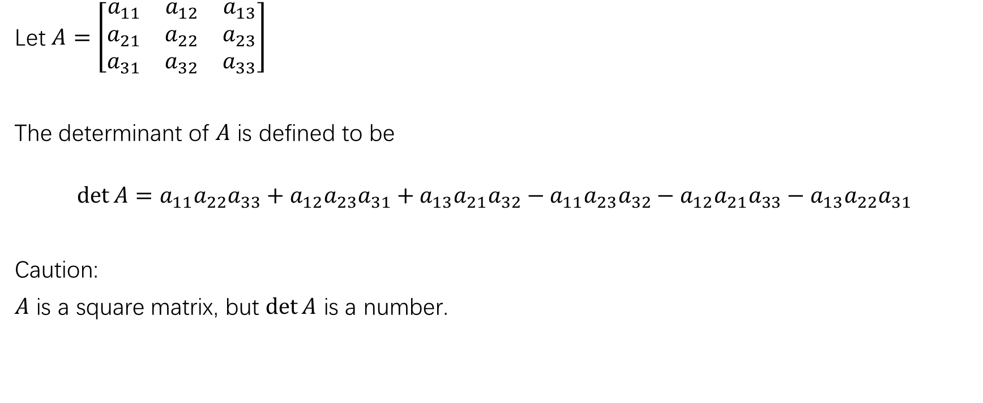

Determinant of a $3×3$ matrix
Let $A=\left[\begin{matrix}a_{11} & a_{12} & a_{13} \\ a_{21} & a_{22} & a_{23} \\ a_{31} & a_{32} & a_{33}\end{matrix}\right]$
The determinant of $A$ is defined to be
$$\det{A}=a_{11}a_{22}a_{33}+a_{12}a_{23}a_{31}+a_{13}a_{21}a_{32}−a_{11}a_{23}a_{32}−a_{12}a_{21}a_{33}−a_{13}a_{22}a_{31}$$
Caution:
$A$ is a square matrix, but $\det{A}$ is a number.

Slide 12

A useful way to memorize the formula of $\det{A}$

Slide 13
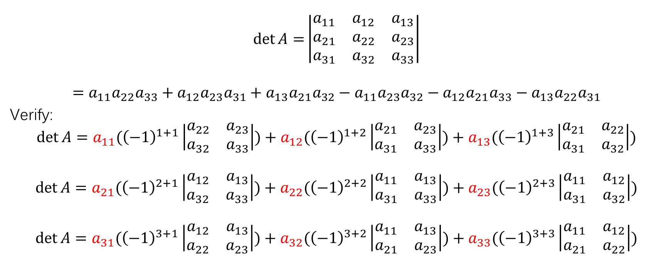

The relation between $3×3$ determinant and $2×2$ determinant
$$\det{A=}\left|\begin{matrix}a_{11} & a_{12} & a_{13} \\ a_{21} & a_{22} & a_{23} \\ a_{31} & a_{32} & a_{33}\end{matrix}\right|$$
$$=a_{11}a_{22}a_{33}+a_{12}a_{23}a_{31}+a_{13}a_{21}a_{32}−a_{11}a_{23}a_{32}−a_{12}a_{21}a_{33}−a_{13}a_{22}a_{31}$$
Verify:
$$\det{A}=a_{11}({\left(−1\right)}^{1+1}\left|\begin{matrix}a_{22} & a_{23} \\ a_{32} & a_{33}\end{matrix}\right|)+a_{12}({\left(−1\right)}^{1+2}\left|\begin{matrix}a_{21} & a_{23} \\ a_{31} & a_{33}\end{matrix}\right|)+a_{13}({\left(−1\right)}^{1+3}\left|\begin{matrix}a_{21} & a_{22} \\ a_{31} & a_{32}\end{matrix}\right|)$$
$$\det{A}=a_{21}({\left(−1\right)}^{2+1}\left|\begin{matrix}a_{12} & a_{13} \\ a_{32} & a_{33}\end{matrix}\right|)+a_{22}({\left(−1\right)}^{2+2}\left|\begin{matrix}a_{11} & a_{13} \\ a_{31} & a_{33}\end{matrix}\right|)+a_{23}({\left(−1\right)}^{2+3}\left|\begin{matrix}a_{11} & a_{12} \\ a_{31} & a_{32}\end{matrix}\right|)$$
$$\det{A}=a_{31}({\left(−1\right)}^{3+1}\left|\begin{matrix}a_{12} & a_{13} \\ a_{22} & a_{23}\end{matrix}\right|)+a_{32}({\left(−1\right)}^{3+2}\left|\begin{matrix}a_{11} & a_{13} \\ a_{21} & a_{23}\end{matrix}\right|)+a_{33}({\left(−1\right)}^{3+3}\left|\begin{matrix}a_{11} & a_{12} \\ a_{21} & a_{22}\end{matrix}\right|)$$

Slide 14
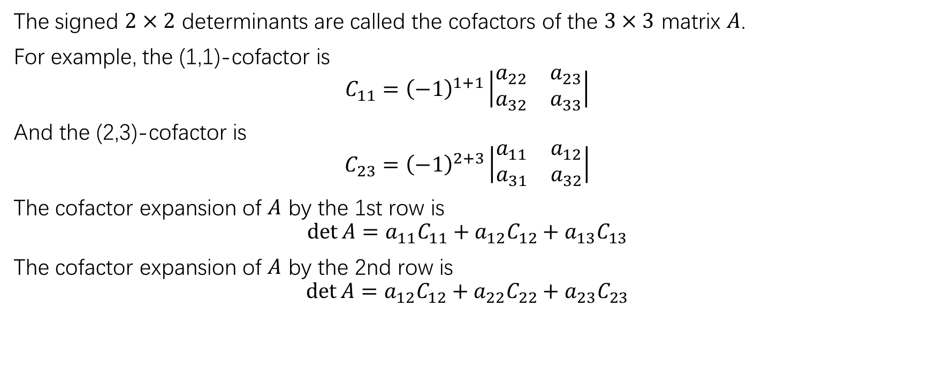
Cofactor expansion
The signed $2×2$ determinants are called the cofactors of the $3×3$ matrix $A$.
For example, the (1,1)-cofactor is
$${C_{11}=\left(−1\right)}^{1+1}\left|\begin{matrix}a_{22} & a_{23} \\ a_{32} & a_{33}\end{matrix}\right|$$
And the (2,3)-cofactor is
$$C_{23}={\left(−1\right)}^{2+3}\left|\begin{matrix}a_{11} & a_{12} \\ a_{31} & a_{32}\end{matrix}\right|$$
The cofactor expansion of $A$ by the 1st row is
$$\det{A=a_{11}C_{11}+a_{12}C_{12}+a_{13}C_{13}}$$
The cofactor expansion of $A$ by the 2nd row is
$$\det{A=a_{12}C_{12}+a_{22}C_{22}+a_{23}C_{23}}$$

Slide 17
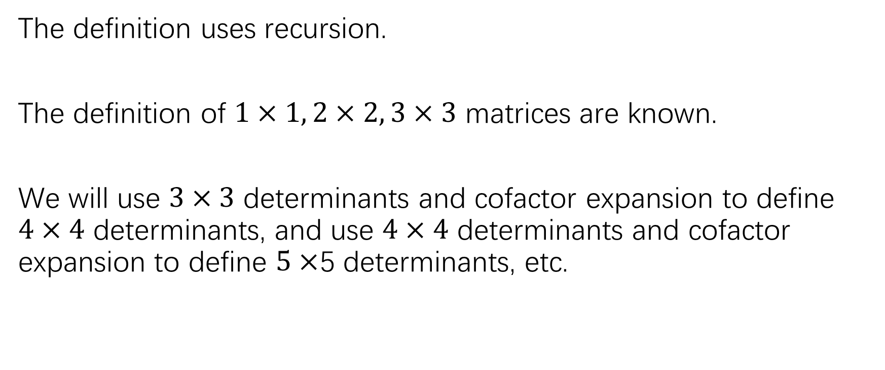

The definition of $n×n$ determinants
The definition uses recursion.
The definition of $1×1, 2×2, 3×3$ matrices are known.
We will use $3×3$ determinants and cofactor expansion to define $4×4$ determinants, and use $4×4$ determinants and cofactor expansion to define $5×$5 determinants, etc.

Slide 18
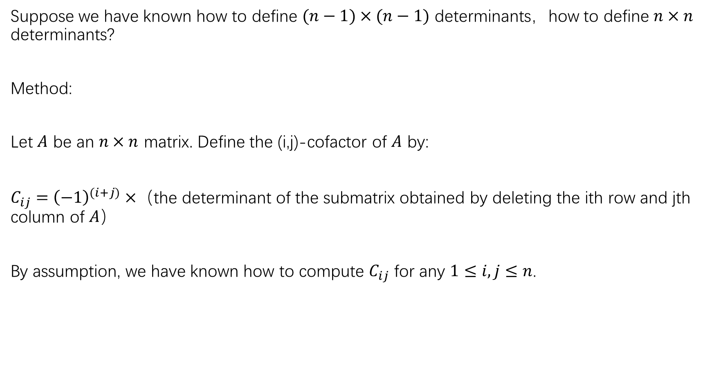
Suppose we have known how to define $(n−1)×(n−1)$ determinants，how to define $n×n$ determinants?
Method:
Let $A$ be an $n×n$ matrix. Define the (i,j)-cofactor of $A$ by:
$C_{ij}={\left(−1\right)}^{(i+j)}×$（the determinant of the submatrix obtained by deleting the ith row and jth column of $A$）
By assumption, we have known how to compute $C_{ij}$ for any $1≤i,j≤n$.

Slide 19
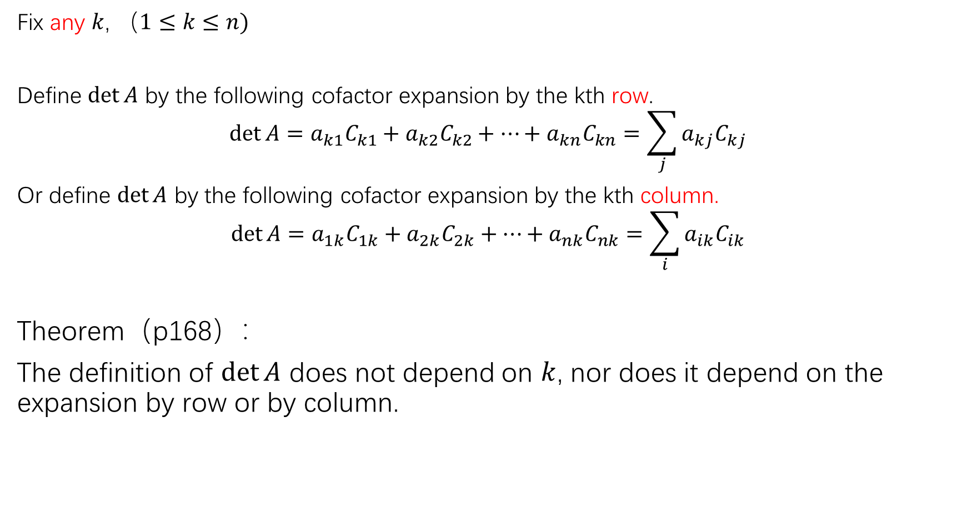
Fix any $k$, $（1≤k≤n)$
Define $\det{A}$ by the following cofactor expansion by the kth row.
$$\det{A}=a_{k1}C_{k1}+a_{k2}C_{k2}+…+a_{kn}C_{kn}=\sum_{j}{a_{kj}C_{kj}}$$
Or define $\det{A}$ by the following cofactor expansion by the kth column.
$$\det{A}=a_{1k}C_{1k}+a_{2k}C_{2k}+…+a_{nk}C_{nk}=\sum_{i}{a_{ik}C_{ik}}$$
Theorem（p168）：
The definition of $\det{A}$ does not depend on $k$, nor does it depend on the expansion by row or by column.

Slide 21
Determinants of upper or lower triangular matrices
The calculation done for the previous example motivates the following theorem.

Slide 22
HW:
P166:11,12
P181:1,2 (use two ways to compute as the text instructs)
P182:9,10,13

