Slide 1
Linear Algebra
Lecturer: Xia Liao
Email: xliao@hqu.edu.cn
Homepage: https://hirzebruch.github.io/main.html
Time: every Tuesday 1-2, Thursday 3-4

Slide 2
Vector space

Slide 3
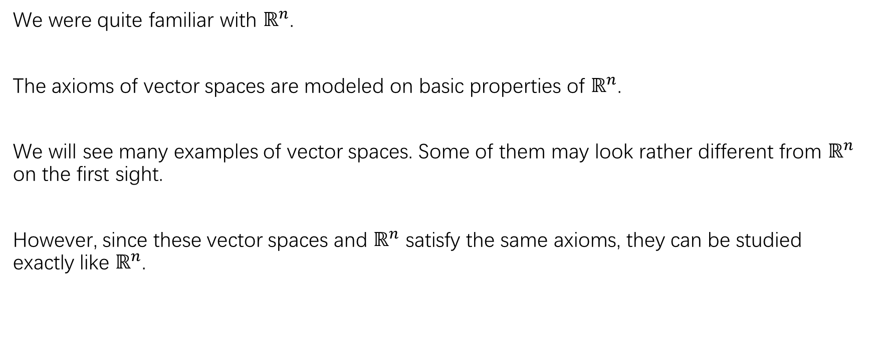
Vector space
We were quite familiar with $ℝ^{n}$.
The axioms of vector spaces are modeled on basic properties of $ℝ^{n}$.
We will see many examples of vector spaces. Some of them may look rather different from $ℝ^{n}$ on the first sight.
However, since these vector spaces and $ℝ^{n}$ satisfy the same axioms, they can be studied exactly like $ℝ^{n}$.

Slide 4
Some remarks

Slide 5
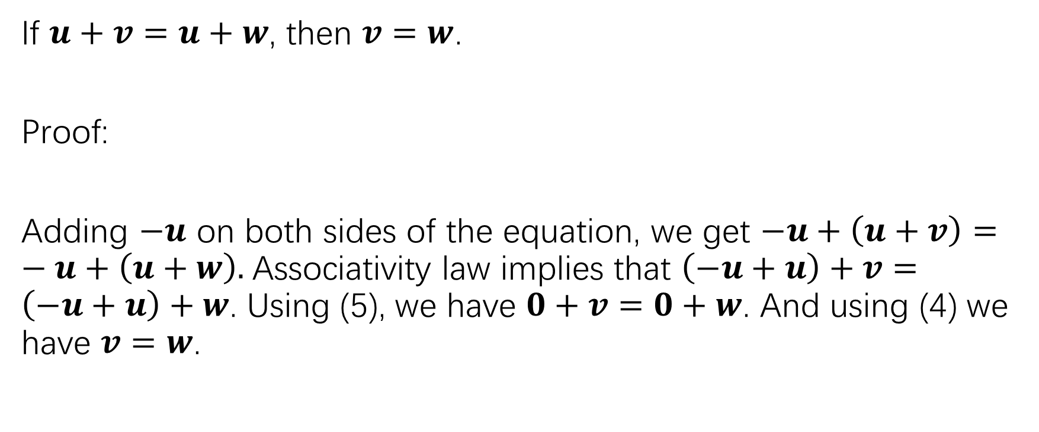
Cancellation law
If $u+v=u+w$, then $v=w$.
Proof:
Adding $−u$ on both sides of the equation, we get $−u+\left(u+v\right)=−u+\left(u+w\right).$Associativity law implies that $\left(−u+u\right)+v=\left(−u+u\right)+w$. Using (5), we have $0+v=0+w$. And using (4) we have $v=w$.

Slide 6
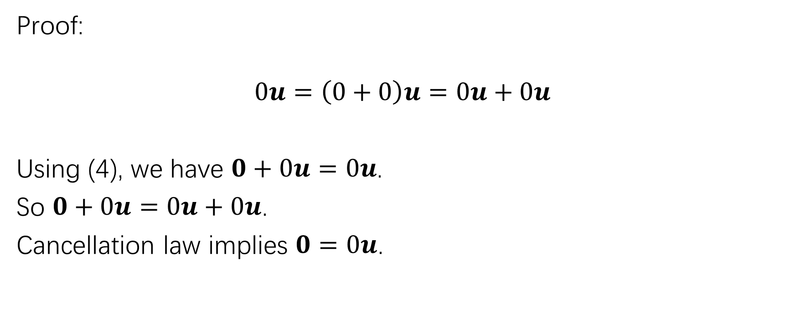
about (1)
Proof:
$$0u=\left(0+0\right)u=0u+0u$$
Using (4), we have $0+0u=0u$.
So $0+0u=0u+0u$.
Cancellation law implies $0=0u$.

Slide 7
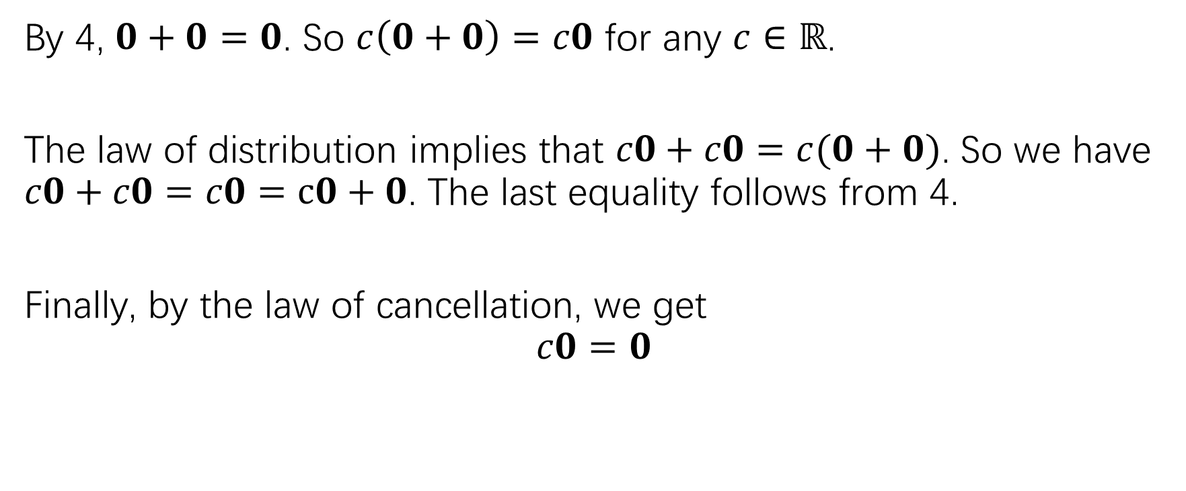
about (2)
By 4, $0+0=0$. So $c\left(0+0\right)=c0$ for any $c∈ℝ$.
The law of distribution implies that $c0+c0=c(0+0)$. So we have $c0+c0=c0=c0+0$. The last equality follows from 4.
Finally, by the law of cancellation, we get
$$c0=0$$

Slide 8
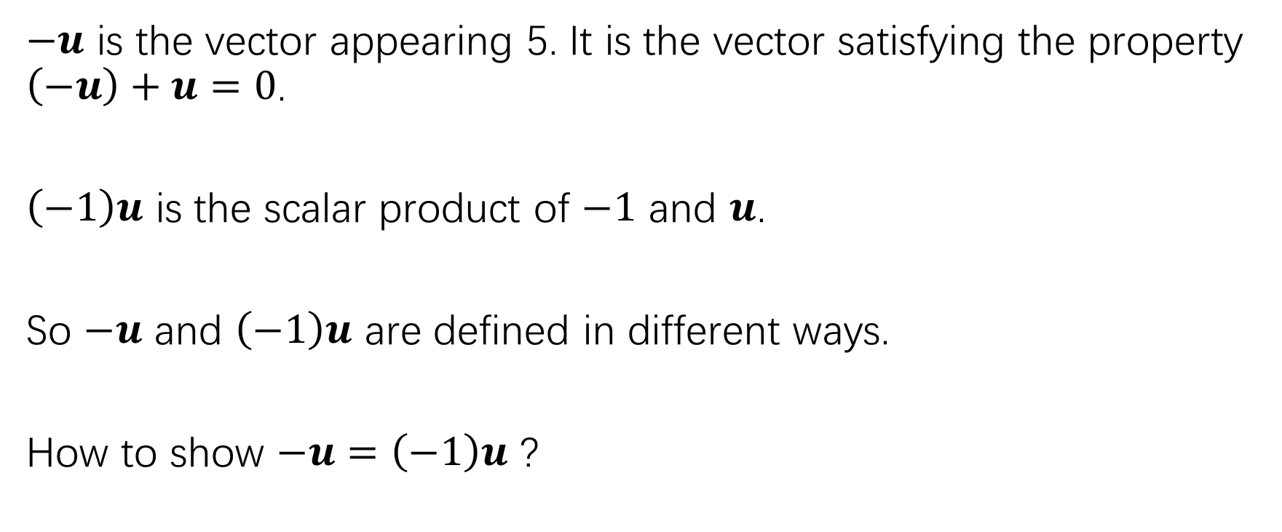
about (3)
$−u$ is the vector appearing 5. It is the vector satisfying the property $\left(−u\right)+u=0$.
$\left(−1\right)u$ is the scalar product of $−1$ and $u$.
So $−u$ and $\left(−1\right)u$ are defined in different ways.
How to show $−u=\left(−1\right)u$ ?

Slide 9
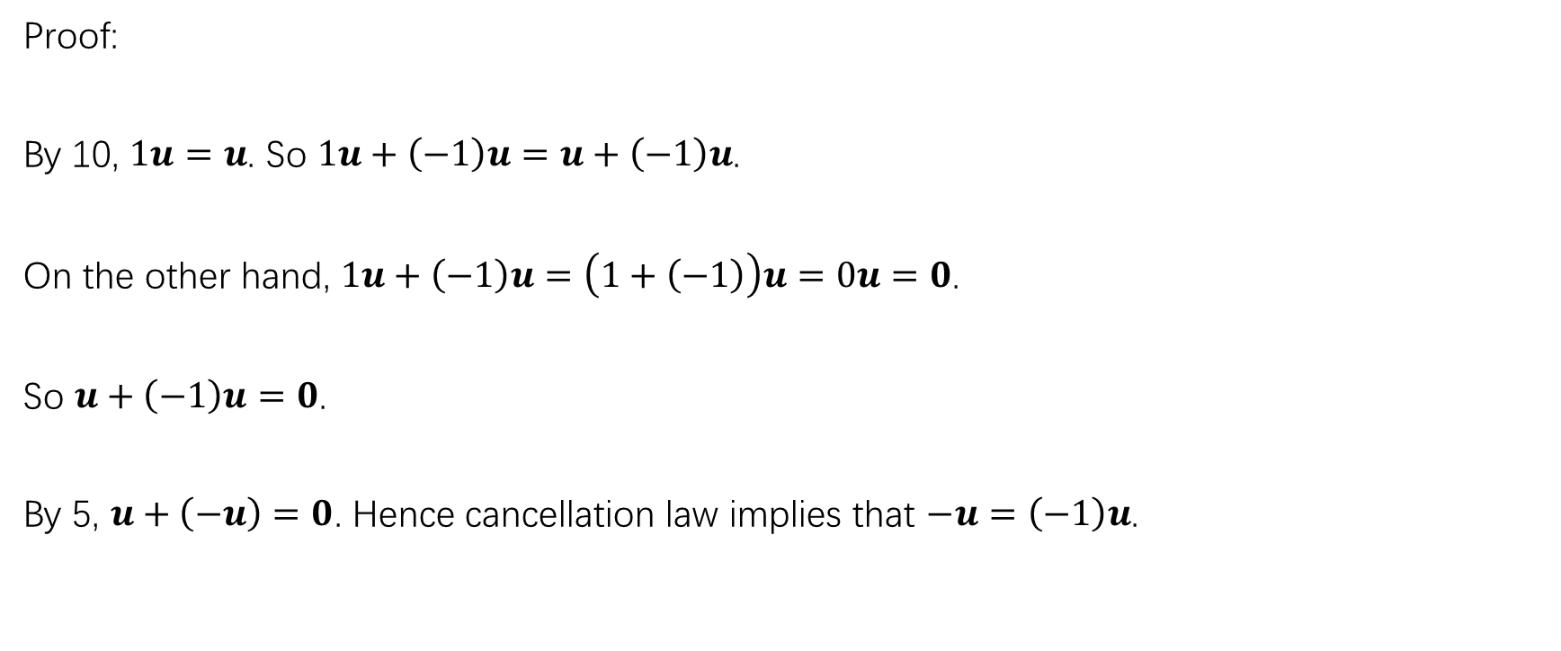
about (3)
Proof:
By 10, $1u=u$. So $1u+\left(−1\right)u=u+\left(−1\right)u$.
On the other hand, $1u+\left(−1\right)u=\left(1+\left(−1\right)\right)u=0u=0$.
So $u+\left(−1\right)u=0$.
By 5, $u+\left(−u\right)=0$. Hence cancellation law implies that $−u=\left(−1\right)u$.

Slide 17
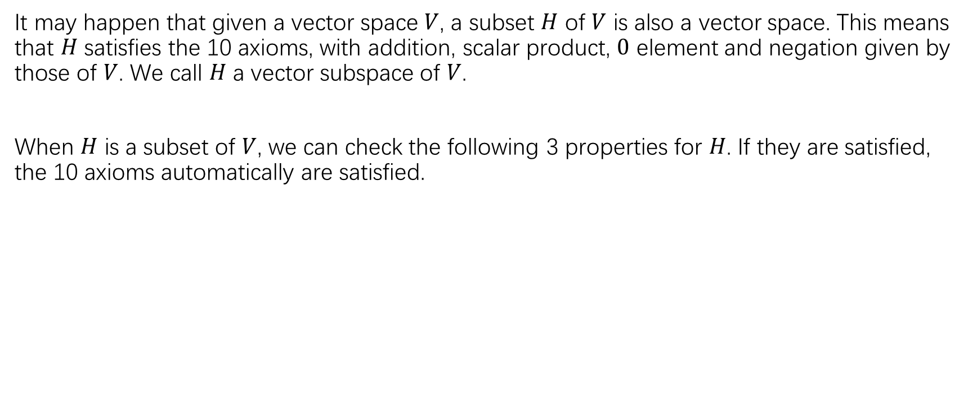
Vector subspace
It may happen that given a vector space $V$, a subset $H$ of $V$ is also a vector space. This means that $H$ satisfies the 10 axioms, with addition, scalar product, $0$ element and negation given by those of $V$. We call $H$ a vector subspace of $V$.
When $H$ is a subset of $V$, we can check the following 3 properties for $H$. If they are satisfied, the 10 axioms automatically are satisfied.

Slide 26
Exercise:
P211-212: 1-14
P212:20-24,32,33

Slide 27
Null space of a matrix

Slide 30
The column space of a matrix

Slide 31
Other descriptions of col A

Slide 32
The contrast between null A and col A

Slide 35
Linear transformation

Slide 36
Kernel and range

Slide 37
Exercise:
P222:5,6,15,16

