Slide 1
Linear Algebra
Lecturer: Xia Liao
Email: xliao@hqu.edu.cn
Homepage: https://hirzebruch.github.io/main.html
Time: every Tuesday 1-2, Thursday 3-4

Slide 2
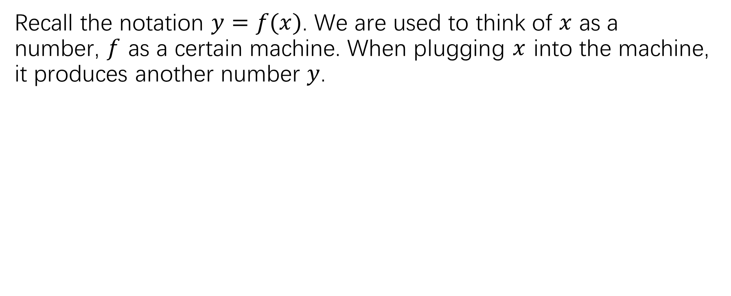
functions
Recall the notation $y=f(x)$. We are used to think of $x$ as a number, $f$ as a certain machine. When plugging $x$ into the machine, it produces another number $y$.
domain
range

Slide 3
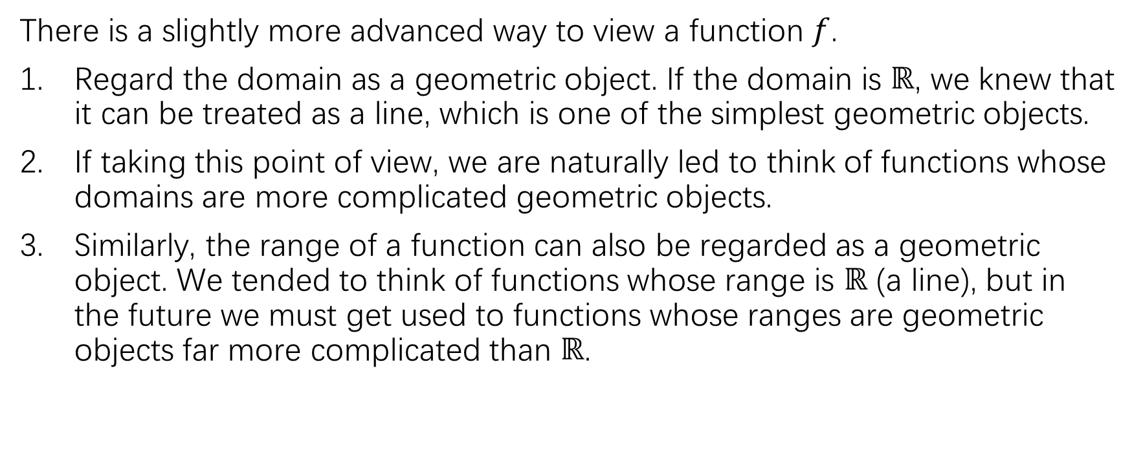
functions
There is a slightly more advanced way to view a function $f$.
Regard the domain as a geometric object. If the domain is $ℝ$, we knew that it can be treated as a line, which is one of the simplest geometric objects.
If taking this point of view, we are naturally led to think of functions whose domains are more complicated geometric objects.
Similarly, the range of a function can also be regarded as a geometric object. We tended to think of functions whose range is $ℝ$ (a line), but in the future we must get used to functions whose ranges are geometric objects far more complicated than $ℝ$.

Slide 4
Geometric objects
There is no mathematical definition of geometric object. However, it is rather safe to simply rely on our intuition.
Example:

Slide 5
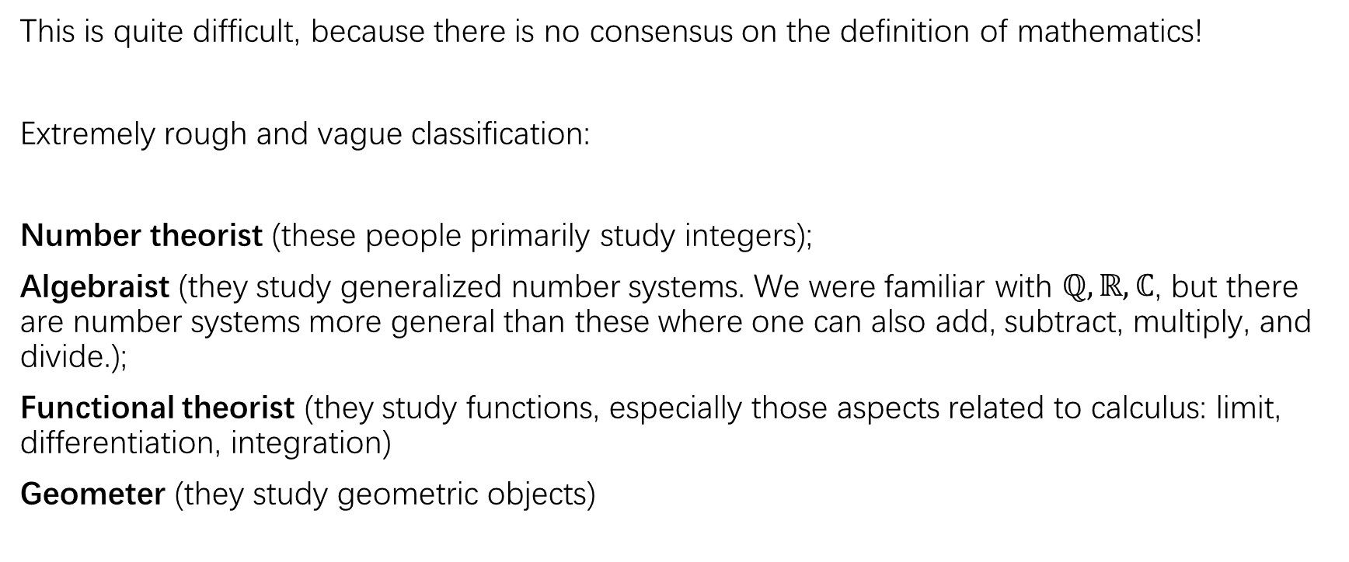
Classification of mathematicians
This is quite difficult, because there is no consensus on the definition of mathematics!
Extremely rough and vague classification:
Number theorist (these people primarily study integers);
Algebraist (they study generalized number systems. We were familiar with $ℚ,ℝ,ℂ$, but there are number systems more general than these where one can also add, subtract, multiply, and divide.);
Functional theorist (they study functions, especially those aspects related to calculus: limit, differentiation, integration)
Geometer (they study geometric objects)

Slide 6
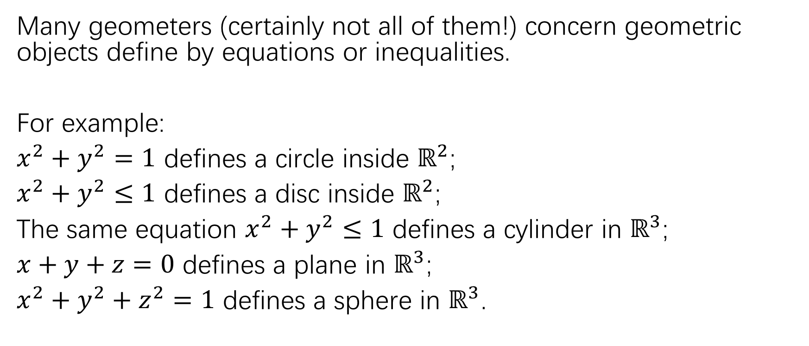
Geometric objects
Many geometers (certainly not all of them!) concern geometric objects define by equations or inequalities.
For example:
$x^{2}+y^{2}=1$ defines a circle inside $ℝ^{2}$;
$x^{2}+y^{2}≤1$ defines a disc inside $ℝ^{2}$;
The same equation $x^{2}+y^{2}≤1$ defines a cylinder in $ℝ^{3}$;
$x+y+z=0$ defines a plane in $ℝ^{3}$;
$x^{2}+y^{2}+z^{2}=1$ defines a sphere in $ℝ^{3}$.

Slide 7

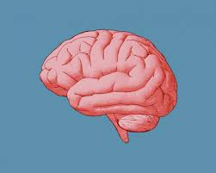
Geometric objects
There are also many geometric objects which are not naturally described by any equation or inequality.
For example, real world objects

Slide 8
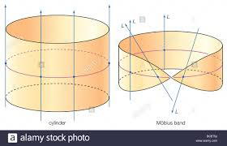
Geometric objects
Many geometric objects are much easier to describe by words than by equations:
For example, the shape obtained by gluing one pair of edges of a triangle:

Slide 9
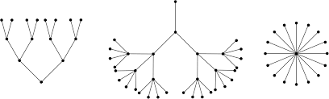
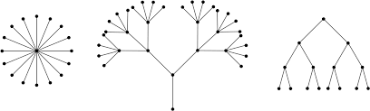
Geometric objects
Equations are usually not the most tool to describe objects in combinatorial geometry, like trees or polygons, because equations cannot capture the essential properties we care about them.

Slide 10
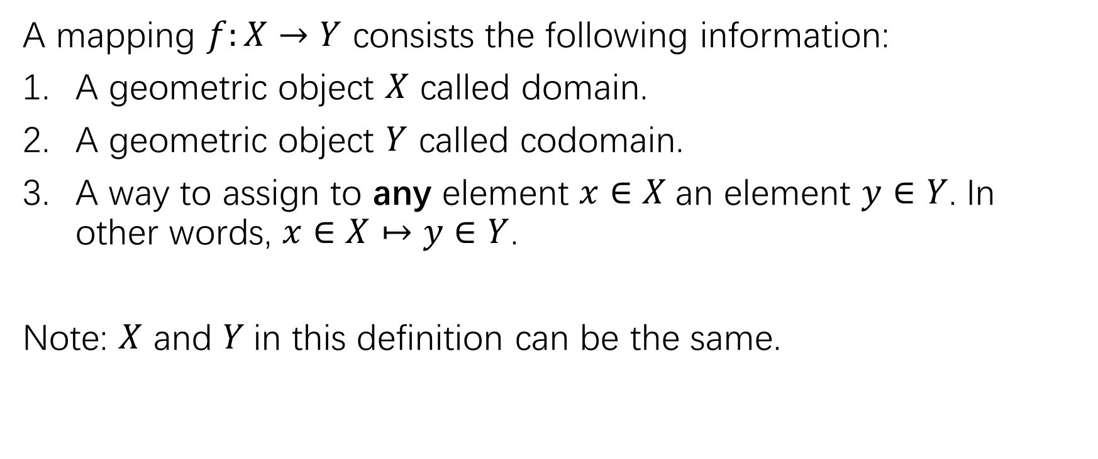
mappings
A mapping $f:X→Y$ consists the following information:
A geometric object $X$ called domain.
A geometric object $Y$ called codomain.
A way to assign to any element $x∈X$an element $y∈Y$. In other words, $x∈X↦y∈Y$.
Note: $X$ and $Y$in this definition can be the same.

Slide 11
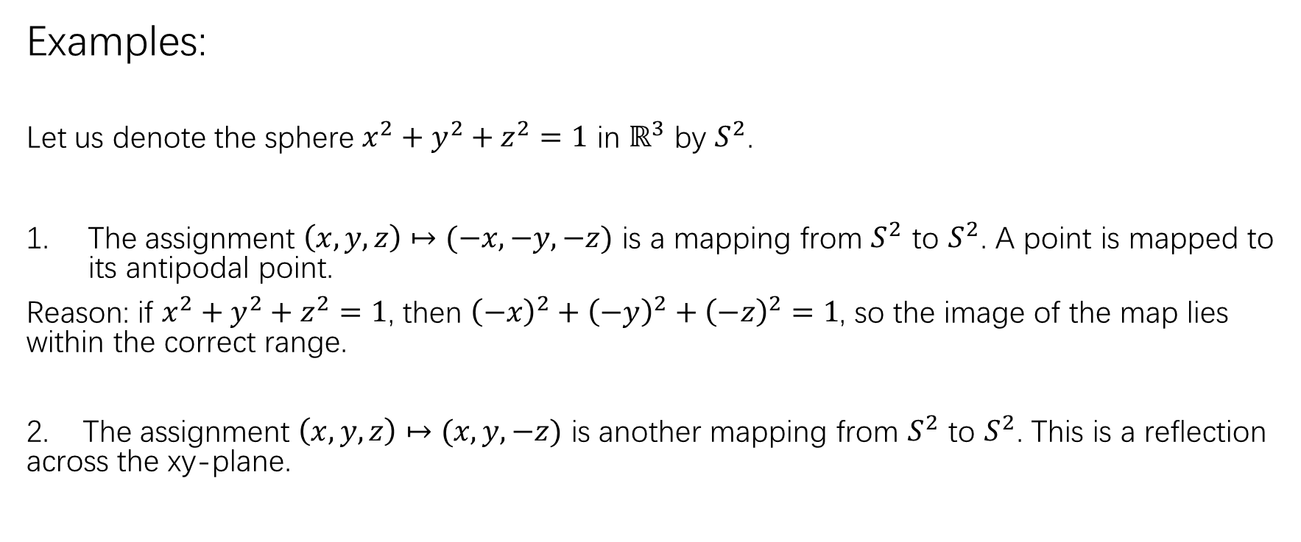
mappings
Examples:
Let us denote the sphere $x^{2}+y^{2}+z^{2}=1$ in $ℝ^{3}$ by $S^{2}$.
The assignment $\left(x,y,z\right)↦(−x,−y,−z)$ is a mapping from $S^{2}$ to $S^{2}$. A point is mapped to its antipodal point.
Reason: if $x^{2}+y^{2}+z^{2}=1$, then ${\left(−x\right)}^{2}+{\left(−y\right)}^{2}+{\left(−z\right)}^{2}=1$, so the image of the map lies within the correct range.
2. The assignment $\left(x,y,z\right)↦(x,y,−z)$ is another mapping from $S^{2}$ to $S^{2}$. This is a reflection across the xy-plane.

Slide 12
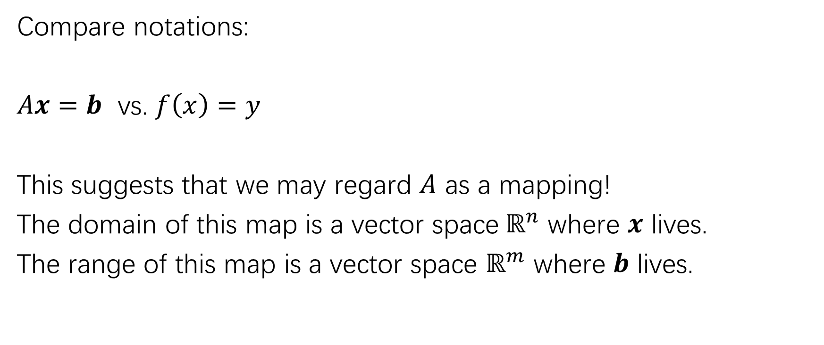
Defining mappings via matrices
Compare notations:
$Ax=b$ vs. $f\left(x\right)=y$
This suggests that we may regard $A$ as a mapping!
The domain of this map is a vector space$ℝ^{n}$ where $x$ lives.
The range of this map is a vector space $ℝ^{m}$ where $b$ lives.

Slide 13
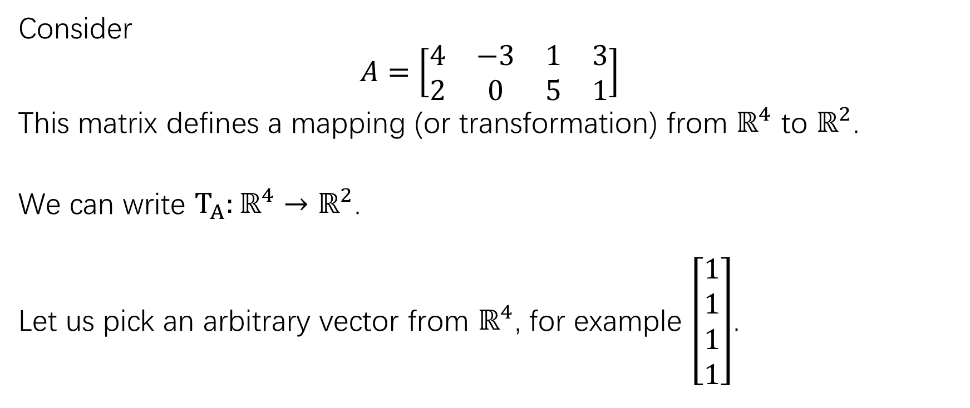
Defining mappings via matrices
Consider
$$A=\left[\begin{matrix}4 & −3 & 1 & 3 \\ 2 & 0 & 5 & 1\end{matrix}\right]$$
This matrix defines a mapping (or transformation) from $ℝ^{4}$ to $ℝ^{2}$.
We can write $T_{A}:ℝ^{4}→ℝ^{2}$.
Let us pick an arbitrary vector from $ℝ^{4}$, for example $\left[\begin{matrix}1 \\ 1 \\ 1 \\ 1\end{matrix}\right]$.

Slide 14
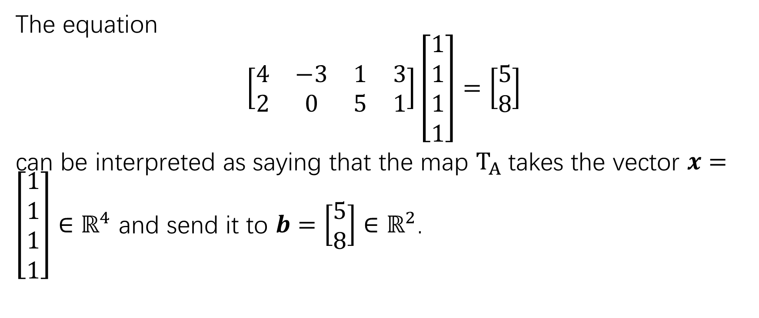
Defining mappings via matrices
The equation
$$\left[\begin{matrix}4 & −3 & 1 & 3 \\ 2 & 0 & 5 & 1\end{matrix}\right]\left[\begin{matrix}1 \\ 1 \\ 1 \\ 1\end{matrix}\right]=\left[\begin{matrix}5 \\ 8\end{matrix}\right]$$
can be interpreted as saying that the map $T_{A}$takes the vector $x=\left[\begin{matrix}1 \\ 1 \\ 1 \\ 1\end{matrix}\right]∈ℝ^{4}$ and send it to $b=\left[\begin{matrix}5 \\ 8\end{matrix}\right]∈ℝ^{2}$.

Slide 15
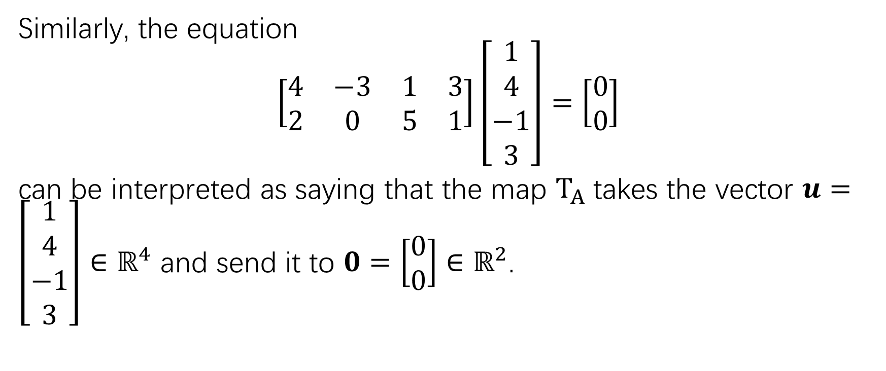
Defining mappings via matrices
Similarly, the equation
$$\left[\begin{matrix}4 & −3 & 1 & 3 \\ 2 & 0 & 5 & 1\end{matrix}\right]\left[\begin{matrix}1 \\ 4 \\ −1 \\ 3\end{matrix}\right]=\left[\begin{matrix}0 \\ 0\end{matrix}\right]$$
can be interpreted as saying that the map $T_{A}$takes the vector $u=\left[\begin{matrix}1 \\ 4 \\ −1 \\ 3\end{matrix}\right]∈ℝ^{4}$ and send it to $0=\left[\begin{matrix}0 \\ 0\end{matrix}\right]∈ℝ^{2}$.

Slide 16
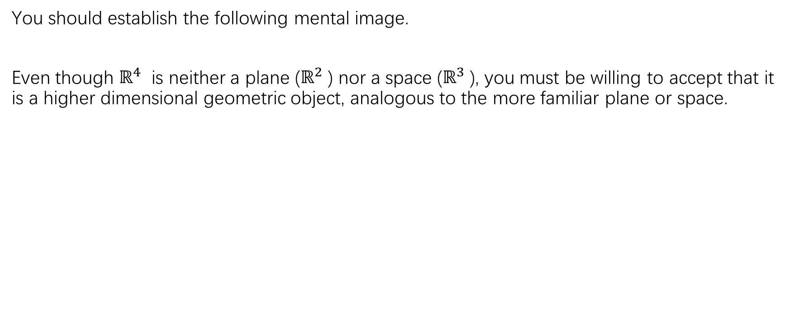
Defining mappings via matrices
You should establish the following mental image.
Even though $ℝ^{4}$ is neither a plane ($ℝ^{2}$) nor a space ($ℝ^{3}$), you must be willing to accept that it is a higher dimensional geometric object, analogous to the more familiar plane or space.

Slide 17
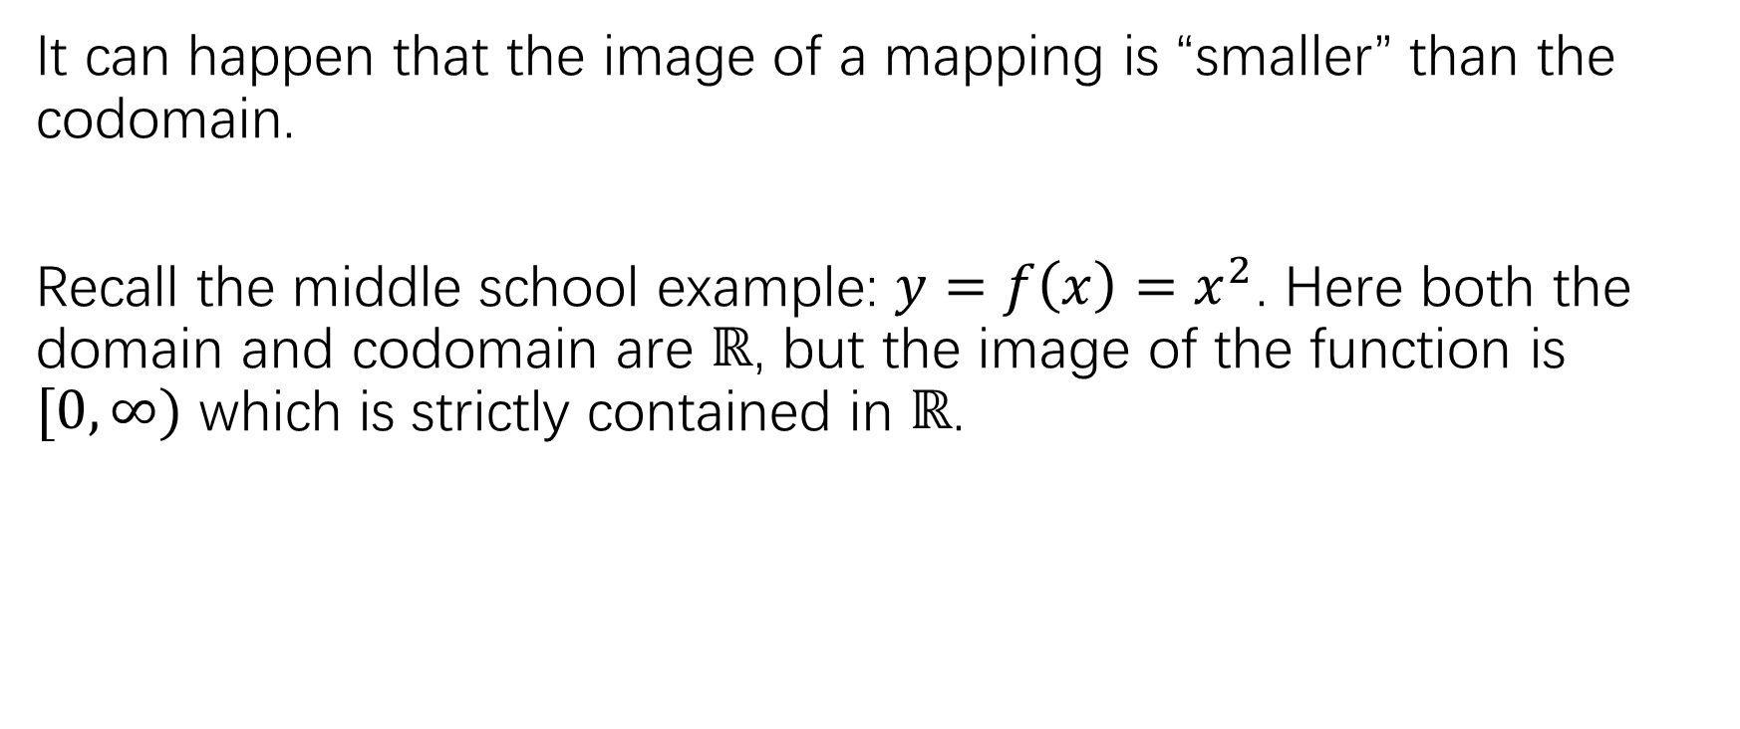
Defining mappings via matrices
It can happen that the image of a mapping is “smaller” than the codomain.
Recall the middle school example: $y=f\left(x\right)=x^{2}$. Here both the domain and codomain are $ℝ$, but the image of the function is $[0,∞)$ which is strictly contained in $ℝ$.

Slide 18
Defining mappings via matrices
In linear algebra, the following situation will arise frequently:

Slide 19
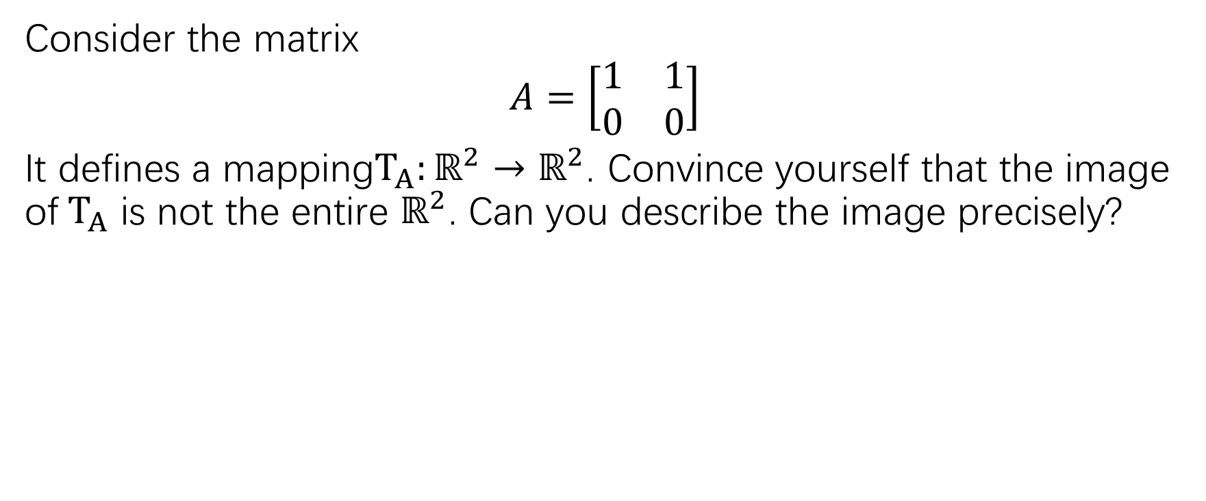
Defining mappings via matrices
Consider the matrix
$$A=\left[\begin{matrix}1 & 1 \\ 0 & 0\end{matrix}\right]$$
It defines a mapping$T_{A}:ℝ^{2}→ℝ^{2}$. Convince yourself that the image of${ T}_{A}$ is not the entire $ℝ^{2}$. Can you describe the image precisely?

Slide 20
Defining mappings via matrices

Slide 23
Defining mappings via matrices

Slide 24
Applications in image processing

Slide 25
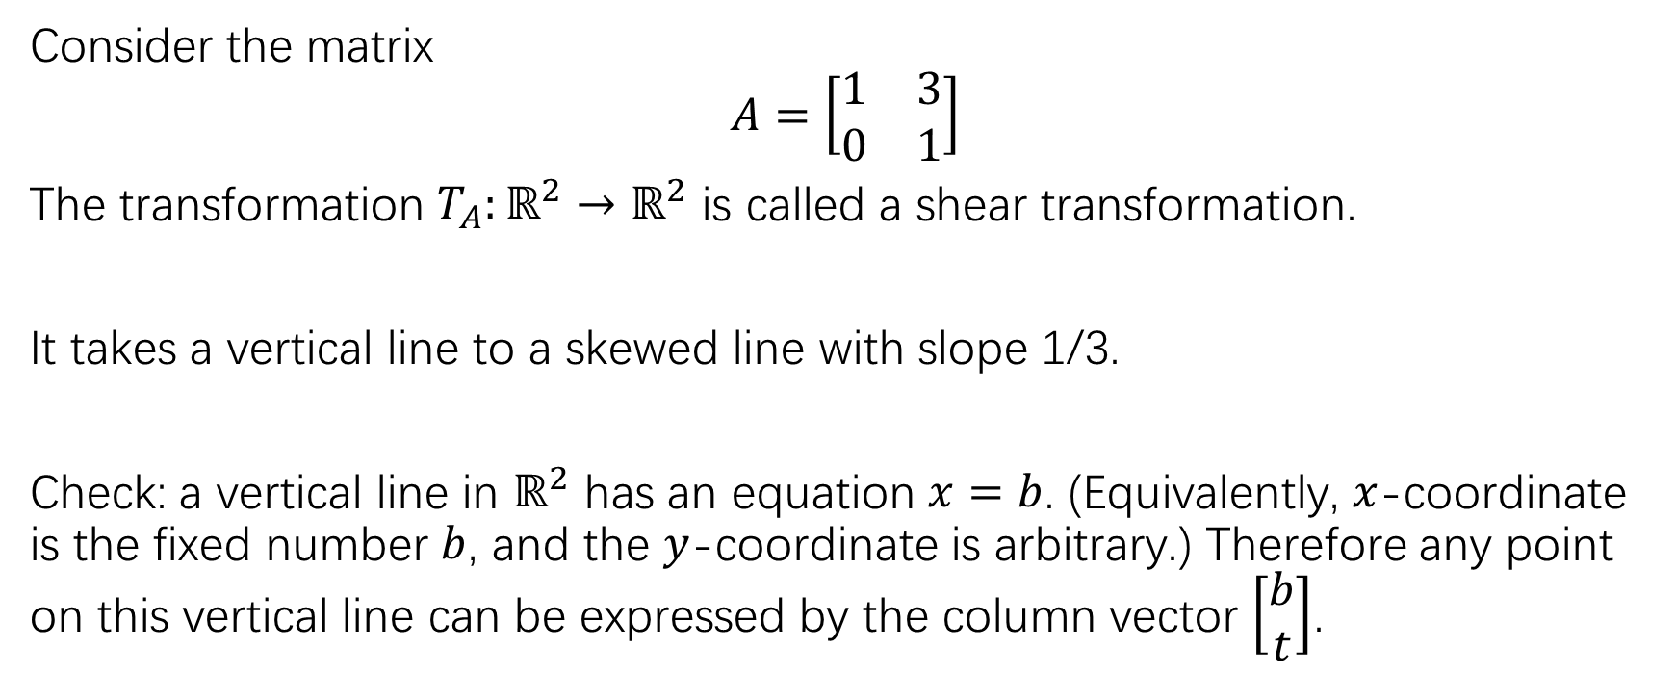
Applications in image processing
Consider the matrix
$$A=\left[\begin{matrix}1 & 3 \\ 0 & 1\end{matrix}\right]$$
The transformation $T_{A}:ℝ^{2}→ℝ^{2}$ is called a shear transformation.
It takes a vertical line to a skewed line with slope 1/3.
Check: a vertical line in $ℝ^{2}$ has an equation $x=b$. (Equivalently, $x$-coordinate is the fixed number $b$, and the $y$-coordinate is arbitrary.) Therefore any point on this vertical line can be expressed by the column vector $\left[\begin{matrix}b \\ t\end{matrix}\right]$.

Slide 26
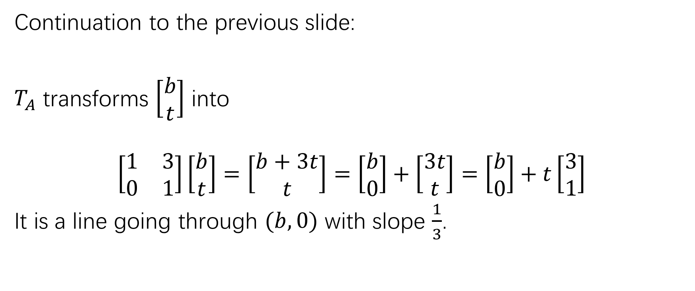
Applications in image processing
Continuation to the previous slide:
$T_{A}$ transforms $\left[\begin{matrix}b \\ t\end{matrix}\right]$ into
$$\left[\begin{matrix}1 & 3 \\ 0 & 1\end{matrix}\right]\left[\begin{matrix}b \\ t\end{matrix}\right]=\left[\begin{matrix}b+3t \\ t\end{matrix}\right]=\left[\begin{matrix}b \\ 0\end{matrix}\right]+\left[\begin{matrix}3t \\ t\end{matrix}\right]=\left[\begin{matrix}b \\ 0\end{matrix}\right]+t\left[\begin{matrix}3 \\ 1\end{matrix}\right]$$
It is a line going through $(b,0)$ with slope $\frac{1}{3}$.

Slide 27
Applications in image processing

Slide 28
Linear transformations
We learned in section 5 that the matrix-vector product satisfies the following properties:

Slide 29
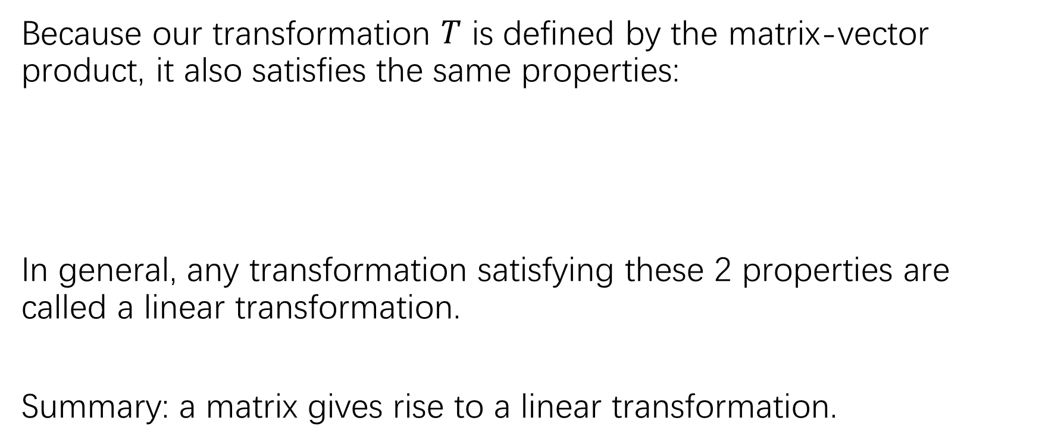
Linear transformations
Because our transformation $T$ is defined by the matrix-vector product, it also satisfies the same properties:
In general, any transformation satisfying these 2 properties are called a linear transformation.
Summary: a matrix gives rise to a linear transformation.

Slide 30
Linear transformations
(i): we can change the order of vector addition and transformation.
(ii) we can change the order of scalar multiplication and transformation.

Slide 31
Linear transformations
Some easy implications:

Slide 32
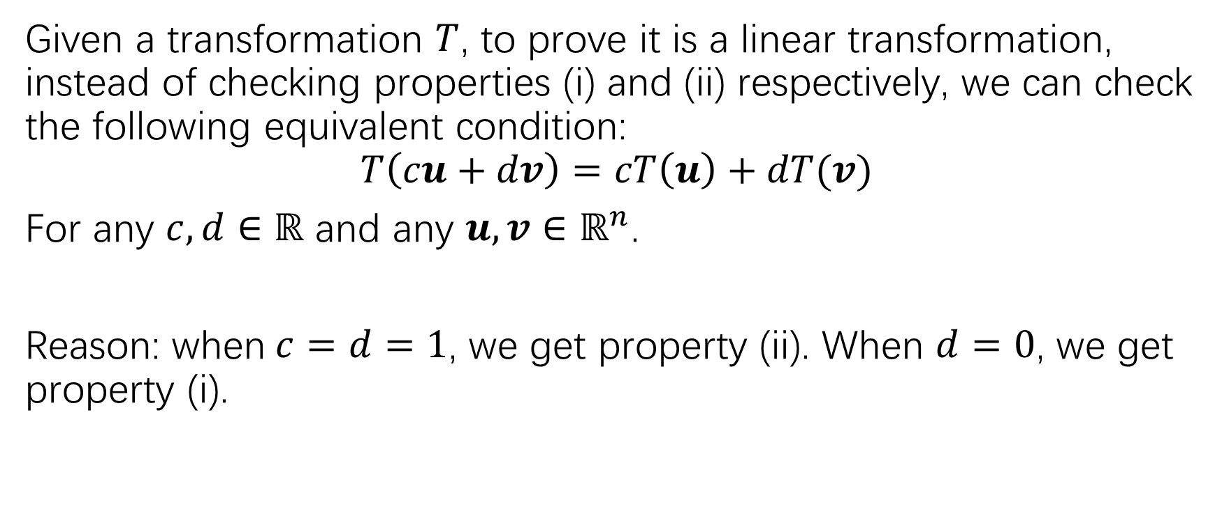
Linear transformations
Given a transformation $T$, to prove it is a linear transformation, instead of checking properties (i) and (ii) respectively, we can check the following equivalent condition:
$$T\left(cu+dv\right)=cT\left(u\right)+dT(v)$$
For any $c,d∈ℝ$ and any $u,v∈ℝ^{n}$.
Reason: when$c=d=1$, we get property (ii). When $d=0$, we get property (i).

Slide 33
Linear transformations

Slide 34
Linear transformations

Slide 35
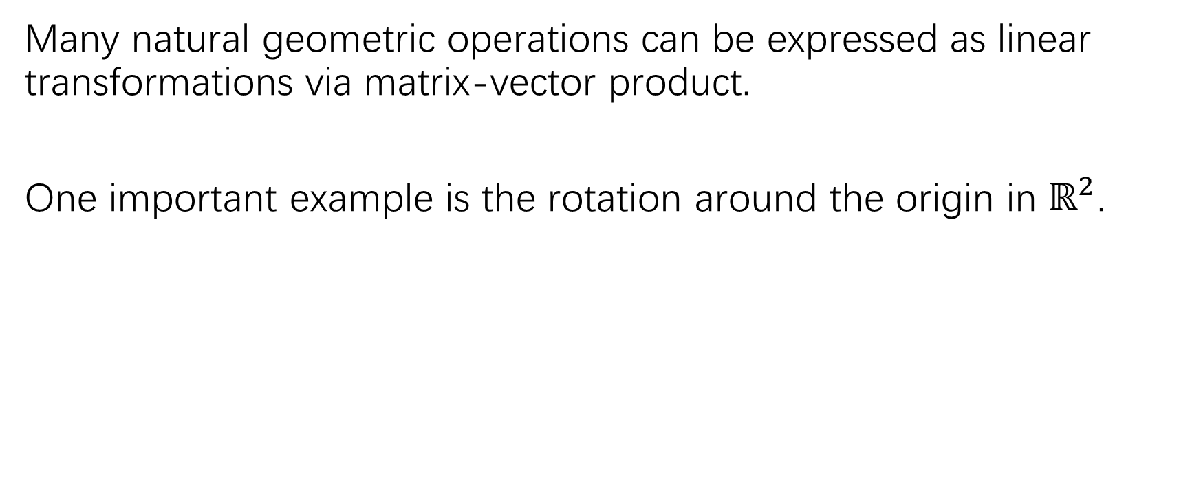
Linear transformations
Many natural geometric operations can be expressed as linear transformations via matrix-vector product.
One important example is the rotation around the origin in $ℝ^{2}$.

Slide 36
Linear transformations

Slide 37
practice
Page 68: practice problem 1-3
Page 68: 3,5; 7,8; 9,11; 13-16
Page 69: 22,23,33
Page 70: 36

