Slide 1
Linear Algebra
Lecturer: Xia Liao
Email: xliao@hqu.edu.cn
Homepage: https://hirzebruch.github.io/main.html
Time: every Tuesday 1-2, Thursday 3-4

Slide 2
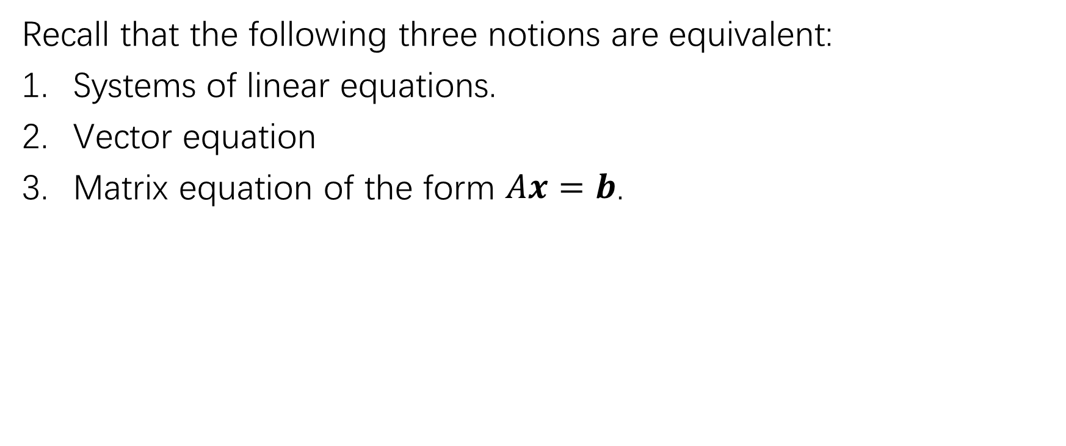
Review
Recall that the following three notions are equivalent:
Systems of linear equations.
Vector equation
Matrix equation of the form $Ax=b$.

Slide 3
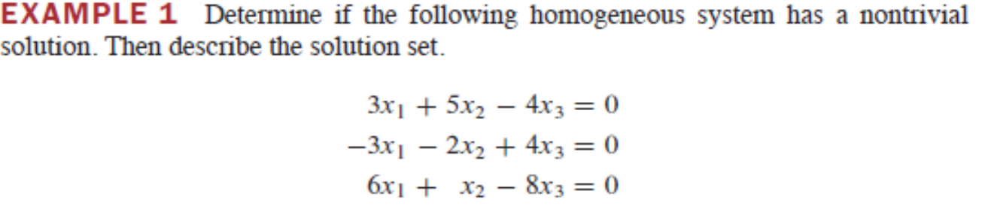

Homogeneous equations
The augmented matrix is
$\left[\begin{matrix}3 & 5 & −4 & 0 \\ −3 & −2 & 4 & 0 \\ 6 & 1 & −8 & 0\end{matrix}\right]$

Slide 4
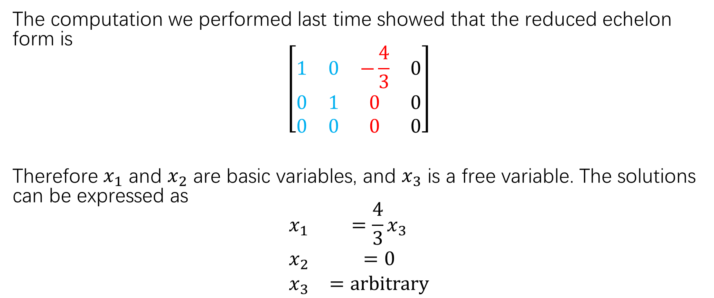
Homogeneous equations
The computation we performed last time showed that the reduced echelon form is
$$\left[\begin{matrix}1 & 0 & −\frac{4}{3} & 0 \\ 0 & 1 & 0 & 0 \\ 0 & 0 & 0 & 0\end{matrix}\right]$$
Therefore $x_{1}$ and $x_{2}$ are basic variables, and $x_{3}$ is a free variable. The solutions can be expressed as
$$\begin{matrix}x_{1} & =\frac{4}{3}x_{3} \\ x_{2} & =0 \\ x_{3} & =arbitrary\end{matrix}$$

Slide 5
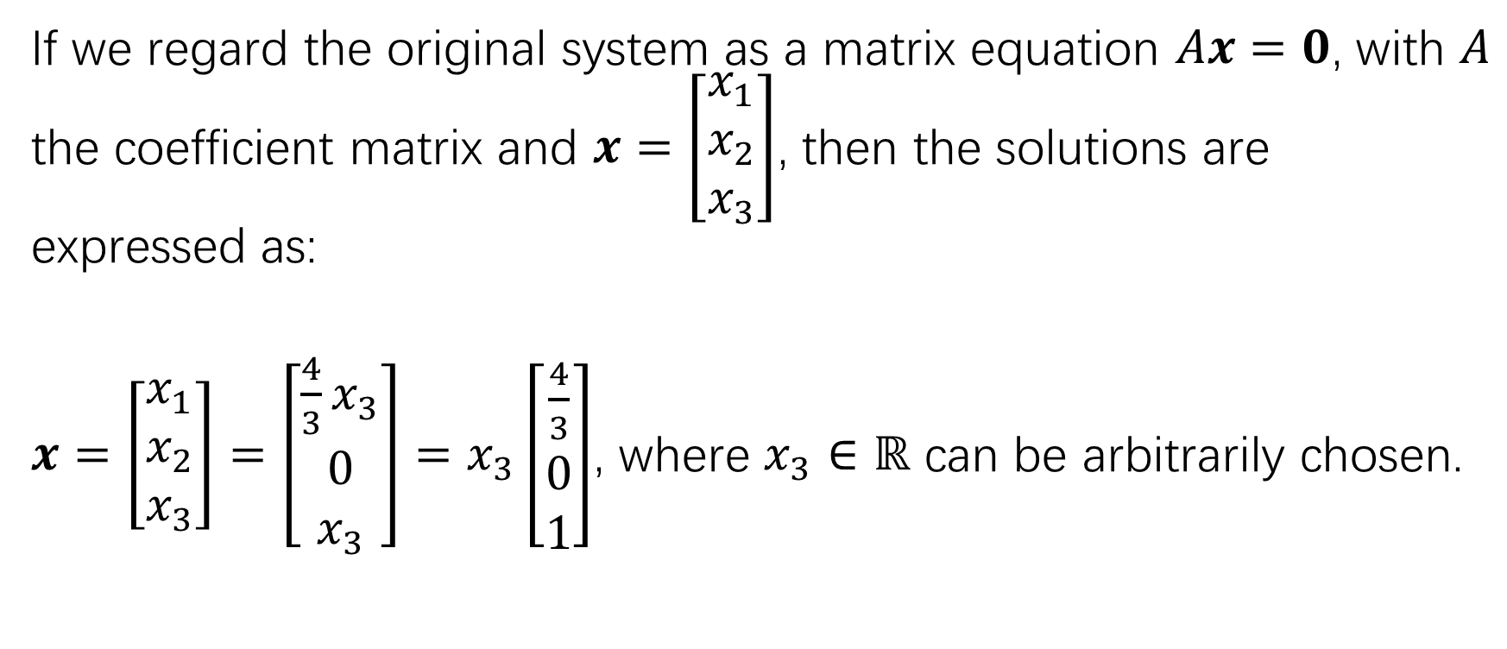
Homogeneous equations
If we regard the original system as a matrix equation $Ax=0$, with $A$ the coefficient matrix and $x=\left[\begin{matrix}x_{1} \\ x_{2} \\ x_{3}\end{matrix}\right]$, then the solutions are expressed as:
$x=\left[\begin{matrix}x_{1} \\ x_{2} \\ x_{3}\end{matrix}\right]=\left[\begin{matrix}\frac{4}{3}x_{3} \\ 0 \\ x_{3}\end{matrix}\right]=x_{3}\left[\begin{matrix}\frac{4}{3} \\ 0 \\ 1\end{matrix}\right]$, where $x_{3}∈ℝ$ can be arbitrarily chosen.

Slide 6
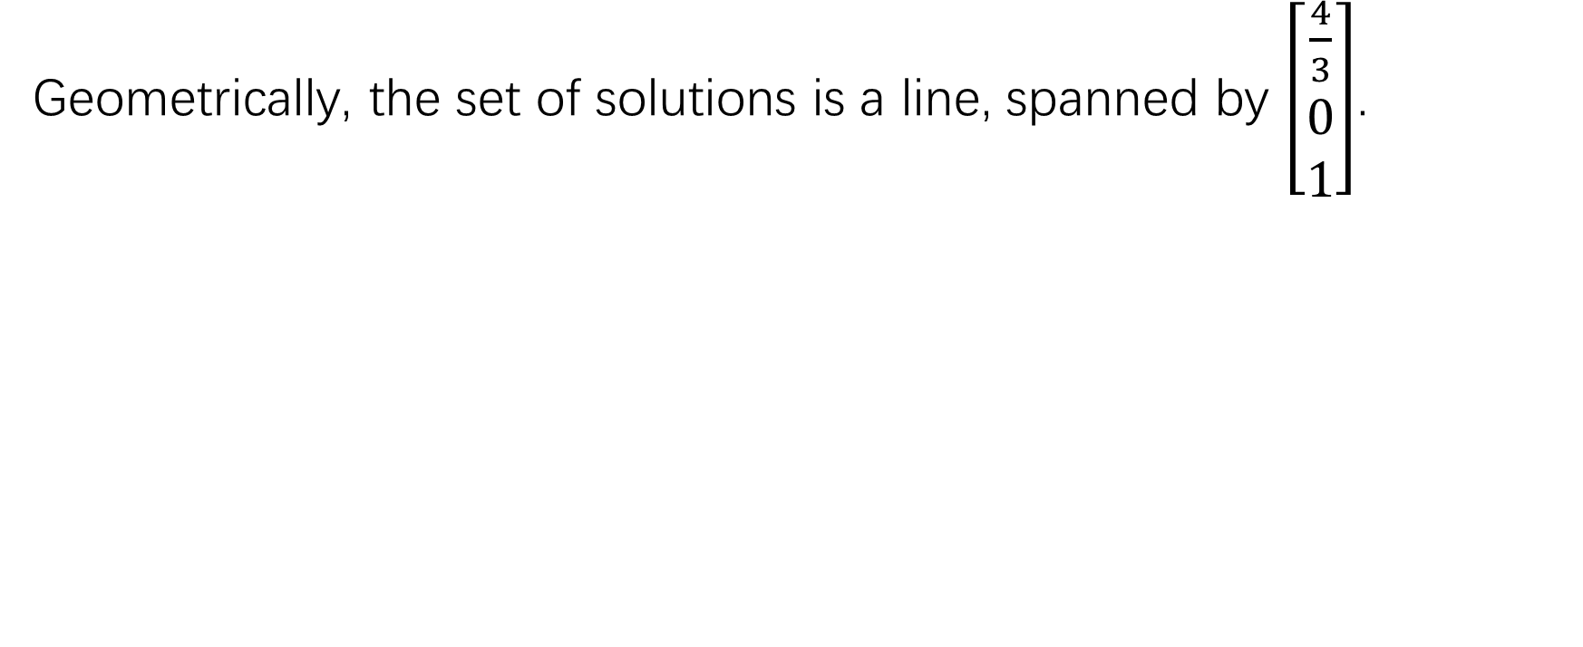
Homogeneous equations
Geometrically, the set of solutions is a line, spanned by $\left[\begin{matrix}\frac{4}{3} \\ 0 \\ 1\end{matrix}\right]$.

Slide 7
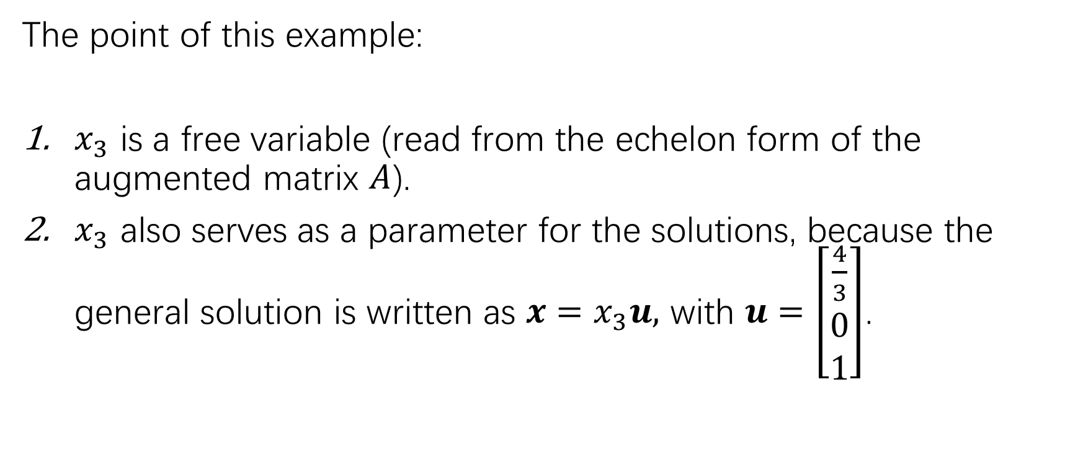
Homogeneous equations
The point of this example:
$x_{3}$ is a free variable (read from the echelon form of the augmented matrix $A$).
$x_{3}$ also serves as a parameter for the solutions, because the general solution is written as $x=x_{3}u,$ with $u=\left[\begin{matrix}\frac{4}{3} \\ 0 \\ 1\end{matrix}\right]$.

Slide 8
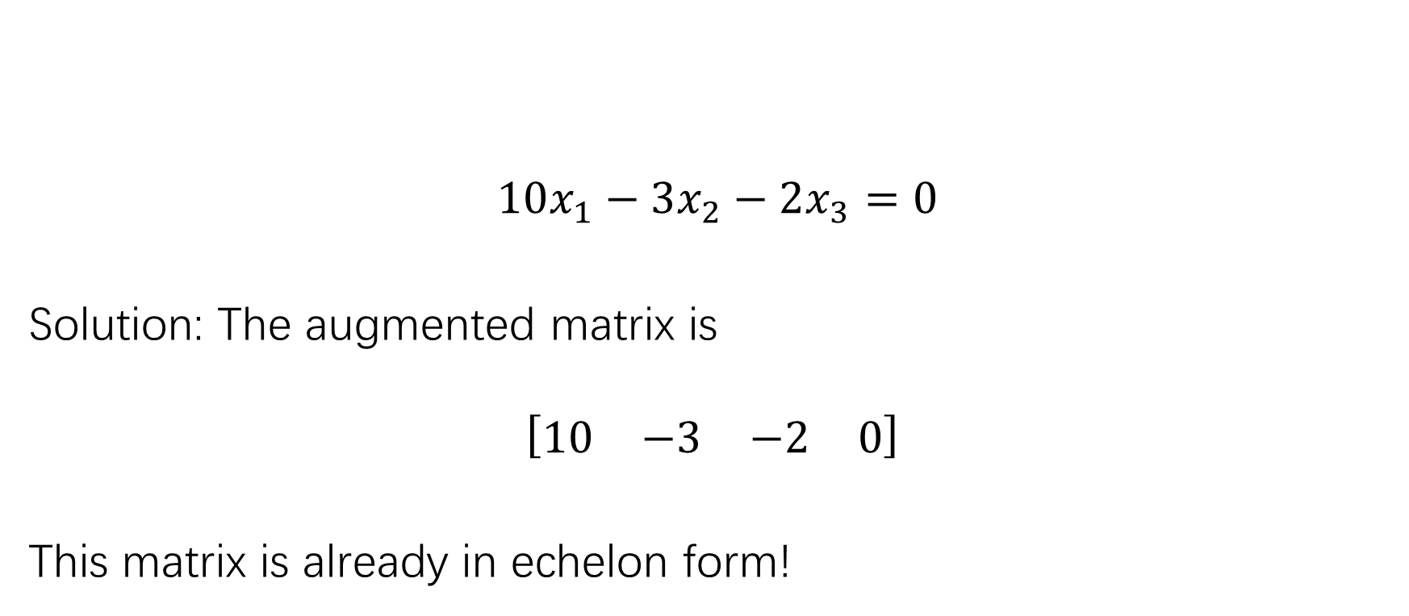
Another example
$$10x_{1}−3x_{2}−2x_{3}=0$$
Solution: The augmented matrix is
$$\left[\begin{matrix}10 & −3 & −2 & 0\end{matrix}\right]$$
This matrix is already in echelon form!

Slide 9
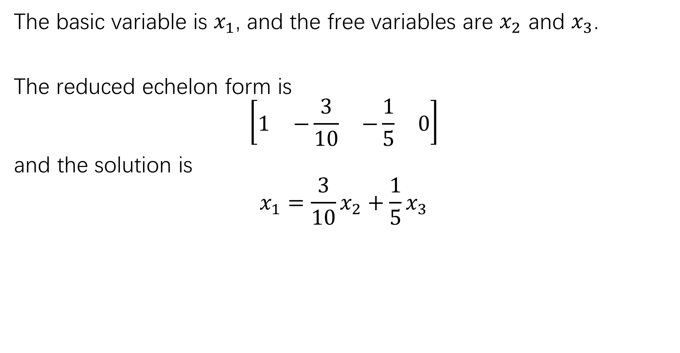
The basic variable is $x_{1}$, and the free variables are $x_{2}$ and $x_{3}$.
The reduced echelon form is
$$\left[\begin{matrix}1 & −\frac{3}{10} & −\frac{1}{5} & 0\end{matrix}\right]$$
and the solution is
$$x_{1}=\frac{3}{10}x_{2}+\frac{1}{5}x_{3}$$

Slide 10
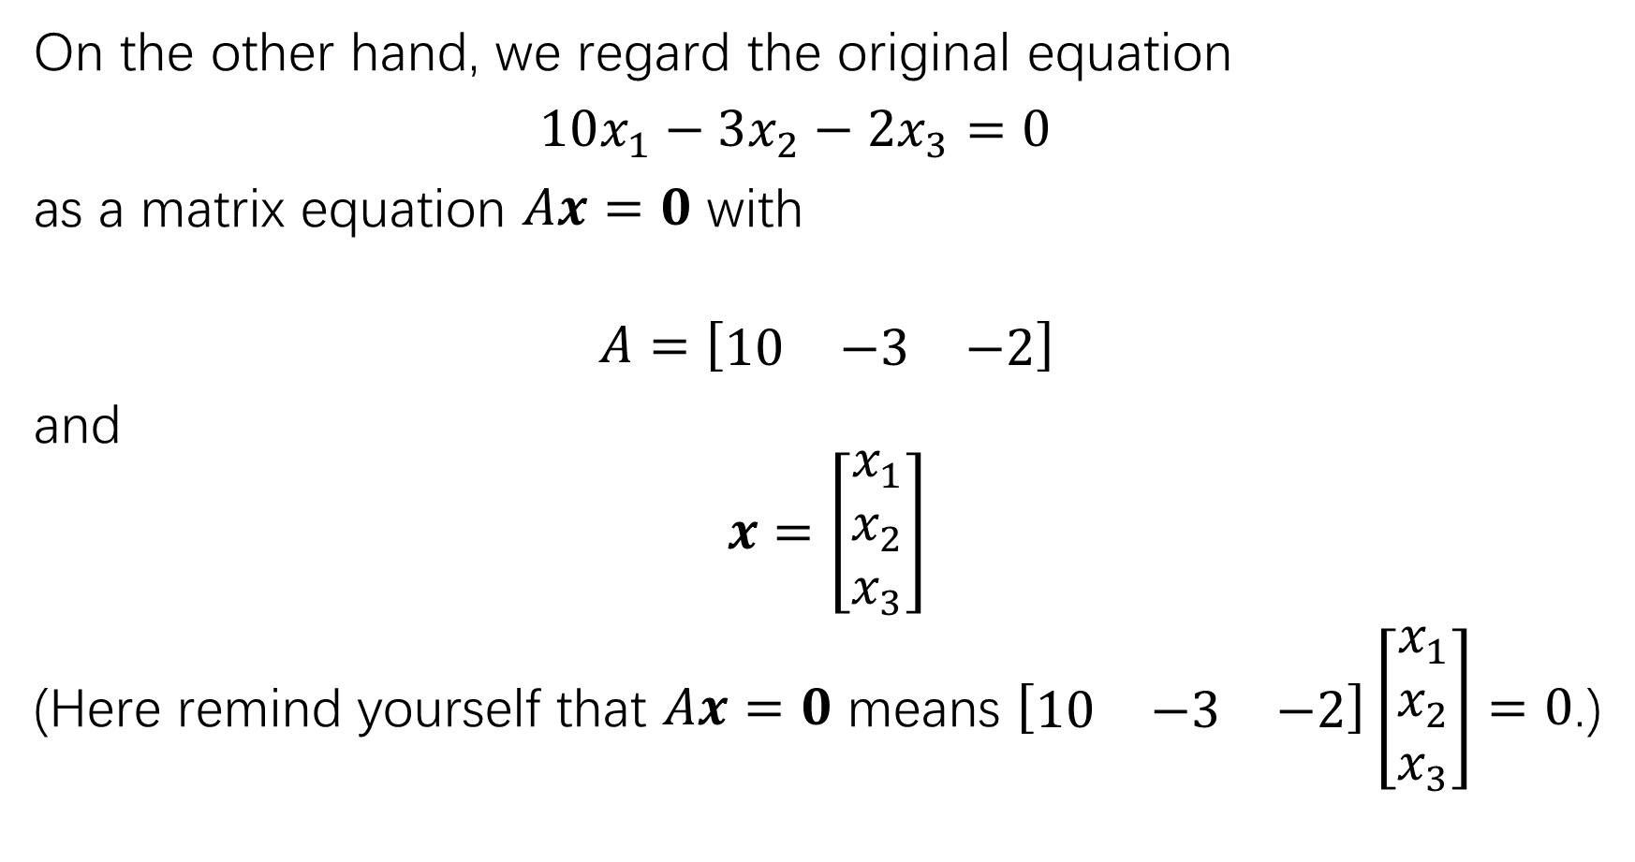
On the other hand, we regard the original equation
$10x_{1}−3x_{2}−2x_{3}=0$
as a matrix equation $Ax=0$ with
$$A=\left[\begin{matrix}10 & −3 & −2\end{matrix}\right]$$
and
$$x=\left[\begin{matrix}x_{1} \\ x_{2} \\ x_{3}\end{matrix}\right]$$
(Here remind yourself that $Ax=0$ means $\left[\begin{matrix}10 & −3 & −2\end{matrix}\right]\left[\begin{matrix}x_{1} \\ x_{2} \\ x_{3}\end{matrix}\right]=0$.)

Slide 11
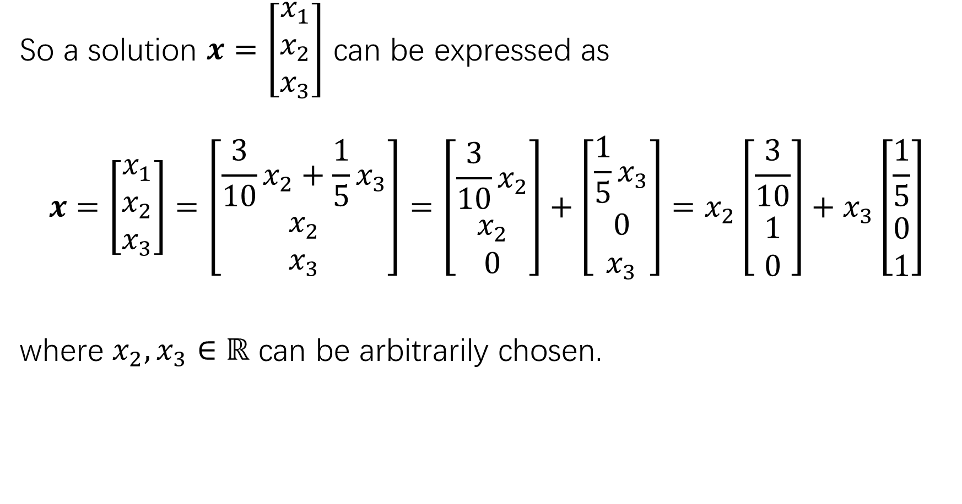
So a solution $x=\left[\begin{matrix}x_{1} \\ x_{2} \\ x_{3}\end{matrix}\right]$ can be expressed as
$$x=\left[\begin{matrix}x_{1} \\ x_{2} \\ x_{3}\end{matrix}\right]=\left[\begin{matrix}\frac{3}{10}x_{2}+\frac{1}{5}x_{3} \\ x_{2} \\ x_{3}\end{matrix}\right]=\left[\begin{matrix}{\frac{3}{10}x}_{2} \\ x_{2} \\ 0\end{matrix}\right]+\left[\begin{matrix}{\frac{1}{5}x}_{3} \\ 0 \\ x_{3}\end{matrix}\right]=x_{2}\left[\begin{matrix}\frac{3}{10} \\ 1 \\ 0\end{matrix}\right]+x_{3}\left[\begin{matrix}\frac{1}{5} \\ 0 \\ 1\end{matrix}\right]$$
where $x_{2},x_{3}∈ℝ$ can be arbitrarily chosen.

Slide 12
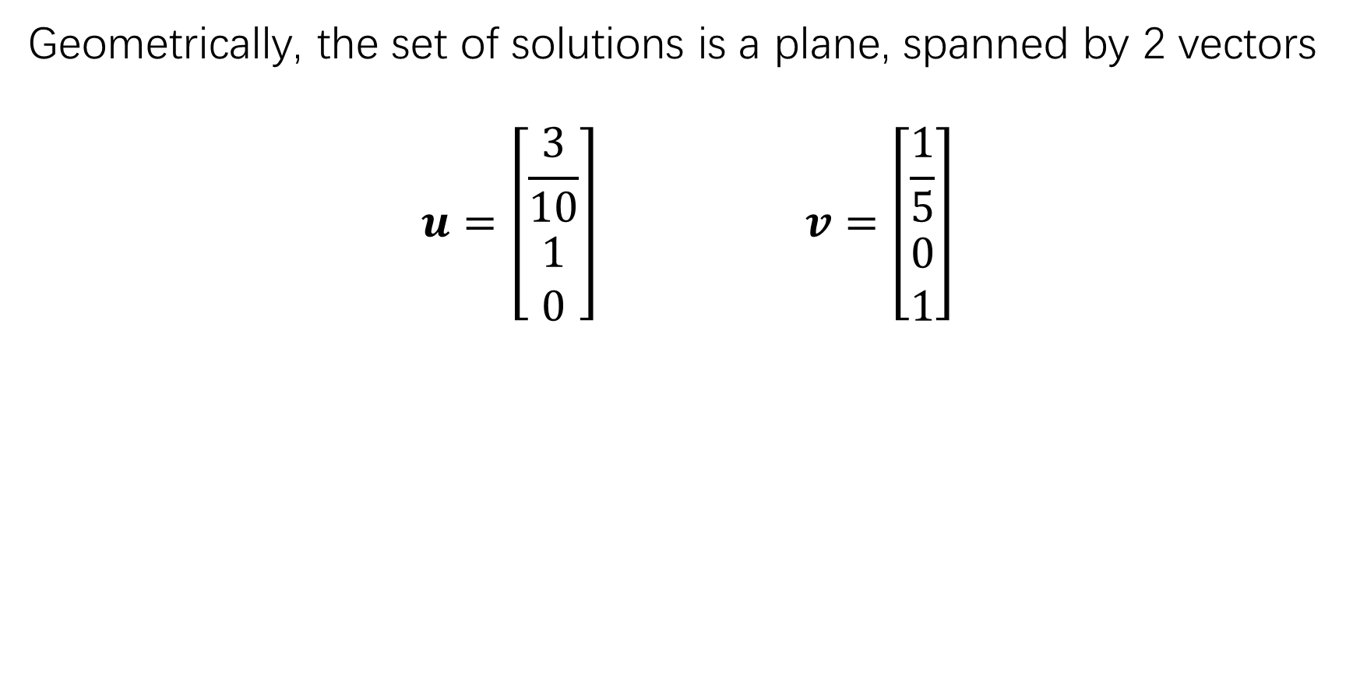
Geometrically, the set of solutions is a plane, spanned by 2 vectors
$$u=\left[\begin{matrix}\frac{3}{10} \\ 1 \\ 0\end{matrix}\right] v=\left[\begin{matrix}\frac{1}{5} \\ 0 \\ 1\end{matrix}\right]$$

Slide 13
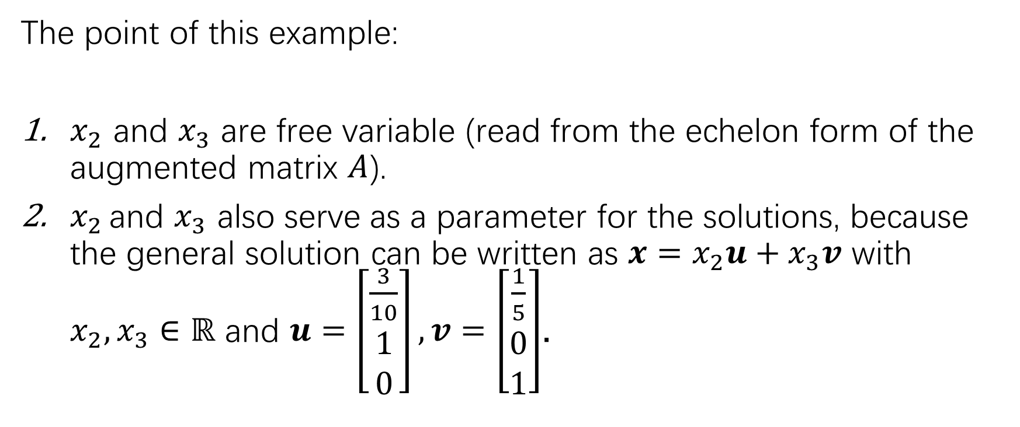
The point of this example:
$x_{2}$ and $x_{3}$ are free variable (read from the echelon form of the augmented matrix $A$).
$x_{2 }$and $x_{3}$ also serve as a parameter for the solutions, because the general solution can be written as $x=x_{2}u+x_{3}v$ with $x_{2},x_{3}∈ℝ$ and $u=\left[\begin{matrix}\frac{3}{10} \\ 1 \\ 0\end{matrix}\right], v=\left[\begin{matrix}\frac{1}{5} \\ 0 \\ 1\end{matrix}\right]$.

Slide 14
summary
General fact:
Free variables parametrizes the solutions of homogeneous system of linear equations!

Slide 15
Inhomogeneous equations

Slide 16

Inhomogeneous equations
Therefore, the solutions can be written as
$$x=p+x_{3}v$$

Slide 17
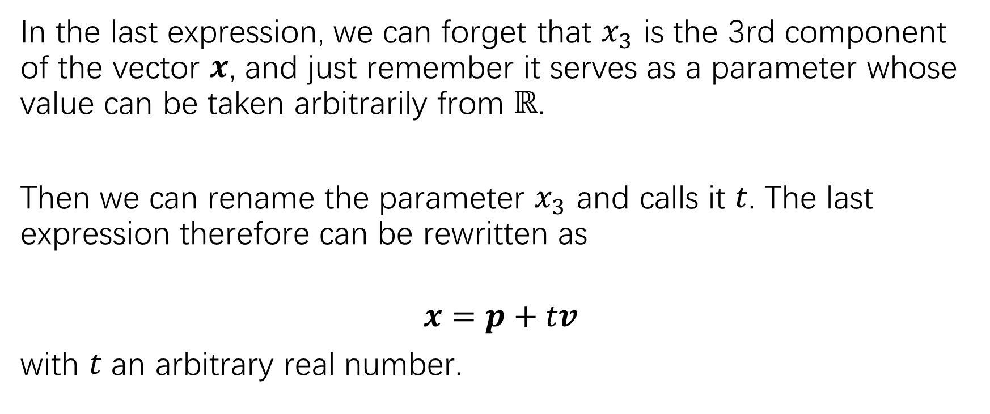
Inhomogeneous equations
In the last expression, we can forget that $x_{3}$ is the 3rd component of the vector $x$, and just remember it serves as a parameter whose value can be taken arbitrarily from $ℝ$.
Then we can rename the parameter $x_{3}$ and calls it $t$. The last expression therefore can be rewritten as
$$x=p+tv$$
with $t$ an arbitrary real number.

Slide 18
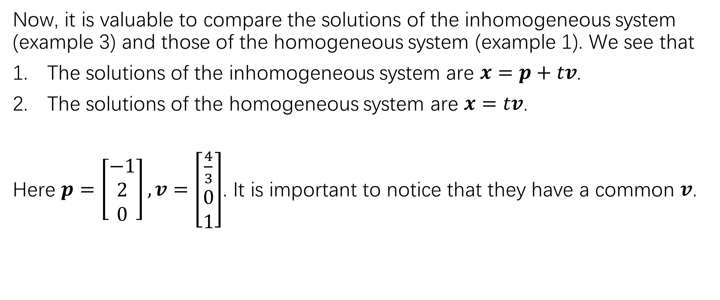
Comparison of solutions
Now, it is valuable to compare the solutions of the inhomogeneous system (example 3) and those of the homogeneous system (example 1). We see that
The solutions of the inhomogeneous system are $x=p+tv$.
The solutions of the homogeneous system are $x=tv$.
Here $p=\left[\begin{matrix}−1 \\ 2 \\ 0\end{matrix}\right], v=\left[\begin{matrix}\frac{4}{3} \\ 0 \\ 1\end{matrix}\right]$. It is important to notice that they have a common $v$.

Slide 19
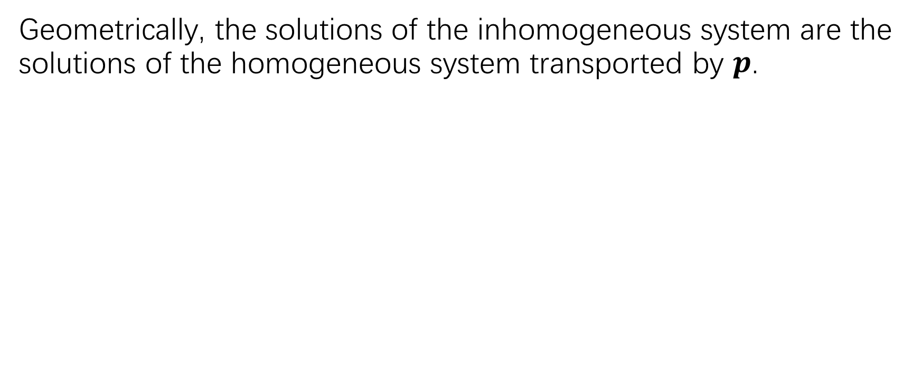
Comparison of solutions
Geometrically, the solutions of the inhomogeneous system are the solutions of the homogeneous system transported by $p$.

Slide 20
Comparison of solutions
The phenomenon we just saw is quite general:
We have the following theorem (theorem 6 in the book):

Slide 21
Comparison of solutions
The situation where there exists 2 free variables:

Slide 22
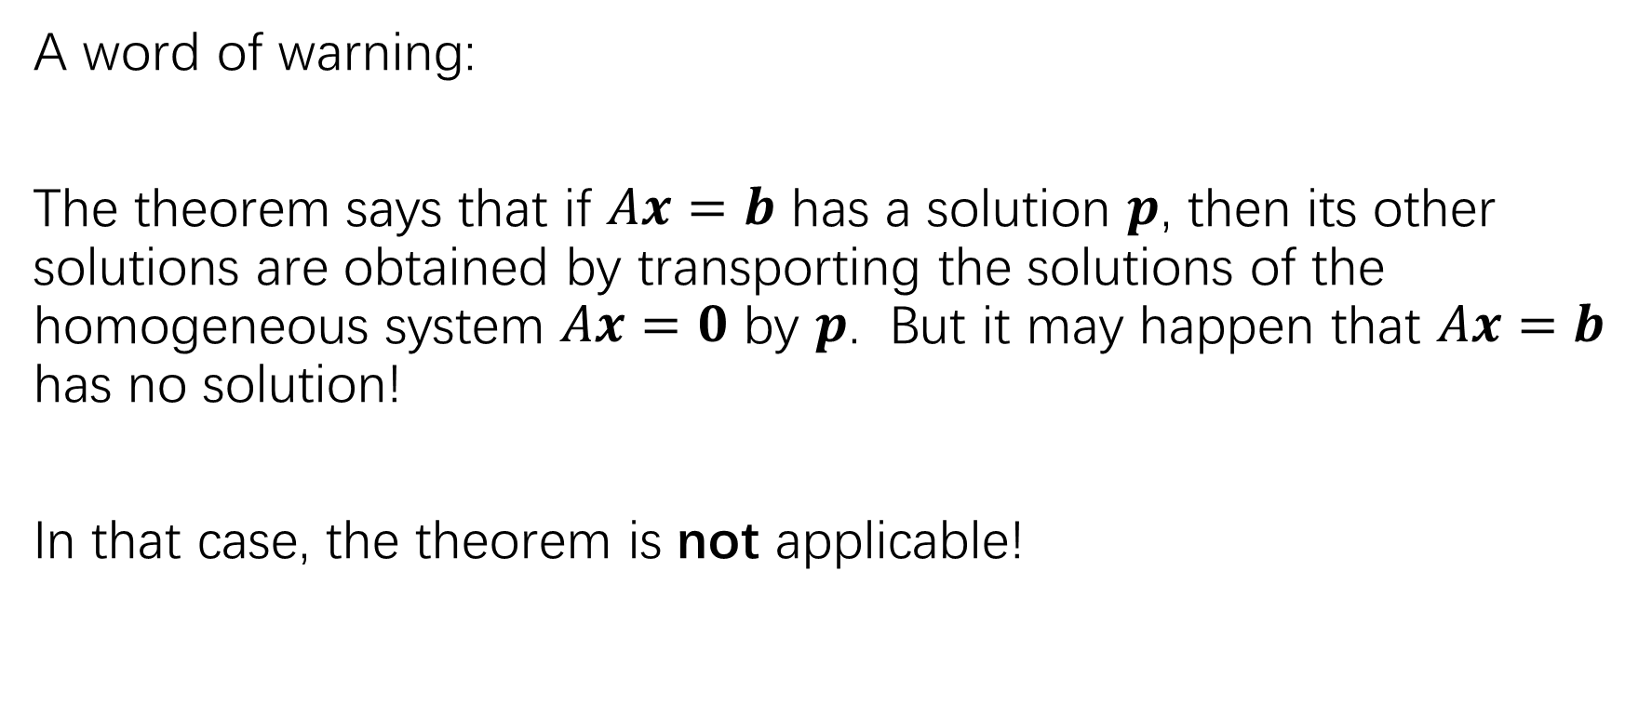
Comparison of solutions
A word of warning:
The theorem says that if $Ax=b$ has a solution $p$, then its other solutions are obtained by transporting the solutions of the homogeneous system $Ax=0$ by $p$. But it may happen that $Ax=b$ has no solution!
In that case, the theorem is not applicable!

Slide 23
Exercise
P47: 5, 17, 11

Slide 27
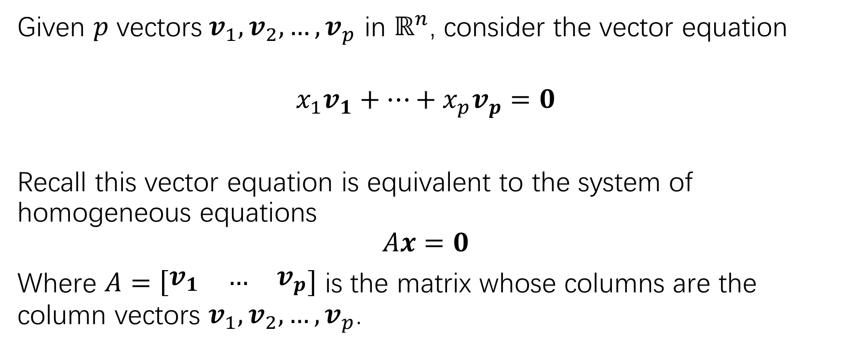
Linear independence
Given $p$ vectors$v_{1},v_{2},…,v_{p}$ in $ℝ^{n}$, consider the vector equation
$$x_{1}v_{1}+…+x_{p}v_{p}=0$$
Recall this vector equation is equivalent to the system of homogeneous equations
$$Ax=0$$
Where $A=\left[\begin{matrix}v_{1} & … & v_{p}\end{matrix}\right]$ is the matrix whose columns are the column vectors $v_{1},v_{2},…,v_{p}$.

Slide 28
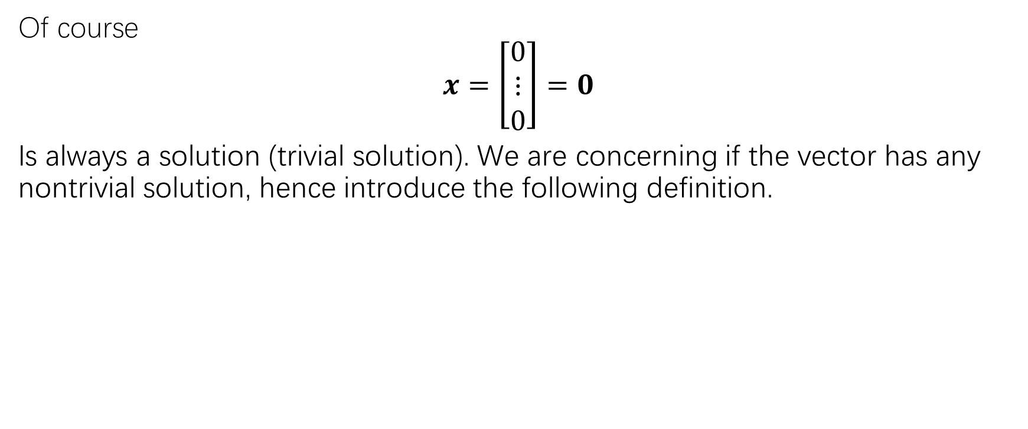
Linear independence
Of course
$$x=\left[\begin{matrix}0 \\ ⋮ \\ 0\end{matrix}\right]=0$$
Is always a solution (trivial solution). We are concerning if the vector has any nontrivial solution, hence introduce the following definition.

Slide 29
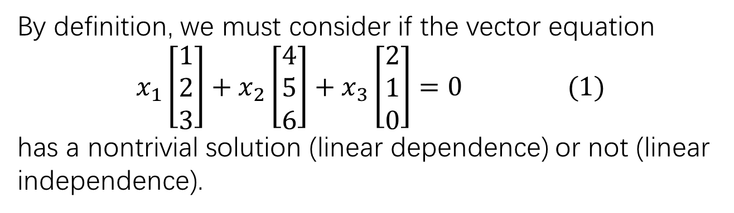
Linear independence
By definition, we must consider if the vector equation
$$x_{1}\left[\begin{matrix}1 \\ 2 \\ 3\end{matrix}\right]+x_{2}\left[\begin{matrix}4 \\ 5 \\ 6\end{matrix}\right]+x_{3}\left[\begin{matrix}2 \\ 1 \\ 0\end{matrix}\right]=0 (1)$$
has a nontrivial solution (linear dependence) or not (linear independence).

Slide 30
Linear independence

Slide 31
Linear independence

Slide 32
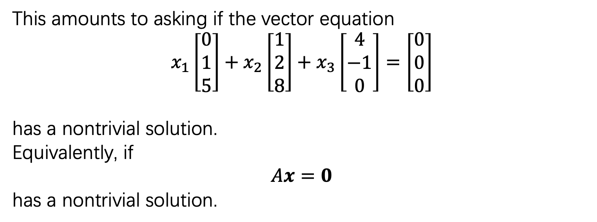
Linear independence of matrix columns
This amounts to asking if the vector equation
$$x_{1}\left[\begin{matrix}0 \\ 1 \\ 5\end{matrix}\right]+x_{2}\left[\begin{matrix}1 \\ 2 \\ 8\end{matrix}\right]+x_{3}\left[\begin{matrix}4 \\ −1 \\ 0\end{matrix}\right]=\left[\begin{matrix}0 \\ 0 \\ 0\end{matrix}\right]$$
has a nontrivial solution.
Equivalently, if
$$Ax=0$$
has a nontrivial solution.

Slide 33
Linear independence of matrix columns

Slide 34
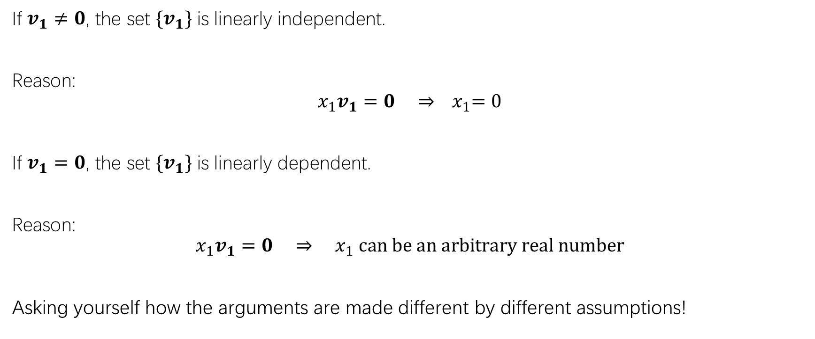
One vector
If $v_{1}≠0$, the set $\{v_{1}\}$ is linearly independent.
Reason:
$$x_{1}v_{1}=0 ⇒{ x}_{1}=0$$
If $v_{1}=0$, the set $\{v_{1}\}$ is linearly dependent.
Reason:
$$x_{1}v_{1}=0 ⇒{ x}_{1} can be an arbitrary real number$$
Asking yourself how the arguments are made different by different assumptions!

Slide 35
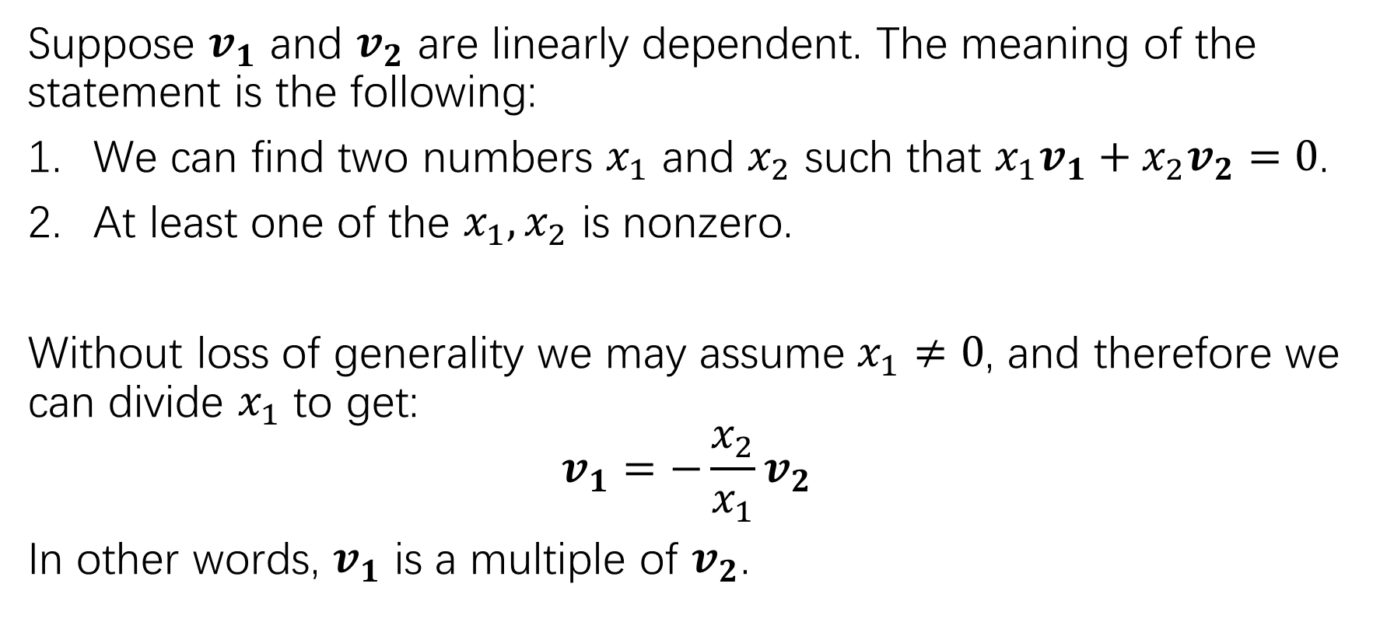
Two vectors
Suppose $v_{1}$ and $v_{2}$ are linearly dependent. The meaning of the statement is the following:
We can find two numbers $x_{1}$ and $x_{2}$ such that $x_{1}v_{1}+x_{2}v_{2}=0$.
At least one of the $x_{1},x_{2}$ is nonzero.
Without loss of generality we may assume $x_{1}≠0$, and therefore we can divide $x_{1}$ to get:
$$v_{1}=−\frac{x_{2}}{x_{1}}v_{2}$$
In other words, $v_{1}$ is a multiple of $v_{2}$.

Slide 36
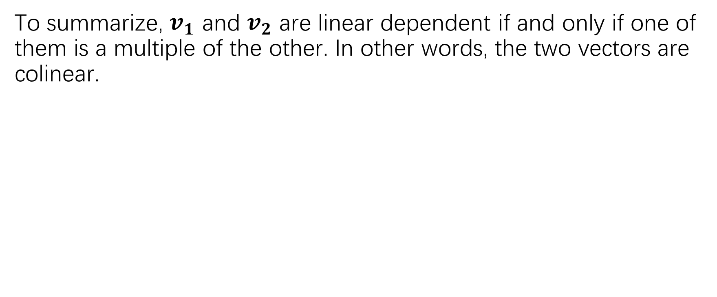
Two vectors
To summarize, $v_{1}$ and $v_{2}$ are linear dependent if and only if one of them is a multiple of the other. In other words, the two vectors are colinear.

Slide 37
Two vectors

Slide 38
Three vectors
Intuitively, three vectors are linearly dependent if and only if they are coplanar. We will use one example to examine this intuition.

Slide 39
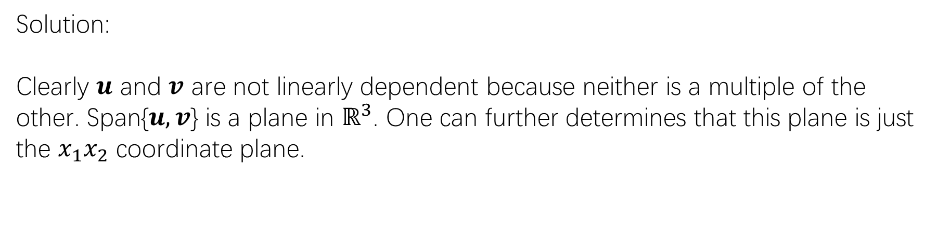
Three vectors
Solution:
Clearly $u$ and $v$ are not linearly dependent because neither is a multiple of the other. Span{$u,v$} is a plane in $ℝ^{3}$. One can further determines that this plane is just the $x_{1}x_{2}$ coordinate plane.

Slide 40
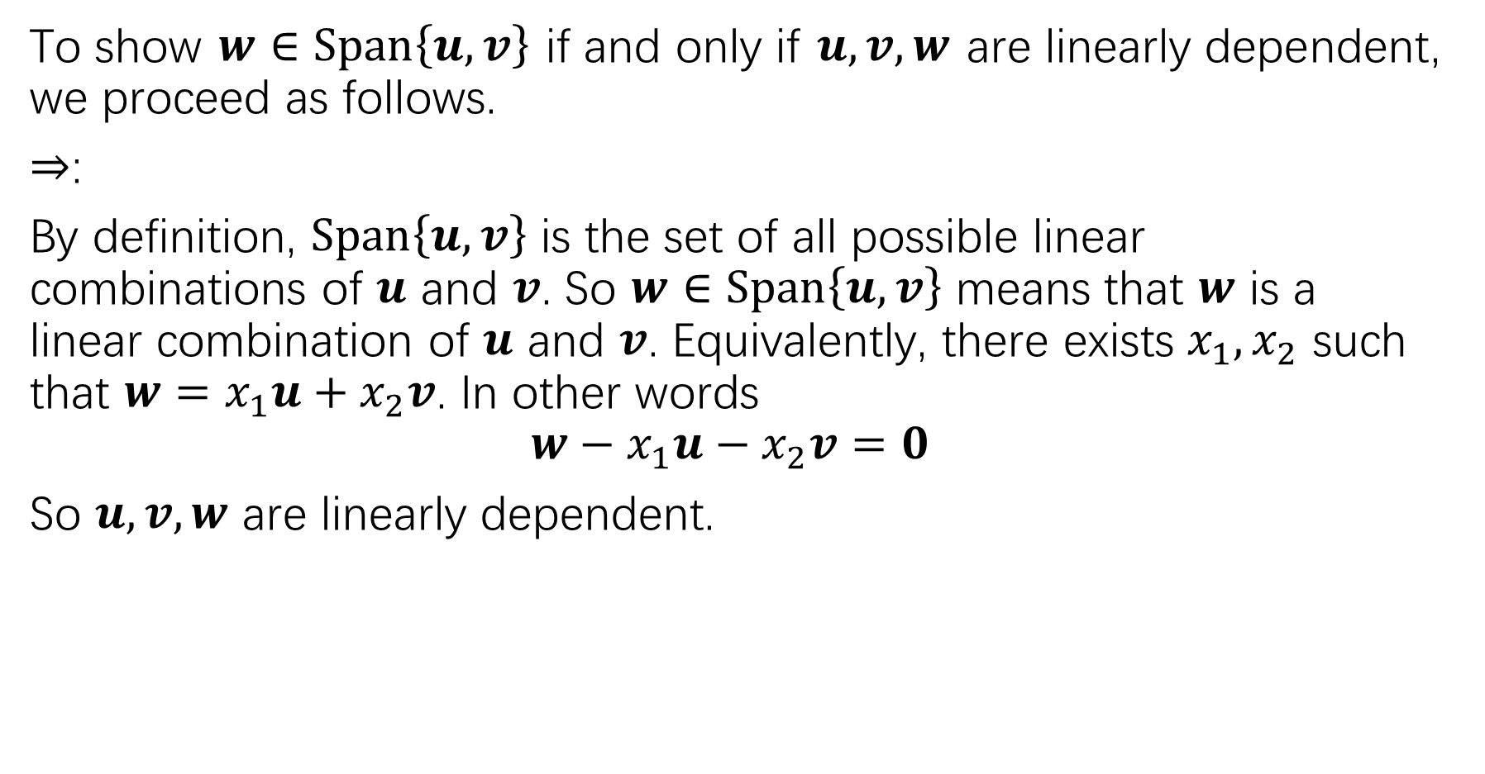
To show $w∈Span\left\{u,v\right\}$ if and only if $u,v,w$ are linearly dependent, we proceed as follows.
$⇒$:
By definition, $Span\left\{u,v\right\}$ is the set of all possible linear combinations of $u$ and $v$. So $w∈Span\left\{u,v\right\}$ means that $w$ is a linear combination of $u$ and $v$. Equivalently, there exists $x_{1},x_{2}$ such that $w=x_{1}u+x_{2}v$. In other words
$$w−x_{1}u−x_{2}v=0$$
So $u,v,w$ are linearly dependent.

Slide 41
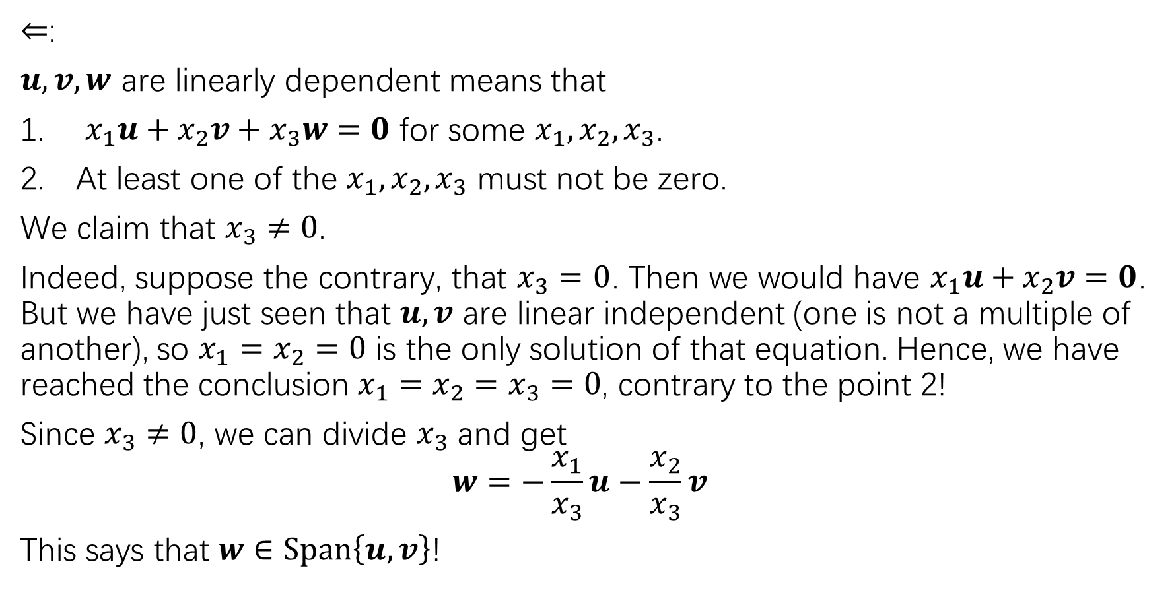
$⇐$:
$u,v,w$ are linearly dependent means that
$x_{1}u+x_{2}v+x_{3}w=0$ for some $x_{1},x_{2},x_{3}$.
At least one of the $x_{1},x_{2},x_{3}$ must not be zero.
We claim that $x_{3}≠0$.
Indeed, suppose the contrary, that $x_{3}=0$. Then we would have $x_{1}u+x_{2}v=0$. But we have just seen that $u,v$ are linear independent (one is not a multiple of another), so $x_{1}=x_{2}=0$ is the only solution of that equation. Hence, we have reached the conclusion $x_{1}=x_{2}=x_{3}=0$, contrary to the point 2!
Since $x_{3}≠0$, we can divide $x_{3}$ and get
$$w=−\frac{x_{1}}{x_{3}}u−\frac{x_{2}}{x_{3}}v$$
This says that $w∈Span\left\{u,v\right\}$!

Slide 42
Characterization of linear dependence sets
In general, we have the following theorem:

Slide 43
homework
Read the proof of Theorem 7 on page 60 carefully. Make sure you understand the arguments.
Page47: 6,12,18
Page60: 1-4; page 61: 21,22

