Slide 1
Linear Algebra
Lecturer: Xia Liao
Email: xliao@hqu.edu.cn
Homepage: https://hirzebruch.github.io/main.html
Time: every Tuesday 1-2, Thursday 3-4

Slide 2
Properties of determinants

Slide 3
Properties of determinants

Slide 8
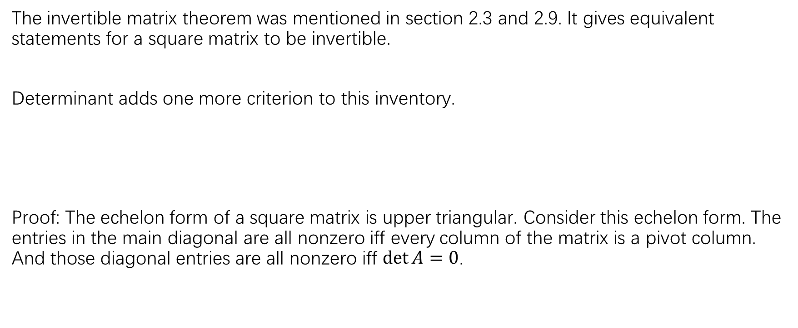
Invertible matrix theorem (continued)
The invertible matrix theorem was mentioned in section 2.3 and 2.9. It gives equivalent statements for a square matrix to be invertible.
Determinant adds one more criterion to this inventory.
Proof: The echelon form of a square matrix is upper triangular. Consider this echelon form. The entries in the main diagonal are all nonzero iff every column of the matrix is a pivot column. And those diagonal entries are all nonzero iff $\det{A}=0$.

Slide 9
How do computers compute determinants?

Slide 10
How do computers compute determinants?

Slide 11
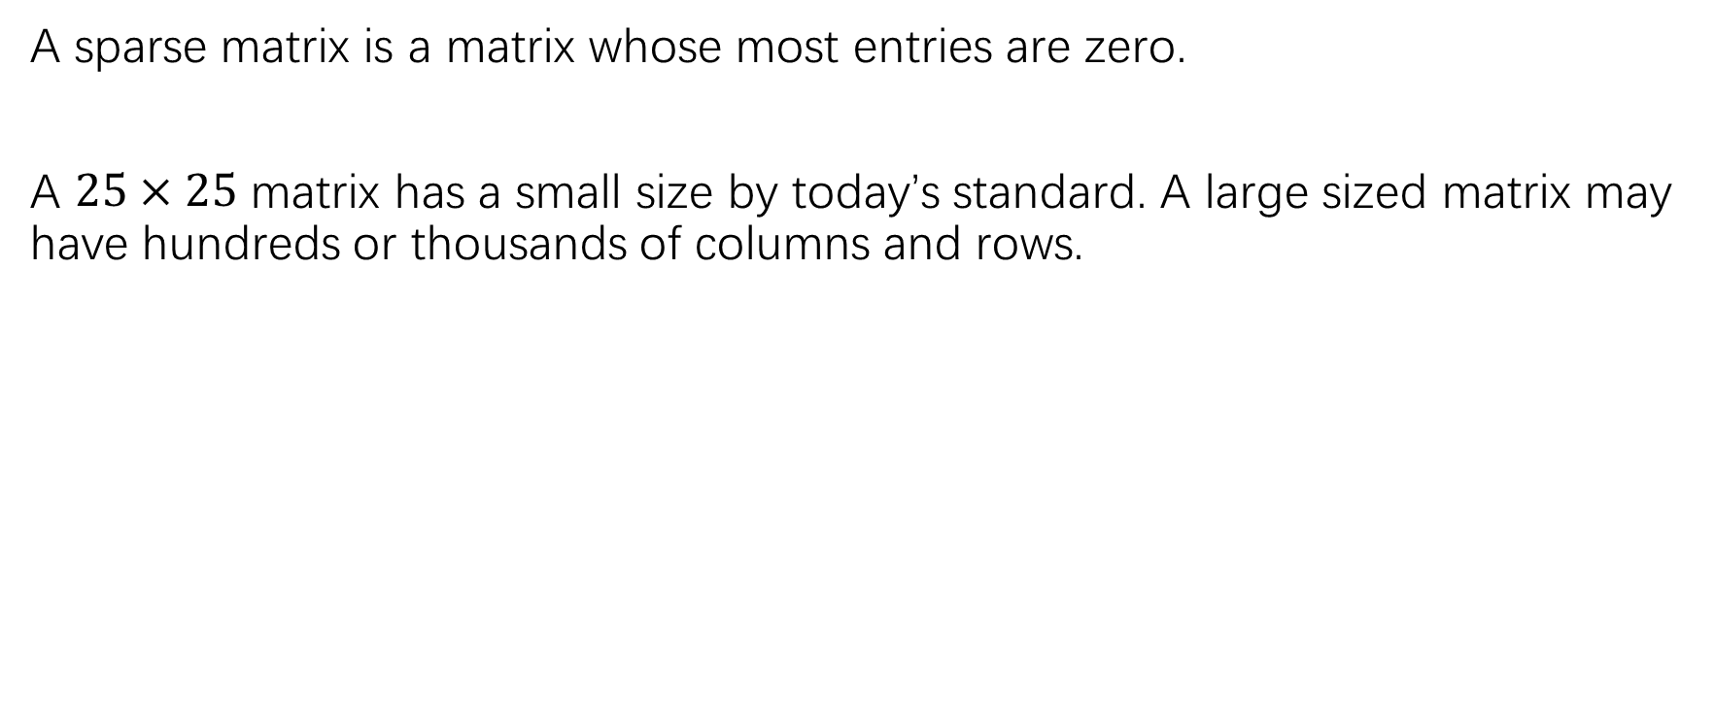
Sparse matrices
A sparse matrix is a matrix whose most entries are zero.
A $25×25$ matrix has a small size by today’s standard. A large sized matrix may have hundreds or thousands of columns and rows.

Slide 13
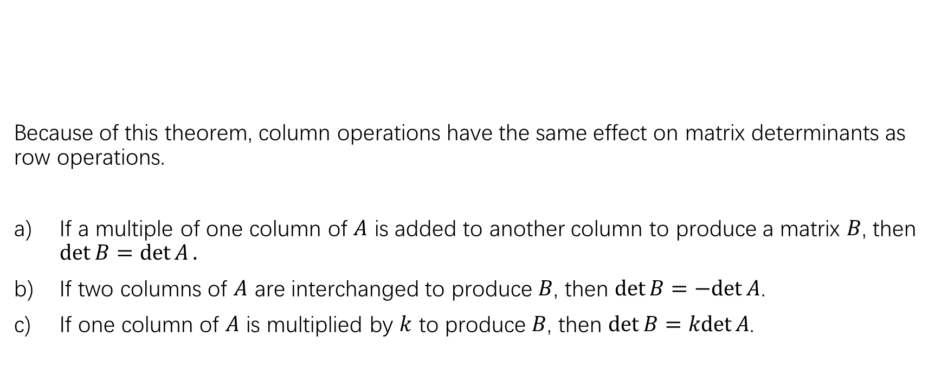
Column operations
Because of this theorem, column operations have the same effect on matrix determinants as row operations.
If a multiple of one column of $A$ is added to another column to produce a matrix $B$, then $\det{B=\det{A}}.$
If two columns of $A$ are interchanged to produce $B$, then $\det{B=−det{A}}$.
If one column of $A$ is multiplied by $k$ to produce $B$, then $\det{B=\operatorname{kdet}{A}}$.

Slide 14
Multiplicative property

Slide 15
Linearity of the determinant function

Slide 16
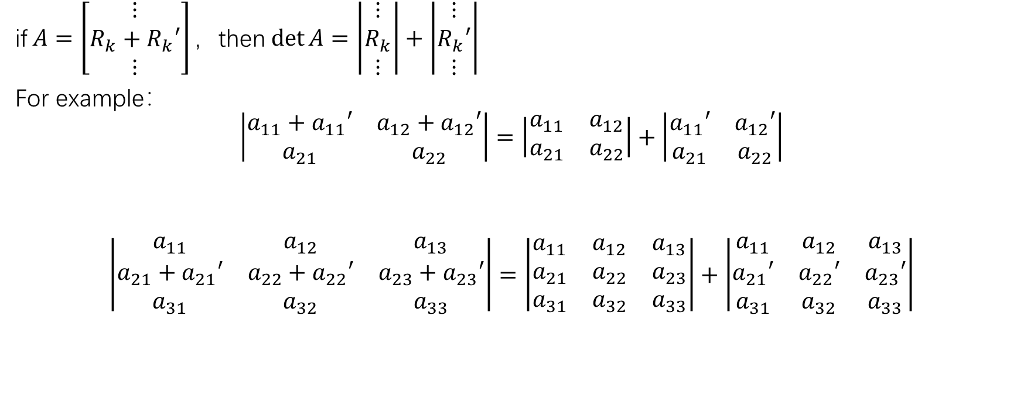
Linearity of the determinant function
if$A=\left[\begin{matrix}⋮ \\ R_{k}+R_{k}′ \\ ⋮\end{matrix}\right]，$then$\det{A}=\left|\begin{matrix}⋮ \\ R_{k} \\ ⋮\end{matrix}\right|+\left|\begin{matrix}⋮ \\ R_{k}′ \\ ⋮\end{matrix}\right|$
For example：
$$\left|\begin{matrix}a_{11}+a_{11}′ & a_{12}+a_{12}′ \\ a_{21} & a_{22}\end{matrix}\right|=\left|\begin{matrix}a_{11} & a_{12} \\ a_{21} & a_{22}\end{matrix}\right|+\left|\begin{matrix}a_{11}′ & a_{12}′ \\ a_{21} & a_{22}\end{matrix}\right|$$
$$\left|\begin{matrix}a_{11} & a_{12} & a_{13} \\ a_{21}+a_{21}′ & a_{22}+a_{22}′ & a_{23}+a_{23}′ \\ a_{31} & a_{32} & a_{33}\end{matrix}\right|=\left|\begin{matrix}a_{11} & a_{12} & a_{13} \\ a_{21} & a_{22} & a_{23} \\ a_{31} & a_{32} & a_{33}\end{matrix}\right|+\left|\begin{matrix}a_{11} & a_{12} & a_{13} \\ a_{21}′ & a_{22}′ & a_{23}′ \\ a_{31} & a_{32} & a_{33}\end{matrix}\right|$$

Slide 17
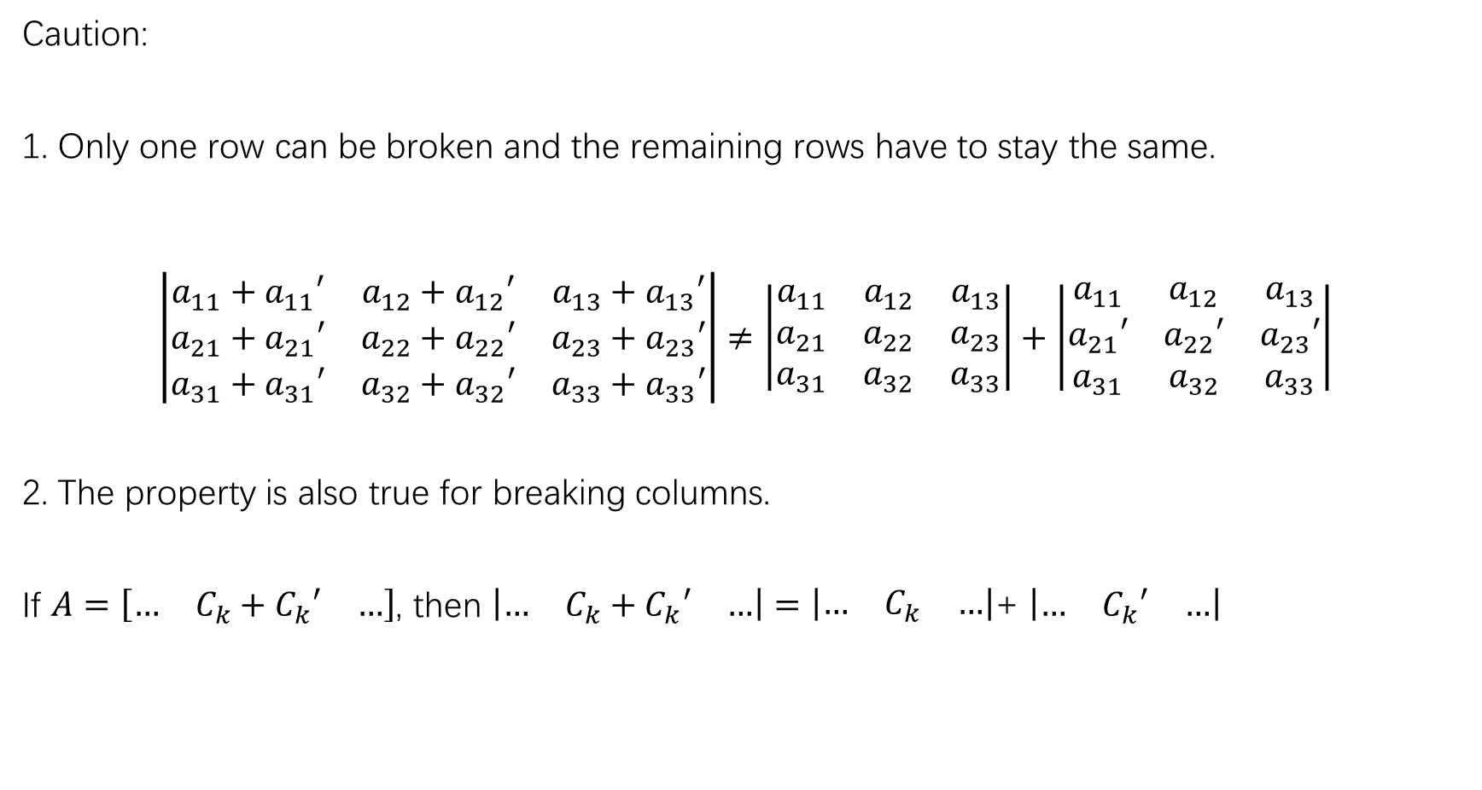
Caution:
1. Only one row can be broken and the remaining rows have to stay the same.
$$\left|\begin{matrix}a_{11}+a_{11}′ & a_{12}+a_{12}′ & a_{13}+a_{13}′ \\ a_{21}+a_{21}′ & a_{22}+a_{22}′ & a_{23}+a_{23}′ \\ a_{31}+a_{31}′ & a_{32}+a_{32}′ & a_{33}+a_{33}′\end{matrix}\right|≠\left|\begin{matrix}a_{11} & a_{12} & a_{13} \\ a_{21} & a_{22} & a_{23} \\ a_{31} & a_{32} & a_{33}\end{matrix}\right|+\left|\begin{matrix}a_{11} & a_{12} & a_{13} \\ a_{21}′ & a_{22}′ & a_{23}′ \\ a_{31} & a_{32} & a_{33}\end{matrix}\right|$$
2. The property is also true for breaking columns.
If $A=\left[\begin{matrix}… & C_{k}+C_{k}′ & …\end{matrix}\right]$, then $\left|\begin{matrix}… & C_{k}+C_{k}′ & …\end{matrix}\right|=\left|\begin{matrix}… & C_{k} & …\end{matrix}\right|$+ $\left|\begin{matrix}… & C_{k}′ & …\end{matrix}\right|$

Slide 18
Cramer’s rule

Slide 20
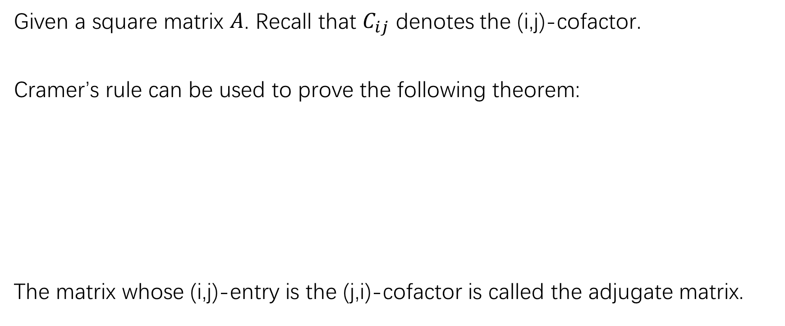

A formula for $A^{−1}$
Given a square matrix $A$. Recall that $C_{ij}$ denotes the (i,j)-cofactor.
Cramer’s rule can be used to prove the following theorem:
The matrix whose (i,j)-entry is the (j,i)-cofactor is called the adjugate matrix.

Slide 21
It is easy to check that $\det{A=14}$, so that

Slide 22
Determinants as area or volumn

Slide 23

Since the columns of $A$ are interpreted as vectors, which start from the origin, we need to translate one of the vertex of the parallelogram to the origin. See Figure 5(b)

Slide 28
HW:
P189:15-20,27,28
P198:1,2,11,12,20,21

