Slide 1
Linear Algebra
Lecturer: Xia Liao
Email: xliao@hqu.edu.cn
Homepage: https://hirzebruch.github.io/main.html
Time: every Tuesday 1-2, Thursday 3-4

Slide 2
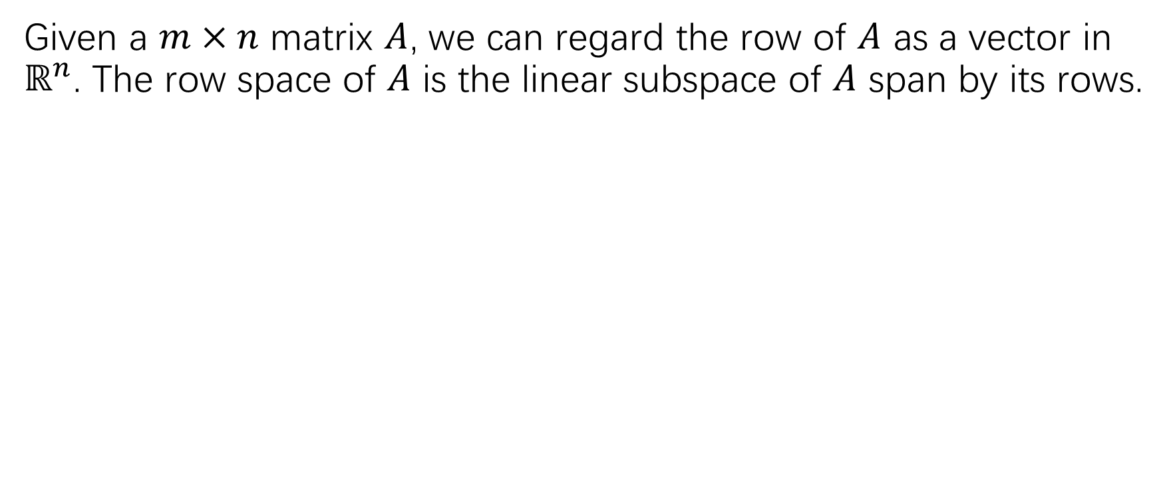
Row space of a matrix
Given a $m×n$ matrix $A$, we can regard the row of $A$ as a vector in $ℝ^{n}$. The row space of $A$ is the linear subspace of $A$ span by its rows.

Slide 4
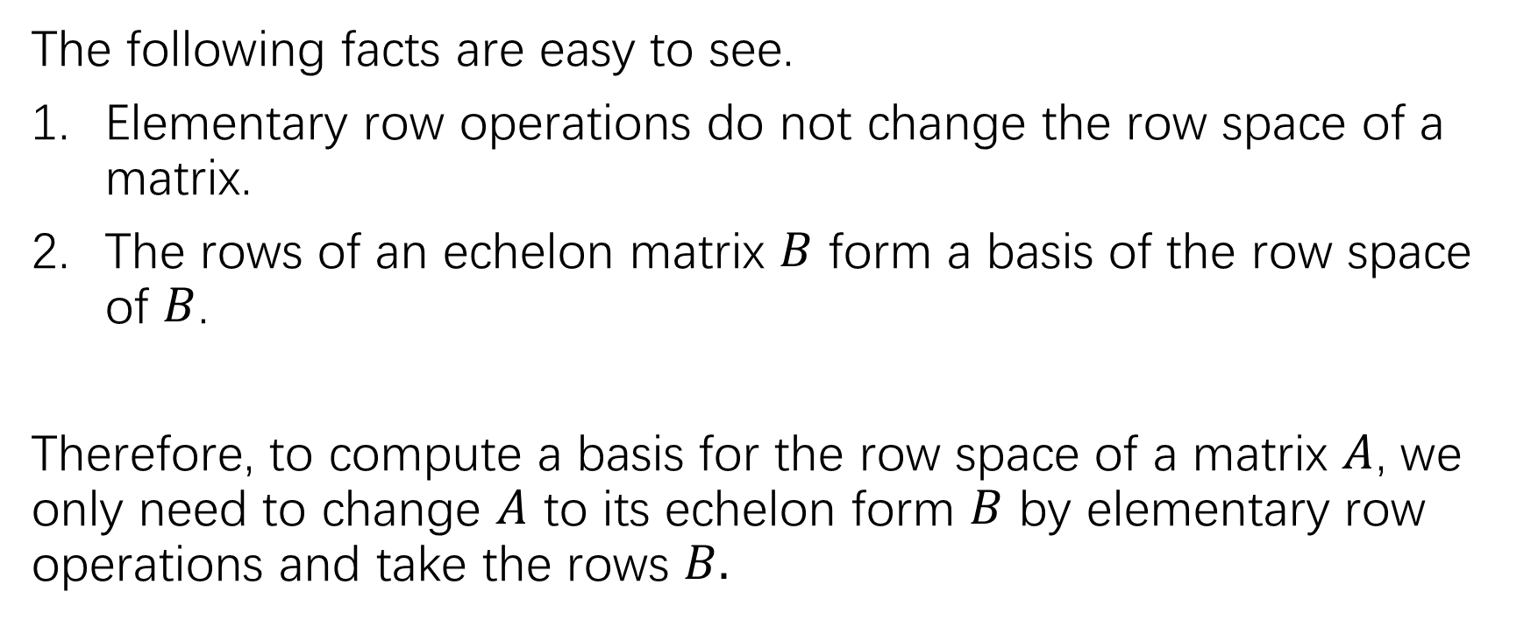
Row space of a matrix
The following facts are easy to see.
Elementary row operations do not change the row space of a matrix.
The rows of an echelon matrix $B$ form a basis of the row space of $B$.
Therefore, to compute a basis for the row space of a matrix $A$, we only need to change $A$ to its echelon form $B$ by elementary row operations and take the rows $B.$

Slide 7
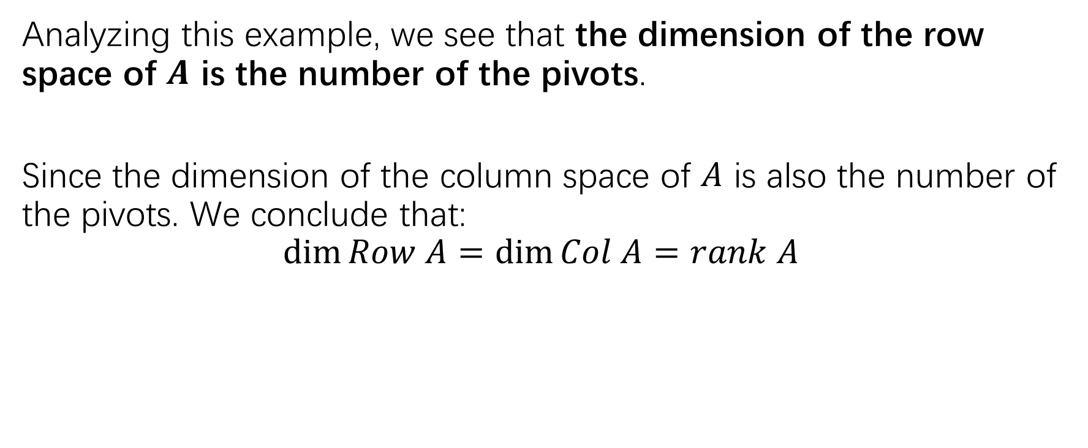
The row space of a matrix
Analyzing this example, we see that the dimension of the row space of $A$ is the number of the pivots.
Since the dimension of the column space of $A$ is also the number of the pivots. We conclude that:
$$\dim{Row A=\dim{Col A}}=rank A$$

Slide 8
The rank theorem

Slide 10
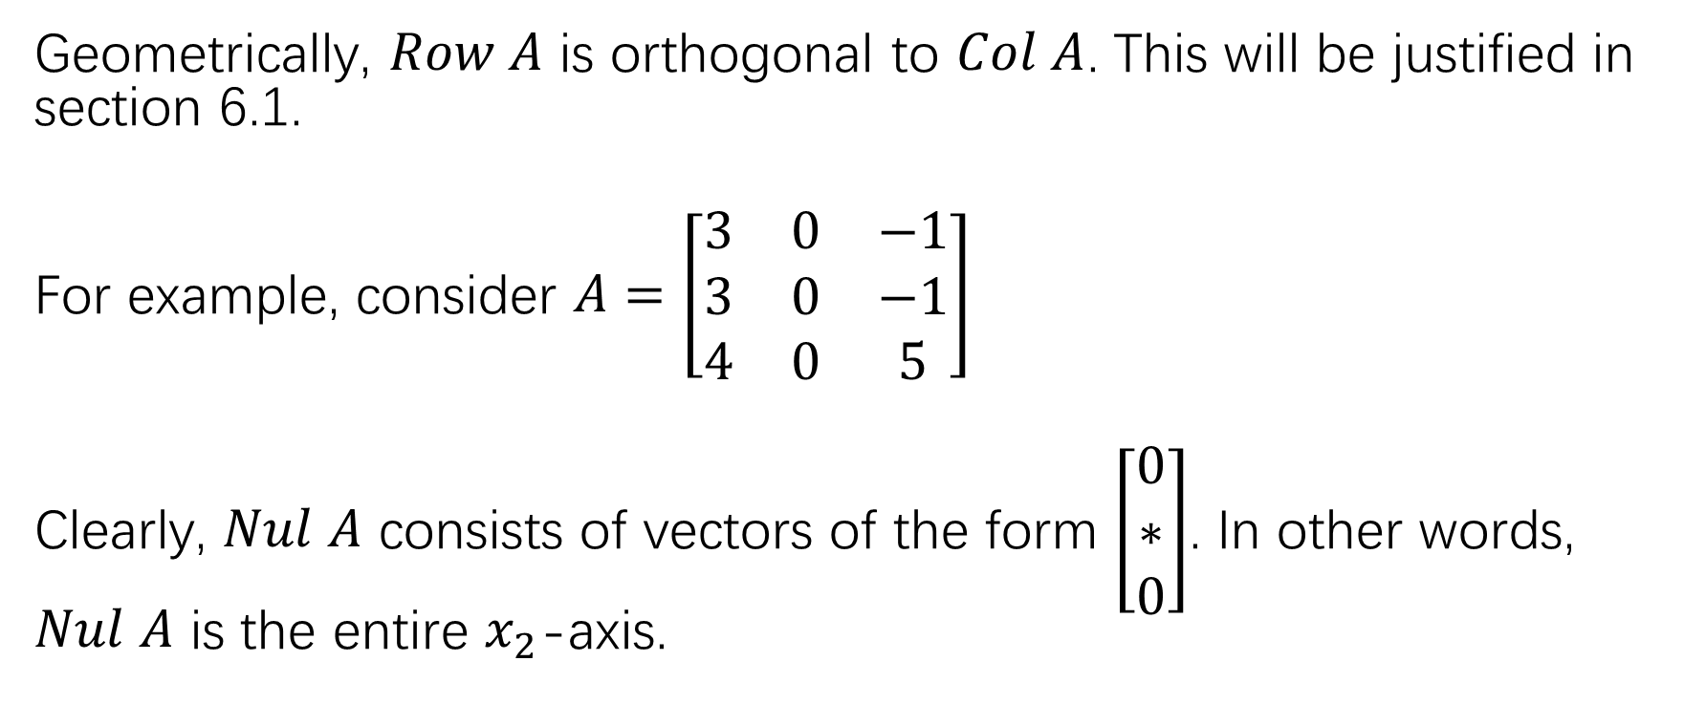
Geometric meaning of row space
Geometrically, $Row A$ is orthogonal to $Col A$. This will be justified in section 6.1.
For example, consider $A=\left[\begin{matrix}3 & 0 & −1 \\ 3 & 0 & −1 \\ 4 & 0 & 5\end{matrix}\right]$
Clearly, $Nul A$ consists of vectors of the form $\left[\begin{matrix}0 \\ ∗ \\ 0\end{matrix}\right]$. In other words, $Nul A$ is the entire $x_{2}$-axis.

Slide 11
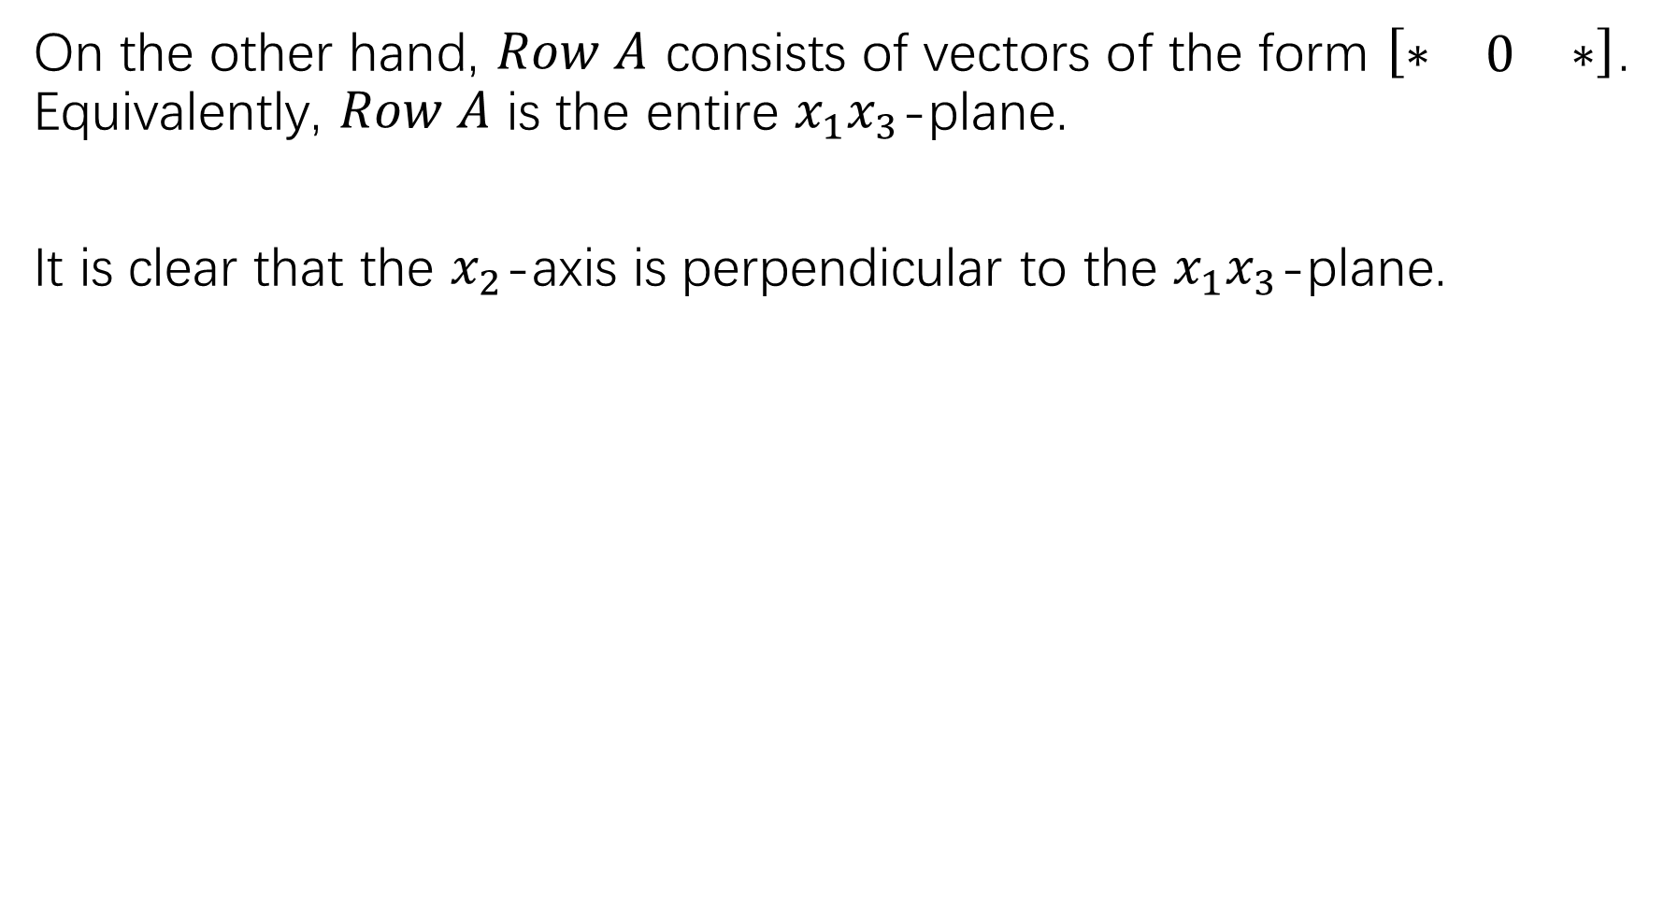
On the other hand, $Row A$ consists of vectors of the form $\left[\begin{matrix}∗ & 0 & ∗\end{matrix}\right]$. Equivalently, $Row A$ is the entire $x_{1}x_{3}$-plane.
It is clear that the $x_{2}$-axis is perpendicular to the $x_{1}x_{3}$-plane.

Slide 12
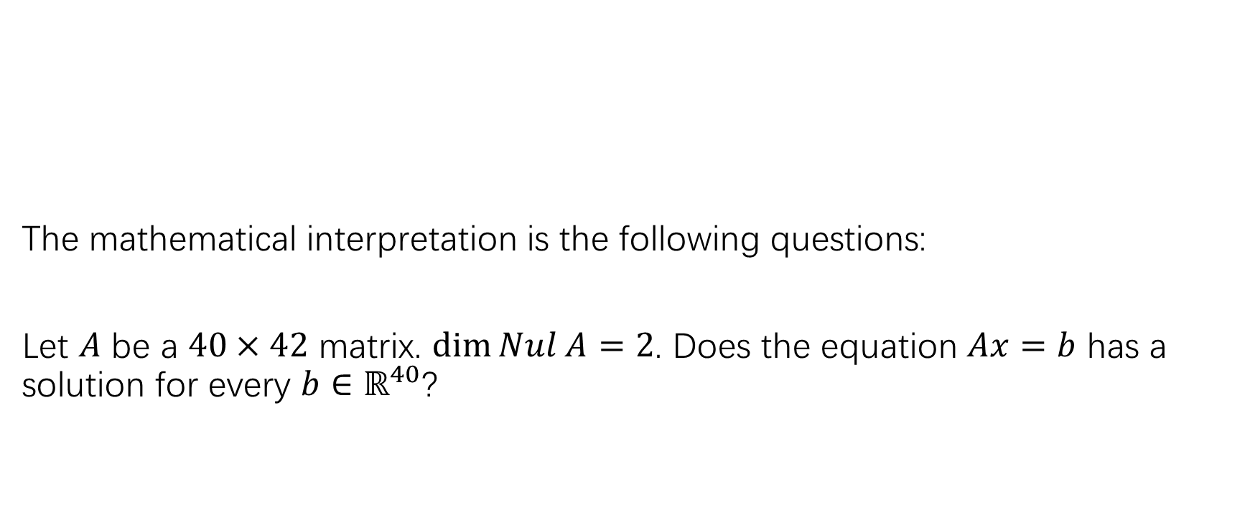
An application of the rank theorem
The mathematical interpretation is the following questions:
Let $A$ be a $40×42$ matrix. $\dim{Nul A}=2$. Does the equation $Ax=b$ has a solution for every $b∈ℝ^{40}$?

Slide 13
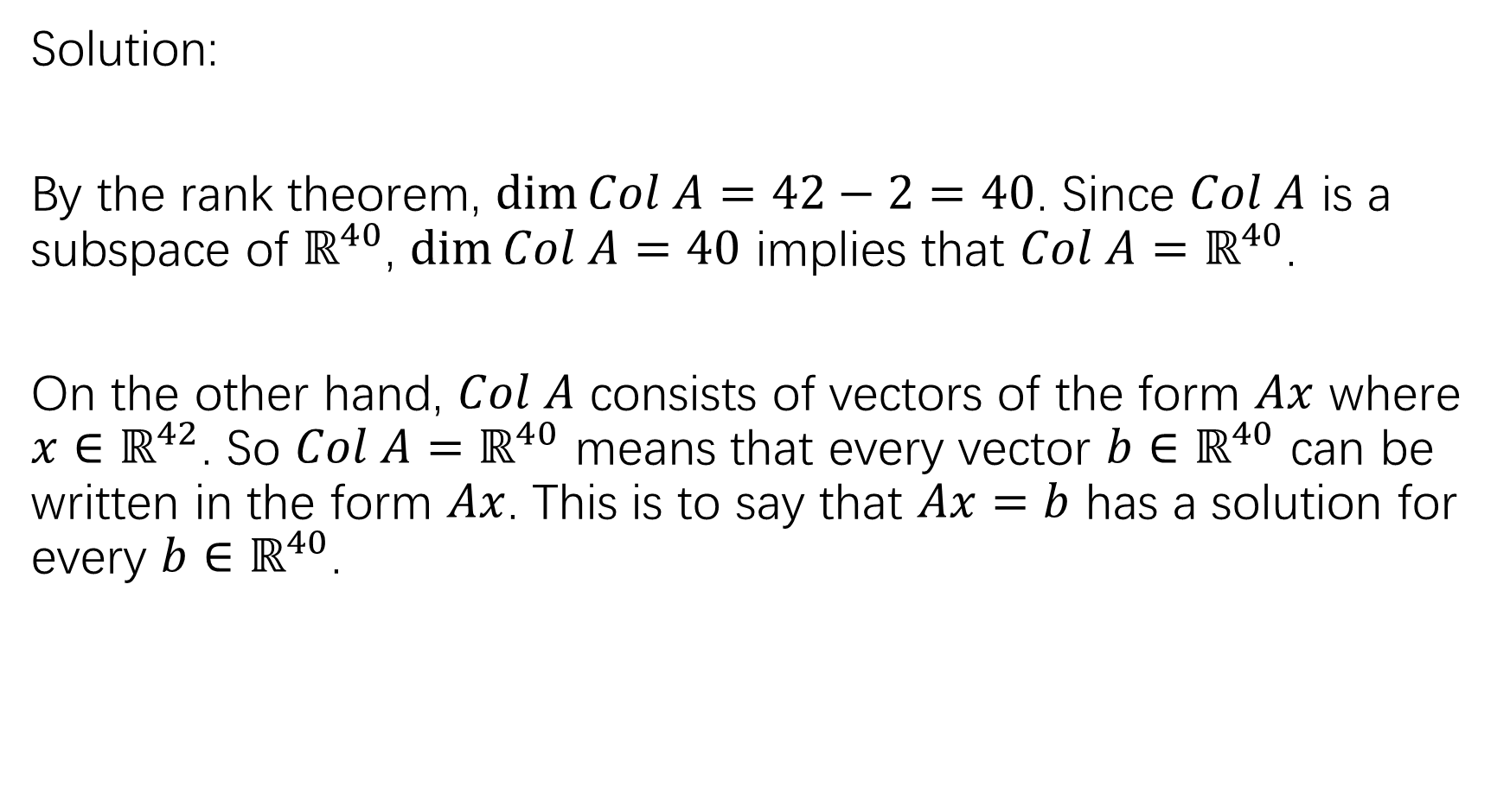
Solution:
By the rank theorem, $\dim{Col A=42−2=40}$. Since $Col A$ is a subspace of $ℝ^{40}$, $\dim{Col A=40}$ implies that $Col A=ℝ^{40}$.
On the other hand, $Col A$ consists of vectors of the form $Ax$ where $x∈ℝ^{42}$. So $Col A=ℝ^{40}$ means that every vector $b∈ℝ^{40}$ can be written in the form $Ax$. This is to say that $Ax=b$ has a solution for every $b∈ℝ^{40}$.

Slide 14

Dynamic systems and spotted owls
Goal: Understanding the discrete dynamic system of the form $x_{k+1}=Ax_{k}$

Slide 15
Eigenvectors and eigenvalues

Slide 16
Eigenvectors and eigenvalues

Slide 17
Testing eigenvectors

Slide 19
Summary of example 2 and 3.

Slide 20
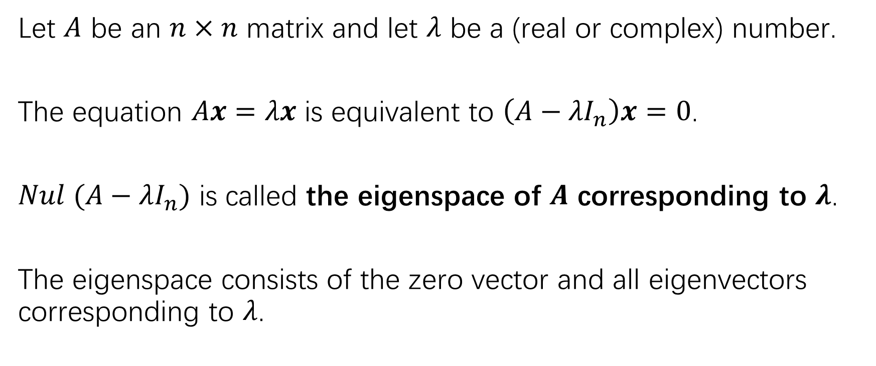
eigenspace
Let $A$ be an $n×n$ matrix and let $λ$ be a (real or complex) number.
The equation $Ax=λx$ is equivalent to $\left(A−{λI}_{n}\right)x=0$.
$Nul (A−λI_{n})$ is called the eigenspace of $A$ corresponding to $λ$.
The eigenspace consists of the zero vector and all eigenvectors corresponding to $λ$.

Slide 22
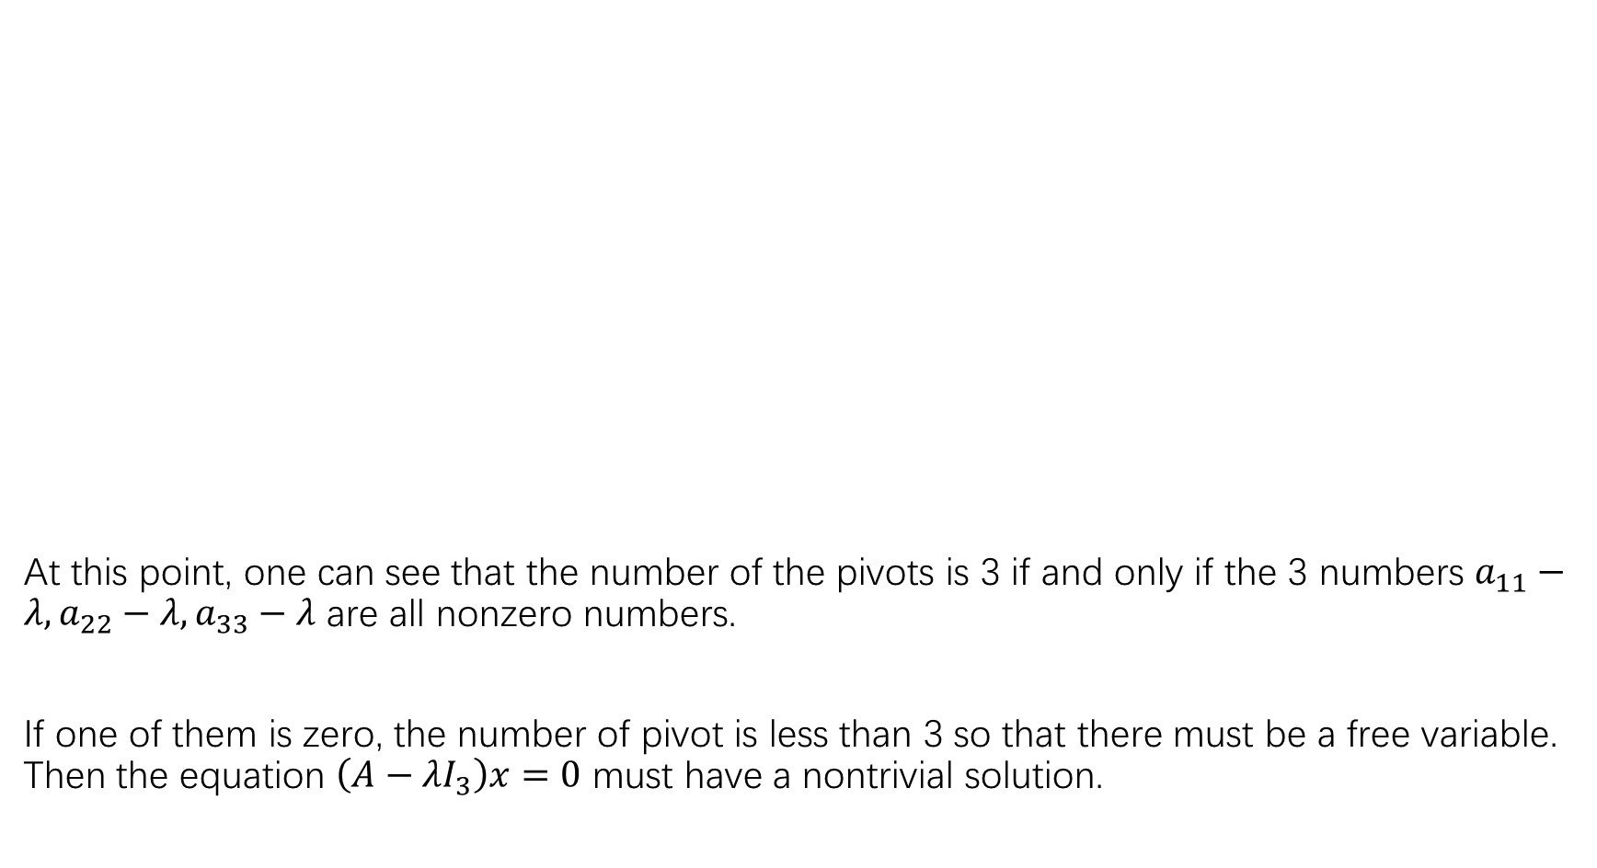
At this point, one can see that the number of the pivots is 3 if and only if the 3 numbers $a_{11}−λ,a_{22}−λ,a_{33}−λ$ are all nonzero numbers.
If one of them is zero, the number of pivot is less than 3 so that there must be a free variable. Then the equation $\left(A−λI_{3}\right)x=0$ must have a nontrivial solution.

Slide 24
0 as an eigenvalue

Slide 25
Eigenvectors corresponding to distinct eigenvalues are linearly independent

Slide 26
作业
P253: 5-19奇数题
P294: 11,13,17,21,23,25,29

