Slide 1
Linear Algebra
Lecturer: Xia Liao
Email: xliao@hqu.edu.cn
Homepage: https://hirzebruch.github.io/main.html
Time: every Tuesday 1-2, Thursday 3-4

Slide 2
Course Plan
Linear Algebra and Its Applications
Chapter 1: 7 lectures
Chapter 2: 5 lectures
Chapter 3: 4 lectures
Chapter 4: 5 lectures
Chapter 5: 4 lectures
Evaluation:
HW: 10%, Mid Term: 20%, Final: 70%

Slide 3
What is Linear Algebra about?
Fundamental aspects:
Systems of linear equations arise naturally in business, science, and engineering. How to solve systems of linear equations effectively?
A system of linear equations will often have infinite solutions. What is the best way to describe them?
How does the change of the linear equations affect the solutions of the system?

Slide 4
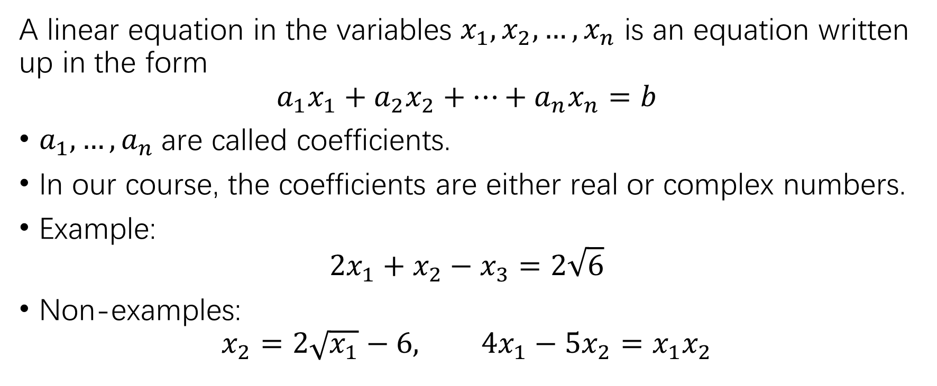
Linear equations
A linear equation in the variables $x_{1},x_{2},…,x_{n}$ is an equation written up in the form
$${a_{1}x}_{1}+a_{2}x_{2}+…+a_{n}x_{n}=b$$
$a_{1},…,a_{n}$are called coefficients.
In our course, the coefficients are either real or complex numbers.
Example:
$$2x_{1}+x_{2}−x_{3}=2\sqrt{6}$$
Non-examples:
$$x_{2}=2\sqrt{x_{1}}−6, 4x_{1}−5x_{2}=x_{1}x_{2}$$

Slide 5
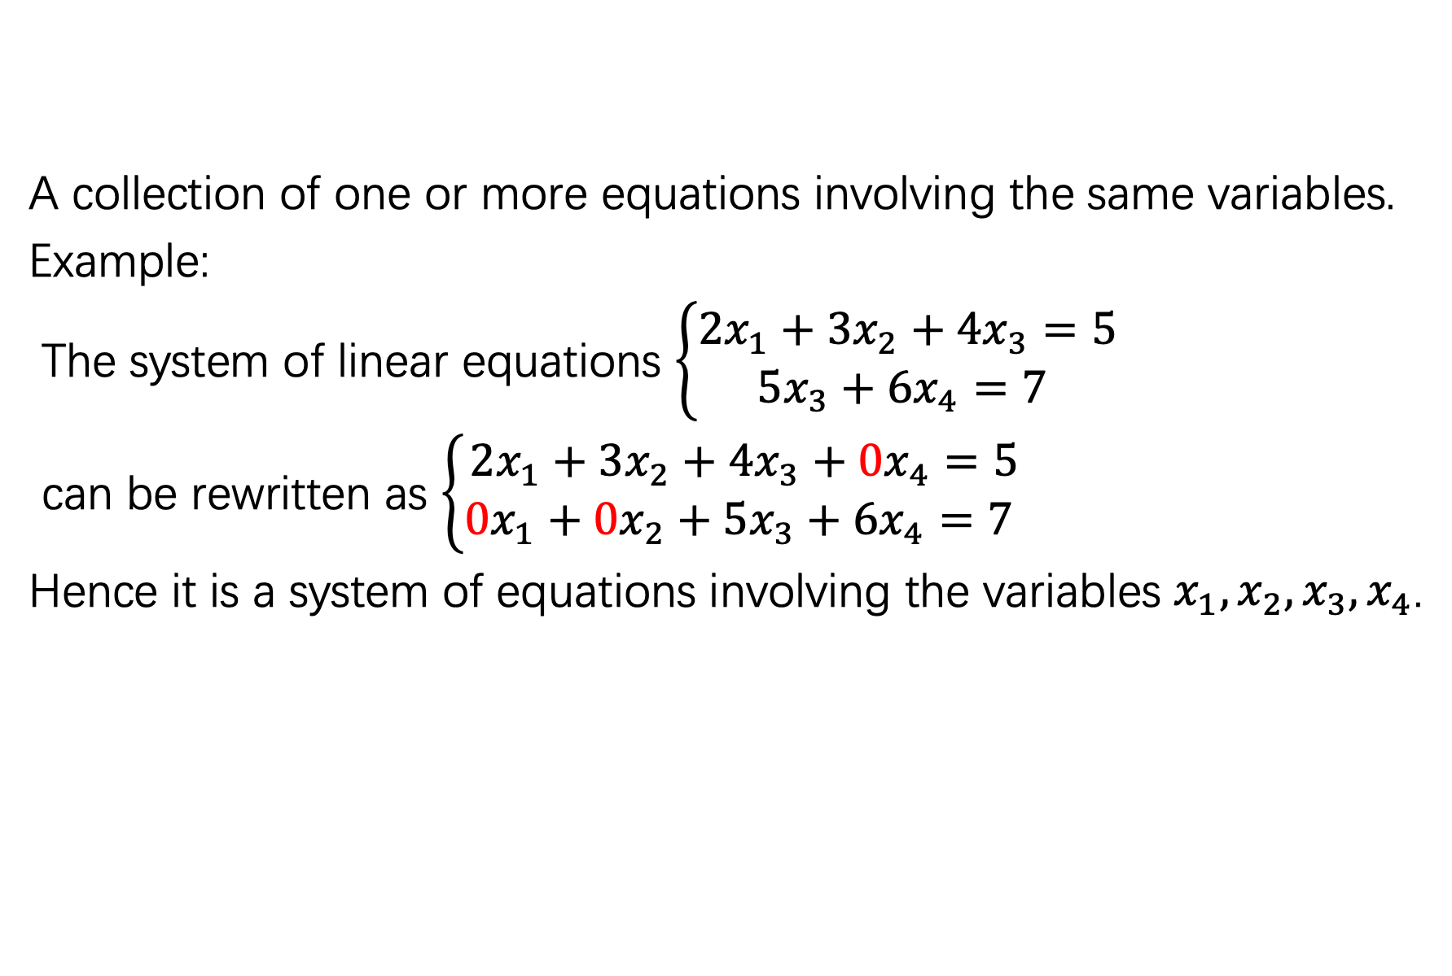
System of linear equations
A collection of one or more equations involving the same variables.
Example:
The system of linear equations $\left\{\begin{aligned}2x_{1}+3x_{2}+4x_{3}=5 \\ 5x_{3}+6x_{4}=7 \end{aligned}\right.$
can be rewritten as $\left\{\begin{aligned}2x_{1}+3x_{2}+4x_{3}+0x_{4}=5 \\ 0x_{1}+0x_{2}+5x_{3}+6x_{4}=7 \end{aligned}\right.$
Hence it is a system of equations involving the variables $x_{1},x_{2},x_{3},x_{4}$.

Slide 6
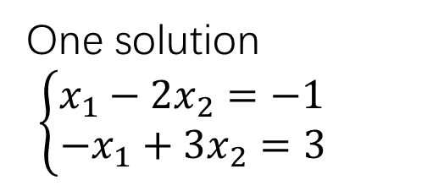
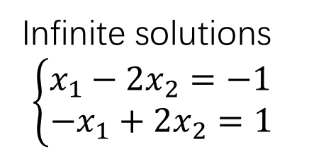
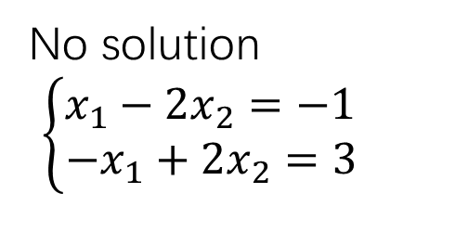
Geometric interpretation of the solutions
Using graph plotting calculator:
https://www.desmos.com/calculator
One solution
$\left\{\begin{aligned}x_{1}−2x_{2}=−1 \\ −x_{1}+3x_{2}=3 \end{aligned}\right.$
No solution
$\left\{\begin{aligned}x_{1}−2x_{2}=−1 \\ −x_{1}+2x_{2}=3 \end{aligned}\right.$
Infinite solutions
$\left\{\begin{aligned}x_{1}−2x_{2}=−1 \\ −x_{1}+2x_{2}=1 \end{aligned}\right.$

Slide 7
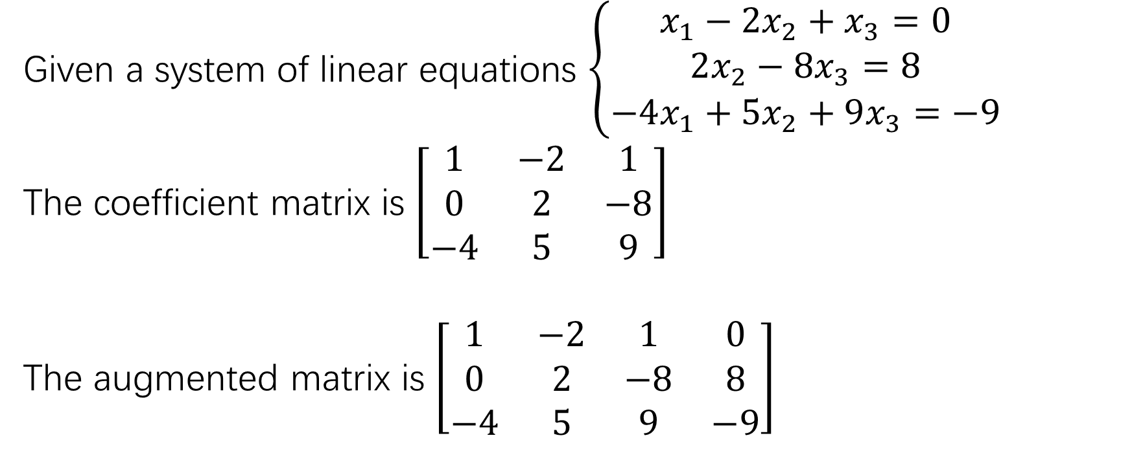
Matrix representation of system of linear equations
Given a system of linear equations $\left\{\begin{aligned}x_{1}−2x_{2}+x_{3}=0 \\ 2x_{2}−8x_{3}=8 \\ −4x_{1}+5x_{2}+9x_{3}=−9\end{aligned}\right.$
The coefficient matrix is $\left[\begin{matrix}1 & −2 & 1 \\ 0 & 2 & −8 \\ −4 & 5 & 9\end{matrix}\right]$
The augmented matrix is $\left[\begin{matrix}1 & −2 & 1 & 0 \\ 0 & 2 & −8 & 8 \\ −4 & 5 & 9 & −9\end{matrix}\right]$

Slide 8
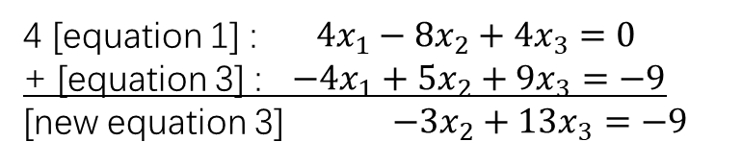
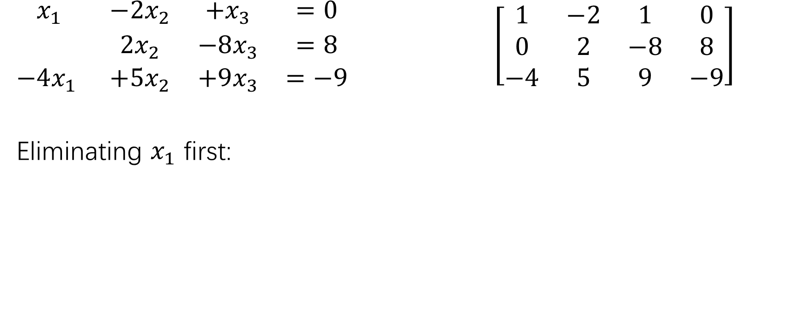
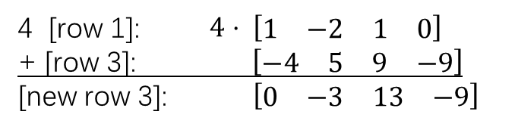
Solving the system of equations by elimination
$\begin{matrix}x_{1} & −2x_{2} & +x_{3} & =0 \\ & 2x_{2} & −8x_{3} & =8 \\ −4x_{1} & +5x_{2} & +9x_{3} & =−9\end{matrix}$ $\left[\begin{matrix}1 & −2 & 1 & 0 \\ 0 & 2 & −8 & 8 \\ −4 & 5 & 9 & −9\end{matrix}\right]$
Eliminating $x_{1}$ first:
4 [equation 1] : $4x_{1}−8x_{2}+4x_{3}=0$
+ [equation 3] : $−4x_{1}+5x_{2}+9x_{3}=−9$
[new equation 3] $−3x_{2}+13x_{3}=−9$
4 [row 1]: $4⋅ \left[\begin{matrix}1 & −2 & 1 & 0\end{matrix}\right]$
+ [row 3]: $\left[\begin{matrix}−4 & 5 & 9 & −9\end{matrix}\right]$
[new row 3]: $\left[\begin{matrix}0 & −3 & 13 & −9\end{matrix}\right]$

Slide 9
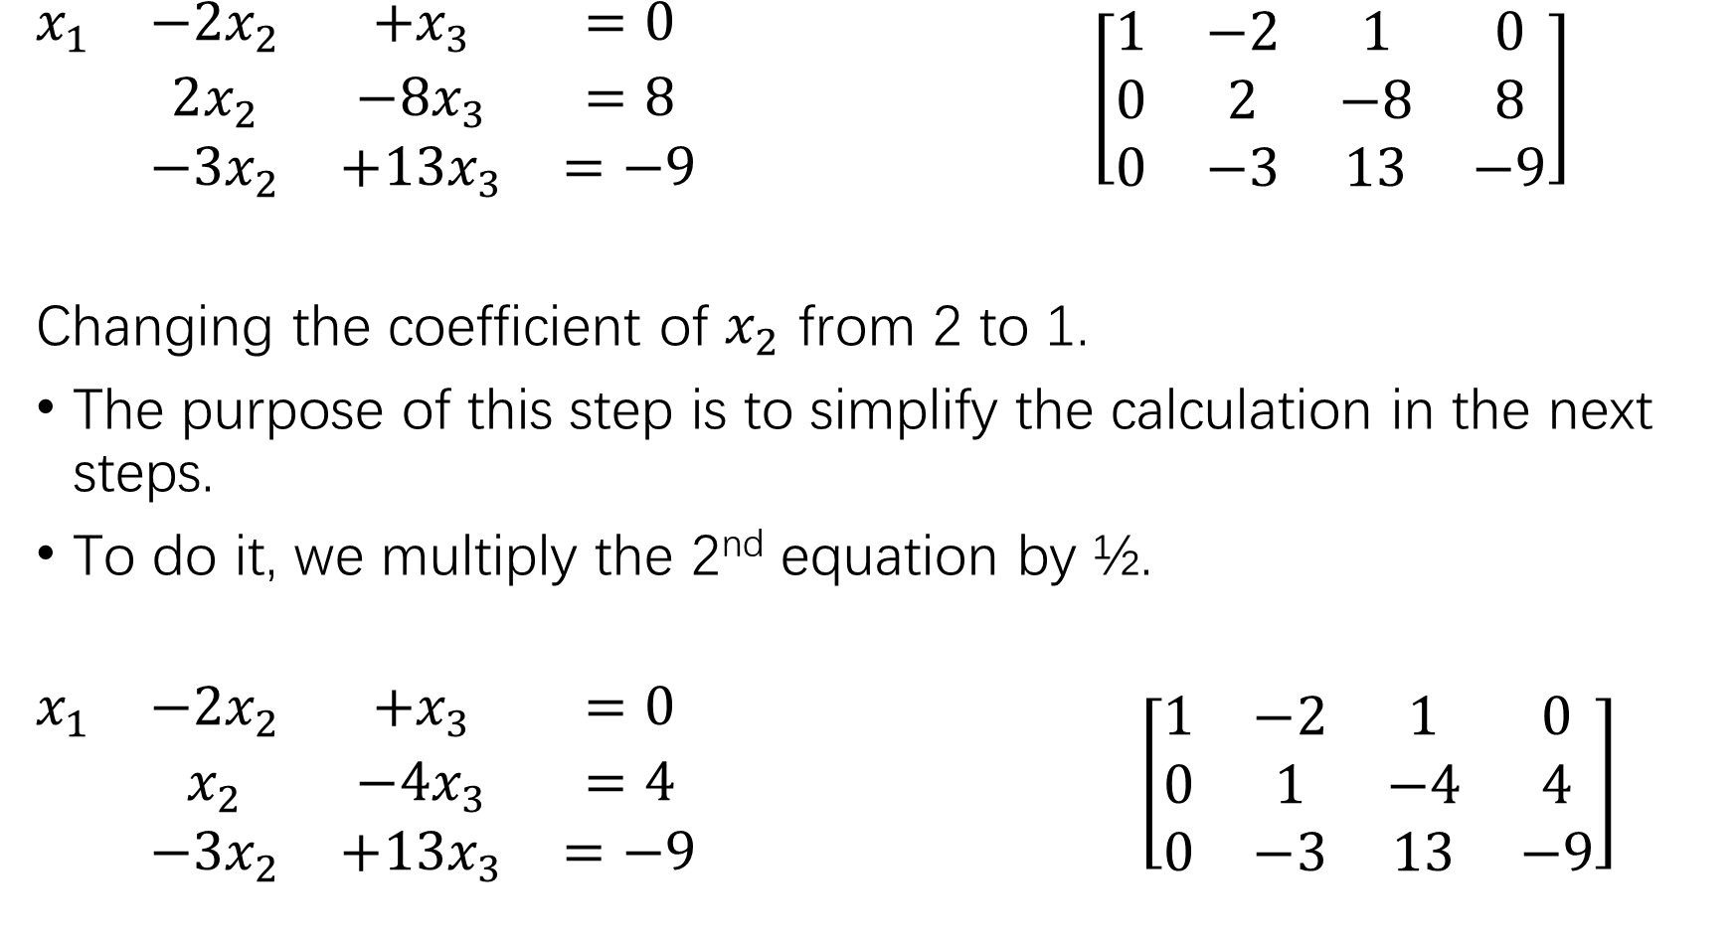
$\begin{matrix}x_{1} & −2x_{2} & +x_{3} & =0 \\ & 2x_{2} & −8x_{3} & =8 \\ & −3x_{2} & +13x_{3} & =−9\end{matrix}$ $\left[\begin{matrix}1 & −2 & 1 & 0 \\ 0 & 2 & −8 & 8 \\ 0 & −3 & 13 & −9\end{matrix}\right]$
Changing the coefficient of $x_{2}$ from 2 to 1.
The purpose of this step is to simplify the calculation in the next steps.
To do it, we multiply the 2nd equation by ½.
$\begin{matrix}x_{1} & −2x_{2} & +x_{3} & =0 \\ & x_{2} & −4x_{3} & =4 \\ & −3x_{2} & +13x_{3} & =−9\end{matrix}$ $\left[\begin{matrix}1 & −2 & 1 & 0 \\ 0 & 1 & −4 & 4 \\ 0 & −3 & 13 & −9\end{matrix}\right]$

Slide 10
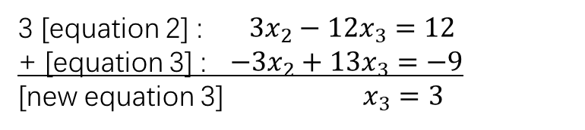
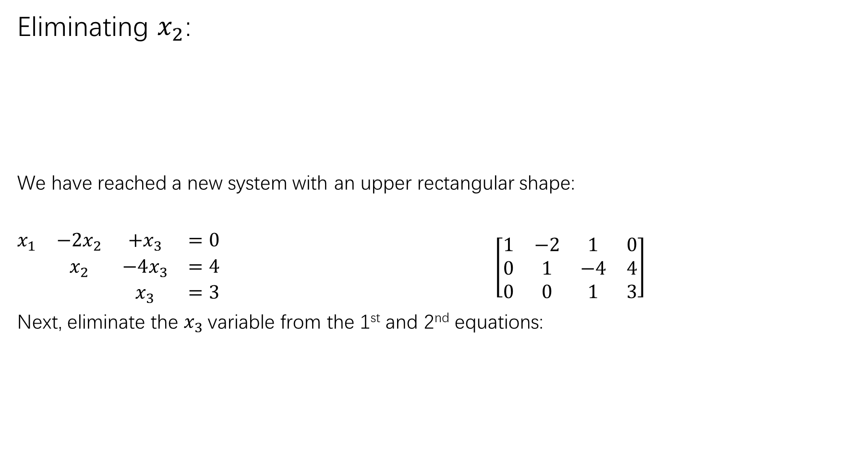
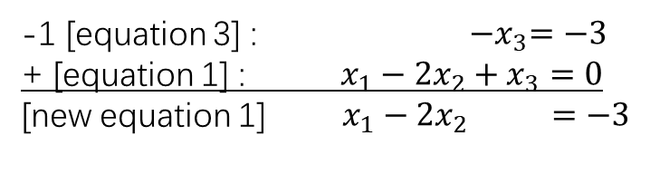
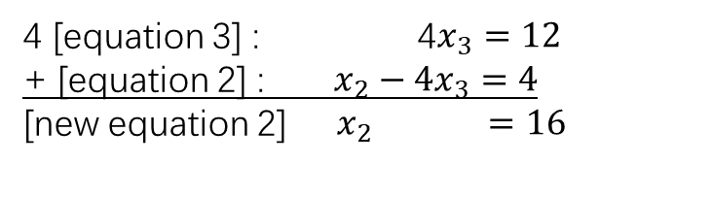
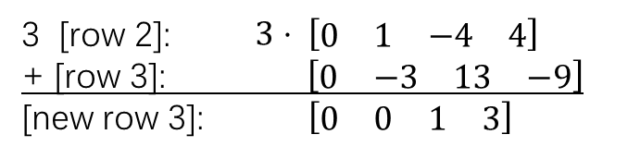
Eliminating $x_{2}$:
We have reached a new system with an upper rectangular shape:
$\begin{matrix}x_{1} & −2x_{2} & +x_{3} & =0 \\ & x_{2} & −4x_{3} & =4 \\ & & x_{3} & =3\end{matrix}$ $\left[\begin{matrix}1 & −2 & 1 & 0 \\ 0 & 1 & −4 & 4 \\ 0 & 0 & 1 & 3\end{matrix}\right]$
Next, eliminate the $x_{3}$variable from the 1st and 2nd equations:
3 [equation 2] : $3x_{2}−12x_{3}=12$
+ [equation 3] : $−3x_{2}+13x_{3}=−9$
[new equation 3] $x_{3}=3$
3 [row 2]: $3⋅ \left[\begin{matrix}0 & 1 & −4 & 4\end{matrix}\right]$
+ [row 3]: $\left[\begin{matrix}0 & −3 & 13 & −9\end{matrix}\right]$
[new row 3]: $\left[\begin{matrix}0 & 0 & 1 & 3\end{matrix}\right]$
4 [equation 3] : 4$x_{3}=12$
+ [equation 2] : $x_{2}−4x_{3}=4$
[new equation 2] $x_{2} =16$
-1 [equation 3] : ${−x}_{3}=−3$
+ [equation 1] : ${x_{1}−2x}_{2}+x_{3}=0$
[new equation 1] ${ x_{1}−2x}_{2} =−3$

Slide 11
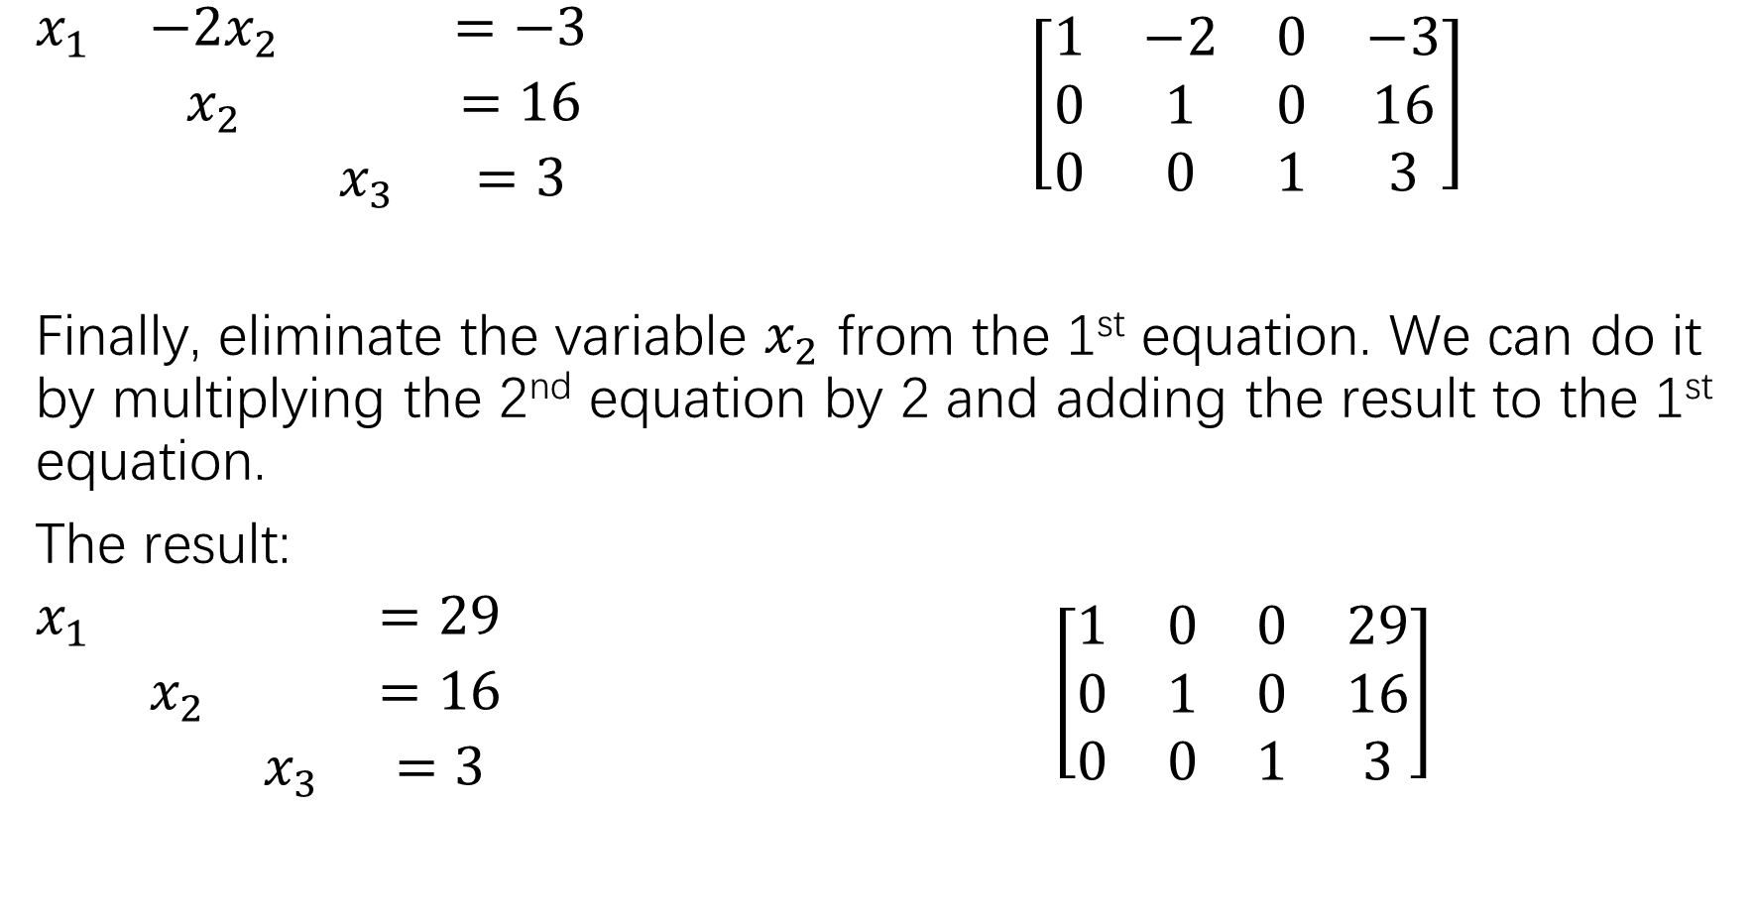
$\begin{matrix}x_{1} & −2x_{2} & & =−3 \\ & x_{2} & & =16 \\ & & x_{3} & =3\end{matrix}$ $\left[\begin{matrix}1 & −2 & 0 & −3 \\ 0 & 1 & 0 & 16 \\ 0 & 0 & 1 & 3\end{matrix}\right]$
Finally, eliminate the variable $x_{2}$ from the 1st equation. We can do it by multiplying the 2nd equation by 2 and adding the result to the 1st equation.
The result:
$\begin{matrix}x_{1} & & & =29 \\ & x_{2} & & =16 \\ & & x_{3} & =3\end{matrix}$ $\left[\begin{matrix}1 & 0 & 0 & 29 \\ 0 & 1 & 0 & 16 \\ 0 & 0 & 1 & 3\end{matrix}\right]$

Slide 12
General algorithm of solving systems of linear equations
Elementary row operations
(Replacement) Replace one row by the sum of itself and a multiple of another row.
(Interchange) Interchange two rows.
(Scaling) Multiply all entries in a row by a nonzero constant.
The elementary row operations change the shape of the system of linear equations but does not change their solutions! The new system and the old system have exactly the same solutions provided there is any.
Therefore, the steps for solving a given system of linear equations involve choosing appropriate elementary row operations to simplify the ‘shape’ of the system, so that the solutions can be eventually read off directly from the equations.
In matrix notation, this amounts to changing the augmented matrix to an upper triangular matrix first. If needed, we can further change the matrix to a reduced echelon form (which will be introduced later).

Slide 13
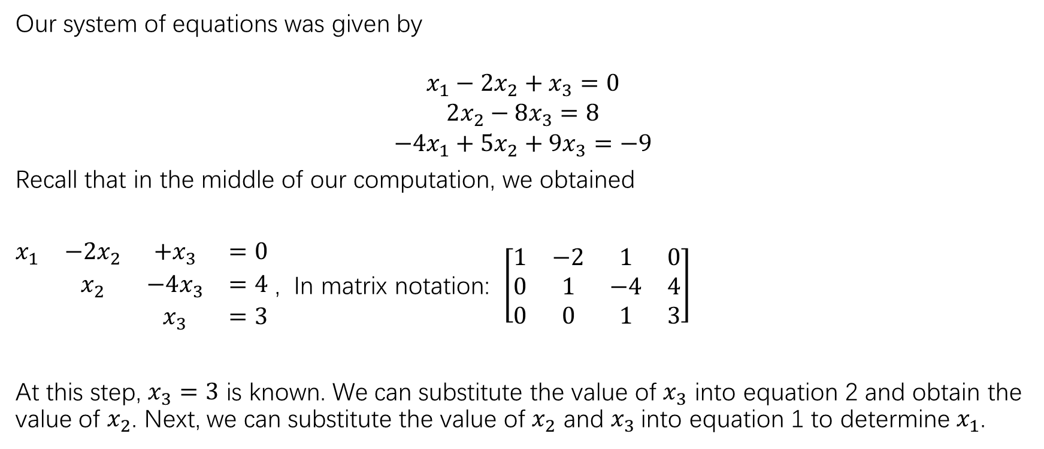
Another solution of the same example
Our system of equations was given by
$$\begin{aligned}x_{1}−2x_{2}+x_{3}=0 \\ 2x_{2}−8x_{3}=8 \\ −4x_{1}+5x_{2}+9x_{3}=−9\end{aligned}$$
Recall that in the middle of our computation, we obtained
$\begin{matrix}x_{1} & −2x_{2} & +x_{3} & =0 \\ & x_{2} & −4x_{3} & =4 \\ & & x_{3} & =3\end{matrix}$ , In matrix notation: $\left[\begin{matrix}1 & −2 & 1 & 0 \\ 0 & 1 & −4 & 4 \\ 0 & 0 & 1 & 3\end{matrix}\right]$
At this step, $x_{3}=3$ is known. We can substitute the value of $x_{3}$ into equation 2 and obtain the value of $x_{2}$. Next, we can substitute the value of $x_{2}$ and $x_{3}$into equation 1 to determine $x_{1}$.

Slide 14
Existence and Uniqueness of solutions
We have seen from the graph plotting, that there are 3 major possibilities for the solutions of a system of linear equations.
There is no solution. (inconsistent system)
Infinite solutions .
A unique solution.
We will learn useful criterions on when any of these occurs. For the moment, we should know how to determine a given system of linear equations falls into which one of these categories quickly by using elementary row operations.

Slide 15
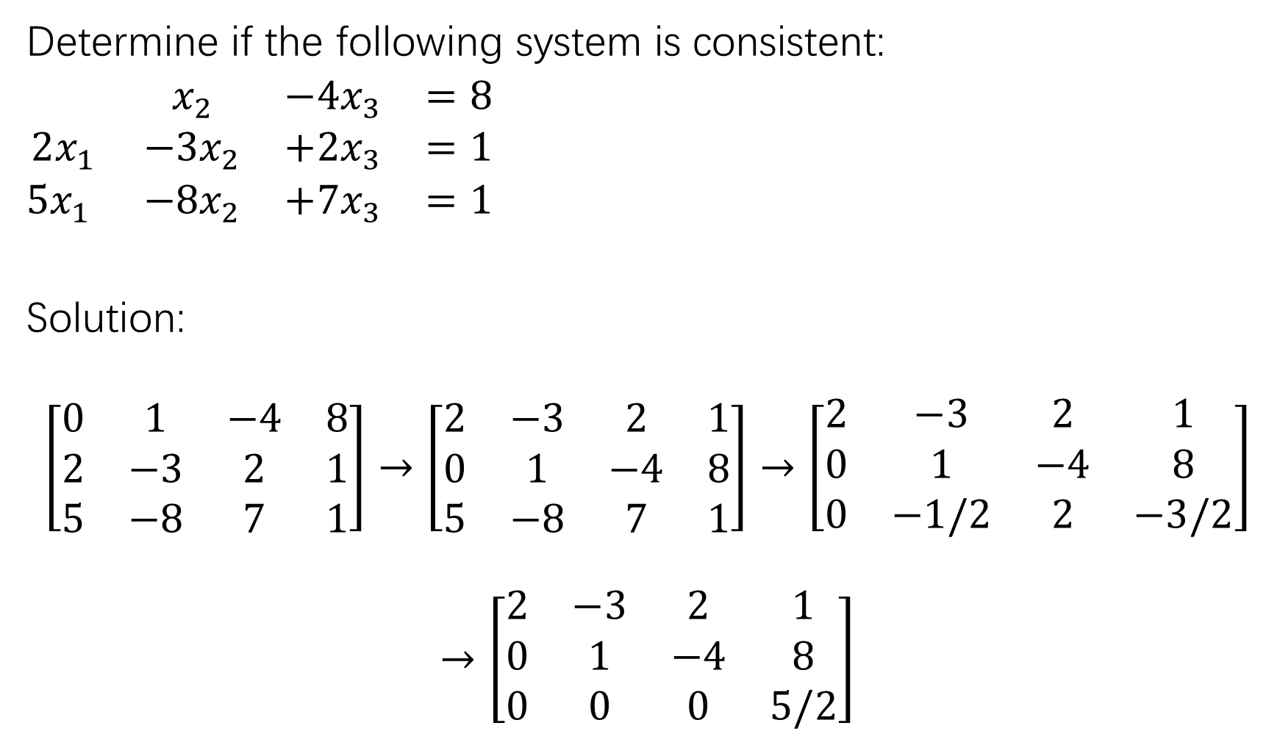
Determine if the following system is consistent:
$\begin{matrix} & x_{2} & −4x_{3} & =8 \\ 2x_{1} & −3x_{2} & +2x_{3} & =1 \\ 5x_{1} & −8x_{2} & +7x_{3} & =1\end{matrix}$
Solution:
$$\left[\begin{matrix}0 & 1 & −4 & 8 \\ 2 & −3 & 2 & 1 \\ 5 & −8 & 7 & 1\end{matrix}\right]→\left[\begin{matrix}2 & −3 & 2 & 1 \\ 0 & 1 & −4 & 8 \\ 5 & −8 & 7 & 1\end{matrix}\right]→\left[\begin{matrix}2 & −3 & 2 & 1 \\ 0 & 1 & −4 & 8 \\ 0 & −1/2 & 2 & −3/2\end{matrix}\right]$$
$$→\left[\begin{matrix}2 & −3 & 2 & 1 \\ 0 & 1 & −4 & 8 \\ 0 & 0 & 0 & 5/2\end{matrix}\right]$$

Slide 16
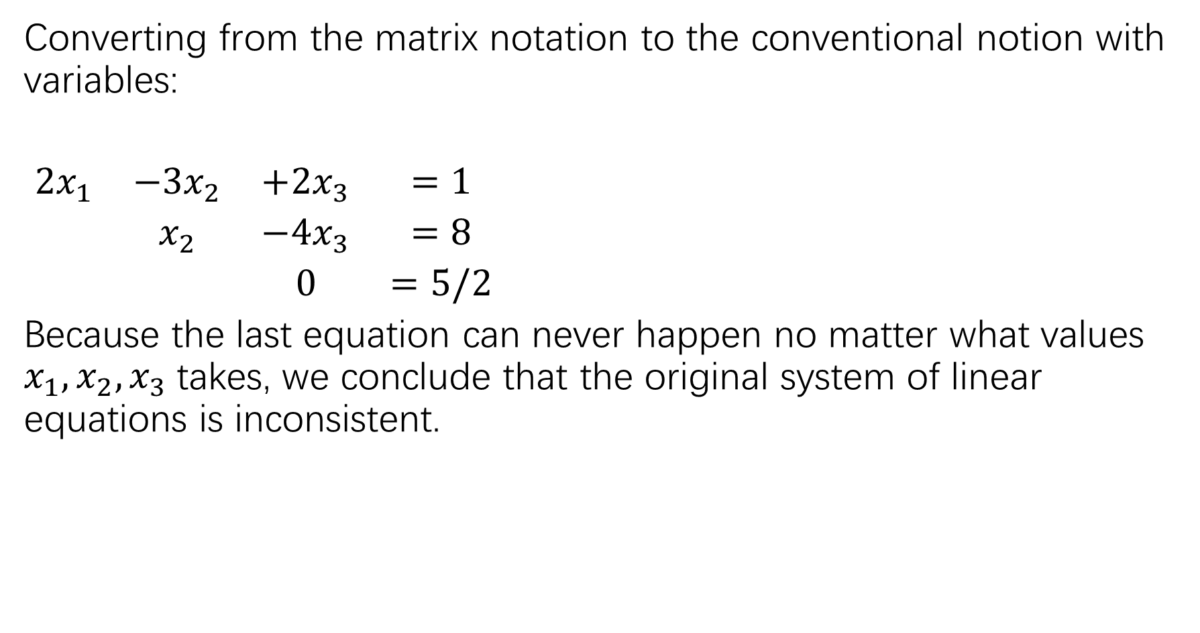
Converting from the matrix notation to the conventional notion with variables:
$\begin{matrix}2x_{1} & {−3x}_{2} & +2x_{3} & =1 \\ & x_{2} & −4x_{3} & =8 \\ & & 0 & =5/2\end{matrix}$
Because the last equation can never happen no matter what values $x_{1},x_{2},x_{3}$takes, we conclude that the original system of linear equations is inconsistent.

Slide 17
Exercise 5, 6 , 11, 13, 15, 26
Some solutions and hints can be found at the end of the book, starting from page 539

Slide 18
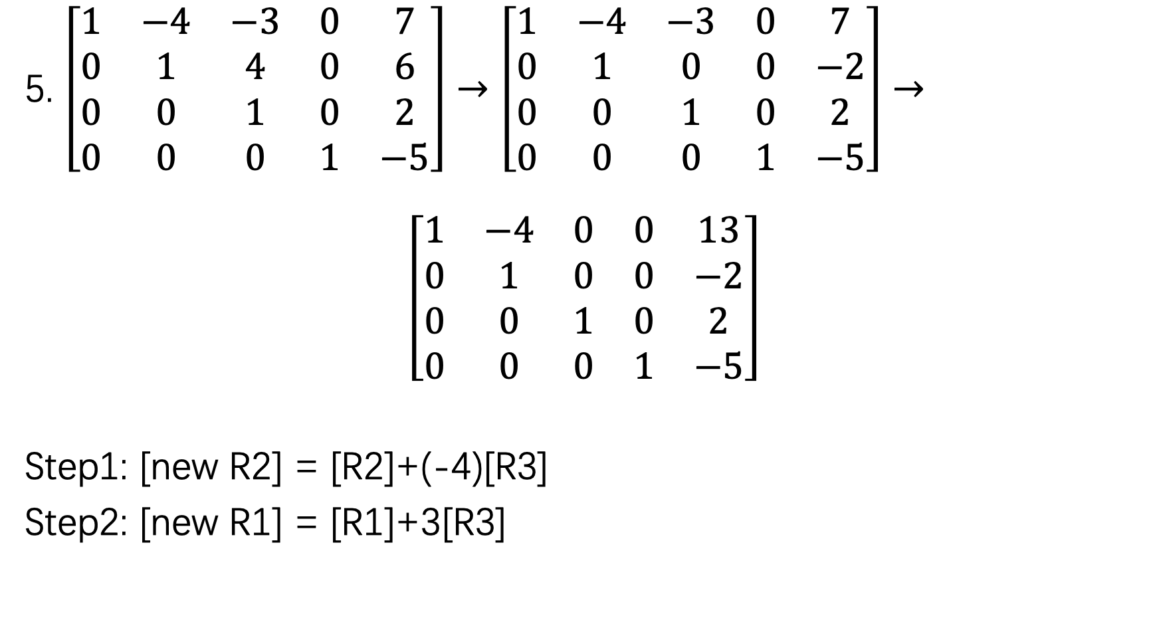
5. $\left[\begin{matrix}1 & −4 & −3 & 0 & 7 \\ 0 & 1 & 4 & 0 & 6 \\ 0 & 0 & 1 & 0 & 2 \\ 0 & 0 & 0 & 1 & −5\end{matrix}\right]→\left[\begin{matrix}1 & −4 & −3 & 0 & 7 \\ 0 & 1 & 0 & 0 & −2 \\ 0 & 0 & 1 & 0 & 2 \\ 0 & 0 & 0 & 1 & −5\end{matrix}\right]→$
$$\left[\begin{matrix}1 & −4 & 0 & 0 & 13 \\ 0 & 1 & 0 & 0 & −2 \\ 0 & 0 & 1 & 0 & 2 \\ 0 & 0 & 0 & 1 & −5\end{matrix}\right]$$
Step1: [new R2] = [R2]+(-4)[R3]
Step2: [new R1] = [R1]+3[R3]

Slide 19
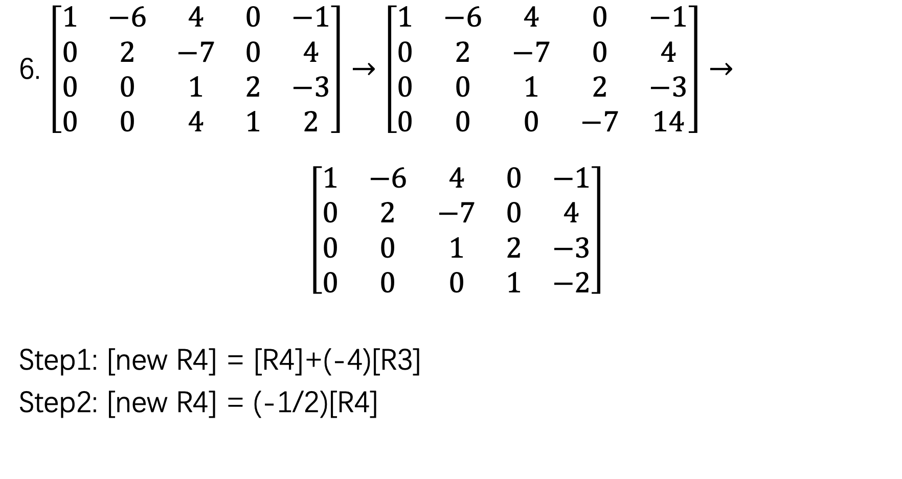
6. $\left[\begin{matrix}1 & −6 & 4 & 0 & −1 \\ 0 & 2 & −7 & 0 & 4 \\ 0 & 0 & 1 & 2 & −3 \\ 0 & 0 & 4 & 1 & 2\end{matrix}\right]→\left[\begin{matrix}1 & −6 & 4 & 0 & −1 \\ 0 & 2 & −7 & 0 & 4 \\ 0 & 0 & 1 & 2 & −3 \\ 0 & 0 & 0 & −7 & 14\end{matrix}\right]→$
$$\left[\begin{matrix}1 & −6 & 4 & 0 & −1 \\ 0 & 2 & −7 & 0 & 4 \\ 0 & 0 & 1 & 2 & −3 \\ 0 & 0 & 0 & 1 & −2\end{matrix}\right]$$
Step1: [new R4] = [R4]+(-4)[R3]
Step2: [new R4] = (-1/2)[R4]

Slide 20
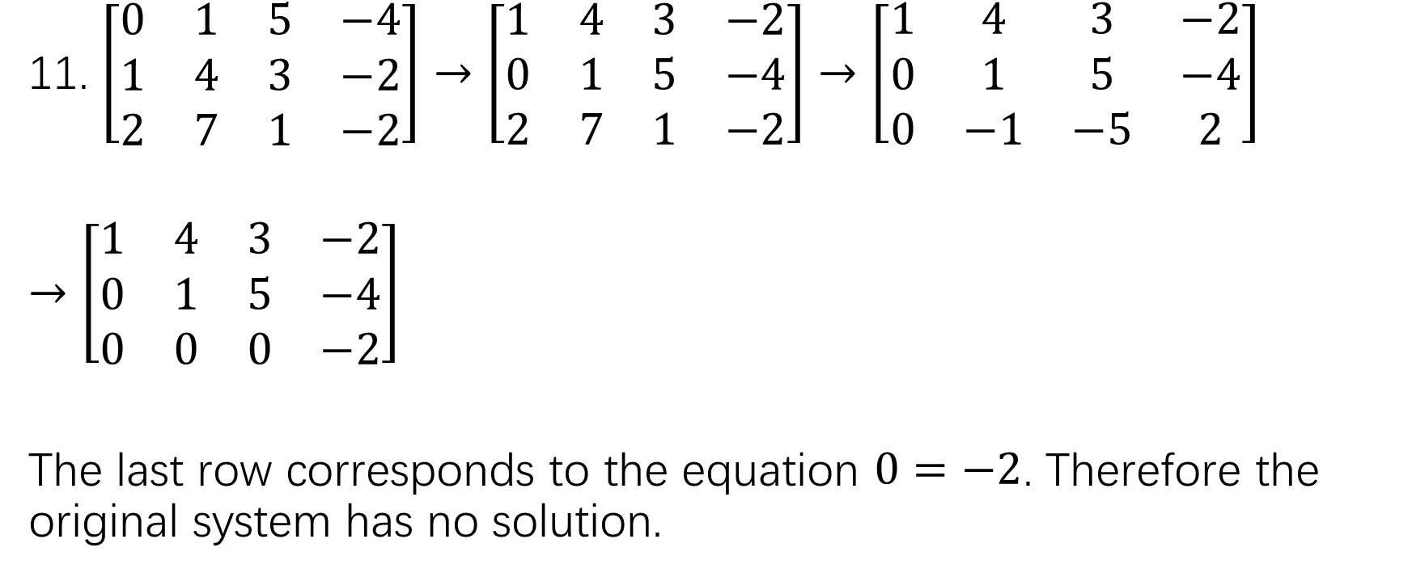
11. $\left[\begin{matrix}0 & 1 & 5 & −4 \\ 1 & 4 & 3 & −2 \\ 2 & 7 & 1 & −2\end{matrix}\right]→\left[\begin{matrix}1 & 4 & 3 & −2 \\ 0 & 1 & 5 & −4 \\ 2 & 7 & 1 & −2\end{matrix}\right]→\left[\begin{matrix}1 & 4 & 3 & −2 \\ 0 & 1 & 5 & −4 \\ 0 & −1 & −5 & 2\end{matrix}\right]$
$→\left[\begin{matrix}1 & 4 & 3 & −2 \\ 0 & 1 & 5 & −4 \\ 0 & 0 & 0 & −2\end{matrix}\right]$
The last row corresponds to the equation $0=−2$. Therefore the original system has no solution.

Slide 21
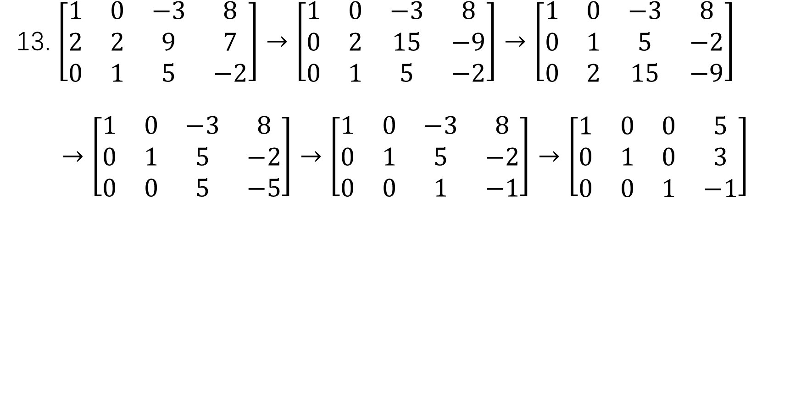
13. $\left[\begin{matrix}1 & 0 & −3 & 8 \\ 2 & 2 & 9 & 7 \\ 0 & 1 & 5 & −2\end{matrix}\right]→\left[\begin{matrix}1 & 0 & −3 & 8 \\ 0 & 2 & 15 & −9 \\ 0 & 1 & 5 & −2\end{matrix}\right]→\left[\begin{matrix}1 & 0 & −3 & 8 \\ 0 & 1 & 5 & −2 \\ 0 & 2 & 15 & −9\end{matrix}\right]$
$$→\left[\begin{matrix}1 & 0 & −3 & 8 \\ 0 & 1 & 5 & −2 \\ 0 & 0 & 5 & −5\end{matrix}\right]→\left[\begin{matrix}1 & 0 & −3 & 8 \\ 0 & 1 & 5 & −2 \\ 0 & 0 & 1 & −1\end{matrix}\right]→\left[\begin{matrix}1 & 0 & 0 & 5 \\ 0 & 1 & 0 & 3 \\ 0 & 0 & 1 & −1\end{matrix}\right]$$

Slide 22
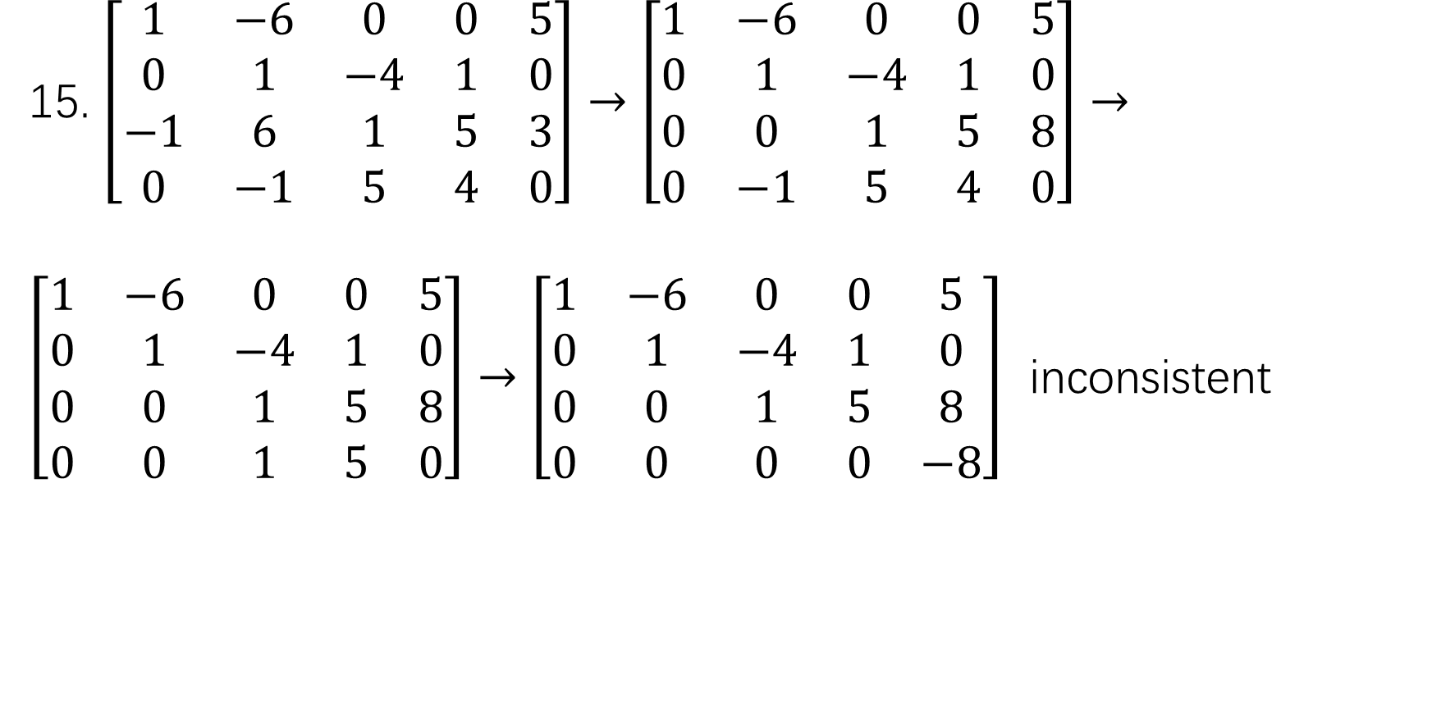
15. $\left[\begin{matrix}1 & −6 & 0 & 0 & 5 \\ 0 & 1 & −4 & 1 & 0 \\ −1 & 6 & 1 & 5 & 3 \\ 0 & −1 & 5 & 4 & 0\end{matrix}\right]→\left[\begin{matrix}1 & −6 & 0 & 0 & 5 \\ 0 & 1 & −4 & 1 & 0 \\ 0 & 0 & 1 & 5 & 8 \\ 0 & −1 & 5 & 4 & 0\end{matrix}\right]→$
$\left[\begin{matrix}1 & −6 & 0 & 0 & 5 \\ 0 & 1 & −4 & 1 & 0 \\ 0 & 0 & 1 & 5 & 8 \\ 0 & 0 & 1 & 5 & 0\end{matrix}\right]→\left[\begin{matrix}1 & −6 & 0 & 0 & 5 \\ 0 & 1 & −4 & 1 & 0 \\ 0 & 0 & 1 & 5 & 8 \\ 0 & 0 & 0 & 0 & −8\end{matrix}\right]$ inconsistent

Slide 23
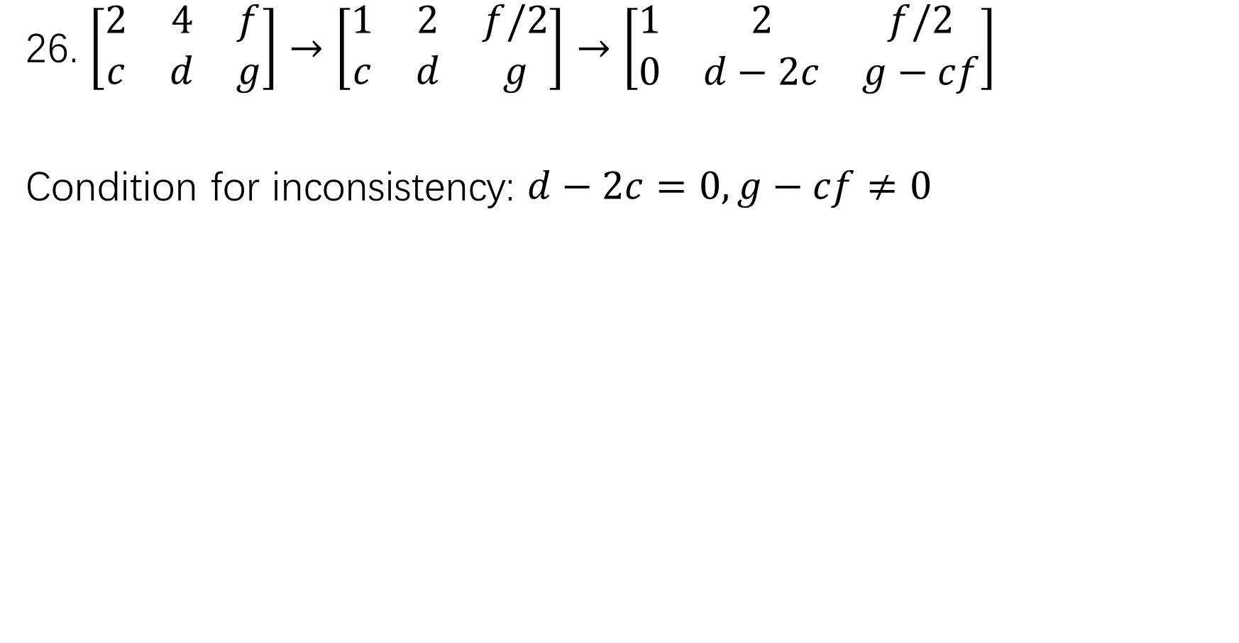
26. $\left[\begin{matrix}2 & 4 & f \\ c & d & g\end{matrix}\right]→\left[\begin{matrix}1 & 2 & f/2 \\ c & d & g\end{matrix}\right]→\left[\begin{matrix}1 & 2 & f/2 \\ 0 & d−2c & g−cf\end{matrix}\right]$
Condition for inconsistency: $d−2c=0, g−cf≠0$

Slide 24
HW: 14, 25, 32
We will not collect homework this time. Just bring your solutions to the class next time.

